Slide 1
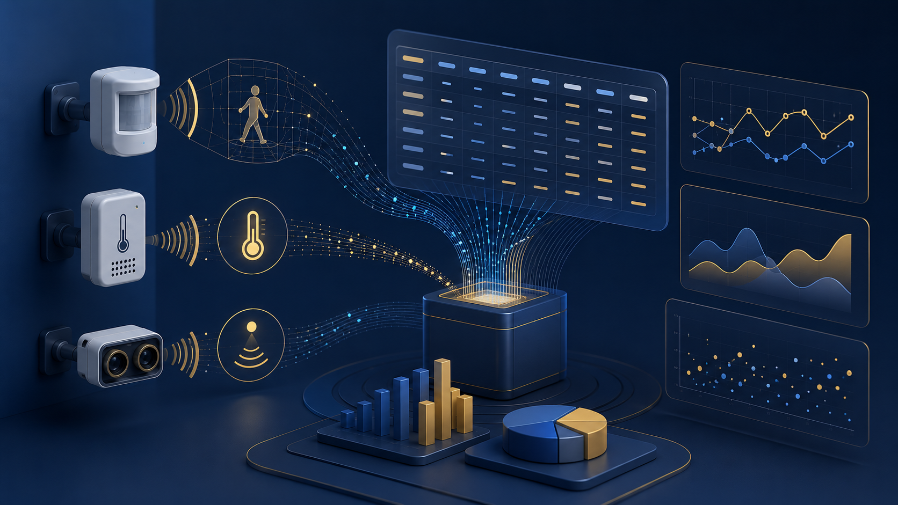
MODULE 2
Data Sources, Sensors, and Inclusive Growth Indicators
Choosing data that can support a responsible physical AI decision
Data sources determine what a system can see, what it misses, and what decisions it can justify.

Slide 2
MODULE 2
Data Sources, Sensors, and Inclusive Growth Indicators
Learning Targets
By the end of this module, you should be able to say and show these skills.
Identify useful physical, public, and community data sources for an applied problem.
01
Distinguish measurements, identifiers, labels, and metadata in a dataset.
02
Explain how data source quality affects physical AI decisions and recommendations.
03
Data science skill path: Data Literacy, Data Curation, Ethical Reasoning
Applied Physical AI + Data Science | Module 2

Slide 3
MODULE 2
Data Sources, Sensors, and Inclusive Growth Indicators
The Data Source Is a Design Choice
Before building a model, decide what evidence belongs in the problem.
A sensor captures one part of reality, not the whole situation.
An open dataset may be incomplete, outdated, or collected for a different purpose.
A community indicator may reveal structural patterns that are invisible in device data alone.
A good dataset is useful only when its limits are understood.
Physical AI projects need both system data and context data.
Applied Physical AI + Data Science | Module 2

Slide 4
MODULE 2
Data Sources, Sensors, and Inclusive Growth Indicators
Four Useful Data Families
Most project datasets come from one or more of these families.
Sensors
Telemetry
Open data
Community indicators
device readings from cameras, lidar, temperature, motion, or audio
status data from robots, drones, vehicles, and edge devices
public records such as transit, safety, health, infrastructure, or environment
neighborhood-level measures of access, opportunity, and vitality
Combining these sources can make the system more useful and more accountable.
Applied Physical AI + Data Science | Module 2

Slide 5
MODULE 2
Data Sources, Sensors, and Inclusive Growth Indicators
Anatomy of a .csv Dataset
A simple file can contain many different kinds of meaning.
Rows usually represent records, events, locations, devices, or observations.
Columns represent variables such as time, score, status, category, or location identifier.
A data dictionary explains what each variable means, how it is measured, and what values are valid.
A clean file structure makes analysis reproducible and easier to review.
A .csv file is not just a spreadsheet; it is a structured record of evidence.
Applied Physical AI + Data Science | Module 2

Slide 6
MODULE 2
Data Sources, Sensors, and Inclusive Growth Indicators
Measurement vs. Identifier
Numbers can behave differently depending on what they represent.
Measurement
Identifier
Can be summarized mathematically
Examples: score, speed, temperature, count
Often used in charts and models
Requires units and scale
Names a record or location
Examples: tract ID, zip code, device ID
Used for joining, filtering, or mapping
Should not be averaged like a measurement
A numeric-looking ID is not automatically a quantitative variable.
Applied Physical AI + Data Science | Module 2

Slide 7
MODULE 2
Data Sources, Sensors, and Inclusive Growth Indicators
Geographic Scale Changes the Question
Zip code, census tract, and coordinate data do not describe the same thing.
A zip code is built for mail delivery and can cross community boundaries.
A census tract is a smaller statistical area often used for neighborhood-level analysis.
Latitude and longitude identify specific points but may raise privacy concerns.
The chosen geography affects what patterns become visible or hidden.
Always match the map scale to the decision being made.
Applied Physical AI + Data Science | Module 2

Slide 8
MODULE 2
Data Sources, Sensors, and Inclusive Growth Indicators
Reading Community Indicators
Three lenses help turn community data into practical design questions.
Place
Economy
Community
What does the physical and social environment make possible?
What signals show opportunity, activity, or financial health?
How do access, support, and local conditions shape outcomes?
The goal is not to rank communities; the goal is to understand where a system can help responsibly.
Applied Physical AI + Data Science | Module 2

Slide 9
MODULE 2
Data Sources, Sensors, and Inclusive Growth Indicators
Combining Data Sources
A project often requires joining physical-world data with context data.
Select
Inspect
Clean
Join
Validate
Analyze
Choose sources
Check fields
Fix issues
Match keys
Check logic
Find insight
A join is only trustworthy when the key fields truly refer to the same place, time, or unit.
Applied Physical AI + Data Science | Module 2

Slide 10
MODULE 2
Data Sources, Sensors, and Inclusive Growth Indicators
Data Quality Questions
Use these questions before trusting a dataset.
Who collected the data, and for what purpose?
What time period, geography, population, or device does the data cover?
Which values are missing, duplicated, inconsistent, or out of range?
What decisions would be risky if this dataset were wrong?
Data quality is not a technical detail; it shapes the fairness and reliability of the system.
Applied Physical AI + Data Science | Module 2

Slide 11
MODULE 2
Data Sources, Sensors, and Inclusive Growth Indicators
Mini-Case: Environmental Monitoring
A short applied scenario connects the concept to a real decision.
A campus wants to deploy low-cost air-quality sensors. Nearby neighborhoods have different infrastructure conditions and different levels of environmental exposure.
Decision questions
What physical sensor data should be collected?
What public or community data would add context?
Which geographic scale would make the analysis most meaningful?
Applied Physical AI + Data Science | Module 2

Slide 12
MODULE 2
Data Sources, Sensors, and Inclusive Growth Indicators
Check Your Understanding
Use these questions to test the most important ideas from the module.
1. Why should a census tract ID be treated as an identifier instead of a measurement?
2. What is one risk of using a dataset without checking its collection purpose?
3. Why might sensor data need community context?
4. What should be documented in a data dictionary?
Applied Physical AI + Data Science | Module 2

Slide 13
MODULE 2
Data Sources, Sensors, and Inclusive Growth Indicators
Key Takeaways
These are the ideas to carry into the next module.
Data source selection shapes the entire physical AI project.
Measurements, identifiers, labels, and metadata have different roles.
Community indicators can reveal context that sensors alone may miss.
Responsible analysis requires documenting data limits and cleaning decisions.
Next module: cleaning, exploring, and visualizing data before modeling.
Applied Physical AI + Data Science | Module 2

