Slide 1
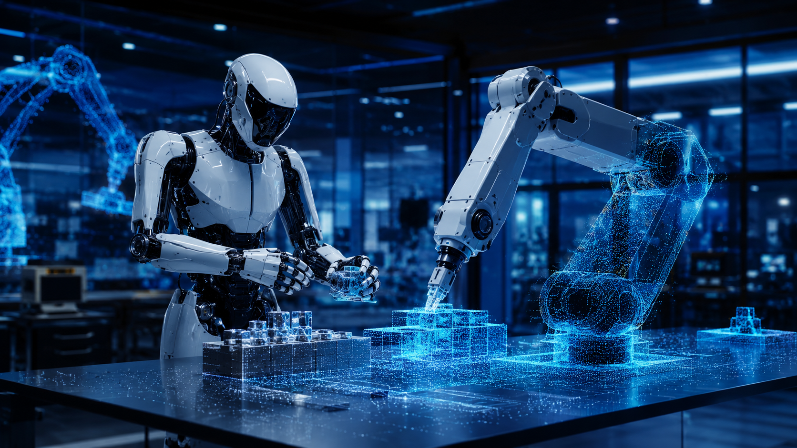
Foundations of
Physical AI
How AI learns to sense, reason, and act in the physical world
30-minute foundation + 20-minute case study module
Notes:
Timing: 0:30. Open by framing the topic: Physical AI is not only about smarter robots; it is the shift from AI that describes the world to AI that operates in the world. The talk gives the foundations, not a vendor-specific product pitch.

Slide 2
SLIDE 02
From digital prediction to physical action
Physical AI is the next step after generative AI: outputs become movements, controls, and interventions.
Physical AI
Digital AI
Action
predicts, writes, classifies, reasons over files
perceives, plans, controls, learns from feedback
robots, vehicles, smart spaces, machines
Key idea: the output is no longer only text or pixels. It becomes a safe physical behavior under real constraints.
FOUNDATIONS OF PHYSICAL AI
02
Notes:
Timing: 1:10. Explain the step change. Language models operate on symbols. Physical AI takes sensor input, maintains a state estimate, chooses actions, and uses actuators to affect the world. Because actions have consequences, safety and control are core parts of the foundation.

Slide 3
SLIDE 04
Working definition
Physical AI systems perceive the physical world, reason about it, and perform actions through machines.
Sensors
Models
Policies
Actuators
vision
force
position
world state
intent
uncertainty
plans
actions
control
wheels
arms
grippers
Closed-loop autonomy
The system constantly compares intended behavior with what actually happened, then updates its next action.
Concept aligned with NVIDIA’s definition of Physical AI: autonomous systems that perceive, understand, reason, and act in the physical world.
FOUNDATIONS OF PHYSICAL AI
04
Notes:
Timing: 1:15. Use the equation to make the definition concrete. A chatbot can give instructions. A physical AI system must sense the current state, choose an action, send commands to actuators, and learn from the result. It is embodied and closed-loop. Sources to mention: NVIDIA Glossary — What is Physical AI.

Slide 4
SLIDE 05
The core loop
Every Physical AI system is built around a feedback loop between perception and action.
Perceive
“Intelligence” emerges from the loop, not from a model alone.
sensors → scene
Act
Learn
Model
policy → control
update models
from outcomes
state → prediction
Failure at any layer can break the system: bad sensing, wrong state, unsafe plan, weak control, or poor feedback.
Reason
goals → plans
FOUNDATIONS OF PHYSICAL AI
05
Notes:
Timing: 1:20. Walk through the loop. Perception is not enough; reasoning is not enough; control is not enough. Physical AI is the integration of these steps into one reliable cycle.

Slide 5
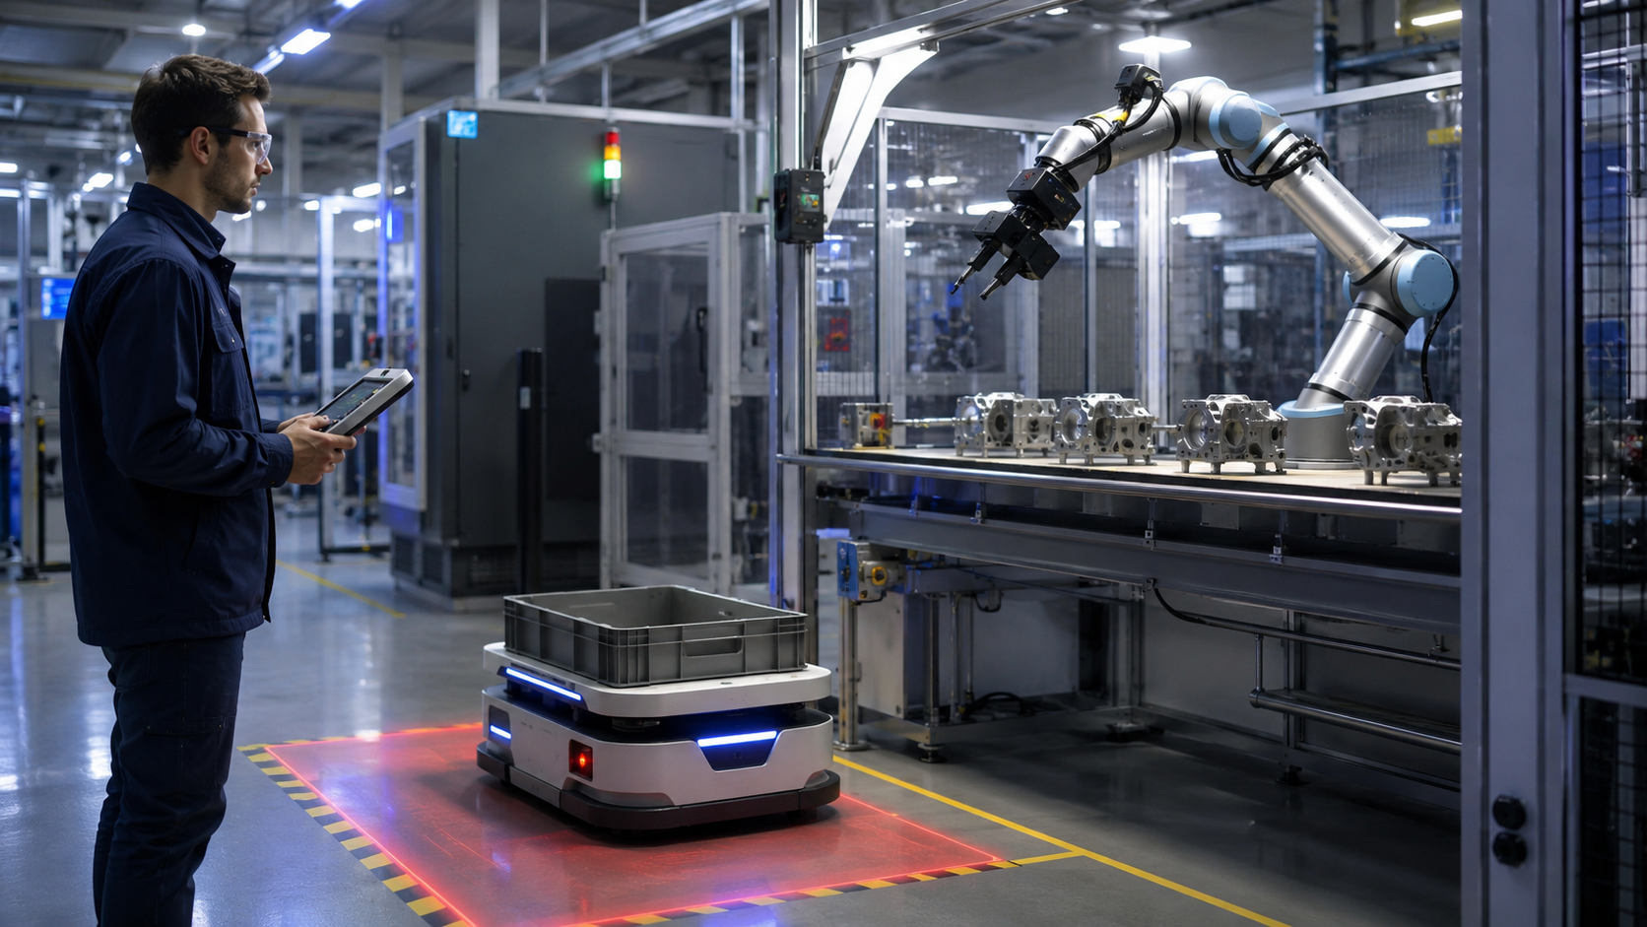
SLIDE 06
Why the physical world is hard
The same model must handle uncertainty, contact, latency, safety, and long-tail edge cases.
Partial observability
sensors miss, occlude, drift
Physics and contact
friction, force, deformable objects
Real-time constraints
milliseconds matter for safety
Irreversible errors
a bad action can damage people or equipment
A robot policy is useful only when it is robust under noisy sensing and imperfect execution.
Long-tail environments
rare events dominate failure modes
FOUNDATIONS OF PHYSICAL AI
06
Notes:
Timing: 1:20. Contrast a text model error with a robotic error. In physical AI, small perception errors can compound into unsafe motion. This is why evaluation, safety envelopes, and control systems are not optional.

Slide 6
SLIDE 07
The Physical AI stack
Think of it as a layered system, from body and sensors up to policies and supervision.
Governance & safety case
risk controls, audits, standards, incident response
Task planning & policy
goals → actions; skill selection; language grounding
World model / state estimation
what is where, what may happen next, uncertainty
Perception
camera, lidar, force, audio, proprioception
Control & actuation
motors, arms, grippers, wheels, low-level controllers
Embodiment & environment
morphology, workspace, objects, people, constraints
Good systems are rarely “one model.” They are engineered stacks that combine learned components with control, monitoring, and safety logic.
FOUNDATIONS OF PHYSICAL AI
07
Notes:
Timing: 1:15. Use this slide to explain why Physical AI projects require both AI and robotics engineering. The foundation model is a component, not the whole system.

Slide 7
SLIDE 08
Grounding: connecting words to the world
Physical AI must translate human goals into geometric, semantic, and actionable representations.
Instruction
Scene
Affordance
Action
“Pick up the red part and place it in bin A.”
objects, positions, people, obstacles
what can be grasped, moved, opened
trajectory + force + timing
Geometry
Semantics
Dynamics
Uncertainty
3D maps, poses, distance
object identity, task meaning
motion, force, cause-effect
confidence, hidden state, risk
FOUNDATIONS OF PHYSICAL AI
08
Notes:
Timing: 1:20. Grounding is the bridge between language and action. The system has to know not only what the instruction means, but where things are, which surfaces can be used, what contacts are allowed, and how confident it is.

Slide 8
SLIDE 09
Foundation models add generalization
The trend is toward models that transfer knowledge across tasks, objects, and robot bodies.
Vision-language models
Research examples
interpret images, objects, scenes, and instructions
RT-2
web-scale vision-language knowledge transferred into robotic control
Vision-language-action models
map observations and commands toward robot actions
Open X-Embodiment
22 robots, 527 skills, shared datasets for cross-robot transfer
Generalist robot policies
Octo
open generalist manipulation policy trained on 800k robot episodes
pretrained across many tasks and embodiments, then fine-tuned
Caveat: bigger models do not remove the need for control, safety limits, and task-specific validation.
Sources: Google DeepMind RT-2; Open X-Embodiment; Octo project pages.
FOUNDATIONS OF PHYSICAL AI
09
Notes:
Timing: 1:40. Explain why foundation models matter. They can bring language, vision, and prior knowledge into robotics. But they are not a substitute for physical testing, robust controllers, and safety cases. Sources to mention: Google DeepMind RT-2; Open X-Embodiment; Octo.

Slide 9
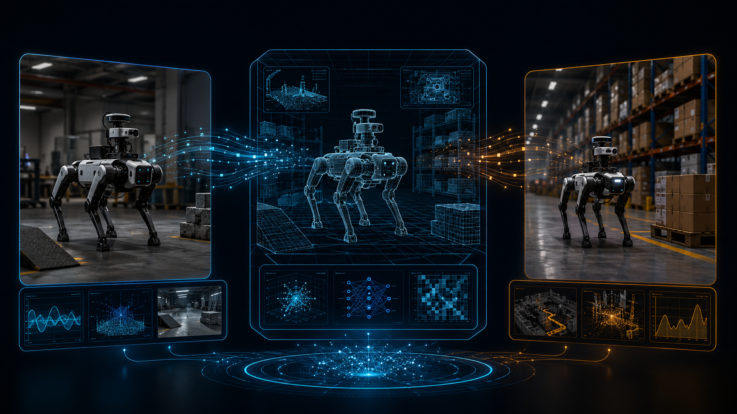
SLIDE 10
World models and simulation
A system needs a place to practice safely before it touches production equipment.
Simulation reduces cost and risk, but production validation remains required because no simulator is complete.
Digital twin
Physics simulation
World model
Policy training
geometry, materials, constraints
motion, contact, sensors
predict likely futures
learn actions safely
Source: NVIDIA Cosmos describes world foundation models for generation, reasoning, and synthetic data in Physical AI workflows.
FOUNDATIONS OF PHYSICAL AI
10
Notes:
Timing: 1:30. Present the basic simulation workflow. Start with a digital twin, add physics and sensors, use world models to generate or predict scenarios, then train and evaluate policies before deployment. Sources to mention: NVIDIA Cosmos; NVIDIA Physical AI Glossary.

Slide 10
SLIDE 11
The Physical AI data flywheel
Progress depends on converting physical experience into reusable training and evaluation data.
1. Real-world logs
sensor streams, outcomes
5. Deploy safely
2. Curate & label
limits, monitoring, feedback
Reusable
experience
state, events, failures
4. Train & evaluate
3. Simulation
policies, models, metrics
edge cases, variants
The strongest teams design the data loop before they scale the robot fleet.
FOUNDATIONS OF PHYSICAL AI
11
Notes:
Timing: 1:20. The key point is operational. Physical AI improves through a data flywheel: deployment produces logs; logs expose gaps; simulation creates targeted edge cases; retraining improves the policy; monitoring validates the next deployment.

Slide 11
SLIDE 12
How Physical AI systems learn
No single learning method is sufficient; practical systems combine several.
Imitation learning
learn from human demonstrations or teleoperation
fast start; limited by demonstration coverage
Reinforcement learning
learn by optimizing reward in simulation or constrained real trials
can discover skills; reward design is hard
Self-supervised learning
predict future frames, state changes, contacts, or affordances
uses raw data; needs robust evaluation
Fine-tuning / adaptation
adjust a pretrained policy to a site, robot, or task
practical but can overfit or forget
Practical recipe
pretrain broadly → demonstrate task → train in simulation → validate on hardware → monitor drift
FOUNDATIONS OF PHYSICAL AI
12
Notes:
Timing: 1:25. Summarize the learning toolbox. Imitation is efficient for known tasks. Reinforcement learning can improve skills in simulation. Self-supervision uses unlabeled data. Fine-tuning adapts foundation models to site-specific conditions.

Slide 12
SLIDE 13
Crossing the sim-to-real gap
The policy trained in simulation must survive the imperfections of the real machine and environment.
Simulation
Real world
controlled physics
perfect labels
cheap retries
rare-event generation
wear and tear
lighting changes
sensor noise
human behavior
Transfer toolkit
randomize, calibrate, constrain, test
Domain randomization
System identification
Safety envelopes
Hardware-in-loop tests
FOUNDATIONS OF PHYSICAL AI
13
Notes:
Timing: 1:20. The sim-to-real gap is the difference between what the simulated system assumes and what the physical system actually does. Practical transfer uses randomization, calibration, staged testing, and hard safety limits.

Slide 13
SLIDE 14
Architecture choices
Physical AI can be built as modular pipelines, end-to-end policies, or hybrid systems.
Modular
End-to-end
Hybrid
perception → planning → control
observation → action
foundation model + controllers + safety layer
interpretable; easier safety review
brittle interfaces between modules
less hand engineering
harder to verify and debug
practical balance
still needs integration discipline
Most industrial deployments today favor hybrid architectures: learned perception and planning with explicit safety and control layers.
FOUNDATIONS OF PHYSICAL AI
14
Notes:
Timing: 1:25. Explain the trade-offs. Modular systems are easier to test but can be brittle. End-to-end models can be flexible but difficult to validate. Hybrid designs are typically the most deployable for near-term Physical AI.

Slide 14
SLIDE 15
Evaluation is multidimensional
A useful robot is not just accurate. It must be safe, robust, fast enough, and maintainable.
Task success
Generalization
Robustness
completion rate, time, quality
new objects, layouts, lighting, users
sensor failures, disturbances, rare events
Latency
Safety
Human factors
perception-to-action delay
near-misses, force limits, stop behavior
handover, trust, supervision workload
Use “release gates”: a policy advances only when it passes offline, simulated, hardware-in-loop, supervised, and production metrics.
FOUNDATIONS OF PHYSICAL AI
15
Notes:
Timing: 1:15. Evaluation must cover more than benchmark accuracy. A policy that succeeds 98% of the time may still be unacceptable if failures are dangerous or hard to detect. Release gates should progressively increase physical exposure.

Slide 15
SLIDE 16
Why now: robotics is scaling while AI capability rises
Industrial adoption creates a practical base for data, deployment, and automation economics.
542k
4.664M
54%
74%
industrial robots installed in 2024
industrial robots operating worldwide
of 2024 global deployments in China
of new deployments in Asia
IFR, 2025
IFR, 2025
IFR, 2025
IFR, 2025
2024 regional deployment split
Asia
Europe
Americas
The opportunity is not just “more robots.” It is reusable robot intelligence across more machines and sites.
Source: International Federation of Robotics, World Robotics 2025 report. See references.
FOUNDATIONS OF PHYSICAL AI
16
Notes:
Timing: 1:25. Use the numbers to ground the discussion. Robotics is already deployed at scale in factories. Physical AI aims to make robotic capabilities more general, adaptive, and easier to transfer across tasks. Sources to mention: International Federation of Robotics, World Robotics 2025 report; Stanford AI Index 2025 for broader AI context.

Slide 16
SLIDE 17
Safety and governance are part of the foundation
Physical AI needs a safety case, not just a model card.
Govern
accountability, roles, human oversight
NIST AI RMF
voluntary risk framework for trustworthy AI
Map
hazards, operating domain, affected stakeholders
ISO 10218-1:2025
industrial robot safety requirements
Measure
tests, simulations, stress cases, incident metrics
EU AI Act
risk-based obligations for selected AI systems
Manage
controls, monitoring, escalation, shutdown
Minimum practice: define the operating design domain, hard safety limits, test coverage, human override, logging, and post-deployment monitoring.
Sources: NIST AI RMF; ISO 10218-1:2025; European Commission AI Act.
FOUNDATIONS OF PHYSICAL AI
17
Notes:
Timing: 1:35. Safety is not a final checklist. It starts at requirements and continues through deployment. Mention that robot safety standards and AI governance frameworks should be integrated, especially when AI changes behavior after updates. Sources to mention: NIST AI RMF; ISO 10218-1:2025; European Commission AI Act.

Slide 17
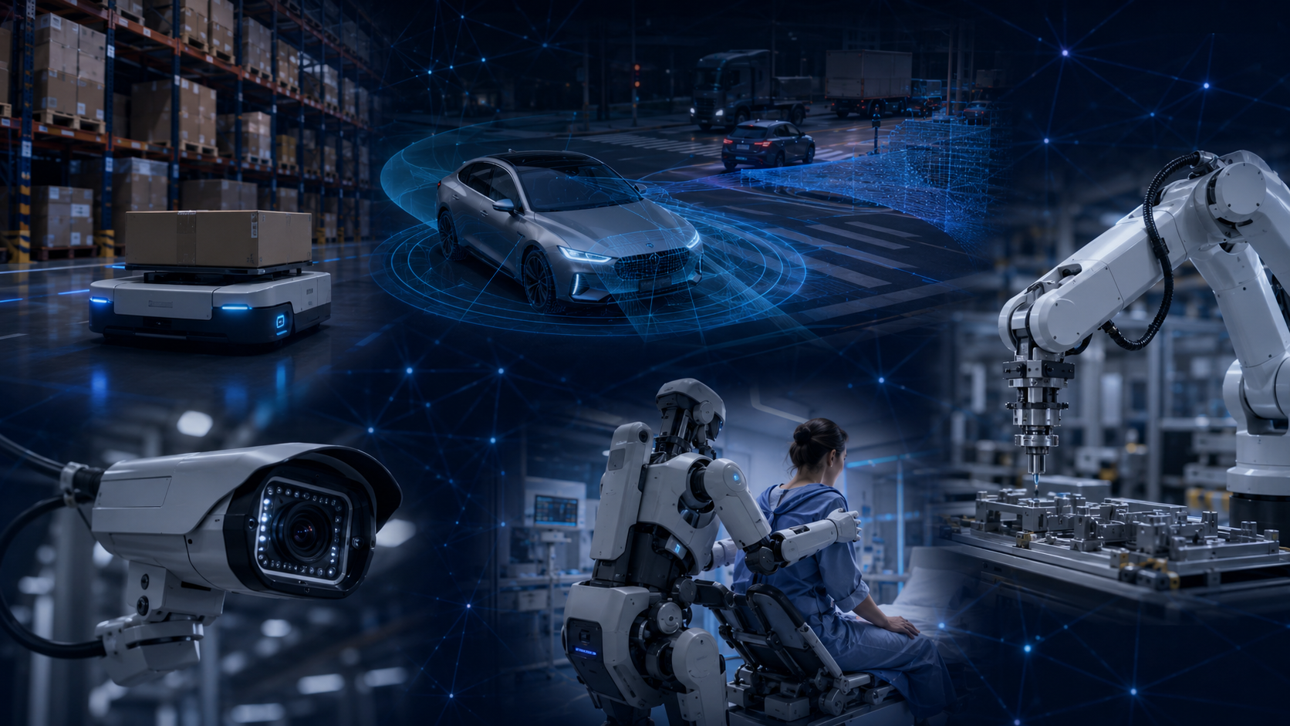
SLIDE 18
Where Physical AI shows up first
The early value is strongest where perception, motion, and operational feedback are already instrumented.
Manufacturing
inspection, assembly, machine tending
Warehouses
AMRs, picking, packing, inventory
Autonomous vehicles
perception, planning, scenario testing
Healthcare robotics
assistive, surgical, lab automation
Smart spaces
traffic flow, safety, monitoring
Pattern: start with bounded environments, measurable tasks, and clear safety constraints.
FOUNDATIONS OF PHYSICAL AI
18
Notes:
Timing: 1:15. Physical AI is likely to appear first in bounded domains. These environments have repeatable tasks, instrumented processes, clear ROI, and manageable safety zones.

Slide 18
SLIDE 19
A practical starting roadmap
Treat Physical AI as an engineered product lifecycle, not a lab demo.
1
2
3
4
5
Bound the task
Instrument the environment
Build a digital testbed
Train and gate releases
Operate the flywheel
choose one workflow and operating domain
collect sensor, outcome, and failure data
simulate normal and rare scenarios
offline → sim → hardware → supervised deployment
monitor, retrain, audit, and improve
Do not begin with “build a humanoid.” Begin with a narrow task where failure modes can be named, tested, and controlled.
FOUNDATIONS OF PHYSICAL AI
19
Notes:
Timing: 1:20. Give the audience a starting path. The most reliable entry point is a bounded task with measurable outcomes. The roadmap is practical: define the operating domain, collect data, build testbeds, gate releases, and run the data flywheel.

Slide 19
SLIDE 20
Current limitations and open problems
The field is advancing quickly, but several foundations remain difficult.
Data scarcity
Brittle generalization
Verification gap
robot data is expensive, heterogeneous, and hard to share
policies can fail under small environmental changes
hard to prove learned behavior is safe in all cases
Compute and latency
Human trust
Governance
large models may not fit real-time edge constraints
users need predictable behavior and clear override paths
updates can change behavior after initial validation
Near-term progress will come from narrower operating domains, stronger data flywheels, better simulation, and explicit safety architecture.
FOUNDATIONS OF PHYSICAL AI
20
Notes:
Timing: 1:25. Keep expectations grounded. Physical AI is promising but not magic. Many current demonstrations are constrained. Scaling requires better data, validation methods, real-time deployment, and governance for model updates.

Slide 20
SLIDE 21
Three takeaways
Use these as the closing frame for the discussion.
Physical AI is closed-loop autonomy
1
It connects perception, state estimation, planning, control, and learning.
Foundation models help, but do not replace engineering
2
The model must sit inside a tested stack with controllers and safety limits.
Deployment is a data-and-safety flywheel
3
Instrumentation, simulation, evaluation, monitoring, and governance drive improvement.
Discussion prompt: What task in your environment is bounded enough to test, but valuable enough to matter?
FOUNDATIONS OF PHYSICAL AI
21
Notes:
Timing: 1:10. Close with three points. Then ask the discussion prompt. The best way to make Physical AI tangible is to identify a bounded, measurable workflow that could be instrumented and tested.

Slide 21
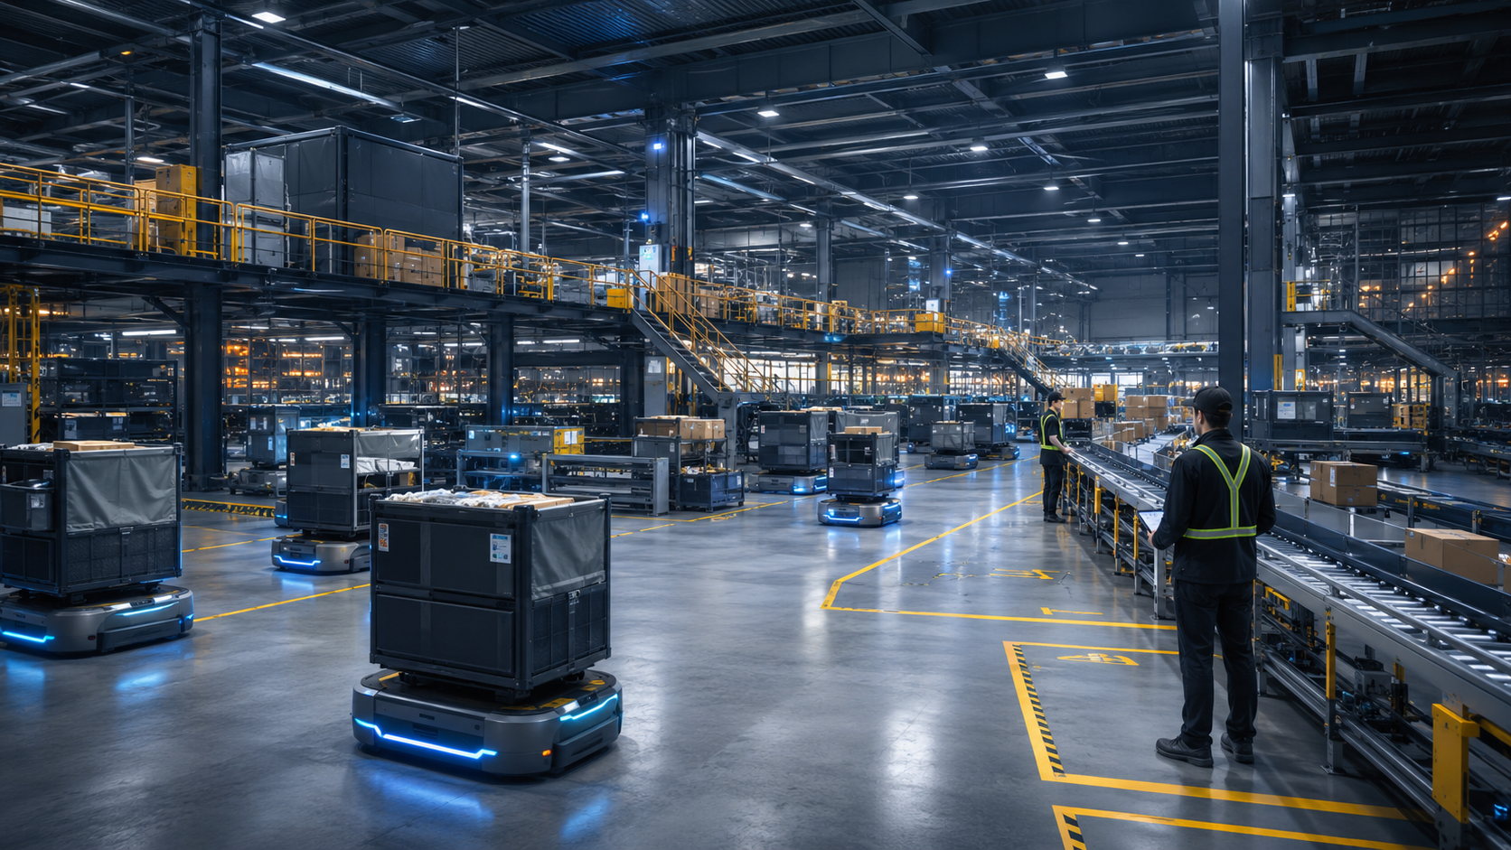
Amazon Robotics
as Physical AI
How a large logistics network combines robots, AI routing, tactile manipulation, human supervision, and operational data.
1M+
+10%
25%
robots deployed
robot travel efficiency target
processing-time reduction
Sources: Amazon Robotics/Operations updates on DeepFleet, Vulcan, and next-generation fulfillment centers.
PHYSICAL AI CASE STUDY
22
Notes:
Timing: 0:45. Introduce this as a practical module. The case is useful because it shows Physical AI as a system: robots, sensors, routing intelligence, manipulation, people, safety limits, and operational feedback. Clarify that the metrics shown are Amazon-reported figures, not independent audit results. Sources to mention: Amazon DeepFleet launch; Amazon next-generation fulfillment center update.

Slide 22
SLIDE 23
Why this case is useful
Amazon’s fulfillment network is a bounded but highly variable physical environment.
1
Scale
Large robot fleet creates enough operational data to improve routing and system behavior.
2
Embodiment
Mobile robots, arms, bins, conveyors, shelves, workers, and packages form one physical system.
3
Feedback
Every movement can produce logs: location, delay, exception, handoff, and outcome.
4
Safety boundary
The environment is designed with zones, workstations, procedures, and human overrides.
The lesson is not “copy Amazon.” The lesson is how Physical AI becomes deployable when the task, environment, metrics, and escalation paths are engineered together.
PHYSICAL AI CASE STUDY
23
Notes:
Timing: 2:00. Frame the case around four properties: scale, embodiment, feedback, and safety boundaries. Emphasize that this is not a general-purpose robot in an uncontrolled world. It is a carefully designed operating domain, which is why Physical AI can work reliably enough to matter.

Slide 23
SLIDE 24
System map: from order to physical action
The intelligence is distributed across planning software, robot policies, controls, and human operators.
Physical AI case studies should be read as systems, not as single-model demos.
Demand
Tasking
Movement
Manipulation
Human handoff
orders, promises, inventory signals
which item, bin, robot, station
routes, traffic, charging, congestion
pick, stow, sort, pack
exceptions, coaching, supervision
Operational data flywheel
logs → exceptions → retraining → deployment gates → monitoring
PHYSICAL AI CASE STUDY
24
Notes:
Timing: 2:15. Walk through the map from left to right. Customer demand becomes tasking. Tasking becomes motion. Motion is constrained by the environment. Manipulation creates exceptions. Human handoff and logs close the loop. The important point is that the AI model is embedded inside a broader automation system.

Slide 24

SLIDE 25
Fleet-level Physical AI: DeepFleet
At fleet scale, routing becomes a learning problem: reduce congestion, travel time, and idle motion.
1M+
+10%
300+
Core idea
traffic management for robots
robots in operations
reported robot travel efficiency
facilities in robot network
Observe
Predict
Optimize
Improve
inventory movement
and robot state
bottlenecks and
travel delays
routes and
fleet coordination
logs feed model
updates
Do not overread the metric: Amazon reports robot travel efficiency improvement, not a universal 10% improvement in all fulfillment outcomes.
Source: Amazon, “AI foundation model to power its robotic fleet,” June 30, 2025.
PHYSICAL AI CASE STUDY
25
Notes:
Timing: 2:30. Explain DeepFleet as fleet-level Physical AI. The model coordinates robot movements across fulfillment centers, similar to traffic management. It is trained on operational data from warehouse and inventory movement. Be precise: the reported 10 percent figure is robot travel efficiency, not total facility productivity. Sources to mention: Amazon DeepFleet launch; Amazon Q2 2025 results.

Slide 25
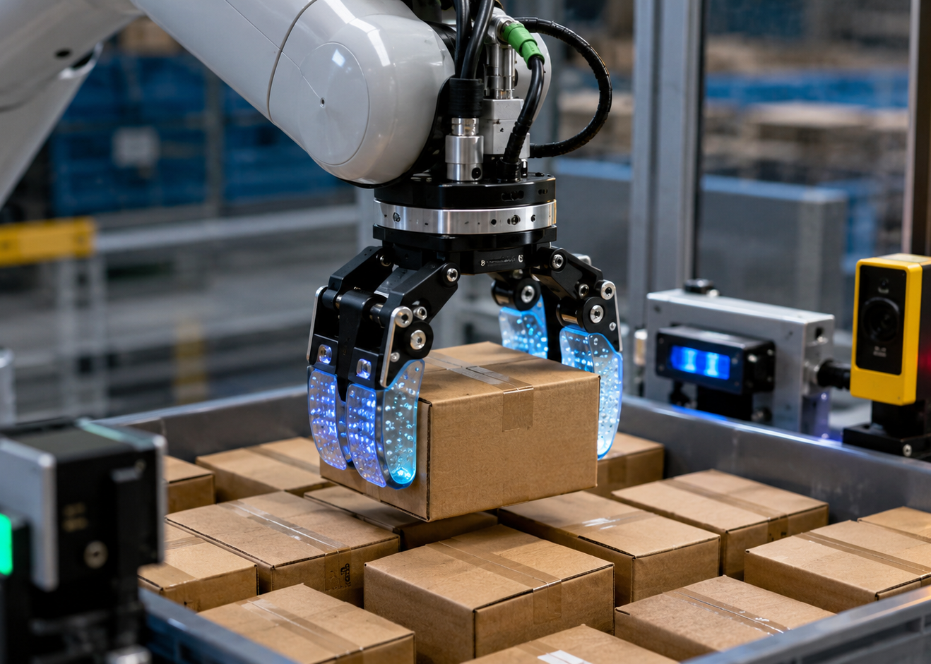
SLIDE 26
Tactile Physical AI: Vulcan
Manipulation becomes harder when contact is expected, not avoided.
Vision
locate the item and the grasp region
Touch
measure contact force and torque
Control
move, slide, back off, or replan
Handoff
ask a human when the item is unsuitable
Case insight: touch changes the policy. The robot can use contact as information, instead of treating contact only as a fault.
Sources: Amazon Vulcan launch; Amazon Science technical explainer on six-axis force/torque sensing.
PHYSICAL AI CASE STUDY
26
Notes:
Timing: 2:30. Use Vulcan to show embodiment. Amazon describes Vulcan as its first robot with a sense of touch. Amazon Science explains that its end-of-arm tools use sensors measuring force and torque along six axes. The system is designed to make contact with random objects and back off before force becomes excessive. This is a clean example of sense, reason, act, and learn in contact-rich manipulation. Sources to mention: Amazon Vulcan launch; Amazon Science Vulcan explainer.

Slide 26
SLIDE 27
Workflow integration: AI plus robotics plus layout
The site design matters as much as the robot model.
3M+
30M+
25%
25%
square feet in Shreveport site
items supported by Sequoia
reported processing-time reduction
targeted cost-to-serve improvement
Store
Bring pods
Pick/stow
Sort
Pack
Ship
Physical AI deployment often succeeds through co-design: robot capability, building layout, workstation ergonomics, telemetry, and exception handling.
Source: Amazon, next-generation fulfillment center update, October 2024.
PHYSICAL AI CASE STUDY
27
Notes:
Timing: 2:15. Show how the system is not just a robot fleet. Amazon describes the Shreveport site as a next-generation fulfillment center with five floors and over 3 million square feet. Sequoia coordinates mobile robots and arms, and Amazon reports up to 25 percent reduced fulfillment processing time in these next-generation sites. The lesson is co-design. Sources to mention: Amazon next-generation fulfillment center update.

Slide 27
SLIDE 28
Human-in-the-loop safety model
Physical AI at scale still depends on designed handoffs, training, and clear operating boundaries.
Operational controls
Workforce design
Operating domain
bounded warehouse areas, stations, pods, and procedures
700k+
30%
Exception handoff
robot asks for human help when confidence or feasibility is low
employees upskilled
more technical support roles in advanced sites
Ergonomics
robots bring work into safer reach zones where possible
Monitoring
logs expose delays, near-misses, failures, and maintenance needs
Use this critically: workforce benefits depend on implementation, job design, transparency, and local labor conditions.
Safety is not only collision avoidance. It includes ergonomic risk, exception handling, training, maintenance, and governance of software updates.
Sources: Amazon DeepFleet launch; Amazon next-generation fulfillment center update.
PHYSICAL AI CASE STUDY
28
Notes:
Timing: 2:15. Connect this to the safety foundations from the earlier section. Physical AI safety is socio-technical: the robot behavior, the site layout, the operators, the training model, and the maintenance process all matter. Use the workforce numbers as Amazon-reported claims and invite critical interpretation.

Slide 28
SLIDE 29
Reported outcomes — and what to question
A good case study includes both evidence and limits.
Reported by Amazon
Critical reading
Scale
more than 1 million robots deployed
Metric scope
robot travel efficiency is not total order-cycle efficiency
Fleet efficiency
DeepFleet targets 10% better robot travel efficiency
Evidence
most published figures are company-reported
Site throughput
up to 25% lower fulfillment processing time in next-gen sites
Transferability
warehouse logistics is more bounded than homes, hospitals, or roads
Human workflow
ergonomic workstations and more technical support roles
Governance
software updates can change behavior after validation
Case-study discipline: separate operational claims, independent evidence, and design lessons.
Sources: Amazon Robotics/Operations updates; interpretation is based on scope of the reported metrics.
PHYSICAL AI CASE STUDY
29
Notes:
Timing: 2:00. This slide prevents overclaiming. The case is impressive, but it should be analyzed carefully. Distinguish robot travel efficiency from total productivity. Distinguish company-reported results from independent verification. Distinguish bounded warehouse automation from open-world autonomy.

Slide 29
SLIDE 30
Transferable design lessons
What another organization can borrow from the case without copying Amazon’s scale.
1
Bound the operating domain
Define where the robot may operate, what objects it can handle, and when it must stop.
2
Instrument before scaling
Capture task state, robot state, failure modes, and human interventions from day one.
3
Use a hybrid stack
Combine learned models with controls, safety monitors, routing rules, and human escalation.
4
Co-design the environment
Layout, bins, workstations, lighting, and labels can reduce the AI burden.
5
Treat data as the product
The durable asset is not only the robot; it is the data flywheel that improves behavior.
PHYSICAL AI CASE STUDY
30
Notes:
Timing: 2:15. Translate the case into actionable lessons. The strongest practical lesson is not scale. It is disciplined system design: bounded domain, instrumentation, hybrid architecture, environmental design, and a data flywheel.

Slide 30
SLIDE 31
Case study readout
Physical AI becomes useful when intelligence is constrained, measured, and connected to operations.
1
Fleet intelligence matters
The routing layer can create value even when individual robots are simple.
2
Touch extends autonomy
Contact-rich manipulation needs force sensing, control, and safe fallback.
3
The system is the product
Robots, humans, layout, data, monitoring, and governance form the deployable unit.
Discussion prompt: Where could your organization build a bounded Physical AI pilot with a measurable data flywheel?
PHYSICAL AI CASE STUDY
31
Notes:
Timing: 1:15. Close the case study. The main conclusion is that Physical AI is not a single technology. It is a deployable operating system for physical work: sensing, movement, manipulation, safety, human collaboration, and data-driven improvement.

Slide 31
SLIDE 32
References and further reading
Key sources used for the deck.
1. NVIDIA Glossary — What is Physical AI? https://www.nvidia.com/en-us/glossary/generative-physical-ai/
9. ISO — ISO 10218-1:2025 Robotics safety requirements. https://www.iso.org/standard/73933.html
2. Google DeepMind — RT-2: New model translates vision and language into action. https://deepmind.google/blog/rt-2-new-model-translates-vision-and-language-into-action/
10. European Commission — AI Act. https://digital-strategy.ec.europa.eu/en/policies/regulatory-framework-ai
3. Open X-Embodiment — Robotic Learning Datasets and RT-X Models. https://robotics-transformer-x.github.io/
11. Amazon — Amazon launches a new AI foundation model to power its robotic fleet and deploys its 1 millionth robot. https://www.aboutamazon.com/news/operations/amazon-million-robots-ai-foundation-model
4. Octo — An Open-Source Generalist Robot Policy. https://octo-models.github.io/
12. Amazon — Amazon has more than 1 million robots that sort, lift, and carry packages. https://www.aboutamazon.com/news/operations/amazon-robotics-robots-fulfillment-center
5. NVIDIA Cosmos — Physical AI with World Foundation Models. https://www.nvidia.com/en-us/ai/cosmos/
13. Amazon — Introducing Vulcan: Amazon’s first robot with a sense of touch. https://www.aboutamazon.com/news/operations/amazon-vulcan-robot-pick-stow-touch
6. International Federation of Robotics — World Robotics 2025 report. https://ifr.org/ifr-press-releases/news/global-robot-demand-in-factories-doubles-over-10-years
14. Amazon Science — How Amazon’s Vulcan robots use touch to plan and execute motions. https://www.amazon.science/blog/how-amazons-vulcan-robots-use-touch-to-plan-and-execute-motions
7. Stanford HAI — 2025 AI Index Report. https://hai.stanford.edu/ai-index/2025-ai-index-report
15. Amazon — Next-generation fulfillment center powered by AI and robotics. https://www.aboutamazon.com/news/operations/amazon-fulfillment-center-robotics-ai
8. NIST — AI Risk Management Framework. https://www.nist.gov/itl/ai-risk-management-framework
16. Amazon IR — Q2 2025 results, DeepFleet update. https://ir.aboutamazon.com/news-release/news-release-details/2025/Amazon-com-Announces-Second-Quarter-Results/
Generated visuals: OpenAI image generation, created for this presentation.
FOUNDATIONS OF PHYSICAL AI
32
Notes:
Timing: 0:30. References slide. Leave this up during questions if useful.

