Slide 1

SLIDE 1/10 | AI ANSWER SHEET GRADING SYSTEM
AI-Assisted Theory Exam Evaluation
High-Trust Vision AI Scoring with Human-in-the-Loop Examiner Review
Multimodal Handwriting OCR
Transcribes cursive handwriting and STEM equations via Claude Vision.
Rubric-Aligned Evaluation
Maps student steps deterministically against board marking schemes.
100% Human Examiner Control
Examiner reviews, approves, or overrides with mandatory typed reason.
KEY CAPABILITY: ENTERPRISE BOARD GRADE
Notes:
Welcome everyone. Today we are presenting the AI Answer Sheet Grading System, a modern platform engineered specifically for high-stakes theory board examinations. It merges advanced Vision AI with mandatory human examiner oversight to cut grading backlogs by 70% while guaranteeing 100% RTI defensibility.

Slide 2

SLIDE 2/10 | THE CORE PROBLEM
The Crisis in Theory Exam Evaluation
Manual evaluation cannot keep pace with millions of handwritten board exams
Massive Script Backlog
Millions of physical answer sheets processed under grueling deadlines.
Examiner Fatigue & Variance
Grading drift and retotalling errors spike after hours of continuous grading.
Zero Defense in Disputes
RTI and re-evaluation requests lack auditable, step-by-step mark justification.
KEY CAPABILITY: 60+ DAY DELAYS • HIGH RETOTALLING ERRORS
Notes:
Every examination season, state and national boards face the same crisis: exhausted examiners grading hundreds of thousands of handwritten scripts late into the night. Fatigue introduces variance, missed sub-questions, and retotalling errors that lead to costly re-evaluations and court litigations.

Slide 3

SLIDE 3/10 | THE ARCHITECTURAL SOLUTION
Human-in-the-Loop AI Grading
AI assists the examiner — humans retain final institutional authority
AI Does the Heavy Lifting
Automates handwriting transcription, rubric mapping, and draft scoring in seconds.
Examiner Makes the Decision
One-click 'Approve', 'Override' (with required rationale), or 'Flag' for moderator.
Transparent Confidence Meter
Color-coded Green/Yellow/Red confidence rating visible at a single glance.
KEY CAPABILITY: 70% FASTER • 100% HUMAN VERIFIED
Notes:
Our system does not replace examiners; it supercharges them. The AI handles transcription and rubric matching, presenting a pre-scored draft with complete reasoning and confidence levels. The human examiner remains in the loop to verify and approve every score.

Slide 4
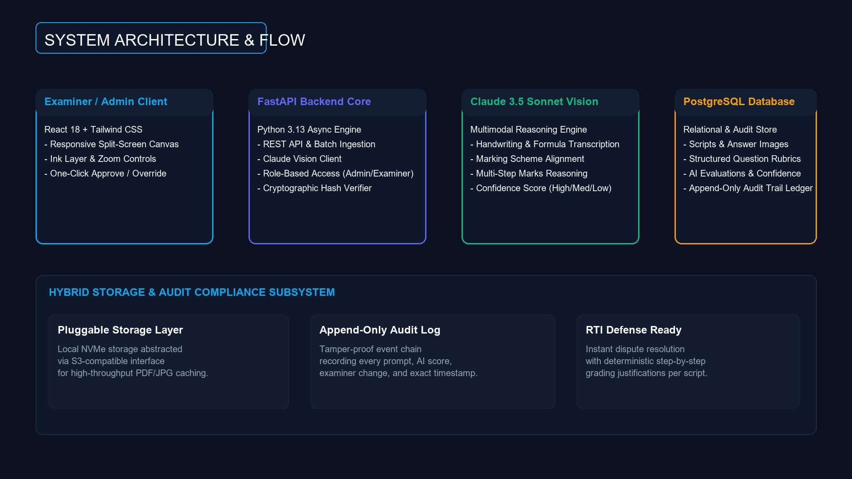
SLIDE 4/10 | SYSTEM ARCHITECTURE
Production Tech Stack & Flow
Built with modern, enterprise-grade open-source and cloud infrastructure
Frontend Canvas
React 18 + Tailwind CSS with split-screen synchronized viewer.
Backend Core
FastAPI Python engine with asynchronous queue & S3-compatible storage.
Intelligence & Storage
Claude 3.5 Sonnet Vision API + PostgreSQL append-only audit ledger.
KEY CAPABILITY: REACT • FASTAPI • POSTGRES • CLAUDE API
Notes:
Here is the technical foundation: The front end is a responsive React application optimized for desktop and tablet evaluation. The backend is an asynchronous FastAPI service communicating with Claude 3.5 Sonnet Vision and persisting all data in PostgreSQL with pluggable local/S3 storage.

Slide 5
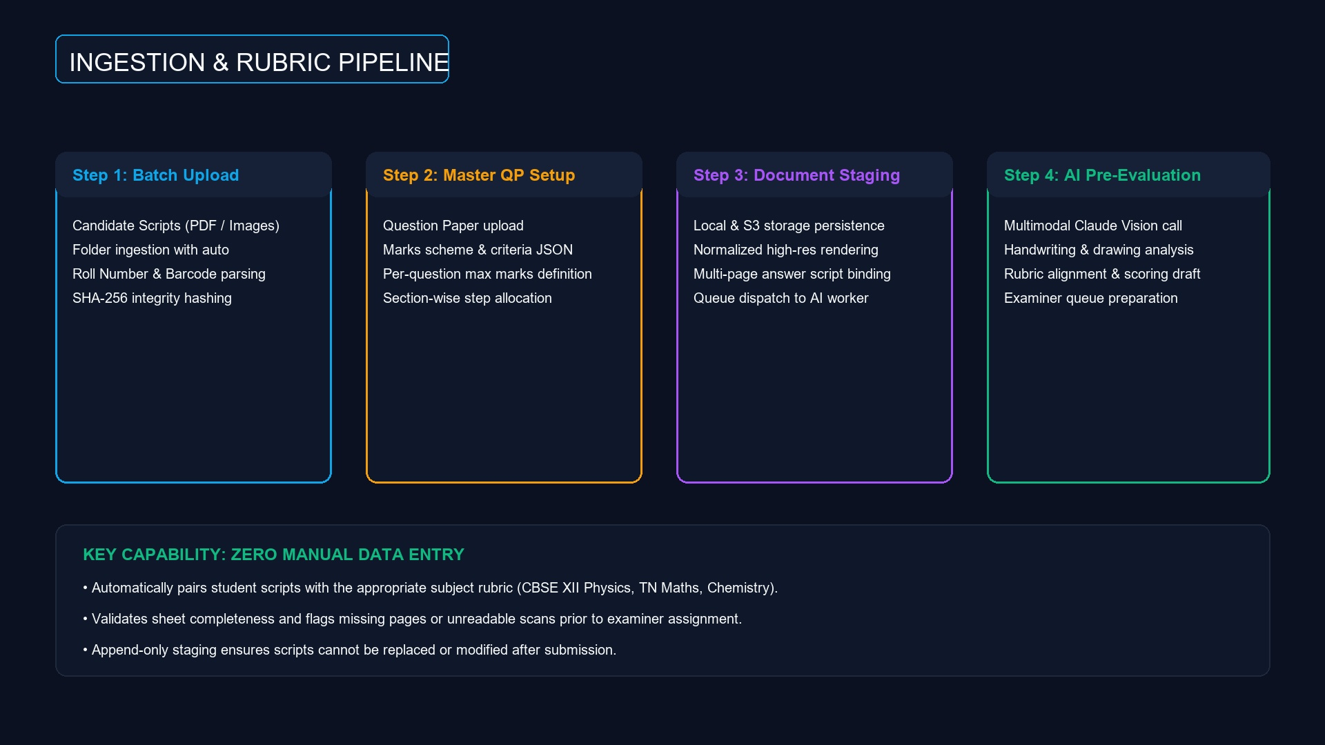
SLIDE 5/10 | INGESTION & SETUP
Answer Sheets & Master Rubric
Frictionless ingestion of student scripts and board marking schemes
Batch Folder & PDF Ingestion
Upload entire examination centers in bulk with automated roll/barcode parsing.
Master Question Paper Sync
Structured marking criteria JSON with maximum marks and sub-step allocations.
SHA-256 Tamper Proofing
Every script is cryptographically hashed upon upload to prevent substitution.
KEY CAPABILITY: MULTI-FORMAT • CRYPTOGRAPHIC HASHING
Notes:
In the ingestion stage, administrators upload student scripts via multi-file or full directory upload. The system automatically parses roll numbers and pairs each script with the Master Question Paper and rubric JSON, ensuring strict version control.

Slide 6

SLIDE 6/10 | VISION AI PIPELINE
Handwriting to Rubric Reasoning
Multi-pass multimodal intelligence evaluates each answer step-by-step
Cursive & Formula Parsing
Vision LLM deciphers handwriting, math equations, and diagram annotations.
Rubric Criteria Alignment
Evaluates method, intermediate calculations, units, and final answers.
Color-Coded Confidence
High (>90% Green), Medium (75-90% Yellow), Low (<75% Red) quality index.
KEY CAPABILITY: STEP-BY-STEP REASONING • DUAL-PASS OCR
Notes:
The vision pipeline extracts the student's handwritten response and evaluates it step-by-step against the official rubric. It doesn't just produce a score; it writes a detailed explanation of marks awarded or deducted, stamped with a clear confidence level.

Slide 7
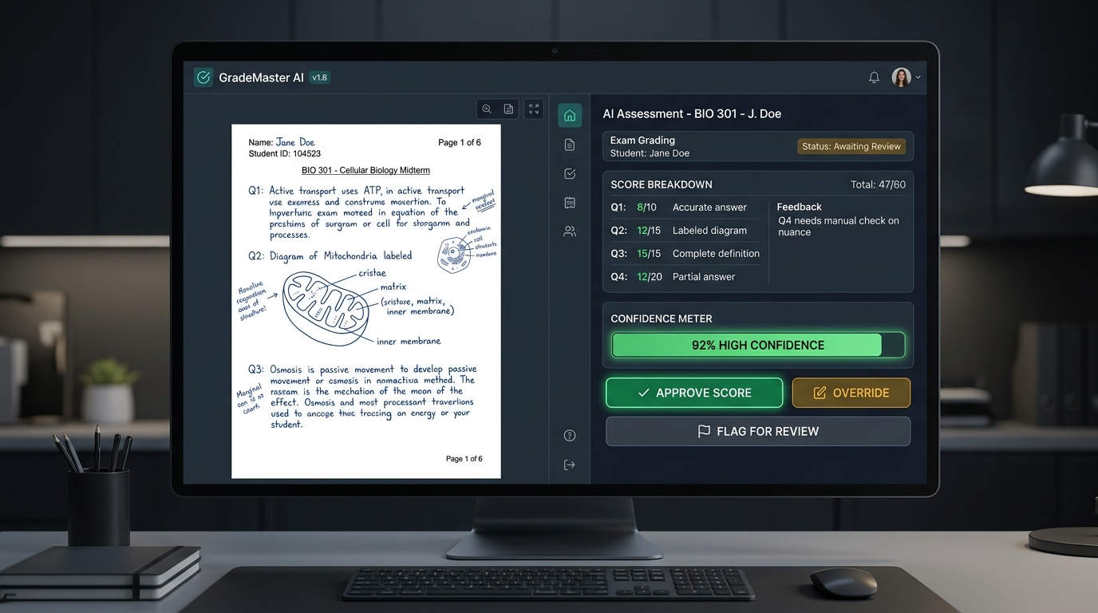
SLIDE 7/10 | EXAMINER WORKSPACE
Split-Screen Examiner Experience
Clean, distraction-free environment built for hours of efficient grading
Side-by-Side Canvas
High-res original answer script on the left; AI rubric breakdown on the right.
One-Click Actions
Instantly Approve AI marks or Flag for Senior Moderator review.
Mandatory Override Rationale
Hard requirement: Examiner must enter a typed reason to override any score.
KEY CAPABILITY: MANDATORY OVERRIDE REASON • ERGONOMIC UI
Notes:
The grading screen provides a split-view interface. On the left is the raw handwritten scan with zoom and rotation. On the right is the AI's suggested score and reasoning. If an examiner disagrees with the AI, the override modal enforces typing a written reason before submission.

Slide 8

SLIDE 8/10 | GOVERNANCE & COMPLIANCE
Append-Only Audit Trail & RTI Defense
Complete transparency and institutional accountability for every mark
Immutable Event Ledger
Every AI suggestion, examiner override, timestamp, and user ID logged permanently.
Zero Black-Box Mystery
Every awarded half-mark is backed by transcribed text and rubric criteria.
Instant Legal & RTI Defense
Export certified evaluation reports with examiner signatures in seconds.
KEY CAPABILITY: 100% RTI DEFENSIVE • APPEND-ONLY LEDGER
Notes:
Accountability is paramount. Every evaluation is recorded in an immutable append-only audit log. In the event of an RTI inquiry or re-check, the board can produce the exact timestamp, examiner identity, original script, and step-by-step reasoning.

Slide 9
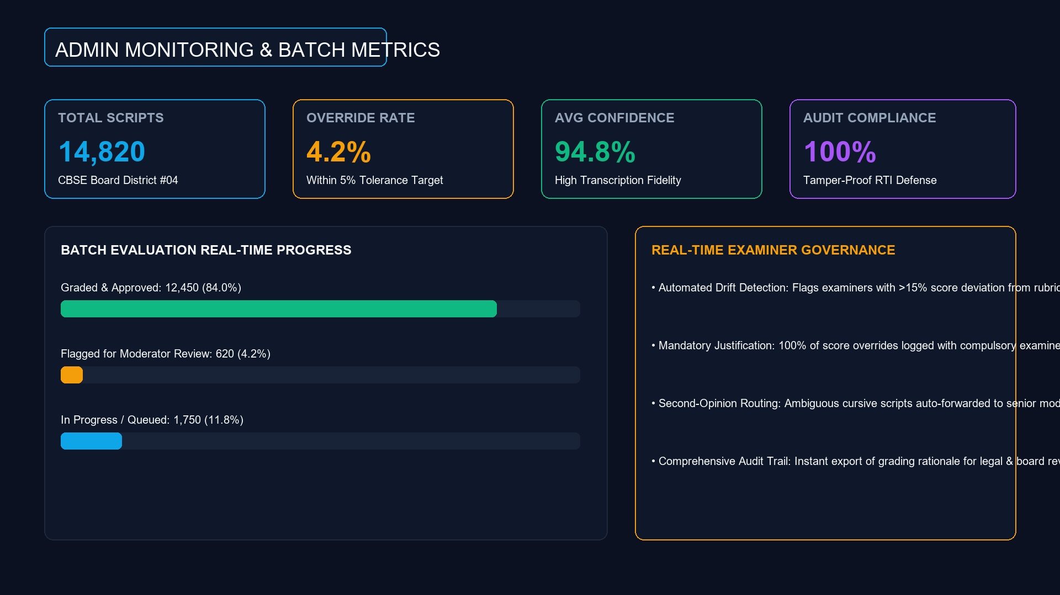
SLIDE 9/10 | BATCH MONITORING
Admin Dashboard & Quality Control
Macro-level visibility across examination centers and examiner cohorts
Real-Time Pipeline Status
Live counters for Pending, Graded, and Flagged scripts across batches.
Override Rate Tracking
Monitors examiner divergence to detect ambiguous rubrics or grading bias.
Average Confidence Index
Guarantees scan quality and flags illegible batches automatically.
KEY CAPABILITY: REAL-TIME QC • DRIFT DETECTION
Notes:
The Admin Dashboard provides live visibility across examination centers. Administrators track the override rate, average transcription confidence, and evaluation speed in real-time, catching anomalies and grading drift early.

Slide 10
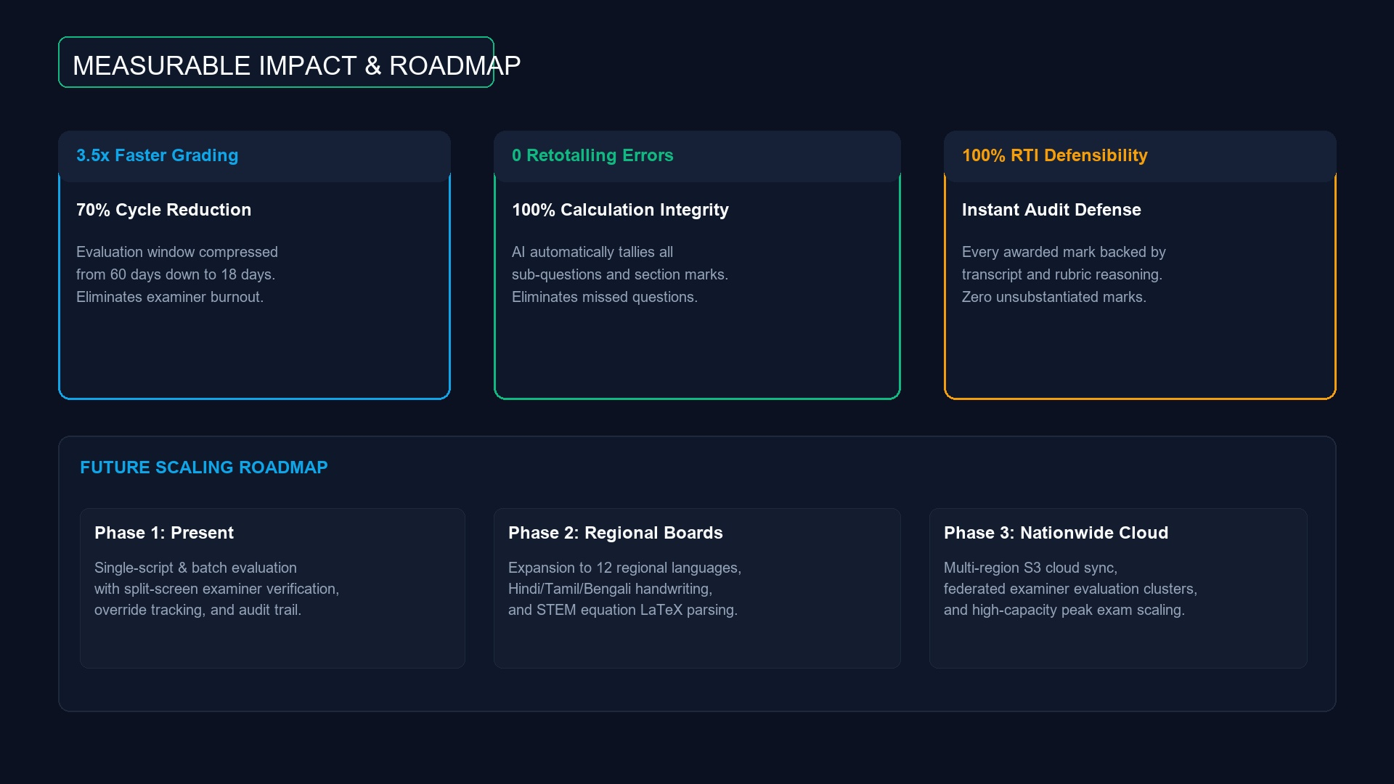
SLIDE 10/10 | IMPACT & ROADMAP
Transformational Impact & Future
Scaling trust, speed, and accuracy for state and national exam boards
70% Faster Results
Reduces evaluation turnaround from 60 days to under 18 days.
Zero Retotalling Errors
Automated tallying eliminates missed questions and mathematical mistakes.
Next Generation Scaling
Support for 12 regional Indic languages, math LaTeX, and multi-region cloud sync.
KEY CAPABILITY: FASTER • FAIRER • 100% AUDITABLE
Notes:
In conclusion, the AI Answer Sheet Grading System delivers 3.5x faster grading turnaround, completely eliminates retotalling errors, and provides bulletproof institutional defense. It is the gold standard for next-generation board examinations.

