Slide 1



Energy Consumption Analysis
Team:
Kumkapalla Chidvilas
Kudithi Krishna Kishore
Bandaru Deva Vara Prasad

Slide 2
Introduction
💡 This project focuses on analyzing global energy consumption, production, and emissions using real-world datasets. 🌍 It explores the strong connection between economic growth, population trends, and energy usage across countries. 📈 Python-based visualizations were used to reveal trends, correlations, and outliers in the data. 🔥 The analysis identifies major contributors to global emissions and their energy source patterns. ♻️ The findings support sustainable energy planning and environmental decision-making for a greener future.

Slide 3

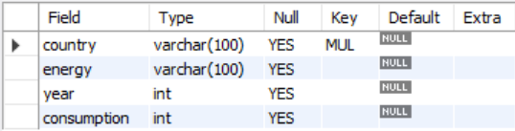
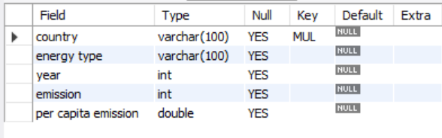
Tables
Country table
consumption table
Emisssion table

Slide 4
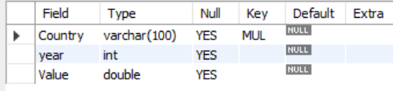
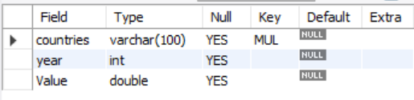
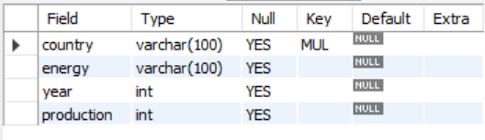
Tables
gdp_ppp table
population table
Emisssion table

Slide 5
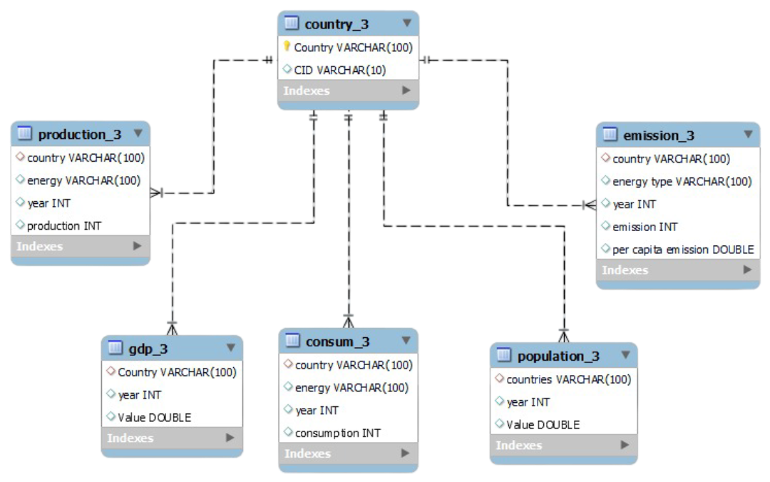
ER Diagram

Slide 6
Problem Statement
The rapid rise in global energy consumption has created significant environmental and economic challenges. Countries vary widely in how they produce and use energy, leading to uneven patterns of emissions, resource dependency, and sustainability performance. This project aims to analyze and compare global energy data — including production, consumption, GDP, and emissions — using MySQL to uncover trends, correlations, and disparities among nations. By doing so, it seeks to identify key contributors to global emissions, evaluate efficiency through per-capita and GDP ratios, and provide insights that can support sustainable energy policy decisions.

Slide 7

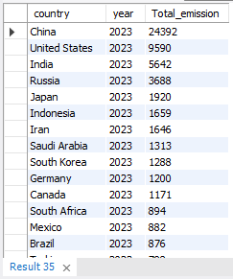
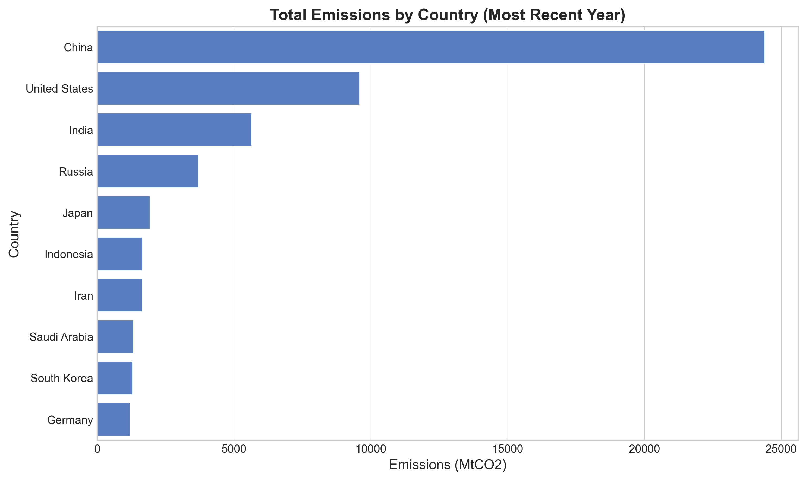
1. What is the total emission per country for the most recent year available?

Slide 8

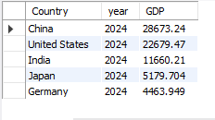
2. What are the top 5 countries by GDP in the most recent year?

Slide 9
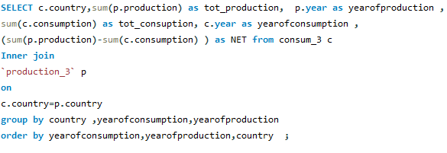
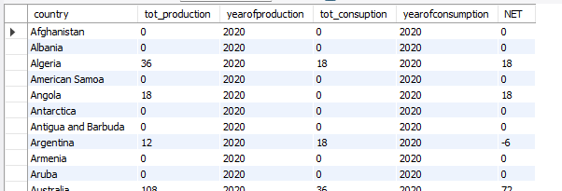
3. Compare energy production and consumption by country & year.

Slide 10
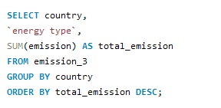
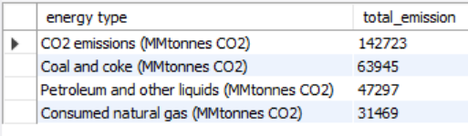
4. Which energy types contribute most to emissions across all countries?

Slide 11


5. How have global emissions changed year over year?

Slide 12

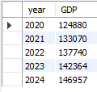
6. What is the trend in GDP for each country over the given years?

Slide 13
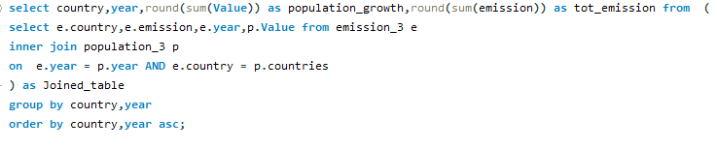
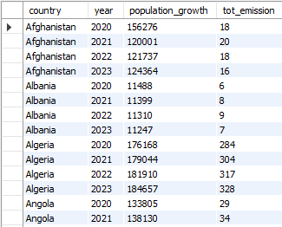
7. How has population growth affected total emissions in each country?

Slide 14
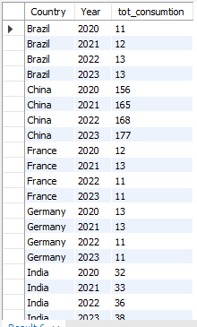
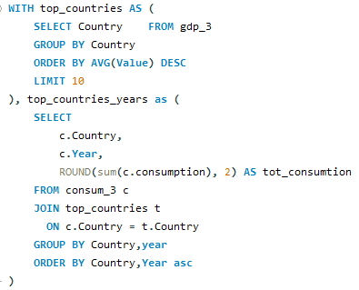
8. Has energy consumption increased or decreased over the years for major economies?

Slide 15
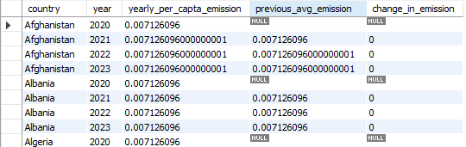
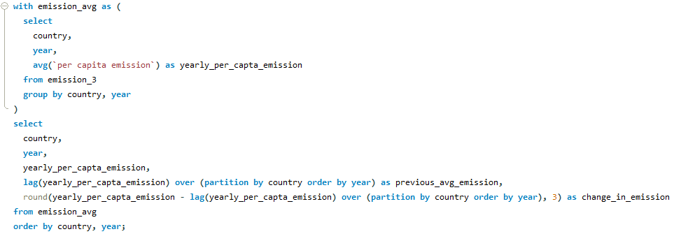
9. What is the average yearly change in emissions per capita for each country?

Slide 16
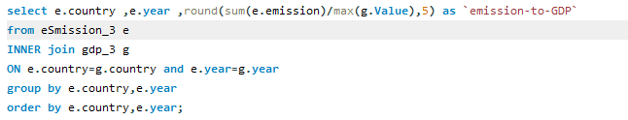
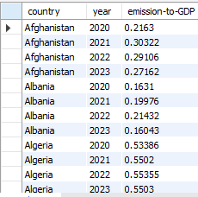
10. What is the emission-to-GDP ratio for each country by year?

Slide 17
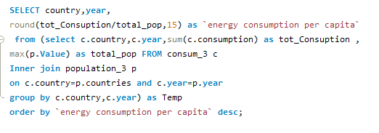
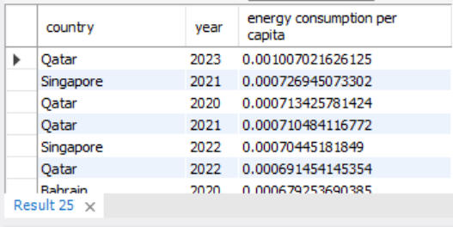
11. What is the energy consumption per capita for each country over the last decade?

Slide 18
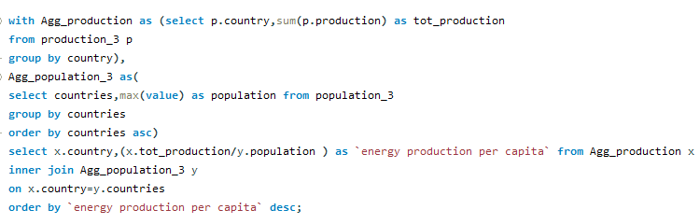
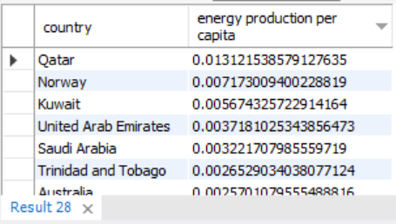
12. How does energy production per capita vary across countries?

Slide 19
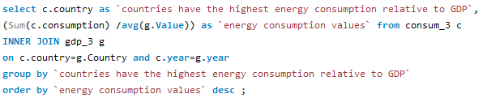
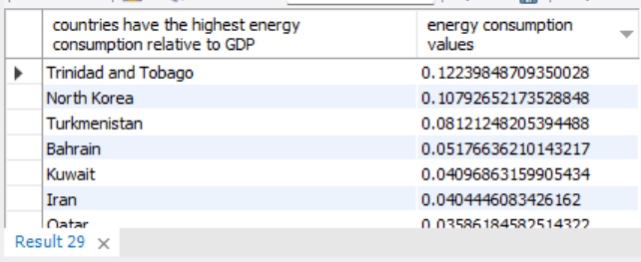
13 . Which countries have the highest energy consumption relative to GDP?

Slide 20
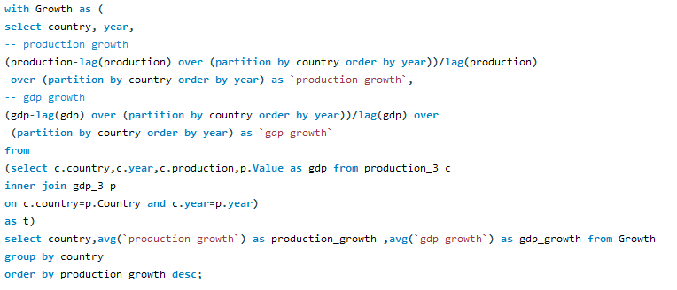
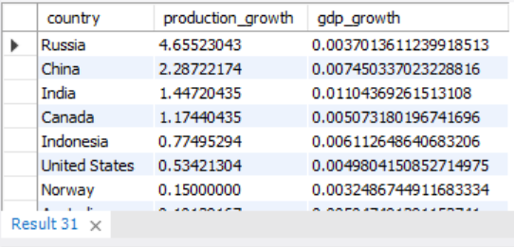
14. What is the correlation between GDP growth and energy production growth?

Slide 21
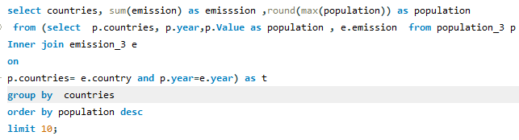
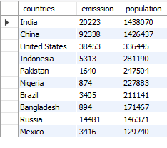
15. What are the top 10 countries by population and how do their emissions compare?

Slide 22
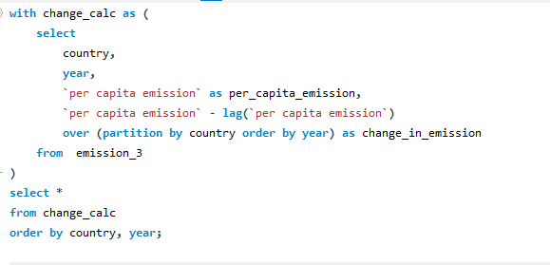
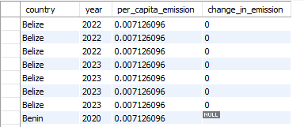
16. Which countries have improved (reduced) their per capita emissions the most over the last decade?

Slide 23
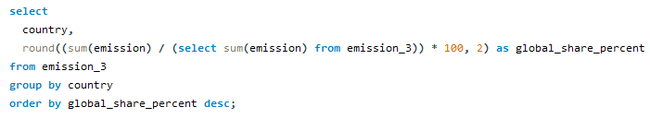
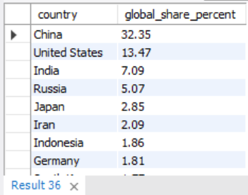
17. What is the global share (%) of emissions by country?

Slide 24
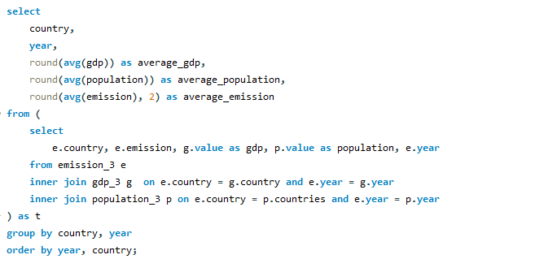
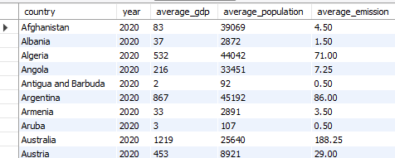
18. What is the global average GDP, emission, and population by year?

Slide 25
Conclusion :
We discovered that energy, economy, and environment are deeply connected, influencing one another in every watt consumed and every emission released.
By harnessing MySQL and Python, we turned raw data into meaningful insights — identifying key contributors to emissions, efficiency trends, and global energy disparities.
Ultimately, this analysis reminds us that sustainable growth is not just a choice — it’s a necessity. The future belongs to those who can transform data into action, and energy into opportunity for a cleaner, balanced planet.”

Slide 26


