Slide 1
NAME : Kishore K REGISTER.NO:2422J0432 NM ID:41AF04091C24DBA8ECD46A6124E02AE4 DEPARTMENT : Bachelor of Computer Applications COLLEGE/ UNIVERSITY :Bishop Thorp College/Bharathiyar University

Slide 2
INTERACTIVE DIGITAL PORTFOLIO USING FRONT END WED DEVELOPMENT

Slide 3
AGENDA:
Problem Statement
Project Overview
End Users
Tools And Technologies
Portfolio Design And Layout
Features And Functionality
Results And Screenshots
Conclusion

Slide 4
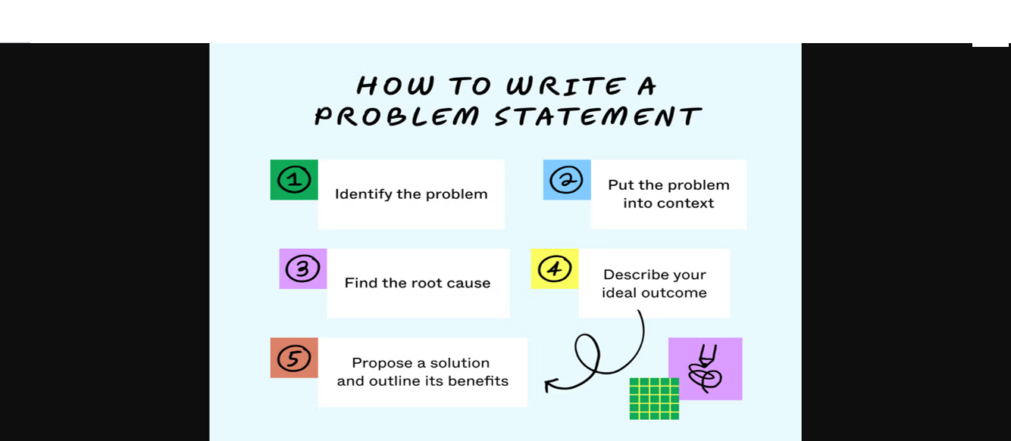

Problem Statement:
A problem statement explains the challenges you face with your work, which can affect your operations, launching new products, or improving existing ones. It shows the gap between the current state and the desired state of a process, product, or service.

Slide 5
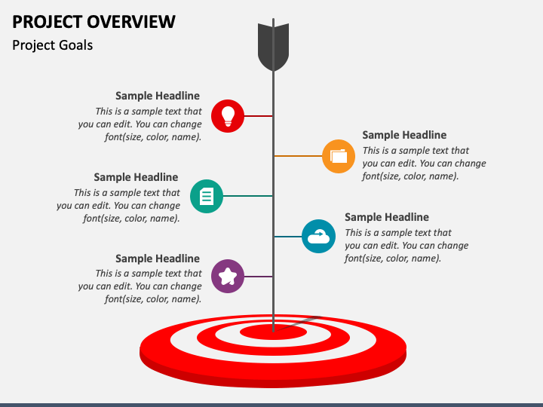
2. Project Overview:
A project overview is an outline of a project that describes important details about it. A project overview includes basic information, such as the project name, project manager, and sponsors. It also includes detailed information that summarizes the project's value, the problem it may solve, and the goals the team hopes to achieve.

Slide 6

3. End users:
The term "end user" refers to the consumer of a good or service, often one who has some innate know-how that is unique to consumers.
In a literal sense, the term is used to distinguish the person who purchases and uses the good or service from individuals who are involved in the stages of its design, development, and production.

Slide 7

4. Tools And Technologies:
Technologies are a matter for solution architects and product managers, Tools are a domain for our teams and skilled engineers. Technologies are fabric solutions made of those solutions.

Slide 8

5. Portfolio Design And Layout:
A portfolio design is a website design in which an individual’s creative professional work is showcased. These websites display projects, artwork, or achievements in an organized manner.

Slide 9
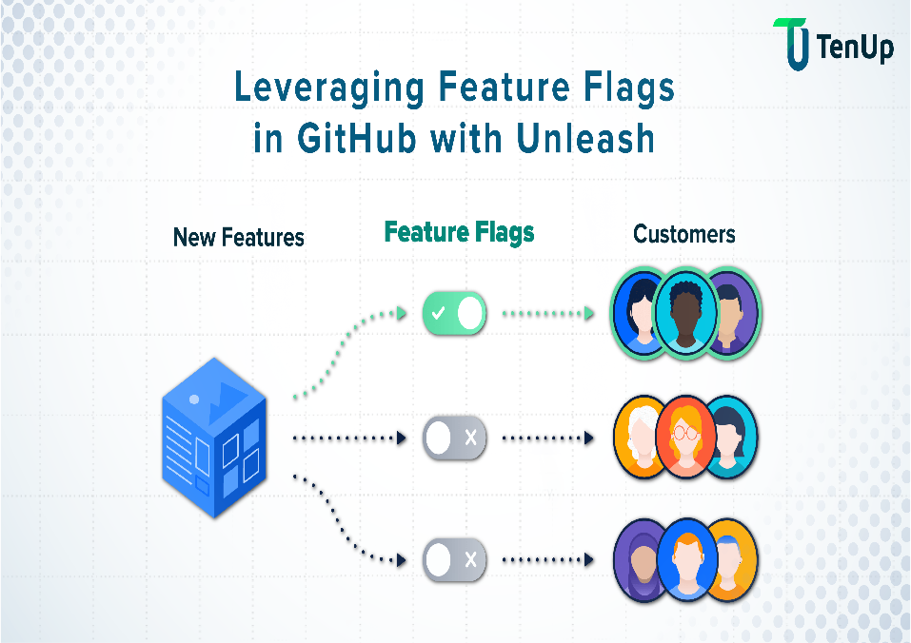
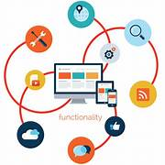
6. Features And Functionality:
Features and functionality are both important aspects of a product or service, but they serve different purposes. Features refer to specific characteristics or capabilities that a product offers, such as a camera on a smartphone or a touch screen on a tablet. Functionality, on the other hand, refers to how well those features work together to provide a seamless user experience. While features may attract customers to a product, it is the functionality that ultimately determines its usability and effectiveness. In essence, features are what a product has, while functionality is how well it works.

Slide 10
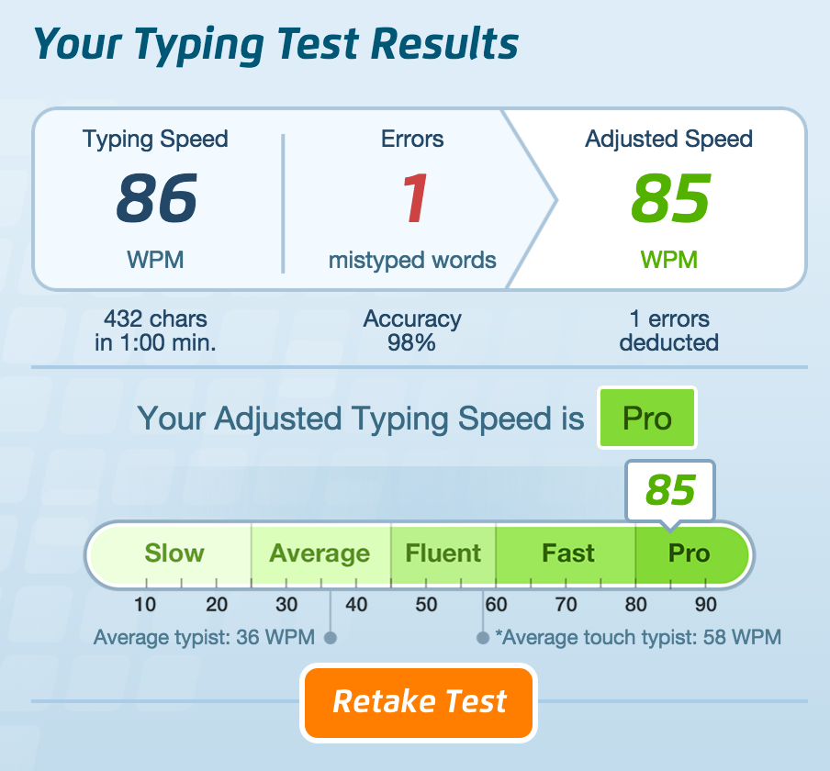
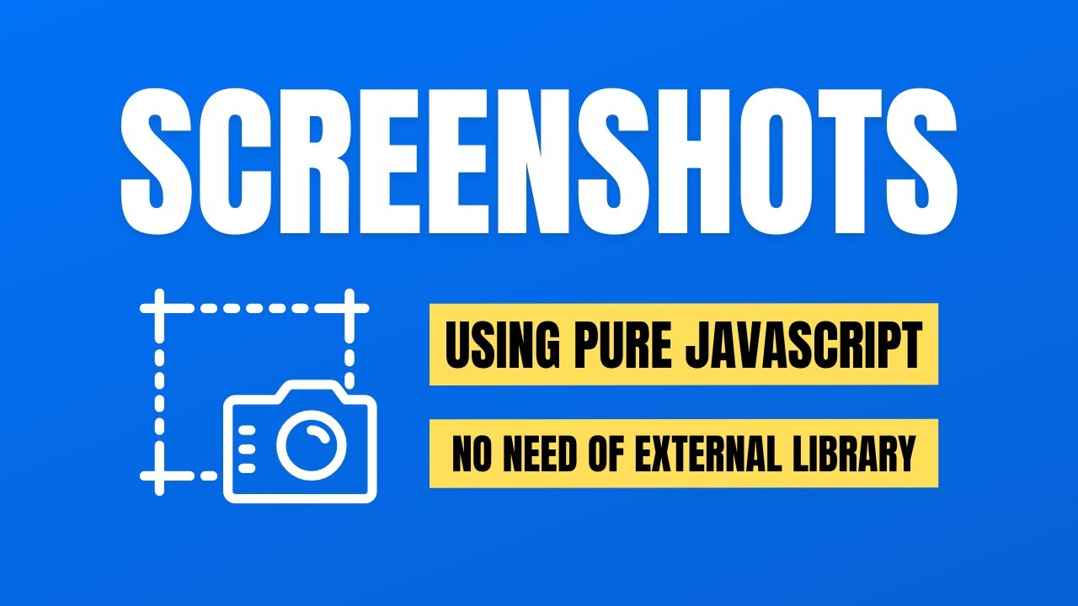
7. Results And Screenshots:
A result (also called upshot) is the outcome or consequence of a sequence of actions or event .A screenshot is an image of the exact thing displayed on the screen of your device.

Slide 11
8. Conclusion:
Here, I have came to the end of this project on the topic “Interactive Digital Portfolio Using Front And Wed Development”. I would like to share my experience while doing this project .I learnt many new things & it wonderful learning experience for me while working on this project. This project increased my research thinking skill and interest in this subject.

