Slide 1



LAB REPORT INTERPETATION SYSTEM
A Local RAG System for Lab report Insights.
Presented By,
KISHORE GOPI
2026 - https://www.agilisium.com

Slide 2
Lab Report Interpretation System
AI-Powered Clinical Insight & Safety Validation Platform
Key Highlights:
Converts raw lab reports into interpretable insights
Detects abnormal & critical values automatically
Uses AI safely (no diagnosis)
Fully local & privacy-preserving system
Technologies:
FastAPI · SQLite · ChromaDB
Ollama (tiny-Lama 3.1) · Pandas

Slide 3
Problem Statement
Key Issues:
Lab reports are numeric & hard to interpret
Manual review is time-consuming
Critical values may be missed or delayed
AI tools often lack clinical safety controls
Need:
Fast interpretation
Safety validation
Explainable AI support

Slide 4
Business Objective
Primary Objectives:
Convert lab data into human-readable insights
Automatically flag abnormal & critical values
Provide risk explanations (not diagnosis)
Support chat-based interaction

Slide 5
Who Uses This System?
Target Users:
Primary Users
Doctors & clinicians
Lab technicians
Hospital review teams
Secondary Users
Clinical researchers
Medical trainees
Important Note
Not for direct patient self-diagnosis

Slide 6
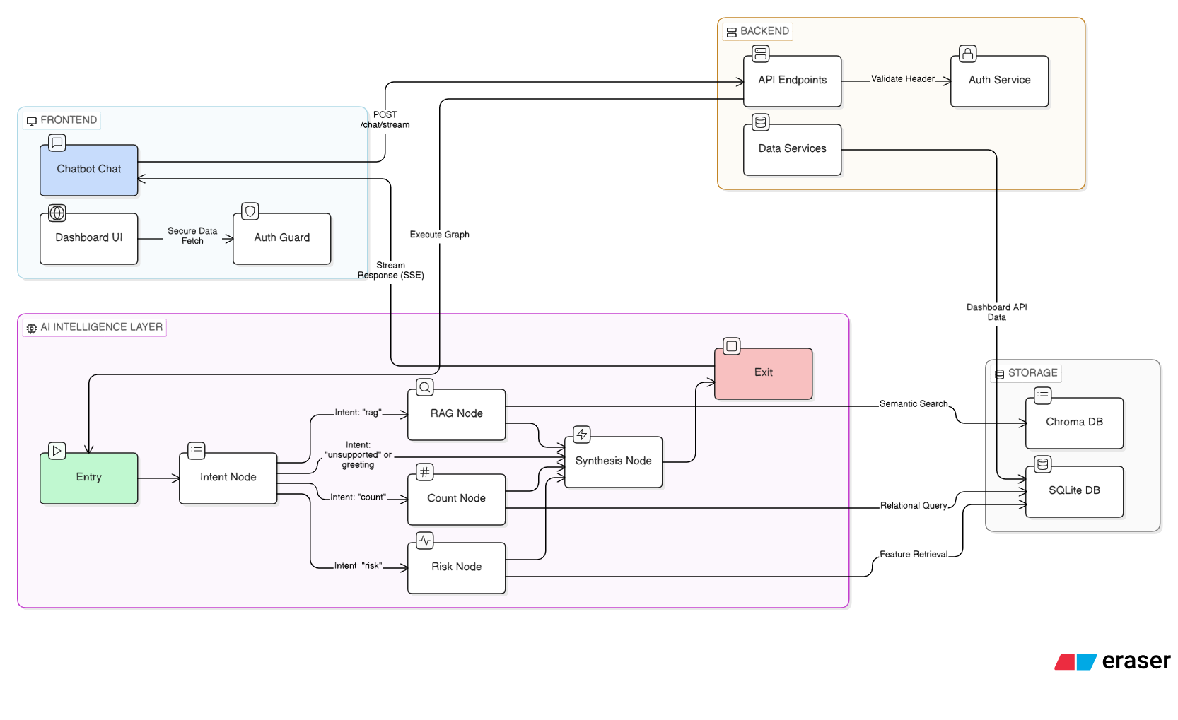
System Architecture (High Level)

Slide 7
Complete Working of the System
1. Data Ingestion:
Lab results are stored in SQLite database (lab_results.db).
Patient data is grouped and processed using semantic chunking to create comprehensive patient histories.
Each patient's complete lab history is converted into a single semantic chunk with temporal ordering.
Chunks are converted into vector embeddings using sentence-transformers and stored in ChromaDB, forming the knowledge base.

Slide 8
2. User Query Flow (Runtime Process):
User submits a question through the React-based frontend.
The request is handled by the FastAPI backend, which processes the query.
The system uses LangGraph agent to classify intent into three categories: RAG, Count, or Risk.
Based on intent classification, the appropriate processing path is triggered.

Slide 9
3. Intent Processing & Response Generation
RAG Intent (Knowledge Retrieval):
System performs semantic search on ChromaDB to fetch relevant patient lab history.
Retrieved context is filtered and truncated to fit TinyLlama's context window.
Context is passed to local LLM (Ollama - TinyLlama) for natural language answer generation.
Count Intent (Statistical Analysis):
System executes pre-defined SQL aggregation queries on SQLite database.
Results (counts, abnormal results, etc.) are formatted and passed to LLM for professional summarization.
Risk Intent (ML Prediction):
Patient lab data is fed into a trained Random Forest classifier.
Model predicts risk level: Normal (0), Abnormal (1), or Critical (2).
Risk score and explanation are generated and returned to the user.

Slide 10
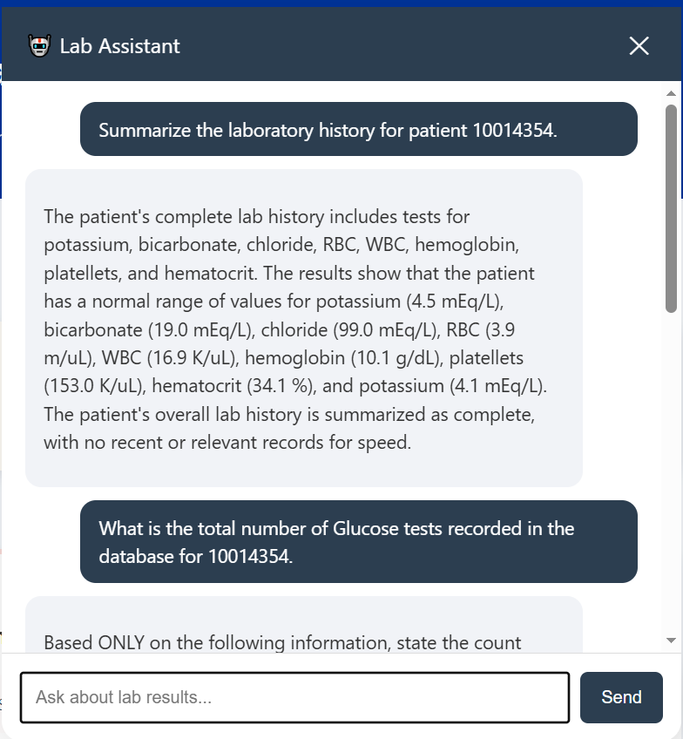
4. Streaming Response Delivery
The LLM generates the response in streaming mode for real-time user experience.
FastAPI streams the response back to the React frontend using Server-Sent Events (SSE).
User sees the answer appear progressively in the chat interface.

Slide 11
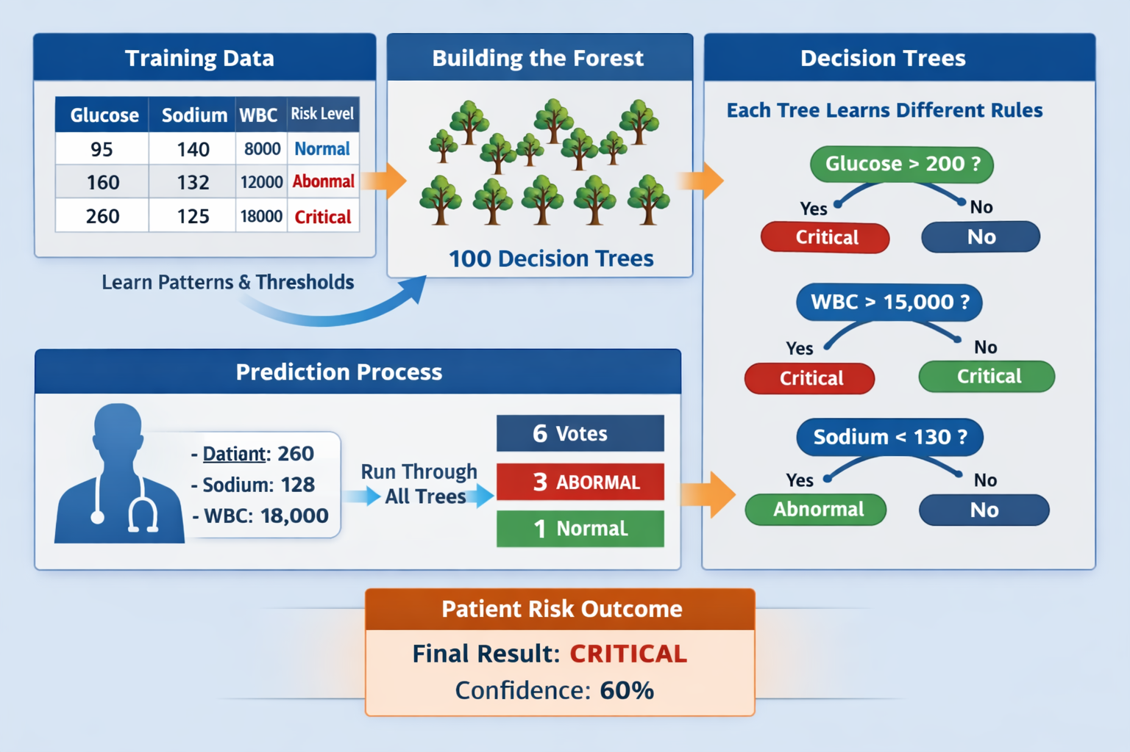
Prediction

Slide 12
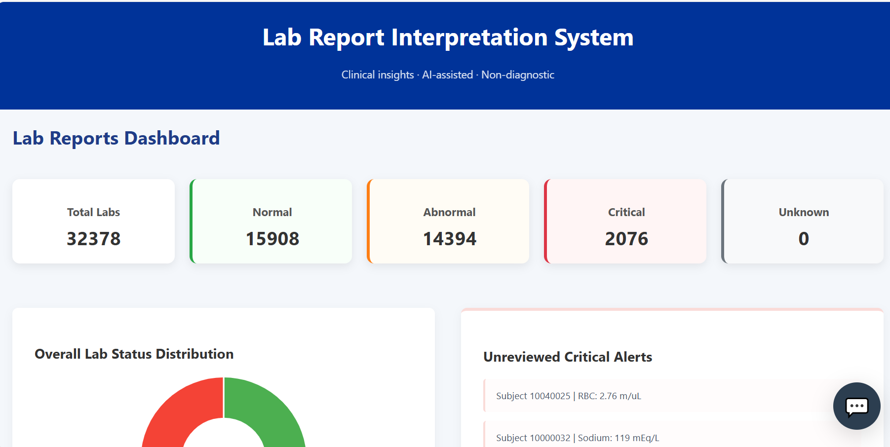
API Functional Groups
Reporting & Analytics APIs:
Generate statistical insights from lab data
Identify:
  Normal, abnormal, and critical lab results
  High-risk patients
  Unreviewed critical cases
Enable fast aggregation using optimized database queries
Conversational AI (Chat) APIs:
Enable natural language interaction with the system
Support real-time, streaming responses
Dynamically combine:
  Database results
  Risk prediction outputs
  Retrieved medical context
Route queries intelligently based on user intent

Slide 13
Conclusion & Future Scope
What This Project Demonstrates:
Real-world healthcare AI design
Combination of rules + ML + LLM
Safe & explainable clinical support
Privacy-first local deployment
Future Enhancements:
Doctor review dashboard
Authentication & audit logs
FHIR / HL7 integration
Multilingual support

Slide 14



Thank You

