Slide 1
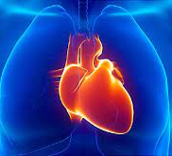

BY POLAGANI KISHORE
FINAL PROJECT
ON
AI-MENTAL FITNESS TRACKER

Slide 2
PROJECT TITLE- HEART STROKE PREDICTION

Slide 3

AGENDA
According to the World Health Organization (WHO) stroke is the 2nd leading cause of death globally, responsible for approximately 11% of total deaths. This dataset is used to predict whether a patient is likely to get stroke based on the input parameters like gender, age, various diseases, and smoking status. Each row in the data provides relevant information about the patient.
. With such well-defined parameters and the rise of data science, a data-driven approach can surely help in stroke prediction using machine learning technologies. Early identification of stroke of improved high-risk individuals using a prediction model can be recommended for a fatality rate reduction, and decision-making is improved for further treatment and prevention.

Slide 4

PROBLEM STATEMENT
Stroke is the second leading cause of death worldwide and remains an important health burden both for the individuals and for the national healthcare systems.
Therefore,the goal of our project is to apply principles of machine learning over large existing data sets to effectively predict the stroke based on potentially modifiable risk factors

Slide 5

PROJECT OVERVIEW
In this project, i have constructed a model for predicting stroke using machine learning algorithms.After thoroughly reviewing select top 3 models such Extra trees,random forest,decision tree.
libraries like pandas,matplotlib,seaborn for representation of data.
Applied different models on the dataset. A comparative study among top 3 Extra Tress classifier was chosen as the best model with high accuracy(99.7%) and less false negative

Slide 6

FUTURE SCOPE
Machine learning applications are becoming more widely used in the health care sector. The predictions of stroke using machine learning algorithms has been studied extensively.
Building a prediction model that can predict the risk of stroke from data could save lives.
In future studies, we aim to use data that provide information about different typed of stroke to build prediction models for each type.

Slide 7

YOUR SOLUTION AND ITS VALUE PROPOSITION
Applied different model on the dataset. A comparative study among the 3 different models showed that Extra trees, Random forest, and Decision tree has an accuracy 93.7%,whereas random forest was 99.3% accurate, and Extra tree exhibits accuracy of 99.7%.
Finally, Extra Tree was chosen as the best model with high accuracy and less false negative.

Slide 8
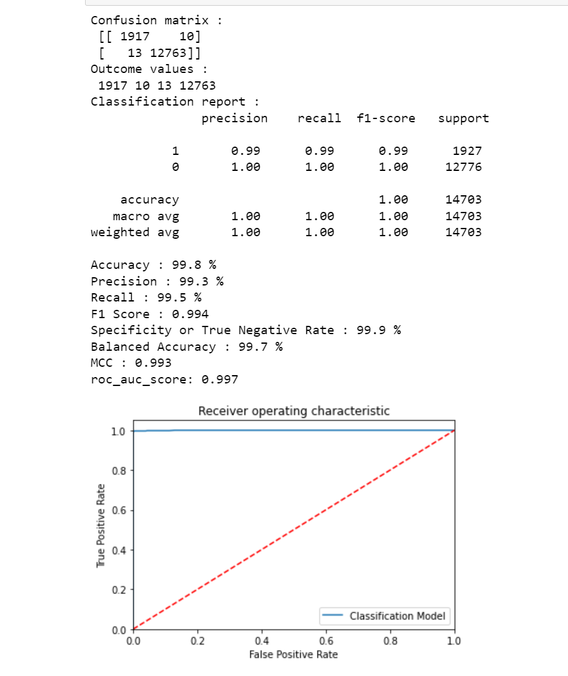
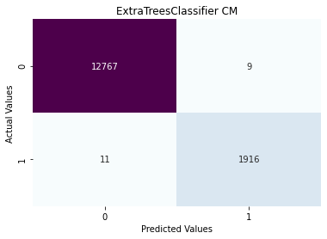

THE WOW IN YOUR SOLUTION

Slide 9
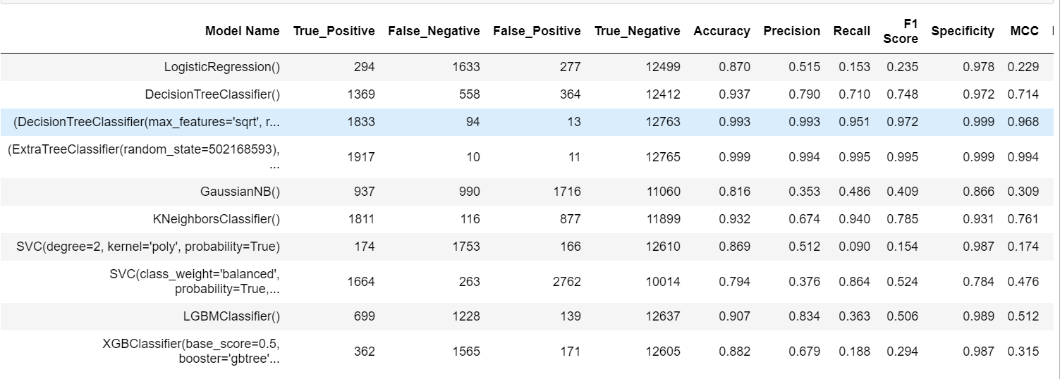
RESULTS
AMONG 10…EXTRA TREE IS BEST WITH HIGH ACCURACY

Slide 10
MEET OUR TEAM
Presentation submitted in partial fulfillment of the requirements for the Award of Degree of
BACHELOR OF TECHNOLOGY
IN
COMPUTER SCIENCE ENGINEERING
BY
POLAGANI KISHORE
.
.

