Slide 1
1. Schedule
07/29 (Mon.)
Tasks: Complete maze on MuJoCo, create slides.
07/29 (Tue.)
Off for open campus
07/30 (Wed.)
Off for open campus
07/31 (Thu.)
Tasks: Create slides.

Slide 2
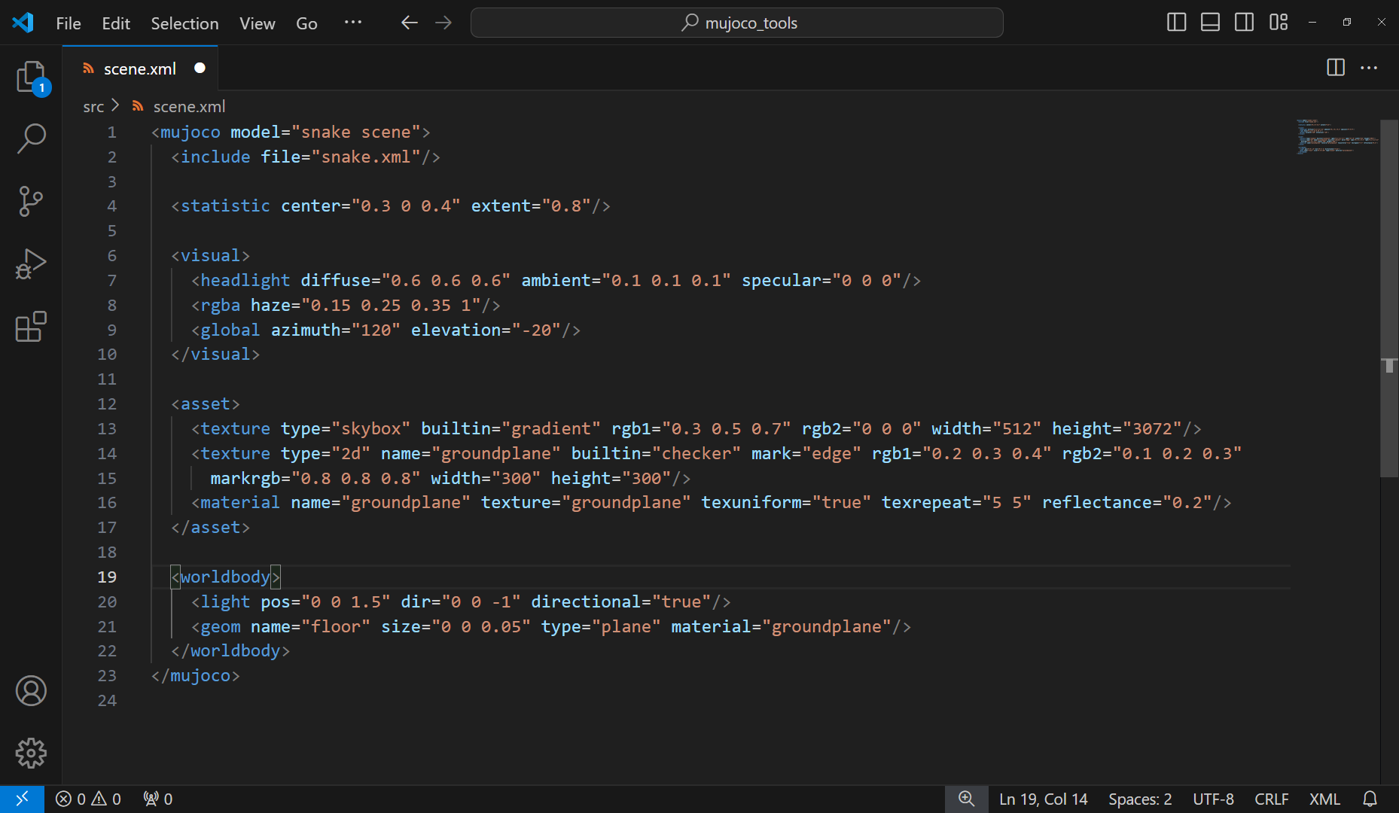
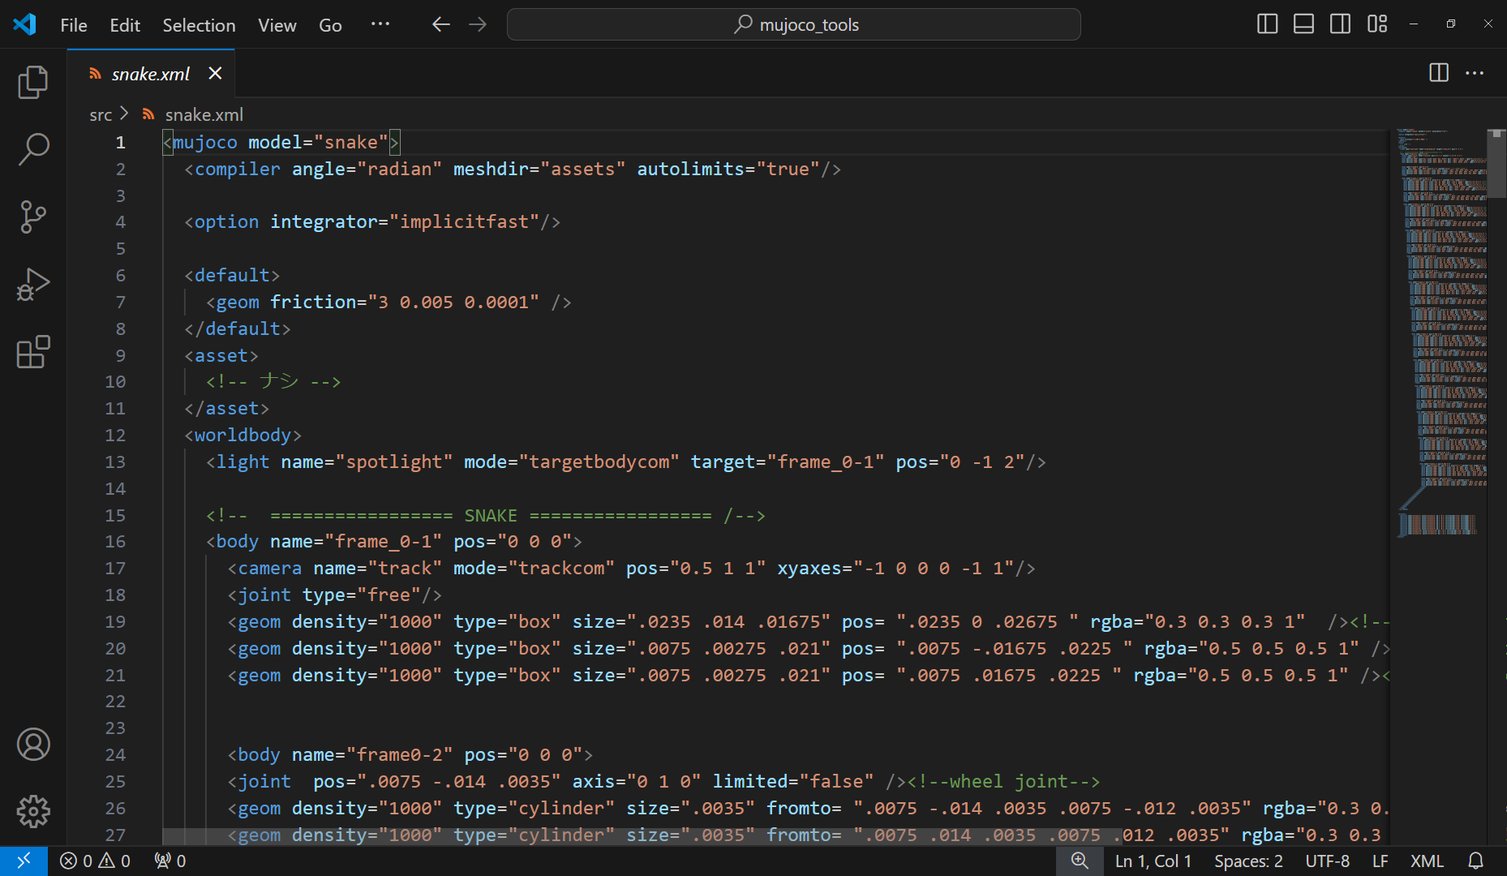
2. mujoco_tools.py (1)
mujoco_tools.make_maze_on_mujoco
Make maze on MuJoCo by arranging box bodies to improve simulation speed.
*1 Set “type” of ground to “plane”.
*2 Set “pos” of “frame_0-1” of snake robot to “0 0 0”

Slide 3
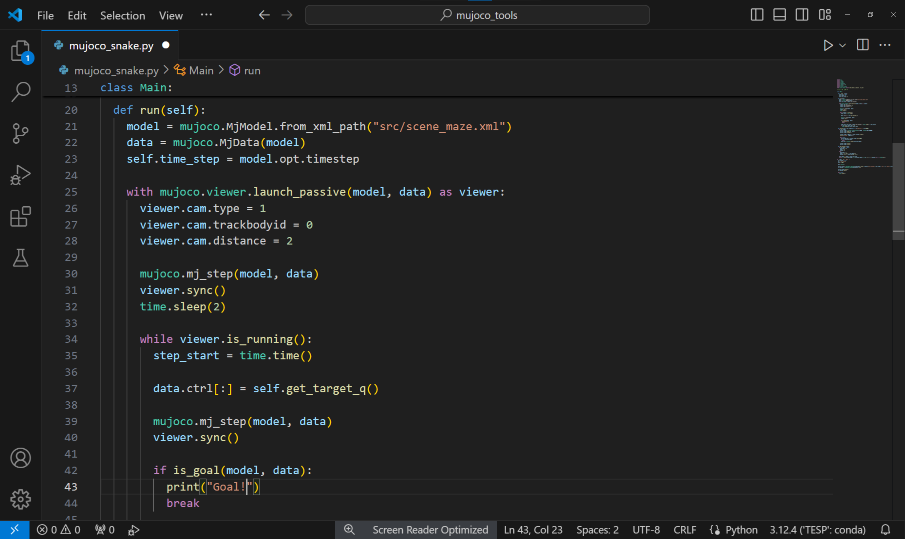
2. mujoco_tools.py (2)
mujoco_tools.is_goal
Detects whether snake robot reaches goal.

