Slide 1


PayrollCentral
INTRODUCTION
INTRODUCTION
Environment Description
A payroll management system is a software application that automates the process of calculating and paying employee salaries.
Payroll management systems can save businesses time and money by eliminating the need for manual calculations and processing.
Analysis & Planning
Proposed System
PayrollCentral
PAYROLL MANAGEMENT SYSTEM
Detail Planning
System Design
Project Profile :
Project Title : Payroll-Central
Project Duration : 2 Months
Team Members : Kishore Sunchu, Jyoti Dwivedi, Rupa Chauhan
Project Status : Completed
Software Testing
Limitation & Future Scope
References

Slide 2
PayrollCentral
INTRODUCTION
INTRODUCTION
Environment Description
A payroll management system is a software application that automates the process of calculating and paying employee salaries.
Payroll management systems can save businesses time and money by eliminating the need for manual calculations and processing.
Analysis & Planning
Proposed System
PayrollCentral
PAYROLL MANAGEMENT SYSTEM
Detail Planning
System Design
Project Profile :
Project Title : Payroll-Central
Project Duration : 2 Months
Team Members : Kishore Sunchu, Jyoti Dwivedi, Rupa Chauhan
Project Status : Completed
Software Testing
Limitation & Future Scope
References

Slide 3
PayrollCentral
Environment Description
INTRODUCTION
INTRODUCTION
Environment Description
Hardware Requirements
Processor : Intel core i3 or higher
SSD : 256GB or higher
RAM : 4GB or higher
A payroll management system is a software application that automates the process of calculating and paying employee salaries.
Payroll management systems can save businesses time and money by eliminating the need for manual calculations and processing.
Analysis & Planning
Proposed System
Detail Planning
System Design
Soft Requirements
Windows 7 or higher
NodeJS
Microsoft visual studio code
Mongodb Compass
Google Crome
Project Profile :
Project Title : Payroll-Central
Project Duration : 2 Months
Team Members : Kishore Sunchu, Jyoti Dwivedi, Rupa Chauhan
Project Status : Completed
Software Testing
Limitation & Future Scope
References

Slide 4
PayrollCentral
INTRODUCTION
System Analysis & Planning
Environment Description
Environment Description
Existing System
greytHR
Keke HR
HROne
Workday HCM
Analysis & Planning
Hardware Requirements
Processor : Intel core i3 or higher
SSD : 256GB or higher
RAM : 4GB or higher
Proposed System
Detail Planning
System Design
Drawbacks of above system:
High cost : implementing and maintaining of can be high.
Inflexibility : Traditional system can be difficult to adapt changes employee info.
Difficult to scale : Manual system can be difficult to scale as a company grows
Soft Requirements
Windows 7 or higher
NodeJS
Microsoft visual studio code
Mongodb Compass
Google Crome
Software Testing
Limitation & Future Scope
References

Slide 5
PayrollCentral
INTRODUCTION
System Analysis & Planning
Environment Description
Analysis & Planning
Requirement gathering and analysis:
Payroll compliance : The system must be able to calculate and deduct all applicable taxes.
Expense management : The system must be able to track and manage employee expense
Dashboard & Reporting : The system must provide a dashboard with real-time data on payroll, expense, and other financial information.
Existing System
greytHR
Keke HR
HROne
Workday HCM
Proposed System
Detail Planning
System Design
Software Testing
Drawbacks of above system:
High cost : implementing and maintaining of can be high.
Inflexibility : Traditional system can be difficult to adapt changes employee info.
Difficult to scale : Manual system can be difficult to scale as a company grows
Limitation & Future Scope
References

Slide 6
PayrollCentral
INTRODUCTION
Proposed System
System Analysis & Planning
Environment Description
Scope
To develop a user-friendly and efficient payroll management system that automates the process of calculating and disbursing employee salaries, bonuses, and deductions.
To ensure compliance with all relevant tax laws and regulations.
To provide accurate and timely payroll reports.
To improve the efficiency of the HR department by freeing up time to focus on other tasks.
To improve employee satisfaction by ensuring that they are paid accurately and on time.
Analysis & Planning
Requirement gathering and analysis:
Payroll compliance : The system must be able to calculate and deduct all applicable taxes.
Expense management : The system must be able to track and manage employee expense
Dashboard & Reporting : The system must provide a dashboard with real-time data on payroll, expense, and other financial information.
Proposed System
Detail Planning
System Design
Software Testing
Limitation & Future Scope
References

Slide 7
PayrollCentral
INTRODUCTION
Proposed System
Environment Description
Project Modules:
Admin
Login
Add employee
Employee details
Employee update
Employee status change
Employees
Login
Profile
Change details
Generate pay-slip
Analysis & Planning
Scope
To develop a user-friendly and efficient payroll management system that automates the process of calculating and disbursing employee salaries, bonuses, and deductions.
To ensure compliance with all relevant tax laws and regulations.
To provide accurate and timely payroll reports.
To improve the efficiency of the HR department by freeing up time to focus on other tasks.
To improve employee satisfaction by ensuring that they are paid accurately and on time.
Proposed System
Detail Planning
System Design
Software Testing
Limitation & Future Scope
References

Slide 8
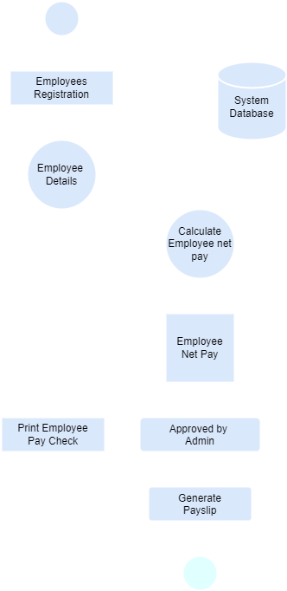
PayrollCentral
INTRODUCTION
Detail Planning
Proposed System
Environment Description
Dataflow from diagram / UML
Analysis & Planning
Project Modules:
Admin
Login
Add employee
Employee details
Employee update
Employee status change
Employees
Login
Profile
Change details
Generate pay-slip
Proposed System
Detail Planning
System Design
Software Testing
Limitation & Future Scope
References

Slide 9
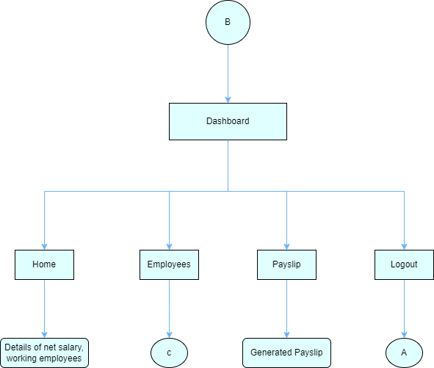
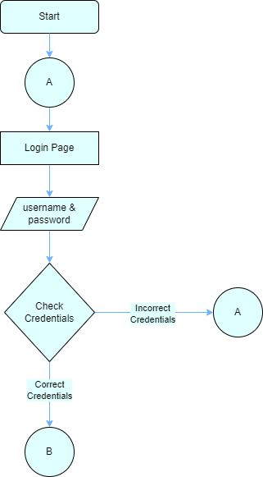
PayrollCentral
INTRODUCTION
Detail Planning
Environment Description
Process Specification / Activity Flow Diagram
Analysis & Planning
Dataflow from diagram / UML
Proposed System
Admin side
Detail Planning
System Design
Software Testing
Limitation & Future Scope
References

Slide 10
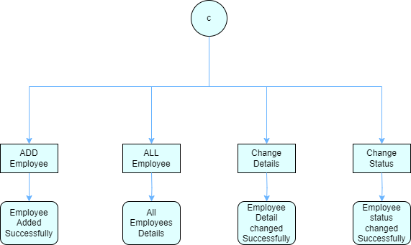
PayrollCentral
INTRODUCTION
Detail Planning
Environment Description
Process Specification / Activity Flow Diagram
Analysis & Planning
Proposed System
Admin side
Detail Planning
System Design
Software Testing
Limitation & Future Scope
References

Slide 11
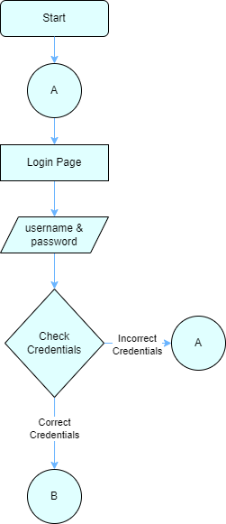
PayrollCentral
INTRODUCTION
Detail Planning
Environment Description
Process Specification / Activity Flow Diagram
Analysis & Planning
Employee side
Proposed System
Admin side
Detail Planning
System Design
Software Testing
Limitation & Future Scope
References

Slide 12
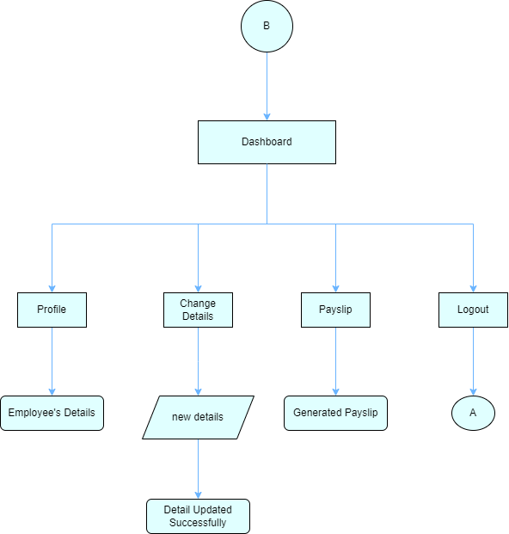
PayrollCentral
INTRODUCTION
Detail Planning
Environment Description
Process Specification / Activity Flow Diagram
Analysis & Planning
Employee side
Admin side
Proposed System
Detail Planning
System Design
Software Testing
Limitation & Future Scope
References

Slide 13
PayrollCentral
INTRODUCTION
Detail Planning
Environment Description
Data Dictionary
Process Specification / Activity Flow Diagram
Analysis & Planning
Admin Table
Employee side
Proposed System
Field Name | Data Type | Description
Id | Integer | Unique identifier for admin
Username | String | Name of the admin
Email | String | Email address of admin
Password | String | Pass code to login into the system
Detail Planning
System Design
Software Testing
Limitation & Future Scope
References

Slide 14
PayrollCentral
INTRODUCTION
Detail Planning
Data Dictionary
Environment Description
Process Specification / Activity Flow Diagram
Admin Table
Analysis & Planning
Employee Table
Employee side
Proposed System
Field Name | Data Type | Description
Id | Integer | Unique identifier for admin
Username | String | Name of the admin
Email | String | Email address of admin
Password | String | Pass code to login into the system
Field Name | Data Type | Description
Employee id | Integer | Unique Identifier for each employee
First Name | String | First name of the employee
Last Name | String | Last name of the employee
Email address | String | Email address of the employee
Phone No. | Integer | Contact No. of the employee
Date of Birth | Date | Birth date of the employee
Gender | String | Gender of the employee
Hire Date | Date | Hiring date of the employee
Designation | String | Designation of the employee
Salary | Integer | Salary of the employee
Detail Planning
System Design
Software Testing
Limitation & Future Scope
References

Slide 15
PayrollCentral
INTRODUCTION
Detail Planning
Data Dictionary
Environment Description
Payrolls Table
Employee Table
Admin Table
Analysis & Planning
Field Name | Data Type | Description
Transaction id | Integer | Unique id for each transaction
Salary month | Date | Month of salary month
Salary year | Date | Year of salary year
Employee id | Integer | Employee id for references to the employee
Net salary | Integer | Total salary of the employee
Status | Integer | Status of the salary (paid/unpaid)
Field Name | Data Type | Description
Employee id | Integer | Unique Identifier for each employee
First Name | String | First name of the employee
Last Name | String | Last name of the employee
Email address | String | Email address of the employee
Phone No. | Integer | Contact No. of the employee
Date of Birth | Date | Birth date of the employee
Gender | String | Gender of the employee
Hire Date | Date | Hiring date of the employee
Designation | String | Designation of the employee
Salary | Integer | Salary of the employee
Proposed System
Field Name | Data Type | Description
Id | Integer | Unique identifier for admin
Username | String | Name of the admin
Email | String | Email address of admin
Password | String | Pass code to login into the system
Detail Planning
System Design
Software Testing
Limitation & Future Scope
References

Slide 16
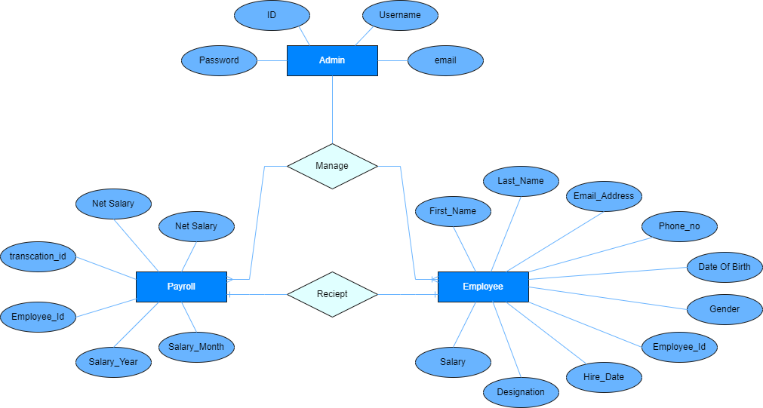
PayrollCentral
INTRODUCTION
Detail Planning
Entity-Relationship Diagram / Class Diagram
Data Dictionary
Environment Description
Payrolls Table
Analysis & Planning
Employee Table
Proposed System
Field Name | Data Type | Description
Transaction id | Integer | Unique id for each transaction
Salary month | Date | Month of salary month
Salary year | Date | Year of salary year
Employee id | Integer | Employee id for references to the employee
Net salary | Integer | Total salary of the employee
Status | Integer | Status of the salary (paid/unpaid)
Field Name | Data Type | Description
Employee id | Integer | Unique Identifier for each employee
First Name | String | First name of the employee
Last Name | String | Last name of the employee
Email address | String | Email address of the employee
Phone No. | Integer | Contact No. of the employee
Date of Birth | Date | Birth date of the employee
Gender | String | Gender of the employee
Hire Date | Date | Hiring date of the employee
Designation | String | Designation of the employee
Salary | Integer | Salary of the employee
Detail Planning
System Design
Software Testing
Limitation & Future Scope
References

Slide 17
PayrollCentral
System Desing
INTRODUCTION
Detail Planning
Environment Description
Entity-Relationship Diagram / Class Diagram
Database Design
Data Dictionary
Analysis & Planning
Admin Table:
This table stores the basic information about admin, such as id unique identifier, name for login purpose, email, password for login into the system.
Employee Table:
This table stores the basic information about each employee, such as employee id, first and last name, email address, phone number, gender, date of birth, joining and hiring date of the employee, designation of the employee and the salary of the employee
Payrolls Table
Proposed System
Detail Planning
Field Name | Data Type | Description
Transaction id | Integer | Unique id for each transaction
Salary month | Date | Month of salary month
Salary year | Date | Year of salary year
Employee id | Integer | Employee id for references to the employee
Net salary | Integer | Total salary of the employee
Status | Integer | Status of the salary (paid/unpaid)
System Design
Software Testing
Limitation & Future Scope
References

Slide 18
PayrollCentral
INTRODUCTION
System Desing
Detail Planning
Environment Description
Entity-Relationship Diagram / Class Diagram
Database Design
Analysis & Planning
Admin Table:
This table stores the basic information about admin, such as id unique identifier, name for login purpose, email, password for login into the system.
Employee Table:
This table stores the basic information about each employee, such as employee id, first and last name, email address, phone number, gender, date of birth, joining and hiring date of the employee, designation of the employee and the salary of the employee
Proposed System
Payslip Table
This table stores the information about pay-slips, such as transaction id, month of the salary is given, year of the salary is given, employee name, net salary of employee and status of payment.
Detail Planning
System Design
Software Testing
Limitation & Future Scope
References

Slide 19
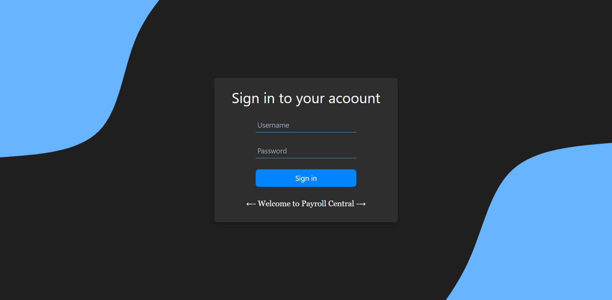
PayrollCentral
INTRODUCTION
System Desing
Environment Description
Input Design
Database Design
Analysis & Planning
Payslip Table
This table stores the information about pay-slips, such as transaction id, month of the salary is given, year of the salary is given, employee name, net salary of employee and status of payment.
Login Page
Proposed System
Admin Table:
This table stores the basic information about admin, such as id unique identifier, name for login purpose, email, password for login into the system.
Employee Table:
This table stores the basic information about each employee, such as employee id, first and last name, email address, phone number, gender, date of birth, joining and hiring date of the employee, designation of the employee and the salary of the employee
Detail Planning
System Design
Software Testing
Limitation & Future Scope
References

Slide 20
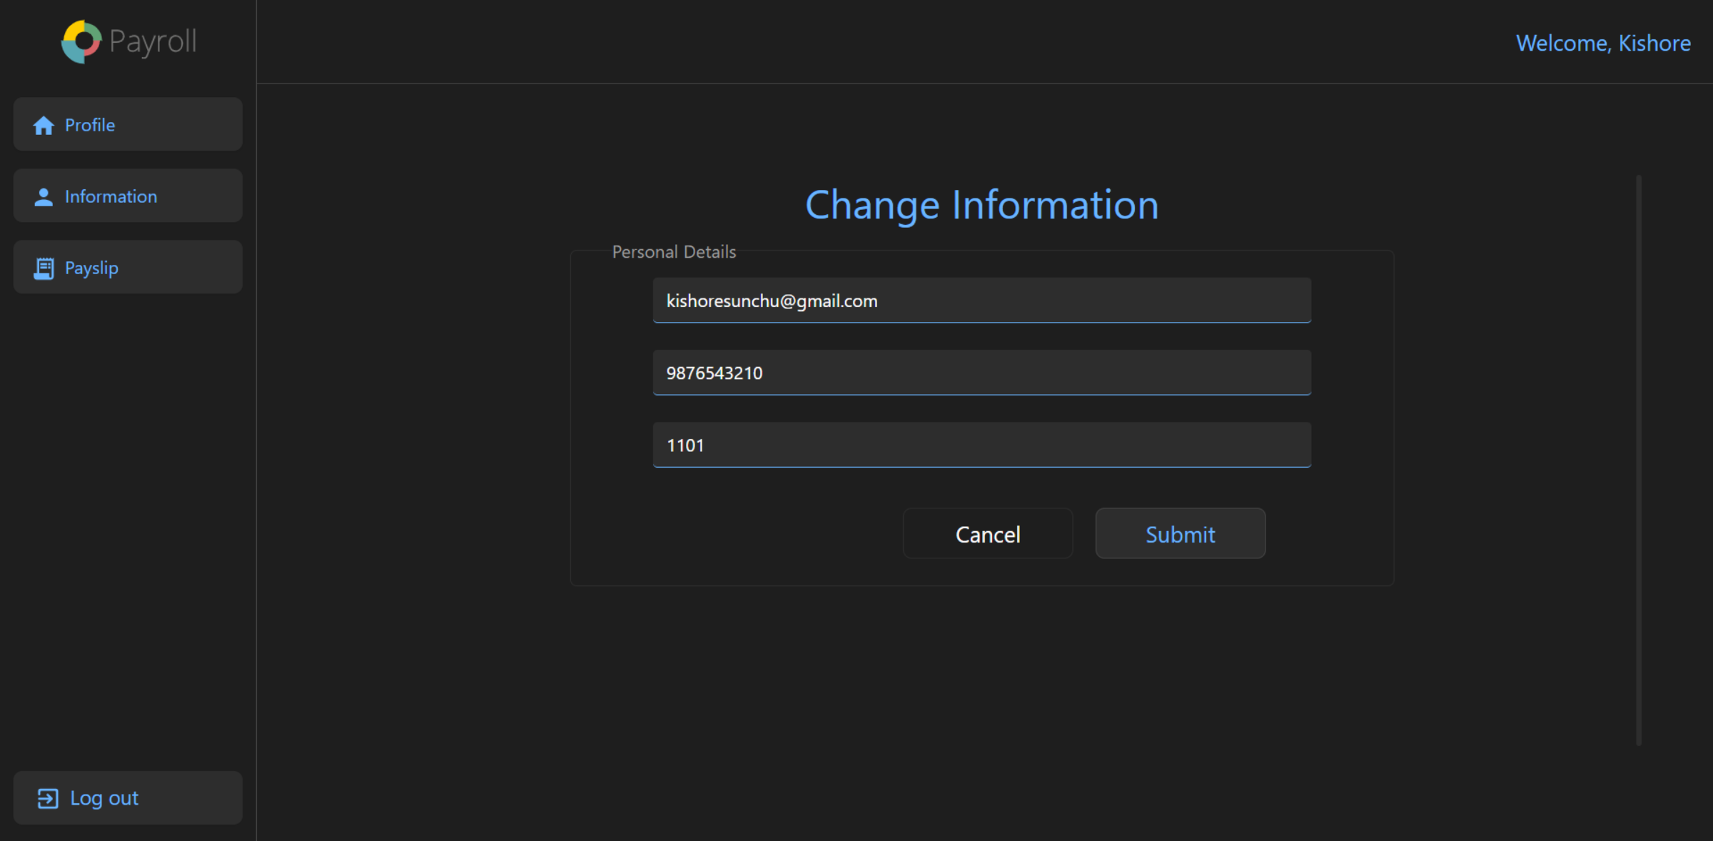
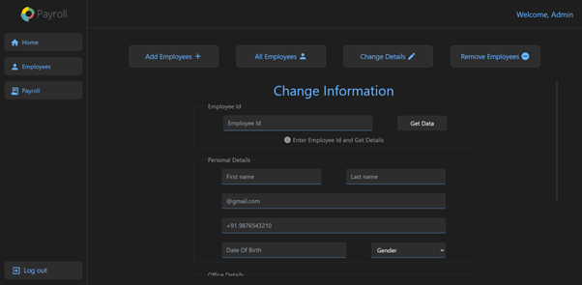
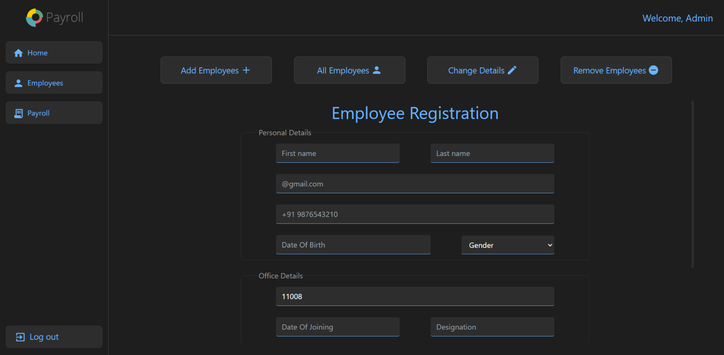
PayrollCentral
INTRODUCTION
System Desing
Environment Description
Input Design
Database Design
Employee Information Change Form (Employee Side)
Employee Information Change Form (Admin Side)
Employee Registration Form
Analysis & Planning
Login Page
Payslip Table
This table stores the information about pay-slips, such as transaction id, month of the salary is given, year of the salary is given, employee name, net salary of employee and status of payment.
Proposed System
Detail Planning
System Design
Software Testing
Limitation & Future Scope
References

Slide 21
PayrollCentral
INTRODUCTION
System Desing
Environment Description
Input Design
Employee Information Change Form (Employee Side)
Employee Information Change Form (Admin Side)
Analysis & Planning
Employee Registration Form
Login Page
Proposed System
Detail Planning
System Design
Software Testing
Limitation & Future Scope
References

Slide 22
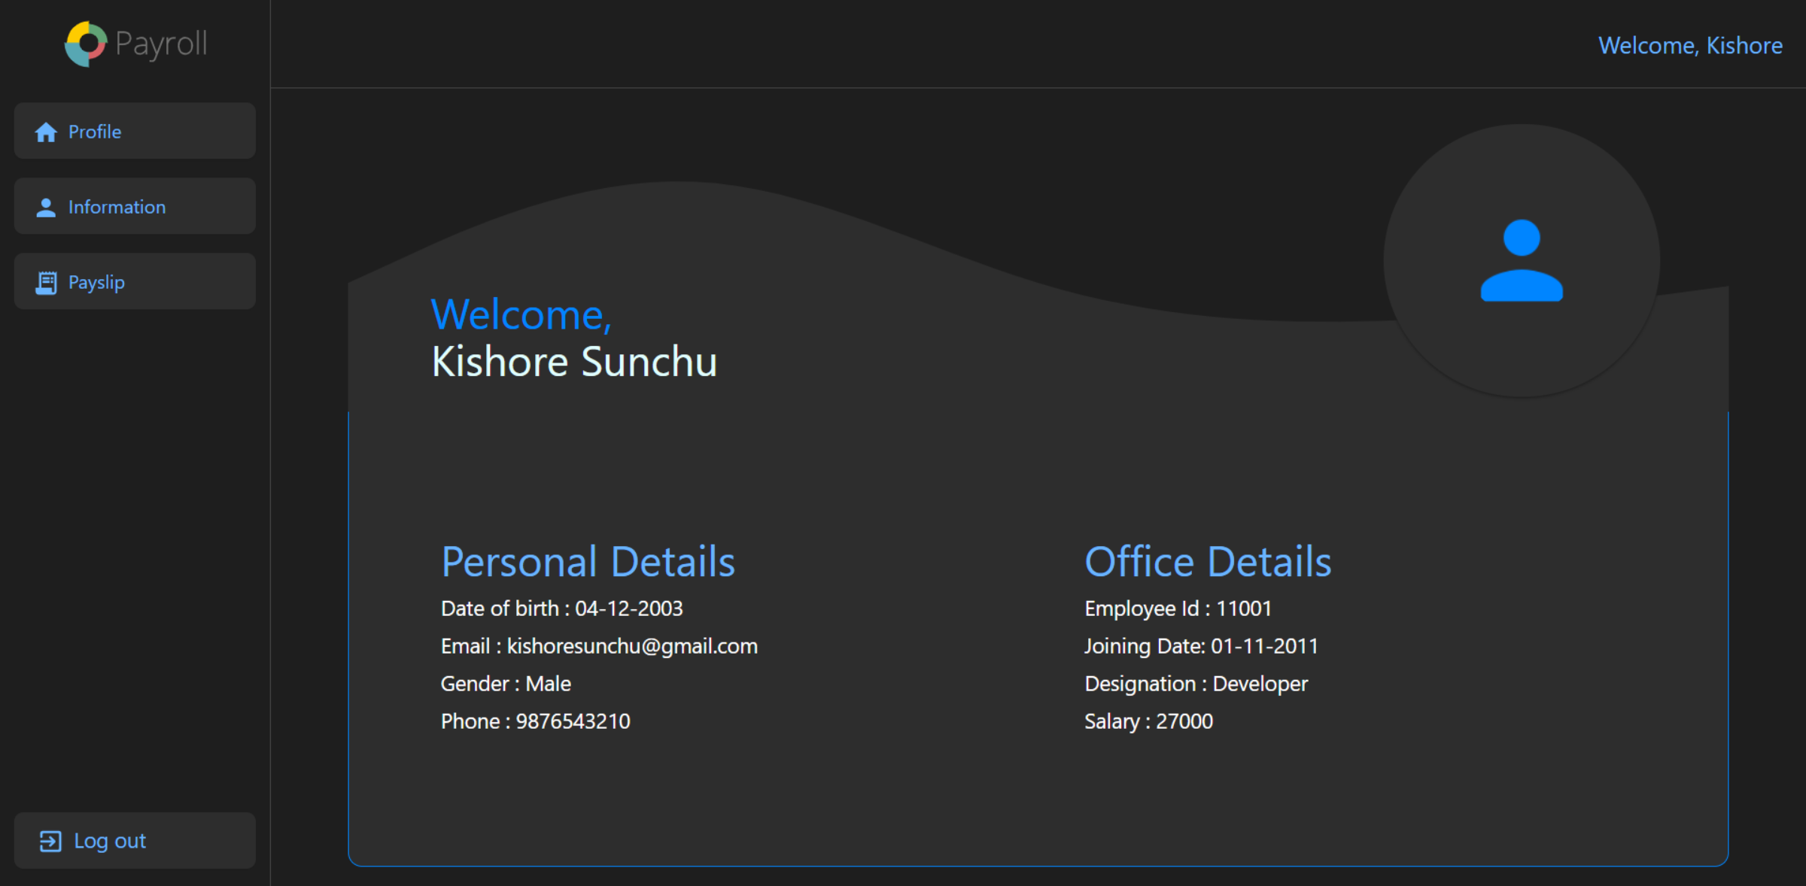
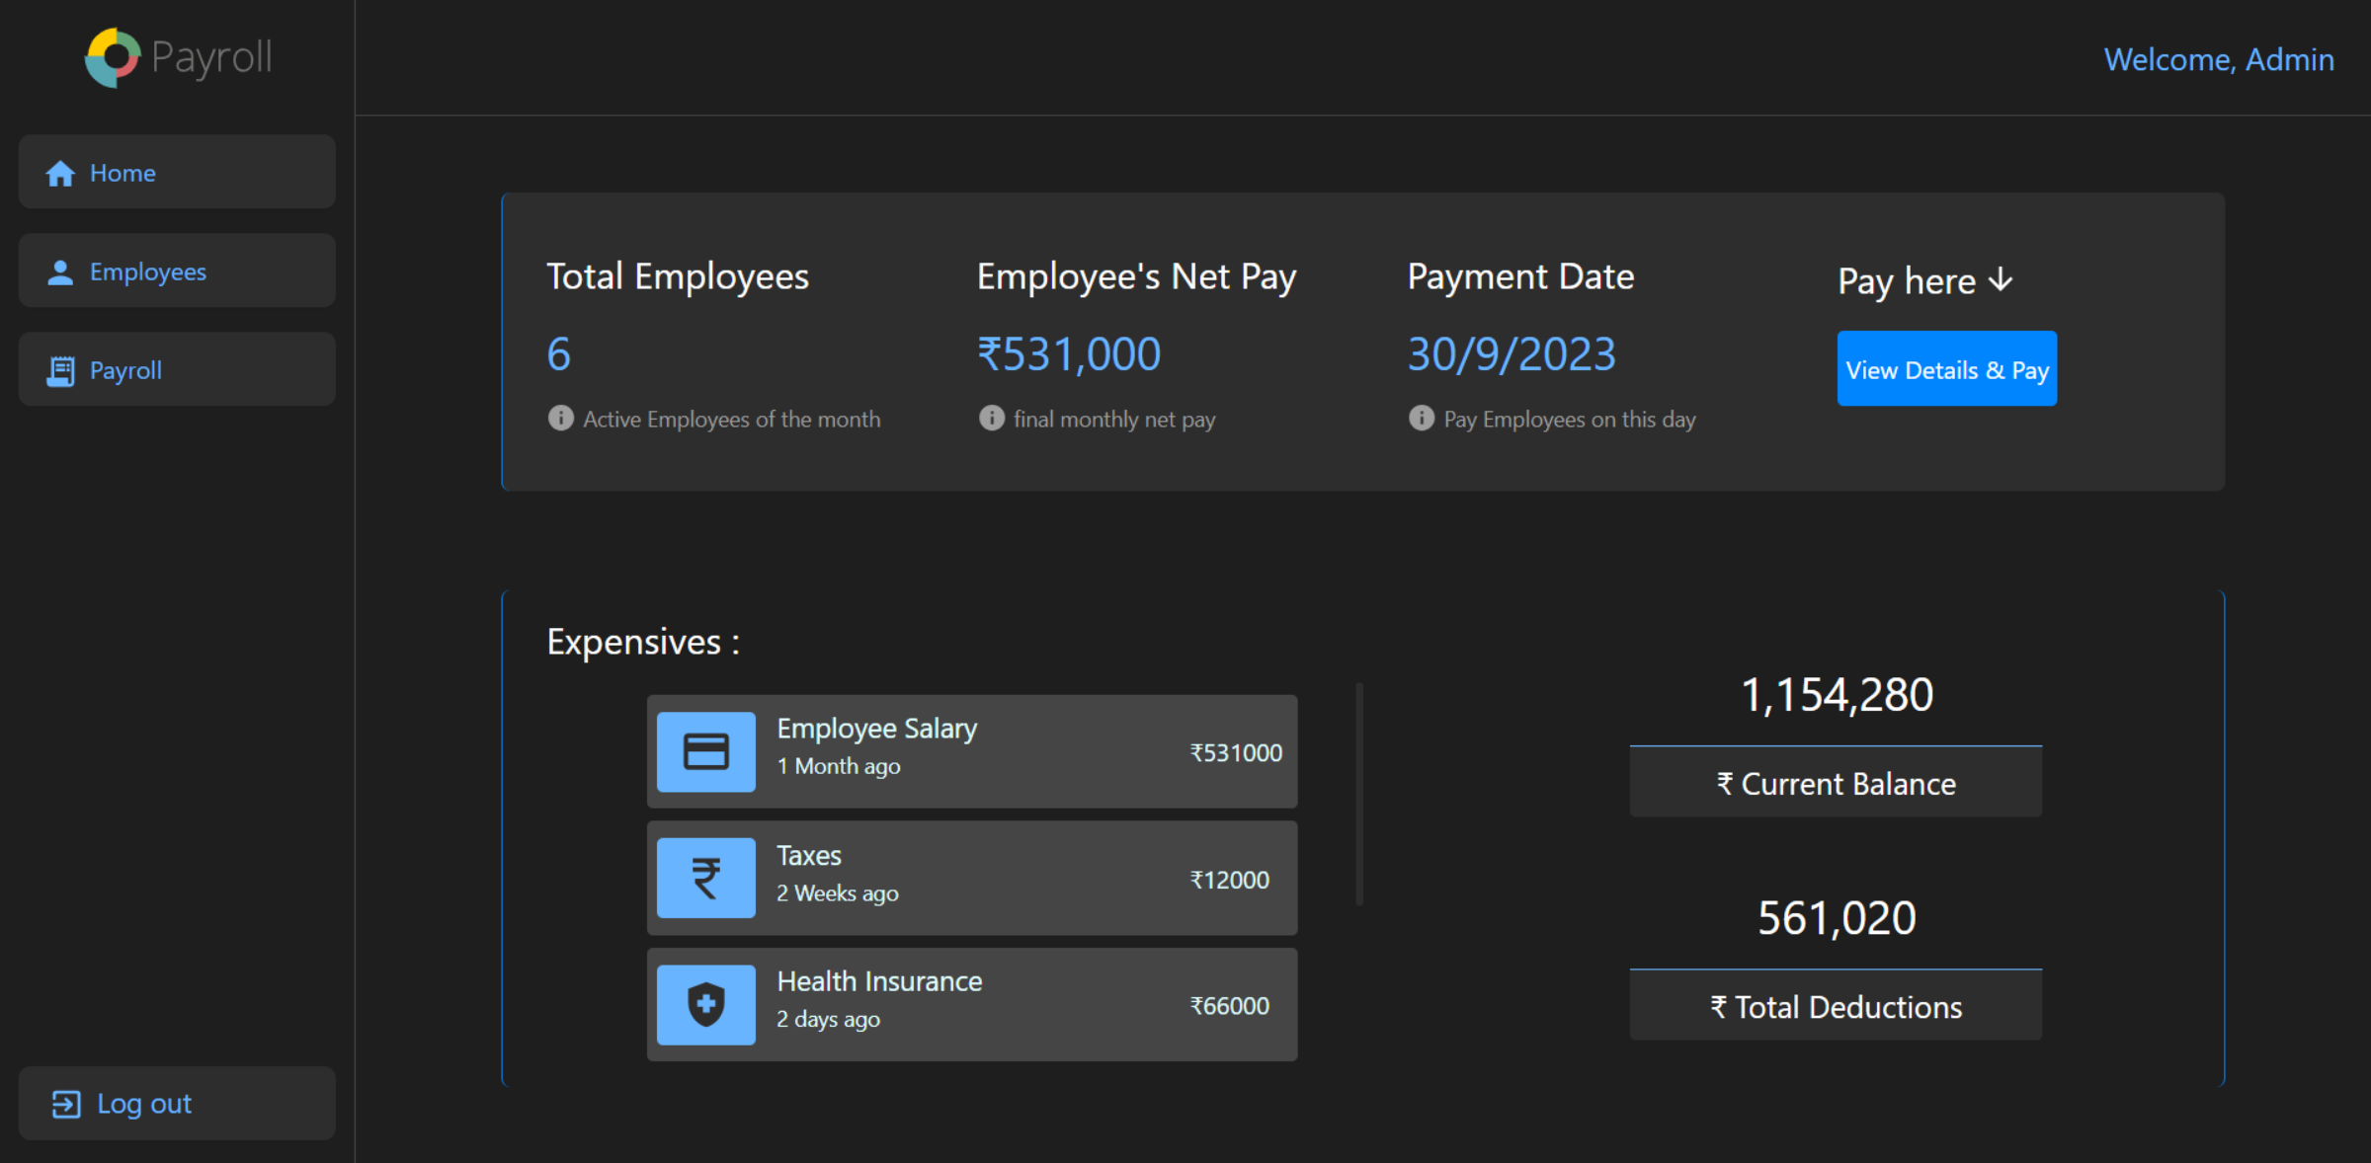
PayrollCentral
INTRODUCTION
System Desing
Environment Description
Input Design
Output Design
Analysis & Planning
Employee Registration Form
Employee Dashboard
Admin Dashboard
Employee Information Change Form (Employee Side)
Employee Information Change Form (Admin Side)
Login Page
Proposed System
Detail Planning
System Design
Software Testing
Limitation & Future Scope
References

Slide 23
PayrollCentral
INTRODUCTION
System Desing
Environment Description
Input Design
Output Design
Analysis & Planning
Employee Registration Form
Employee Dashboard
Admin Dashboard
Employee Information Change Form (Employee Side)
Employee Information Change Form (Admin Side)
Login Page
Proposed System
Detail Planning
System Design
Software Testing
Limitation & Future Scope
References

Slide 24
PayrollCentral
INTRODUCTION
System Desing
Environment Description
Output Design
Admin Dashboard
Input Design
Analysis & Planning
Employee Registration Form
Employee Dashboard
Employee Information Change Form (Admin Side)
Employee Information Change Form (Employee Side)
Login Page
Proposed System
Detail Planning
System Design
Software Testing
Limitation & Future Scope
References

Slide 25
PayrollCentral
Software Testing
INTRODUCTION
System Desing
Environment Description
Output Design
Data entry: Test the data entry fields to make sure they are properly formatted and validated. For example, the phone no field should only accept numeric values and 10-digit number and hire date field should only accept date values.
Calculation: Test the payroll calculations to make sure they are accurate. For example, the system should correctly calculate all employee salary accurately.
Security: Test the security of the payroll system to make sure it is protected form unauthorized access. For example, the system should require users to authenticate themselves before they can access sensitive data.
Reports: Test the payroll reports to make sure they are accurate and easy to read. For example, the system should generate a report that list all employees and their pay stubs for a given period.
Input Design
Analysis & Planning
Employee Dashboard
Employee Information Change Form (Admin Side)
Employee Registration Form
Admin Dashboard
Employee Information Change Form (Employee Side)
Login Page
Proposed System
Detail Planning
System Design
Software Testing
Limitation & Future Scope
References

Slide 26
PayrollCentral
Limitation and Future Scope of Enhancements
INTRODUCTION
Software Testing
System Desing
Environment Description
Output Design
Limitation:
Internet is required
Proper data is required
Future scope of Enhancements:
Make the system more user-friendly.
Use AI and Machine Learning.
Automate more tasks.
Make the system more secure.
Make the mobile app for system.
Data entry: Test the data entry fields to make sure they are properly formatted and validated. For example, the phone no field should only accept numeric values and 10-digit number and hire date field should only accept date values.
Calculation: Test the payroll calculations to make sure they are accurate. For example, the system should correctly calculate all employee salary accurately.
Security: Test the security of the payroll system to make sure it is protected form unauthorized access. For example, the system should require users to authenticate themselves before they can access sensitive data.
Reports: Test the payroll reports to make sure they are accurate and easy to read. For example, the system should generate a report that list all employees and their pay stubs for a given period.
Analysis & Planning
Employee Dashboard
Proposed System
Detail Planning
System Design
Software Testing
Limitation & Future Scope
References

Slide 27
PayrollCentral
References
INTRODUCTION
Limitation and Future Scope of Enhancements
Software Testing
Environment Description
https://tailwindcss.com/
https://www.npmjs.com/
https://legacy.reactjs.org/
https://www.mongodb.com/
https://mongoosejs.com/
https://expressjs.com/
https://nodejs.org/en
https://mui.com/
https://aicolors.co/
https://app.haikei.app/
Limitation:
Internet is required
Proper data is required
Future scope of Enhancements:
Make the system more user-friendly.
Use AI and Machine Learning.
Automate more tasks.
Make the system more secure.
Make the mobile app for system.
Data entry: Test the data entry fields to make sure they are properly formatted and validated. For example, the phone no field should only accept numeric values and 10-digit number and hire date field should only accept date values.
Calculation: Test the payroll calculations to make sure they are accurate. For example, the system should correctly calculate all employee salary accurately.
Security: Test the security of the payroll system to make sure it is protected form unauthorized access. For example, the system should require users to authenticate themselves before they can access sensitive data.
Reports: Test the payroll reports to make sure they are accurate and easy to read. For example, the system should generate a report that list all employees and their pay stubs for a given period.
Analysis & Planning
Proposed System
Detail Planning
System Design
Software Testing
Limitation & Future Scope
References

Slide 28
PayrollCentral
References
INTRODUCTION
Environment Description
Limitation and Future Scope of Enhancements
https://tailwindcss.com/
https://www.npmjs.com/
https://legacy.reactjs.org/
https://www.mongodb.com/
https://mongoosejs.com/
https://expressjs.com/
https://nodejs.org/en
https://mui.com/
https://aicolors.co/
https://app.haikei.app/
Data entry: Test the data entry fields to make sure they are properly formatted and validated. For example, the phone no field should only accept numeric values and 10-digit number and hire date field should only accept date values.
Calculation: Test the payroll calculations to make sure they are accurate. For example, the system should correctly calculate all employee salary accurately.
Security: Test the security of the payroll system to make sure it is protected form unauthorized access. For example, the system should require users to authenticate themselves before they can access sensitive data.
Reports: Test the payroll reports to make sure they are accurate and easy to read. For example, the system should generate a report that list all employees and their pay stubs for a given period.
Analysis & Planning
Limitation:
Internet is required
Proper data is required
Future scope of Enhancements:
Make the system more user-friendly.
Use AI and Machine Learning.
Automate more tasks.
Make the system more secure.
Make the mobile app for system.
Proposed System
Thank You !
Detail Planning
System Design
Software Testing
Limitation & Future Scope
References

Slide 29
PayrollCentral
INTRODUCTION
References
Environment Description
Analysis & Planning
https://tailwindcss.com/
https://www.npmjs.com/
https://legacy.reactjs.org/
https://www.mongodb.com/
https://mongoosejs.com/
https://expressjs.com/
https://nodejs.org/en
https://mui.com/
https://aicolors.co/
https://app.haikei.app/
Proposed System
Thank You !
Detail Planning
System Design
Software Testing
Limitation & Future Scope
References

