Slide 1
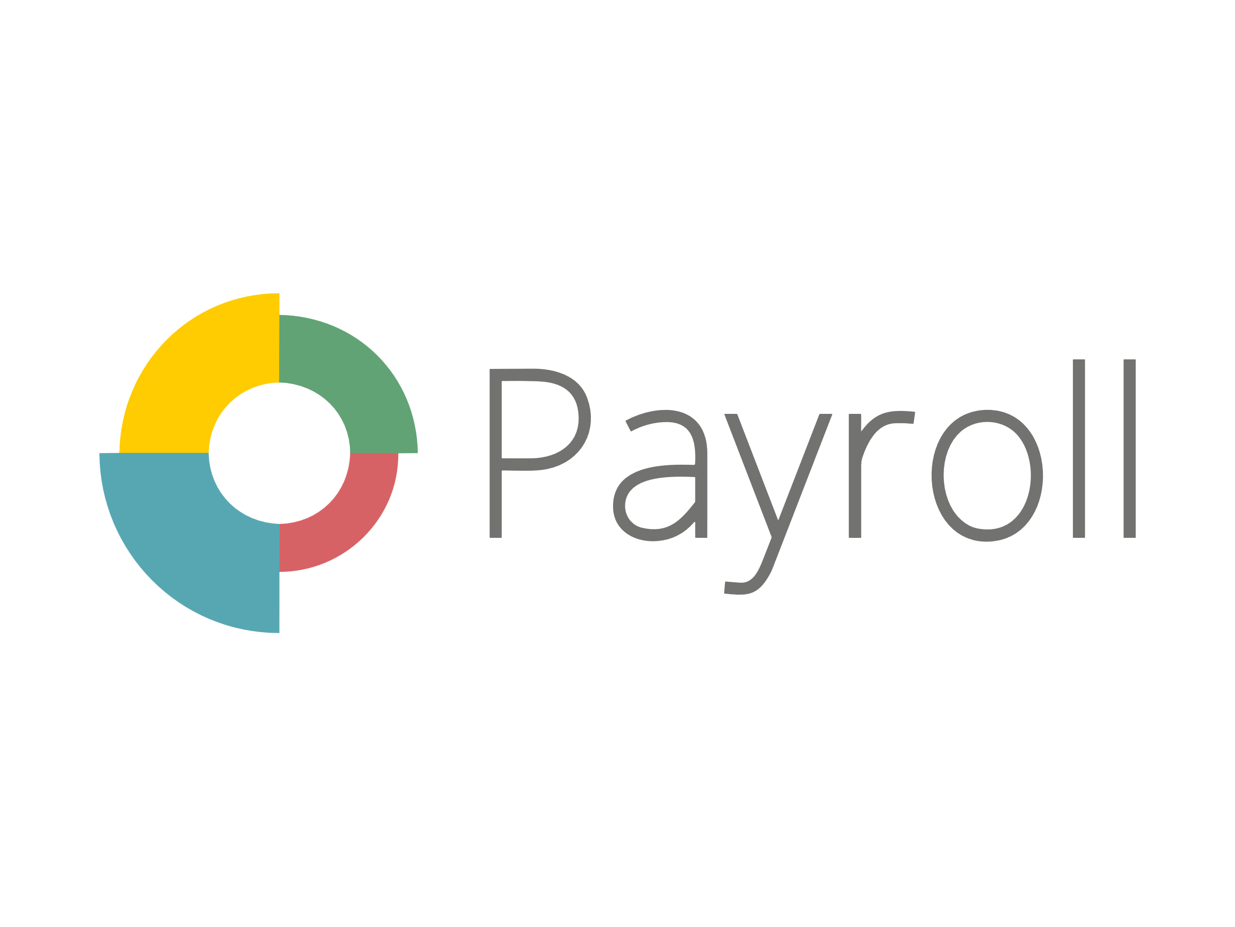

PayrollCentral
INTRODUCTION
INTRODUCTION
Environment Description
A payroll management system is a software application that automates the process of calculating and paying employee salaries.
Payroll management systems can save businesses time and money by eliminating the need for manual calculations and processing.
Analysis & Planning
Proposed System
PayrollCentral
PAYROLL MANAGEMENT SYSTEM
Detail Planning
System Design
Project Profile :
Project Title : Payroll-Central
Project Duration : 2 Months
Team Members : Kishore Sunchu, Jyoti Dwivedi, Rupa Chauhan
Project Status : Completed
Software Testing
Limitation & Future Scope
References

Slide 2
PayrollCentral
INTRODUCTION
INTRODUCTION
Environment Description
A payroll management system is a software application that automates the process of calculating and paying employee salaries.
Payroll management systems can save businesses time and money by eliminating the need for manual calculations and processing.
Analysis & Planning
Proposed System
PayrollCentral
PAYROLL MANAGEMENT SYSTEM
Detail Planning
System Design
Project Profile :
Project Title : Payroll-Central
Project Duration : 2 Months
Team Members : Kishore Sunchu, Jyoti Dwivedi, Rupa Chauhan
Project Status : Completed
Software Testing
Limitation & Future Scope
References

Slide 3
PayrollCentral
Environment Description
INTRODUCTION
INTRODUCTION
Environment Description
Hardware Requirements
Processor : Intel core i3 or higher
SSD : 256GB or higher
RAM : 4GB or higher
A payroll management system is a software application that automates the process of calculating and paying employee salaries.
Payroll management systems can save businesses time and money by eliminating the need for manual calculations and processing.
Analysis & Planning
Proposed System
Detail Planning
System Design
Soft Requirements
Windows 7 or higher
NodeJS
Microsoft visual studio code
Mongodb Compass
Google Crome
Project Profile :
Project Title : Payroll-Central
Project Duration : 2 Months
Team Members : Kishore Sunchu, Jyoti Dwivedi, Rupa Chauhan
Project Status : Completed
Software Testing
Limitation & Future Scope
References

Slide 4
PayrollCentral
INTRODUCTION
System Analysis & Planning
Environment Description
Environment Description
Existing System
greytHR
Keke HR
HROne
Workday HCM
Analysis & Planning
Hardware Requirements
Processor : Intel core i3 or higher
SSD : 256GB or higher
RAM : 4GB or higher
Proposed System
Detail Planning
System Design
Drawbacks of above system:
High cost : implementing and maintaining of can be high.
Inflexibility : Traditional system can be difficult to adapt changes employee info.
Difficult to scale : Manual system can be difficult to scale as a company grows
Soft Requirements
Windows 7 or higher
NodeJS
Microsoft visual studio code
Mongodb Compass
Google Crome
Software Testing
Limitation & Future Scope
References

Slide 5
PayrollCentral
INTRODUCTION
System Analysis & Planning
Environment Description
Analysis & Planning
Requirement gathering and analysis:
Payroll compliance : The system must be able to calculate and deduct all applicable taxes.
Expense management : The system must be able to track and manage employee expense
Dashboard & Reporting : The system must provide a dashboard with real-time data on payroll, expense, and other financial information.
Existing System
greytHR
Keke HR
HROne
Workday HCM
Proposed System
Detail Planning
System Design
Software Testing
Drawbacks of above system:
High cost : implementing and maintaining of can be high.
Inflexibility : Traditional system can be difficult to adapt changes employee info.
Difficult to scale : Manual system can be difficult to scale as a company grows
Limitation & Future Scope
References

Slide 6
PayrollCentral
INTRODUCTION
Proposed System
System Analysis & Planning
Environment Description
Scope
To develop a user-friendly and efficient payroll management system that automates the process of calculating and disbursing employee salaries, bonuses, and deductions.
To ensure compliance with all relevant tax laws and regulations.
To provide accurate and timely payroll reports.
To improve the efficiency of the HR department by freeing up time to focus on other tasks.
To improve employee satisfaction by ensuring that they are paid accurately and on time.
Analysis & Planning
Requirement gathering and analysis:
Payroll compliance : The system must be able to calculate and deduct all applicable taxes.
Expense management : The system must be able to track and manage employee expense
Dashboard & Reporting : The system must provide a dashboard with real-time data on payroll, expense, and other financial information.
Proposed System
Detail Planning
System Design
Software Testing
Limitation & Future Scope
References

Slide 7
PayrollCentral
INTRODUCTION
Proposed System
Environment Description
Project Modules:
Admin
Login
Add employee
Employee details
Employee update
Employee status change
Employees
Login
Profile
Change details
Generate pay-slip
Analysis & Planning
Scope
To develop a user-friendly and efficient payroll management system that automates the process of calculating and disbursing employee salaries, bonuses, and deductions.
To ensure compliance with all relevant tax laws and regulations.
To provide accurate and timely payroll reports.
To improve the efficiency of the HR department by freeing up time to focus on other tasks.
To improve employee satisfaction by ensuring that they are paid accurately and on time.
Proposed System
Detail Planning
System Design
Software Testing
Limitation & Future Scope
References

Slide 8
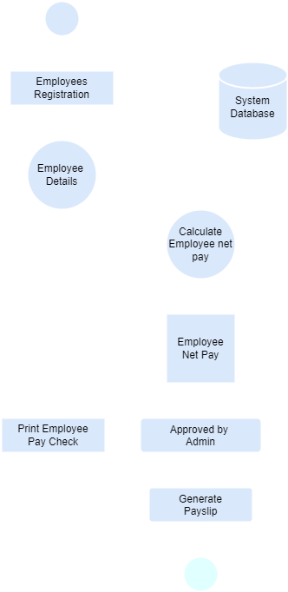
PayrollCentral
INTRODUCTION
Detail Planning
Proposed System
Environment Description
Dataflow from diagram / UML
Analysis & Planning
Project Modules:
Admin
Login
Add employee
Employee details
Employee update
Employee status change
Employees
Login
Profile
Change details
Generate pay-slip
Proposed System
Detail Planning
System Design
Software Testing
Limitation & Future Scope
References

Slide 9
PayrollCentral
INTRODUCTION
Detail Planning
Proposed System
Environment Description
Process Specification / Activity Flow Diagram
Project Modules:
Admin
Login
Add employee
Employee details
Employee update
Employee status change
Employees
Login
Profile
Change details
Generate pay-slip
Analysis & Planning
Dataflow from diagram / UML
Proposed System
Detail Planning
System Design
Software Testing
Limitation & Future Scope
References

