Slide 1
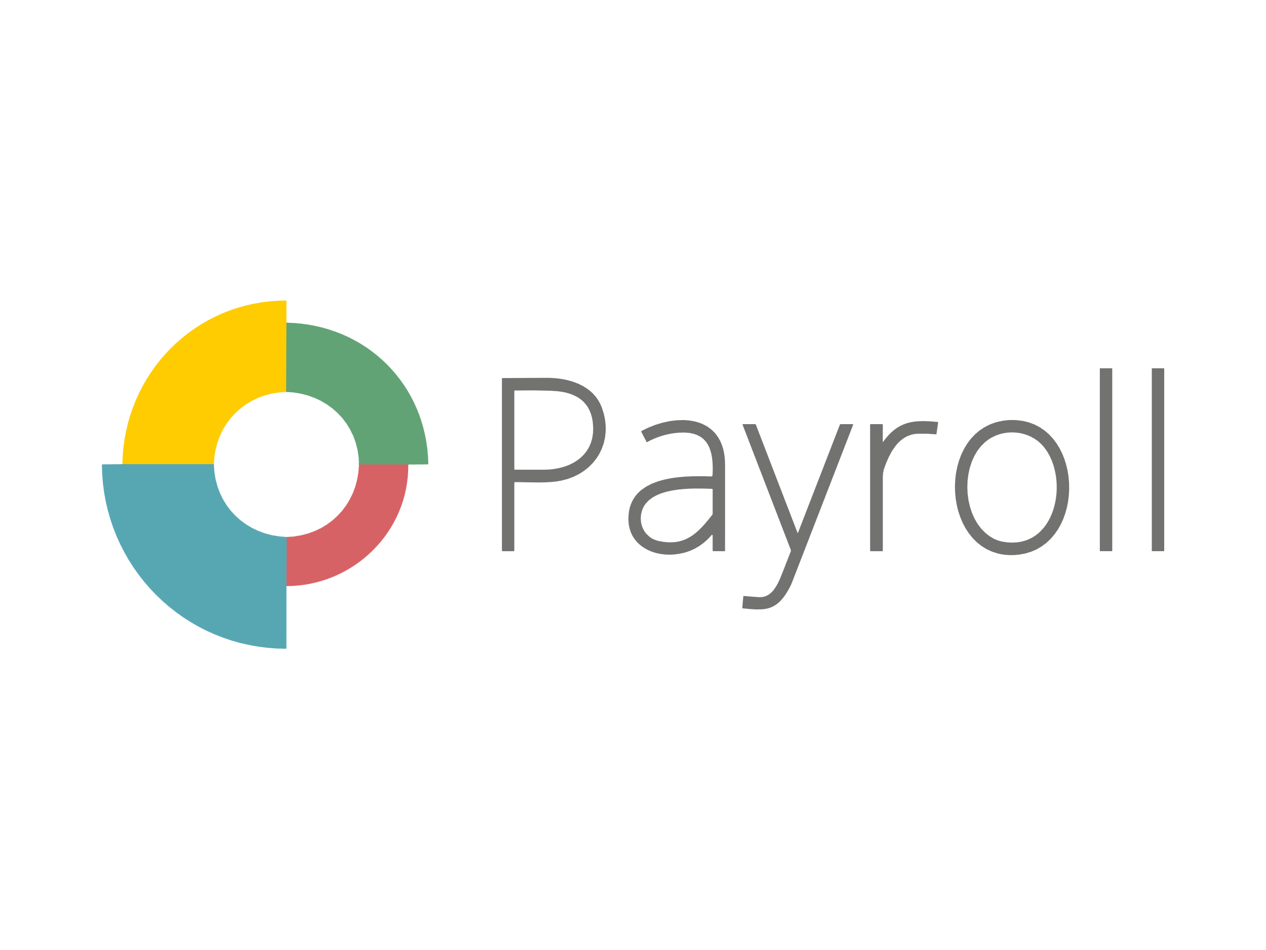

PayrollCentral
INTRODUCTION
INTRODUCTION
ENVIRONMENT
DESCRIPTION
A payroll management system is a software application that automates the process of calculating and paying employee salaries.
Payroll management systems can save businesses time and money by eliminating the need for manual calculations and processing.
Analysis & Planning
PayrollCentral
PAYROLL MANAGEMENT SYSTEM
Proposed System
Project Profile :
Project Title : Payroll-Central
Project Duration : 2 Months
Team Members : Kishore Sunchu, Jyoti Dwivedi, Rupa Chauhan
Project Status : Completed

Slide 2
PayrollCentral
INTRODUCTION
INTRODUCTION
ENVIRONMENT
DESCRIPTION
A payroll management system is a software application that automates the process of calculating and paying employee salaries.
Payroll management systems can save businesses time and money by eliminating the need for manual calculations and processing.
Analysis & Planning
PayrollCentral
PAYROLL MANAGEMENT SYSTEM
Project Profile :
Project Title : Payroll-Central
Project Duration : 2 Months
Team Members : Kishore Sunchu, Jyoti Dwivedi, Rupa Chauhan
Project Status : Completed

Slide 3
PayrollCentral
Environment Description
INTRODUCTION
INTRODUCTION
ENVIRONMENT
DESCRIPTION
Hardware Requirements
Processor : Intel core i3 or higher
SSD : 256GB or higher
RAM : 4GB or higher
A payroll management system is a software application that automates the process of calculating and paying employee salaries.
Payroll management systems can save businesses time and money by eliminating the need for manual calculations and processing.
Analysis & Planning
Soft Requirements
Windows 7 or higher
NodeJS
Microsoft visual studio code
Mongodb Compass
Google Crome
Project Profile :
Project Title : Payroll-Central
Project Duration : 2 Months
Team Members : Kishore Sunchu, Jyoti Dwivedi, Rupa Chauhan
Project Status : Completed

Slide 4
PayrollCentral
System Analysis & Planning
Environment Description
INTRODUCTION
ENVIRONMENT
DESCRIPTION
Existing System
greytHR
Keke HR
HROne
Workday HCM
Hardware Requirements
Processor : Intel core i3 or higher
SSD : 256GB or higher
RAM : 4GB or higher
Analysis & Planning
Soft Requirements
Windows 7 or higher
NodeJS
Microsoft visual studio code
Mongodb Compass
Google Crome
Drawbacks of above system:
High cost : implementing and maintaining of can be high.
Inflexibility : Traditional system can be difficult to adapt changes employee info.
Difficult to scale : Manual system can be difficult to scale as a company grows

Slide 5
PayrollCentral
INTRODUCTION
System Analysis & Planning
ENVIRONMENT
DESCRIPTION
Requirement gathering and analysis:
Payroll compliance : The system must be able to calculate and deduct all applicable taxes.
Expense management : The system must be able to track and manage employee expense
Dashboard & Reporting : The system must provide a dashboard with real-time data on payroll, expense, and other financial information.
Analysis & Planning
Analysis & Planning

Slide 6
PayrollCentral
INTRODUCTION
Proposed System
System Analysis & Planning
ENVIRONMENT
DESCRIPTION
Scope
To develop a user-friendly and efficient payroll management system that automates the process of calculating and disbursing employee salaries, bonuses, and deductions.
To ensure compliance with all relevant tax laws and regulations.
To provide accurate and timely payroll reports.
To improve the efficiency of the HR department by freeing up time to focus on other tasks.
To improve employee satisfaction by ensuring that they are paid accurately and on time.
Requirement gathering and analysis:
Payroll compliance : The system must be able to calculate and deduct all applicable taxes.
Expense management : The system must be able to track and manage employee expense
Dashboard & Reporting : The system must provide a dashboard with real-time data on payroll, expense, and other financial information.
Analysis & Planning
Proposed System

