Slide 1
CUSTOMER LIFETIME VALUE ANALYSIS

Slide 2
Objective: Analyze the customer life-time value for an Auto Insurance Company. Its revenue would increase if the amount claimed by customers who have insured in the company is low. It helps marketers to find optimum marketing spending to acquire and retain customers. That basically says how much to spend on acquiring and retaining.
Benefits:
Tailored Service: CLV assessment helps customize offerings based on individual customer needs, enhancing satisfaction and retention.
Precise Marketing: By identifying high CLV customers, resources can be focused on targeted marketing campaigns, optimizing acquisition costs.
Risk Management: CLV analysis aids in predicting potential claims and assessing policyholder behavior, leading to improved risk evaluation.
Long-Term Profitability: Strategic decisions driven by CLV data foster higher customer loyalty, translating into sustained revenue growth over time.

Slide 3
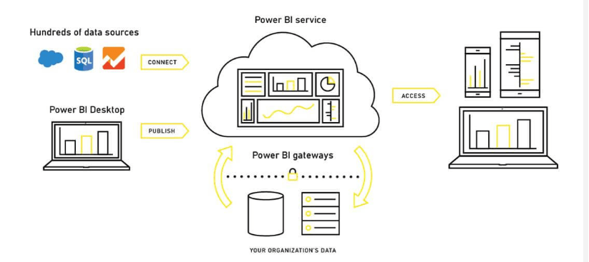
Power BI Architecture

Slide 4
Data Collection and Preparation:
I Identified the data sources want to use in my project.
I collected the data provided by ineuron and imported data from Excel to Power BI
Data Transformation:
I cleaned and transformed the data to ensure it's in the desired format for analysis.
Performed data shaping tasks like filtering, sorting, and grouping to remove null values, errors in data, and made the single table into 4 tables for better understanding.

Slide 5
Data Modeling:
I defined relationships between different tables as I needed.
Created calculated columns and measures using DAX (Data Analysis Expressions) language.
Report Design:
I Created 2 report pages.
Added visualizations such as charts, tables, matrices, and maps to the report pages which suits my data.
Customized the formatting and layout of the visuals.

Slide 6
Adding Interactivity:
Added slicers, filters to enhance user interactivity.
Created bookmarks to save specific views and states of the report
Data Refresh and Publishing:
I Configured data refresh settings to keep the data up-to-date.
I Published the report and dashboard to the Power BI service (Power BI Online) or a compatible on-premises server.

Slide 7
Power BI Service (Power BI Online):
Published your Power BI reports and dashboards to the Power BI service, which is a cloud-based platform provided by Microsoft.
This allows users to access and interact with the reports using a web browser or the Power BI mobile app.
We can share reports with colleagues and control access using different sharing options.
The Power BI service also supports automatic data refresh for keeping the data up-to-date.

Slide 8
Deployment Pipelines:
Power BI Premium and Premium Per User offer deployment pipelines for managing the deployment of Power BI artifacts.
Deployment pipelines allow you to promote changes through different environments (e.g., development, testing, production) while ensuring consistency.

