Slide 1
What is Volume management ?
In computer storage, logical volume management or LVM provides a method of allocating space on mass-storage devices that is more flexible than conventional partitioning schemes. In particular, a volume manager can concatenate, stripe together or otherwise combine partitions into larger virtual ones that administrators can re-size or move, potentially without interrupting system use.

Slide 2
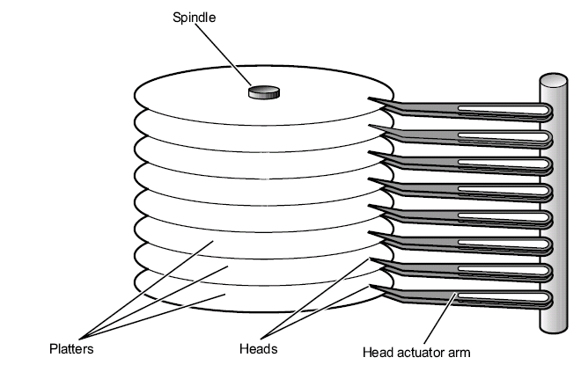
Basic Architecture of a Disk
A disk is physically composed of a series of flat, magnetically coated platters that are stacked on a spindle. The spindle turns while the read/write heads move as a single unit radially, reading and writing data on the platters.

Slide 3
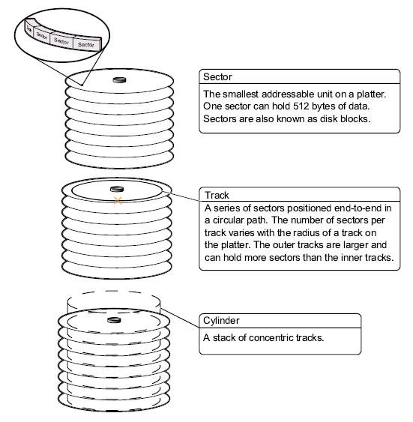
Data Organization on Disk Platters

Slide 4
Disk Slices
Disks are logically divided into individual partitions known as disk slices. Disk slices are groupings of cylinders that are commonly used to organize data by function. For example, one slice can store critical system files and programs while another slice on the same disk can store user-created files.
Note – Grouping cylinders into slices is done to organize data, facilitate backups, and provide swap space.
A disk under the Solaris OS can be divided into eight slices that are labeled Slice 0 through Slice 7. By convention, Slice 2 represents the entire disk. Slice 2 maintains important data about the entire disk, such as the size of the actual disk and the total number of cylinders available for the storage of files and directories.
Slice e.g. in solaris: # /dev/dsk/c0t0d0s0
Slice e.g. in RedHat:# /dev/sda1

Slide 5
Utilities to manage Disk Slices
fdisk is a utility to manage disk partitions in RedHat. You can view disks and their partitioning by running the utility with the -l option and the name of the disk (fdisk -cul /dev/vda). Changes can be made by running the utility interactively and choosing appropriate menu options (fdisk -cu /dev/vda). -c disables legacy DOS compatibility mode and -u displays output in sectors (not cylinders, which are obsolete).

Slide 6
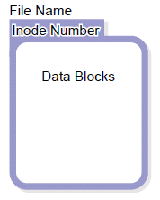
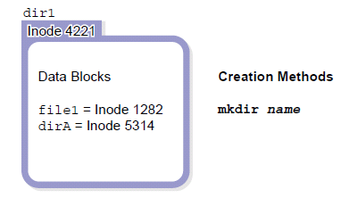
File Intro:
Introducing File Components
All files in the OS make use of a file name and a record called an inode. Most files also make use of data blocks. In general, a file name is associated with an inode, and an inode provides access to data blocks.
Below shows the relationship between the file components.
File components Directory components.

Slide 7
File Components
File Names
File names are the objects most often used to access and manipulate files. A file must have a name that is associated with an inode.
Inodes
Inodes are the objects the OS uses to record information about a file. In general, inodes contain two parts. First, inodes contain information about the file, including its owner, its permissions, and its size. Second, inodes contain pointers to data blocks associated with the file content. Inodes are numbered, and each file system contains its own list of inodes. When a new file system is created, a complete list of new inodes is also created in that file system.
Data Blocks
Data blocks are units of disk space that are used to store data. Regular files, directories, and symbolic links make use of data blocks. Device files do not hold data.

Slide 8
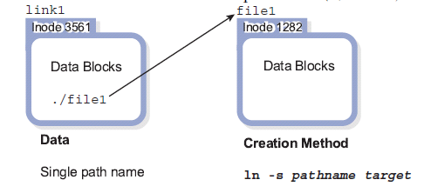
Symbolic Links
A symbolic link is a file that points to another file. Like directories, which contain only directory information, symbolic links contain only one type of data.
A symbolic link contains the path name of the file to which it points. Because symbolic links use path names to point to other files, they can point to files in other file systems. The ln command with the –s option creates a symbolic link.
# ln -s file1 link1

Slide 9
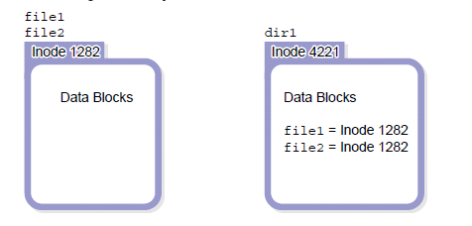
Hard Links
A hard link is the association between a file name and an inode. Information in each inode keeps count of the number of file names associated with it. This is called a link count. In the output from the ls -l command, the link count appears between the column of file permissions and the column identifying the owner. In the following example, the file called file1 uses one hard link.
# cd dir1; # touch file1; # ls -l
-rw-r--r-- 1 root root 0 Sep 23 13:19 file1

Slide 10
Creating Hard Links
A new hard link for a file name increments the link count in the associated inode. In the following example, inode 1282 now has two hard links, one for file1 and the other for file2. The ls -li command lists the inode number in the left-most column. The find -inum command locates files and directories that have the same inode numbers.
# ln file1 file2; # ls -l
-rw-r--r-- 2 root root 0 Sep 23 13:19 file1
-rw-r--r-- 2 root root 0 Sep 23 13:19 file2
# ls -li
1282 -rw-r--r-- 2 root root 0 Sep 23 13:19 file1
1282 -rw-r--r-- 2 root root 0 Sep 23 13:19 file2
# find . -inum 1282
./file1
./file2

Slide 11
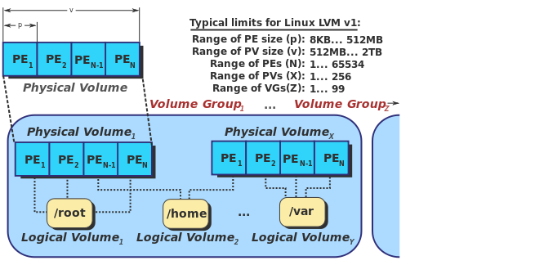
Components of Volume management
PV
Disk group
Volume
file system

Slide 12
LINUX Filesystems
fdisk is a utility to manage disk partitions. You can view disks and their partitioning by running the utility with the -l option and the name of the disk (fdisk -cul /dev/vda). Changes can be made by running the utility interactively and choosing appropriate menu options (fdisk /dev/vda )
[root@serverX -]# fdisk -l
Disk Idev/vda (1): 6442 MB (2), 6442458944 bytes
16 heads, 63 sectors/track, 12483 cylinders, total 12582912 sectors (3)
Units = sectors of 1 * 512 = 512 bytes
sector size (logical/physical): 512 bytes / 512 bytes
I/O size (minimum/optimal): 512 bytes / 512 bytes
Disk identifier: 0x000a9b12
Device Boot Start End Blocks ID System
/dev/vda1 * 2048 526335 262144 83 Linux
/dev/vda2 526336 9914367 4694016 (4) 8e Linux LVM
(1) Name of disk
(2) Total size of disk
(3) Total sectors
(4) Last used sector

Slide 13
Creating new Partition
[root@serverX -]# fdisk -cu /dev/vda
Command (m for help): n
Command action
e extended
p primary partition (1-4)
p
Partition number (1-4): 3
First sector (9914368-12582911, default 9914368): Enter
Using default value 9914368
Last sector, +sectors or +size{K,M,G} (9914368-12582911, default 12582911): +1G
Command (m for help): w
The partition table has been altered!
Calling ioctl() to re-read partition table.
WARNING: Re-reading the partition table failed with error 16: Device or resource busy.
The kernel still uses the old table. The new table will be used at the next reboot or after you run partprobe(8) or kpartx(8).
Syncing disks.
[root@serverx -]# reboot

Slide 14
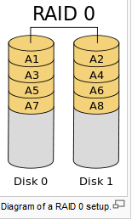
RAID levels
RAID 0
RAID0 is striping, in which data is spread across multiple spindles (disks). Data written to the RAID0 is broken up into chunks of a specified size (interlace value) and spread across the disks
Diagram of a RAID 0 setup

Slide 15
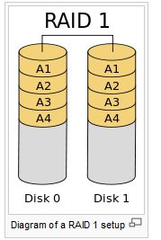
RAID
RAID 1
An exact copy (or mirror) of a set of data on two disks. This is useful when read performance or reliability is more important than data storage capacity. Such an array can only be as big as the smallest member disk. A classic RAID 1 mirrored pair contains two disks (see reliability geometrically) over a single disk. Since each member contains a complete copy and can be addressed independently, ordinary wear-and-tear reliability is raised by the power of the number of self-contained copies.
Diagram of a RAID 1 setup

Slide 16
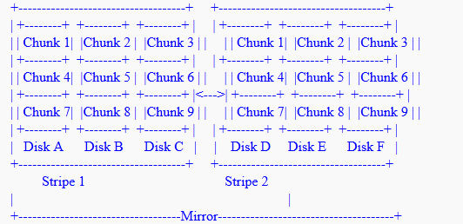
RAID 0+1: In RAID 0+1, the stripes are created first, then are mirrored together. Logically, the resulting device looks like:

Slide 17
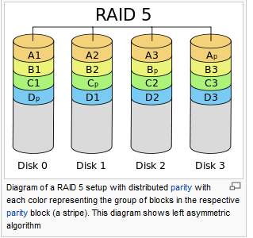
RAID
RAID 5
A RAID 5 uses block-level striping with parity data distributed across all member disks. RAID 5 has achieved popularity because of its low cost of redundancy.
Diagram of a RAID 5 setup with distributed parity with each color representing the group of blocks in the respective parity block (a stripe). This diagram shows left asymmetric algorithm

Slide 18
Homework ( submit by next class )
What is RAID 6?
What is more advantageous ? Is it RAID 0 or 1 or 5 or 6 ?

Slide 19
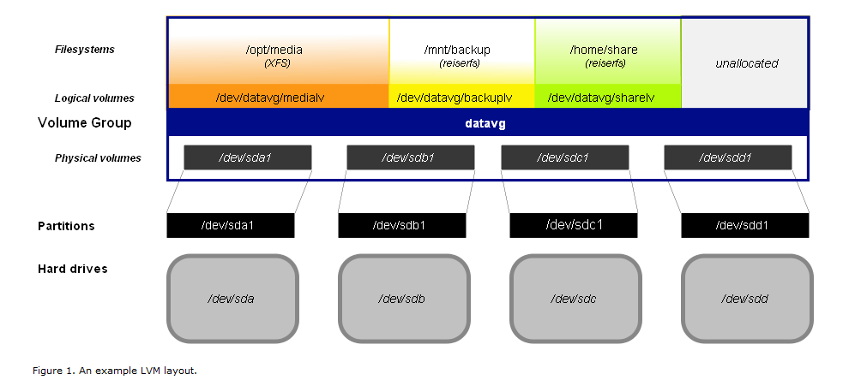
LVM ( Linux )

Slide 20
Creating a Virtual Volume
Initialize each of the disks using the pvcreate command:
# pvcreate /dev/sda /dev/sdb /dev/sdc /dev/sdd This sets up all the partitions on these drives for use under LVM, allowing creation of volume groups. To examine available PVs, use the pvdisplay command. This system will use a single-volume group named datavg:
# vgcreate datavg /dev/sda1 /dev/sdb1 /dev/sdc1 /dev/sdd1 Use vgdisplay to see the newly created datavg VG with the four drives stitched together. Now create the logical volumes within them:
# lvcreate datavg --name medialv --size 400G
# lvcreate datavg --name backuplv --size 50G
# lvcreate datavg --name sharelv --size 10G

Slide 21
LVM contd..
Without LVM, you might allocate all available disk space to the partitions you're creating, but with LVM, it is worthwhile to be conservative, allocating only half the available space to the current requirements. As a general rule, it's easier to grow a filesystem than to shrink it, so it's a good strategy to allocate exactly what you need today, and leave the remaining space unallocated until your needs become clearer. This method also gives you the option of creating new volumes when new needs arise (such as a separate encrypted file share for sensitive data). To examine these volumes, use the lvdisplay command.
Now you have several nicely named logical volumes at your disposal:
/dev/datavg/backuplv (also /dev/mapper/datavg-backuplv) /dev/datavg/medialv (also /dev/mapper/datavg-medialv) /dev/datavg/sharelv (also /dev/mapper/datavg-sharelv)

Slide 22
LVM contd..
Next create filesystems
# mkfs.ext4 /dev/datavg/backuplv
Mounting
Finally, to mount the file systems, first add the following lines to /etc/fstab:
/dev/datavg/backuplv /var/backup ext3 rw,noatime 0 0
and then establish and activate the mount points:
# mkdir /var/media /var/backup /var/share # mount /var/media /var/backup /var/share
Other commands :
# lvextend -L15G /dev/datavg/sharelv
# resize2fs /dev/datavg/sharelv
# pvcreate /dev/md2 /dev/md3
# vgextend datavg /dev/md2 /dev/md3

