Slide 1
Design, Development and Implementation of an Offline Real-Time Pothole Detection System Using YOLOv8 on an ARM-Based Embedded Platform
Bharat AI-SoC Student Challenge (ARM – C2S Programme)
PROJECT GUIDE: Mrs.PRISCILLA SOPHIA
COLLEGE : SRI SHAKTHI INSITITUTE OF ENGINEERING AND TECHNOLOGY
TEAM MEMBERS:
AVINASH .C.K
KISHORE .P.S
MANOSARAN.P

Slide 2
PROBLEM STATEMENT
Road infrastructure degradation is a major concern affecting vehicle safety, passenger comfort, and transportation efficiency. Potholes develop due to continuous traffic load, water seepage, poor construction quality, and lack of timely maintenance.
Current road inspection methods rely on manual surveys, which are time-consuming, costly, and prone to human error. There is a need for an automated, real-time, and cost-effective solution that can detect potholes efficiently without cloud dependency.

Slide 3
OBJECTIVES
The main objectives of this project are:
To develop an offline real-time pothole detection system
To deploy a deep learning model on an ARM-based embedded platform
To eliminate dependency on cloud-based processing
To provide real-time visual output for road monitoring
To design a low-cost and portable embedded AI solution

Slide 4
WHY OFFLINE EDGE AI?
Most existing AI-based road monitoring systems rely on cloud servers, which introduces:
High latency
Internet dependency
Privacy concerns
Increased operational cost
By implementing Edge AI:
Processing happens locally on the device
Response time is reduced
System works in remote and rural areas
Data privacy is preserved
This project demonstrates a complete offline edge AI solution

Slide 5
SYSTEM OVERVIEW
The system captures live road video using a camera and processes each frame locally using a deep learning model.
Detected potholes are highlighted and displayed in real time on a connected monitor.
The entire pipeline operates without internet connectivity, making it suitable for on-road and field deployment.

Slide 6
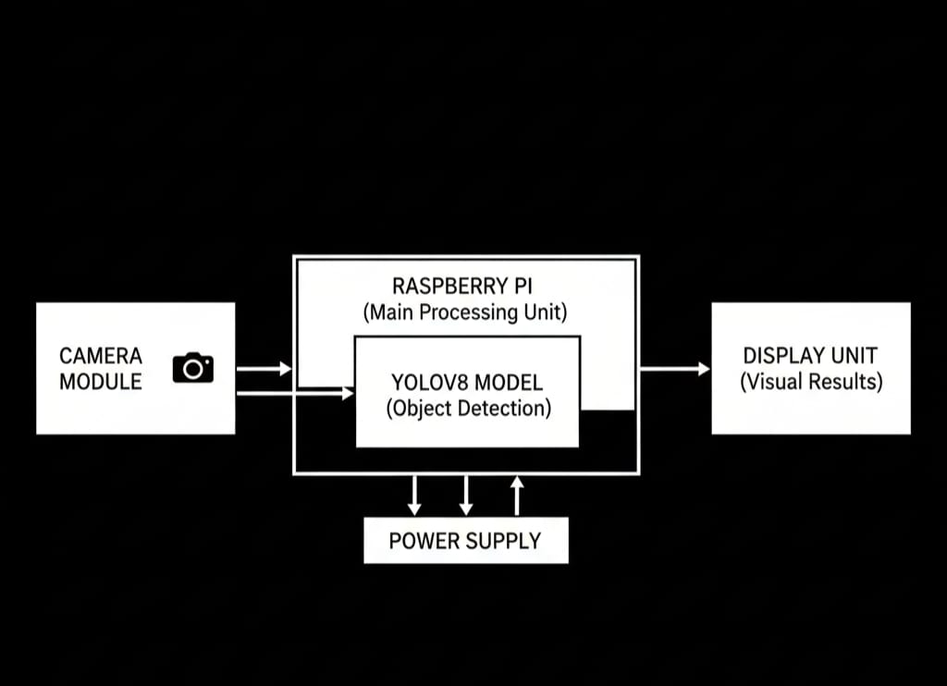
BLOCK DIAGRAM

Slide 7
HARDWARE COMPONENTS
The hardware components used in this project include:
Raspberry Pi 4 / Raspberry Pi 5 (ARM-based processor)
USB Webcam / Dashcam
HDMI Monitor
MicroSD Card (Operating System & Storage)
Power Supply
The Raspberry Pi acts as the central processing unit for AI inference and visualization.

Slide 8
ARM-BASED EMBEDDED PLATFORM
The project is implemented on Raspberry Pi, which is based on ARM architecture.
Key features include:
Quad-core ARM processor
Low power consumption
Linux OS support
USB camera and HDMI display support
Ideal for edge AI applications

Slide 9
SOFTWARE STACK
The software technologies used are:
Python Programming Language
OpenCV for video processing
Ultralytics YOLOv8 framework
PyTorch (CPU-based inference)
Raspberry Pi OS (Linux)
All software components are optimized for CPU-based execution.

Slide 10
VIDEO ACQUISITION PROCESS
The USB camera continuously captures live road footage. Each frame is transmitted to the Raspberry Pi through the USB interface.
OpenCV handles:
Camera initialization
Frame capture
Frame resizing and preprocessing
Captured frames are passed sequentially to the detection model.

Slide 11
YOLOv8 MODEL OVERVIEW
The pothole detection model is based on YOLOv8 (You Only Look Once version 8).
YOLOv8 performs object detection in a single forward pass, making it suitable for real-time applications on embedded systems.
The YOLOv8 Nano (YOLOv8n) variant is used due to its lightweight nature.

Slide 12
INTERNAL WORKING OF YOLOv8
YOLOv8 architecture consists of:
Backbone network for feature extraction
Neck network for multi-scale feature fusion
Detection head for bounding box prediction
The model processes the entire image at once and directly predicts object locations and confidence scores.

Slide 13
MATHEMATICAL EXPLANATION OF YOLO
YOLO divides the input image into a grid of cells.
For each grid cell, the model predicts:
Bounding box coordinates: (x, y, w, h)
Object confidence score
Class probability
Bounding box confidence is calculated as:
Confidence = P(Object) × IoU
Where IoU (Intersection over Union) is given by:
IoU = Area of Overlap / Area of Union
Non-Maximum Suppression (NMS) is applied to remove overlapping boxes and retain the best predictions.

Slide 14
DETECTION PIPELINE
The complete detection pipeline includes:
Frame capture using OpenCV
Image resizing and normalization
YOLOv8 inference
Confidence threshold filtering
Non-Maximum Suppression
Bounding box rendering
Each step runs sequentially on the Raspberry Pi.

Slide 15
OUTPUT VISUALIZATION
Detected potholes are displayed as bounding boxes on the live video stream. Each bounding box includes a confidence score indicating detection reliability.
The annotated output is displayed in real time through HDMI on a monitor.

Slide 16
PERFORMANCE ANALYSIS
Performance evaluation on Raspberry Pi shows:
Average inference time: 200–500 ms per frame
Frame rate: 2–5 FPS
CPU utilization: High during inference
Memory usage: Moderate
The performance is acceptable for real-time embedded applications.

Slide 17
CONCLUSION
This project successfully demonstrates an offline real-time pothole detection system using deep learning on an ARM-based embedded platform.
The system proves that intelligent computer vision solutions can be deployed on low-cost hardware without cloud dependency, making it suitable for real-world road monitoring applications.

