Slide 1
Predicting Short-Term Residential Electricity Load
By: Steve Burgos, Kishore Prakasen, Ivan Macsemchuck, Jason Kluge
Notes:
Predicting Short-Term Residential Electricity Load
By: Steve Burgos, Kishore Prakasen, Ivan Macsemchuck, Jason Kluge

Slide 2

Content
Introduction
Research Problem
Dataset
Models
Technology
Results
Task Allocation
Discussion
QA
Notes:
Introduction
Research Problem
Proposed Research
RNN Models
Simple RNN
LSTM
MomentumRNN
Mogrifier LSTM
Data Collection
Expected Results
Tasks
Conclusion

Slide 3
Introduction
Advance Metering Infrastructure (AMI) used to collect continuous information about utilities
Short-term load forecasting (STLF) predicts electrical usage 1 day to a week in advance
STLF uses:
  Generation scheduling of power system
  Optimizing operation of power plants
  Reliability of power system
Notes:
Advance Metering Infrastructure is an important part of ‘smart’ cities ICTs. AMI’s collect continuous information about utilities using smart meters. This allows for short-term load forecasting. Prior to smart meters, employees would have to come out and read meters usually once every month.
Short term load forecasting is typically a prediction for energy usage from a day to a week from now.
Accurate STLF lends itself to generation scheduling, dealing with the supply and demand of the electrical grid,
optimizing power plant operations,
and reliability of the power system.
(More on reliability) If load demand underestimated, there is a power supply shortage. If it is overestimated more resources than needed are used to generate the power.
Advance Metering Infrastructure (AMI) used to collect continuous information about utilities
Short-term load forecasting (STLF) predicts electrical usage 1 day to a week in advance
STLF uses:
Generation scheduling of power system
Optimizing operation of power plants
Reliability of power system

Slide 4


Research Problem
Predicting Short-Term Residential Electricity Load with different types of neural networks
Challenges for predicting
  Weather
  Demand Peaks
  Individual User Behavior
Notes:
Predict Short-Term Residential Electricity Load
Challenges
Weather
Demand Peaks
Individual User Behavior
Opportunities
Demand Response
Resource Allocation
Environmental Impact

Slide 5
Research Problem
Short-Term Residential Electricity Load
Challenges
  Weather
  Demand Peaks
  Individual User Behavior
Opportunities
  Demand Response
  Resource Allocation
  Environmental Impact
Notes:
Predict Short-Term Residential Electricity Load
Challenges
Weather
Demand Peaks
Individual User Behavior
Opportunities
Demand Response
Resource Allocation
Environmental Impact

Slide 6
Dataset
The dataset used is a compilation of three different datasets:
London Weather Data
ACORN classification details
  Acorns = different segments of the UK and demographic information on each segment
Energy Consumption Readings from London Households
  5,567 London households
Notes:
Each dataset was collected by the Kaggle user who posted this dataset
About each dataset:
London Weather Data: Collected from Darksky API, a weather api, during the times the energy consumption dataset was collect
ACORN classification details: Acorns are ‘geodemographic segmentations’, it splits up the UK into different segments and provided demographic information on each segment
Energy Consumption Readings: These are from a project done by the UK Power Networks. It consists of energy consumption every half hour from 5,567 London households over the course of a little over two years.

Slide 7
Models
SIMPLE RNN Simple architecture makes it easy to implement and understand Limited ability to process long-term dependencies in sequence data. | LSTM Excellently handles long-term dependencies due to its gating mechanism. Effectively mitigates vanishing gradient problem, allowing for deeper networks
MOMENTUM RNN Faster convergence during training due to momentum factor in optimization. Improved ability to deal with vanishing gradients compared to Simple RNNs. | MOGRIFIER LSTM Enhanced LSTM variant with improved handling of long-term dependencies. Longer training times and increased demand for data to achieve optimal performance.
Notes:
Old Model & Old Domain
LSTM
SimpleRNN
Old Model & New Domain
Mogrifier LSTM
MomentumRNN

Slide 8
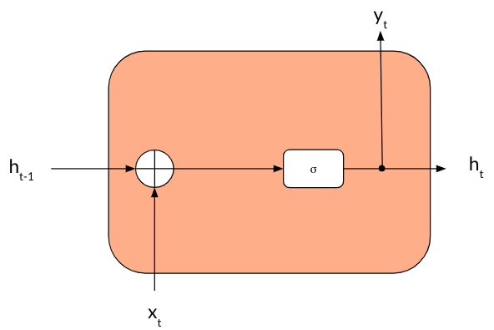
Simple RNN
Model:
Two layers:
  Simple RNN
  Dense
Training:
Optimizer:
Loss:
Epoch:

Slide 9
LSTM
y_{t}
C_{t-1}
C_{t}
i_{t}
tanh
f_{t}
Ĉ_{t}
o_{t}
σ
σ
tanh
σ
h_{t}
h_{t-1}
x_{t}
Hochreiter, Sepp & Schmidhuber, Jürgen. (1997). Long Short-term Memory. Neural computation. 9. 1735-80. 10.1162/neco.1997.9.8.1735
Notes:
Hochreiter, Sepp & Schmidhuber, Jürgen. (1997). Long Short-term Memory. Neural computation. 9. 1735-80. 10.1162/neco.1997.9.8.1735.

Slide 10
Momentum RNN
y_{t}
h_{t-1}
σ
h_{t}
v_{t-1}
v_{t}
x_{t}
Nguyen, Tan & Baraniuk, Richard & Bertozzi, Andrea & Osher, Stanley & Wang, Bao. (2020). MomentumRNN: Integrating Momentum into Recurrent Neural Networks.

Slide 11
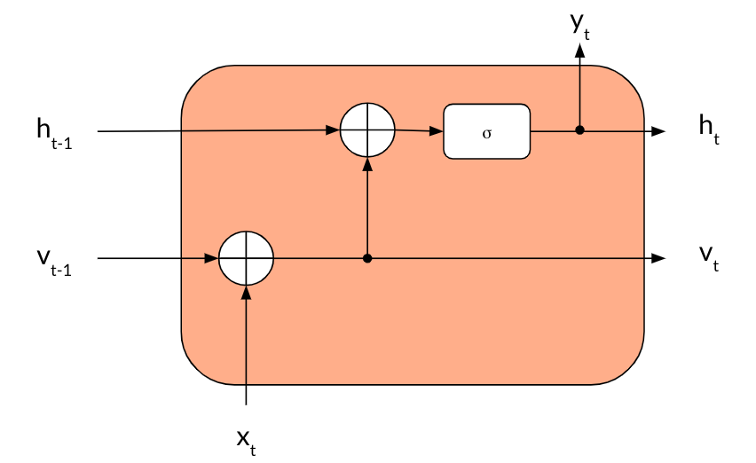
Momentum RNN
Model:
Two layers:
  Momentum Cell Layer
  Linear Layer
Training:

Slide 12
Mogrifier LSTM
y_{t}
C_{t-1}
C_{t}
i_{t}
tanh
f_{t}
Ĉ_{t}
o_{t}
σ
σ
tanh
σ
h_{t}
h_{t-1}
x_{t}
h⁰
h²
QR decomposition interaction
x⁻¹
x¹
x³
Melis, Gábor & Kočiský, Tomáš & Blunsom, Phil. (2019). Mogrifier LSTM
Notes:
Melis, Gábor & Kočiský, Tomáš & Blunsom, Phil. (2019). Mogrifier LSTM

Slide 13
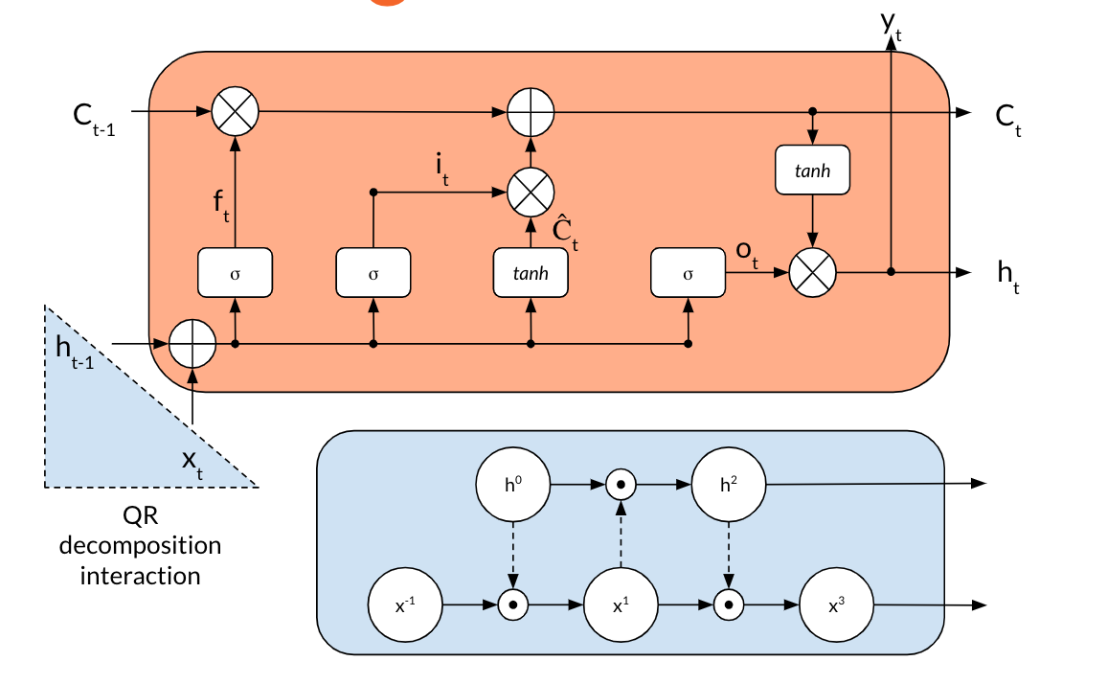
Mogrifier LSTM
Model:
Training:
Notes:
Melis, Gábor & Kočiský, Tomáš & Blunsom, Phil. (2019). Mogrifier LSTM

Slide 14







Storage
Environment
Coding
Notes:
Each dataset was collected by the Kaggle user who posted this dataset
About each dataset:
London Weather Data: Collected from Darksky API, a weather api, during the times the energy consumption dataset was collect
ACORN classification details: Acorns are ‘geodemographic segmentations’, it splits up the UK into different segments and provided demographic information on each segment
Energy Consumption Readings: These are from a project done by the UK Power Networks. It consists of energy consumption every half hour from 5,567 London households over the course of a little over two years.

Slide 15
Results
MODEL | MAPE | TRAIN TIME | TESTING TIME
SimpleRNN Individual | 86.55% | 57,106 Sec | 750 Sec
Simple RNN Aggregate | 12.44% | 57,106 Sec | 750 Sec
LSTM Individual | 79.77% | 84,266 Sec | 958 Sec
LSTM Aggregate | 7.55% | 84,266 Sec | 958 Sec
Momentum RNN Individual | 89.47% | 43,201 Sec | 725 Sec
Momentum RNN Aggregate | 14.95% | 43,201 Sec | 725 Sec
Mogrifier LSTM Individual | 78.82% | 106,211 Sec | 955 Sec
Mogrifier LSTM Aggregate | 7.16% | 106,211 Sec | 955 Sec
Notes:
Contributions to Research
Data analysis and exploration from dataset
Predict residential load using MomentumRNN and Mogrifier LSTM
Compare results of Models on previously studied models in domain

Slide 16
Task Allocation
Data Preprocessing: Jason Kluge, Kishore Prakasan
Build MomentumRNN Model: Jason Kluge
Build MogrifierLSTM Model: Steve Burgos
Implementing Training and Testing of Models: Steve Burgos, Ivan Macsemchuck
Implement Code for Capturing Results: Kishore Prakasan, Ivan Macsemchuck
Notes:
Each dataset was collected by the Kaggle user who posted this dataset
About each dataset:
London Weather Data: Collected from Darksky API, a weather api, during the times the energy consumption dataset was collect
ACORN classification details: Acorns are ‘geodemographic segmentations’, it splits up the UK into different segments and provided demographic information on each segment
Energy Consumption Readings: These are from a project done by the UK Power Networks. It consists of energy consumption every half hour from 5,567 London households over the course of a little over two years.

Slide 17
Discussion
While individual prediction remains a challenge we are able to reach satisfactory results on a city scale by aggregating individual results
Mogrifier LSTM does provide modest improvements in accuracy with an increase in training and testing time

Slide 18
QA

