Slide 1
Zenz Mart
Weekly Store Performance & Sales Analysis Deck
Period: Past 7 Days | Generated on: 2026-09-07 by Supermarket Ops Agent

Slide 2
Executive Summary — Store KPIs
Total Sales Revenue
₹417.00
Total Invoices Cut
1
Average Ticket Size
₹417.00
Low Stock Alerts
0 SKUs

Slide 3
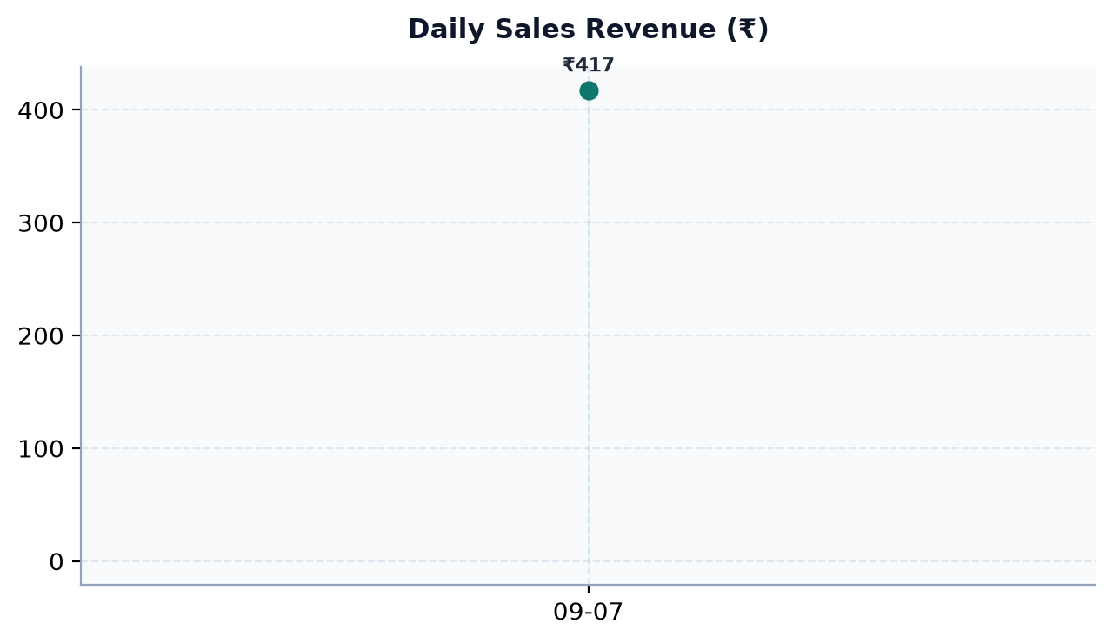
Daily Revenue Trends

Slide 4
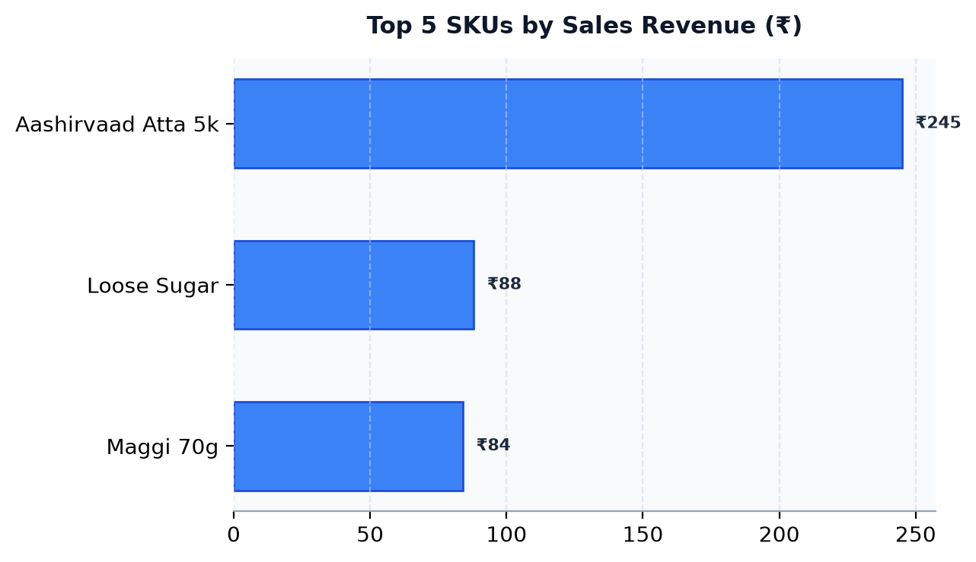
Top Selling Products & Velocity

Slide 5
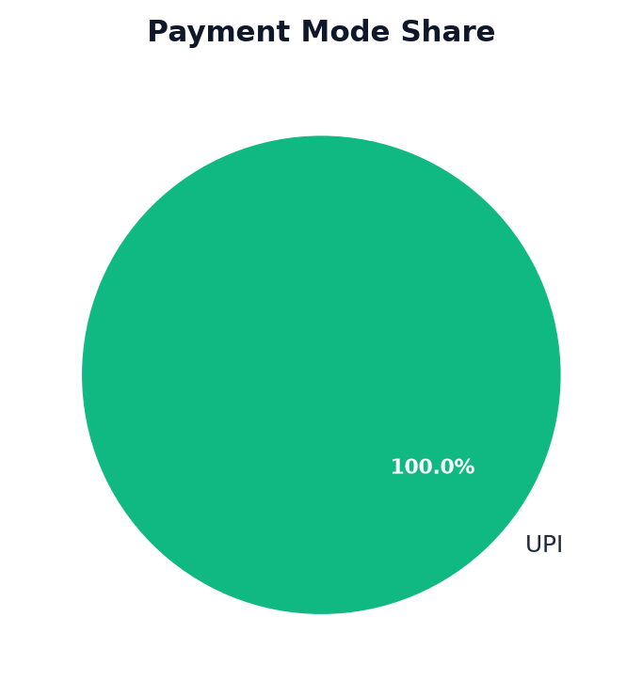
Payment Shares & Inventory Health
⚠️ Low Stock Items to Reorder:
✅ All SKUs are above reorder threshold.

