Slide 1

TEAM LEADER:
SONALEESWARI J
EXHAUST GAS CONVERTER
TEAM MEMBERS:
PRIYADHARISHINI B
MONICA R
PRINCE KELWIN LAZAR M
KISHORE T
TEAM MENTOR:
N PADMAVATHI

Slide 2

PROBLEMS INDENTIFIED:
EFFECTS OF AIR POLLUTION:
Environmental Effects: An overview of the environmental effects of air pollution.
Climate Change: Discusses how air pollution has an impact on climate change.
Climate Control: A study on the effects of air pollution on climate.
Ozone: Read about ozone and ozone layer depletion in relation to air pollution.
Acid Rain: Offers great information on the subject of acid rain.
Ozone & Air Pollution: Describes how air pollution has an impact on the Earth's ozone.
Long-term health effects from air pollution include heart disease, lung cancer, and respiratory diseases such as emphysema. Air pollution can also cause long-term damage to people's nerves, brain, kidneys, liver, and other organs. Some scientists suspect air pollutants cause birth defects.

Slide 3
INTRODUCTION:
The Main problem faced by today’s world is Air pollution.
Exhaust gases from heavy load vehicles includes CO,CO2, etc.
Co2 is particularly very harmful.
The main motive of our project is to control air pollution from vehicle exhaust and converting it into liquid. The converted form of liquid is used for various purposes. The steps for converting gas into liquid are
Exhaust cool gas container
Exhaust gas converter (EGC)
Filtering process

Slide 4
TECHNOLOGY USED FOR THIS SYSTEM:
Refrigerant – for cooling purpose
Heater – for heating purpose
Reverse osmosis- for filtering the water
Ultrasonic sensor- for measuring the water level in the machine
NODE MCU ESP8862 Wi-Fi module- for sending the data to IBM cloud
MQ2 sensor-for detecting gas

Slide 5
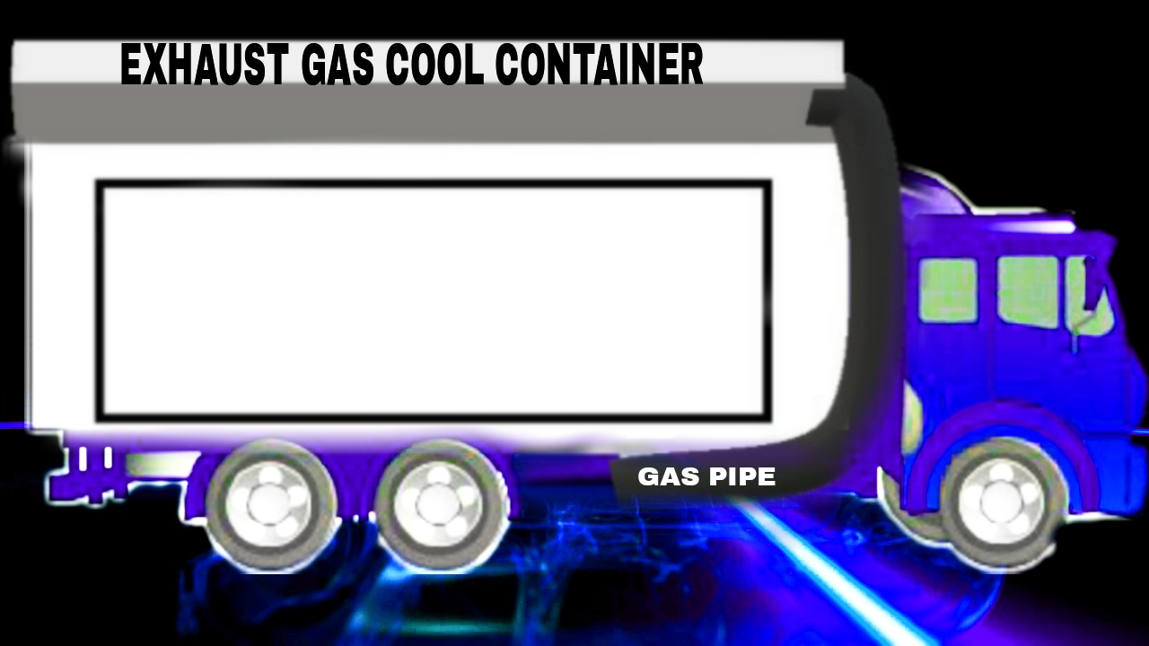

EXHAUST COOL CONTAINER:
The Exhaust gas from the Heavy loaded vehicle is collected in a container with the help of gas tube which is placed in the upper part of the vehicle. The container is called Exhaust gas cool container which cools the gas frequently . The amount of Exhausted air collected by the container is detected with the help MQ2 sensor. When the container is full, the MQ2 sensor alerts the driver with beep sound.

Slide 6


WORKING PRINCIPLE(EXHAUST COOL GAS CONTAINER):
GAS PIPE
Level
VALVE
Exhaust Gas
Refrigerator coil

Slide 7
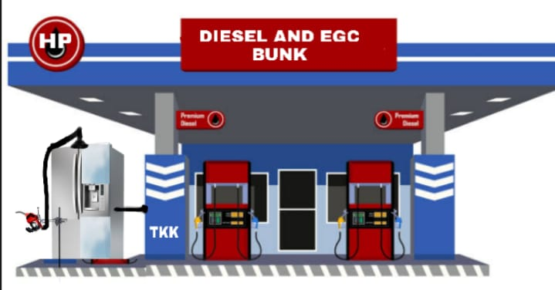
EGC MACHINE(EXHAUST GAS CONVERTER):
The Gas filled container is detached from the vehicle. The gas from the container is inserted in the EGC machine (EXHAUST GAS CONVERTER) which converts gas into liquid form under internal cooling.

Slide 8
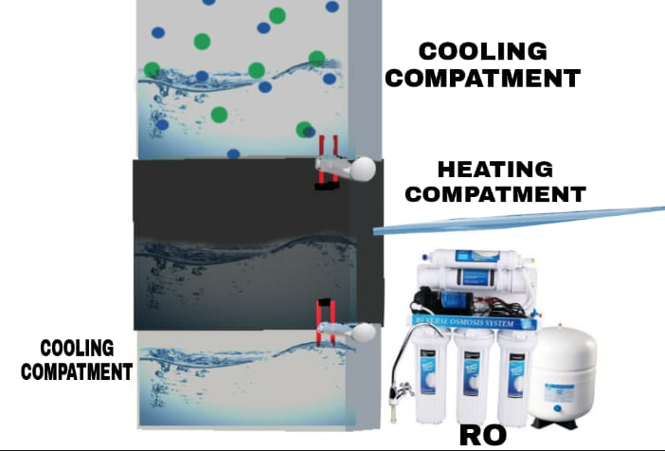
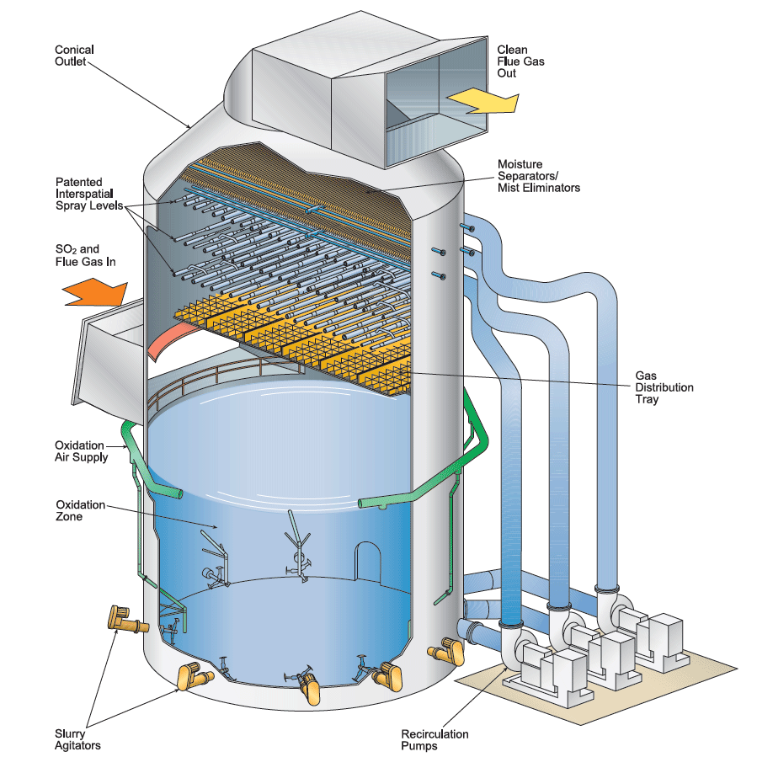
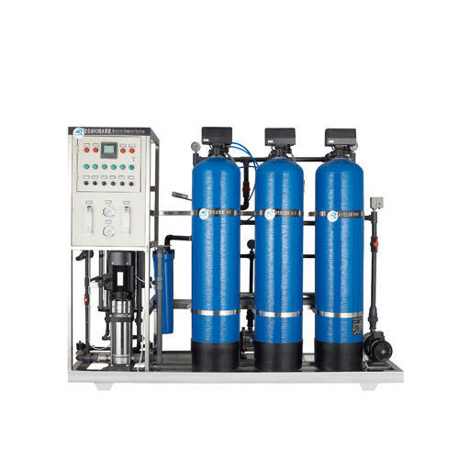
WORKING PRINCIPLE (EGC):
INBUILD STRUCTURE OF EGC
COOLING COMPARTMENT
HEATING COMPARTMENT
Gas pipe
COOLING COMPARTMENT
Ro PROCESS

Slide 9
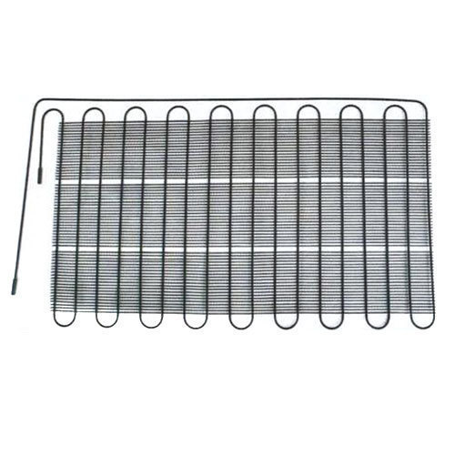
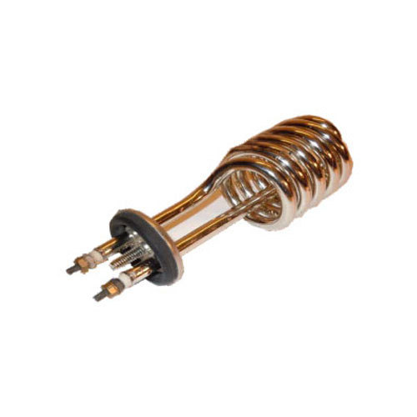
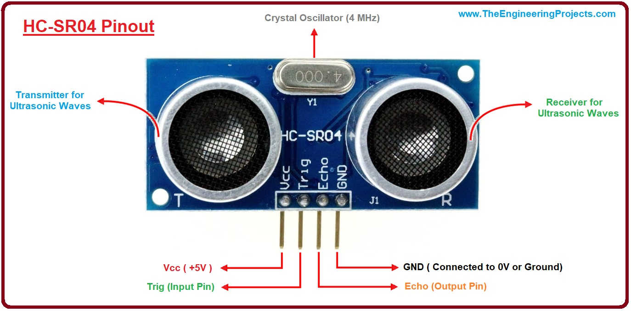

INNER PART OF THE EGC MACHINE
REFRIGERANT
HEATER
ULTRA SONIC SENSOR
NODE MCU ESP8266 WIFI MODULE
RO SYSTEM

Slide 10
ADVANTAGES:
Once the gas is converted to water it is used for various purpose.
After the separation of gases in water, the remaining gas is used to make GTL fuel which is used as a fuel for ships, truck ,car and aeroplanes .
The co2 gas obtained from this process is used for the gas extinguishers , ink etc..
By separating these gases we can even make money.
From this method we can control air pollution
DISADVANTAGES:
The capacity of Exhaust gas cool container is limited
The cost of the machine is high

Slide 11
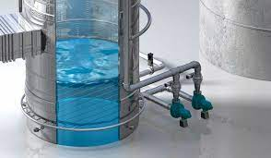
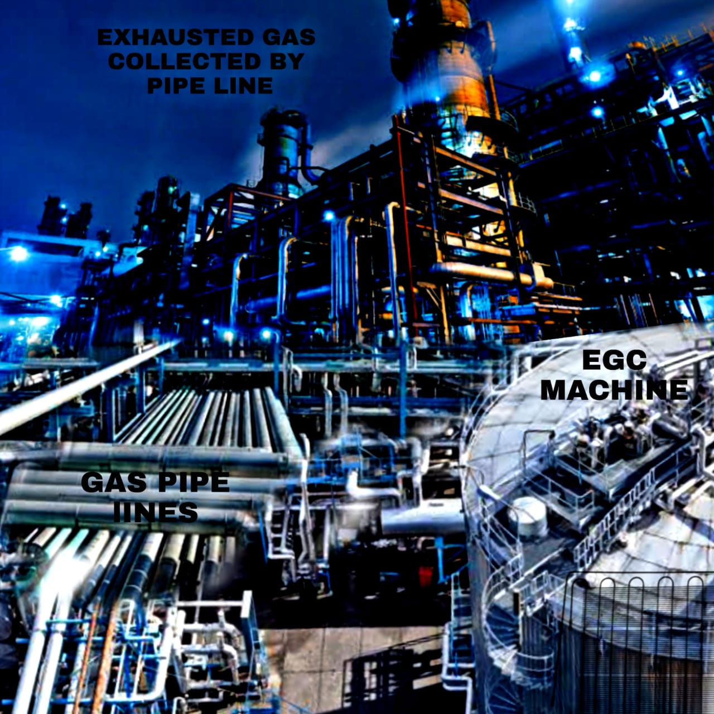
FUTURE SCOPE:
In future we can even try to implement this process in Industries because of increasing air pollution .
We can even work on reducing the cost of EGC machines so that its available in every houses

Slide 12


