Slide 1
Financial Analyzer AI
Personal UPI Usage and Financial Analyzer using LLMs
Streamlit & Langflow Integration

Slide 2
Introduction & Problem Statement
Managing personal finances and tracking UPI usage can be challenging:
Bank statements are often cluttered and hard to analyze manually.
Categorizing transactions accurately is time-consuming.
Lack of personalized financial advice based on actual spending patterns.

Slide 3
Our Solution: Financial Analyzer AI
An intelligent, AI-driven dashboard for UPI transaction analysis:
Automated Document Parsing: Extracts and cleans data directly from bank-generated PDFs.
Intelligent Classification: Organizes transactions into Income, Expense, and specific Categories.
Smart Wealth Advisor: Leverages AI (Google Gemini & Langflow) to provide actionable financial insights.

Slide 4
Key Features & Workflow
The application offers a seamless user experience:
1. Upload: Users drop their UPI statement PDF into the app.
2. Analyze: Instant KPIs (Total Spend, Income, Txn Count) and visual charts (Daily Trend, Category breakdowns).
3. Ask AI: Users can query their financial patterns (e.g., 'How much did I spend on food?').
4. Export: Download analyzed data as CSV for offline use.

Slide 5
Architecture & Tech Stack
Built using modern, scalable technologies:
Frontend: Streamlit for an interactive, responsive UI.
Data Processing: pandas & pdfplumber for data extraction and cleaning.
Visualizations: Plotly Express for dynamic charting.
AI Engine: Google Gemini & Langflow for intelligent insights and reasoning.
Deployment: Dockerized setup for easy execution and scaling.

Slide 6
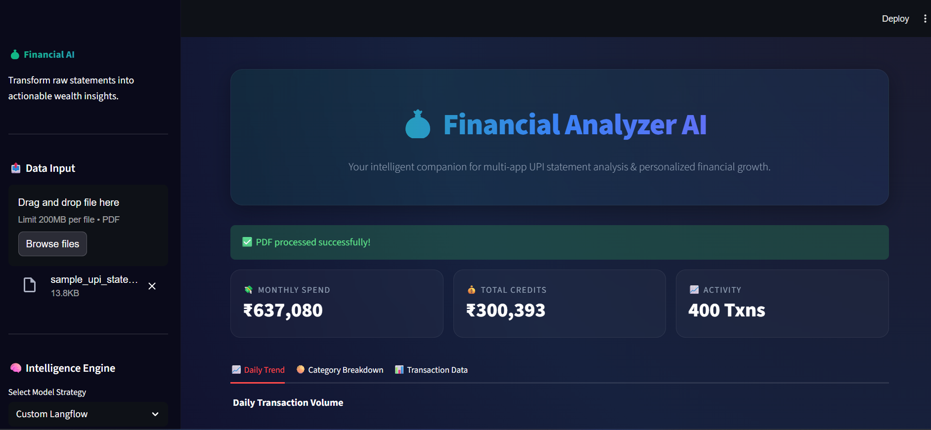
Streamlit

Slide 7
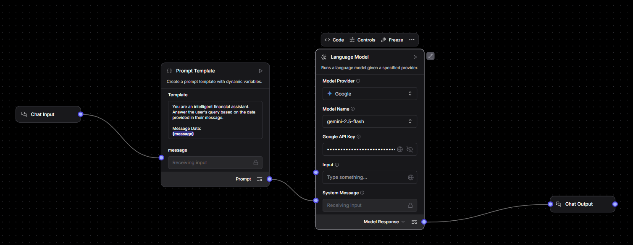
Langflow

Slide 8
Conclusion
Summary:
Financial Analyzer AI bridges the gap between raw UPI data and actionable financial wisdom.
Empowers users to make informed, data-driven financial decisions.
Highly extensible framework ready for future personal finance integrations.

