Slide 1

DEPARTMENT OF
ARTIFICIAL INTELLIGENCE AND MACHINE LEARNING
API & Microservices
Title of the Project:
E-Commerce Product & Order Management System
BATCH NUMBER: 22
Presented by
B.HEMANTH 24B11AI040
G.KASYAP 24B11AI134
J.SV.S.CHARAN 24B11AI143
D.JAYANTH 24B11AI077
Notes:
Project 3: E-Commerce Product & Order Management System, also called ApexMart. The team names, roll numbers and batch number follow the supplied reference.

Slide 2

Table of Contents
1
Introduction
3
2
Problem Statement & Proposed Solution
4
3
Objectives
5
4
Modules in the Project (5 modules, with outputs)
6 - 15
5
Future Enhancements
16
6
Conclusion
17
Notes:
The five presentation modules group related features. The runtime consists of four business microservices and one API Gateway. Slide 18 closes the presentation.

Slide 3
Introduction
ApexMart is an academic marketplace where customers buy products and sellers manage their listings.
Administrators use a separate login to manage products across the marketplace.
Angular provides the storefront. Java Spring Boot services handle users, products, orders and invoices.
CockroachDB stores service data. REST connects shopping APIs, while SOAP supports invoice generation.
Main Idea
A working marketplace that demonstrates API design, secure access, inventory control and communication between microservices.
Notes:
Sources: docs/architecture.md and docs/api.md. If asked why this exists alongside Amazon or Flipkart: the objective is to implement and explain the engineering of a smaller marketplace. It is an academic implementation, with possible adaptation for local sellers or a campus community.

Slide 4
Problem Statement
A marketplace must keep product listings, stock and order records consistent.
Repeated checkout requests and service failures can cause duplicate orders or stock errors.
Customers, sellers and administrators need different permissions.
Proposed Solution
Separate Spring Boot services own users, products, orders and invoices.
Stock reservations and idempotency keys make checkout retries safe.
JWT authentication and ownership checks protect customer and seller data.
REST APIs support shopping, SOAP generates invoices, and AOP records execution details.
Notes:
Sources: docs/architecture.md, common/src/main/java/com/ecom/common/OperationLogging.java. These are the engineering problems addressed by this project, not claims that existing commercial marketplaces lack these features.

Slide 5
Objectives
Provide product browsing with search, filters, pagination and sorting.
Allow sellers to upload local photos and manage their own listings.
Support customer checkout, order history and controlled cancellation.
Generate invoices through a SOAP service using confirmed order data.
Protect operations with JWT and Customer, Seller and Admin roles.
Demonstrate Spring Data JPA, transactions, AOP logging and validation.
Notes:
Sources: docs/api.md and docs/requirements.md. Uploaded image files remain on disk and the database stores their paths. Payment selection is for an academic demonstration, without payment collection.

Slide 6
Module 1: Authentication & User Roles
Key functionalities
How it works
Customer registration and login
BCrypt password hashing
Signed JWT access tokens
Customer, Seller and Admin access
Separate admin ID login at /admin
User Service verifies credentials and returns a signed JWT. Angular sends it as a Bearer token through the gateway. Each business service validates the token and checks roles or ownership. Public registration cannot grant administrator access.
Notes:
Sources: docs/api.md, user-service and common modules. User Service listens on port 8081. Gateway routes authentication requests but business services enforce JWT authentication. Seller enablement issues an updated token.

Slide 7
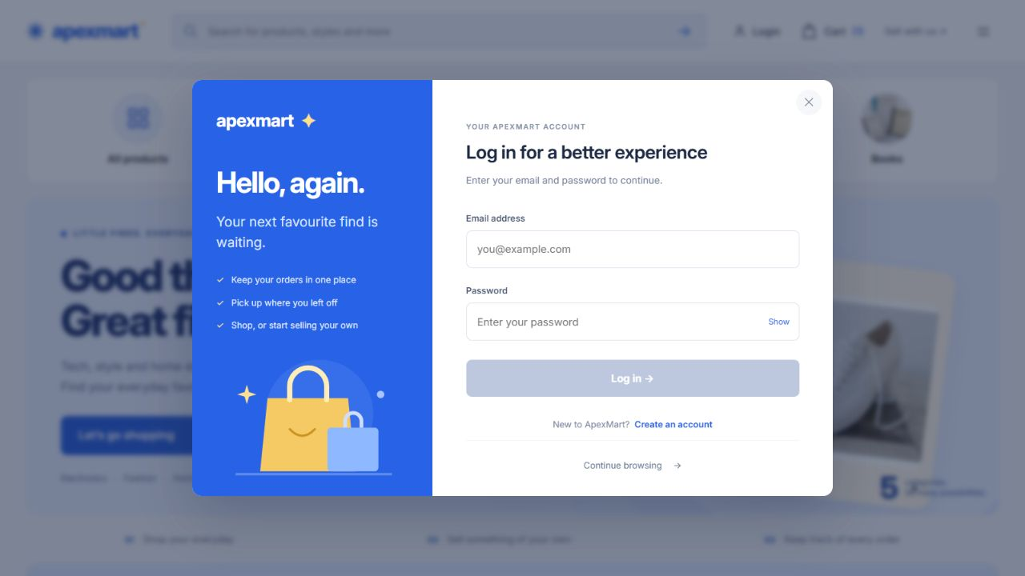
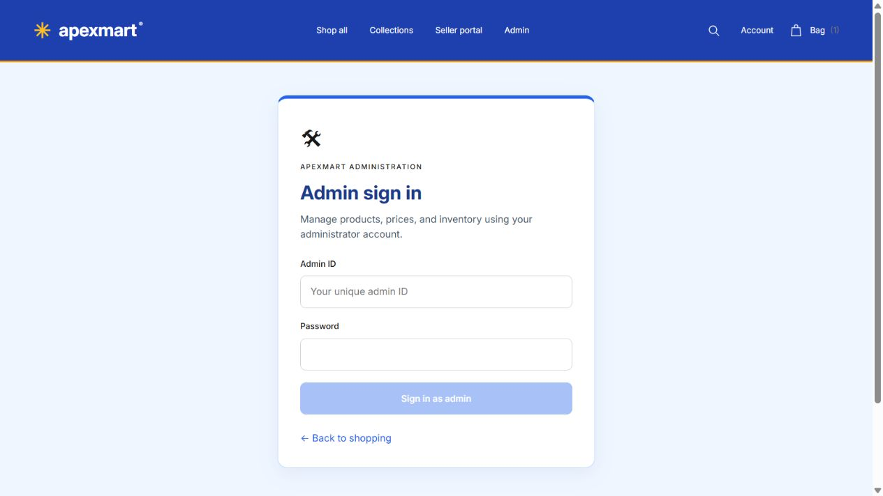
Module 1: Authentication Screens
Customer login
Administrator login
Email and password for customers. A separate admin ID grants access only to an authorised administrator.
Notes:
Sources: saved project captures frontend/__screenshots__/redesign-login.png and admin-login.jpg. Login is email/password rather than phone OTP. /admin is a normal route protected by backend authentication and authorisation.

Slide 8
Module 2: Products & Inventory
Key functionalities
How it works
Browse, search, filter and sort products
Pagination across the full catalogue
Seller and admin product management
Upload JPG/PNG photos to local storage
Generated product codes and stock control
Product Service stores listing details and inventory. Sellers can change only their own products, while admins can manage all listings. The service generates a product code when omitted. Uploaded images stay on disk, with their paths in the database.
Notes:
Sources: docs/api.md and product-service. Product Service listens on port 8082. The sample catalogue has 75 products across five categories. Uploaded images are at most 5 MB. Available stock equals stock on hand minus active reservations.

Slide 9
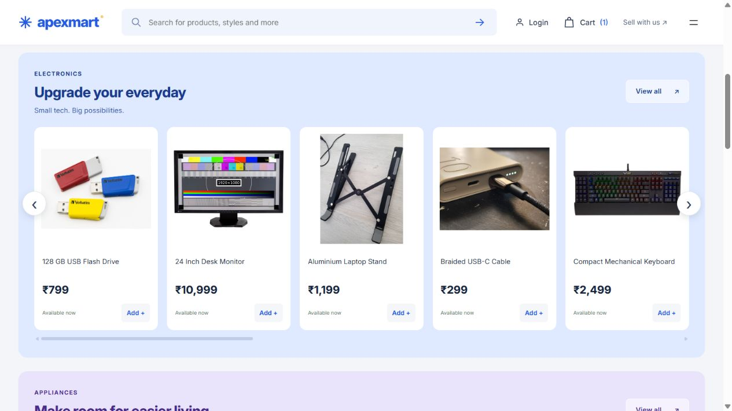
Module 2: Product Catalogue Output
Category collections with product photos, prices and stock availability
Notes:
Source: frontend/__screenshots__/redesign-storefront.png, captured during the October 9 frontend checks. Product photo source and licence credits are in frontend/public/photo-credits.html and scripts/data/photo-sources.json. The catalogue contains representative product photos.

Slide 10
Module 3: Checkout & Order Management
Key functionalities
How it works
Cart and structured delivery address
Cash on delivery or online selection
Stock reservation and confirmation
Retry protection with idempotency keys
Order Service saves a pending order, then asks Product Service to reserve stock. It stores the server-side prices, confirms the stock deduction and marks the order CONFIRMED. Recovery retries interrupted work. Payment choices do not collect money.
Notes:
Sources: docs/architecture.md and docs/api.md. Order Service listens on port 8083. Each service uses its own local database transactions. There is no global transaction across services. Cancellation restores stock once and is unavailable after invoice generation begins. Address line 2 is optional.

Slide 11
Module 3: Recorded Order Output
Confirmed checkout
Recorded API result from the project verification on 5 October 2026
Field | Recorded value
Order status | CONFIRMED
Customer | Demo Customer
Product | Academic Demo Keyboard - Admin Reviewed
Quantity | 2
Unit price | INR 499.50
Order total | INR 999.00
Verification also confirmed that repeated checkout returned the same order and deducted stock only once.
Notes:
Source: docs/verification.json, verifiedAt 2026-10-05T13:30:15.8918644Z. Confirmed order ID: 905ee491-cd92-4973-b4e6-866266a407b1. The table presents the saved real API result, not a new live request. No payment provider was used.

Slide 12
Module 4: SOAP Invoice Generation
Key functionalities
How it works
Generate a bill for a confirmed order
SOAP request and response in XML
WSDL describes service operations
XSD validates message structure
Stable invoice identity on repeated calls
Display and print invoice details
When the user requests a bill, Order Service sends a SOAP XML request to Invoice Service. The invoice contains the customer and item details with the total. Invoice Service stores one invoice per order. Repeated requests return the same invoice.
Notes:
Sources: docs/api.md, order-service/src/main/java/com/ecom/order/InvoiceClient.java and invoice-service. Invoice Service listens on port 8084 at /ws. Its WSDL is /ws/invoices.wsdl. An internal service key protects both. Invoices are generated on request, not automatically during checkout.

Slide 13
Module 4: Recorded Invoice Output
Invoice generated through SOAP
Customer: Demo Customer
Currency: INR Issued: 5 October 2026
Item | Quantity | Unit price | Amount
Academic Demo Keyboard Admin Reviewed | 2 | INR 499.50 | INR 999.00
Total |  |  | INR 999.00
The recorded invoice matches the order total. Repeated generation returned the same invoice.
SOAP endpoint: http://localhost:8084/ws
Notes:
Source: docs/verification.json, verifiedAt 2026-10-05T13:30:15.8918644Z. Invoice number: INV-4562a4a7-5ba1-4620-93b4-d8428ba3fe83. Order ID: 905ee491-cd92-4973-b4e6-866266a407b1. The table is an editable summary of the recorded invoice response. It is not a screenshot of the invoice page. Invoice line quantities and unit prices equal a total of INR 999.00.

Slide 14
Module 5: Gateway & AOP Logging
Key functionalities
How it works
One frontend API address on port 8080
REST calls for inventory coordination
AOP logs operation, duration and outcome
Trace IDs connect related service logs
The gateway routes requests by URL path. Order Service calls Product Service using REST and Invoice Service using SOAP. A shared @Aspect uses @Around advice to time public service methods and record success or failure, without repeating logging code.
Notes:
Sources: api-gateway/src/main/resources/application.yml, common/src/main/java/com/ecom/common/OperationLogging.java and CommonConfiguration.java. The AOP pointcut is execution(public * com.ecom..*Service.*(..)). call.proceed() executes the business method. Timing includes database and HTTP waits. Self-invocation within the same object bypasses a separate proxy interception. Service URLs come from configuration.

Slide 15
Module 5: Service Communication
Component | Port | Responsibility
Angular frontend | 4200 | Shopping and management pages
API Gateway | 8080 | Routes frontend API requests
User Service | 8081 | Accounts, login and roles
Product Service | 8082 | Listings and stock reservations
Order Service | 8083 | Checkout and order history
Invoice Service | 8084 | SOAP invoice generation
Order Service calls Product Service over REST and Invoice Service over SOAP. Each business service owns a database in CockroachDB.
AOP log fields: operation, outcome, durationMs, traceId
Internal service calls carry a separate backend credential.
Notes:
Sources: docs/architecture.md and the application.yml files for the five backend applications. Database names: users_db, products_db, orders_db, invoices_db. All are logical databases within the same CockroachDB cluster. Different ports identify different server processes. Gateway removes client-supplied X-Service-Key. Services use configured URLs, without automatic service discovery.

Slide 16
Future Enhancements
Integrate a payment provider with secure payment confirmation.
Add delivery tracking, returns and refund workflows.
Send order and invoice notifications by email or SMS.
Use a message broker for asynchronous service events.
Add centralised monitoring, circuit breakers and service discovery.
Move uploaded images to managed object storage for deployment.
Notes:
These are proposed enhancements, not features claimed as implemented. Current payment modes only record a selection. Uploads currently use local disk. Current communication uses configured REST and SOAP URLs.

Slide 17
Conclusion
Built a marketplace with customer, seller and administrator workflows.
Implemented REST product and order APIs with validation and access control.
Used stock reservations and retry handling to keep checkout consistent.
Demonstrated SOAP invoicing, AOP logging and separate service databases.
Notes:
Sources: docs/architecture.md, docs/testing.md and docs/verification.json. The academic value is demonstrating the implementation of API and microservice concepts. Production payments, shipping and large-scale deployment remain future work.

Slide 18
THANK YOU...
E-Commerce Product & Order Management System
Notes:
Questions and discussion.

