Slide 1

E-Commerce Product & Order
Management System
ApexMart
API & Microservices Project
Team 1
Roll Number | Name
24B11AI108 | G Ram Prasad
24B11AI452 | V Sri Sai Kishore
24B11AI454 | V Siva Kumar
24B11AI340 | P Karthikeya Kumar
1
Notes:
ApexMart academic project. Team 1. Project sources: C:/Users/kisho/OneDrive/Documents/UsefulStuff/ecom_order/README.md; C:/Users/kisho/OneDrive/Documents/UsefulStuff/ecom_order/docs/architecture.md; C:/Users/kisho/OneDrive/Documents/UsefulStuff/ecom_order/docs/api.md; C:/Users/kisho/OneDrive/Documents/UsefulStuff/ecom_order/docs/requirements.md. Database tables follow the versioned Flyway SQL migrations. University logo supplied in the reference presentation.

Slide 2
Introduction
ApexMart is an ecommerce application for browsing products and managing orders.
Customers place orders, view purchase history and request invoices.
Sellers upload product photos and manage their own listings and stock.
Administrators use a separate portal to monitor customers and orders.
The project demonstrates Java Spring Boot APIs and microservice communication.
2
Notes:
ApexMart academic project. Team 1. Project sources: C:/Users/kisho/OneDrive/Documents/UsefulStuff/ecom_order/README.md; C:/Users/kisho/OneDrive/Documents/UsefulStuff/ecom_order/docs/architecture.md; C:/Users/kisho/OneDrive/Documents/UsefulStuff/ecom_order/docs/api.md; C:/Users/kisho/OneDrive/Documents/UsefulStuff/ecom_order/docs/requirements.md. Database tables follow the versioned Flyway SQL migrations.

Slide 3
Abstract
The application combines an Angular storefront with independent Spring Boot services.
REST APIs support account access, product management and customer orders.
A SOAP service generates an invoice when a customer requests a bill.
CockroachDB stores account, inventory, order and invoice records.
Transactions, validation and recovery logic support reliable checkout.
3
Notes:
ApexMart academic project. Team 1. Project sources: C:/Users/kisho/OneDrive/Documents/UsefulStuff/ecom_order/README.md; C:/Users/kisho/OneDrive/Documents/UsefulStuff/ecom_order/docs/architecture.md; C:/Users/kisho/OneDrive/Documents/UsefulStuff/ecom_order/docs/api.md; C:/Users/kisho/OneDrive/Documents/UsefulStuff/ecom_order/docs/requirements.md. Database tables follow the versioned Flyway SQL migrations.

Slide 4
Problem Statement
Product listings, stock quantities and customer orders need consistent records.
Repeated checkout requests can create duplicate orders without protection.
Stock must remain accurate when several customers order the same product.
Customers need purchase history and bills that retain the original prices.
Sellers and administrators need clear access rules for managing listings.
4
Notes:
ApexMart academic project. Team 1. Project sources: C:/Users/kisho/OneDrive/Documents/UsefulStuff/ecom_order/README.md; C:/Users/kisho/OneDrive/Documents/UsefulStuff/ecom_order/docs/architecture.md; C:/Users/kisho/OneDrive/Documents/UsefulStuff/ecom_order/docs/api.md; C:/Users/kisho/OneDrive/Documents/UsefulStuff/ecom_order/docs/requirements.md. Database tables follow the versioned Flyway SQL migrations.

Slide 5
Existing vs Proposed System
Area | Manual approach | Proposed system
Product records | Separate files or static lists | Searchable catalog with product APIs
Order tracking | Notes and manual updates | Stored orders with clear statuses
Inventory | Manual quantity checks | Stock checks and reservations
Bills | Manually prepared records | SOAP invoice generation
Access control | Shared or informal permissions | Roles and product ownership checks
5
Notes:
ApexMart academic project. Team 1. Project sources: C:/Users/kisho/OneDrive/Documents/UsefulStuff/ecom_order/README.md; C:/Users/kisho/OneDrive/Documents/UsefulStuff/ecom_order/docs/architecture.md; C:/Users/kisho/OneDrive/Documents/UsefulStuff/ecom_order/docs/api.md; C:/Users/kisho/OneDrive/Documents/UsefulStuff/ecom_order/docs/requirements.md. Database tables follow the versioned Flyway SQL migrations. The comparison describes a manual workflow, not the capabilities of commercial marketplaces.

Slide 6
Objectives
Design product and order entities with persistent database records.
Build REST APIs for product and order operations.
Support catalog search, pagination and sorting.
Manage inventory and order placement with transactions and recovery.
Generate order invoices through a SOAP web service.
Apply AOP logging, input validation and consistent exception handling.
6
Notes:
ApexMart academic project. Team 1. Project sources: C:/Users/kisho/OneDrive/Documents/UsefulStuff/ecom_order/README.md; C:/Users/kisho/OneDrive/Documents/UsefulStuff/ecom_order/docs/architecture.md; C:/Users/kisho/OneDrive/Documents/UsefulStuff/ecom_order/docs/api.md; C:/Users/kisho/OneDrive/Documents/UsefulStuff/ecom_order/docs/requirements.md. Database tables follow the versioned Flyway SQL migrations.

Slide 7
Technologies Used
Component | Technology
Frontend | Angular, TypeScript, HTML and CSS
Backend | Java and Spring Boot
Service communication | REST with JSON and SOAP with XML
Database | CockroachDB Cloud, SQL database named ecomm
Data access | Spring Data JPA, Hibernate and PostgreSQL JDBC
Security | Spring Security, JWT and BCrypt
Supporting tools | Flyway, Maven, Postman and Git
7
Notes:
ApexMart academic project. Team 1. Project sources: C:/Users/kisho/OneDrive/Documents/UsefulStuff/ecom_order/README.md; C:/Users/kisho/OneDrive/Documents/UsefulStuff/ecom_order/docs/architecture.md; C:/Users/kisho/OneDrive/Documents/UsefulStuff/ecom_order/docs/api.md; C:/Users/kisho/OneDrive/Documents/UsefulStuff/ecom_order/docs/requirements.md. Database tables follow the versioned Flyway SQL migrations.

Slide 8
System Architecture
Angular Frontend
Port 4200
API Gateway
Port 8080
User Service: 8081
users schema
Product Service: 8082
products schema
REST
Order Service: 8083
orders schema
SOAP
Invoice Service: 8084
invoices schema
CockroachDB Cloud: ecomm database
Each business service manages its own schema
8
Notes:
ApexMart academic project. Team 1. Project sources: C:/Users/kisho/OneDrive/Documents/UsefulStuff/ecom_order/README.md; C:/Users/kisho/OneDrive/Documents/UsefulStuff/ecom_order/docs/architecture.md; C:/Users/kisho/OneDrive/Documents/UsefulStuff/ecom_order/docs/api.md; C:/Users/kisho/OneDrive/Documents/UsefulStuff/ecom_order/docs/requirements.md. Database tables follow the versioned Flyway SQL migrations.

Slide 9
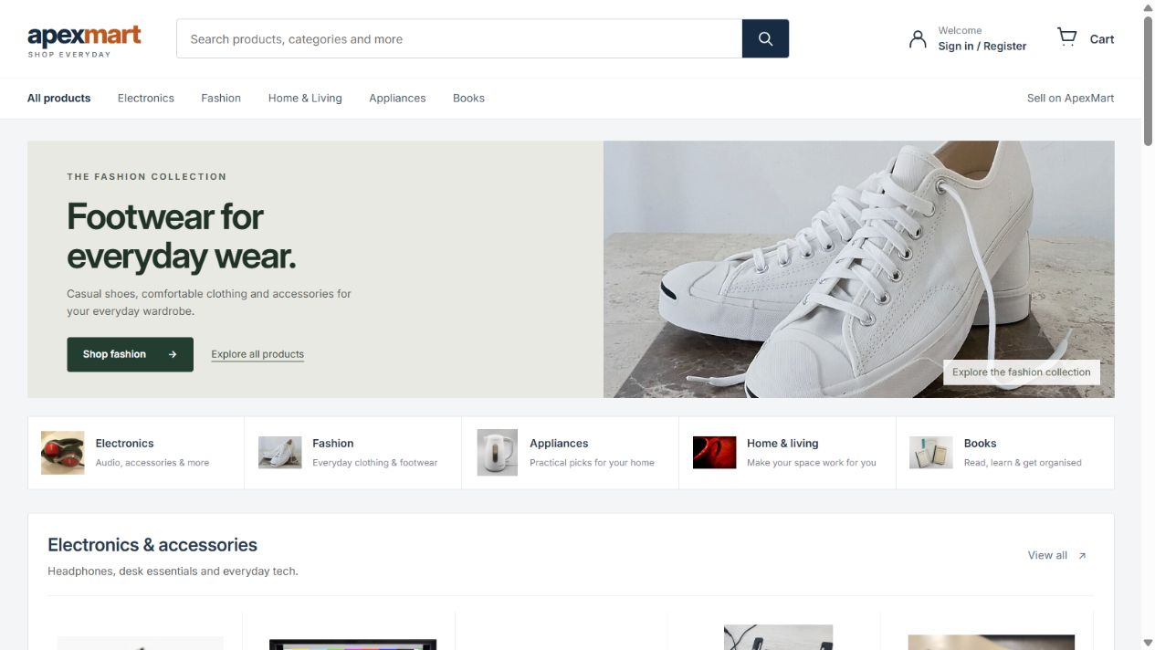
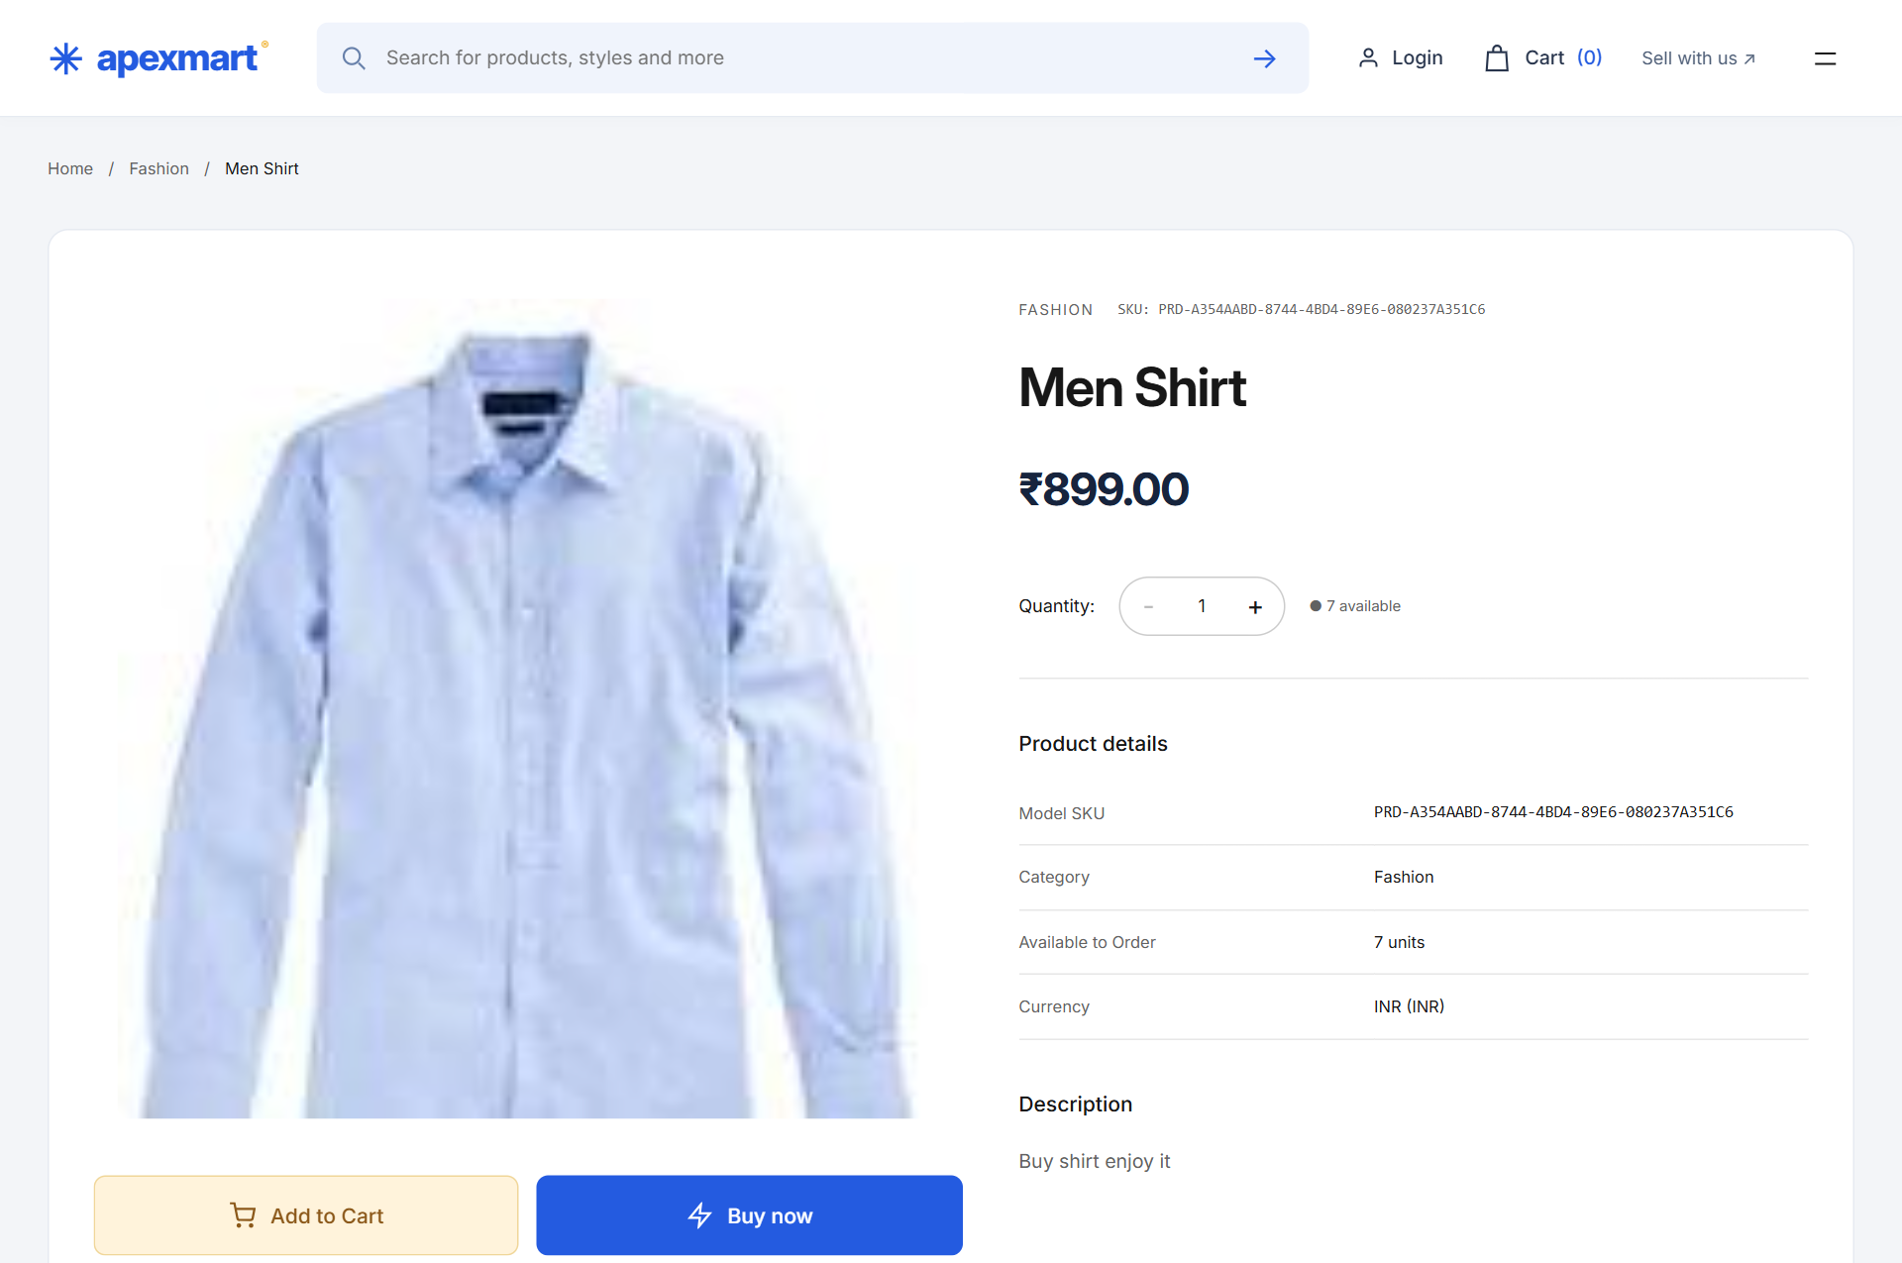
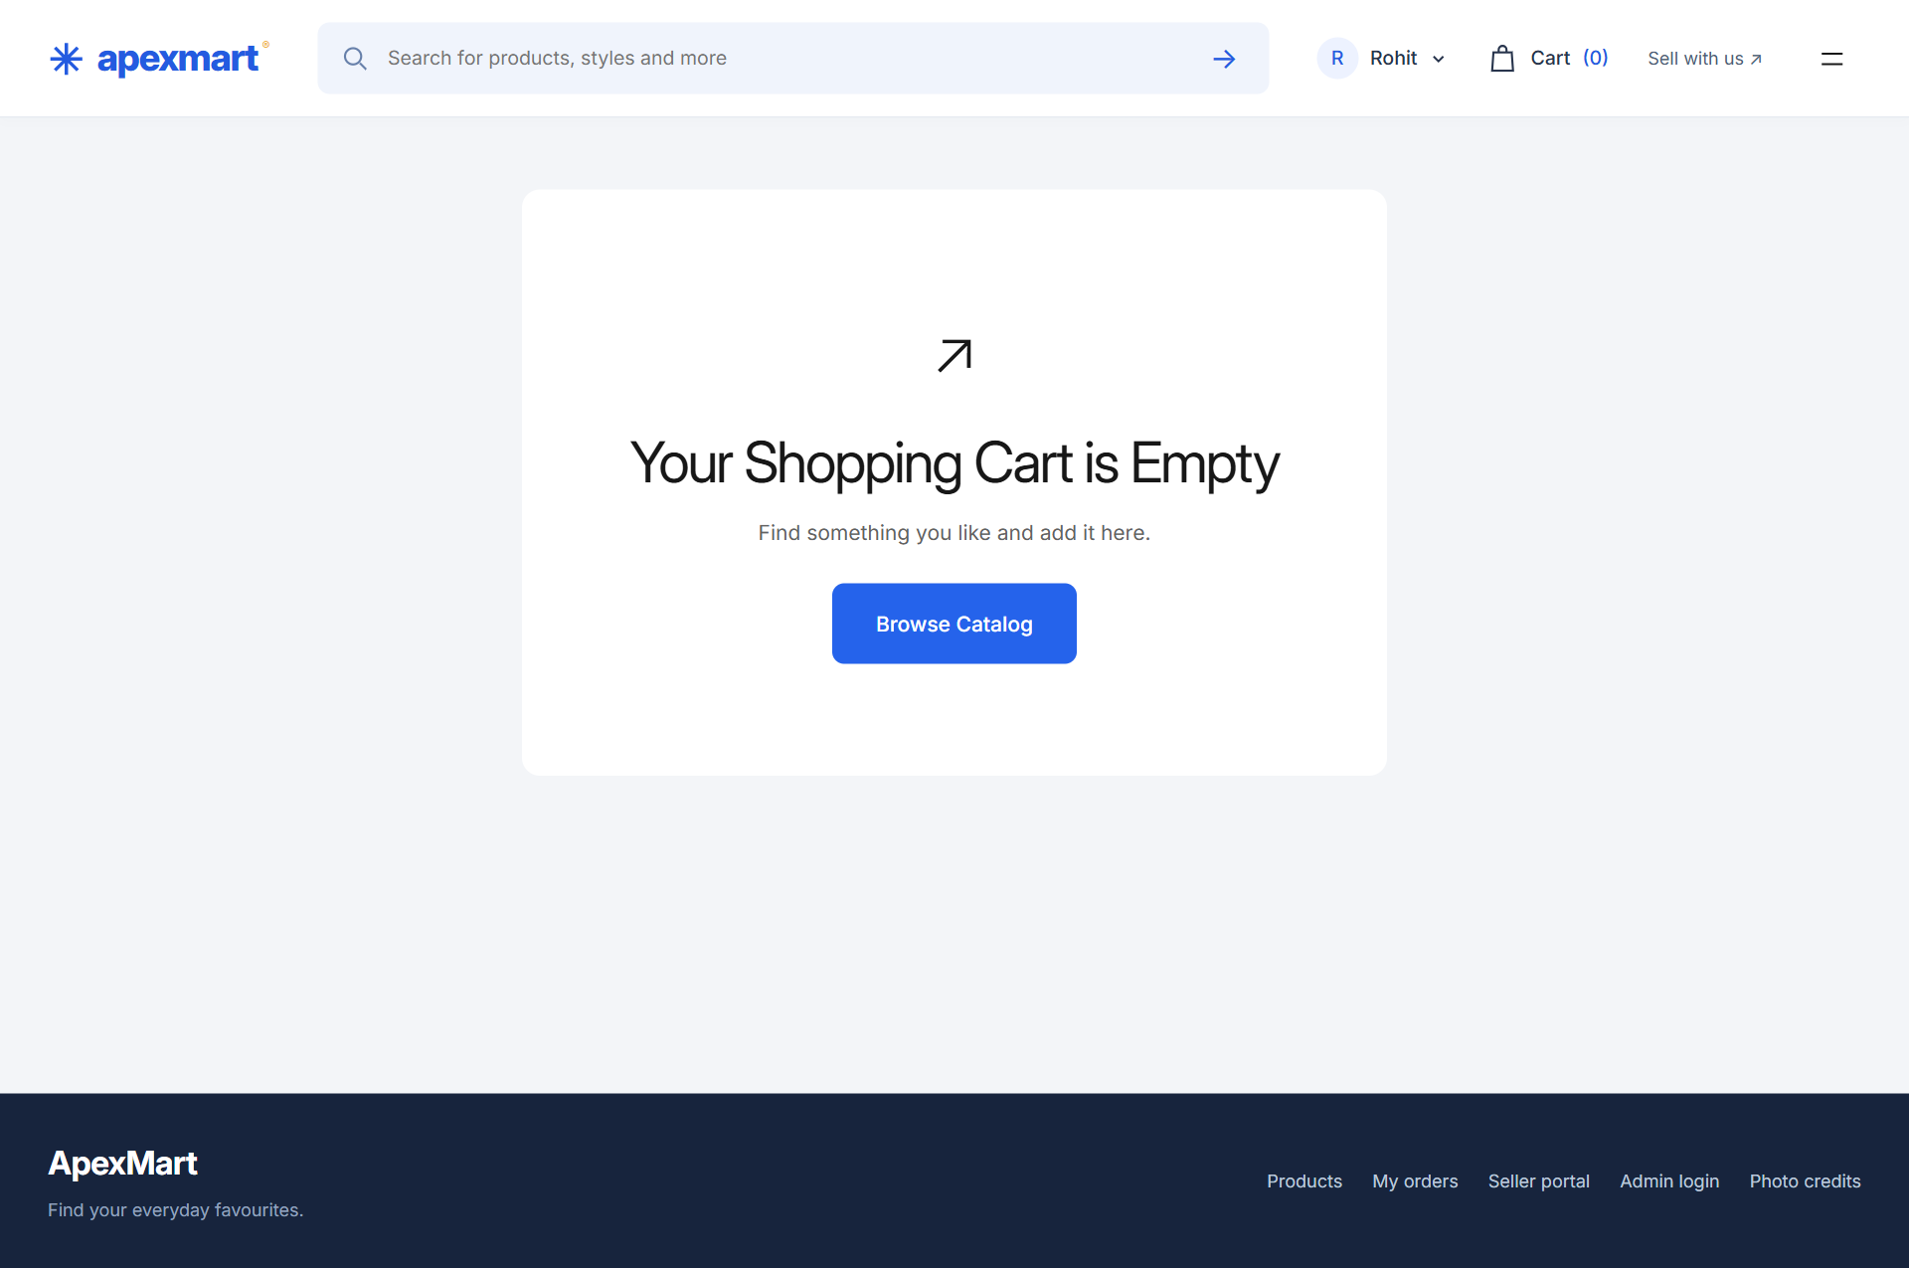
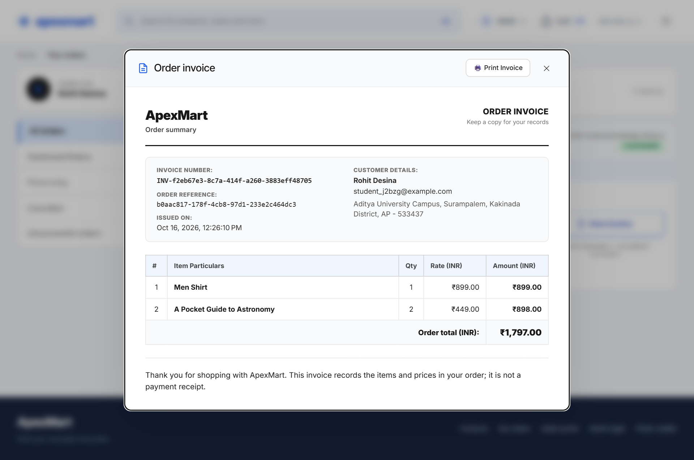
Outputs: Customer Features
Product browsing
Product details
Shopping cart
Order invoice
9
Notes:
ApexMart academic project. Team 1. Project sources: C:/Users/kisho/OneDrive/Documents/UsefulStuff/ecom_order/README.md; C:/Users/kisho/OneDrive/Documents/UsefulStuff/ecom_order/docs/architecture.md; C:/Users/kisho/OneDrive/Documents/UsefulStuff/ecom_order/docs/api.md; C:/Users/kisho/OneDrive/Documents/UsefulStuff/ecom_order/docs/requirements.md. Database tables follow the versioned Flyway SQL migrations. Screenshots from the project files listed in each image description.

Slide 10
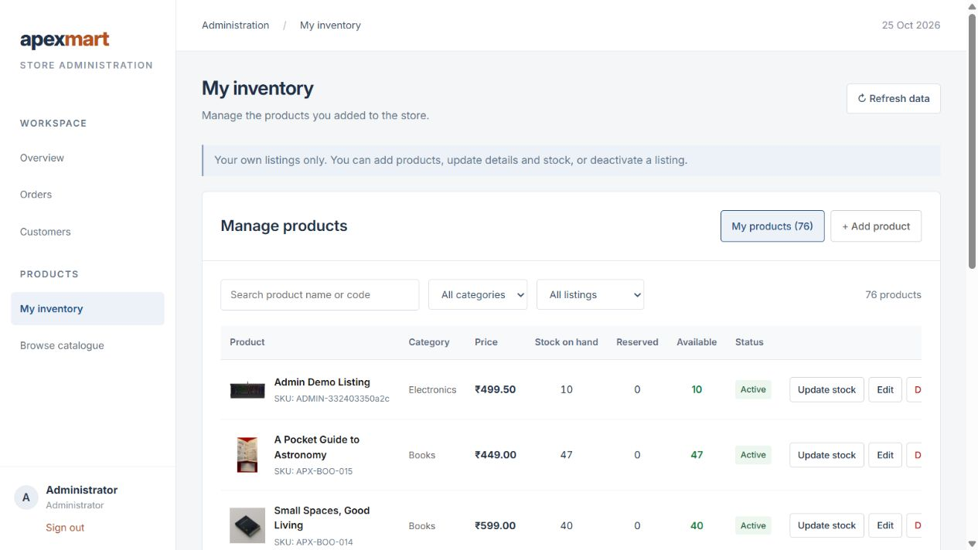
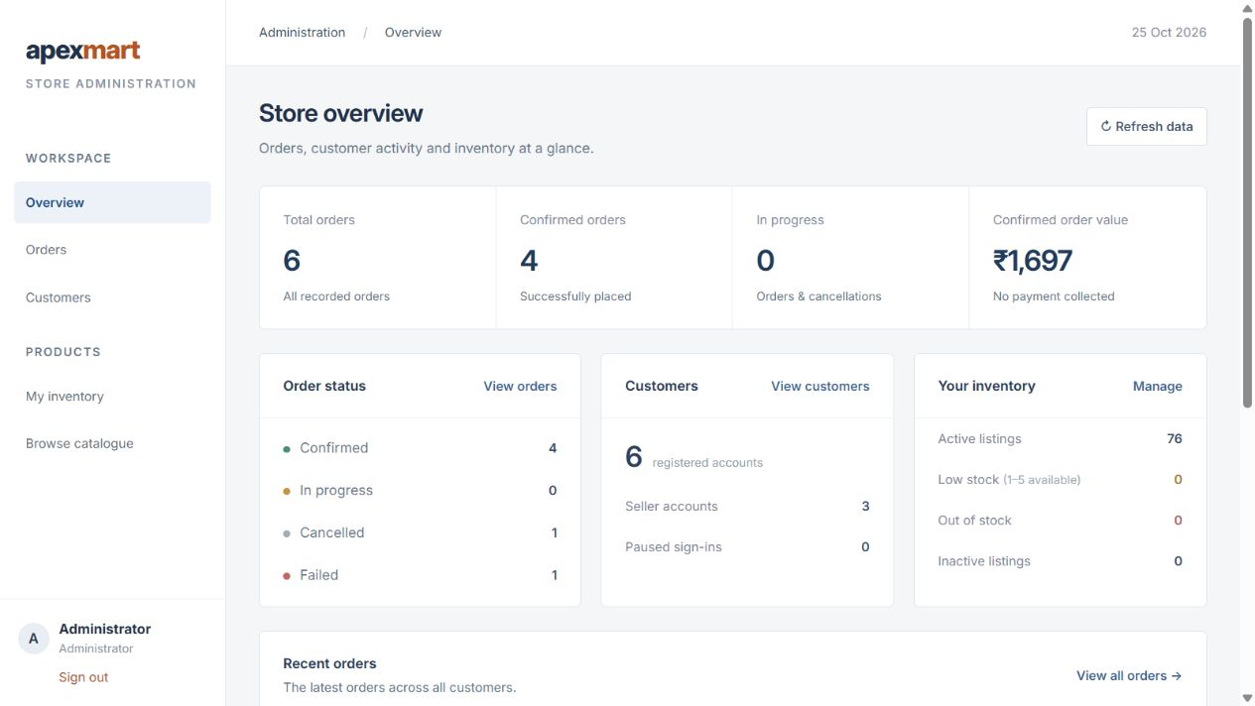
Outputs: Management Features
Product inventory
Administrator dashboard
10
Notes:
Current application screenshots captured on 25 October 2026: administrator own inventory and administrator overview. Inventory ownership checks also apply to sellers. Source files: C:/Users/kisho/OneDrive/Documents/UsefulStuff/ecom_order/.local/presentation-team1/current-screens/admin-inventory.jpg and admin-overview.jpg.

Slide 11
Modules and Database Design
One CockroachDB database: ecomm. Four schemas and ten application tables.
Module / schema | Application tables
User / users | users, user_roles
Product / products | products, stock_reservations, stock_reservation_items
Order / orders | orders, order_items, order_workflows
Invoice / invoices | invoices, invoice_items
Each schema also has a Flyway migration-history table. Services exchange data through APIs.
11
Notes:
ApexMart academic project. Team 1. Project sources: C:/Users/kisho/OneDrive/Documents/UsefulStuff/ecom_order/README.md; C:/Users/kisho/OneDrive/Documents/UsefulStuff/ecom_order/docs/architecture.md; C:/Users/kisho/OneDrive/Documents/UsefulStuff/ecom_order/docs/api.md; C:/Users/kisho/OneDrive/Documents/UsefulStuff/ecom_order/docs/requirements.md. Database tables follow the versioned Flyway SQL migrations. Each schema also has a Flyway migration-history table. Services exchange data through APIs.

Slide 12
Implementation: Services
Application | Port | Responsibility
API Gateway | 8080 | Routes public API requests and handles CORS
User Service | 8081 | Registration, login and account roles
Product Service | 8082 | Product listings, ownership and inventory
Order Service | 8083 | Checkout, order history, recovery and cancellation
Invoice Service | 8084 | SOAP invoice creation and retrieval
Angular runs on port 4200. The common module is a shared library, not a separate service.
12
Notes:
ApexMart academic project. Team 1. Project sources: C:/Users/kisho/OneDrive/Documents/UsefulStuff/ecom_order/README.md; C:/Users/kisho/OneDrive/Documents/UsefulStuff/ecom_order/docs/architecture.md; C:/Users/kisho/OneDrive/Documents/UsefulStuff/ecom_order/docs/api.md; C:/Users/kisho/OneDrive/Documents/UsefulStuff/ecom_order/docs/requirements.md. Database tables follow the versioned Flyway SQL migrations. Angular runs on port 4200. The common module is a shared library, not a separate service.

Slide 13
Implementation: Order Flow
The customer submits products, quantities and delivery details.
Order Service creates a PENDING order and a recovery workflow.
Product Service validates availability and reserves the requested stock.
Order Service saves the product names, prices and total from the reservation.
Product Service confirms inventory and the order becomes CONFIRMED.
The customer can request an invoice through the SOAP service.
An idempotency key prevents duplicate orders. COD and online payment choices are simulated.
13
Notes:
ApexMart academic project. Team 1. Project sources: C:/Users/kisho/OneDrive/Documents/UsefulStuff/ecom_order/README.md; C:/Users/kisho/OneDrive/Documents/UsefulStuff/ecom_order/docs/architecture.md; C:/Users/kisho/OneDrive/Documents/UsefulStuff/ecom_order/docs/api.md; C:/Users/kisho/OneDrive/Documents/UsefulStuff/ecom_order/docs/requirements.md. Database tables follow the versioned Flyway SQL migrations. An idempotency key prevents duplicate orders. COD and online payment choices are simulated.

Slide 14
Implementation: REST APIs
Method | Endpoint | Purpose
POST | /api/auth/register | Customer registration
POST | /api/auth/login | Customer and seller sign-in
POST | /api/auth/admin/login | Dedicated admin sign-in
GET | /api/products | Catalog search, pagination and sorting
POST | /api/seller/products | Create a product listing
POST | /api/orders | Place or retry an order
GET | /api/orders | View the buyer's order history
POST | /api/orders/{id}/invoice | Request an invoice through SOAP
14
Notes:
ApexMart academic project. Team 1. Project sources: C:/Users/kisho/OneDrive/Documents/UsefulStuff/ecom_order/README.md; C:/Users/kisho/OneDrive/Documents/UsefulStuff/ecom_order/docs/architecture.md; C:/Users/kisho/OneDrive/Documents/UsefulStuff/ecom_order/docs/api.md; C:/Users/kisho/OneDrive/Documents/UsefulStuff/ecom_order/docs/requirements.md. Database tables follow the versioned Flyway SQL migrations.

Slide 15
Security, Validation and Logging
JWT authentication controls access to protected backend operations.
BCrypt hashes protect stored account passwords.
Administrators have a separate portal and do not use customer checkout.
Sellers and administrators can edit only the products they own.
Validation checks email, delivery details, quantities and stock. Errors use consistent responses.
AOP logging records service operations, outcomes, execution time and trace IDs.
15
Notes:
ApexMart academic project. Team 1. Project sources: C:/Users/kisho/OneDrive/Documents/UsefulStuff/ecom_order/README.md; C:/Users/kisho/OneDrive/Documents/UsefulStuff/ecom_order/docs/architecture.md; C:/Users/kisho/OneDrive/Documents/UsefulStuff/ecom_order/docs/api.md; C:/Users/kisho/OneDrive/Documents/UsefulStuff/ecom_order/docs/requirements.md. Database tables follow the versioned Flyway SQL migrations.

Slide 16
Future Scope
Connect a payment provider for actual online payments.
Add shipment tracking and customer notifications.
Store uploaded product images in cloud object storage.
Add reviews, ratings and a customer wishlist.
Use a separate SQL login with restricted grants for each service schema.
Expand performance testing for larger catalogs and concurrent orders.
16
Notes:
ApexMart academic project. Team 1. Project sources: C:/Users/kisho/OneDrive/Documents/UsefulStuff/ecom_order/README.md; C:/Users/kisho/OneDrive/Documents/UsefulStuff/ecom_order/docs/architecture.md; C:/Users/kisho/OneDrive/Documents/UsefulStuff/ecom_order/docs/api.md; C:/Users/kisho/OneDrive/Documents/UsefulStuff/ecom_order/docs/requirements.md. Database tables follow the versioned Flyway SQL migrations.

Slide 17
Conclusion
ApexMart supports product browsing, seller listings and customer order management.
Four business services and an API Gateway separate backend responsibilities.
REST APIs, SOAP invoicing and AOP logging demonstrate the course concepts.
CockroachDB schemas organize accounts, inventory, orders and invoices.
The sample catalog contains 75 products across five categories.
Transactions, validation and recovery protect the order workflow.
17
Notes:
ApexMart academic project. Team 1. Project sources: C:/Users/kisho/OneDrive/Documents/UsefulStuff/ecom_order/README.md; C:/Users/kisho/OneDrive/Documents/UsefulStuff/ecom_order/docs/architecture.md; C:/Users/kisho/OneDrive/Documents/UsefulStuff/ecom_order/docs/api.md; C:/Users/kisho/OneDrive/Documents/UsefulStuff/ecom_order/docs/requirements.md. Database tables follow the versioned Flyway SQL migrations.

Slide 18
Thank You
Team 1
ApexMart
API & Microservices
18
Notes:
ApexMart academic project. Team 1. Project sources: C:/Users/kisho/OneDrive/Documents/UsefulStuff/ecom_order/README.md; C:/Users/kisho/OneDrive/Documents/UsefulStuff/ecom_order/docs/architecture.md; C:/Users/kisho/OneDrive/Documents/UsefulStuff/ecom_order/docs/api.md; C:/Users/kisho/OneDrive/Documents/UsefulStuff/ecom_order/docs/requirements.md. Database tables follow the versioned Flyway SQL migrations.

