Slide 1




API & Microservices Project
E-Commerce Product & Order System
ApexMart: a Spring Boot microservices project for product and order management with SOAP invoicing
Submitted by
Team Number
G Ram Prasad - 24B11AI108
V Sri Sai Kishore - 24B11AI452
V Siva Kumar - 24B11AI454
P Karthikeya Kumar - 24B11AI340
1
API & Microservices
Department of AI & ML
Aditya University, Surampalem, Andhra Pradesh
Notes:
ApexMart, Team 1. Academic E-Commerce Product and Order Management System. Project sources: README.md, docs/architecture.md, docs/api.md and the Flyway migrations. Four business services plus API Gateway. One CockroachDB database ecomm with four service schemas. Payment choices are simulated. The university logo and slide design come from the user-supplied Campus Food Preorder presentation.

Slide 2
Introduction
ApexMart is an ecommerce application for product browsing, customer orders and invoice generation.
A reliable checkout must keep product prices, reserved stock and order records consistent.
Customers, sellers and administrators have separate responsibilities and access rules.
Customers browse the catalog and place orders. Sellers manage their own listings and stock. Administrators monitor customers and orders through a separate portal.
The Angular frontend connects to Java Spring Boot microservices through an API Gateway, using REST APIs and SOAP invoicing.
Manual workflow
1
Separate product lists
2
Record each order
3
Update stock by hand
With our system
1
Browse products
2
Place order online
3
View order and bill
Notes:
ApexMart, Team 1. Academic E-Commerce Product and Order Management System. Project sources: README.md, docs/architecture.md, docs/api.md and the Flyway migrations. Four business services plus API Gateway. One CockroachDB database ecomm with four service schemas. Payment choices are simulated. The university logo and slide design come from the user-supplied Campus Food Preorder presentation.

Slide 3
Abstract
An ecommerce application needs consistent records for products, stock, customers and orders. Duplicate checkout requests, changing prices and interrupted service calls can otherwise lead to incorrect inventory or purchase history.
ApexMart is an E-Commerce Product and Order Management System built with an Angular frontend and Java Spring Boot microservices. Customers browse products, place orders and request invoices. Product Service reserves and confirms inventory, while Order Service records purchase details and recovers interrupted operations. Invoice Service generates bills through SOAP.
CockroachDB Cloud stores the data in one database named ecomm with four service schemas. JWT authentication, product ownership checks, input validation and AOP logging support controlled access and traceable operations. The project demonstrates the API and Microservices course requirements.
Keywords:
Microservices
Spring Boot
REST API
API Gateway
SOAP
JWT
AOP
Notes:
ApexMart, Team 1. Academic E-Commerce Product and Order Management System. Project sources: README.md, docs/architecture.md, docs/api.md and the Flyway migrations. Four business services plus API Gateway. One CockroachDB database ecomm with four service schemas. Payment choices are simulated. The university logo and slide design come from the user-supplied Campus Food Preorder presentation.

Slide 4
Problem Statement
An ecommerce backend must keep inventory, orders and purchase history consistent while enforcing user permissions.
1
2
3
Stock conflicts
Duplicate orders
Changing prices
Concurrent purchases must not sell more units than the available stock.
Repeated checkout submissions need protection against duplicate purchases.
Old orders must retain the product name and price at the time of purchase.
4
5
6
Product ownership
Order interruptions
Scattered records
Sellers and administrators should manage only the products they own.
Temporary service or network failures need persistent recovery steps.
Customers need order history and bills, while admins need order summaries.
Notes:
ApexMart, Team 1. Academic E-Commerce Product and Order Management System. Project sources: README.md, docs/architecture.md, docs/api.md and the Flyway migrations. Four business services plus API Gateway. One CockroachDB database ecomm with four service schemas. Payment choices are simulated. The university logo and slide design come from the user-supplied Campus Food Preorder presentation.

Slide 5
Existing vs Proposed System
Manual / Basic System
Proposed System
✗
Orders recorded separately
✓
Orders placed through a website
✗
Product details in static lists
✓
Persistent product and order records
✗
Inventory updated manually
✓
Stock reservations and safe retries
✗
Informal access permissions
✓
Roles and product ownership checks
✗
Bills prepared separately
✓
SOAP invoice generation
✗
Limited order summaries
✓
Admin customer and order reports
Notes:
ApexMart, Team 1. Academic E-Commerce Product and Order Management System. Project sources: README.md, docs/architecture.md, docs/api.md and the Flyway migrations. Four business services plus API Gateway. One CockroachDB database ecomm with four service schemas. Payment choices are simulated. The university logo and slide design come from the user-supplied Campus Food Preorder presentation.

Slide 6
Objectives
1
Design product and order entities with persistent account and inventory records.
2
Provide REST APIs with product search, pagination and sorting.
3
Manage inventory and order placement with transactions, retries and recovery.
4
Generate an order invoice through a SOAP web service when requested.
5
Separate customer, seller and admin access with product ownership checks.
6
Apply AOP logging, input validation and consistent exception handling.
Notes:
ApexMart, Team 1. Academic E-Commerce Product and Order Management System. Project sources: README.md, docs/architecture.md, docs/api.md and the Flyway migrations. Four business services plus API Gateway. One CockroachDB database ecomm with four service schemas. Payment choices are simulated. The university logo and slide design come from the user-supplied Campus Food Preorder presentation.

Slide 7
Technologies Used
Backend
Microservices
Security
Java 21
Spring Boot 3.5
Spring Web
REST and SOAP services
Spring Cloud Gateway
Four business services
REST service clients
Persistent order recovery
Spring Security
JWT tokens
Role-based access
BCrypt hashing
Database
Frontend
Tools
CockroachDB Cloud
Spring Data JPA
Hibernate
Four service schemas
Angular
TypeScript
HTML and CSS
Angular Router
Flyway migrations
Postman
Maven
Git and GitHub
Notes:
ApexMart, Team 1. Academic E-Commerce Product and Order Management System. Project sources: README.md, docs/architecture.md, docs/api.md and the Flyway migrations. Four business services plus API Gateway. One CockroachDB database ecomm with four service schemas. Payment choices are simulated. The university logo and slide design come from the user-supplied Campus Food Preorder presentation.

Slide 8
System Architecture
Customer Portal
Angular
Seller Portal
Angular
Admin Portal
Angular /admin
API Gateway (Spring Cloud Gateway, port 8080)
Single entry point for routing and CORS
Invoice Service
:8084
SOAP bills in the invoices schema of ecomm
User Service
port 8081
Login, JWT and roles
Product Service
port 8082
Listings and stock
Order Service
port 8083
Checkout and recovery
users
schema
products
schema
orders
schema
Flow: Angular calls the API Gateway. Order Service uses Product REST APIs and Invoice SOAP APIs. CockroachDB uses one ecomm database with four service schemas.
Notes:
ApexMart, Team 1. Academic E-Commerce Product and Order Management System. Project sources: README.md, docs/architecture.md, docs/api.md and the Flyway migrations. Four business services plus API Gateway. One CockroachDB database ecomm with four service schemas. Payment choices are simulated. The university logo and slide design come from the user-supplied Campus Food Preorder presentation.

Slide 9
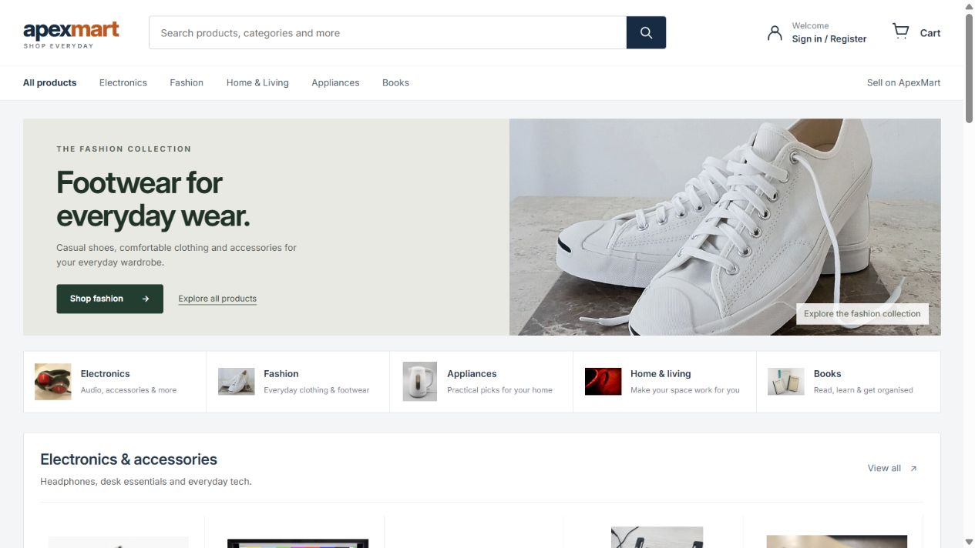
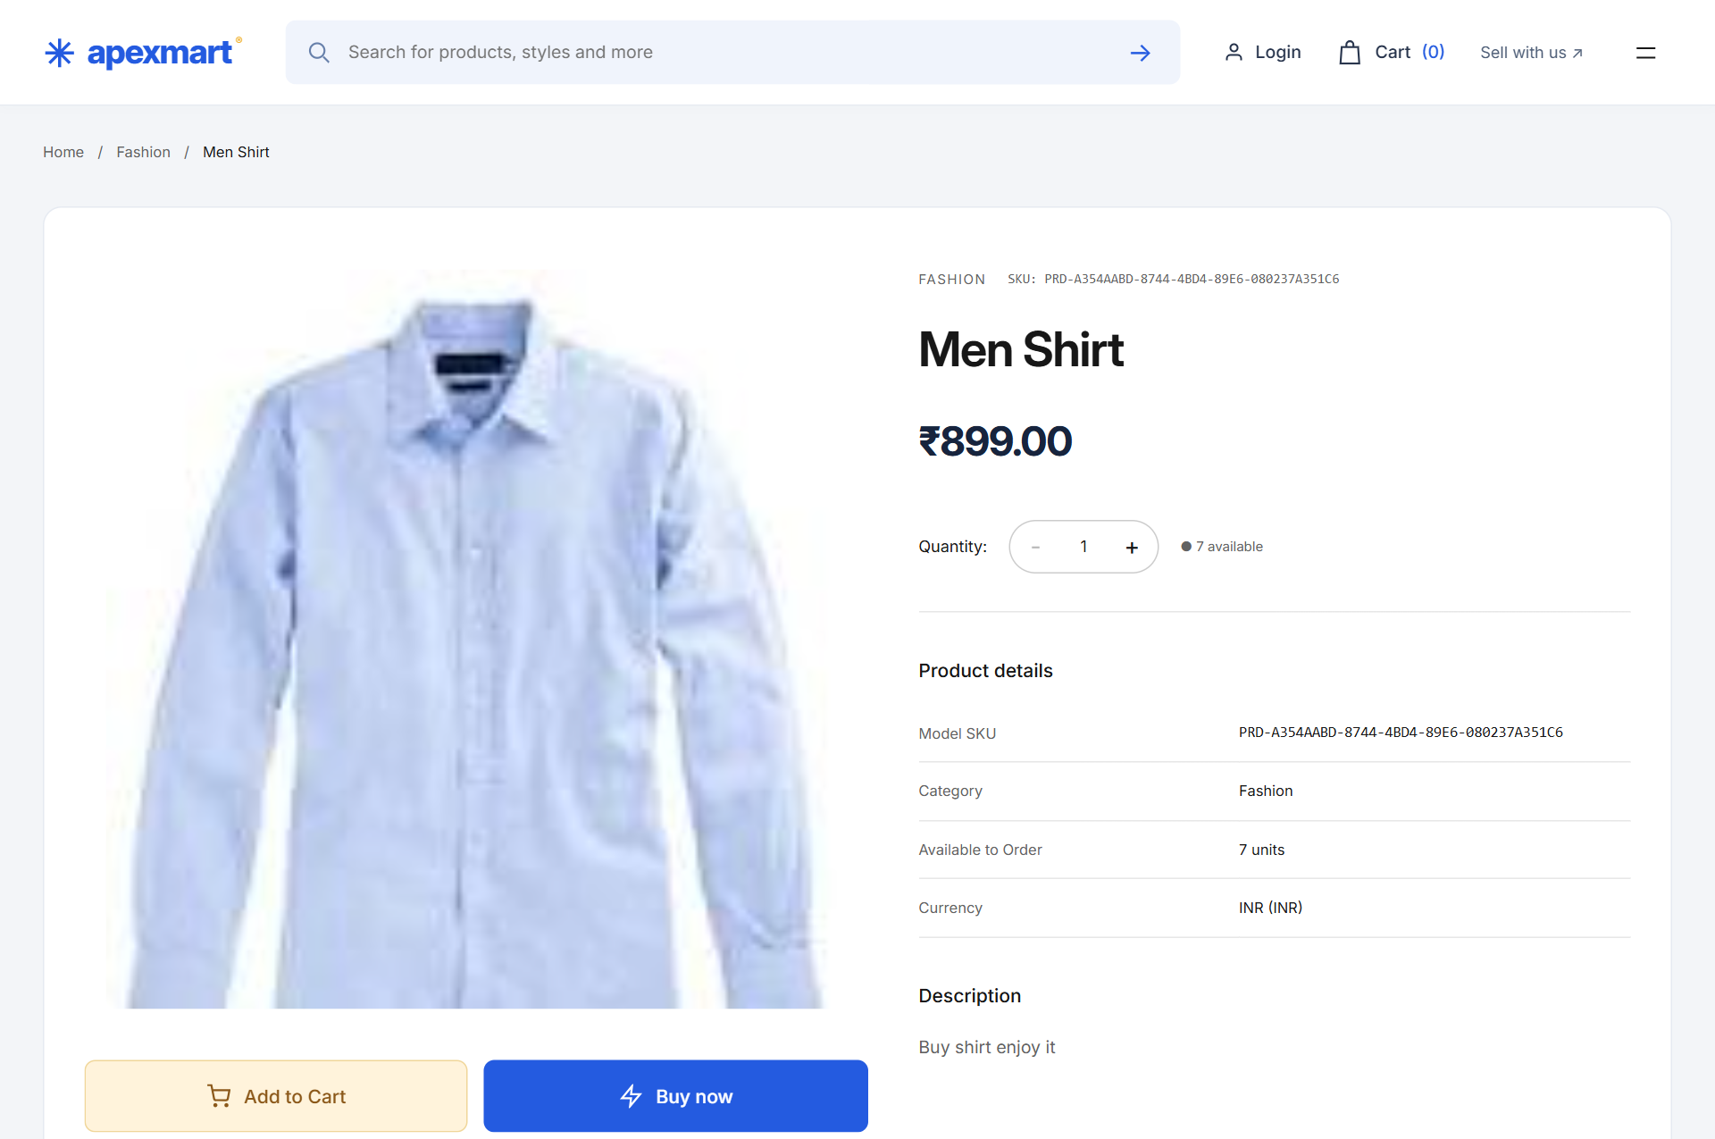
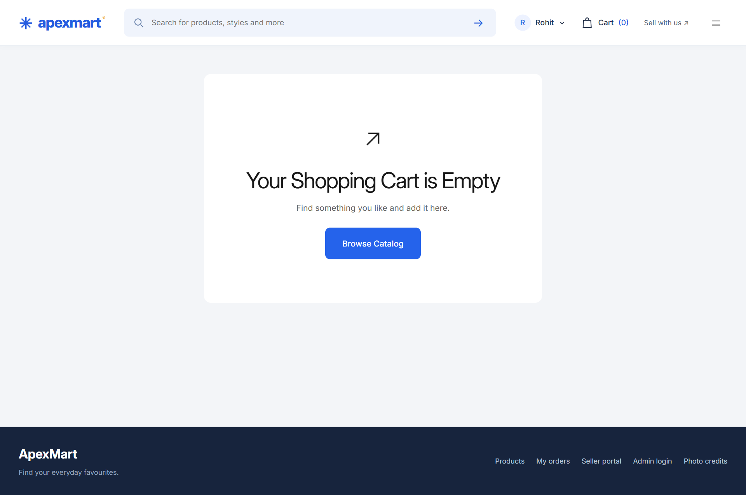
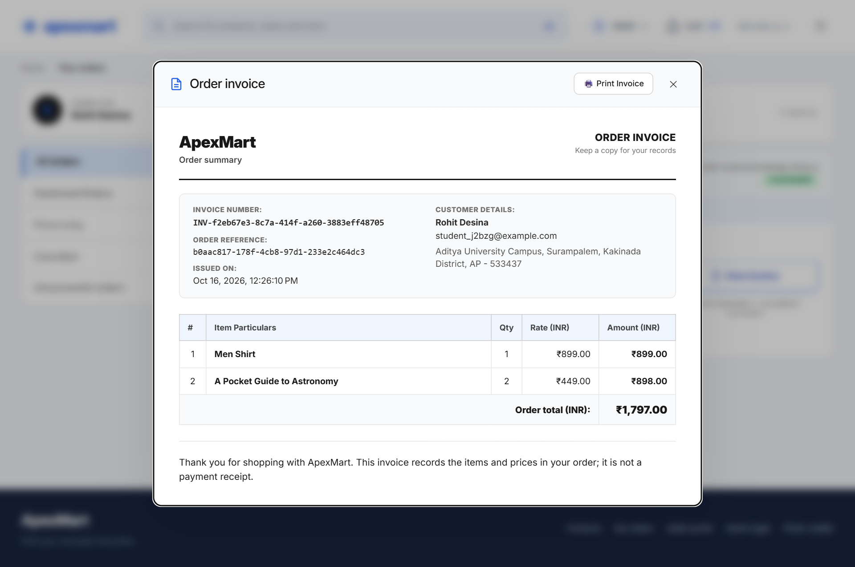
OUTPUTS
OUTPUTS
OUTPUTS
Fig1 Product catalog
Fig2 Product details
Fig3 Shopping cart
Fig4 Order invoice
Notes:
ApexMart, Team 1. Academic E-Commerce Product and Order Management System. Project sources: README.md, docs/architecture.md, docs/api.md and the Flyway migrations. Four business services plus API Gateway. One CockroachDB database ecomm with four service schemas. Payment choices are simulated. The university logo and slide design come from the user-supplied Campus Food Preorder presentation.

Slide 10
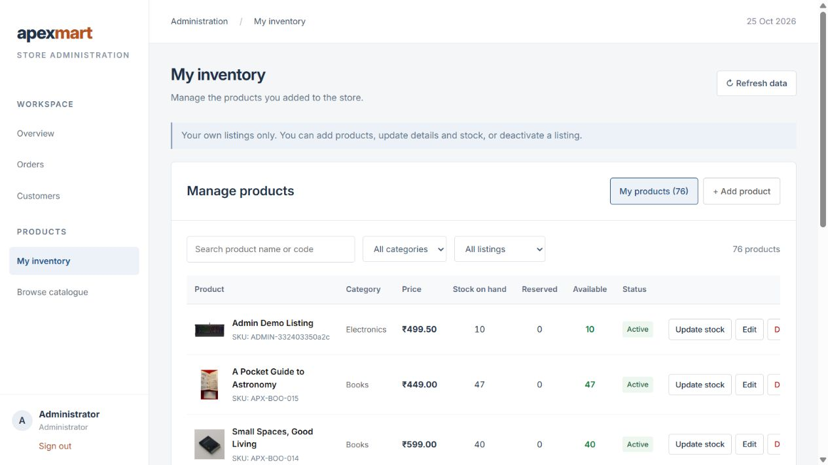
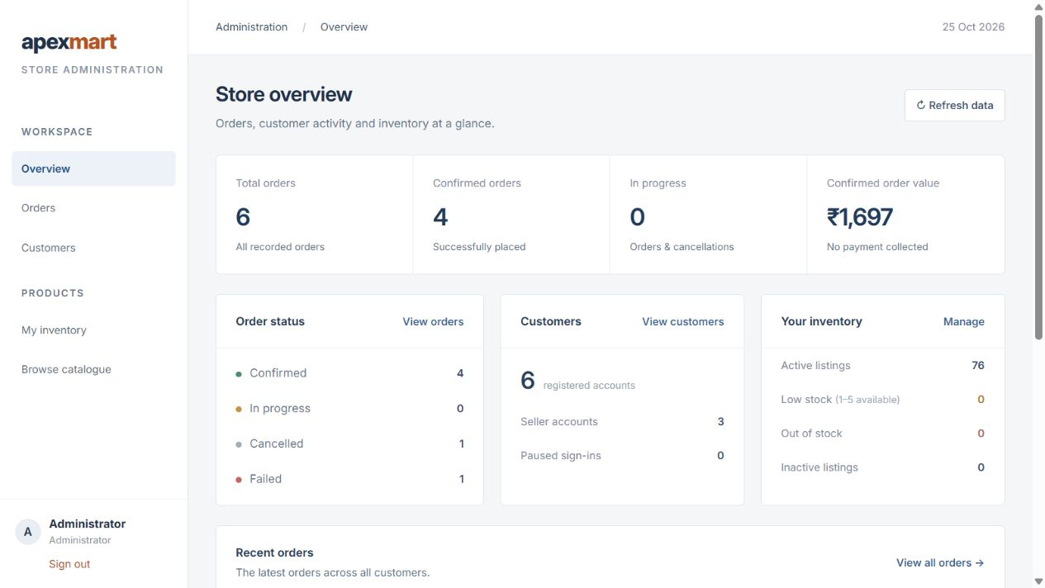
OUTPUTS
OUTPUTS
OUTPUTS
Fig5 Product inventory
Fig6 Admin dashboard
Notes:
ApexMart, Team 1. Academic E-Commerce Product and Order Management System. Project sources: README.md, docs/architecture.md, docs/api.md and the Flyway migrations. Four business services plus API Gateway. One CockroachDB database ecomm with four service schemas. Payment choices are simulated. The university logo and slide design come from the user-supplied Campus Food Preorder presentation.

Slide 11
Modules
C
S
A
Customer
Seller
Administrator
Register and sign in
Browse product categories
Search and sort products
Add products to the cart
Place orders with an address
View order history
Request an order invoice
Enable selling on an account
Create own product listings
Upload local product photos
Edit product descriptions
Set prices and stock
Pause or restore listings
Manage only owned products
Use a separate admin login
View order summaries
Search customers by name or email
View customer order counts
Pause customer sign-in
Manage only owned products
Keep admin access separate from shopping
Notes:
ApexMart, Team 1. Academic E-Commerce Product and Order Management System. Project sources: README.md, docs/architecture.md, docs/api.md and the Flyway migrations. Four business services plus API Gateway. One CockroachDB database ecomm with four service schemas. Payment choices are simulated. The university logo and slide design come from the user-supplied Campus Food Preorder presentation.

Slide 12
Implementation – Services
Each Spring Boot application runs independently on its own port. Four business services own the application data:
Microservice | Port | Responsibility | Schema
API Gateway | 8080 | Public routing and Angular CORS | -
User Service | 8081 | Accounts, JWT and customer / seller / admin roles | users
Product Service | 8082 | Product listings, ownership and inventory | products
Order Service | 8083 | Checkout, history, cancellation and recovery | orders
Invoice Service | 8084 | SOAP invoice creation and retrieval | invoices
Database: ecomm in CockroachDB, with users, products, orders and invoices schemas.
Frontend: Angular on port 4200 calls the API Gateway. Services use REST and SOAP.
Data and operations: Spring Data JPA, Flyway migrations, AOP logging and order recovery.
Notes:
ApexMart, Team 1. Academic E-Commerce Product and Order Management System. Project sources: README.md, docs/architecture.md, docs/api.md and the Flyway migrations. Four business services plus API Gateway. One CockroachDB database ecomm with four service schemas. Payment choices are simulated. The university logo and slide design come from the user-supplied Campus Food Preorder presentation.

Slide 13
Implementation – Order Flow
1
Customer
2
Customer
3
Customer
4
Orders
Signs in and browses the product catalog
Adds products and quantities to the cart
Enters delivery details and submits checkout
Creates a PENDING order and recovery workflow
5
Products
6
Orders
7
Products
8
Invoices
Checks availability and reserves the requested stock
Saves the product names, prices and order total
Confirms stock and completes order confirmation
Generates a SOAP invoice when the customer requests it
An idempotency key prevents duplicate orders. COD and online payment choices are simulated. No payment is collected.
Notes:
ApexMart, Team 1. Academic E-Commerce Product and Order Management System. Project sources: README.md, docs/architecture.md, docs/api.md and the Flyway migrations. Four business services plus API Gateway. One CockroachDB database ecomm with four service schemas. Payment choices are simulated. The university logo and slide design come from the user-supplied Campus Food Preorder presentation.

Slide 14
Implementation – REST APIs
Method | Endpoint | Access | Purpose
POST | /api/auth/register | Public | Customer registration
POST | /api/auth/login | Public | Sign in and receive JWT
GET | /api/products | Public | Search, pagination and sorting
POST | /api/auth/admin/login | Public | Dedicated admin sign-in
POST | /api/orders | Customer | Place or retry an order
GET | /api/orders | Customer | Own order history
POST | /api/seller/products | Seller/Admin | Create an owned listing
PATCH | /api/seller/products/{id}/stock | Owner | Update product stock
GET | /api/admin/users | Admin | Search customer accounts
POST | /api/orders/{id}/invoice | Customer | Request a SOAP invoice
GET | /api/admin/orders | Admin | Order overview and reports
Notes:
ApexMart, Team 1. Academic E-Commerce Product and Order Management System. Project sources: README.md, docs/architecture.md, docs/api.md and the Flyway migrations. Four business services plus API Gateway. One CockroachDB database ecomm with four service schemas. Payment choices are simulated. The university logo and slide design come from the user-supplied Campus Food Preorder presentation.

Slide 15
Security & Access Control
1
Role-based access
2
Product ownership
Business services validate JWTs and enforce customer, seller and administrator roles.
Sellers and administrators can change only the products they own.
3
Separate admin portal
4
Password protection
Admins sign in through /admin. Admin accounts do not use customer checkout.
BCrypt hashes protect stored passwords. Registration validates email and password length.
5
Input validation
6
AOP logging
The backend checks addresses, quantities and stock, and returns consistent errors.
Service logs record operation, outcome, execution time and trace ID without request contents.
Notes:
ApexMart, Team 1. Academic E-Commerce Product and Order Management System. Project sources: README.md, docs/architecture.md, docs/api.md and the Flyway migrations. Four business services plus API Gateway. One CockroachDB database ecomm with four service schemas. Payment choices are simulated. The university logo and slide design come from the user-supplied Campus Food Preorder presentation.

Slide 16
Future Scope
1
2
3
Online payments
Order notifications
Mobile app
Connect a payment provider for actual online payments.
Notify customers about order and delivery updates.
Build Android and iOS apps using the existing APIs.
4
5
6
Shipment tracking
Ratings and reviews
Production deployment
Add delivery tracking and expected arrival details.
Let customers review products after purchase.
Add cloud image storage and separate SQL credentials per service.
Notes:
ApexMart, Team 1. Academic E-Commerce Product and Order Management System. Project sources: README.md, docs/architecture.md, docs/api.md and the Flyway migrations. Four business services plus API Gateway. One CockroachDB database ecomm with four service schemas. Payment choices are simulated. The university logo and slide design come from the user-supplied Campus Food Preorder presentation.

Slide 17
Conclusion
3
4
4
user roles
business services
database schemas
ApexMart supports product browsing, seller listings, customer orders and invoice generation.
Transactions, stock reservations and persistent recovery protect the checkout workflow.
Sellers and administrators manage their own products, while the admin portal provides customer and order summaries.
Angular, Spring Boot, REST APIs, SOAP invoicing, AOP logging and CockroachDB demonstrate the course concepts in a working academic project.
Notes:
ApexMart, Team 1. Academic E-Commerce Product and Order Management System. Project sources: README.md, docs/architecture.md, docs/api.md and the Flyway migrations. Four business services plus API Gateway. One CockroachDB database ecomm with four service schemas. Payment choices are simulated. The university logo and slide design come from the user-supplied Campus Food Preorder presentation.

Slide 18
Thank You
Thank You!
Questions?
ApexMart: E-Commerce Product and Order Management
API & Microservices · Team 1 · Aditya University, Surampalem
Notes:
ApexMart, Team 1. Academic E-Commerce Product and Order Management System. Project sources: README.md, docs/architecture.md, docs/api.md and the Flyway migrations. Four business services plus API Gateway. One CockroachDB database ecomm with four service schemas. Payment choices are simulated. The university logo and slide design come from the user-supplied Campus Food Preorder presentation.

