Slide 1
CAPSTONE PROJECT
SAUCEDEMO AUTOMATION TESTING PROJECT
Submitted By : Uppala Venkata Kishore

Slide 2
Content :
Overview
Features
Pre – Requisites
Work flow
Modules implemented
Test Execution & reports
Future Enhancements
Jenkins & Git Implementation
Dependencies
Outcome
Test Cases Screenshots
Jenkins – Outcome
Conclusion
References & links

Slide 3
Project Overview :
This project automates the functionality of the SauceDemo.com website using Java, Selenium WebDriver, and TestNG.
The automation suite covers login, add to cart, checkout, sorting, logout, locked-out scenarios, and cart badge count.
Test results are captured using Allure and Surefire reports, ensuring smooth functionality and stability under various scenarios.

Slide 4
Features :
Automated Login Test :Automated login Test with valid and invalid credentials.
Add to Cart : Automated add to cart functionalities with adding/removing product in cart.
Checkout Operation : Automates the entire checkout process with followed all steps like enter first name, last name zip code
Sorting Product Validation : Sort by dropdown a to z, z to a, by name and price low to high , high to low.
Automated Logout :click on menu bar and click on logout button.
Locked Out User : login with locked person user pass and verify properly pop a error massage.
Cart Badge Count : Adding multiple product and removing verify to cart badges are counted correctly.
Report Generate with Allure : Generates rich, visually appealing HTML reports of the test executions.

Slide 5
Pre-Requisites :
Programming Language : Java
Automation Tool : Selenium WebDriver
Testing Framework : TestNG
Build Tool : Maven
Reporting : Allure Reports
Version Control : GitHub
Continuous Integration : Jenkins

Slide 6
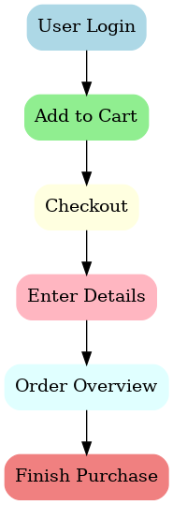
Workflow :

Slide 7
Modules implemented :
Login Page Testing (valid & invalid users)
Inventory Page (product listing & selection)
Product Details Page Testing
Cart & Checkout Flow
Negative Test Cases (e.g., locked user login)

Slide 8
Test Execution & Reports :
Automated test execution via TestNG
Results captured by Allure Framework
Interactive Allure HTML reports
Screenshots captured for all test cases

Slide 9
Future Enhancements :
Integrate with Jenkins for CI/CD pipeline.
Perform cross-browser testing on cloud platforms.
Expand coverage with complex scenarios.

Slide 10
Jenkins & Git Implementation :
GitHub repository for project version control
Jenkins integrated with Git for CI/CD
Automated build trigger on commit
Test execution (Selenium + TestNG + Allure)
Report generation after each build

Slide 11
Dependencies :
Selenium dependencies
<dependency>
<groupId>org.seleniumhq.selenium</groupId>
<artifactId>selenium-java</artifactId>
<version>4.25.0</version>
</dependency>
TestNG dependencies
<dependency>
<groupId>org.testng</groupId>
<artifactId>testng</artifactId>
<version>7.10.2</version>
<scope>test</scope>
</dependency>
Allure dependencies
<dependency>
<groupId>io.qameta.allure</groupId>
<artifactId>allure-testng</artifactId>
<version>2.29.0</version>
</dependency>

Slide 12
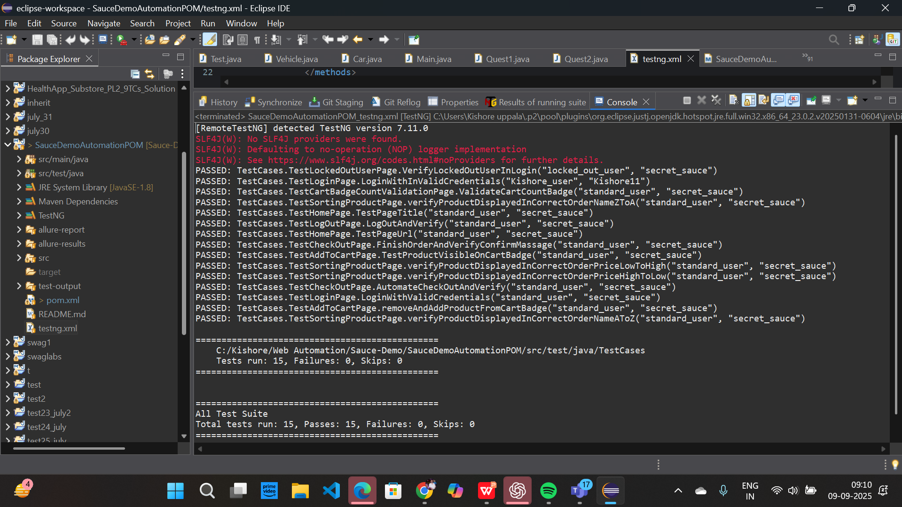
Outcome :

Slide 13
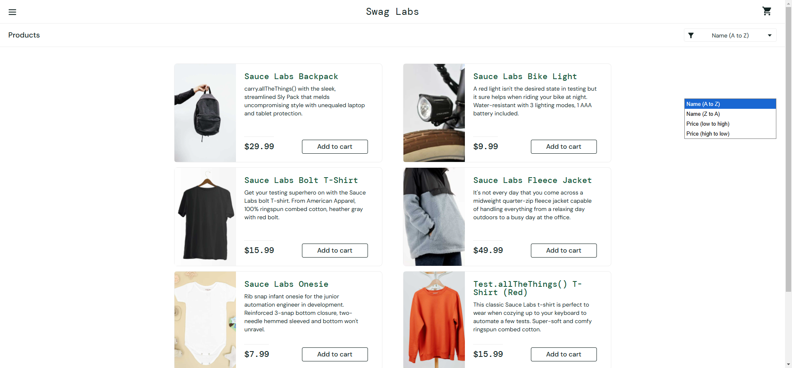
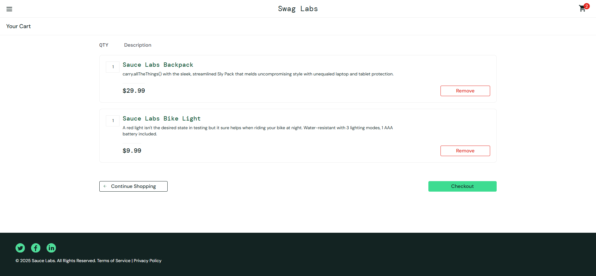
Test cases Screenshots :

Slide 14
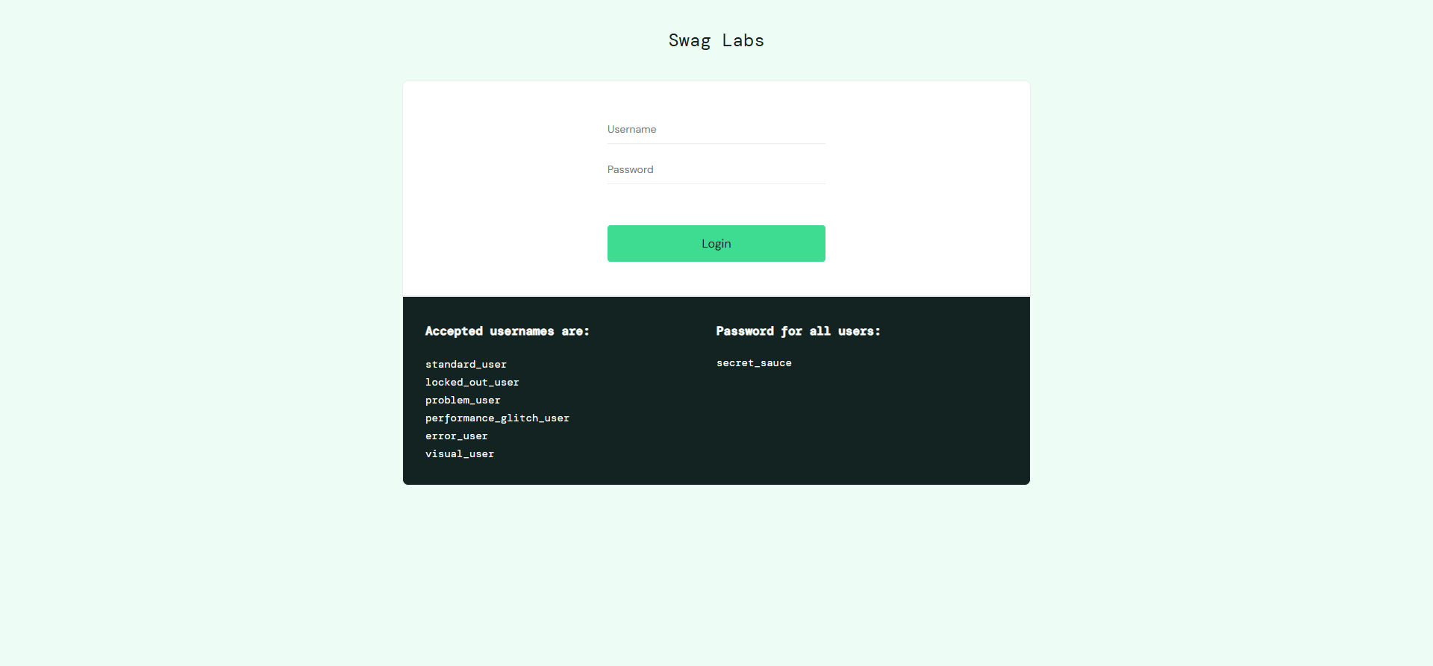
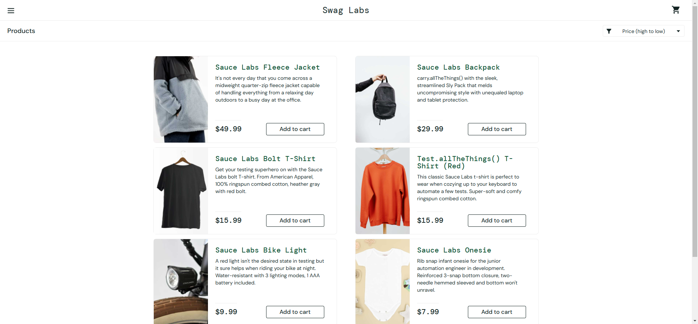
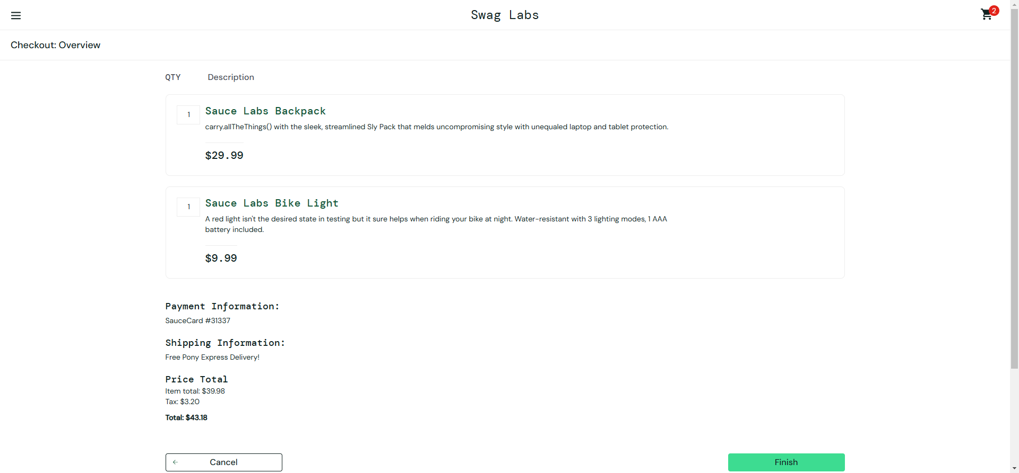
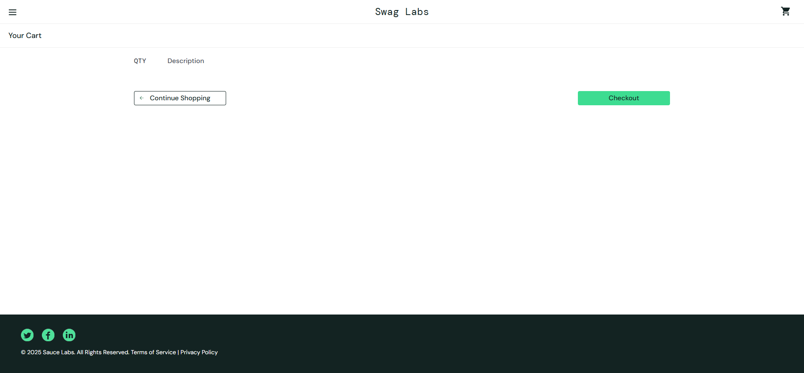

Slide 15
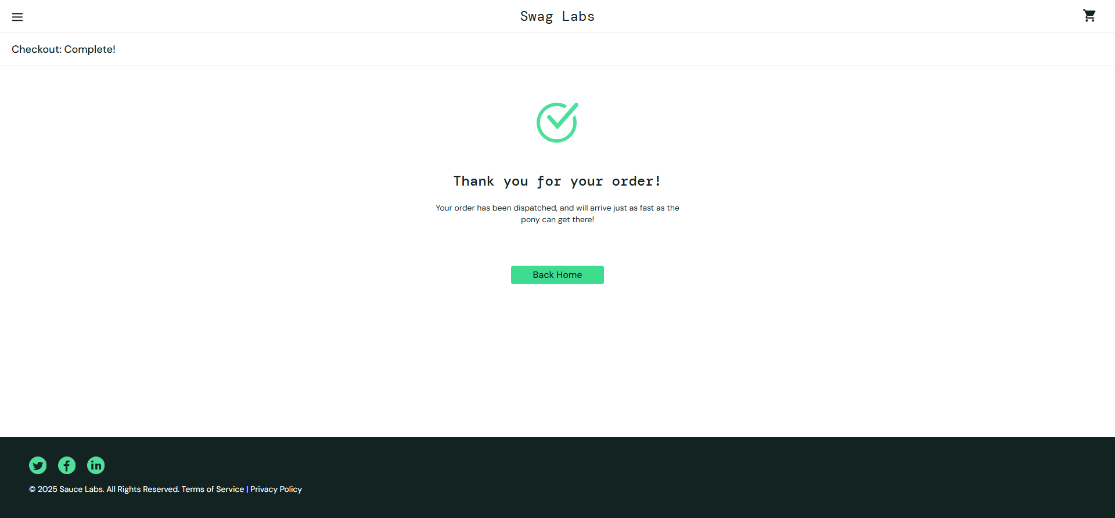

Slide 16
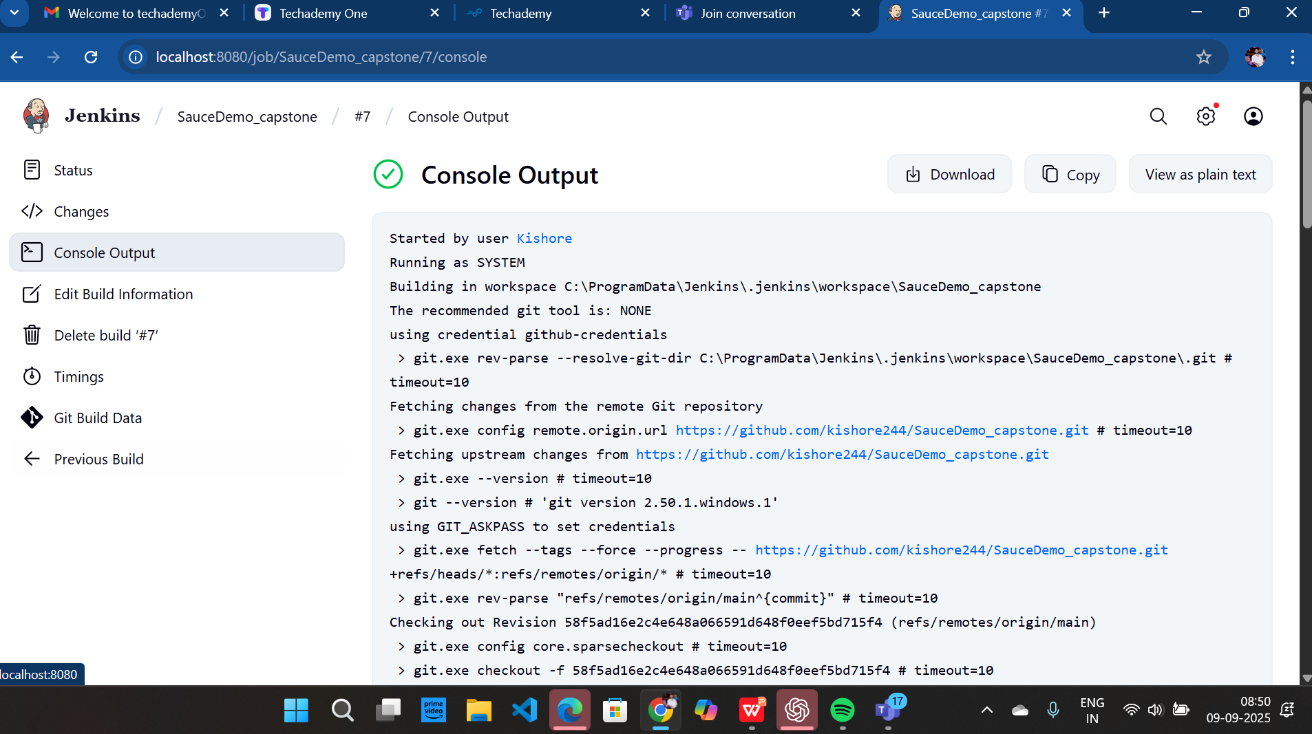
Jenkins :

Slide 17
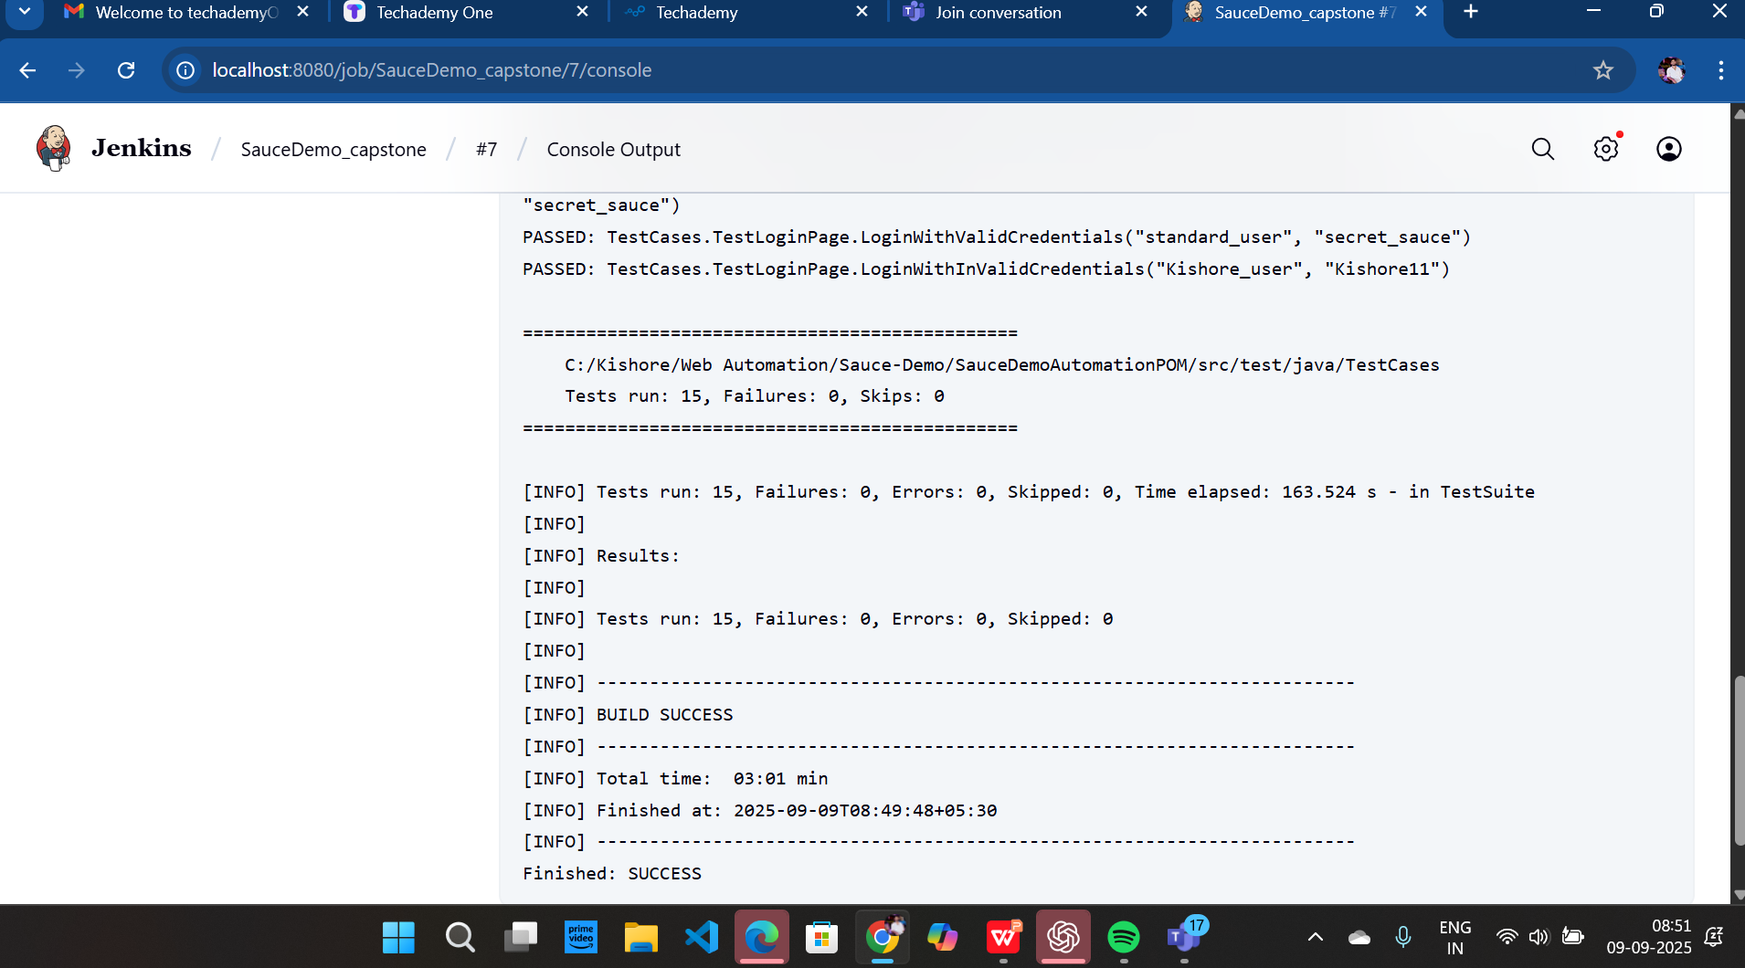

Slide 18
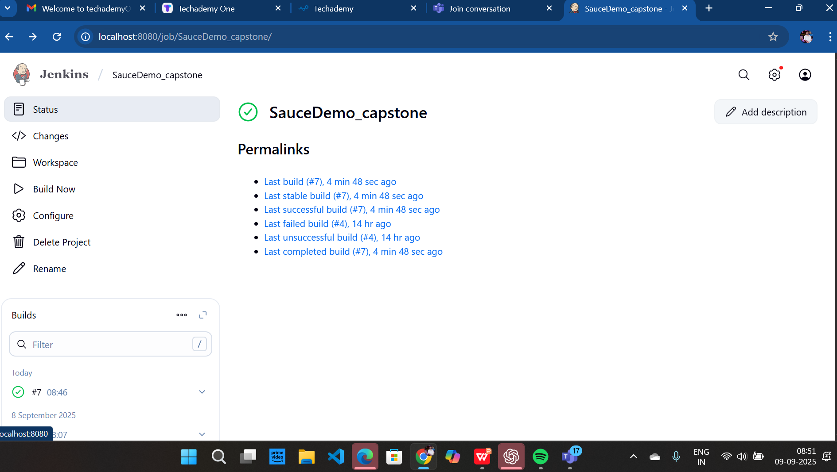

Slide 19
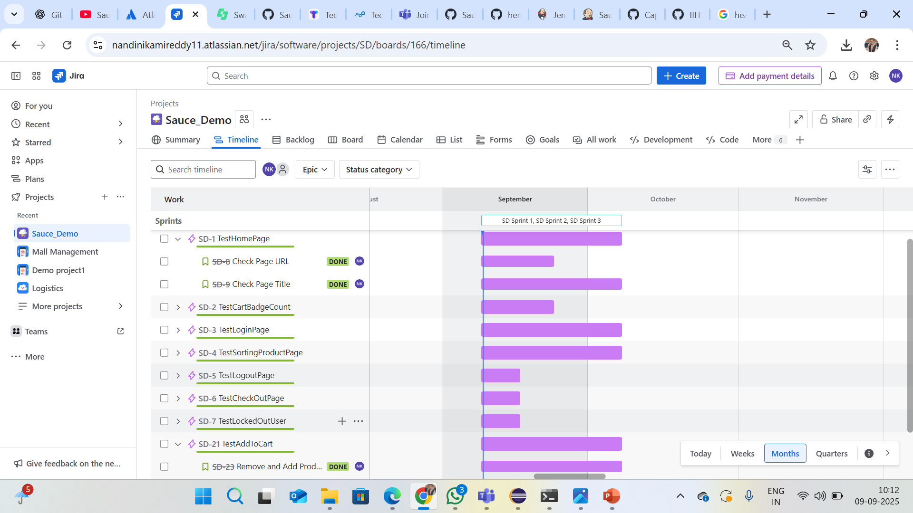
Jira – agile board :

Slide 20
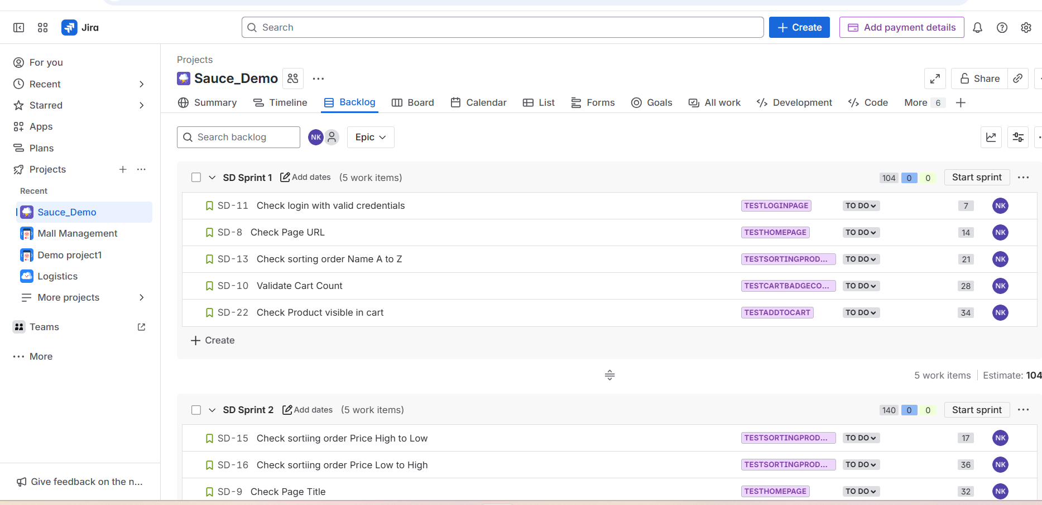
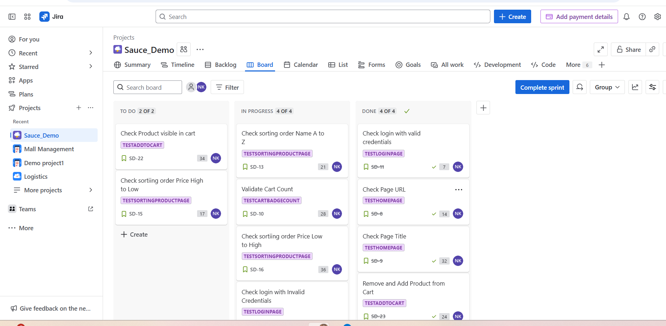
Sprint creation :

Slide 21
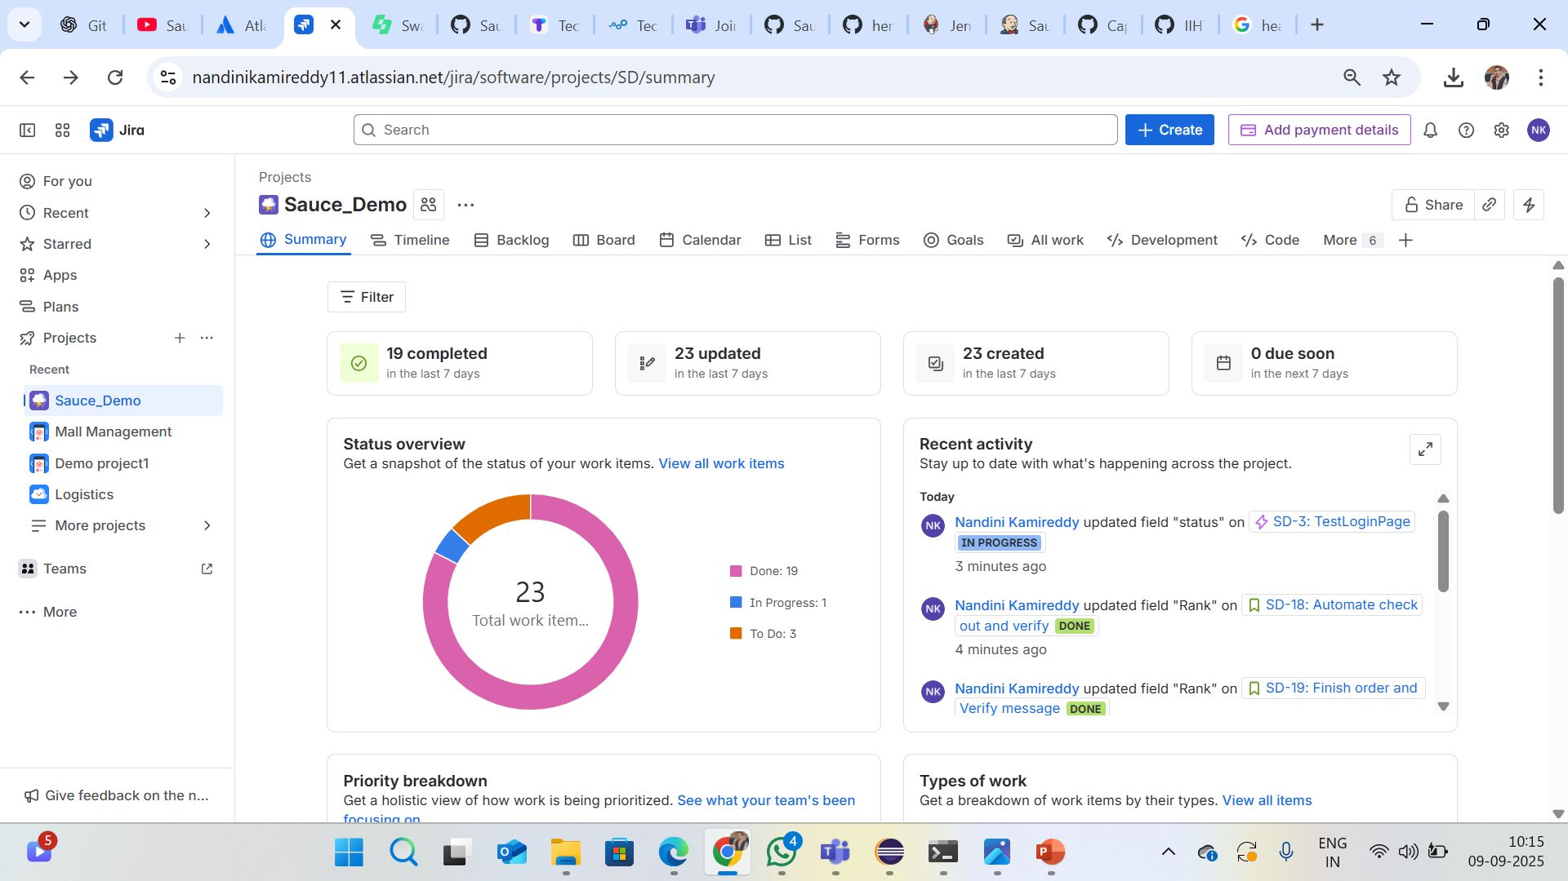
Summary :

Slide 22
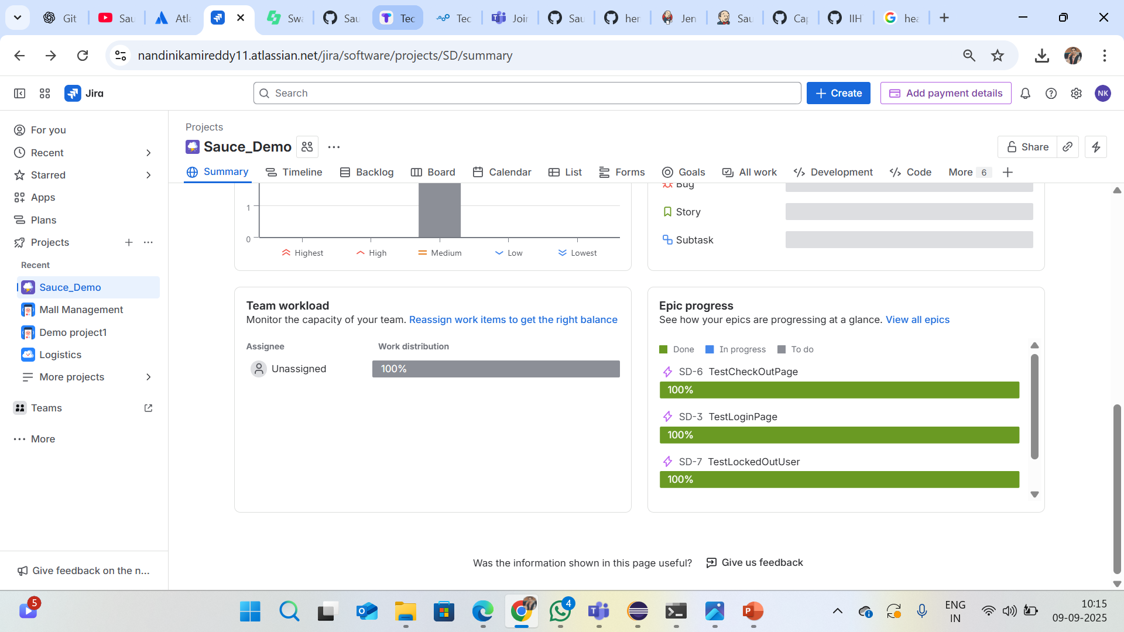

Slide 23
conclusion :
Project successfully automated Sauce Demo website.
Improved efficiency, reliability, and reusability.
Ready for integration into real-time pipelines.
References & links :
GitHub : https://github.com/kishore244/SauceDemo_capstone.git
Website :
https://www.saucedemo.com/

Slide 24
Thank You...

