Slide 1


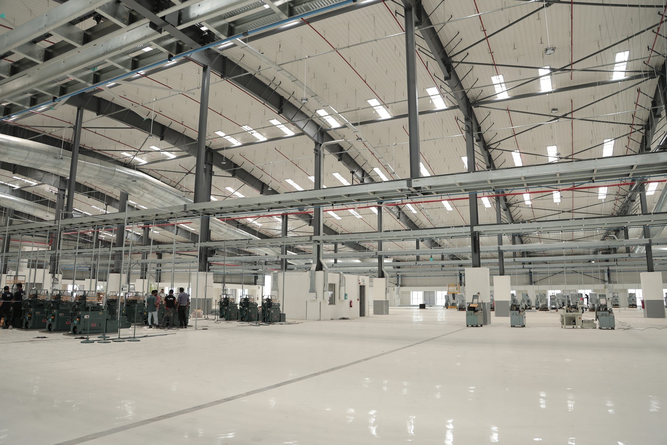
ADLER
CONTRACTS
Powering Possibilities. Delivering End to End Electrical Solutions.
Class I Electrical Contractor · Licence No. 1CL202315BGM
Licensed for electrical works up to & including 33 kV

Slide 2

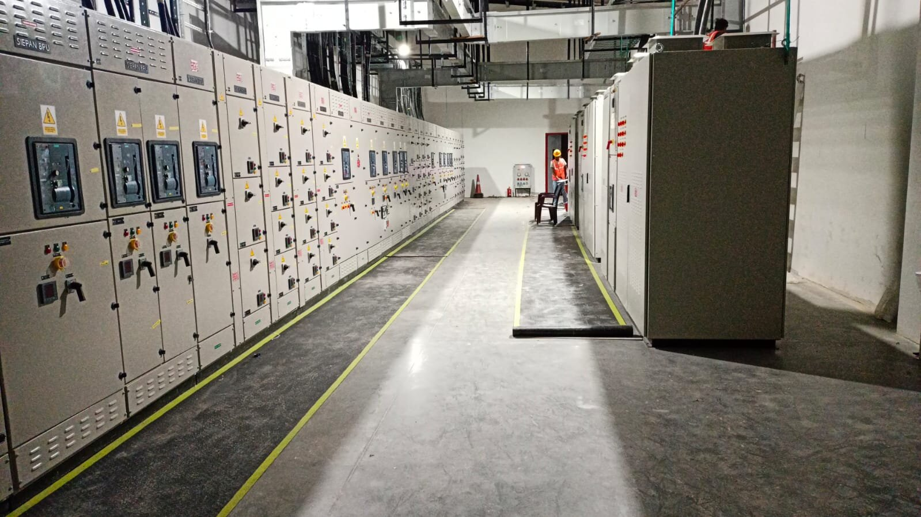
Who are we
WHO
ARE WE ?
A Class I electrical contractor with deep expertise in turnkey, end-to-end electrical solutions, Adler delivers everything from design and planning to installation, testing and commissioning.
Our reputation is built on:
• Meticulous planning
• Robust project management
• Relentless focus on quality, safety and speed
• Transparent and trustworthy partnerships
2024
Our Company Founded

Slide 3

At a Glance
At a Glance
Clients Served
Year of Establishment
15th July 2024
• Aequs SEZ Ltd
• Scon Projects, Pune
• Sterling Tech Mobility Ltd
• Crownstone Constructions Pvt Ltd
• Surya Priya Constructions
• SFS Group India Pvt Ltd
• Jinabakul Forge Pvt Ltd
• White Oaks
• Thyssenkrupp Aerospace India
• Inovit Aerospace Solutions Pvt Ltd
Total Projects Completed
14 +
Headquartered in
Belagavi, Karnataka
Clients Served
8+

Slide 4
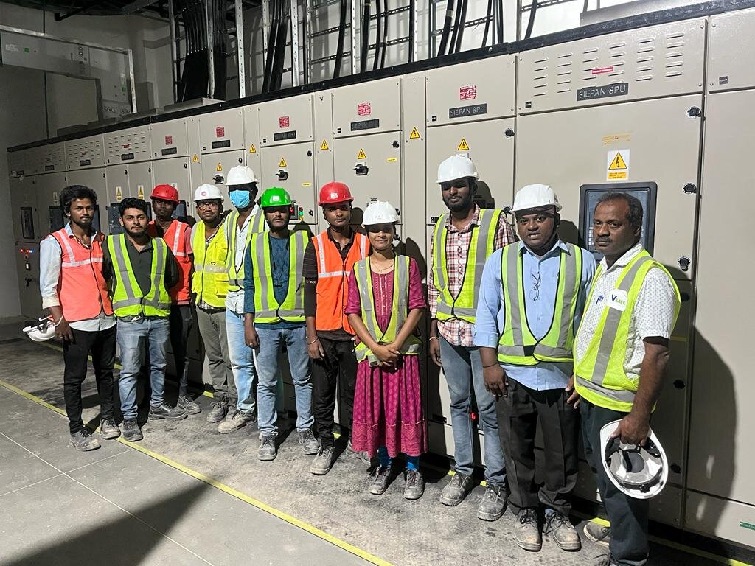
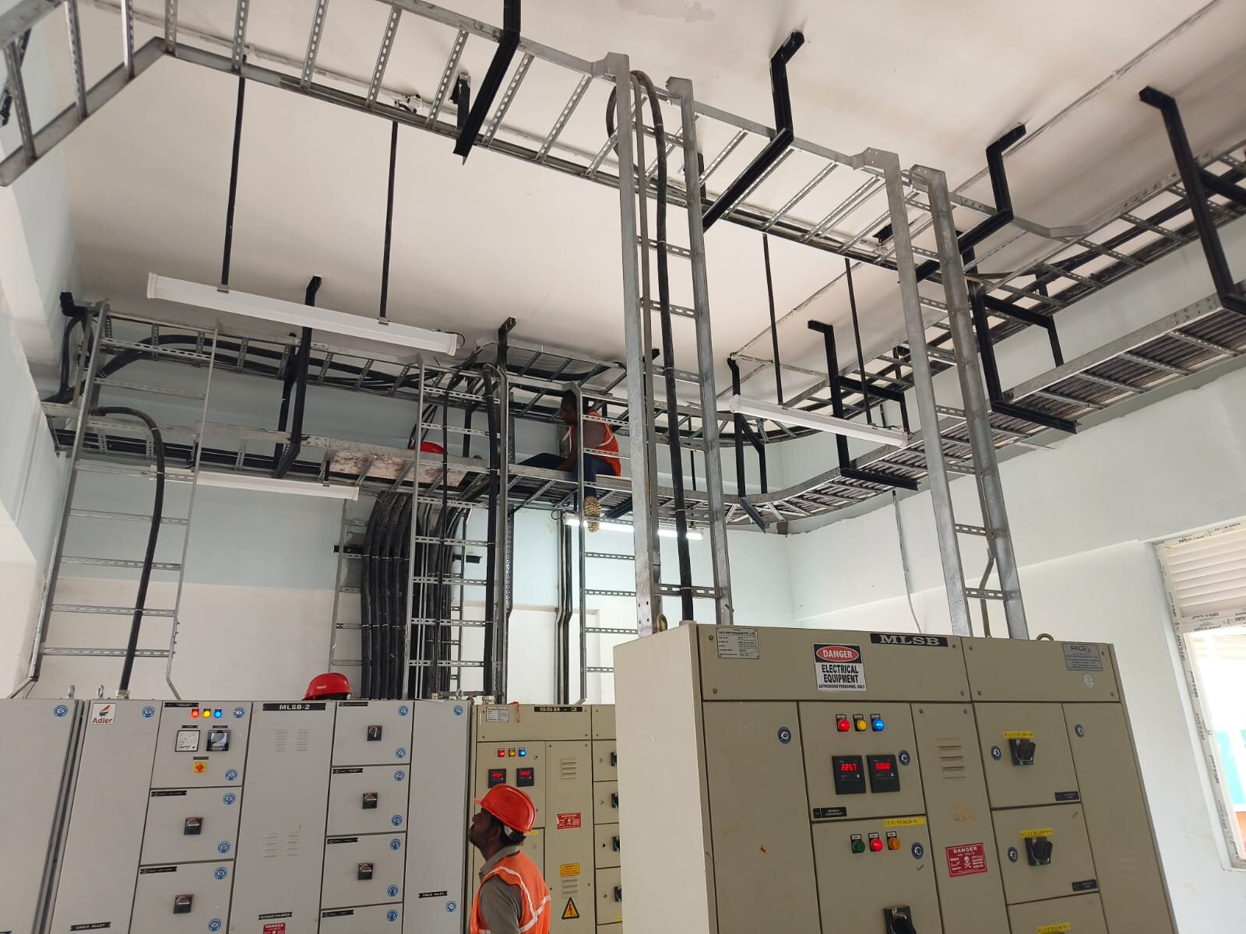
Our Vision & Mission
OUR
VISION & MISSION
VISION
To deliver exceptional value to our clients and stakeholders by building world-class infrastructure rooted in reliability, executed with safety, and delivered with excellence
MISSION
To provide safe, reliable, and high-quality electrical solutions through innovative engineering, skilled execution, and uncompromising quality. We are committed to exceeding client expectations, building lasting partnerships, and delivering every project with integrity, efficiency, and excellence.

Slide 5
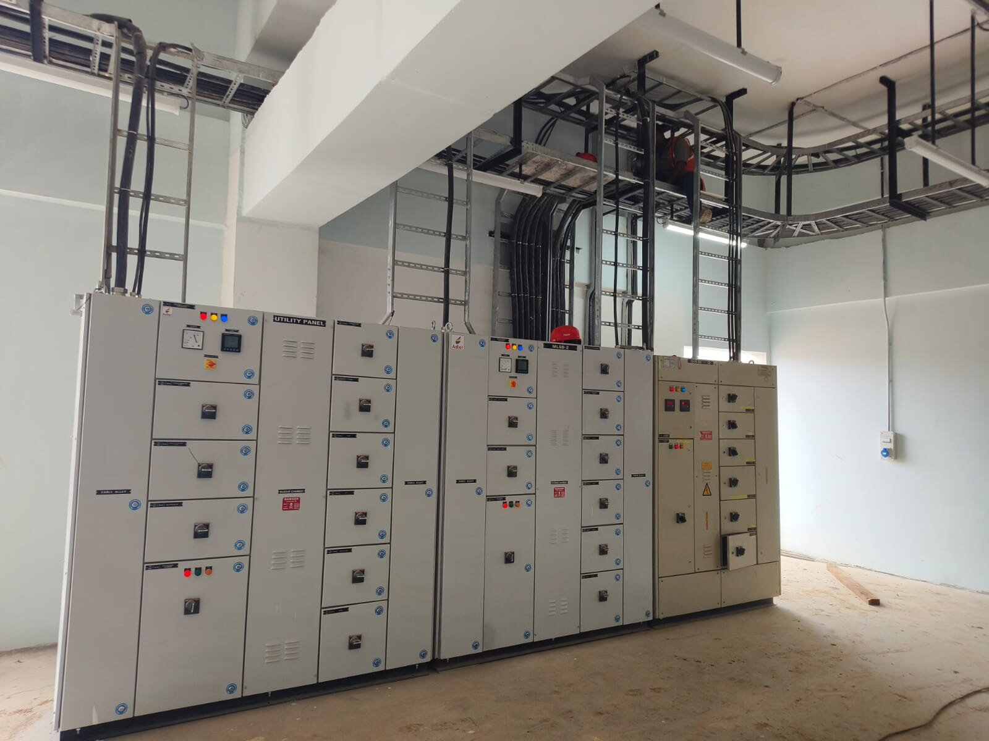
Our Core Values
OUR CORE VALUES
These ideals are ingrained in every cable we lay and every system we energise at Adler, making them more than just guiding concepts.
QUALITY
SAFETY
TRUST
Every installation tested and checked before handover.
Safe work methods and full PPE on every site, every day.
Honest dealings and commitments delivered on time.

Slide 6
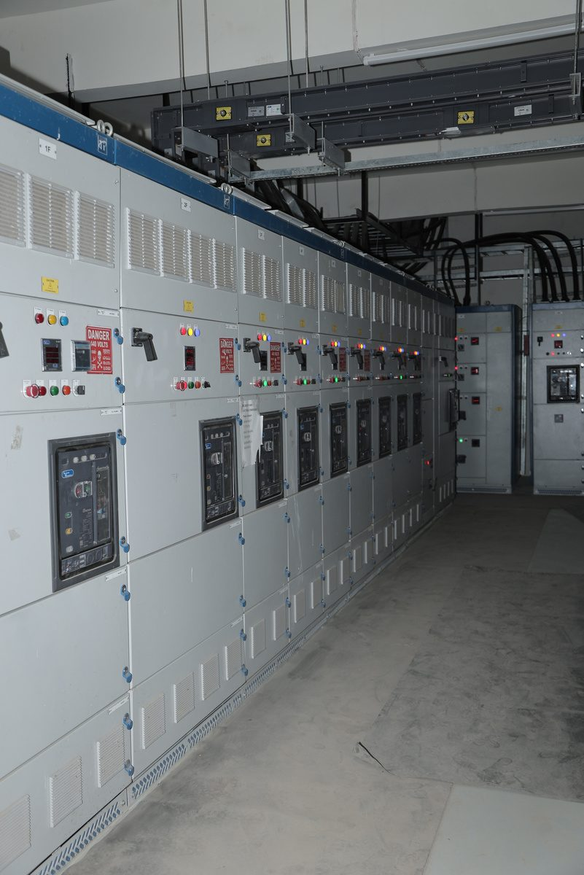
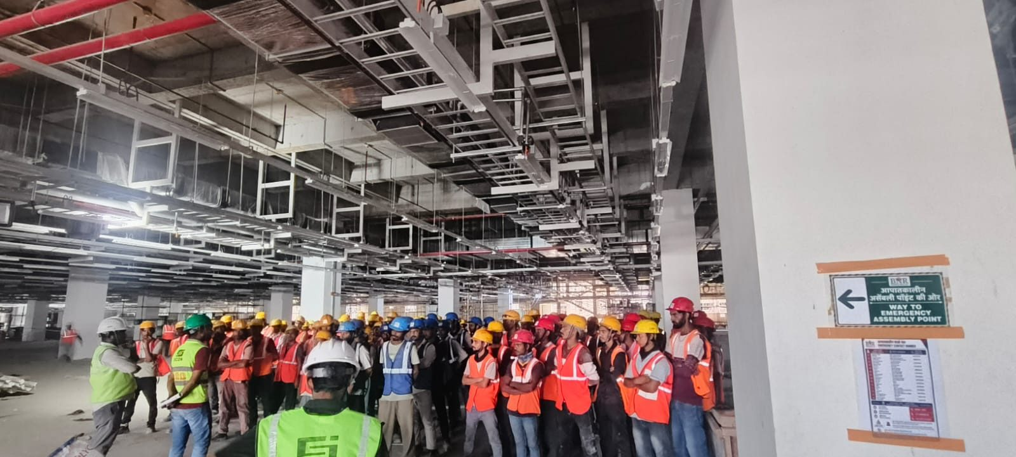
About
Our Core Differentiators
OUR CORE
DIFFERENTIATORS
What sets Adler apart from others?
• End-to-end electrical expertise – HT/LT works, substations, panels, cabling and lighting
• Class I licence for electrical works up to 33 kV, with a Grade I licensed supervisor
• Proven record in securing CEIG / Electrical Inspectorate approvals – incl. Thyssenkrupp Aerospace, Inovit Aerospace Solutions, Bengaluru
• Trusted by 14+ clients across SEZ, aerospace and EV sectors in Karnataka and Tamil Nadu
• 14 projects since 2024 – ₹10.7 Cr+ in project value and 27 MVA+ of capacity

Slide 7
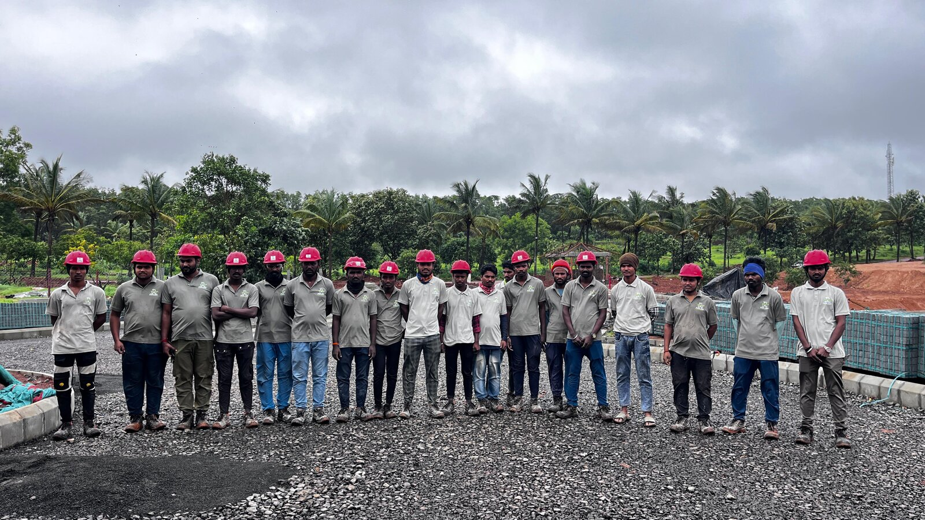
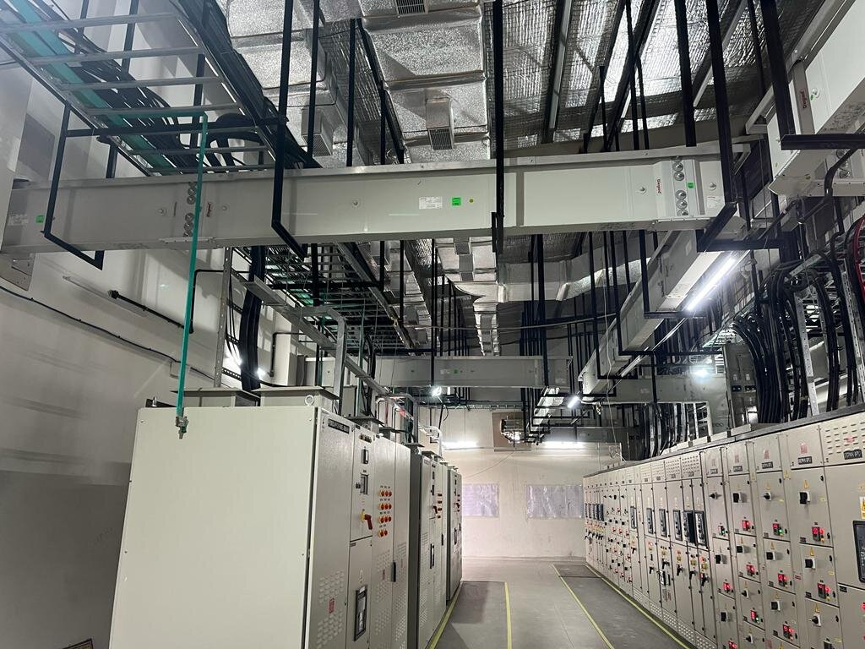
Quality & Safety
QUALITY & SAFETY
Quality Framework Includes
• Project-specific quality plans • Execution methodologies
• Third-party quality checks • Continuous supervision
Safety Framework Includes
• Detailed safety plans • Safe work method statements • Logistics & EOHS planning • Certified safety training & protocols
Key Documents
• Project-specific quality plan • Project-specific safety plan • Method statement for each activity • Joint measurement records • EOHS policy • Material approval & test records • Quality control checklists • Logistics plan

Slide 8
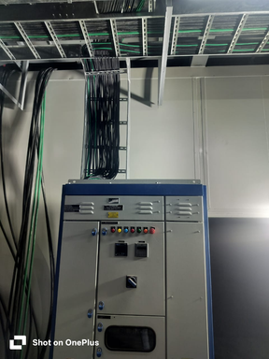
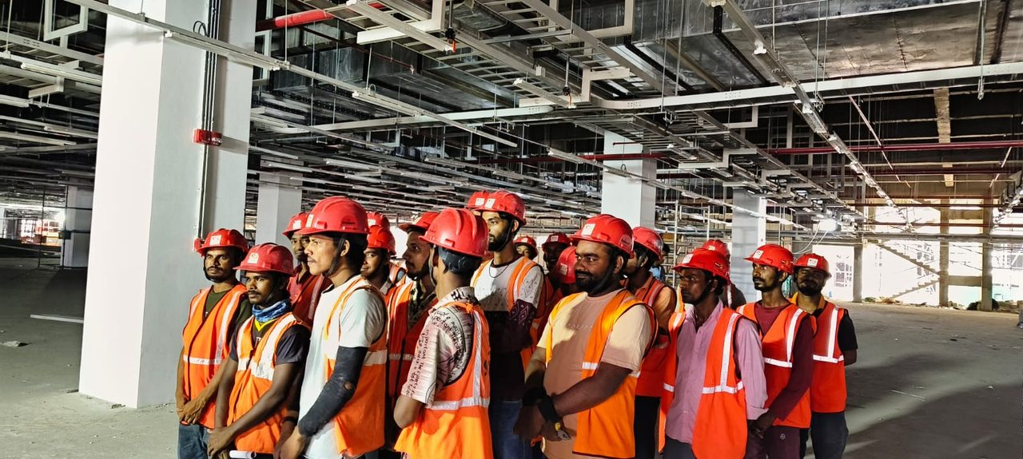
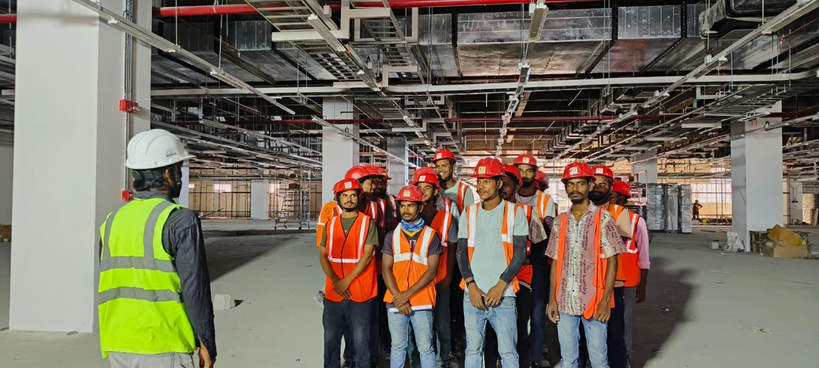
Skill & Safety Training
SKILL AND SAFETY
TRAINING
Investing in our people ensures long-term reliability.
• PPE training • Aerial lift operation • Construction technologies • Work-at-height & harness safety • Electrical safety • Heavy equipment operation • First aid & CPR
100% site induction • Daily toolbox talks • Permit-to-work & LOTO • [_134_] workers trained • [_0_] lost-time incidents

Slide 9
Ongoing Projects
Major ONGOING PROJECTS
1 | Industrial | Oragadam, Walajabad Taluk, Tamil Nadu – 631604 | Axana Estate LLP – A03 (Foxconn) | Scon Projects, Pune
2 | Industrial | Oragadam, Walajabad Taluk, Tamil Nadu – 631604 | Axana Estate LLP – B05 (Foxconn) | Scon Projects, Pune
3 | Industrial | Devanahalli , Aerospace Park , Bengluru , Karnatak | Inovit Aerospace Solutions Pvt Ltd (IASPL) | Crownstone Constructions Pvt Ltd
4 | Industrial | Aequs HDC, Itigatti, Hubballi – 580114 | Unit-4, Aequs HDC | Crownstone Constructions Pvt Ltd
5 | Residential | Belagavi, Karnataka | Farmhouse | Crownstone Constructions Pvt Ltd
Sno
Type of Project
Location
Project Name
Client Name

Slide 10
Completed Projects
Major COMPLETED PROJECTS
1 | Industrial | Kanagala Industrial Area, Belagavi | SFS Group India Pvt Ltd | Scon Projects, Pune
2 | Institutional (School) | Near Rani Channamma University, Belagavi | Phase-II Indus Altum International School – DP & Hostel Blocks | Crownstone Constructions Pvt Ltd
3 | Industrial | KIADB Industrial Area, Budigere, Devanahalli, Bengaluru | Thyssenkrupp Aerospace India Pvt Ltd | Crownstone Constructions Pvt Ltd
4 | Industrial | KIADB Industrial Area, Arebannimangala, Bengaluru – 562149 | Sterling Tech Mobility Ltd | Sterling Tech Mobility Ltd
Sno
Type of Project
Location
Project Name
Client Name

Slide 11
Project Portfolio
About
Project Portfolio
Completed & Ongoing Projects
14 projects · ₹10.7 Cr+ project value · 27 MVA+ capacity · Karnataka & Tamil Nadu

Slide 12
About
SFS
PROJECT INFORMATION
SFS GROUP INDIA PVT LTD
Client: Scon Projects, Pune
Project: SFS Group India Pvt Ltd – industrial facility
Location: Kanagala Industrial Area, Belagavi, Karnataka
Project Type: Industrial
Capacity: 5 MVA
Work Awarded: HT/LT supply & installation
Detailed Scope: [Detailed scope – e.g. no. & rating of transformers, HT/LT panels, cable length, CEIG approval]
Project Value: ₹1.7 Cr
Duration: 8 months
Status: Completed

Slide 13
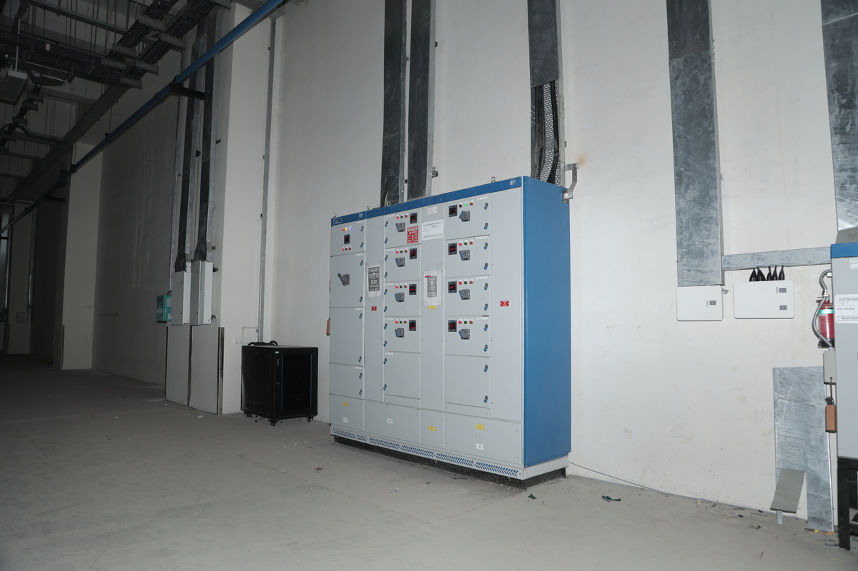
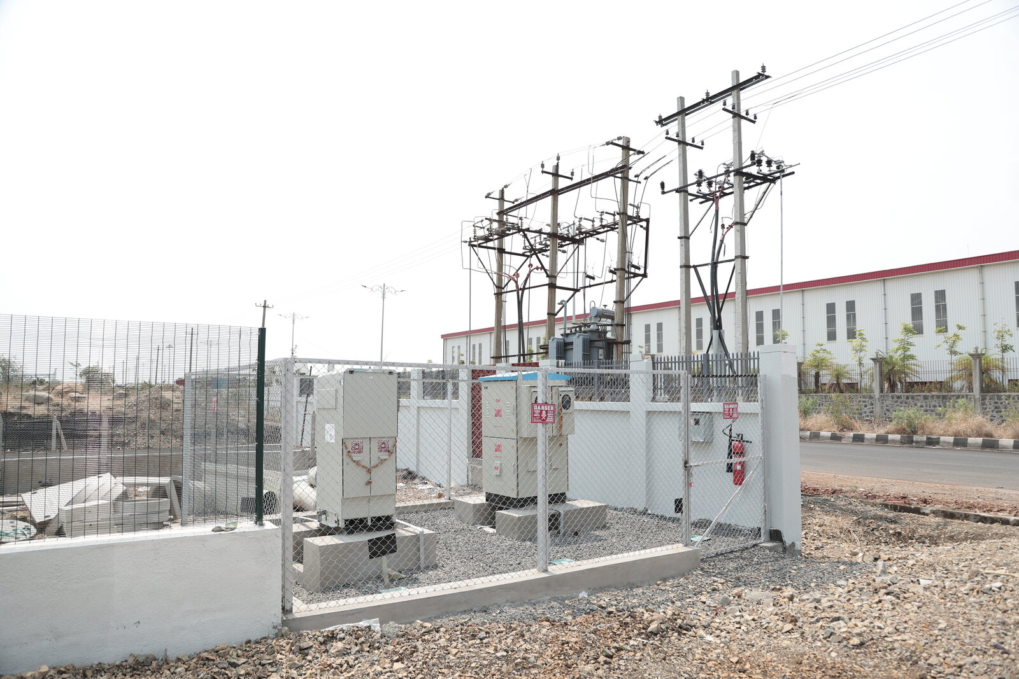
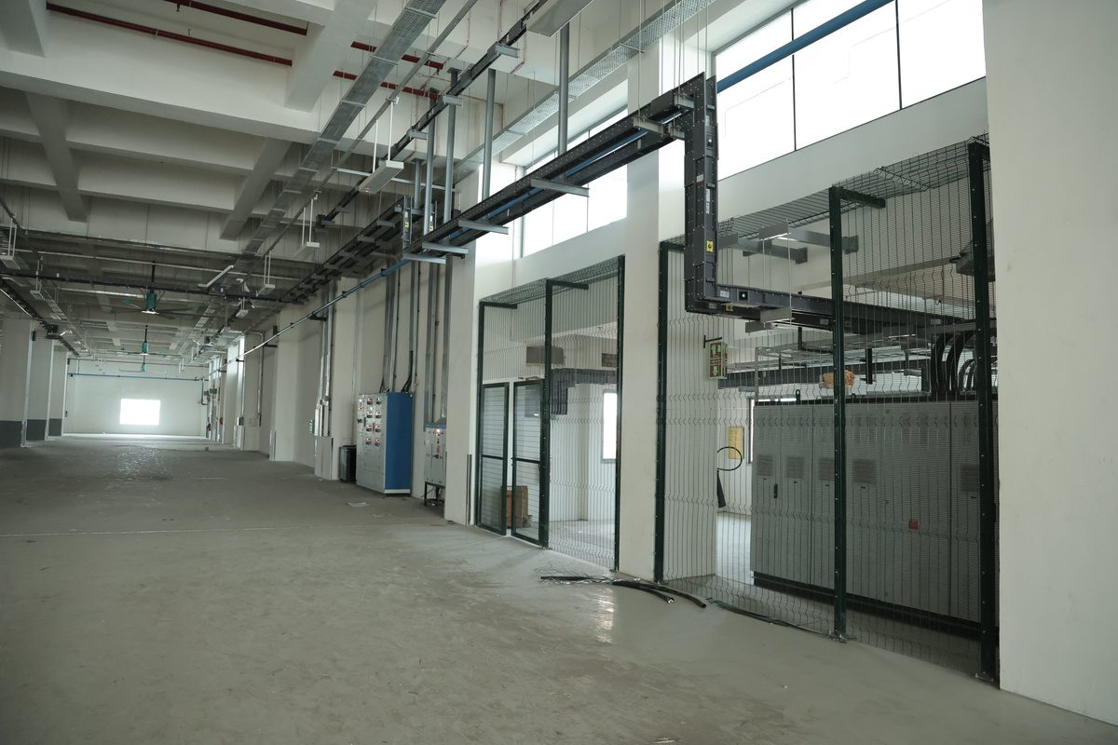
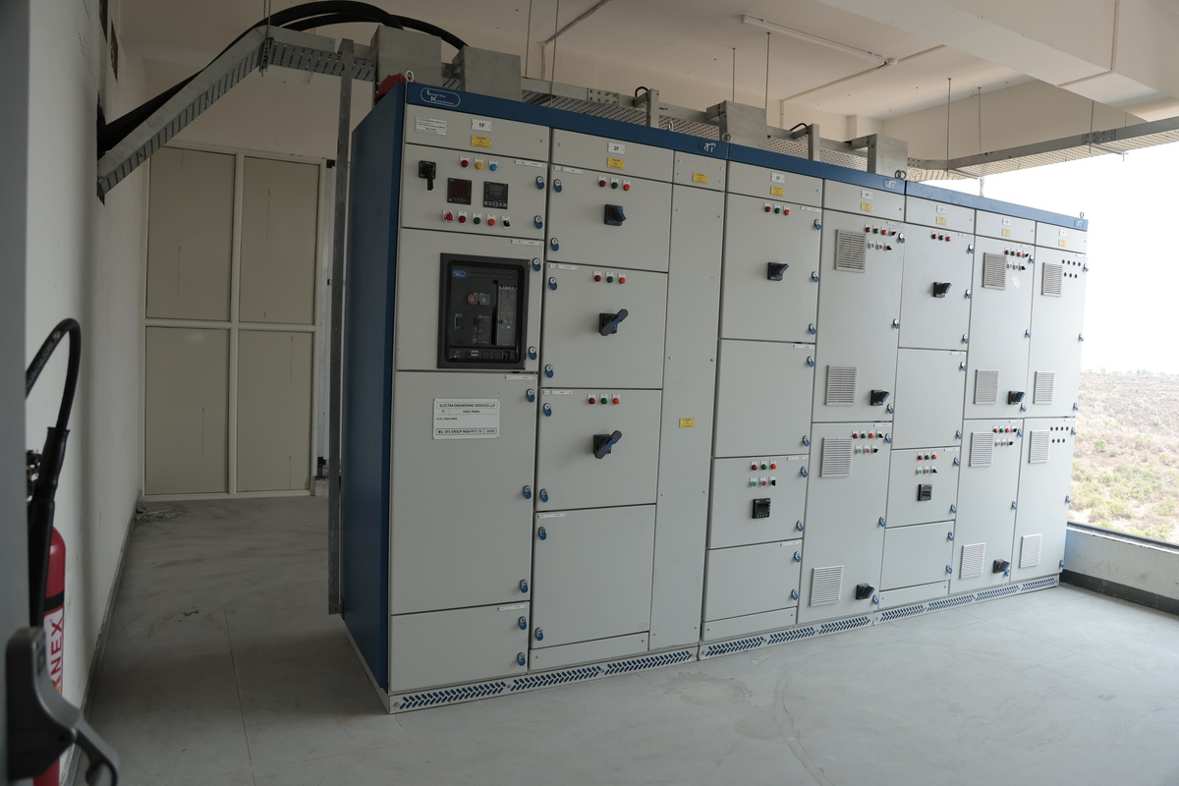
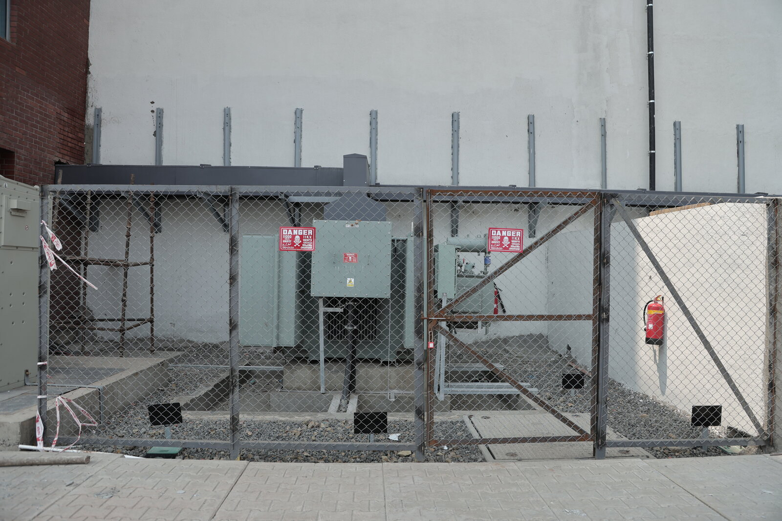
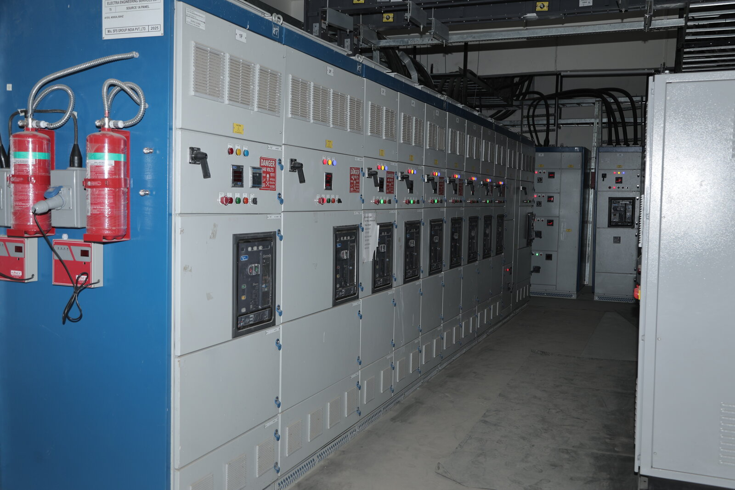
SFS
PROJECT IMAGES
SFS GROUP INDIA PVT LTD
LT distribution panel
HT yard & DP structure
Cable trays & sub-panels
LT panel board
Transformer enclosure
LT panel room

Slide 14
Indus Altum
PROJECT INFORMATION
INDUS ALTUM INTERNATIONAL SCHOOL – DP & HOSTEL BLOCKS
Client: Crownstone Constructions Pvt Ltd
Project: Phase-II, Indus Altum International School – DP & Hostel Blocks
Location: Near Rani Channamma University, Belagavi, Karnataka [confirm]
Project Type: Institutional (School)
Capacity: 500 kVA
Work Awarded: LT works – supply & installation
Detailed Scope: [Detailed scope – e.g. no. & rating of transformers, HT/LT panels, cable length, CEIG approval]
Project Value: ₹1 Cr
Duration: 6 months
Status: Completed

Slide 15
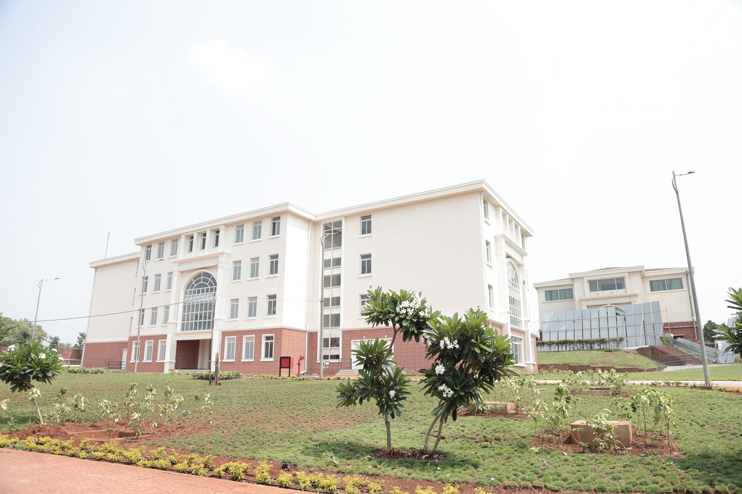
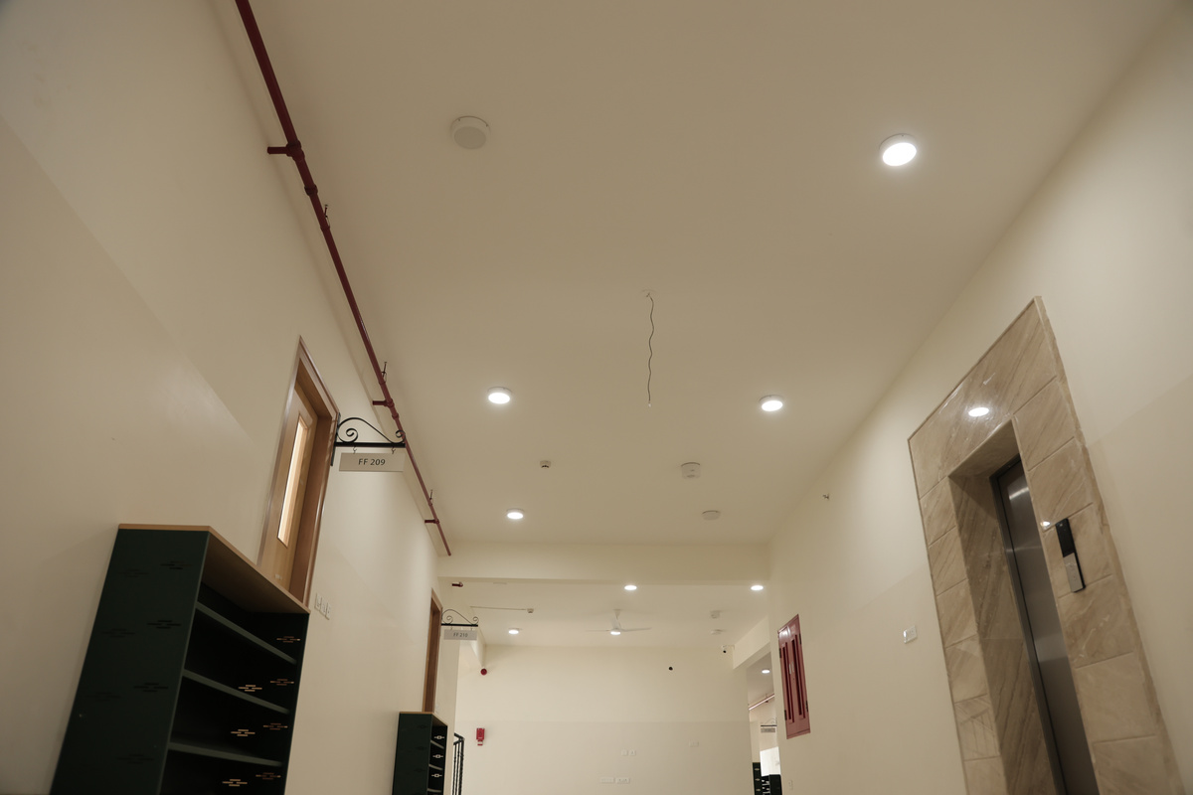
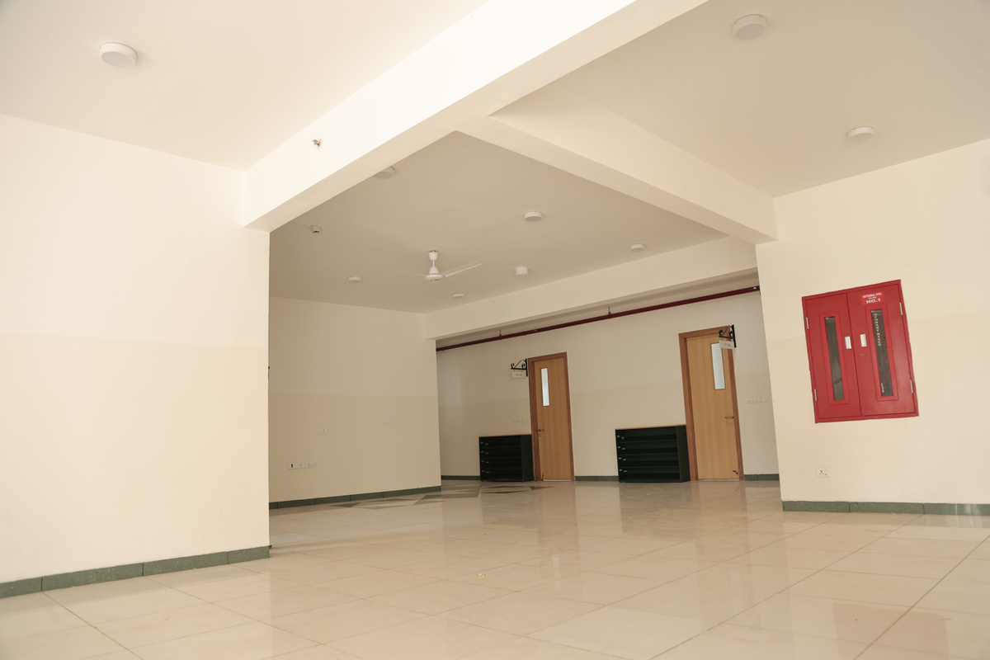
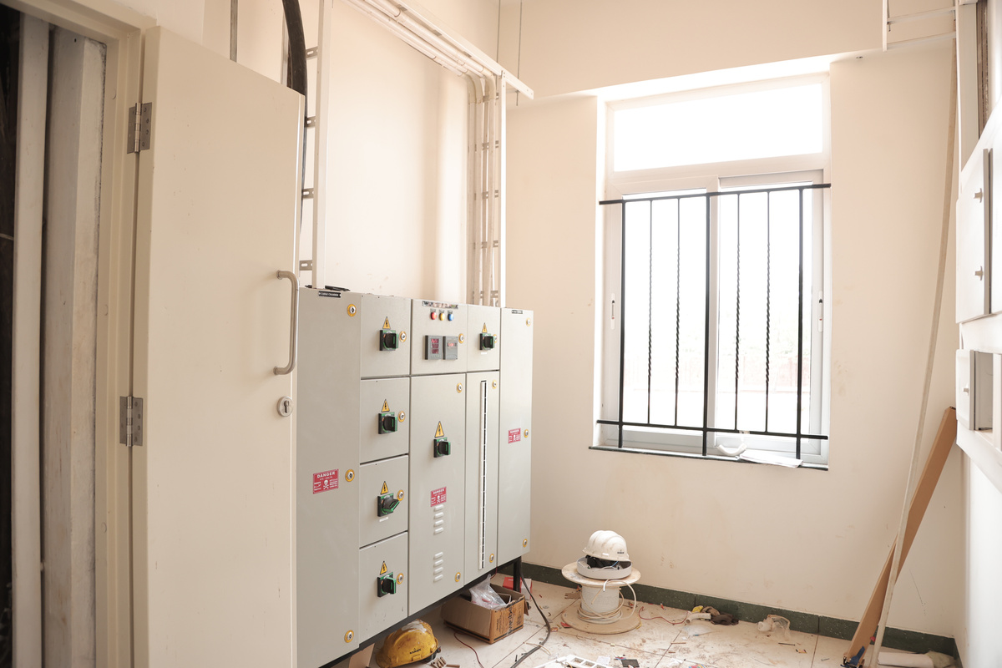
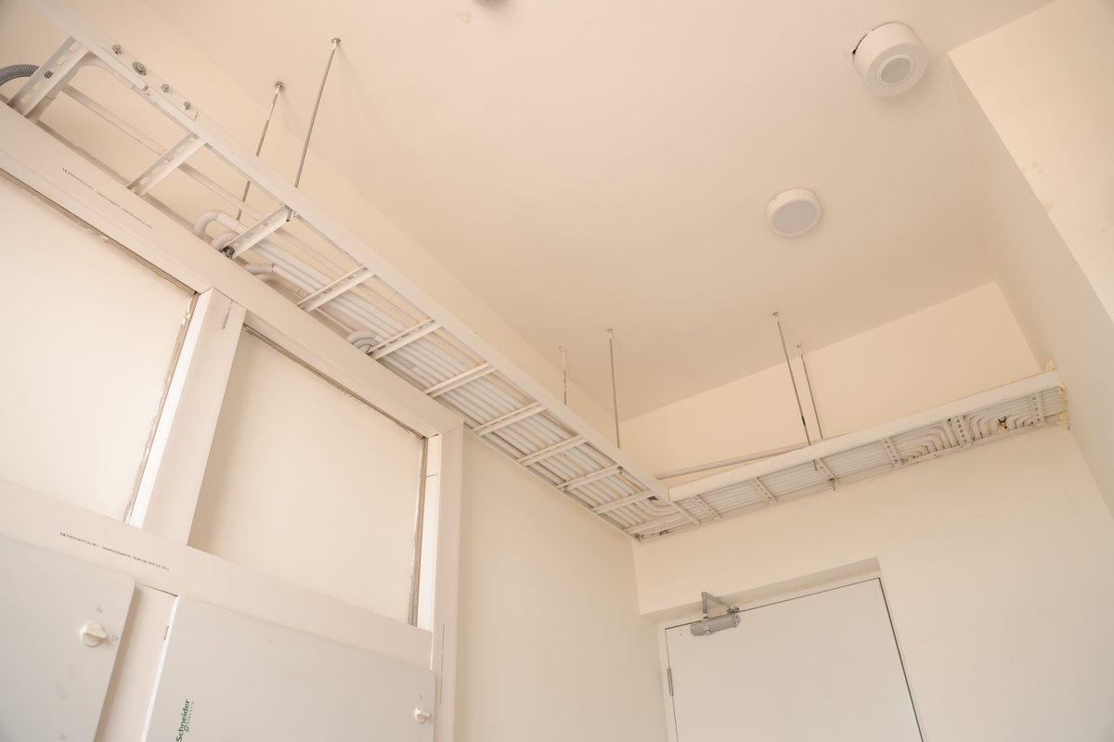
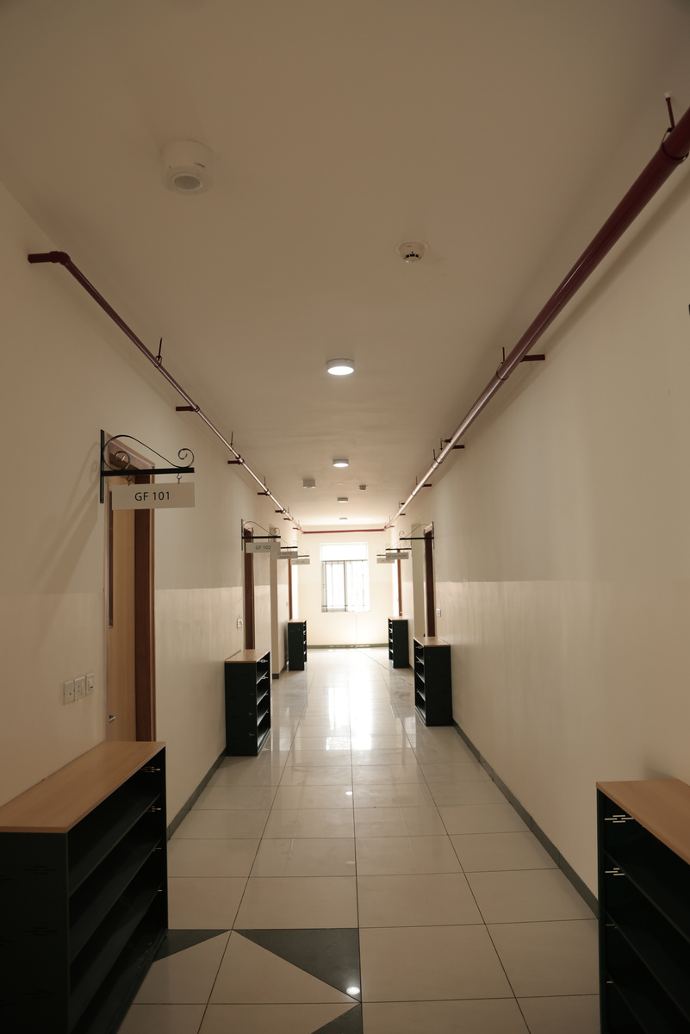
Indus Altum
PROJECT IMAGES
[Add a 2–4 word caption under each photo, e.g. “Main LT Panel”]
INDUS ALTUM SCHOOL – DP & HOSTEL BLOCKS

Slide 16
Thyssenkrupp
PROJECT INFORMATION
THYSSENKRUPP AEROSPACE INDIA PVT LTD
Client: Crownstone Constructions Pvt Ltd
Project: Thyssenkrupp Aerospace India Pvt Ltd
Location: KIADB Industrial Area, Budigere, Devanahalli, Bengaluru
Project Type: Industrial
Capacity: 500 kVA
Work Awarded: Temporary power connection, HT/LT power connection, supply & installation, CEIG approval
Project Value: ₹2.1 Cr
Duration: 8 months
Status: Completed

Slide 17
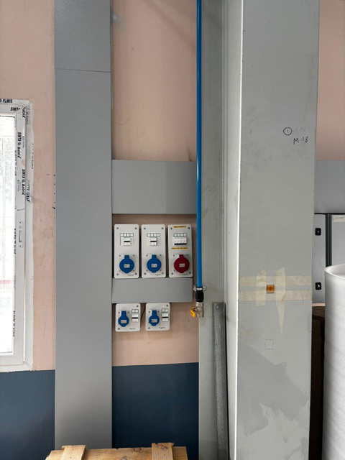
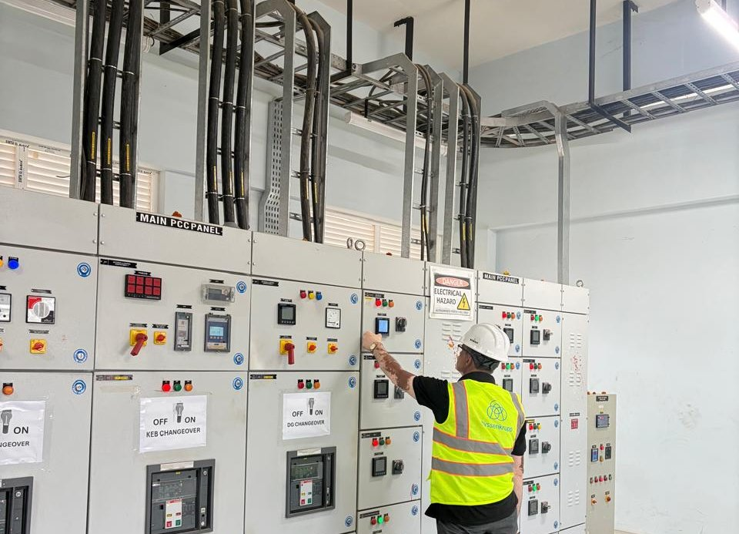
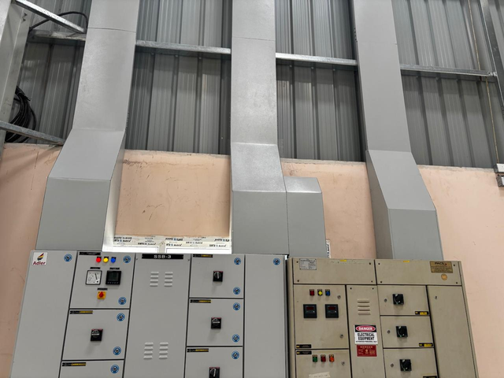
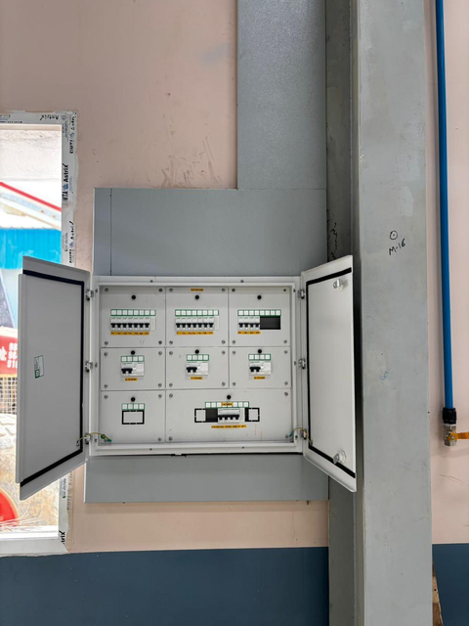
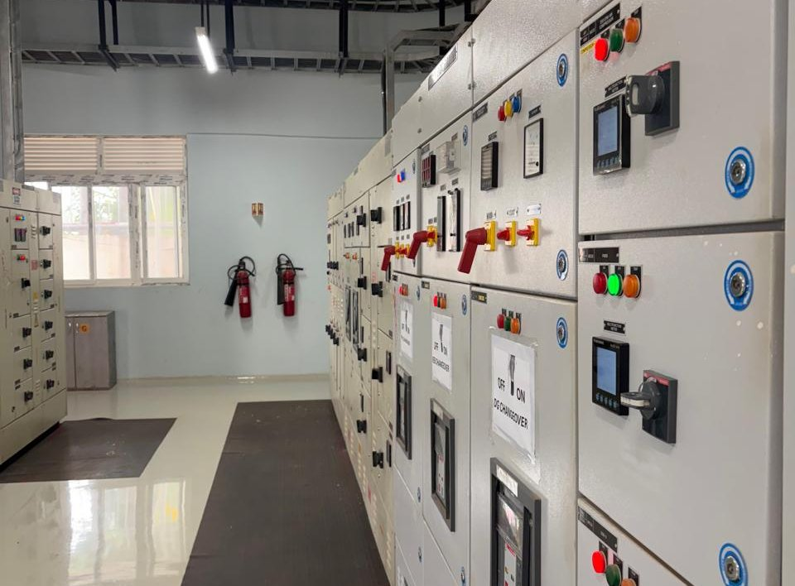
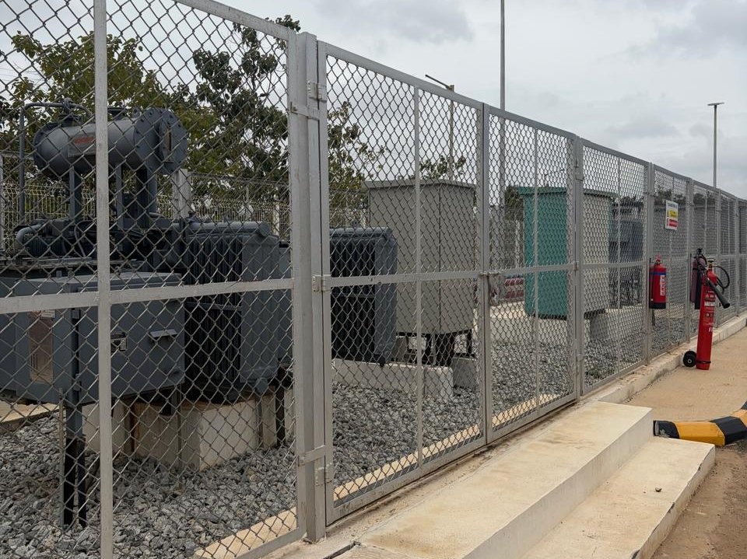
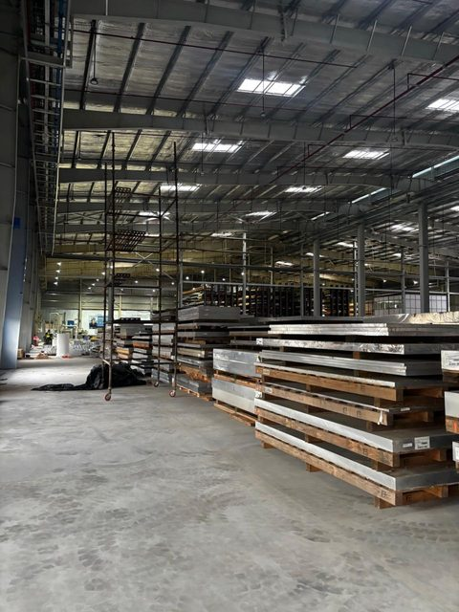
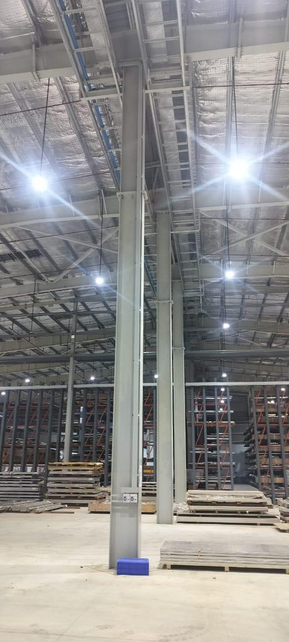
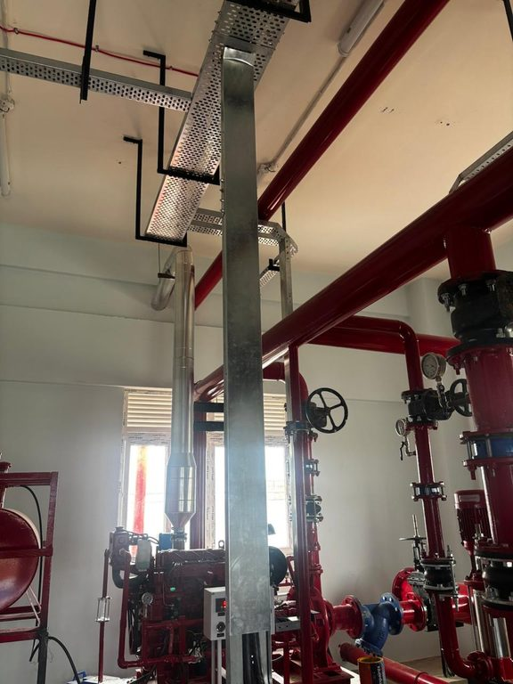
Thyssenkrupp
PROJECT IMAGES
THYSSENKRUPP AEROSPACE INDIA PVT LTD
Industrial socket outlets
LT panel commissioning
LT panels & cable trunking
Distribution board
Main LT panel room
Transformer yard

Slide 18
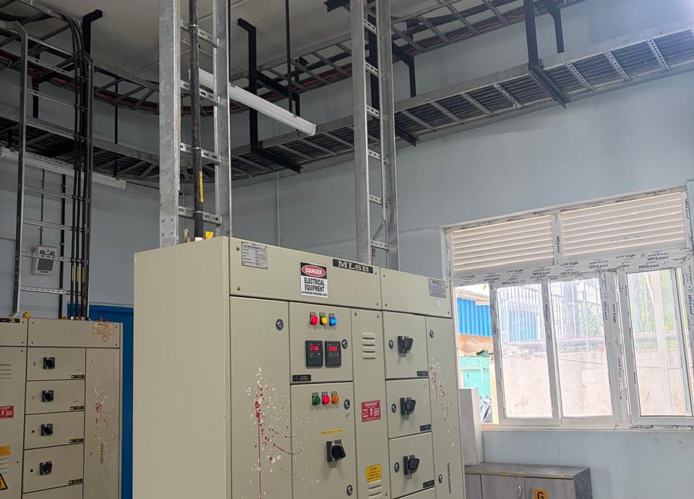
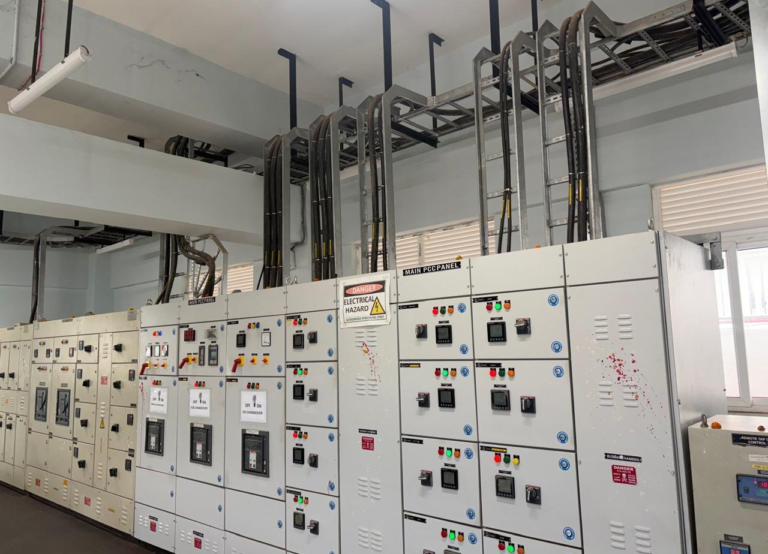
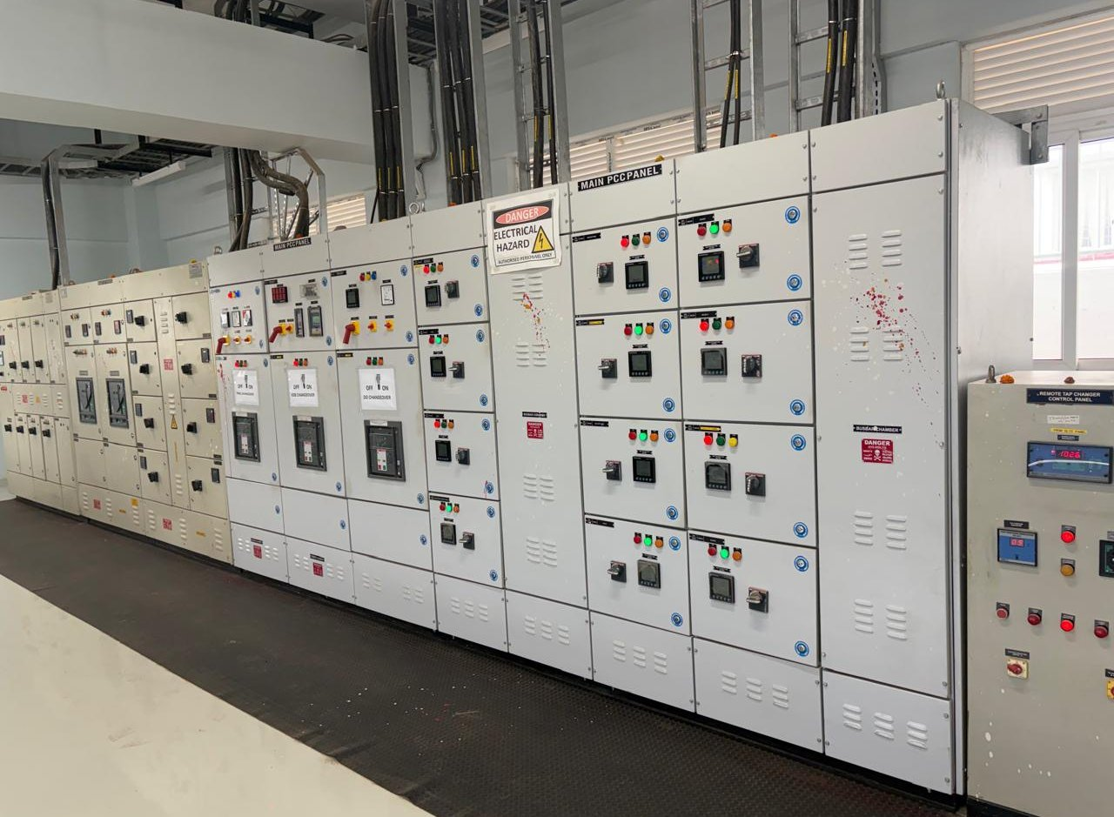
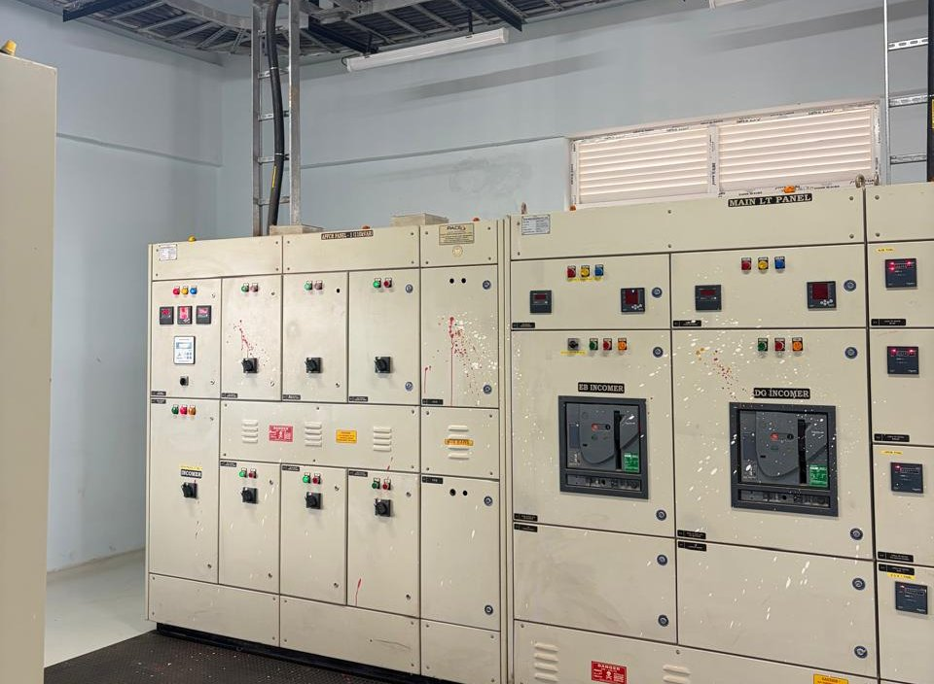
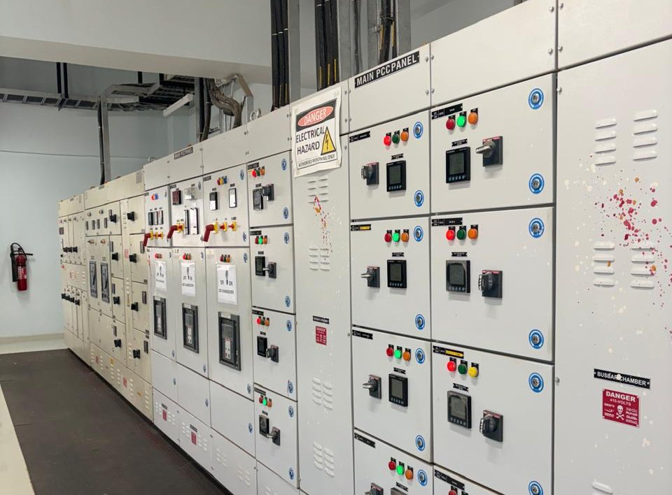
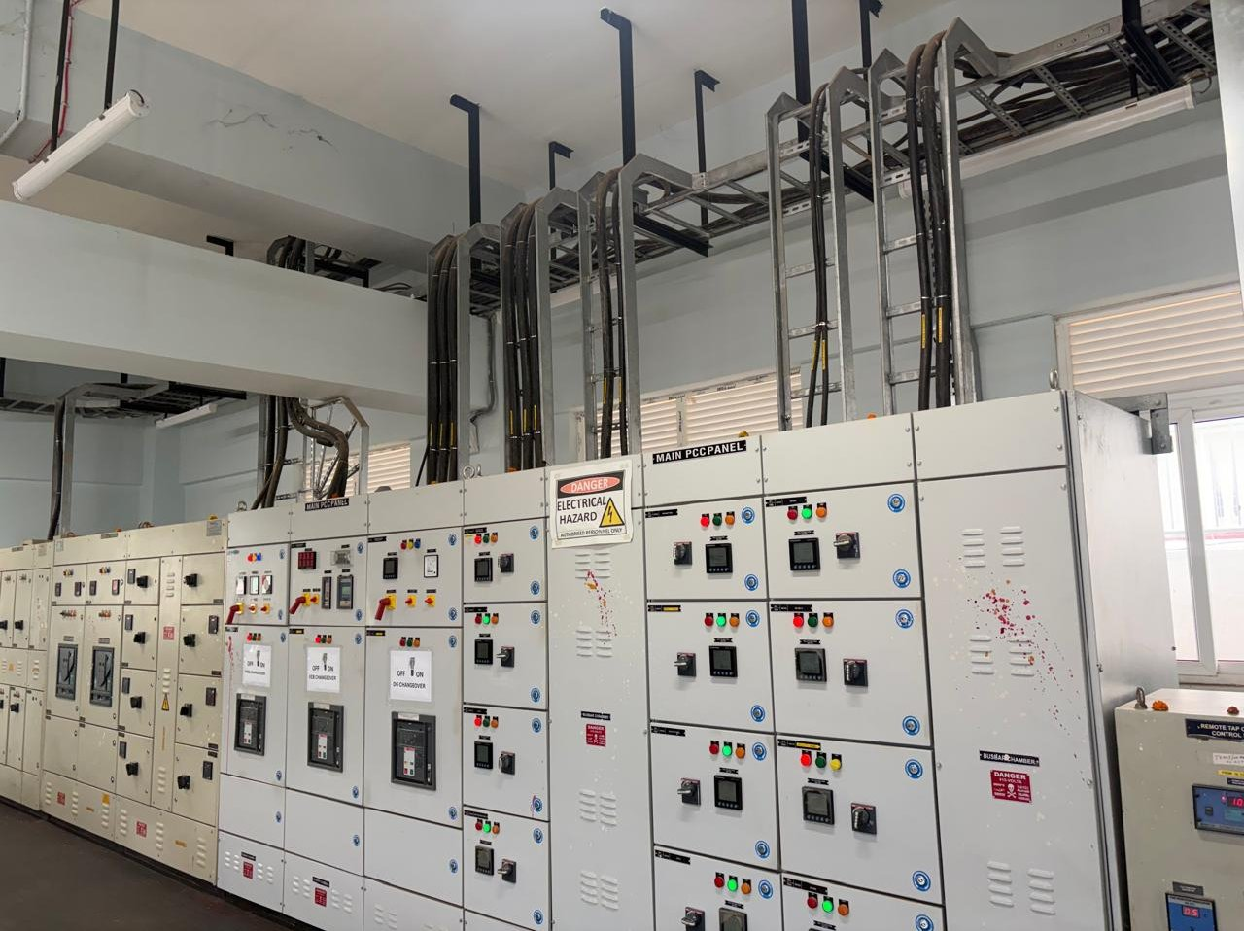
Thyssenkrupp
PROJECT IMAGES
THYSSENKRUPP AEROSPACE INDIA PVT LTD
Sub-distribution panel
LT panel line-up
MCC & metering panels
PCC & ACB panels
Panel room & cable risers
Cable trays over panels

Slide 19
Foxconn
PROJECT INFORMATION
FOXCONN – A03
[Confirm you are permitted to use the Foxconn name]
Client: Scon Projects, Pune
Project: Axana Estate LLP – A03
Location: Oragadam, Walajabad Taluk, Tamil Nadu – 631604
Project Type: Industrial
Capacity: 10 MVA
Work Awarded: HT/LT installation
Detailed Scope: [Detailed scope – e.g. no. & rating of transformers, HT/LT panels, cable length, CEIG approval]
Project Value: ₹2 Cr
Duration: 6 months
Status: Ongoing

Slide 20
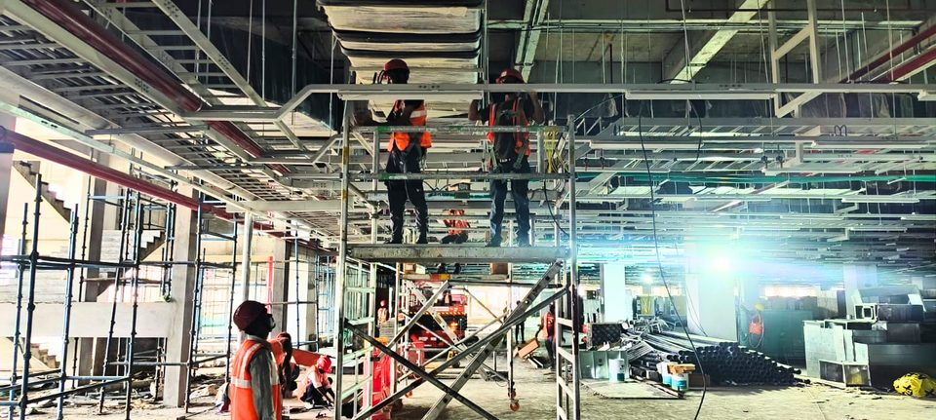
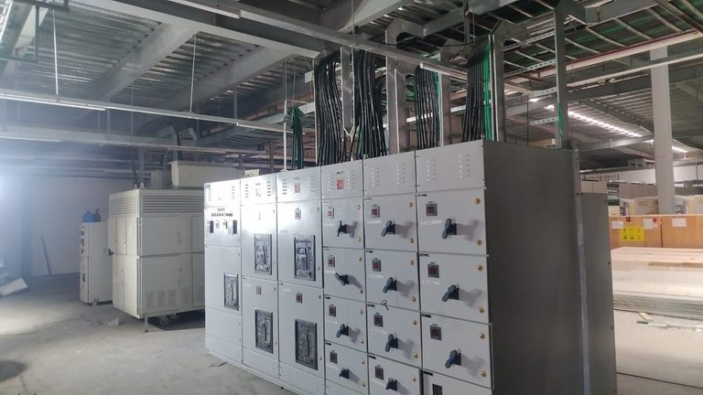
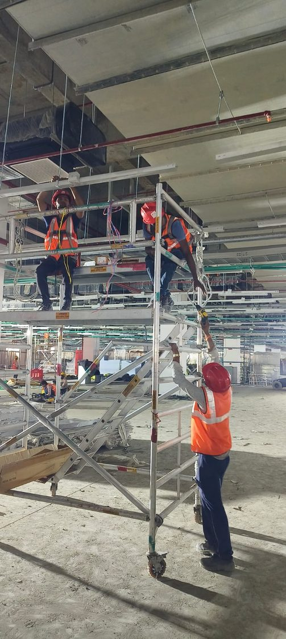
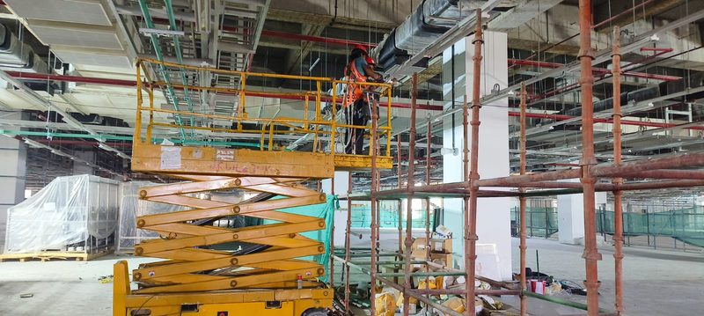
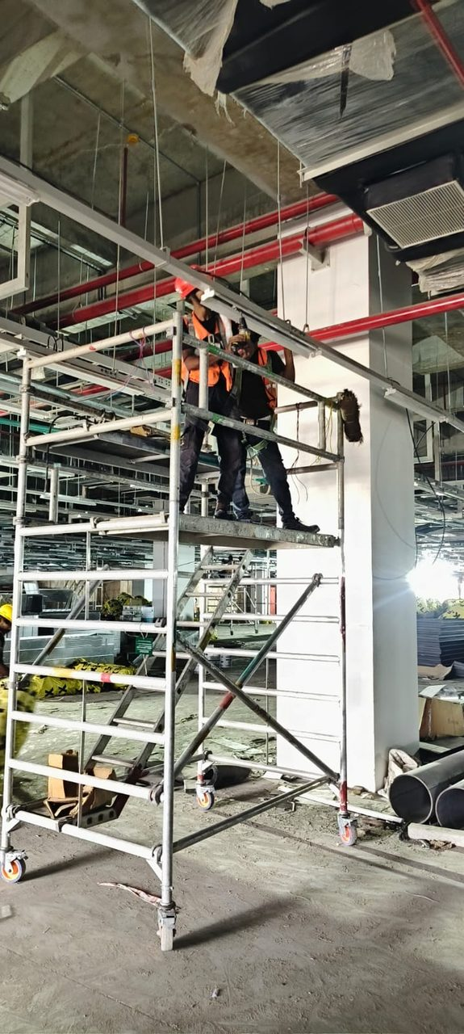
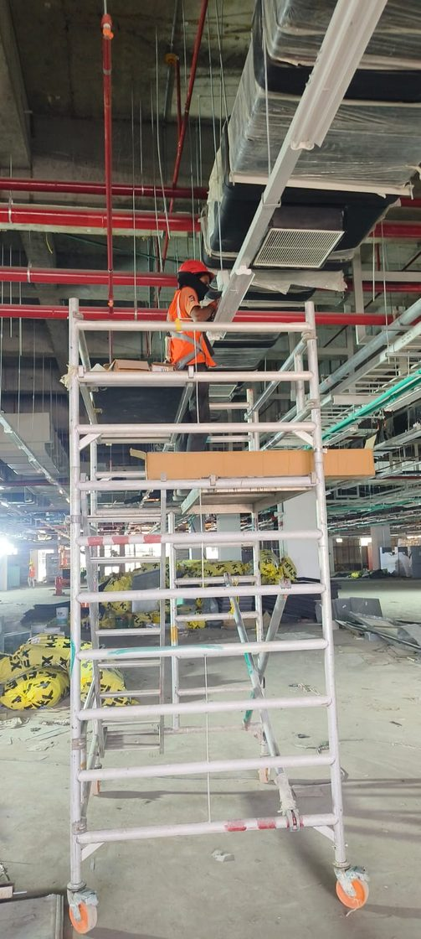
Foxconn
PROJECT IMAGES
FOXCONN – A03
[Add a 2–4 word caption under each photo, e.g. “Main LT Panel”]
[Check work-at-height photos: harness & guardrails must be clearly visible]

Slide 21
Foxconn
PROJECT INFORMATION
FOXCONN – B05
[Confirm you are permitted to use the Foxconn name]
Client: Scon Projects, Pune
Project: Axana Estate LLP – B05
Location: Oragadam, Walajabad Taluk, Tamil Nadu – 631604
Project Type: Industrial
Capacity: [confirm capacity]
Work Awarded: HT/LT installation [confirm]
Detailed Scope: [Detailed scope – e.g. no. & rating of transformers, HT/LT panels, cable length, CEIG approval]
Project Value: [confirm value]
Duration: [confirm duration]
Status: Ongoing

Slide 22
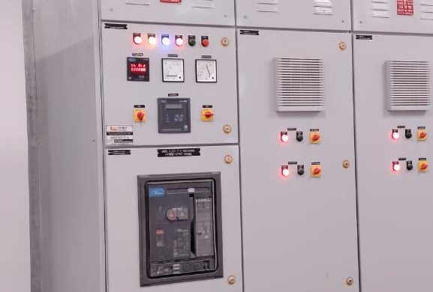
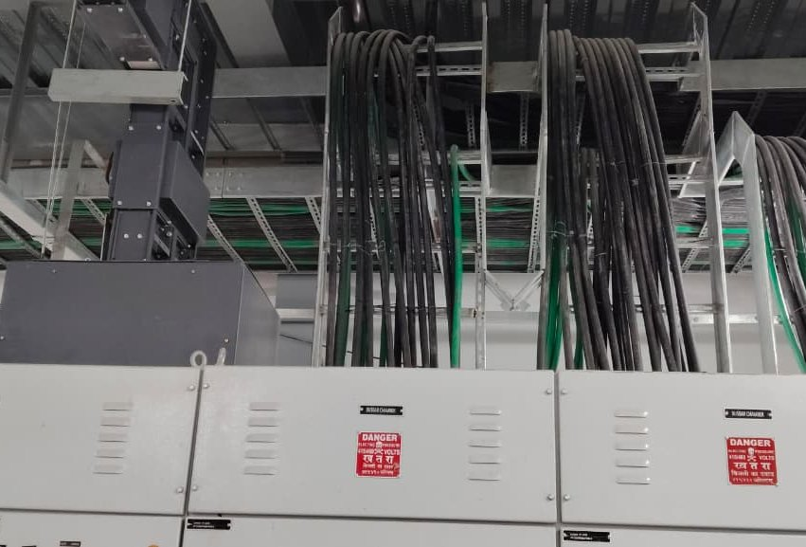
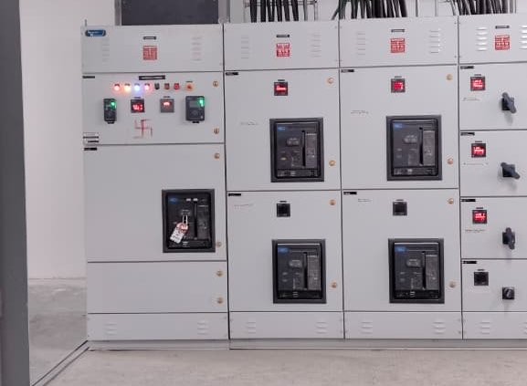
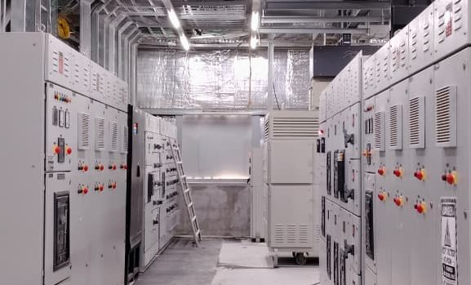
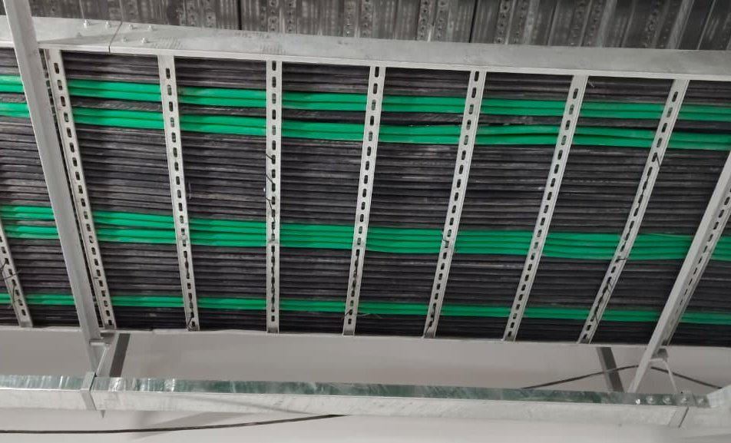

Foxconn
PROJECT IMAGES
FOXCONN – B05
ACB incomer panel
Cable trays & LT panels
LT panel board
LT panel room
Cable tray routing
Panels & cable risers

Slide 23
Aequs Unit-4
About
PROJECT INFORMATION
AEQUS UNIT-4, HUBBALLI
Client: Crownstone Constructions Pvt Ltd
Project: Unit-4, Aequs HDC
Location: Aequs HDC, Itigatti, Hubballi – 580114
Project Type: Industrial
Capacity: 10 MVA
Work Awarded: HT/LT supply & installation
Detailed Scope: [Detailed scope – e.g. no. & rating of transformers, HT/LT panels, cable length, CEIG approval]
Project Value: ₹2.2 Cr
Duration: 6 months
Status: Ongoing

Slide 24











Aequs Unit-4
PROJECT IMAGES
AEQUS UNIT-4, HUBBALLI
HT panel installation
Compact substation
Transformer installation
MCB distribution board
Outdoor LT panels
Wiring in progress

Slide 25
Sterling Tech
About
PROJECT INFORMATION
STERLING TECH MOBILITY
Client: Sterling Tech Mobility Ltd
Project: [Describe the facility – e.g. EV manufacturing plant]
Location: KIADB Industrial Area, Arebannimangala, Bengaluru – 562149
Project Type: Industrial
Capacity: 1,000 kVA (1 MVA)
Work Awarded: LT-side supply & installation
Project Value: ₹1.2 Cr
Duration: 8 months
Status: Completed

Slide 26






Sterling Tech
PROJECT IMAGES
STERLING TECH MOBILITY
DG set installation
Transformer yard
UPS & battery bank
LT panel board
UPS distribution board
Office lighting

Slide 27





Sterling Tech
PROJECT IMAGES
STERLING TECH MOBILITY
Structure stage
Main LT panel room
Wall panel & cable risers
Cable routing & junction boxes
Corridor lighting
Completed facility

Slide 28
Farmhouse
About
PROJECT INFORMATION
FARMHOUSE
Client: Crownstone Constructions Pvt Ltd
Project: Farmhouse
Location: Belagavi, Karnataka [confirm exact location]
Project Type: Residential
Capacity: 500 kVA [confirm – earlier version said 50 kVA]
Work Awarded: LT supply & installation
Project Value: ₹50 Lakh
Duration: 2 years
Status: Ongoing
[No photos for this project – add a photo slide, or show it only in the Ongoing Projects table]

Slide 29




Licences
About
LICENCES & PERMITS
Electrical Supervisor Permit – Grade I
Permit No.
1SP200879BGM
Valid till 31/12/2030
Class I Electrical Contractor Licence
Licence No.
1CL202315BGM
Works up to & including 33 kV
Valid till 31/01/2031
[If this is a renewal, add “Licensed since 20XX”]
Verify at
vidyuthsuraksha.karnataka.gov.in

Slide 30

Licences
UDYAM (MSME) REGISTRATION
Udyam Registration No.
UDYAM-KR-04-0120128
Enterprise type: Micro · Activity: Services
NIC 43219 – Electrical installation
GSTIN: 29CIZPP4477R1ZK
Verify at
udyamregistration.gov.in

Slide 31
Contact Us
CONTACT US
Name: Mrs. Priyadarshini B.P.
Designation: Proprietor
Mobile: +91 90350 27395
Email: priya@adlercontracts.com | adlercontracts@gmail.com
Address: Shop No. G-01, Saraf Enclave, Plot No. 1/A, RS No. 43/2A, Bauxite Road, Azam Nagar, Belagavi – 590010, Karnataka
GSTIN: 29CIZPP4477R1ZK
Website: www.adlercontracts.com
Thank you

