Slide 1


SQL - Business Case: Target

Slide 2
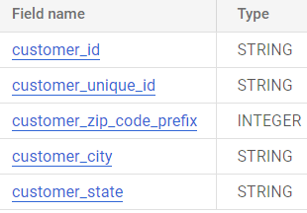
1→1. Import the dataset and do usual exploratory analysis steps like checking the structure & characteristics of the dataset:
1.Data type of all columns in the "customers" table.
The Data Type present in these columns are:
customer_id ---> STRING
customer_unique_id ---> STRING
customer_zip_code_prefix ---> INTEGER
customer_city ---> STRING
customer_state ---> STRING

Slide 3
1→ 2. Get the time range between which the orders were placed.
The Time Range Between The Orders Placed Where
QUERY:
SELECT MIN(order_purchase_timestamp) AS first_order_date,MAX(order_purchase_timestamp) AS last_order_date,
ABS(DATETIME_DIFF(MIN(order_purchase_timestamp),MAX(order_purchase_timestamp),DAY)) AS number_of_days
FROM `TARGET_RETAIL_STORE.orders`
CODE IN BIGQUERY :
QUERY RESULT:

Slide 4
Therefore:
The First Order Was Made On ----> “2016-09-04”
The Second Order Was Made On ----> “2018-10-17”
The Time Range Between Orders Placed Was ----> 772 Days

Slide 5

1→ 3.Count the Cities & States of customers who ordered during the given period.
The Count Of Cities And States Was
QUERY:
SELECT COUNT(DISTINCT c.customer_city) AS city_count,COUNT(DISTINCT c.customer_state) AS state_count
FROM`TARGET_RETAIL_STORE.customers`AS c JOIN `TARGET_RETAIL_STORE.orders`AS o ON
c.customer_id=o.customer_id WHERE order_purchase_timestamp BETWEEN "2016-09-04 21:15:19 UTC" AND "2018-10-17 17:30:18 UTC"
CODE IN BIGQUERY:
RESULT:

Slide 6
Therefore:
The Count Of Cities Of Customers Was ----> 4119
The Count Of States Of Customers Was ---- >27

Slide 7
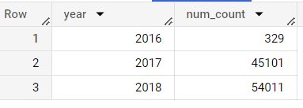
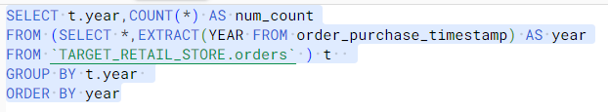
2.In-depth Exploration 2→1. Is there a growing trend in the no. of orders placed over the past years?
QUERY:
SELECT t.year, COUNT(*) AS num_count
FROM (SELECT * ,EXTRACT (YEAR FROM order_purchase_timestamp) AS year
FROM`TARGET_RETAIL_STORE.orders`) t
GROUP BY t.year
ORDER BY year
CODE IN BIGQUERY: RESULT:

Slide 8
IN 2017 The Number Of Orders Was 45101 But In 2018 The Order Was 54011 Which Is 19.77 Percent Hike .Therefore There Is A Growing Trend In Number Of Orders Placed Over Past Year .
RECOMMENDATION:
Target retail store has experienced a significant growth in the number of orders placed, with a notable increase from 329 orders in 2016 to 54,011 orders in 2018.To maximize this upward trend , Target retail store should prioritize improving the online shopping experience.

Slide 9
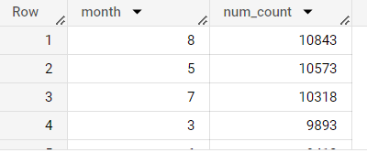
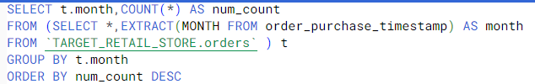
2→2.Can we see some kind of monthly seasonality in terms of the no. of orders being placed?
QUERY:
SELECT t.month,COUNT(*) AS num_count
FROM (SELECT *, EXTRACT (MONTH FROM order_purchase_timestamp) AS month
FROM`TARGET_RETAIL_STORE.orders`)t
GROUP BY t.month
ORDER BY num_count DESC
QUERY : RESULT:
Result:

Slide 10
IN 2017 The Number Of Orders Was 45101 But In 2018 The Order Was 54011 Which Is 19.77 Percent Hike .Therefore There Is A Growing Trend In Number Of Orders Placed Over Past Year .
RECOMMENDATION:
Target should analyse the monthly seasonality in the number of orders placed to identify patterns .By planning targeted promotions and enhancing operational capacity during peak months, Target can maximize sales and improve customer satisfaction.

Slide 11
2→3. During what time of the day, do the Brazilian customers mostly place their orders? (Dawn, Morning, Afternoon or Night) 0-6 hrs : Dawn , 7-12 hrs : Mornings ,13-18 hrs : Afternoon ,19-23 hrs : Night
QUERY :
SELECT
CASE
WHEN EXTRACT(HOUR FROM order_purchase_timestamp) BETWEEN 0 AND 6 THEN "Dawn"
WHEN EXTRACT(HOUR FROM order_purchase_timestamp) BETWEEN 7 AND 12 THEN "Morning"
WHEN EXTRACT(HOUR FROM order_purchase_timestamp) BETWEEN 13 AND 18 THEN "Afternoon"
ELSE "Night" END AS time_of_day, COUNT(order_id) AS num_orders
FROM`TARGET_RETAIL_STORE.orders`
GROUP BY
CASE
WHEN EXTRACT(HOUR FROM order_purchase_timestamp) BETWEEN 0 AND 6 THEN "Dawn"
WHEN EXTRACT(HOUR FROM order_purchase_timestamp) BETWEEN 7 AND 12 THEN "Morning"
WHEN EXTRACT(HOUR FROM order_purchase_timestamp) BETWEEN 13 AND 18 THEN "Afternoon"
ELSE "Night" END

Slide 12
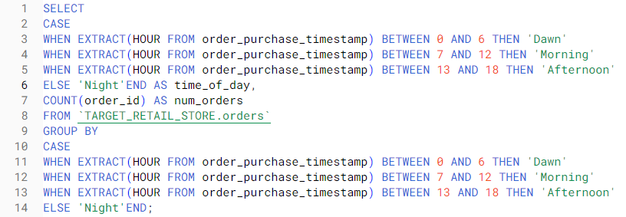
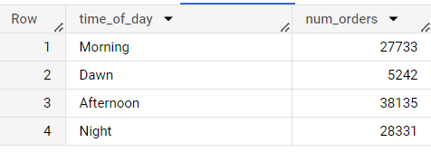
CODE IN BIGQUERY :
RESULT:

Slide 13
RECOMMENDATION:
Brazilian customers predominantly place their orders in the afternoon, followed by the morning and night, with fewer orders during dawn.
To optimize operations, Target should allocate resources accordingly during peak hours, ensuring efficient order processing and timely customer support.
Additionally, Target should focus on offering promotions or discounts during the morning and night to encourage more orders during those times and running targeted campaigns.

Slide 14
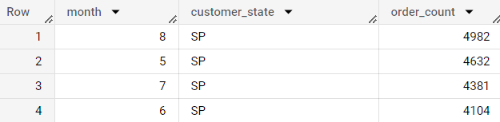
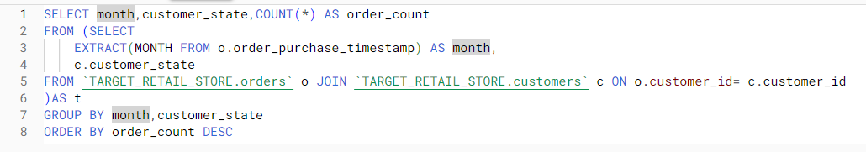
3.Evolution of E-commerce orders in the Brazil region: 3→1.Get the month on month no. of orders placed in each state
QUERY:
SELECT month,customer_state,COUNT(*) AS order_count
FROM(SELECT EXTRACT(MONTH FROM o.order_purchase_timestamp) AS month,c.customer_state
FROM `TARGET_RETAIL_STORE.orders` o JOIN `TARGET_RETAIL_STORE.customers` c
ON o.customer_id=c.customer_id) AS t
GROUP BY month,customer_state
ORDER BY order_count DESC
CODE IN BIGQUERY: RESULT:

Slide 15
RECOMMENDATION:
Implement targeted marketing campaigns in São Paulo to maintain market dominance.
Focus on market expansion and localized strategies in Rio de Janeiro and Minas Gerais with local influencers, and targeted promotions to increase brand awareness, attract new customers, which will higher order volumes in these states.
Offer personalized rewards, exclusive discounts,to customers in each state to foster long-term loyalty and increase order counts.
By capitalizing on peak seasons and specific events, Target can boost customer engagement and drive increased orders.

Slide 16

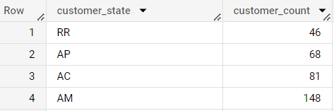
3→2.How are the customers distributed across all the states?
QUERY:
SELECT customer_state,COUNT(DISTINCT customer_id) AS customer_count
FROM `TARGET_RETAIL_STORE.customers`
GROUP BY customer_state
ORDER BY customer_count ASC
CODE IN BIGQUERY: RESULT:

Slide 17
RECOMMENDATION:
Target should continue to invest in strengthening its market presence in high-density states like SP, RJ, and MG.
Implement targeted marketing campaigns, enhance customer engagement to maintain and expand the customer base in these states.
Target should explore expansion opportunities in states with lower customer counts, such as RR, AP, AC, and AM. It will further increase new customers.

Slide 18
4. Impact on Economy: Analyze the money movement by e-commerce by looking at order prices, freight and others. 4→1.Get the % increase in the cost of orders from year 2017 to 2018 (include months between Jan to Aug only). You can use the "payment_value" column in the payments table to get the cost of orders.
QUERY:
WITH cte AS
(SELECT P.payment_value ,EXTRACT(YEAR FROM O.order_purchase_timestamp ) AS date_year
FROM `TARGET_RETAIL_STORE.orders` AS O JOIN `TARGET_RETAIL_STORE.payments` AS P ON O.order_id = P.order_id
WHERE O.order_purchase_timestamp BETWEEN "2017-01-01" AND "2017-08-31"
UNION ALL
SELECT P.payment_value , EXTRACT(YEAR FROM O.order_purchase_timestamp ) AS date_year
FROM `TARGET_RETAIL_STORE.orders` as O join `TARGET_RETAIL_STORE.payments` AS P ON O.order_id = P.order_id
WHERE O.order_purchase_timestamp BETWEEN "2018-01-01" AND "2018-08-31"),
cte2 AS (
SELECT SUM(
CASE WHEN date_year = 2017 THEN payment_value ELSE 0 END) AS total_spend_2017,
SUM(
CASE WHEN date_year = 2018 THEN payment_value ELSE 0 END) AS total_spend_2018
FROM cte
)
SELECT ROUND(total_spend_2017,2) AS total_spend_2017,ROUND(total_spend_2018,2) AS total_spend_2018 ,
ROUND((total_spend_2018 - total_spend_2017)*100 / total_spend_2017,2) AS percentage_increase
FROM cte2

Slide 19
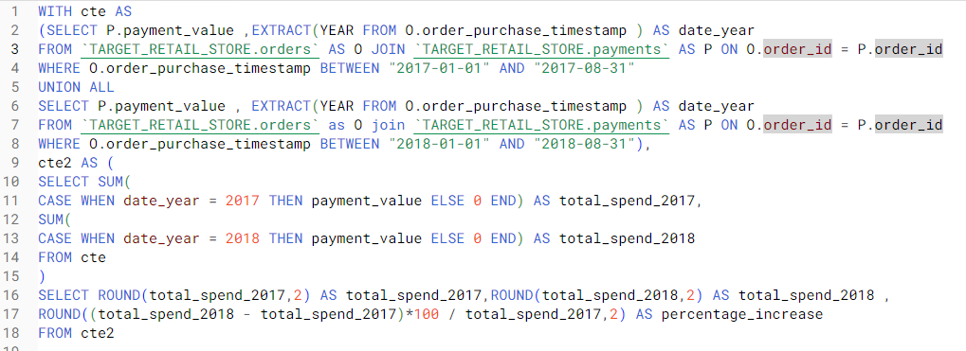

CODE IN BIGQUERY :
QUERY RESULT:

Slide 20
RECOMMENDATION:
Segment the customers based on purchasing behavior to personalize marketing and promotions, enhancing customer satisfaction and loyalty.
Improve customer experience through streamlined processes, responsive support, and convenient delivery options.

Slide 21
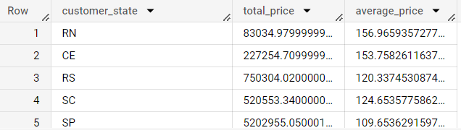
4→2. Calculate the Total & Average value of order price for each state.
QUERY:
SELECT t.customer_state,SUM(t.price) AS total_price,AVG(t.price) AS average_price
FROM(SELECT *
FROM `TARGET_RETAIL_STORE.customers` AS c JOIN `TARGET_RETAIL_STORE.orders` AS o ON c.customer_id=o.customer_id
JOIN `TARGET_RETAIL_STORE.order_items` AS os ON o.order_id=os.order_id) t
GROUP BY t.customer_state
CODE IN BIGQUERY: RESULT:

Slide 22
RECOMMENDATION:
The Target should focus on Paraíba state to do targeted marketing campaigns to attract and retain high-value customers.
Offer personalized recommendations, exclusive promotions to further increase their spending.
Identify states with lower total order prices and focus on improving the conversion rate by enhancing the customer experience.
Develop localized marketing strategies for different states to cater to regional preferences and cultural nuances

Slide 23
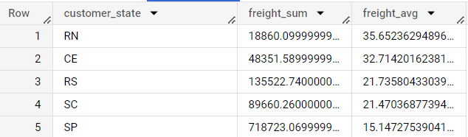
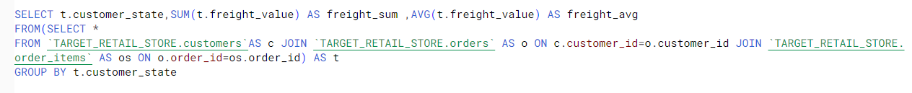
4→3. Calculate the Total & Average value of order freight for each state.
QUERY:
SELECT t.customer_state,SUM(t.freight_value) AS freight_sum, AVG(t.freight_value) AS freight_avg
FROM(SELECT *
FROM `TARGET_RETAIL_STORE.customers` AS c JOIN `TARGET_RETAIL_STORE.orders` AS o ON c.customer_id=o.customer_id JOIN `TARGET_RETAIL_STORE.order_items` AS os ON o.order_id=os.order_id) AS t
GROUP BY t.customer_state
CODE IN BIGQUERY: RESULT:

Slide 24
RECOMMENDATION:
Analyse the factors contributing to higher freight charges in states like Rondônia and identify opportunities to optimize shipping strategies.
Explore partnerships with logistics providers to negotiate better rates.
Consider establishing regional warehouses or distribution centres strategically located in states with higher total freight values. This can reduce shipping distances and costs.

Slide 25
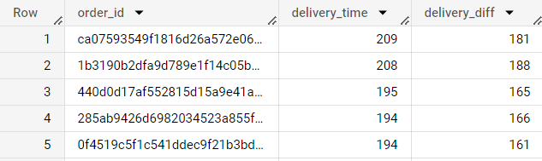
5. Analysis based on sales, freight and delivery time. 5→1.Find the no. of days taken to deliver each order from the order’s purchase date as delivery time. Also, calculate the difference (in days) between the estimated & actual delivery date of an order. Do this in a single query.
QUERY:
SELECT order_id,DATE_DIFF(order_delivered_customer_date,order_purchase_timestamp,DAY)AS delivery_time,
DATE_DIFF(order_delivered_customer_date,order_estimated_delivery_date,DAY) AS
Delivery_diff
FROM `TARGET_RETAIL_STORE.orders`
ORDER BY delivery_time DESC,delivery_diff DESC
CODE IN BIGQUERY: RESULT:

Slide 26
RECOMMENDATION:
Analyse the factors contributing to longer delivery times, such as transportation issues, or order processing delays.
Streamline the order full fillment process by optimizing warehouse operations, improving inventory management, and implementing efficient shipping and logistics practices to reduce delivery times.
Maintain clear and transparent communication with customers regarding estimated delivery dates and any potential delays. Proactively provide updates on order status and notify customers of any changes to the expected delivery timeframe.
Consider partnering with reliable logistics providers who can offer faster and more efficient delivery services.
Provide customers with a tracking system that allows them to monitor the progress of their orders in real-time.

Slide 27
. 5→2Find out the top 5 states with the highest & lowest average freight value
QUERY:
SELECT *
FROM(
(SELECT t.customer_state,t.freight_average,DENSE_RANK()OVER(ORDER BY t.freight_average DESC) AS highest_freight_average
FROM( SELECT c.customer_state,AVG(os.freight_value) AS freight_average
FROM `TARGET_RETAIL_STORE.customers` AS c JOIN `TARGET_RETAIL_STORE.orders` AS o ON c.customer_id=o.customer_id JOIN `TARGET_RETAIL_STORE.order_items` AS os ON o.order_id=os.order_id
GROUP BY c.customer_state
ORDER BY freight_average DESC) AS t) AS h
JOIN
(SELECT u.customer_state,u.freight_average,DENSE_RANK()OVER(ORDER BY u.freight_average ASC) AS lowest_freight_average
FROM( SELECT c.customer_state,AVG(os.freight_value) AS freight_average
FROM `TARGET_RETAIL_STORE.customers` AS c JOIN `TARGET_RETAIL_STORE.orders` AS o ON c.customer_id=o.customer_id JOIN `TARGET_RETAIL_STORE.order_items` AS os ON o.order_id=os.order_id
GROUP BY c.customer_state
ORDER BY freight_average DESC) AS u) AS l
ON h.highest_freight_average=l.lowest_freight_average)
ORDER BY lowest_freight_average
LIMIT 5

Slide 28
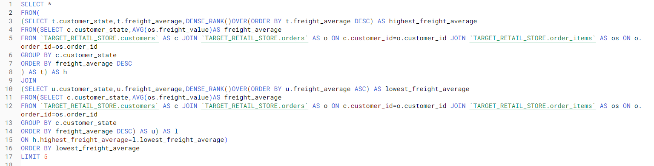
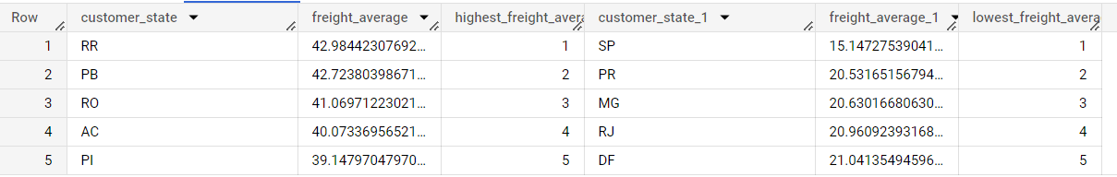
CODE IN BIGQUERY:
RESULT:

Slide 29
RECOMMENDATION:
Analyse the factors contributing to the high average freight values in states like RR, PB, RO, AC, and PI. Identify any inefficiencies in transportation networks, logistics processes, or shipping routes that may be causing higher freight costs.
Review the contracts with shipping providers in states like SP, PR, MG, RJ, and DF, where the average freight values are comparatively lower.
Look for opportunities to optimize routes, negotiate better contracts with shipping providers, or explore alternative transportation methods to reduce freight expenses.
By combining multiple orders into a single shipment whenever possible, you can minimize the number of individual shipments and reduce overall freight costs.

Slide 30
5→3. Find out the top 5 states with the highest & lowest average delivery time.
QUERY:
SELECT * FROM( (SELECT t.customer_state,t.average_diff,RANK()OVER(ORDER BY t.average_diff DESC) AS highest_day_diff
FROM( SELECT c.customer_state,AVG(DATE_DIFF(o.order_delivered_customer_date,o.order_purchase_timestamp,DAY)) AS average_diff
FROM `TARGET_RETAIL_STORE.customers` AS c JOIN `TARGET_RETAIL_STORE.orders` AS o ON c.customer_id=o.customer_id
GROUP BY c.customer_state) AS t) AS H
JOIN
(
SELECT u.customer_state,u.average_diff,RANK()OVER(ORDER BY u.average_diff ASC) AS lowest_day_diff
FROM( SELECT c.customer_state,AVG(DATE_DIFF(o.order_delivered_customer_date,o.order_purchase_timestamp,DAY)) AS average_diff
FROM `TARGET_RETAIL_STORE.customers` AS c JOIN `TARGET_RETAIL_STORE.orders` AS o ON c.customer_id=o.customer_id
GROUP BY c.customer_state) AS u) AS L
ON H.highest_day_diff=L.lowest_day_diff)
ORDER BY lowest_day_diff
LIMIT 5

Slide 31
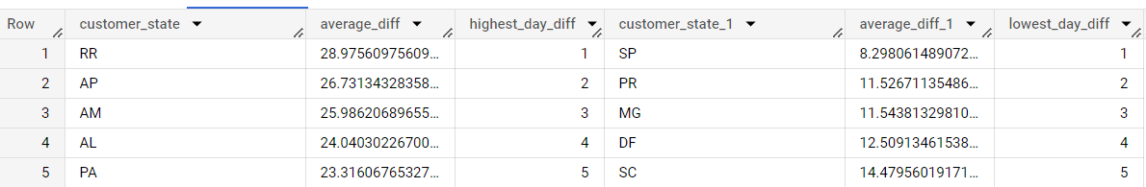
CODE IN BIGQUERY:
RESULT:

Slide 32
RECOMMENDATION:
Evaluate the logistics processes in states with higher average delivery times, such as RR, AP, AM, AL, and PA.
optimize transportation routes, and explore partnerships with reliable local logistics providers to reduce delivery times.
Optimize warehouse operations to minimize processing and handling times for orders and improve coordination between warehouses and distribution centres.
Collaborate closely with shipping carriers and logistics partners to ensure timely and reliable delivery.
Consider establishing regional fullfillments centres or warehouses in states with high average delivery times

Slide 33
5→4. Find out the top 5 states where the order delivery is really fast as compared to the estimated date of delivery. You can use the difference between the averages of actual & estimated delivery date to figure out how fast the delivery was for each state.
QUERY:
SELECT t.customer_state,t.average_diff,RANK()OVER(ORDER BY t.average_diff DESC) AS rank_number
FROM( SELECT c.customer_state,AVG(DATE_DIFF(o.order_estimated_delivery_date,o.order_delivered_customer_date,DAY))AS average_diff
FROM `TARGET_RETAIL_STORE.customers` AS c JOIN `TARGET_RETAIL_STORE.orders` AS o ON c.customer_id=o.customer_id
GROUP BY c.customer_state) AS t
ORDER BY rank_number
LIMIT 5

Slide 34
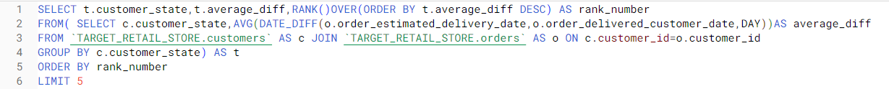
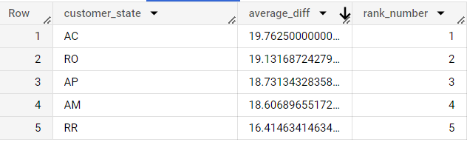
CODE IN BIGQUERY:
RESULT:

Slide 35
RECOMMENDATION:
Analyse the delivery operations and processes in states with faster delivery times, such as AC, RO, AP, AM, and RR.
Identify the factors contributing to their success, such as efficient logistics networks, effective coordination between stakeholders, optimized transportation routes.
Invest in improving logistics infrastructure in states where delivery times are slower.
Evaluate the transportation network, road conditions, and warehouse facilities in these states.

Slide 36
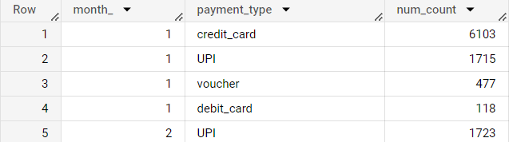
6→1. Find the month on month no. of orders placed using different payment types.
QUERY:
SELECT EXTRACT(MONTH FROM o.order_purchase_timestamp) AS month_ , p.payment_type,COUNT(o.order_id) AS num_count
FROM `TARGET_RETAIL_STORE.orders` AS o JOIN `TARGET_RETAIL_STORE.payments` AS p ON o.order_id=p.order_id
GROUP BY month_,payment_type
ORDER BY month_
CODE IN BIGQUERY: RESULT:

Slide 37
RECOMMENDATION:
Ensure that there are diverse range of payment options to customer preferences.
Consider integrating popular payment methods such as credit cards, UPI , debit cards, and vouchers.
Offering a variety of payment choices can enhance the customer experience.
Highlight the benefits, convenience, and security features of these payment options to encourage more customers to adopt them.
Ensure that the payment options are clearly displayed and easily accessible.
Stay updated with emerging payment technologies.

Slide 38
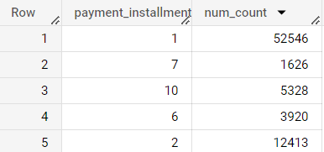
6→2. Find the no. of orders placed on the basis of the payment installments that have been paid.
QUERY:
SELECT p.payment_installments,COUNT(o.order_id) AS num_count
FROM `TARGET_RETAIL_STORE.orders` AS o JOIN `TARGET_RETAIL_STORE.payments` AS p ON o.order_id=p.order_id
GROUP BY payment_installments
CODE IN BIGQUERY: RESULT:

Slide 39
RECOMMENDATION:
Ensure that customers have clear and transparent information about the available payment installment options.
Highlight the availability of installment payment plans to customers.
Clearly communicate the benefits, such as spreading out payments over time or making larger purchases more affordable.
Keep track of customer feedback and preferences to identify any areas for improvement or adjustments to your payment offerings.
Regularly evaluate the performance of installment plans and make necessary updates to optimize customer satisfaction and conversion rates.

