Slide 1
Uber Cases tudy
By Kishore Kumar Poosa

Slide 2
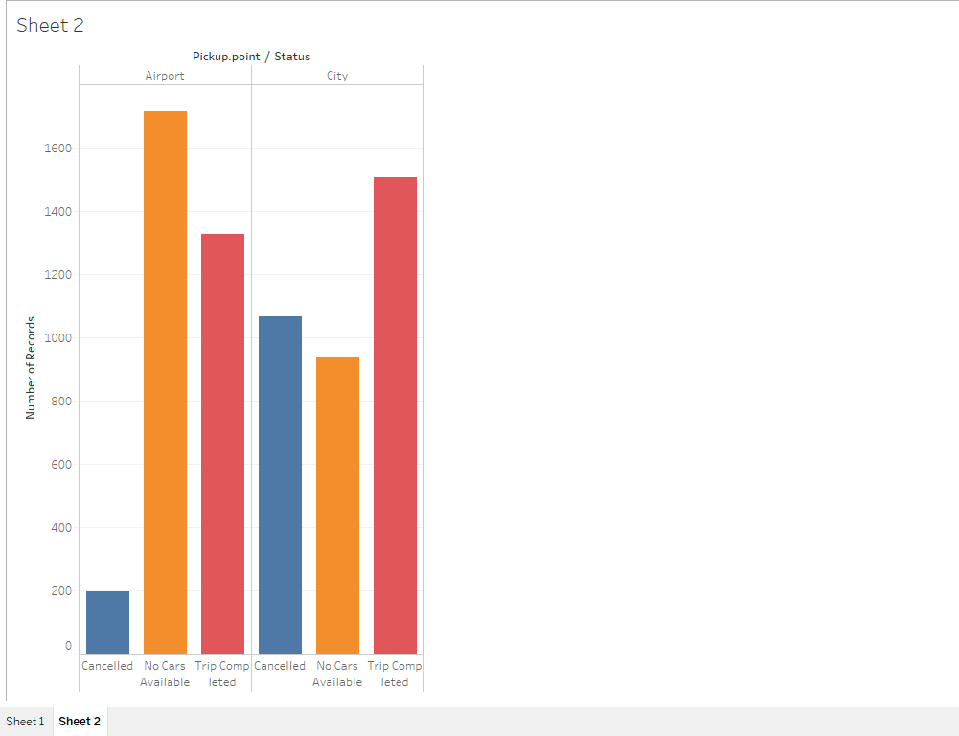
Results discussions
This says major number of airport pick ups, showing the status of no cars available.
Secondly major portion City pick ups are getting cancelled due to the drop location is airport.
It is clear that many are cancelling from city to air-port
Let us analyze this further to find out during what time this is happening.

Slide 3
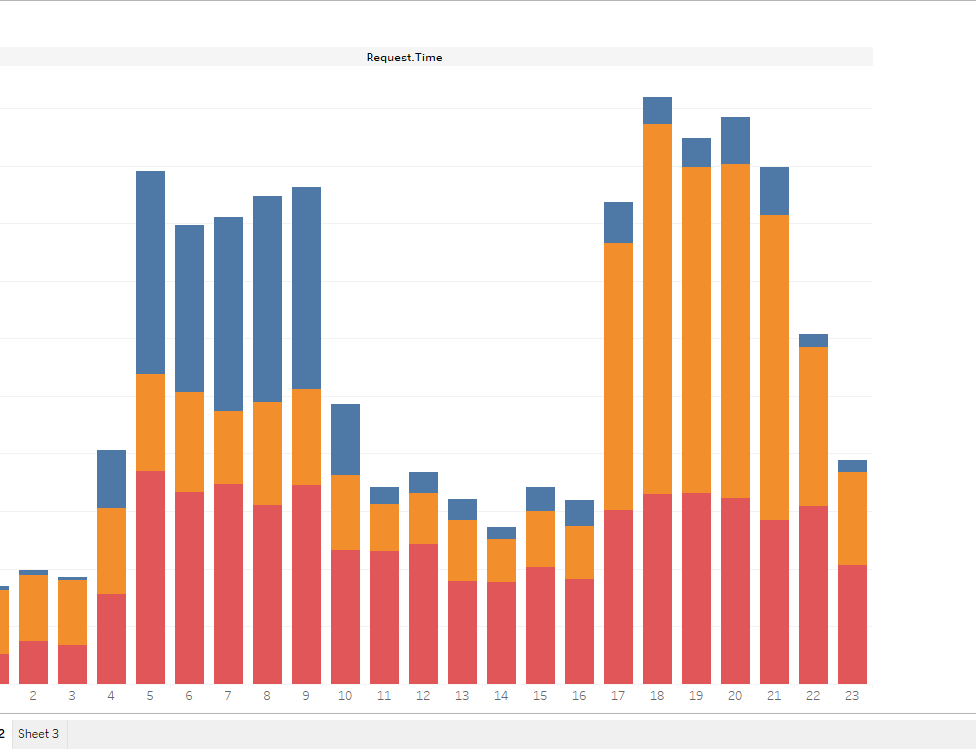
This figure shows along the time axis , the number of bookings and cancellations done
To make this much clear, I have divided time axis into time slots
01 to 04 - Late Nights
04 to 08 – Early Mornings
08 to 12 – Mornings
12 to 15 – Afternoon
15 to 20 – Evenings
20 to 24 - Nights

Slide 4
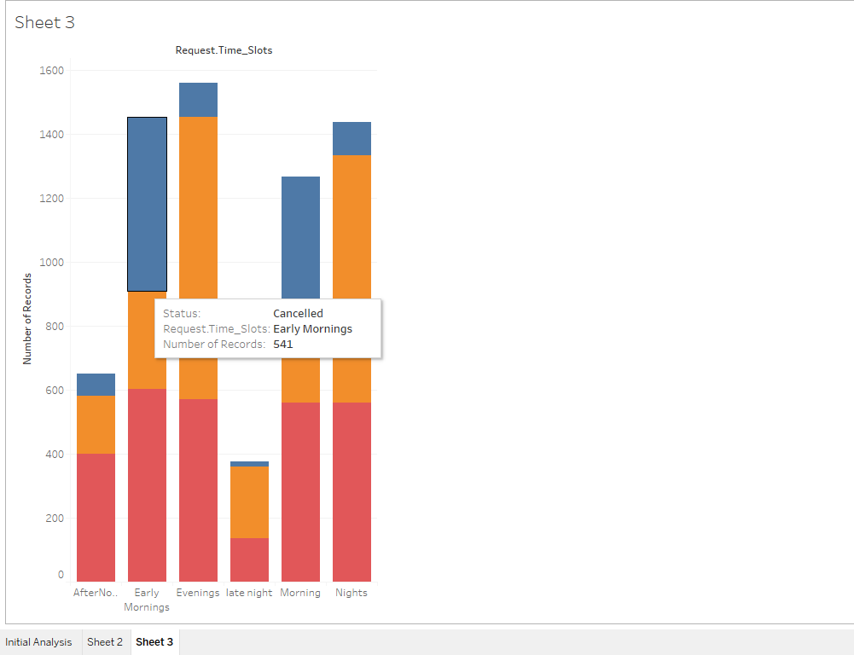
This picture drawn by keeping time slot on X-Axis and Number of requests on Y-Axis
Now this depicts that most number of cancellations happening during early mornings and mornings. Means 4 AM to 10 AM roughly.
We have to analyze why so ?

Slide 5
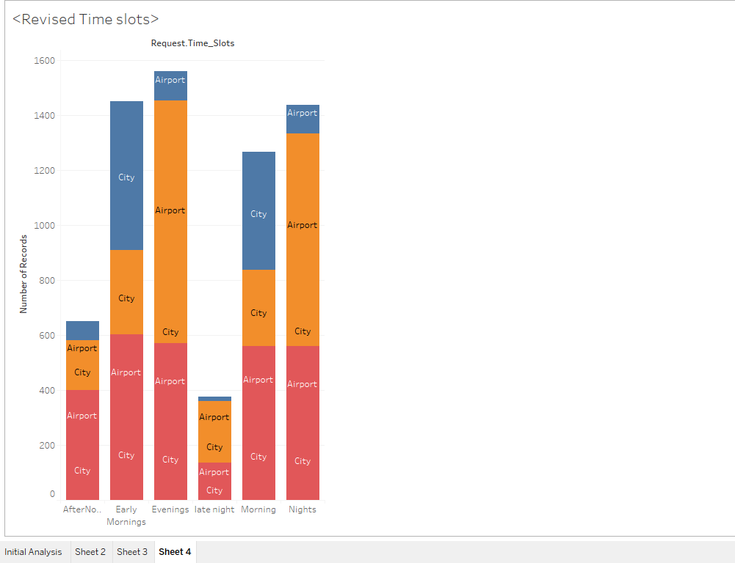
This is revised time slots and checked with the request locations.
Early mornings : 3 to 6
Morning : 6 to 10
Afternoon: 10 to 3
Evenings: 3 to 7
Night : 7 to 11
Graph clearly shows that major portion cancelled having pick up locations in the city.

Slide 6
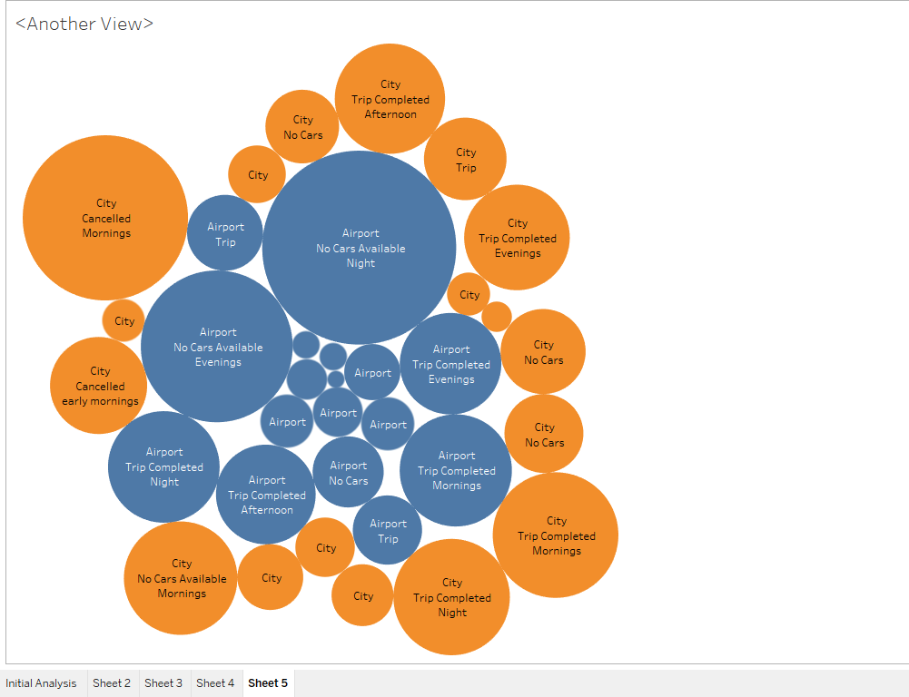
During Evenings and Nights we can see a demand supply gap a lot
Mainly Airport pick ups are facing this problem.

