Slide 1
Uber Cases tudy
By Kishore Kumar Poosa

Slide 2
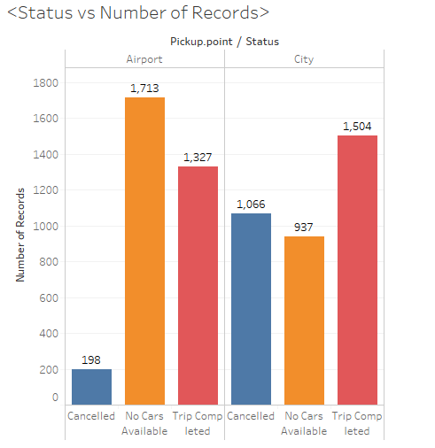
Analysis of Plots - Airport v/s City
Airport pickups are showing a large “No cars available” status
Secondly major portion City pick ups are getting cancelled
City to airport are getting cancelled and is almost 4.7 times compared to airport pickups.
Let us analyze this further to find out during what time this is happening.

Slide 3
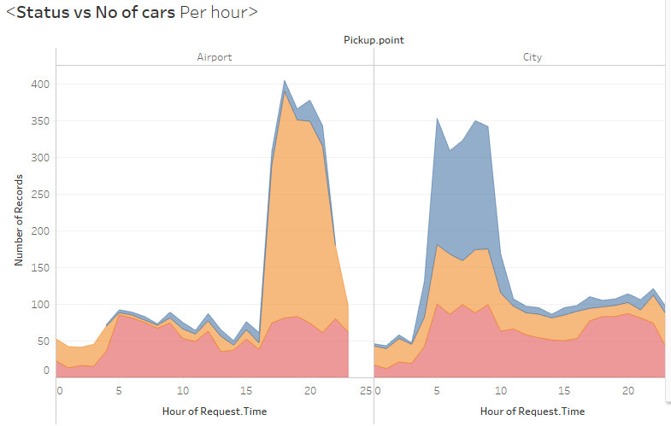
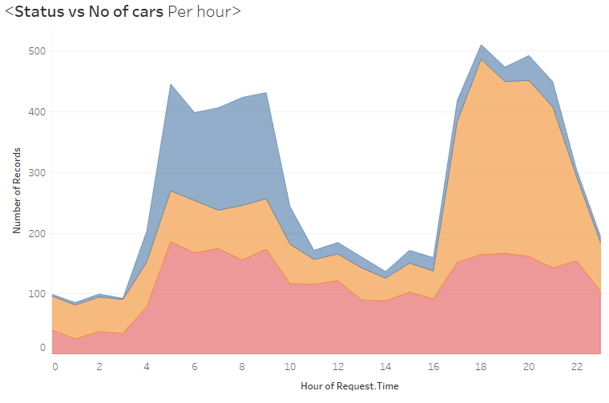
Hourly Analysis
This figure shows along the time axis , the number of bookings and cancellations done
It is evident that during 15 to 24 hours more Airport pickups are showing “No Cars Available” and during 4 to 20 city pickups are getting cancelled.
To make this much clear, I have divided time axis into time slots
01 to 04 - Late Nights
04 to 08 – Early Mornings
08 to 12 – Mornings
12 to 15 – Afternoon
15 to 20 – Evenings
20 to 24 - Nights

Slide 4
Overall Time slot analysis
Totals for | Early Mornings | Morning | AfterNoon | Evening | Night | Late Night
Completed Trips | 604 | 559 | 400 | 572 | 560 | 136
No Cars Available | 307 | 279 | 182 | 882 | 774 | 225
Cancelled Trips | 541 | 430 | 69 | 105 | 105 | 14

Slide 5
Airport Analysis
Totals | Early Morning | Morning | Afternoon | Evening | Night | Late Night
Completed trips | 277 | 243 | 187 | 276 | 277 | 67
No Cars Available | 44 | 34 | 55 | 801 | 665 | 114
Cancelled Trips | 15 | 24 | 36 | 63 | 60 | 0

Slide 6
City Analysis
Totals | Early Morning | Morning | AfterNoon | Evening | Night | LateNight
Completed trips | 327 | 316 | 213 | 296 | 283 | 69
No Cars Available | 263 | 245 | 127 | 82 | 109 | 111
Cancelled Trips | 526 | 406 | 33 | 42 | 14 | 45

Slide 7
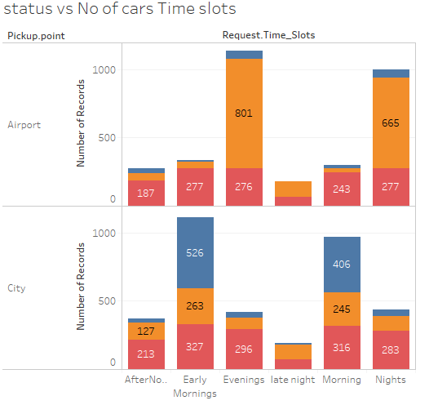
Time Slot Analysis
This picture drawn by keeping time slot on X-Axis and Number of requests on Y-Axis
Red: Trip Complete
Orange: No Cars
Blue: Cancelled Bookings
Now this depicts that most number of cancellations happening during early mornings and mornings. Means 4 AM to 10 AM roughly.
Let us analyze further to find some more insights

Slide 8
This is revised time slots and checked with the request locations.
Graph clearly shows that major portion showing cars not available during evenings and nights effectively time between 16 to 23.
This is Demand –Supply Gap
Let us view the whole scenario in a single diagram

Slide 9
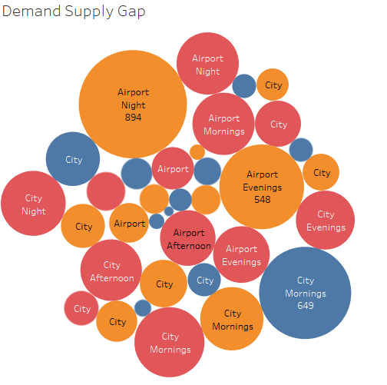
Hawk View
AIRPORTS: no cars available during evenings and nights
CITY: More cancellations happening during mornings
Average travel time 52.41 minutes

Slide 10
Cause analysis and Improvement suggestions
Reasons for Demand supply gap :
This is happening during evenings and nights, during which all schools , colleges and office closing time.
So drivers may get many short trips which gives them more profit. Hence no one going towards airport, which is creating a demand supply gap.
The uber drivers may be late in the city and the long waits by prospective passengers and second time or more passengers may result in cancellations
There could be traffic and rush hours during the day time and lack of drivers for night shifts at night resulting in short supply at night
Long wait times could result in more cancellations in the morning
If driver pickups the ride in the mornings and goes to airport, there may not be any pick ups, which consisted long wait times for drivers.

Slide 11
Proposed Solutions:
Divert the cars to airports during late nights by giving more offers to driver during evenings for air port pickups may reduce demand supply gap.
Planning and Scheduling should be resorted to with the help or operations research and critical path for the rides from the city to the Airport
Monthly Weekly and hourly stats for cancellations should be tracked and these callers should be given less priority
Ensure more drivers are available at night and realistic wait times are given to city and airport customers to avoid cancellations in cities and longer wait times and demand at the airport

