Slide 1
Affordify
By Team 24

Slide 2
Team Details
Client Team : 23 Development Team : 24 Team members: Giri Sharan Reddy Pusuluru (B00913674) Jay Jitendrakumar Mulani (B00940800) Kishoreganesh Sundararajan (B00934548) Kovarthanan Murugan (B00936880) Vishwa Pankajbhai Parmar (B00930141)

Slide 3
Meeting Statistics
Meeting with Client: 14 Meeting with TA: 7 Internal Meeting: 24

Slide 4
Project Summary
Web-application to compare price of groceries from various websites.
View the price trend chart of the product user wish to buy.​
User can favourite the items they like.
Newsletter feature to notify on recent price changes.
Feature to add favourite items.
Navigate user to desired selling site.

Slide 5
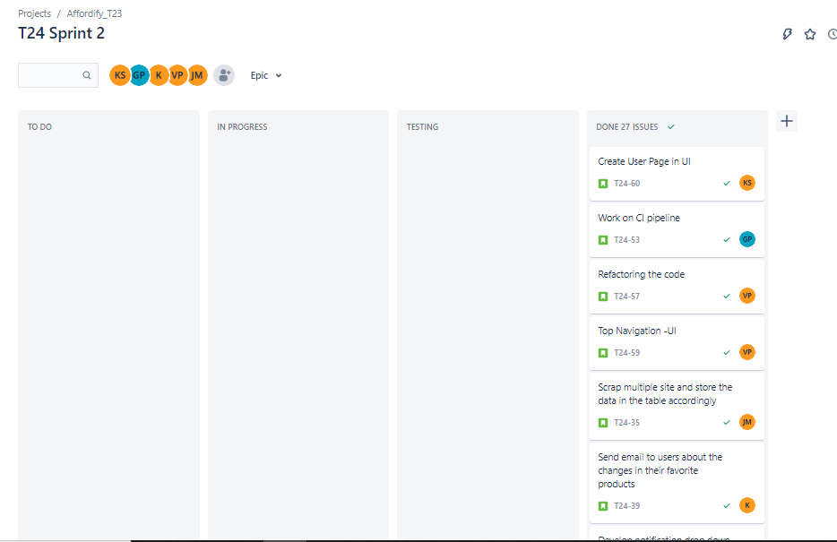
Dashboard

Slide 6
Task status
Team Member | Tasks done
Giri Sharan Reddy Pusuluru | Save and read favorite product, login and JWT Authentication,Registration page,category fearure, navigation bar, Unit Testing.
Jay Jitendrakumar Mulani | Web Scraping, CI/CD , Notification (UI), Remote Database connection and bug fixes.
Kishoreganesh Sundararajan | Price chart feature, Price chart(UI), User page (UI),Erd and Class diagram, Search Product feture, refactoring.
Kovarthanan Murugan | Delete favorite, Filer product, price change notification, Newsletter feature, favorite page (UI), Login page, display products (UI),
Vishwa Pankajbhai Parmar | Registration Feature, Email feature, refactoting code smells, product filter (UI) , Top navigation bar (UI).

Slide 7
Demo
Video Link :
https://drive.google.com/drive/folders/1nPIgOIaKNDTQv7QFq6Z3vmZtpa4iZ73I?usp=sharing

Slide 8
Project Milestones (Mid-term)
Requirements | Status
Login and Registration​ | Achieved
Email Notification Service | Achieved
​ Product Page (static) | Achieved
Search features | Achieved

Slide 9
Project Milestones (End of term)
Requirement | Feature | Status
Home page | Search | Achieved
 | Filters | Achieved
 | Category cards | Achieved
 | Navigation bar | Achieved
Search Result Page | Products List | Achieved
 | Filters | Achieved

Slide 10
Requirement | Feature | Status
Product Page | Product Details | Achieved
 | Price Chart | Achieved
 | Add Favourites | Achieved
 | Order Button | Achieved
Favourite Page | List Favourite Products | Achieved
Web Scraping | Scraping Bot | Achieved
 | Scrap Multiple Sites | Partially Achieved
Additional Features | Remove favourites | Achieved

Slide 11
Learnings:
Challenges:
Learning springboot and React.
Understanding web scraping techniques.
Writing clean Rest Api’s.
Maintaining pipelines and Tests.
Code refactoring and Code smell analysis.
Script based websites and anti-scraping technology.
Cleaning scraped data.
Learning new frameworks, technology and languages.
New Team with minimal experience.

Slide 12
Thank you

