Slide 1


Drone-based thermal imaging for forest fire detection
International Conference on
Modern Trends in Engineering, Science, Management, and Technology (MESMT-2026)
Authors: Suriya P B
Mohamed Arsal A
Sharan S
Supervisor: Ms.M.Mathumitha
Institute: M.A.M.College of engineering and technology

Slide 2
Outline / Agenda
Introduction
Problem Statement & Objectives
Literature Review
Proposed Methodology
Experimental Setup / Implementation
Results & Discussion
Conclusion & Future Scope

Slide 3
Introduction:
It’s core domain of drone-based thermal imaging for forest fire detection lies at the intersection of Remote Sensing, Computer Vision.
It is a specialized field designed to overcome the limitations of satellite monitoring and ground fields. It mainly used in Operational Environment & Constraints.

Slide 4
Problem Statement & Objectives
Problem Statement:
Current forest fire monitoring systems rely heavily on satellite imagery and fixed ground-based watchtowers, both of which possess critical operational gaps.
Satellites suffer from low temporal resolution and signal attenuation caused by cloud cover or heavy smoke, while ground towers are limited by topographical blind spots and line-of-sight obstructions.
Objectives:
To develop: develop an integrated hardware-software payload for a Vertical Take-Off and Landing (VTOL) drone, incorporating a radiometric thermal sensor and an onboard edge-AI processor.

Slide 5
To analyze: the spectral signatures of various forest materials (dry timber, peat, green foliage) under thermal imaging to establish a robust temperature-threshold algorithm that minimizes false-positive detections.
To evaluate: the efficiency of multi-spectral image fusion (overlaying thermal heat maps onto RGB visual feeds) in improving the situational awareness and coordinate accuracy for ground-based firefighting teams.

Slide 6
Literature Review
Author A-Yandouzi et al. (2025)
Method: Implemented a Deep Learning-based semantic segmentation approach using Mask R-CNN.
Author B-Shi et al. (2025)
Method: Developed a Thermal Transformer Network (TTN) based on the Vision Transformer (ViT) architecture to identify fire patterns in the FLAME 3 UAV dataset.

Slide 7
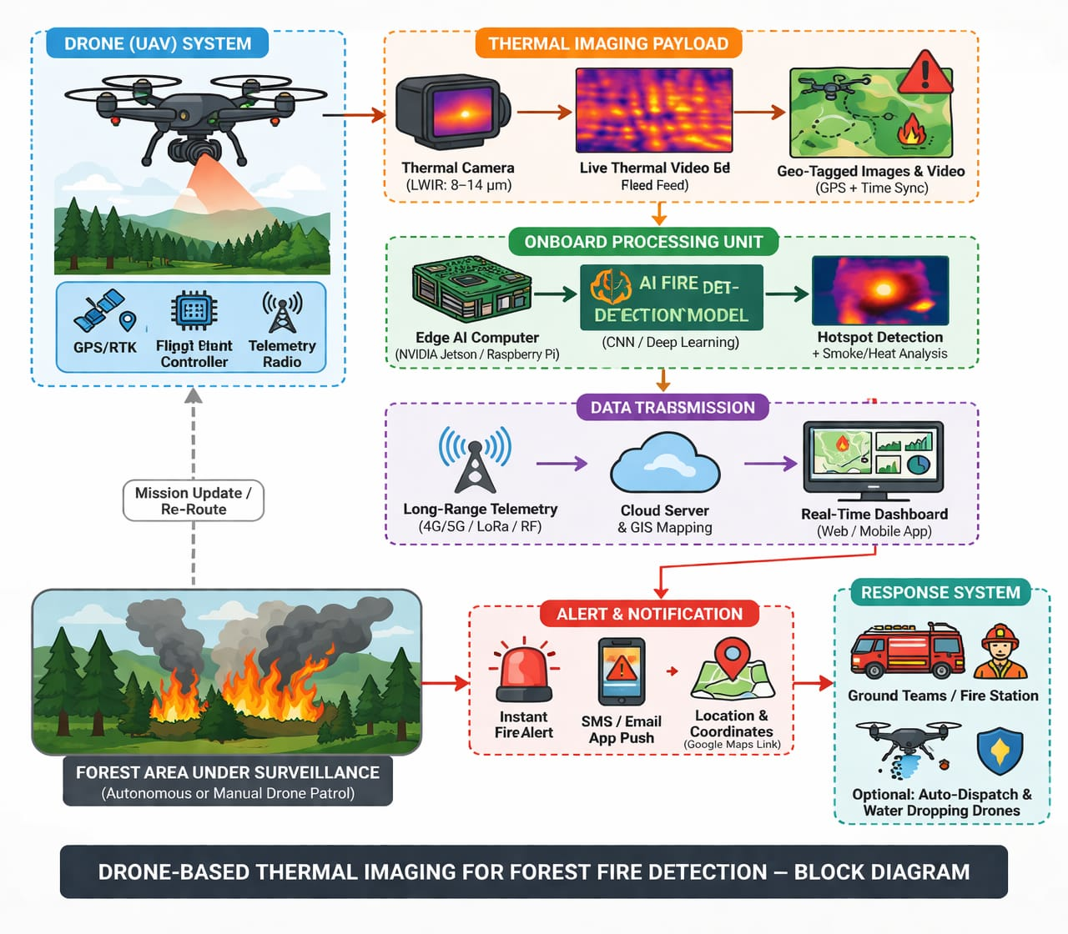
Block Diagram:

Slide 8
Proposed Methodology
Data collection : it’s an drone’s way of “seeing” the forest by using special cameras to pick up heat signals and normal pictures.
Processing: The drone’s onboard computer analyzes the thermal images in real-time to tell the difference between a real fire and “fake” heat.
Final output: The drone immediately sends a high-priority alert to the ground team showing the exact GPS coordinates of the fire on a map.

Slide 9
Experimental Setup:
Hardware utilized: Thermal Sensor- FLIR Boson 640-Radiometric,4K RGB for multi-spectral image fusion attached with Drone and its controller.
Software/Tools utilized: DJI Pilot or QGroundControl for autonomous waypoint navigation and mission planning.
Datasets or simulation parameters: Utilization of the FLAME (Fire Luminosity Airborne Masked Colour Dataset) and FLAME 2, which contain thousands of annotated thermal and RGB drone frames of forest fires.

Slide 10
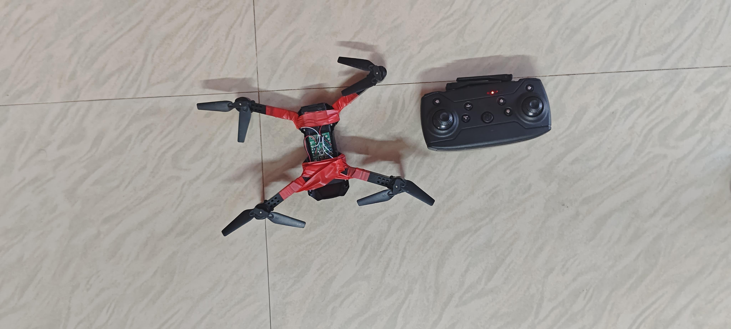
Hardware used

Slide 11
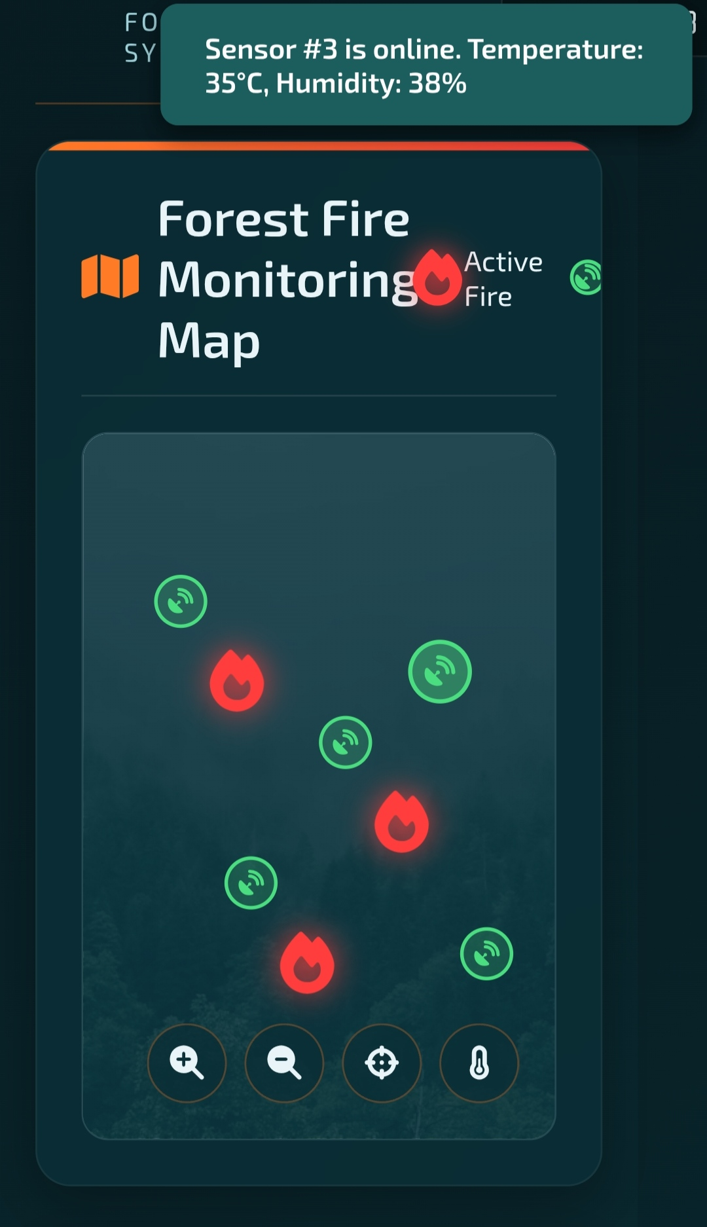
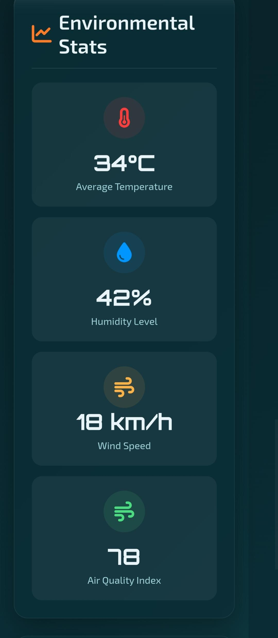
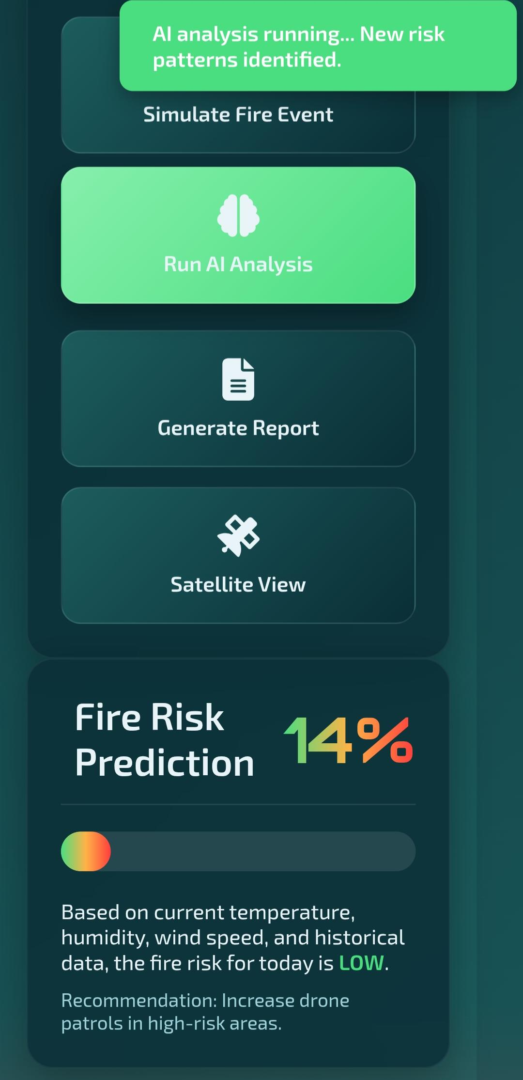
Result : Software screenshot

Slide 12
Conclusion & Future Scope
Conclusion:
Enhanced Operational Safety in The system significantly reduces the “Response Latency” of firefighting teams by providing an immediate, accurate aerial heat map, which minimizes the risk to human life.
Future Scope:
This work can be extended by deploying a Swarm of Drones that communicate with each other via decentralized mesh networks, and Advanced Predictive AI and Hyper-Spectral Imaging.

Slide 13
References
Alkhatib, A. A., Mohammad Jaber, K., & Al-Madi, M. (2024). A proposed automatic forest fire extinguishing and prevention system using drones. 2024 IEEE International Humanitarian Technologies Conference (IHTC), 1–6.
Lelis, C. A. S., Roncal, J. J., Silveira, L., De Aquino, R. D. G., Marcondes, C. A. C., Marques, J., Loubach, D. S., Verri, F. A. N., Curtis, V. V., & De Souza, D. G. (2024). Drone-based AI system for wildfire monitoring and risk prediction. IEEE Access, 12, 139865–139882.
Yandouzi, M., Berrahal, M., Grari, M., Boukabous, M., Moussaoui, O., Azizi, M., Ghoumid, K., & Kerkour Elmiad, A. (2024). Semantic segmentation and thermal imaging for forest fires detection and monitoring by drones. Bulletin of Electrical Engineering and Informatics, 13(4), 2784–2796.

Slide 14
Questions & Discussion
Thank you for your attention!
Queries?

Slide 15
Thank you for this wonderful opportunity.

