Slide 1

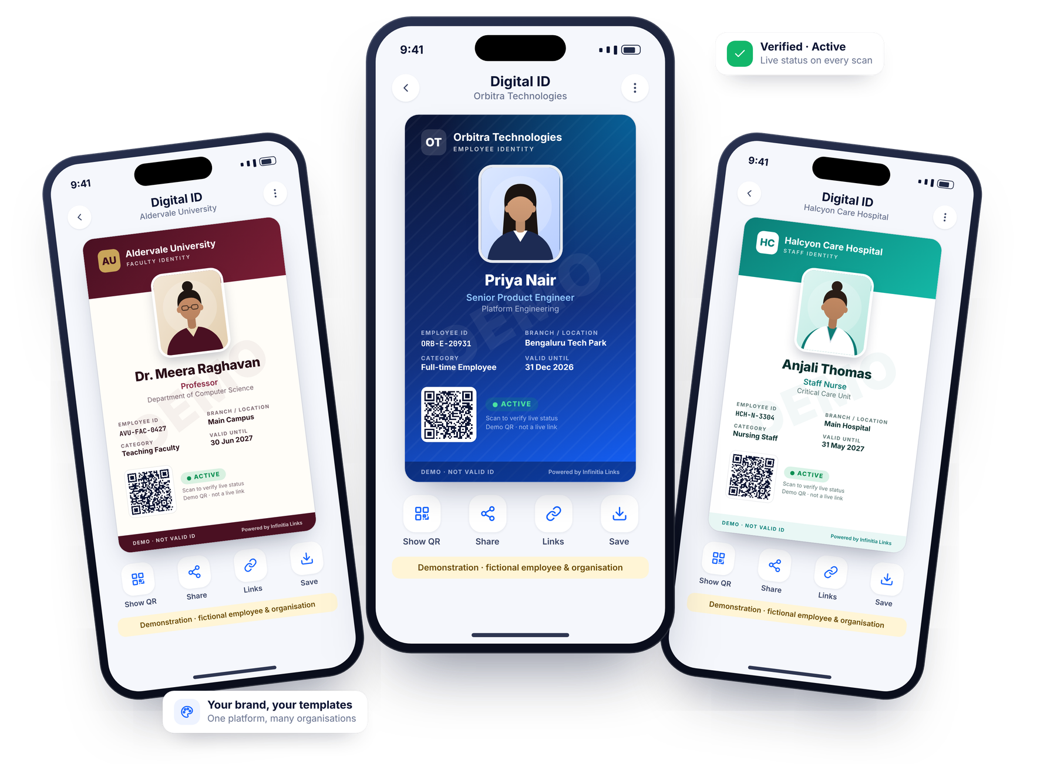

Enterprise Digital Identity & Verification Platform
A centralised digital identity, verification and workforce information platform for universities, healthcare, corporates, financial services and field workforces.
One link. Infinite possibilities.
An enterprise digital identity solution by Infinitia Hub
infinitialinks.com
Notes:
Opening. Infinitia Links is a configurable platform: every employee gets a secure, mobile-accessible digital identity with a unique QR code; the organisation issues, verifies, updates, suspends and revokes those identities centrally. All people and organisations shown in this deck are fictional demonstrations.

Slide 2






Physical ID cards were never designed for today’s workforce
THE CHALLENGE
Slow, costly to reissue
Hard to verify on the spot
Leavers’ cards stay in circulation
Printing, reprinting and replacing lost or outdated cards takes time and budget.
A printed card cannot tell a verifier whether it is still valid today.
Cards of suspended or exited staff can still look authentic.
Fragmented records
Field staff, unverifiable
Inconsistent branding
Identity details live in spreadsheets, HR systems and ID vendors — rarely in sync.
Customers have little way to confirm that a field visitor is genuinely authorised.
Multiple campuses or branches issue different-looking cards over time.
Notes:
Frame the problem in the audience’s language: cost and delay of physical cards, the difficulty of checking whether a card is still valid, and the risk of cards staying in circulation after someone leaves. Avoid quoting numbers we cannot substantiate.

Slide 3



Every employee carries a verifiable identity. Every organisation controls it centrally.
OUR VISION
Digital first
Verifiable anywhere
Centrally governed
A secure, branded identity on every phone — reducing dependence on physical cards.
A unique QR that checks live credential status with the issuing organisation.
Issue, renew, suspend and revoke from one console, with a full audit trail.
Notes:
The vision in one sentence. Three pillars: digital first, verifiable anywhere, centrally governed.

Slide 4
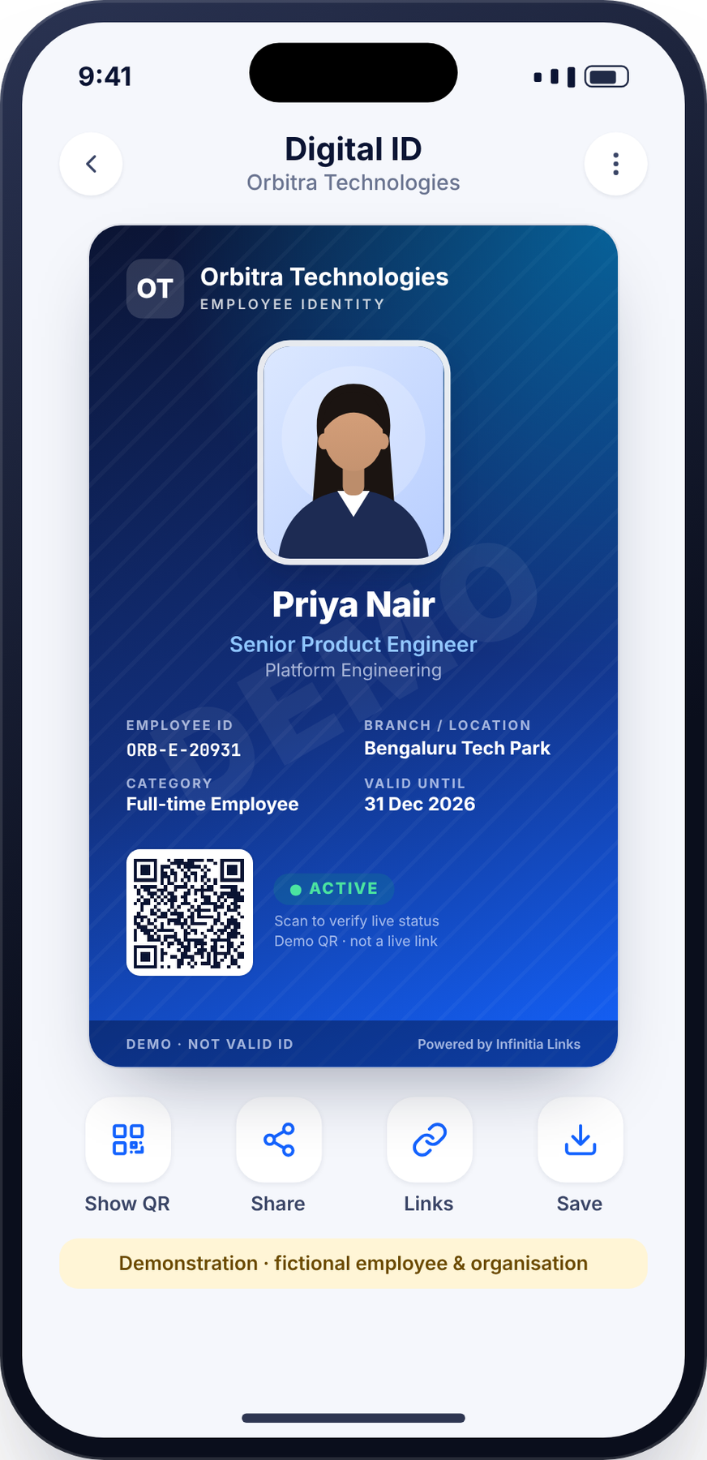
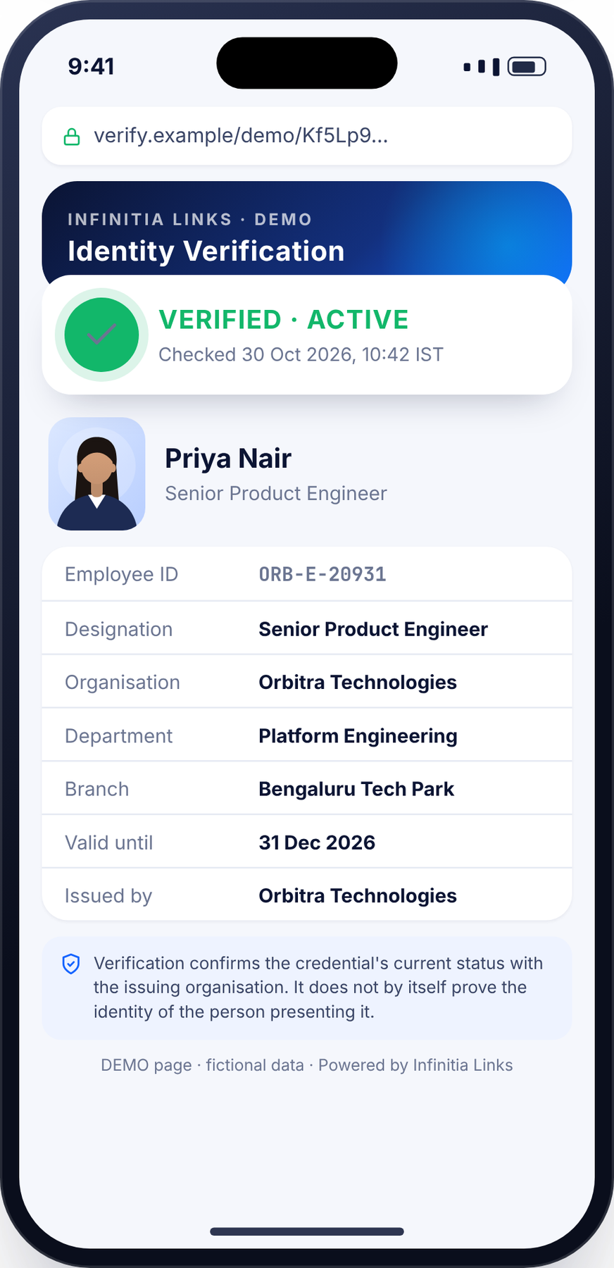



More than an ID card — a complete workforce identity platform
INTRODUCING INFINITIA LINKS
Organisations issue each employee a secure, mobile-accessible digital identity with a unique QR code — then manage, verify, update, suspend and deactivate it from one administrative dashboard.
Digital identity cards
QR verification
Branded templates per organisation
Live, server-side status checks
Admin console
Directory & service links
Full credential lifecycle & audit
Optional, privacy-controlled
Infinitia Hub › Infinitia Links › “Powered by Infinitia Links” on every identity page
The organisation’s brand leads. Infinitia Links appears as a discreet endorsement.
Notes:
Position this as more than an ID card generator: it is the system of record for workforce identity credentials, with verification, lifecycle management and optional directory and service links.

Slide 5



Four steps, one continuously verifiable identity
HOW THE PLATFORM WORKS
1
2
3
4
Issue
Carry
Verify
Manage
Admins add employees individually or by Excel/CSV import; identities are generated on the organisation’s template.
Each employee opens their digital ID on a phone via a secure link — no physical card required.
Anyone scans the QR code and sees the live credential status from the issuing organisation.
Renew, suspend, revoke or update centrally. Every change is logged and reflected on the next scan.
Verification is server-side.
A suspended, expired or revoked credential stops showing as valid the moment its status changes — even if an old screenshot of the card is still circulating.
Notes:
Walk the lifecycle: issue, carry, verify, manage. Emphasise that status changes take effect at the next scan because verification is server-side.

Slide 6
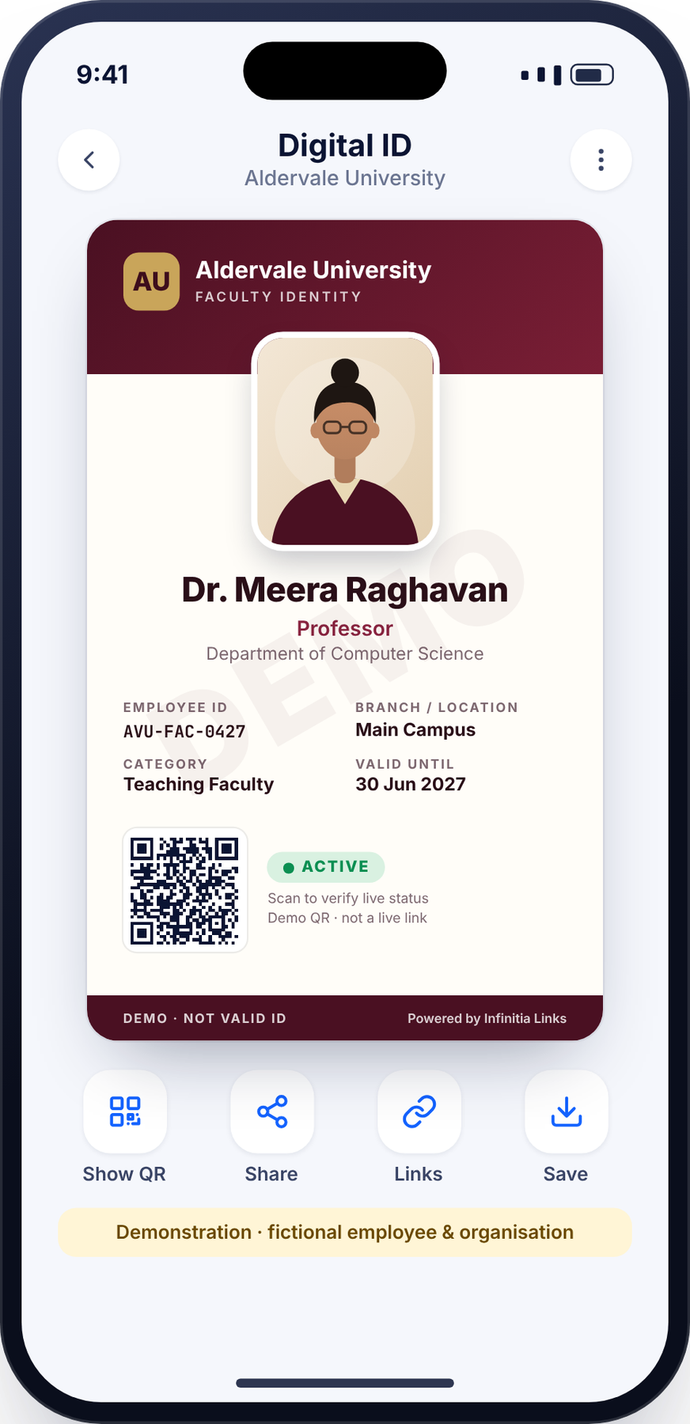





A premium identity experience on every phone
DIGITAL STAFF ID
Organisation branding
Employee details
Logo, colours and template chosen by the organisation
Photo, full name, unique employee ID, designation, department
Placement
Validity
Branch or location, employment category, joining date where appropriate
Expiry date and current credential status shown on the card
Unique QR code
Contacts
Opens a secure verification link for that credential only
Official contact; emergency contact only where authorised
ALL SAMPLE IDENTITIES IN THIS DECK ARE FICTIONAL · DEMO
Notes:
Point to the card: organisation branding, photograph, name, employee ID, designation, department, branch, category, validity, QR and live status. Emergency contact and joining date appear only where the organisation authorises them.

Slide 7
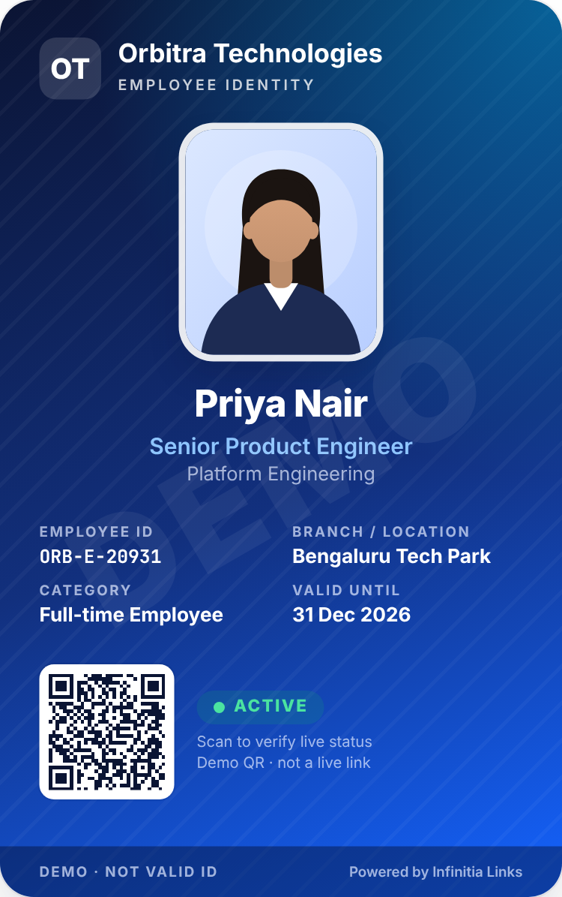
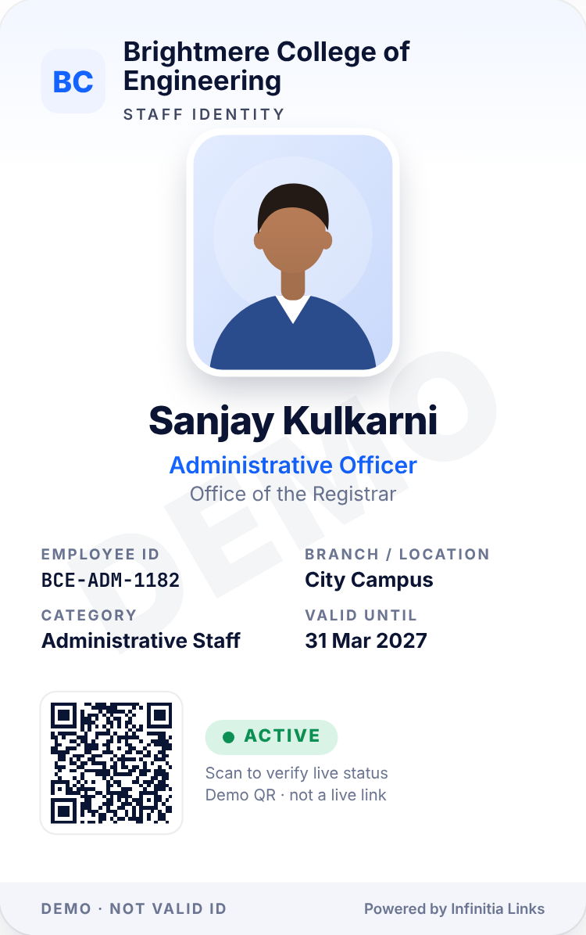
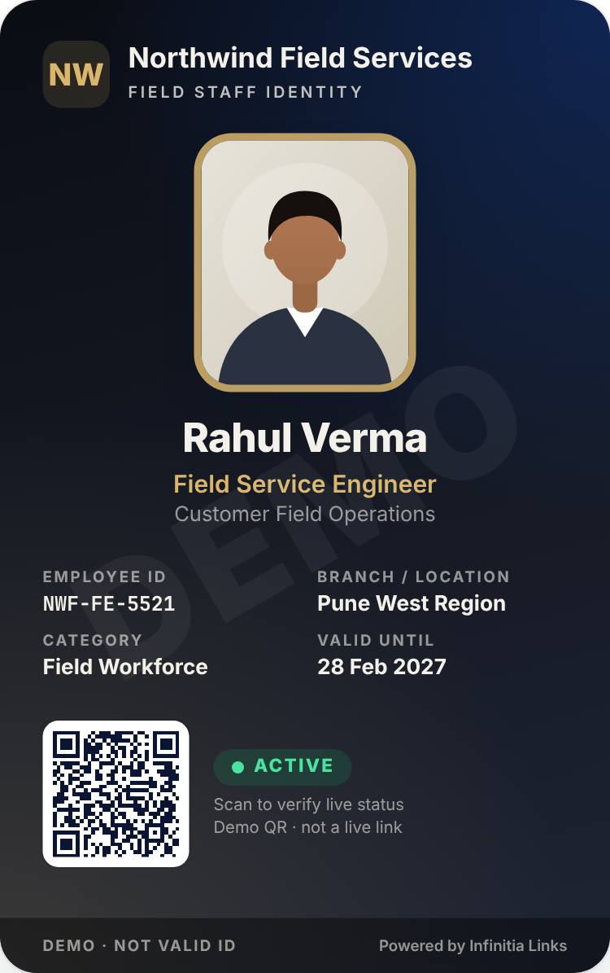

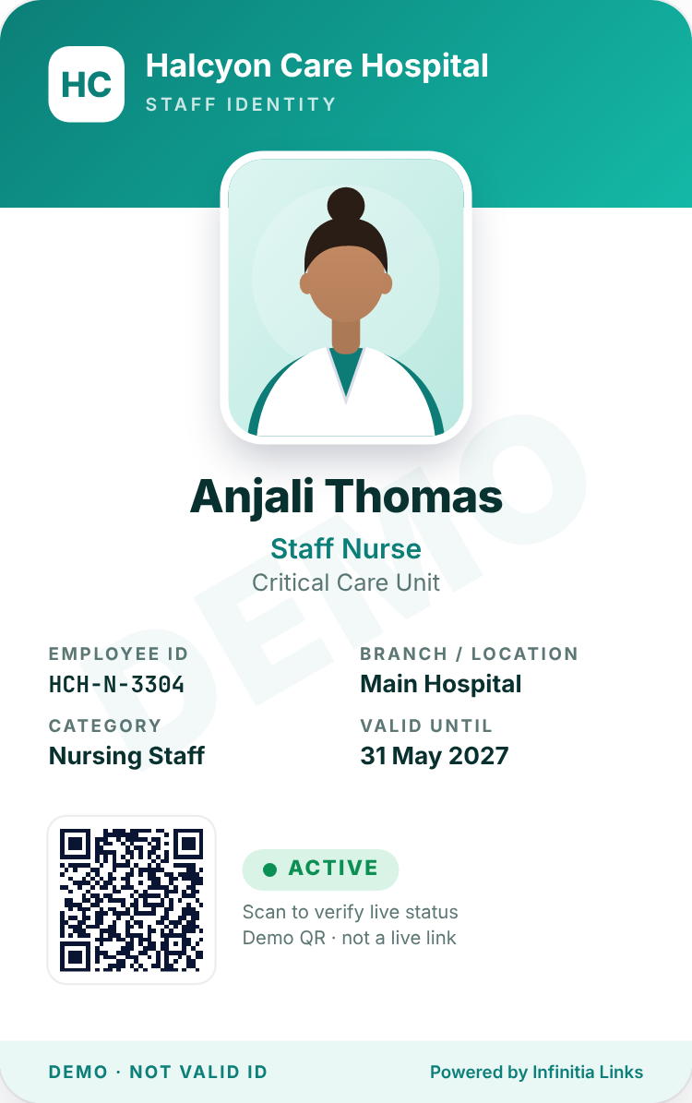
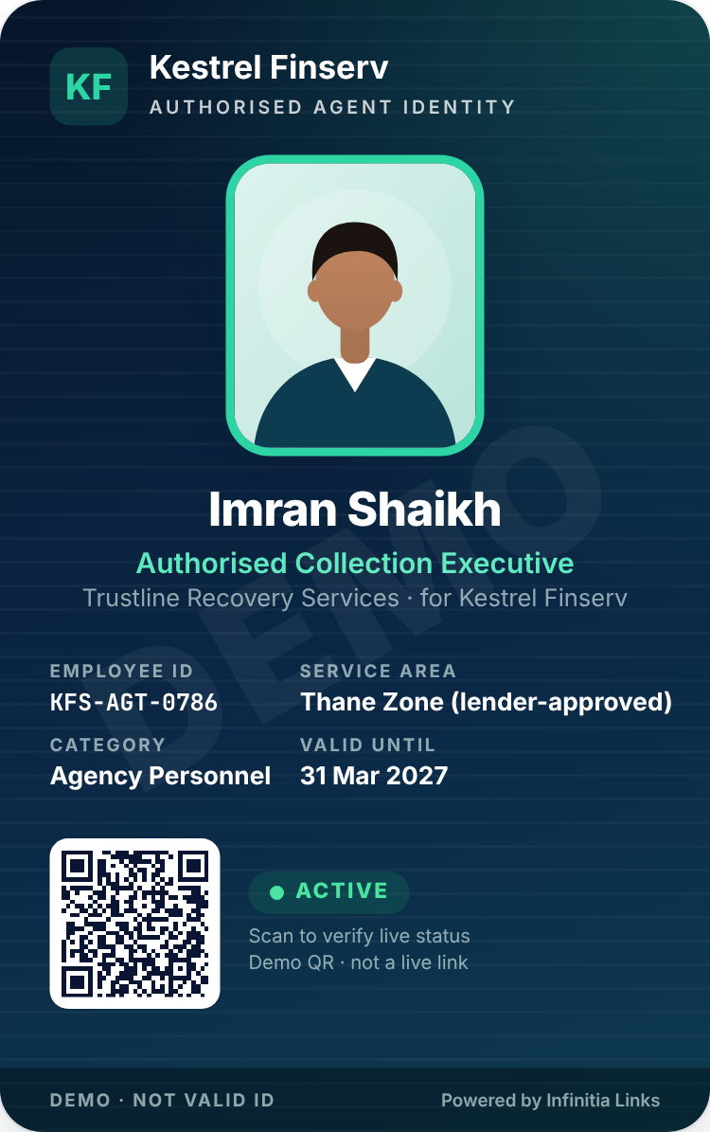
Six templates, configurable to each organisation’s brand
ID CARD DESIGN GALLERY
Premium Corporate Blue
Modern Minimal White
Premium Dark
University Institutional
Healthcare Professional
Financial Services
Corporate employee
College administrative staff
Field executive
University professor
Hospital employee
Loan recovery agent
Every template supports: organisation logo · photograph · name · employee ID · designation · department · branch · category · validity · unique QR · live status · official contact
Notes:
Templates are starting points. Each organisation configures logo, colours, fields and layout. Sample identities are fictional and labelled DEMO.

Slide 8






A six-step workflow that always checks live status
QR VERIFICATION
1. ID presented
2. QR scanned
3. Secure link opens
4. Status checked
5. Details shown
6. Verdict
Employee shows their digital or printed ID
Any phone camera, no app or login
Unique, non-guessable credential URL
Server-side lookup, never in the QR itself
Only fields the organisation approves
Active · Suspended · Expired · Revoked
Built-in safeguards
Unique, non-guessable identifiers
Server-side verification only
Revoked IDs never appear valid
Confidential data never exposed
Anti-tampering & rate limiting
Verification timestamp on every result
QR verification confirms credential status. It does not independently prove the physical identity of the person presenting it.
Notes:
Stress the safeguard: QR verification confirms credential status with the issuing organisation; it does not independently prove the physical identity of the person presenting the card. Verifiers should still compare the photograph.

Slide 9
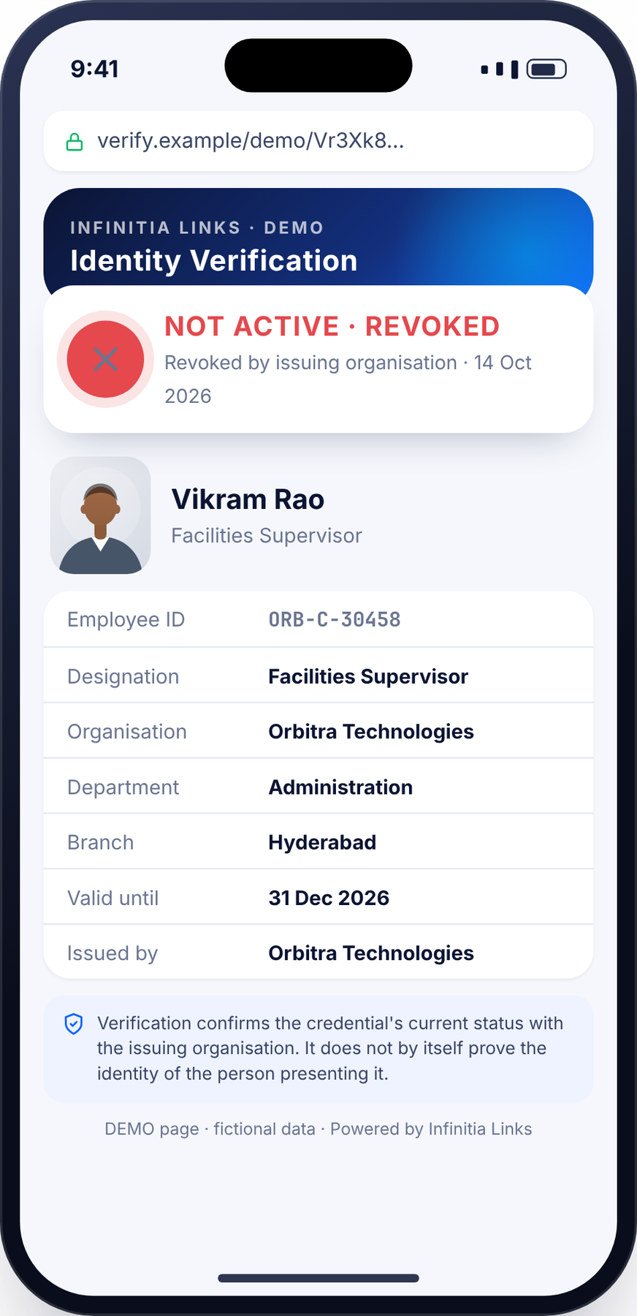
What a verifier sees — in seconds, without an app
CUSTOMER & VISITOR VERIFICATION
The verification page shows
Verified / Not Active status, prominently
Employee photograph and name
Employee ID, designation, department, branch
Organisation and issuing organisation
Validity date and verification timestamp
Designed for trust
Suspended, expired and revoked credentials are clearly marked as not active. Only fields approved by the organisation are ever displayed.
Notes:
Two outcomes on the same page design: verified-active, and not-active (revoked). Non-active results withhold personal details.

Slide 10
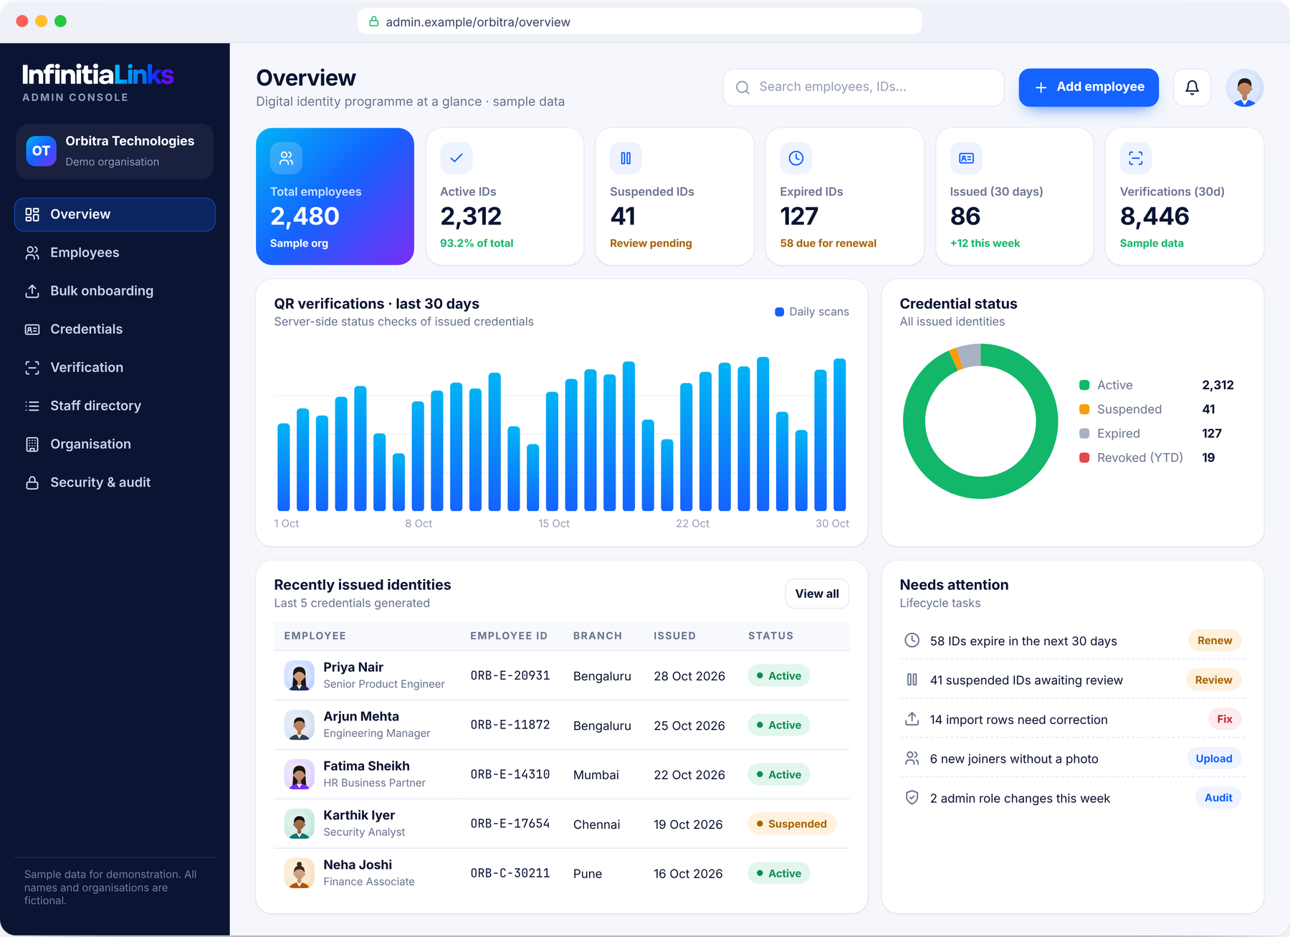
One console for the entire identity lifecycle
ENTERPRISE ADMIN DASHBOARD
Overview
Totals, active, suspended, expired, recently issued, verifications
Employee management
Add, edit, photo, department, branch, designation, renew
Credential status
Activate · suspend · expire · revoke, with history
Organisation
Profile, logo, colours, templates, branches, roles
Security & audit
Role-based access, activity and access logs
Notes:
Modules: overview, employee management, bulk management, verification analytics, organisation management, security and audit. Figures on screen are sample data.

Slide 11
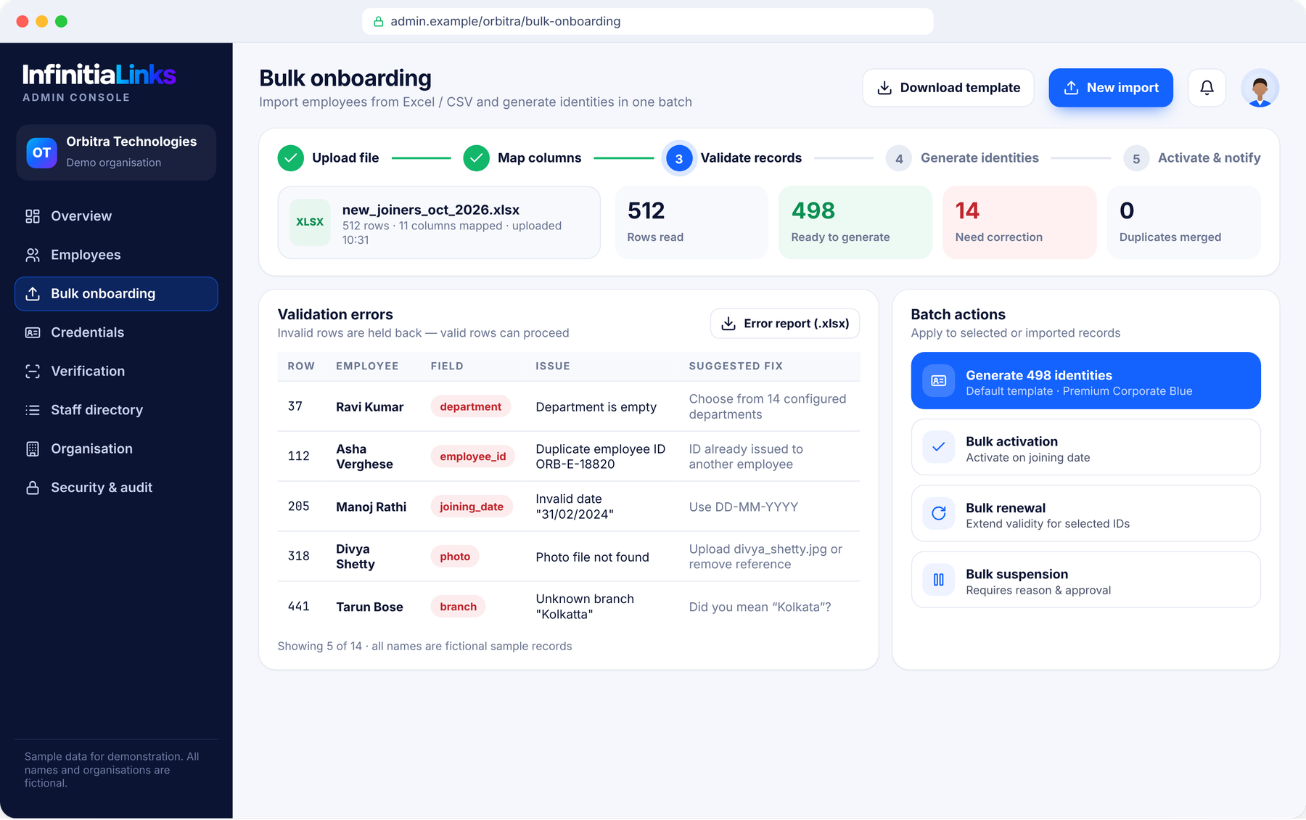

Hundreds of identities in a single, validated batch
BULK EMPLOYEE ONBOARDING
Excel / CSV import
Standard template or mapped columns
Validation & error reports
Missing fields, duplicates, invalid dates
Bulk ID generation
On the organisation’s default template
Bulk activate · renew · suspend
With reasons and approvals
Notes:
Excel/CSV import with column mapping and validation. Invalid rows are held back with a downloadable error report while valid rows proceed. Bulk activation, renewal and suspension follow the same pattern.

Slide 12
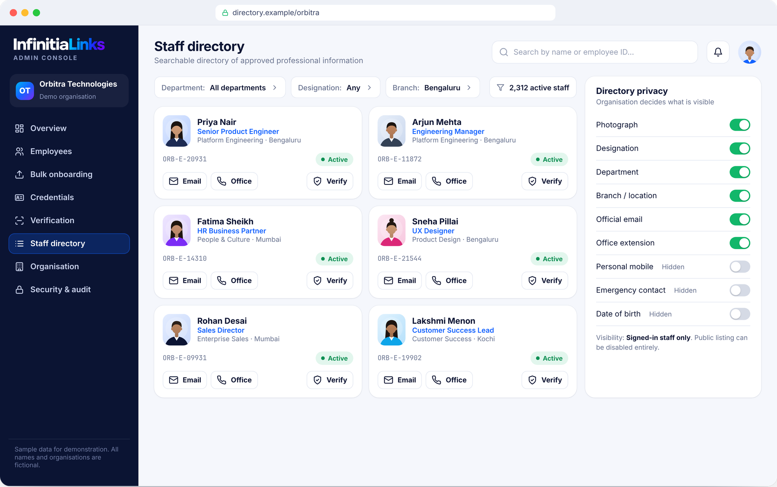



Find the right person — with privacy set by the organisation
DIGITAL STAFF DIRECTORY · OPTIONAL
Search
By employee name or employee ID
Filter
By department, designation or branch
Official contact
Email or office line, where authorised
Visibility controls
Organisation chooses every visible field
Notes:
Optional module. The organisation decides which fields are visible and to whom (public, signed-in staff only, or disabled).

Slide 13
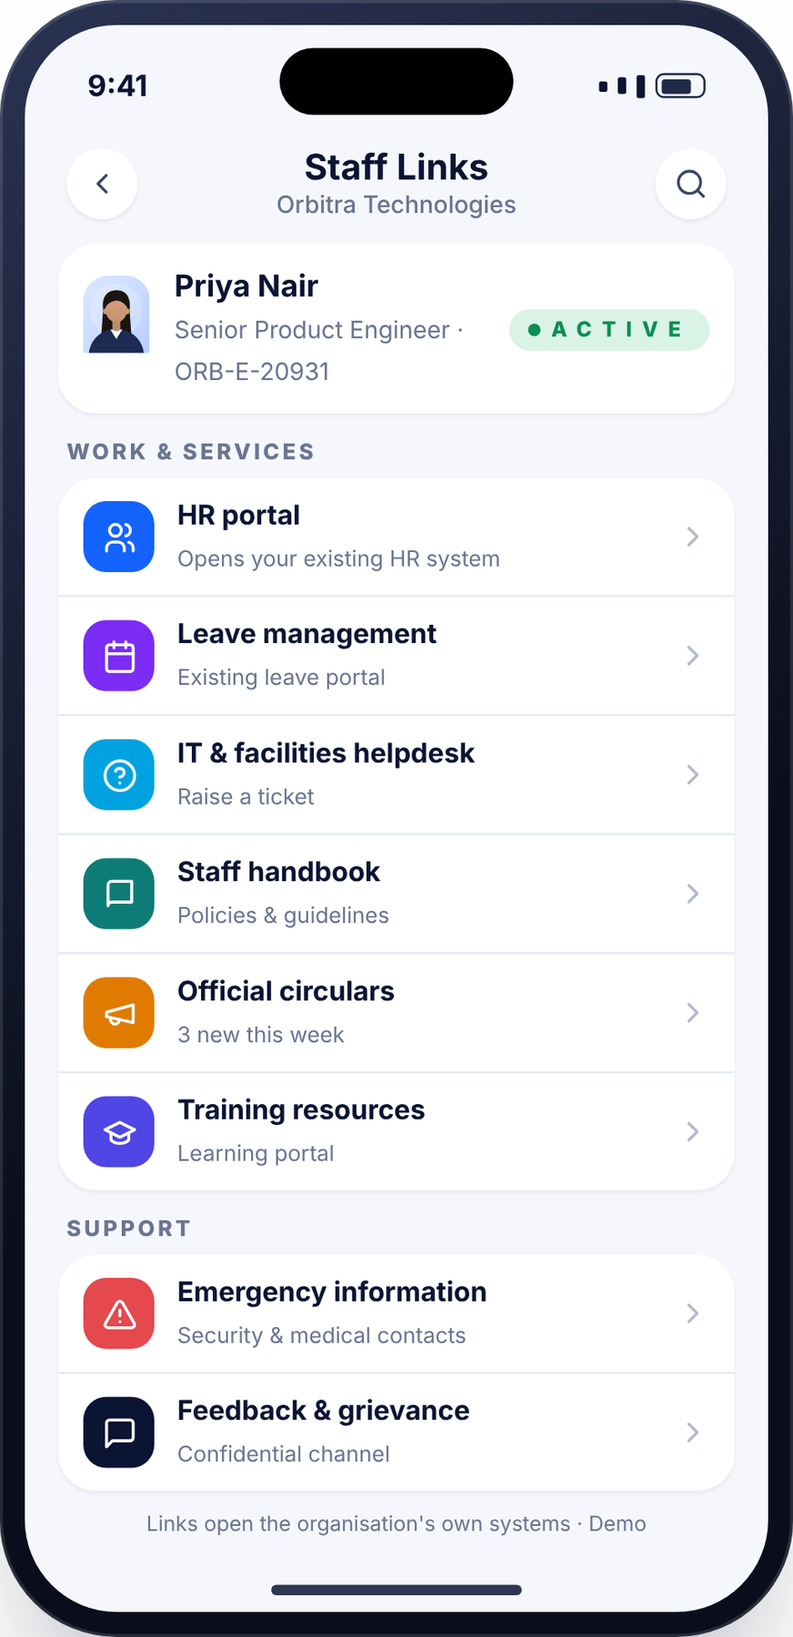







The identity page becomes a gateway to existing systems
STAFF COMMUNICATION & SERVICE LINKS
HR portal
Leave management portal
Internal helpdesk
Staff handbook
Official circulars
Training resources
Event registrations
Department websites
Emergency information
Feedback & grievance
Links open the organisation’s existing systems. Infinitia Links does not replace an HRMS, payroll or attendance platform.
Notes:
These links connect to the organisation’s existing systems. Infinitia Links is not an HRMS, payroll or attendance system.

Slide 14
One identity platform across campuses, faculties and staff
UNIVERSITIES & COLLEGES
Faculty & professors
Administrative staff
Verified academic identity with department and designation
Registrar, examination, accounts and support staff
Multi-campus institutions
Visitor-facing verification
Branches and constituent colleges under one console
Parents, examiners and partners can verify staff quickly
Academic directory
Campus service links
Optional faculty directory with approved details
LMS, library, circulars and helpdesk shortcuts
Universities · engineering, medical, dental, nursing & pharmacy colleges · schools · autonomous & research institutions
Notes:
Education segment. Same platform; each institution configures its own branding, roles and templates.

Slide 15
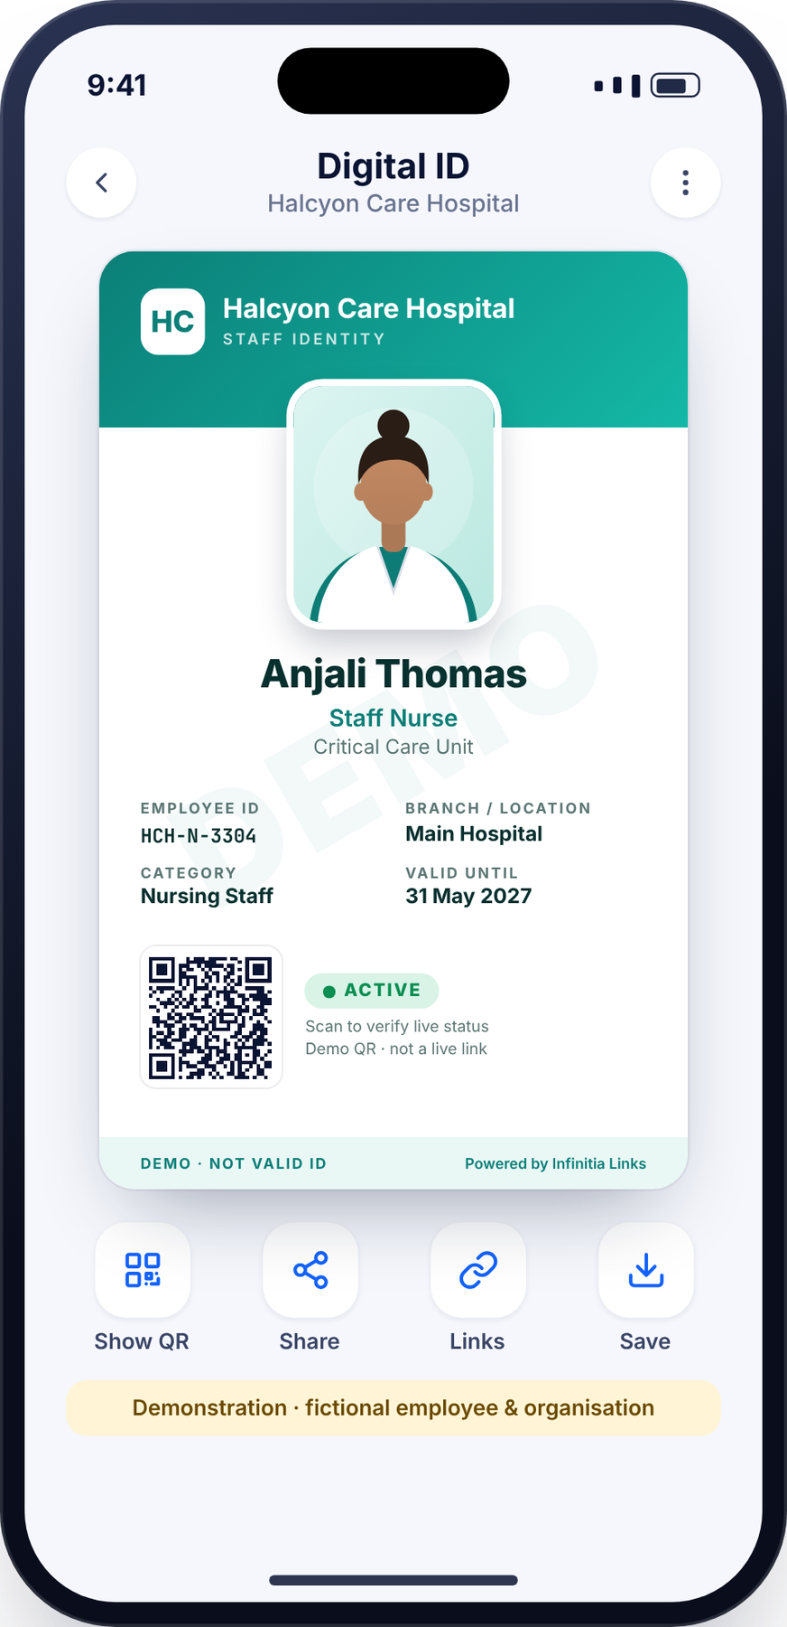

Trusted identification across wards, shifts and visiting consultants
HEALTHCARE
Clinical & nursing staff
Visiting consultants
Department and role visible at a glance
Time-bound credentials with clear validity
Patient-facing trust
Rapid deactivation
Patients and families can confirm staff status
Exits and contract ends reflected on the next scan
Multi-facility groups
Emergency information
Hospitals, clinics and diagnostic centres
Links to internal emergency protocols
Hospitals · clinics · diagnostic centres · medical institutions · healthcare staff and visiting consultants
Notes:
Healthcare segment. Emphasise visiting consultants and time-bound validity.

Slide 16

Consistent identity for every office, branch and contractor
CORPORATE
Multi-branch organisations
Employees & contractors
Branch-level administration and reporting
Different categories, templates and validity
Onboarding & offboarding
Visitor & client trust
Issue on day one, revoke on exit
Clients can confirm staff identity status
Group branding
Administrative visibility
Business groups with multiple brands
Who holds an active credential, at any time
IT companies · manufacturing · corporate offices · business groups · multi-branch organisations
Notes:
Corporate segment.

Slide 17
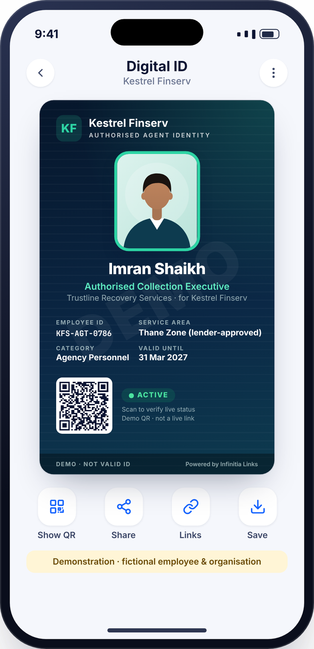
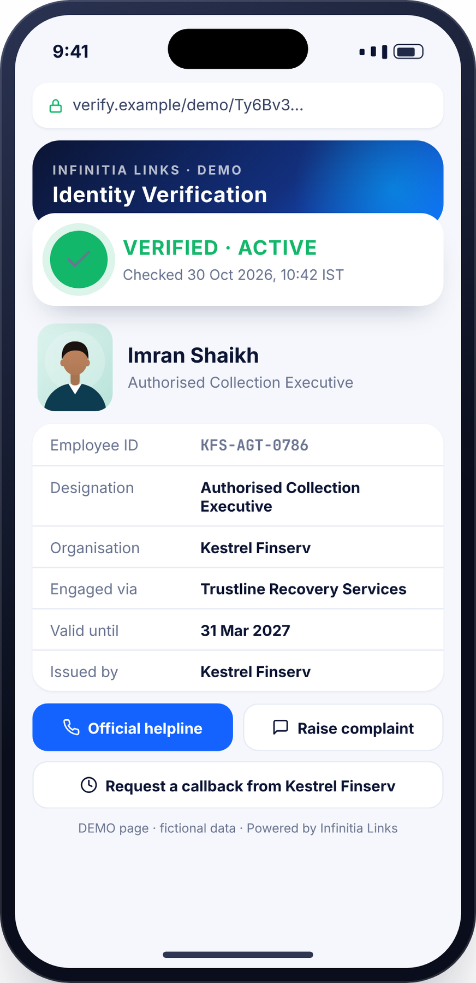

Customers can confirm a field visitor is genuinely authorised
FIELD EXECUTIVES & LOAN RECOVERY AGENTS
Agent identity module
Employer and agency information
Designation and authorised service area
Active / suspended / expired status
Customer complaint and callback links
Official company contact
Verification history for the organisation
Never shown on public pages
Borrower account numbers, loan amounts, personal financial information or any confidential customer details. Agent authorisation and lender assignments are provided and approved by the organisation — Infinitia Links does not authorise agents.
Notes:
Most sensitive use case. The lending organisation provides and approves the agent’s authorisation details; Infinitia Links displays them and their status. Borrower information is never shown.

Slide 18
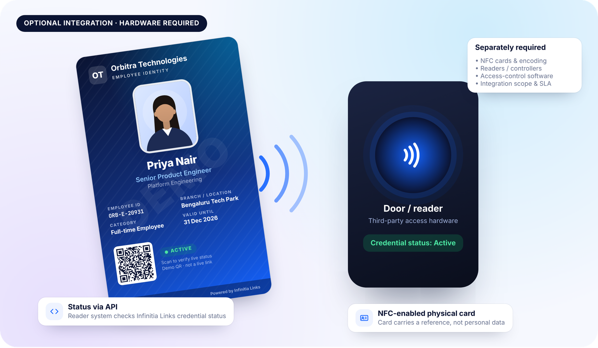









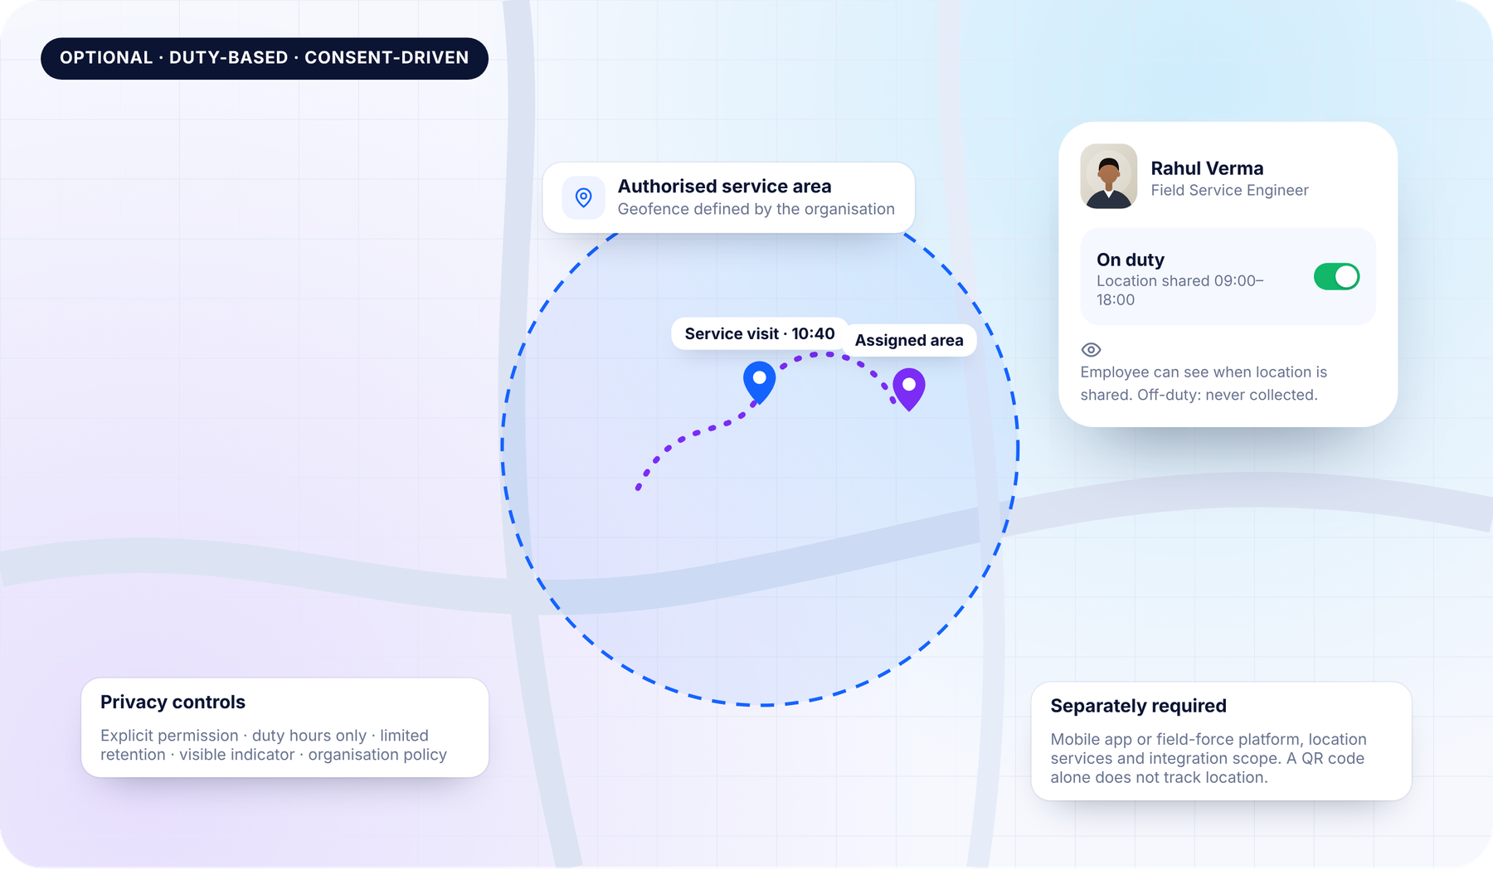



Extend the platform when you need to — scoped separately
OPTIONAL ADVANCED INTEGRATIONS
NFC-enabled ID cards
Mobile wallet credentials
Attendance system integration
Physical access control
Visitor management
GPS & field-force platforms
Geofencing
Emergency SOS
REST API integration
Single Sign-On (SSO)
Existing HRMS integration
University ERP integration
NFC readers, access-control hardware, GPS services, mobile apps, third-party APIs and their subscriptions may be separately required. A standard QR code does not provide NFC, biometric attendance, physical access or continuous GPS tracking.
Notes:
These are optional capabilities or future integrations, not automatically available. Hardware, apps, third-party APIs and subscriptions may be separately required. A normal QR code does not provide NFC, biometric attendance, physical access or continuous GPS tracking.

Slide 19


Identity data is sensitive — governance is built in, not bolted on
SECURITY, PRIVACY & GOVERNANCE
Role-based administrative access
Unique credential identifiers
QR verification controls
Location features
Credential revocation
Expiry management
Audit trails
Explicit permission from the employee
Duty-based controls — never off-duty
Limited, defined retention
Transparent, visible sharing indicator
Configured to the organisation’s policy
Data minimisation
Organisation-controlled visibility
Consent & transparency
Retention & deletion policies
Secure transmission (HTTPS/TLS)
Backup & recovery
Each deployment is configured to applicable data-protection laws and the customer’s policies. No certification is claimed here.
Notes:
Each deployment must be configured according to applicable data-protection law and the customer’s own policies. We make no claim of ISO, SOC or other certifications in this proposal.

Slide 20
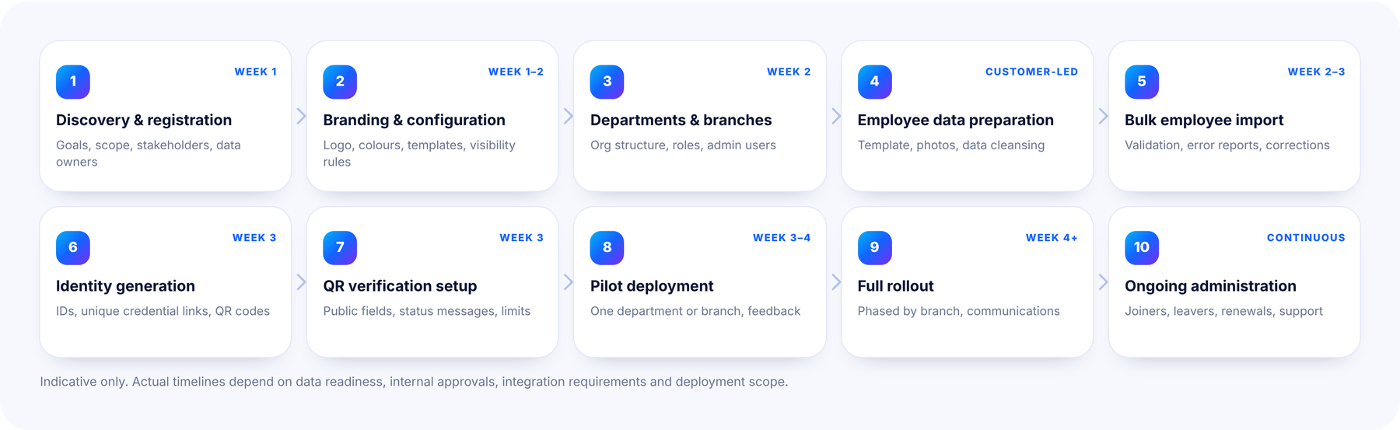
A structured ten-stage path from discovery to steady state
DEPLOYMENT WORKFLOW
Notes:
Timelines are indicative and depend on data readiness, approvals, integration requirements and scope.

Slide 21
From a single department to thousands of employees
ENTERPRISE SCALABILITY
Deployment size | Typical pilot | Rollout approach | Indicative timeline*
100 employees | Full group | Single-phase launch | 2 – 3 weeks
500 employees | 1 department | Two phases | 3 – 5 weeks
2,000 employees | 1 branch or faculty | Phased by branch | 5 – 8 weeks
5,000 employees | 1–2 branches | Phased by region / unit | 8 – 12 weeks
Designed to scale
Multi-organisation
Many organisations, each with segregated data and branding
Multi-branch
Branch-level administrators and reporting
*Indicative only. Depends on data readiness, approvals, integration requirements and deployment scope.
Batch operations
Import, renew and suspend thousands of records
Each organisation configures its own branding, templates, structure, permissions and administrative controls.
Role-based delegation
HQ, branch and department admin roles
Notes:
Indicative rollout plans by size. Actual timelines depend on data readiness, approvals, integration requirements and deployment scope.

Slide 22


A transparent, modular pricing framework
COMMERCIAL MODEL
Component | Basis | Price
Initial setup & onboarding | One-time | ₹[To be quoted]
Branding & configuration | One-time | ₹[To be quoted]
Per-employee annual subscription | Per employee / year | ₹[To be quoted]
Enterprise annual subscription | Per organisation / year | ₹[To be quoted]
API & integration | Per integration | Separately quoted
NFC / GPS hardware | Per device / card | Separately quoted
Custom development | Per scope | Based on scope
Revenue models
Annual subscription
Per-employee licensing
Enterprise licensing
Initial onboarding
Integration services
Optional premium modules
All figures are placeholders and will be quoted after discovery. Nothing here is an approved quotation.
Notes:
All prices are placeholders to be quoted after discovery. No figure in this deck is an approved quotation.

Slide 23
What organisations gain
BUSINESS VALUE
Less physical card replacement
Faster credential issuance
Centralised identity management
Faster identity verification
Better lifecycle management
Easier onboarding & offboarding
Improved administrative visibility
Consistent organisation branding
Convenient mobile access
Verification auditability
ROI is assessed per organisation with transparent assumptions (headcount, card replacement frequency, issuance effort). No savings are claimed in advance.
Notes:
Benefits are qualitative. We do not quote savings figures without a customer-specific assessment.

Slide 24




Built for identity, designed for trust
WHY INFINITIA LINKS
Purpose-built for verification
Your brand first
One platform, every sector
Live, server-side credential status — not just a printable card
White-labelled templates; Infinitia Links stays discreet
Education, healthcare, corporate, finance and field workforce
Privacy by configuration
Fast to deploy
Connects, doesn’t replace
Organisations decide every visible field
Bulk onboarding and a structured ten-stage rollout
Links to your existing HR, LMS and service systems
Notes:
Close the argument with differentiators that are true of the proposition: purpose-built, configurable, privacy-first, honest about scope.

Slide 25
Let’s design your organisation’s digital identity
CONTACT
infinitialinks.com
Name: [To be added]
Email: [To be added]
Phone: [To be added]
1
Discovery call — Goals, scope and data readiness
An enterprise digital identity solution by Infinitia Hub
2
Pilot scope — One department or branch
3
Tailored proposal — Configuration, timeline and quotation
One link. Infinite possibilities.
All people, organisations, QR codes and figures shown are fictional demonstrations.
Notes:
Close with three next steps and invite a discovery call. Contact details are placeholders to be filled in before sending.

