Slide 1
Secure data hiding in image using steganography
CAPSTONE PROJECT
Presented By: Kishore Guntuku
Student Name : Kishore Guntuku
College Name & Department : University College of Science Saifabad, Osmania University - MCA

Slide 2
OUTLINE
Problem Statement
Technology used
Wow factor
End users
Result
Conclusion
Git-hub Link
Future scope

Slide 3
Problem Statement
In today’s digital world, secure communication is crucial. However, traditional encryption methods make secret messages obvious, attracting attention. This project uses steganography to hide data inside images, making it invisible to outsiders while ensuring secure and undetectable communication.

Slide 4
Technology used
Libraries Used(Python):
1.OpenCv (cv2) – For image Processing and reading/writing images
2.Os (os) –To interact with the operating system (ex: opening the encrypted images)
3. String (string) – Used for character encoding and mapping
Platform:
Programming Language: Python
Development Environment: Python IDLE
Operating System: Windows

Slide 5
Wow factors
Invisible Communication – The hidden message is stored in an image without noticeable changes, making it undetectable to the human eye.
Secure with Passcode – The embedded message can only be retrieved with the current passcode, adding an extra layer of security
Lightweight & Fast – The algorithm runs efficiently without requiring complex cryptographic computations
User-Friendly – Simple encoding and decoding process, making it easy for anyone to use

Slide 6
End users
General Users
Cybersecurity Professionals
Forensic Experts
Government Organizations
Businesses

Slide 7
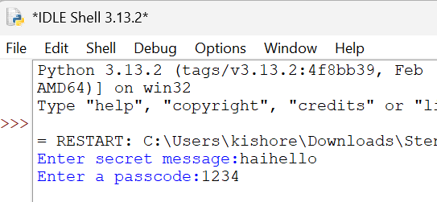
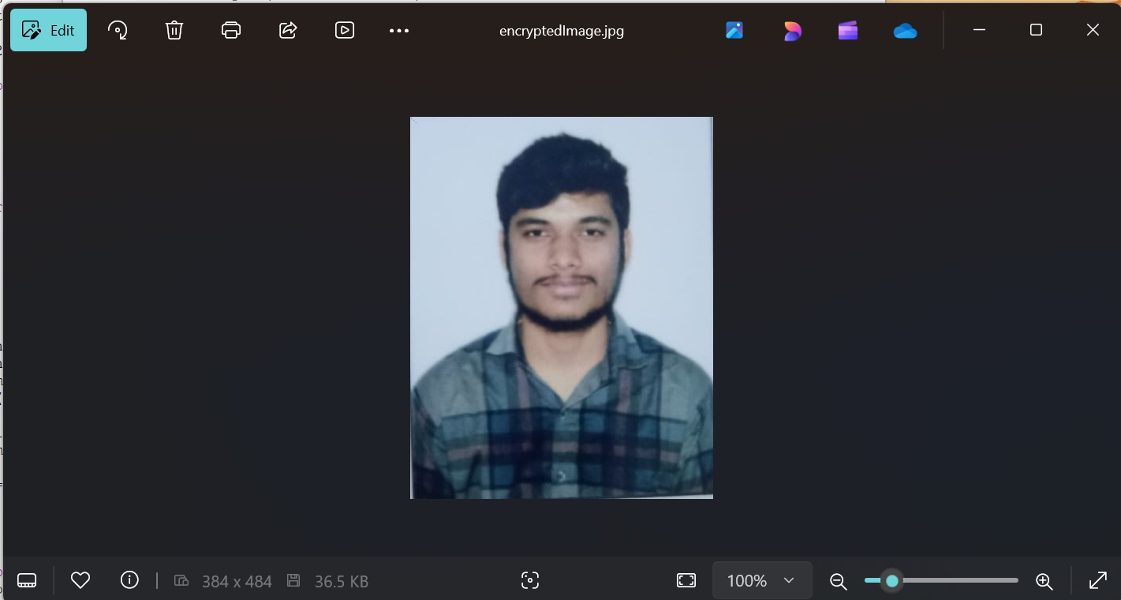
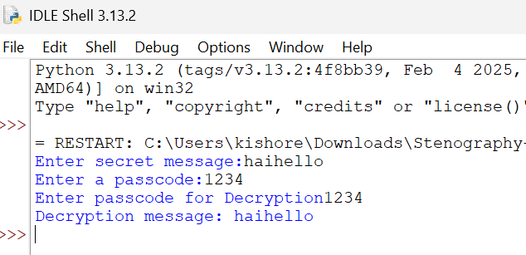
Results

Slide 8
Conclusion
This project successfully demonstrates secure data hiding using steganography, allowing users to embed secret messages inside images without noticeable changes. With this simple yet effective implementation, this method provides an additional layer of security for confidential communication, making it useful for journalists, cybersecurity professionals.

Slide 9
GitHub Link
https://github.com/kishore9e/steganography.git

Slide 10
Future scope(optional)
In the future, this project can be enhanced by integrating stronger encryption techniques, supporting different file formats, and developing a graphical user interface (GUI) for ease of use

Slide 11
THANK YOU

