Slide 1
Text Classification with Convolutional Neural Networks (CNNs)

Slide 2
Introduction
Traditional CNNs: CNNs excel at computer vision tasks. They detect patterns (edges, shapes, textures) in images regardless of their position.
Intuition for Text: The same idea applies to text. A CNN can learn to detect meaningful patterns in sequences of words—such as key phrases, n-grams, or sentiment-bearing combinations—regardless of their exact location in a sentence.
Core Idea: Instead of scanning over pixels, a 1D convolutional layer scans over a sequence of word vectors to identify informative groupings of words.

Slide 3
From Words to Vectors: The Input Layer
Before a CNN can process text, words must be converted into numerical representations.
Word Embeddings: Each word in the vocabulary is represented as a dense, low-dimensional vector (e.g., 50, 100, 300 dimensions).
Pre-trained embeddings like GloVe or Word2Vec are often used. They come with semantic knowledge (e.g., "king" - "man" + "woman" ≈ "queen").
Embeddings can also be learned from scratch during training.

Slide 4
From Words to Vectors: The Input Layer
Input Matrix: A sentence of n words is represented as a 2D matrix of size n x d, where d is the embedding dimension.
This matrix can be thought of as a "1D image" where the width is the number of words (n) and the "channels" are the embedding dimensions (d).

Slide 5
Step 1: the cat sat on the mat
Preprocessing the Text
First, we need to standardize the input. Common steps include:
Tokenization: Split the sentence into individual words (tokens).
["the", "cat", "sat", "on", "the", "mat"]

Slide 6
Step 1: the cat sat on the mat
Padding: CNNs require fixed-length inputs. We choose a maximum sequence length (max_len). Let's set max_len = 6. A shorter sentence would be padded with padding token, and a longer one would be truncated.
Our processed sequence remains: ["the", "cat", "sat", "on", "the", "mat"]

Slide 7
Step 2: the cat sat on the mat
Step 2: The Embedding Lookup Layer
Each word is mapped to its corresponding dense vector from an embedding model. Let's assume we are using an embedding with 4 dimensions (d=4) for simplicity (real-world embeddings use 100-300 dimensions).

Slide 8
Step 2: the cat sat on the mat
Imagine our embedding model provides the following vectors:
the -> [0.1, 0.2, 0.3, 0.4]
cat -> [0.5, 0.6, 0.7, 0.8]
sat -> [0.9, 1.0, 1.1, 1.2]
on -> [1.3, 1.4, 1.5, 1.6]
mat -> [1.7, 1.8, 1.9, 2.0]

Slide 9
Step 3: the cat sat on the mat
Step 3: Constructing the Input Matrix
We create a matrix where each row is the vector for the corresponding word in the sequence.

Slide 10
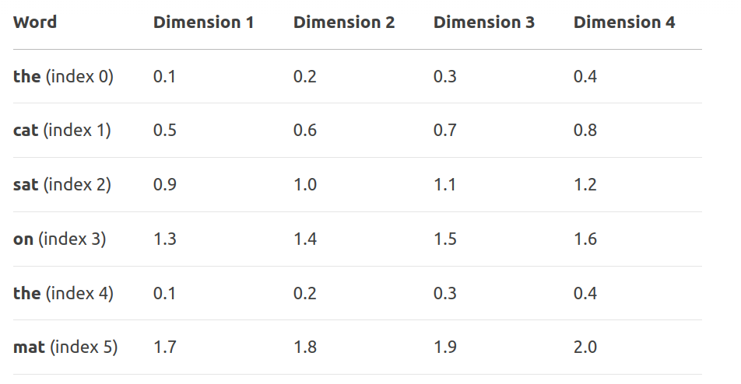
Step 3: the cat sat on the mat

Slide 11
Step 4: the cat sat on the mat
CNN uses a 1D convolution operation. Here’s the intuition:
Filter (Kernel): A small "window" of weights that slides across the rows (words) of the matrix.
Let's use a filter of size 2 (it looks at 2 words at a time).
This filter also has a depth of 4 (the embedding dimension), so its shape is (2, 4).

Slide 12
Step 4: the cat sat on the mat
Let's say our filter W has the following weights: [[0.5, 0.5, 0.5, 0.5], [ -0.5, -0.5, -0.5, -0.5]]
This filter is designed to compute a rough difference between the two word vectors it covers.

Slide 13
Step 4: the cat sat on the mat
Convolution Operation:
The filter starts at the top of the matrix and slides down one word at a time (stride=1).
At each position, it performs an element-wise multiplication between the filter weights and the word vectors, then sums all the results into a single number. This number is a feature.

Slide 14
Step 4: the cat sat on the mat
Let's calculate the first few features:
Position 1: Covers ["the", "cat"]
(0.1*0.5 + 0.2*0.5 + 0.3*0.5 + 0.4*0.5) + (0.5*-0.5 + 0.6*-0.5 + 0.7*-0.5 + 0.8*-0.5)
(0.1+0.2+0.3+0.4)*0.5 + (0.5+0.6+0.7+0.8)*-0.5
(1.0*0.5) + (2.6*-0.5) = 0.5 - 1.3 = -0.8

Slide 15
Step 4: the cat sat on the mat
Position 2: Covers ["cat", "sat"]
(0.5+0.6+0.7+0.8)*0.5 + (0.9+1.0+1.1+1.2)*-0.5
(2.6*0.5) + (4.2*-0.5) = 1.3 - 2.1 = -0.8
Position 3: Covers ["sat", "on"]
(0.9+1.0+1.1+1.2)*0.5 + (1.3+1.4+1.5+1.6)*-0.5
(4.2*0.5) + (5.8*-0.5) = 2.1 - 2.9 = -0.8
... and so on until the filter covers ["the", "mat"].

Slide 16
Step 4: the cat sat on the mat
Feature Map: The result of this sliding operation is a list of features (a feature map). For our (6,4) input and a filter of size 2, we get 6 - 2 + 1 = 5 features.
The feature map for our example might look like: [-0.8, -0.8, -0.8, 1.0, 0.2]
Each feature represents the presence of a specific pattern (in this case, a rough difference between adjacent words) at that specific location in the sentence.

Slide 17
The Nature of Text: A 1D Sequence
Fundamental Structure: At its core, text is a sequence of tokens (words, subwords, or characters) occurring one after the other.
The order of these tokens is crucial for meaning.
"The dog bit the man" vs. "The man bit the dog" have completely different meanings despite containing the exact same words.

Slide 18
The Nature of Text: A 1D Sequence
Temporal vs. Spatial: This sequential structure is analogous to a temporal signal, like an audio waveform or a time series.
Each word is a "point in time."
Convolution along this single dimension (the sequence order) is the logical way to process it.

Slide 19
How 1D Convolution Works on Text
The Input Matrix: As shown in the previous example, a sentence is a 2D matrix of shape (sequence_length, embedding_dimension).
The "1D" refers to the direction of movement: The convolution filter only slides along one axis—the sequence_length axis.
The Filter's Perspective: A filter of size k (e.g., 2, 3, 5) looks at k consecutive words at a time. It performs a weighted sum across all embedding dimensions simultaneously for those k words to produce a single feature value.

Slide 20
How 1D Convolution Works on Text
Crucial Point: Even though the filter touches all embedding dimensions, it's still called a 1D convolution because its kernel movement and pattern detection are constrained to a single spatial/temporal dimension (the sequence of words).

Slide 21
1D CNNs have key advantages
Parameter Efficiency: A small filter (e.g., size 3) is shared across all positions in the sequence. This drastically reduces the number of parameters compared to a dense layer that connects to every word.
Translation Invariance: A CNN learns that a pattern (e.g., the n-gram "very good") is important regardless of whether it appears at the start, middle, or end of a sentence. This is a powerful inductive bias for text.

Slide 22
1D CNNs have key advantages
Hierarchical Feature Learning: Lower layers detect simple n-grams (e.g., "not good"). Subsequent layers can combine these simple features into more complex patterns (e.g., "was definitely not good at all"), mimicking how human language is structured.

Slide 23
1D CNNs have key advantages
Reason | Explanation
Data Structure | Text is a 1D sequence of tokens. 1D convolution is designed for such sequential data.
Pattern Detection | It efficiently detects local patterns (n-grams) that are predictive of the output class.
Parameter Sharing | The same filter is used across all sequence positions, making the model efficient and easier to train.
Translation Invariance | It recognizes that a meaningful phrase has the same importance no matter where it appears in the text.
Dimensionality Correctness | The embedding dimensions are feature channels, not a spatial axis. 2D convolution would misuse this structure.

Slide 24
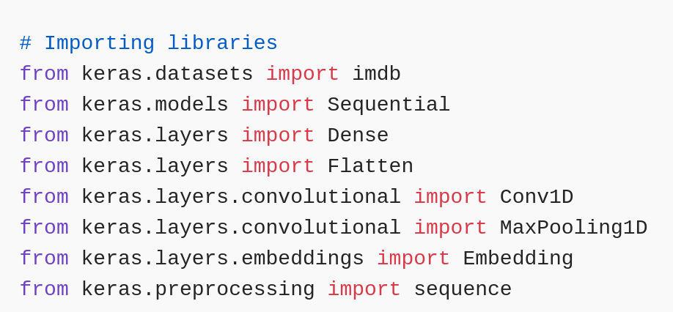
Code:

Slide 25
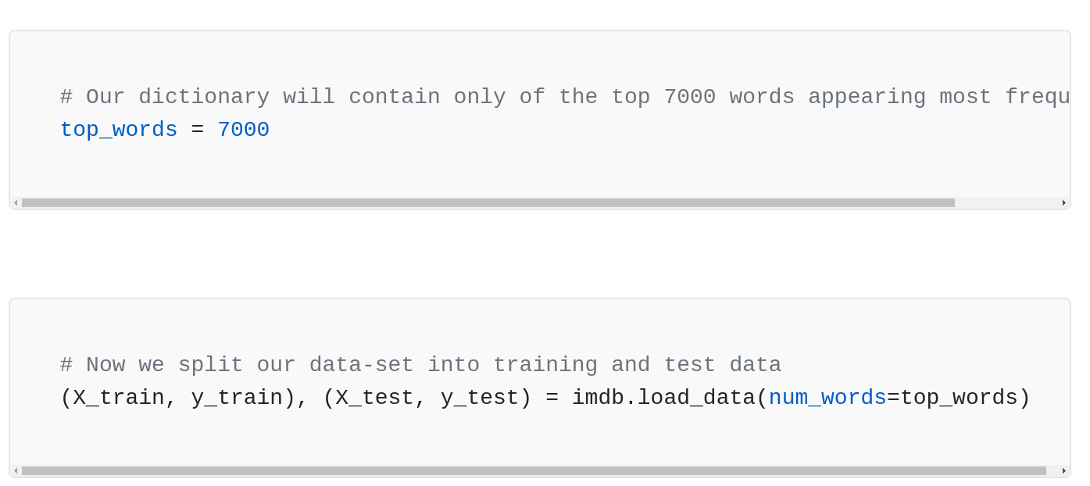
Code:

Slide 26
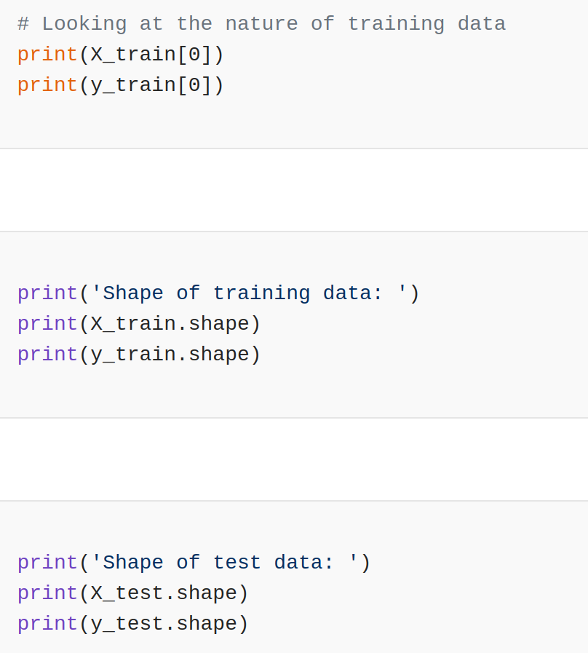
Code:

Slide 27
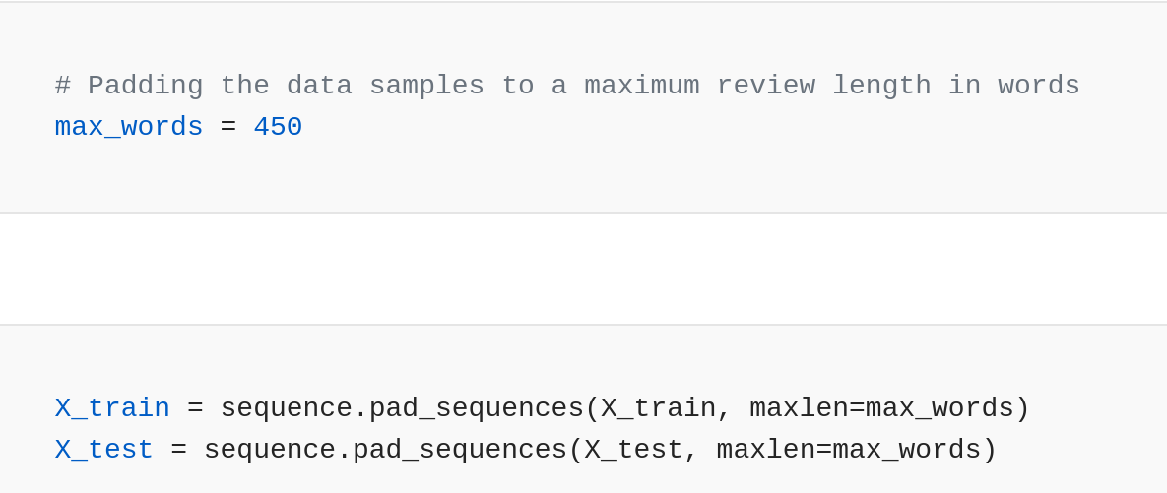
Code:

Slide 28
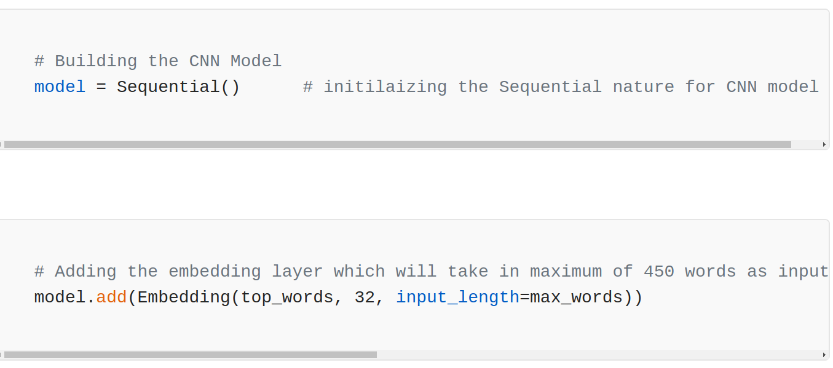
Code:

Slide 29
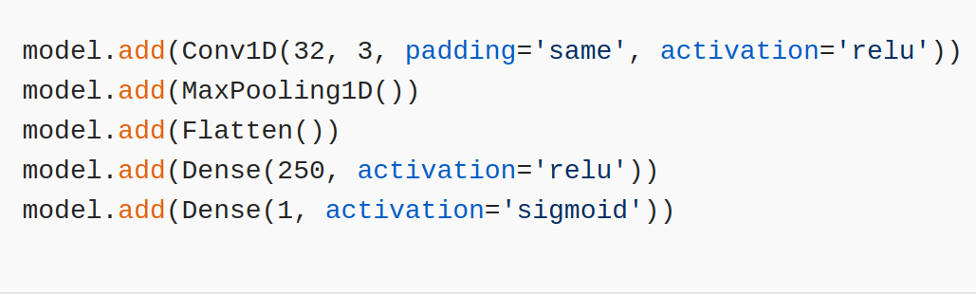
Code:

Slide 30
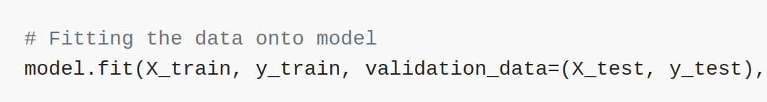
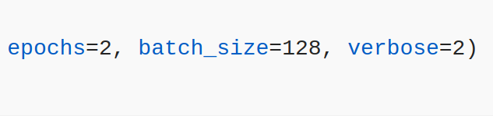
Code:

Slide 31
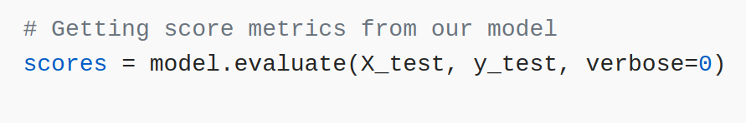
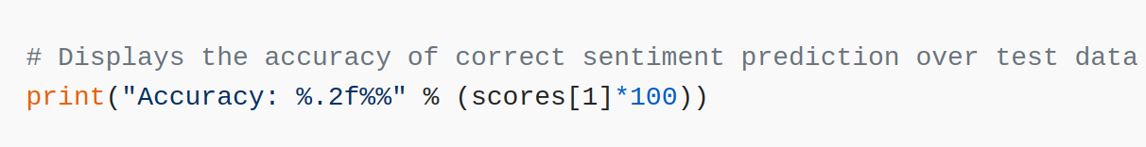
Code:

Slide 32
Implementing a 1D CNN for a Named Entity Recognition (NER) system
The model architecture for this problem is defined as follows:
Embedding Layer: input_dim=5 (vocab size), output_dim=3
1D Convolutional Layer: filters=2, kernel_size=2, activation='relu', padding='valid'
Global Max Pooling Layer: To extract the most important feature for the entire word.
Output Dense Layer: units=2 (number of entity tags: e.g., 0 for 'O', 1 for 'B-PER'), activation='softmax'

Slide 33
Implementing a 1D CNN for a Named Entity Recognition (NER) system
A sample sentence "Artificial Intelligence" is converted into a sequence of 2 word indices based on a vocabulary:
Character Vocabulary: {'Artificial':0, 'BERT':1, 'Intelligence':2, 'N-gram':3, ' ':4}
Input Sequence (X): [0, 2] // representing the characters 'A' and 'I'

Slide 34
Pre-trained Embedding Matrix
Index | Embedding Vector
0 | [1.0, 0.0, 0.0] | // 'Artificial'
1 | [0.0, 1.0, 0.0] | // 'BERT'
2 | [0.0, 0.0, 1.0] | // 'Intelligence'
3 | [0.5, 0.5, 0.0] | // 'N-gram'
4 | [0.0, 0.0, 0.0] | // padding

Slide 35
Pre-trained Embedding Matrix
A sample sentence "Artificial Intelligence" is converted into a sequence of 2 word indices based on a vocabulary:
Character Vocabulary: {'Artificial':0, 'BERT':1, 'Intelligence':2, 'N-gram':3, ' ':4}
Input Sequence (X): [0, 2] // representing the characters 'A' and 'I'

Slide 36
Pre-trained Embedding Matrix
The weights for 1D Convolutional layer (2 filters, kernel size=2) are:
Filter 1 (F1) - Kernel Weights (2x3 matrix):
[[0.5, 0.0, 0.5], [0.0, 1.0, 0.0]]
Filter 1 Bias: b1 = 0.0
Filter 2 (F2) - Kernel Weights (2x3 matrix):
[[0.0, 0.5, 0.0], [1.0, 0.0, 0.0]]
Filter 2 Bias: b2 = 0.5

Slide 37
Pre-trained Embedding Matrix
The Dense layer weights are:
Weights (W): A (2, 2) matrix: [[2.0, 0.0], [0.0, 1.0]]
Biases (b): [0.1, -0.1]

Slide 38
Pre-trained Embedding Matrix
Create the Input Embedding Matrix (E)
Index 0 (Artificial): [1.0, 0.0, 0.0]
Index 2 (Intelligence): [0.0, 0.0, 1.0]
E = [ [1.0, 0.0, 0.0], [0.0, 0.0, 1.0] ]

Slide 39
Pre-trained Embedding Matrix
Number of valid time steps
n_timesteps = input_sequence_length - kernel_size + 1
2 - 2 + 1 = 1
1 valid time step.

Slide 40
Calculate feature values for the first time step
For Filter 1 (F1):
Operation: Element-wise multiplication of the filter kernel and the input window, then sum all elements, then add bias.

Slide 41
Calculate feature values for the first time step
F1_Output = sum(dot product of (Window * F1_Kernel)) + b1
= (1.0*0.5 + 0.0*0.0 + 0.0*0.5) + (0.0*0.0 + 0.0*1.0 + 1.0*0.0) + 0.0
= (0.5 + 0 + 0) + (0 + 0 + 0) + 0.0
= 0.5
Apply ReLU: ReLU(0.5) = 0.5

Slide 42
Calculate feature values for the first time step
For Filter 2 (F2):
F2_Output = sum(dot product(Window * F2_Kernel)) + b2
= (1.0*0.0 + 0.0*0.5 + 0.0*0.0) + (0.0*1.0 + 0.0*0.0 + 1.0*0.0) + 0.5
= (0 + 0 + 0) + (0 + 0 + 0) + 0.5
= 0.5
Apply ReLU: ReLU(0.5) = 0.5

Slide 43
Feature vector for the time step (before pooling)
Feature vector for the time step (before pooling): [0.5, 0.5]

Slide 44
Global Max Pooling & Dense Layer
Global Max Pooling Output
Global Max Pooling takes the maximum value across each feature map (each filter's output across all time steps). We only have one time step.
The feature map for Filter 1 is [0.5]. The max is 0.5.
The feature map for Filter 2 is [0.5]. The max is 0.5.
Output after Global Max Pooling: [0.5, 0.5]

Slide 45
Dense Layer Application
Input features (after pooling): [0.5, 0.5]
Dense Layer Operation: Z = (features • W) + b
Z = [0.5, 0.5] • [[2.0, 0.0], [0.0, 1.0]] + [0.1, -0.1]
Z_tag0 = (0.5 * 2.0) + (0.5 * 0.0) + 0.1 = 1.0 + 0.0 + 0.1 = 1.1
Z_tag1 = (0.5 * 0.0) + (0.5 * 1.0) + (-0.1) = 0.0 + 0.5 - 0.1 = 0.4
Scores (Z): [1.1, 0.4]

Slide 46
Apply Softmax
softmax(z_i) = exp(z_i) / sum(exp(z_i))
exp(Z) = [exp(1.1), exp(0.4)] ≈ [3.004, 1.492]
sum(exp(Z)) ≈ 3.004 + 1.492 = 4.496
P(tag0) = 3.004 / 4.496 ≈ 0.668
P(tag1) = 1.492 / 4.496 ≈ 0.332
Final Probability Distribution: [0.668, 0.332]

