Slide 1
Flow Path Routing (FPR)

Slide 2
Agenda
Problem statement
Roles
Lookup flow

Slide 3
Problem statement
AI training network workloads are predictable
Require low latency, ultra minimum loss in fabric (ideally zero)
Current schemes are based on advanced congestion control
Difficult to manage and implement, solution is pointed at the box
Relies on existing ethernet mechanisms to load balance
Load balancing is not perfect, polarization can occur leading to more congestion
We can’t invent a perfect congestion control algorithm unless we move to a fully scheduled fabric
Expensive

Slide 4
Ideal scenario
Can we implement a fully scheduled fabric without VoQ or deep buffers?
Can we remove the complexity from congestion control algorithms?
Can we remove polarization from load balancing and provide a predictable path for AI training flows from CPU to GPU and back?
Can this be orchestrated at a network level?
IE: can we view the fabric as one entity from an application perspective removing the need for switches to implement complex schemes
Can the fabric be scheduled per the workload mapping
Can this be set up by an intelligent controller before sending traffic

Slide 5
Mindset shift
Need to view the network as one entity for AI training
Remove intelligence from switches and punt it to a controller
When a model compiles down from PyTorch to xPUs, we know where data will flow for training as the mapper/controller knows where each sub job is located
Collectives are probably not required
Use SW to preschedule the flows across the network and set up tables

Slide 6
Flow Path Routing
Once flows are prescheduled, switches need to be aware of paths to move traffic
A new protocol is required to move data
Flows are source routed
Paths are well known
Protection schemes can be implemented
Need to handle clos/dragonfly topologies

Slide 7
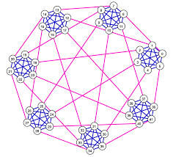
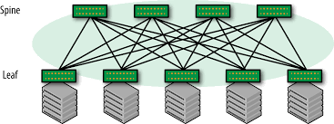
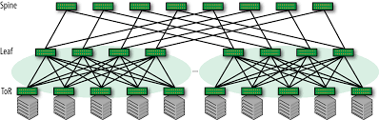
Topologies
2-tier CLOS
3-tier CLOS
Dragonfly
Maximum three hops
Lower scale limited by radix
Lower network latency
Maximum five hops
Better scale but higher cost
Higher network latency
Maximum three hops
Better scale than 2-tier clos
With same radix
Lower network latency

Slide 8
FPR header description
Distinguish between fabric ports and access ports in management plane
Access ports are allowed to terminate or start FPR “tunnel”
Add FPR header for traffic entering into fabric
Delete FPR header for traffic exiting out of fabric
FPR header contains (128 bits, 16 bytes):
5 16 bit fields for local switch port id (total 80 bits, support up to 16K radix) (up to 5 hops supported)
4 bits for hops left count
3 bits version

Slide 9
FPR Header Format
0 1 2 3
0 1 2 3 4 5 6 7 8 9 0 1 2 3 4 5 6 7 8 9 0 1 2 3 4 5 6 7 8 9 0 1
+-+-+-+-+-+-+-+-+-+-+-+-+-+-+-+-+-+-+-+-+-+-+-+-+-+-+-+-+-+-+-+-+
| | hops | | hop 4 |
| Ver | left | rsvd | port |
| | | | id |
+-+-+-+-+-+-+-+-+-+-+-+-+-+-+-+-+-+-+-+-+-+-+-+-+-+-+-+-+-+-+-+-+
| hop 3 | hop 2 |
| port | port |
| id | id |
+-+-+-+-+-+-+-+-+-+-+-+-+-+-+-+-+-+-+-+-+-+-+-+-+-+-+-+-+-+-+-+-+
| hop 1 | hop 0 |
| port | port |
| id | id |
+-+-+-+-+-+-+-+-+-+-+-+-+-+-+-+-+-+-+-+-+-+-+-+-+-+-+-+-+-+-+-+-+

Slide 10
FPR Packet Format
Typical
FPR
L2
L2
IP
FPR
Transport
IP
Transport
Place FPR header in between L2 and IP
Can’t put FPR ahead of L2 as then you need proprietary MAC implementation

Slide 11
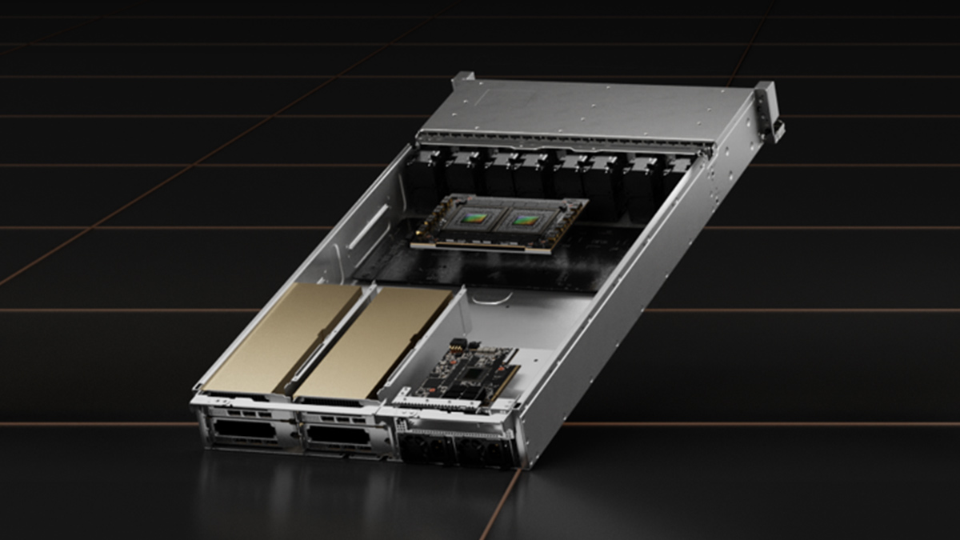
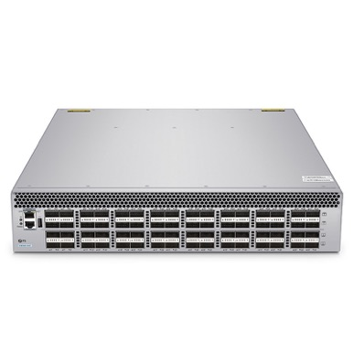
FPR Control Pipeline
Access port
Flow lookup (src port, sip, dip, qp-s, qp-d)
Get primary path (up to 5 switch ports)
Get secondary path (up to 5 switch ports)
Encap FPR header
Redirect and decrement hops left
Bypass to TM
Fabric Port
Redirect to next port
Decrement hops left
Hops left == 0, decap FPR header
Access
Port
Fabric
Port
Fabric
Port
Fabric
Port
Fabric
Port
Access
Port
Fabric Port
Redirect to next port
Decrement hops left in FPR

Slide 12
Future work: FPR protection
Use port load or link down to decide when to activate protection path
If dest port load is greater than some threshold (configurable) re-direct to protect path
If link down detected, automatically switch to protect path
Flip prt bit in fpr when doing redirect

Slide 13
FPR Orchestration
Use P4 and P4RT to build pipeline and orchestrate flows during workload set up
Flow mapping done at the time of GPU job mapping done by ML/AI tooling
View the entire distributed system as one monolithic system from a mapping point of view

Slide 14
SAI proposal
New Module: saifpr.h
Objects/Attributes:
APIs
sai_fpr_endpoint_create, sai_fpr_endpoint_delete, sai_fpr_endpoint_set_attribute, sai_fpr_endpoint_get_attribute
sai_fpr_flow_tuple_create, sai_fpr_flow_tuple_delete, sai_fpr_flow_tuple_set_attribute, sai_fpr_endpoint_get_attribute
sai_fpr_hop_list_create, sai_fpr_hop_list,delete, sai_fpr_hop_list_set_attribute, sai_fpr_hop_list_get_attribute
Objects | Attributes
sai_fpr_endpoint | sai_fpr_endpoint_access_node sai_fpr_endpoint_fabric_node
sai_fpr_flow_tuple | sai_fpr_flow_tuple_hop_list
sai_fpr_hop_list | sai_fpr_hop_list_tlv sai_fpr_hop_list_depth

