Slide 1

SEASONAL AGRICULTURE PERFORMANCE ANALYSIS
Student Name: KISHORE B
College Name: DAYANANDA SAGAR ACADEMY OF TECHNOLOGY & MANAGEMENT
AICTE STU ID : STU6a69f516665051785328918

Slide 2

PROBLEM STATEMENT
Agricultural performance changes across seasons due to variations in:
Environmental conditions
Farming practices
Resource availability
Crop characteristics
Economic conditions
Raw agricultural data does not clearly show how performance changes across seasons.
Analyze seasonal patterns, relationships and variations to support data-driven agricultural planning.
This closely follows the problem framing in your project template.

Slide 3
Project Description
Analyzes 4,000 agricultural records with 28 features.
Compares agricultural performance across Kharif, Rabi and Zaid seasons.
Studies crop productivity, profitability and resource utilization.
Examines environmental factors such as rainfall, temperature, humidity and sunlight.
Analyzes soil, nutrients, irrigation, water efficiency and disease/pest risk.
Uses statistical analysis and machine learning to identify important patterns.
Develops an Agricultural Performance Index (API) for overall comparison.
Predicts crop yield using regression models.
Your notebook confirms the dataset contains 4,000 records and 28 features.

Slide 4
OBJECTIVES
Understand seasonal agricultural performance.
Clean and prepare agricultural data for analysis.
Compare crop yield and production across seasons.
Analyze environmental and soil conditions.
Study irrigation and water efficiency.
Compare seasonal revenue, cost and profit.
Identify disease and pest risk patterns.
Apply statistical hypothesis testing.
Develop an Agricultural Performance Index.
Predict crop yield using Machine Learning

Slide 5

WHO ARE THE END USERS?
Farmers For seasonal crop and resource planning.
Agricultural Departments For regional and seasonal performance assessment.
Agricultural Researchers For studying crop, environmental and resource relationships.
Resource Managers For improving irrigation and water utilization.
Agricultural Analysts For data-driven decision-making and performance monitoring.

Slide 6

Technology Used
Programming
Python
Data Analysis
Pandas
NumPy
Visualization
Matplotlib
Seaborn
Plotly
Statistical Analysis
SciPy
Machine Learning
Scikit-learn
Google Colab / Jupyter Notebook

Slide 7
Results: Seasonal Performance
Season | Yield
Kharif | 5.64 Tonnes/Ha
Rabi | 5.08 Tonnes/Ha
Zaid | 4.67 Tonnes/Ha
Finding
Kharif recorded the highest average yield.
Zaid recorded the lowest average yield.
Seasonal conditions have a noticeable effect on agricultural productivity.
Add: Seasonal Yield bar chart.

Slide 8
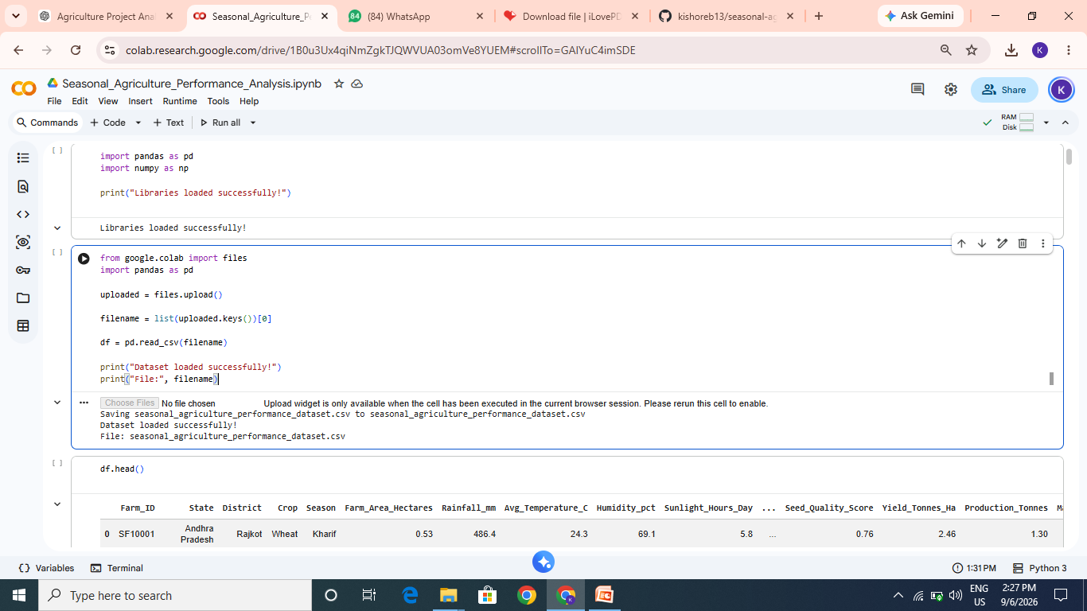

Slide 9
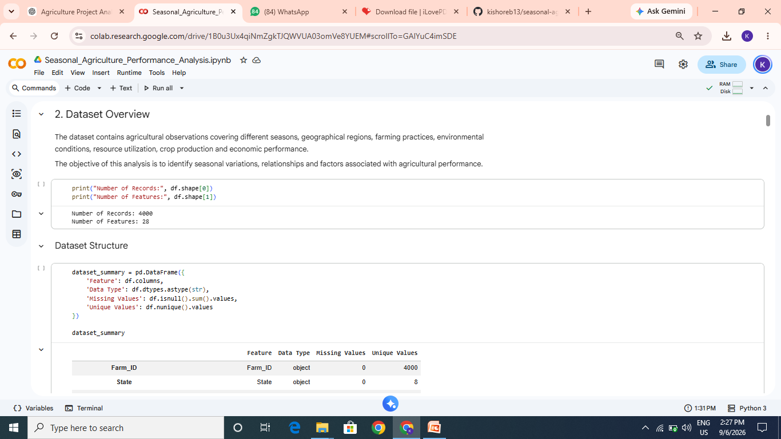
RESULTS
[Add screen shots of your code ]

Slide 10
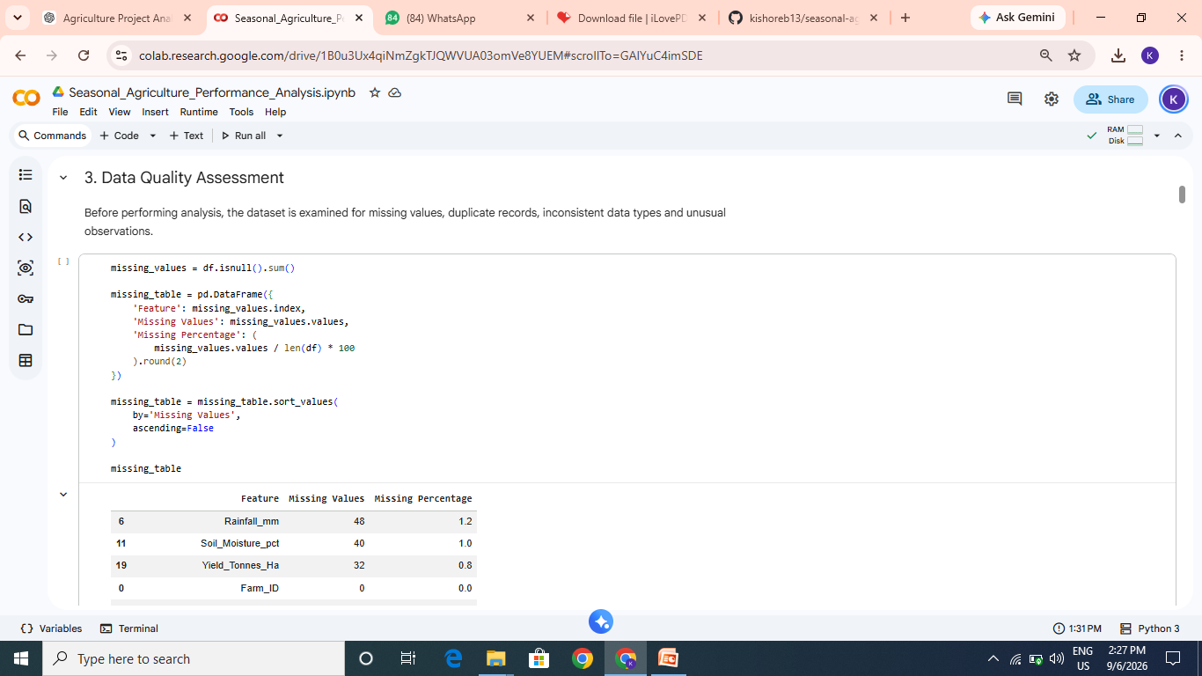
RESULTS
[Add screen shots of your code ]

Slide 11
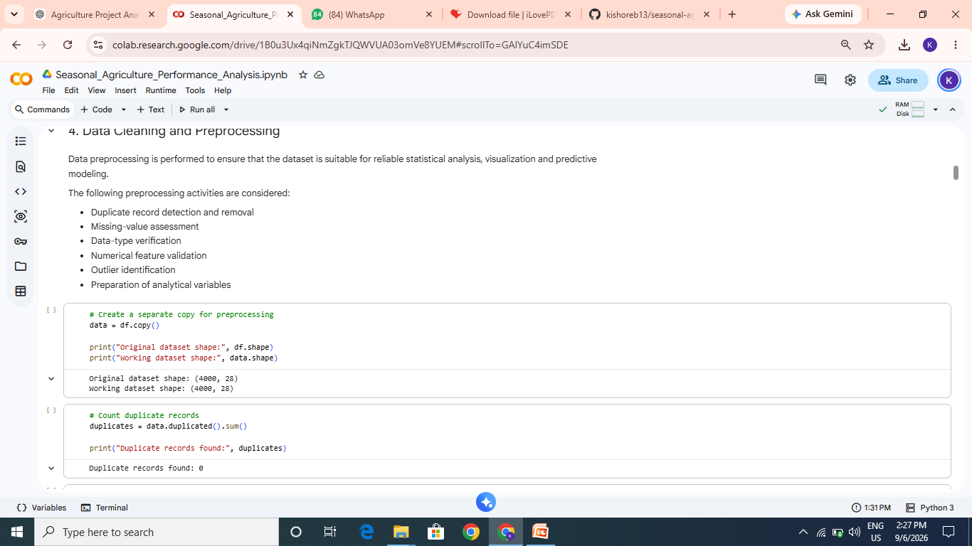
RESULTS
[Add screen shots of your code ]

Slide 12
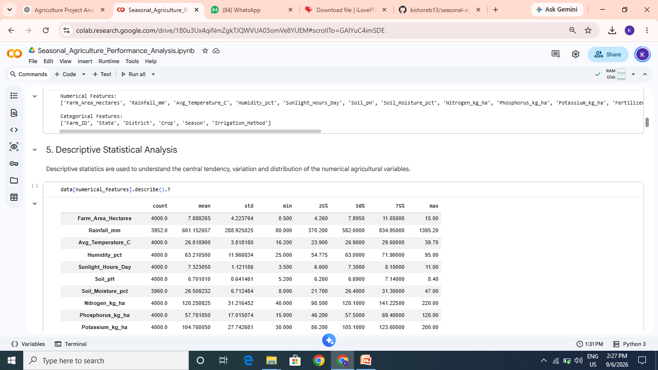
RESULTS
[Add screen shots of your code ]

Slide 13
Machine Learning
Crop Yield Prediction
Three regression models were evaluated:
Linear Regression
Random Forest Regression
Gradient Boosting Regression
Best Model
Gradient Boosting Regression
R² Score: 0.9709 MAE: 0.7004 RMSE: 2.1176
Purpose
Machine Learning was used to:
Predict crop yield.
Identify important factors influencing yield.
Provide an additional predictive perspective for agricultural planning.

Slide 14
RECOMMENDATION
Plan agricultural activities according to seasonal performance.
Select crops based on observed productivity and profitability.
Improve irrigation strategies where water efficiency is low.
Monitor rainfall, temperature and soil moisture.
Optimize fertilizer and pesticide usage.
Closely monitor high-risk disease and pest periods.
Use the API as a comparative decision-support indicator.
Use ML predictions as an additional tool for yield planning.
Continue collecting agricultural data for future analysis.

Slide 15
Future scope
Develop a real-time agricultural monitoring dashboard.
Integrate live weather and rainfall data.
Add satellite/remote-sensing information.
Develop crop-specific yield prediction models.
Add disease and pest prediction.
Introduce real-time irrigation recommendations.
Deploy the ML model as a web/mobile application.
Use larger datasets for improved generalization.

Slide 16
GitHub Link
Project Repository
Seasonal Agriculture Performance Analysis
Include :
Dataset
Colab Notebook
Results & Graphs
Requirements
GitHub repository link :
https://github.com/kishoreb13/seasonal-agriculture-performance-analysis.git

Slide 17

VOIS Course completion certificate - Data Visualization

Slide 18
Thank you
.
.

