Slide 1
Standard Template Library (STL):
What is STL?
Standard Template Library (STL) is a collection of standard C++ template classes.
It consists of generic methods and classes to work with different forms of data.
Standard Template Library is basically a generic library i.e. a single method/class can operate on different data types.
So, we won’t have to declare and define the same methods/classes for different data types.
Thus, STL saves a lot of effort, reduces the redundancy of the code and therefore, leads to the increased optimization of the code blocks.

Slide 2
Generic Functions using Template:
#include <iostream>
using namespace std;
template <typename T>
T myMax(T x, T y)
{
return (x > y) ? x : y;
}
int main()
{
// Call myMax for int
cout << myMax<int>(3, 7) << endl;
// call myMax for double
cout << myMax<double>(3.0, 7.0) << endl;
// call myMax for char
cout << myMax<char>('g', 'e') << endl;
return 0;
}

Slide 3
Generic Class using Template:
#include<iostream>
using namespace std;
template<class T>
class TempExample
{
public:
T a,b;
void setData(T n1,T n2)
{
a=n1;
b=n2;
}
void display()
{
cout<<"a+b="<<a+b;
}
};
int main()
{
TempExample<int> ob;
ob.setData(10,20);
ob.display();
return 0;
}

Slide 4
https://nuwen.net/mingw.html
https://www.youtube.com/watch?v=jvg4VtYEhKU

Slide 5
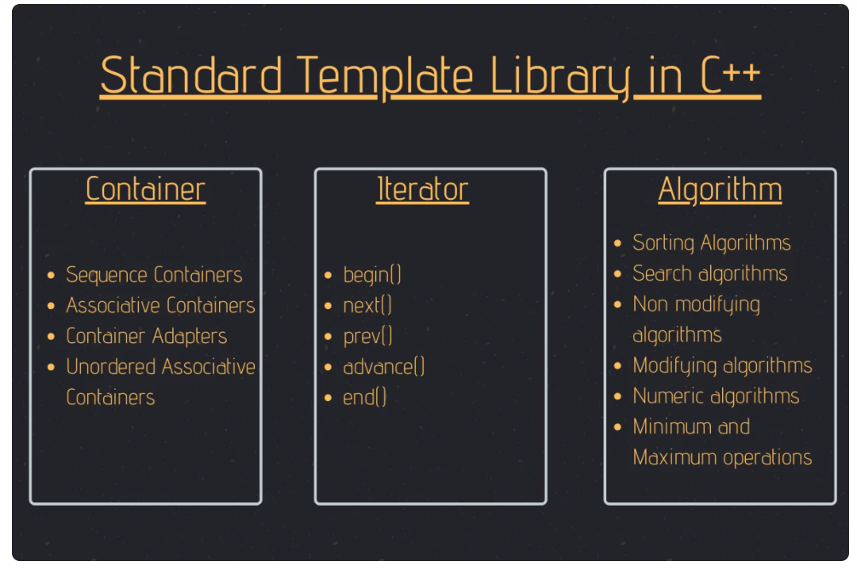

Slide 6
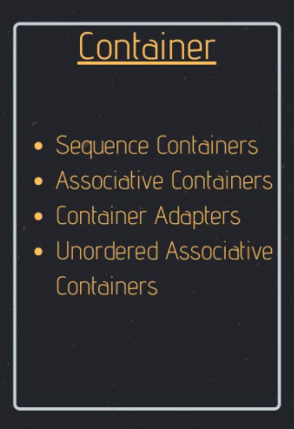
1. Containers in Standard Template Library
In Standard Template Library, Containers create and store data and objects.
Containers create generic data structures that can hold values of different data types altogether.
Sequence Containers:
Array,Vector,List,Deque, etc
Associative Containers:
Set,Map,Multiset,Multimap
Container Adapters:
Queue, Priority Queue, Stack
Unordered Associative Containers:
Unordered_set, Unordered_map, Unordered_multiset, Unordered_multimap

Slide 7
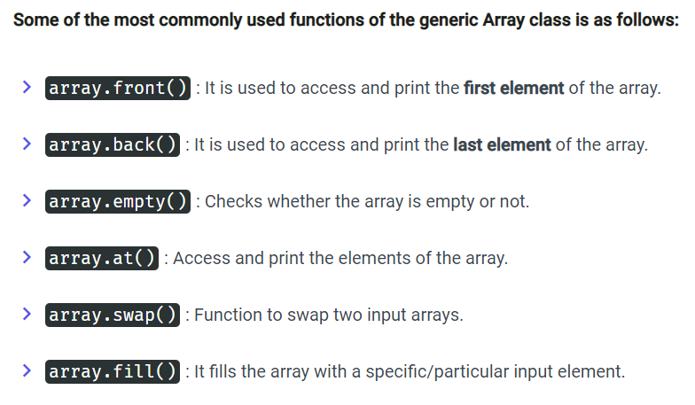
Sequence Containers: Arrays
The Array class of Sequential Containers is much more efficient than the default array structure.
array<data_type, size> = {value1, value2, ...., valueN};

Slide 8
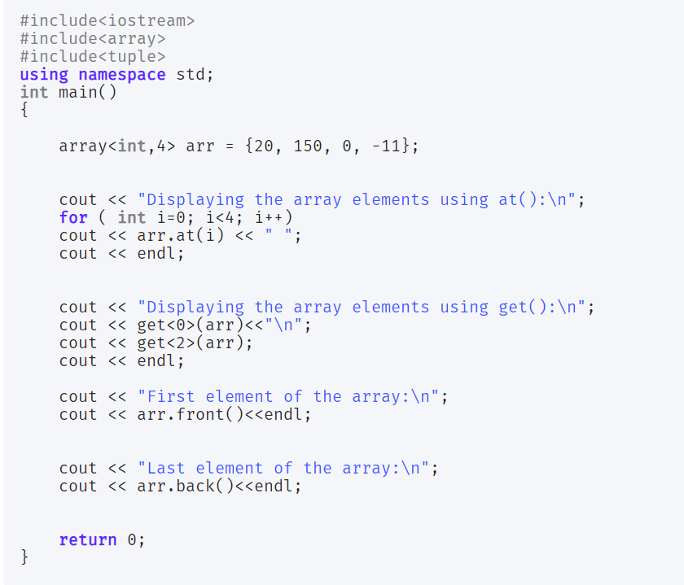
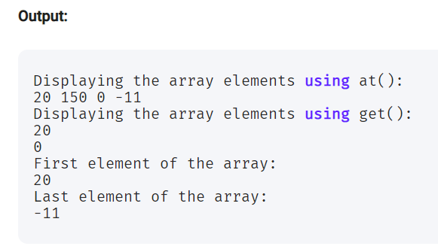
Sequence Containers: Arrays

Slide 9
Exercise : Array
Array A
Array B
N=6
100,55,250,77,99,46
150,35,20,90,39,18,56,10
M=8
Odd numbers
55,77,99,35,39
100,250,46,150,20,90,18,56,10
Even numbers
Arrange all the Odd numbers in ascending order
Arrange all the Even numbers in descending order
Odd numbers should be followed by Even numbers
Result should be stored in a single array.
35,39,55,77,99,250,150,100,90,56,46,20,18,10

Slide 10
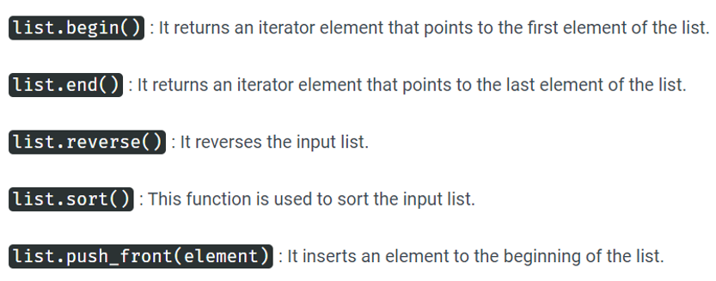
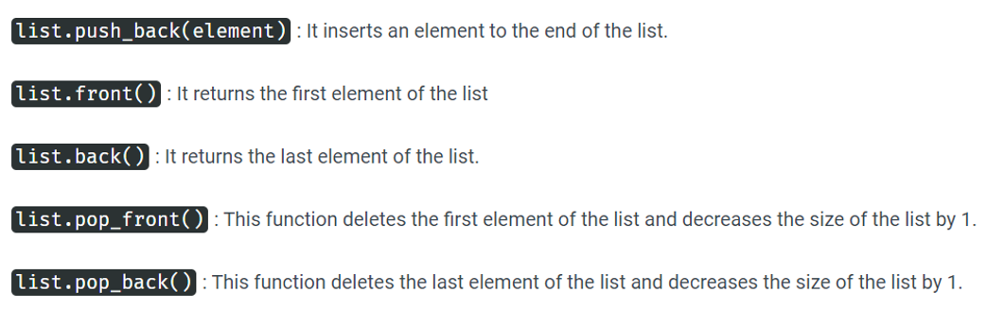
Sequence Containers: List
The List class of the Sequential Containers provides storage to elements with non-contagious memory locations.
list <data_type> list_name

Slide 11
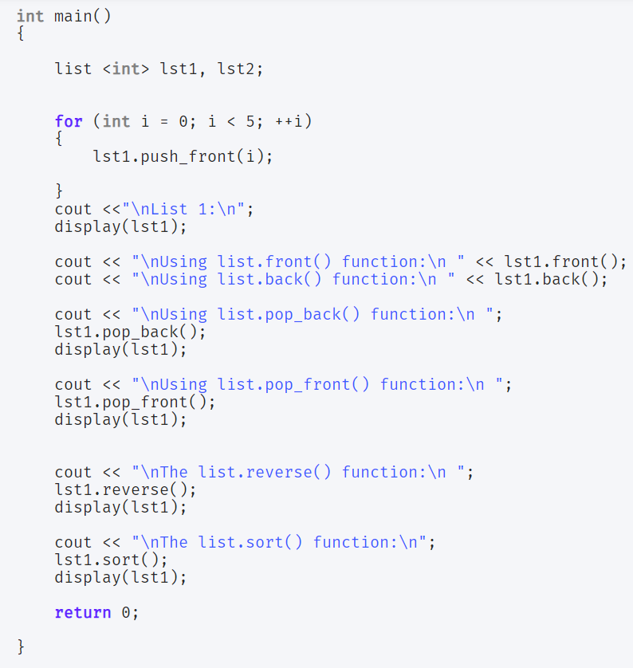
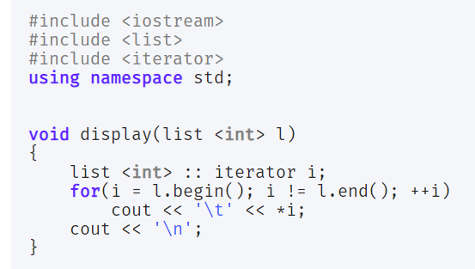
Sequence Containers: List
we have used an Iterator to traverse the list efficiently.

Slide 12
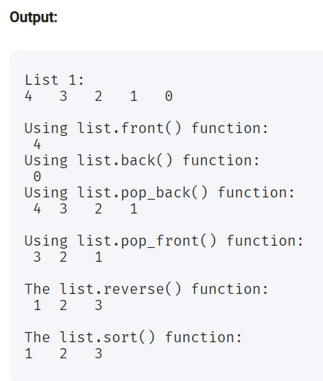

Slide 13
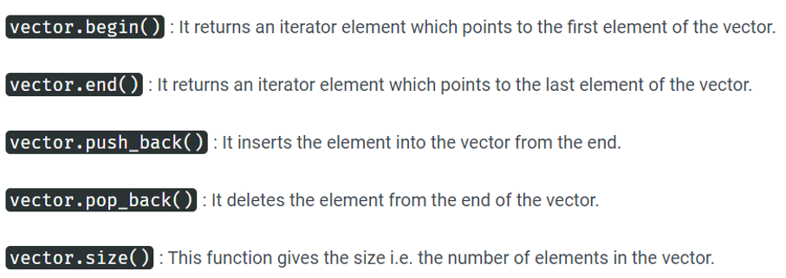
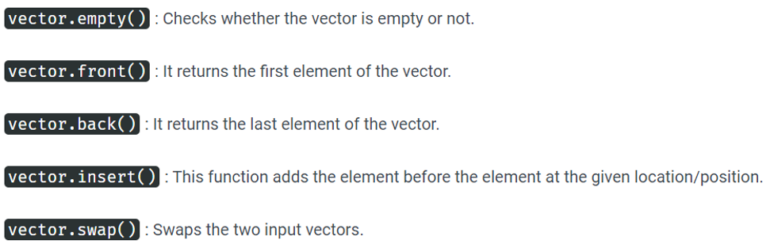
Sequence Containers: Vector
Vectors in C++, function the same way as Arrays in a dynamic manner i.e. vectors can resize itself automatically whenever
an item is added/deleted from it.
The data elements in Vectors are placed in contagious memory locations and Iterator can be easily used to access those elements.
Moreover, insertion (push) of items is takes place at the end of Vector.
vector<data_type> vector_name;

Slide 14
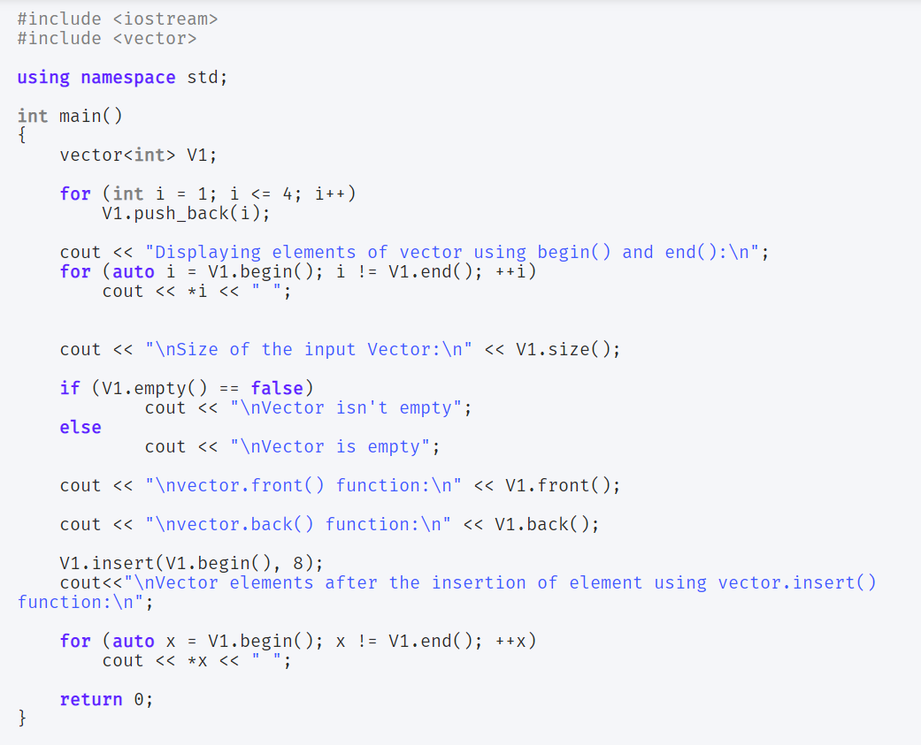
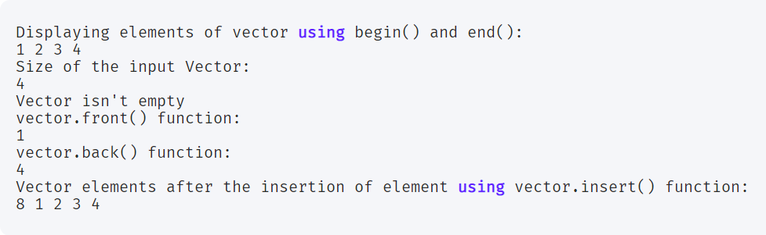
Sequence Containers: Vector

Slide 15
Associative Containers
Associated Containers implement and inculcate generic classes and functions with sorted data structures which in turns leads to
reduced time complexity.
Associative Containers:
1.Set
2.Map
3.Multiset
4.Multimap

Slide 16
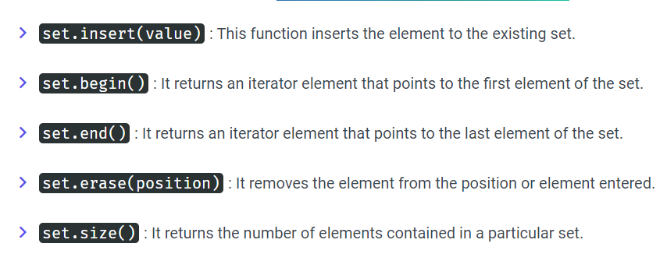
Associative Containers: Set
Sets in Associative Containers stores unique elements i.e. redundant elements are not allowed.
Moreover, once the element is inserted into the set, it cannot be altered or modified.
set <data_type> set_name;

Slide 17
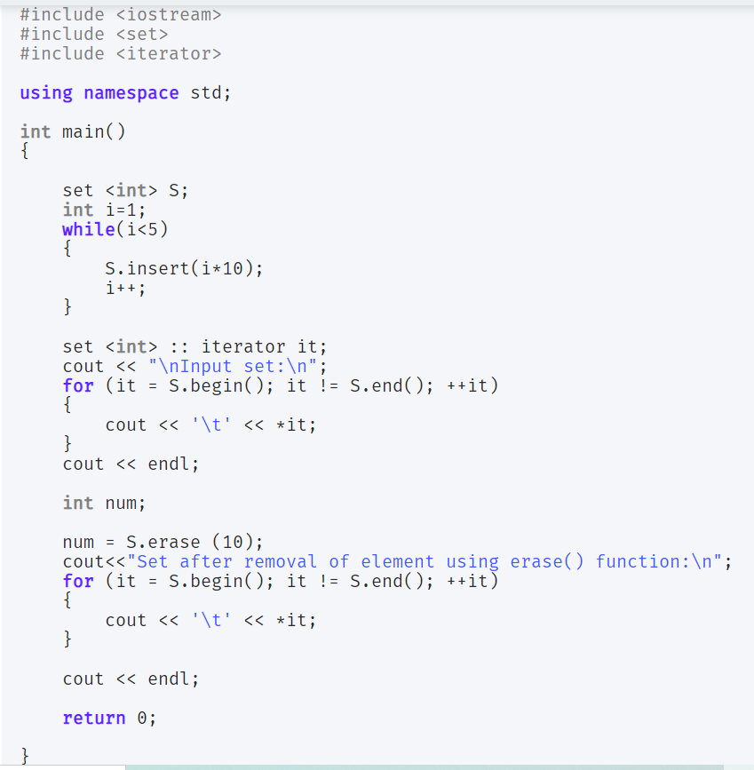
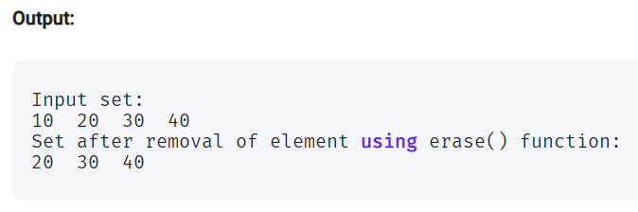
Associative Containers: Set

Slide 18
Associative Containers: MultiSet
Multisets serve the same functionality as that of Sets.
The only difference is that Multisets can have duplicate elements in it i.e. it allows redundancy.
multiset<data_type> multiset_name;

Slide 19
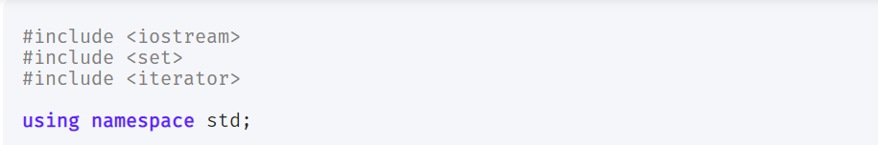
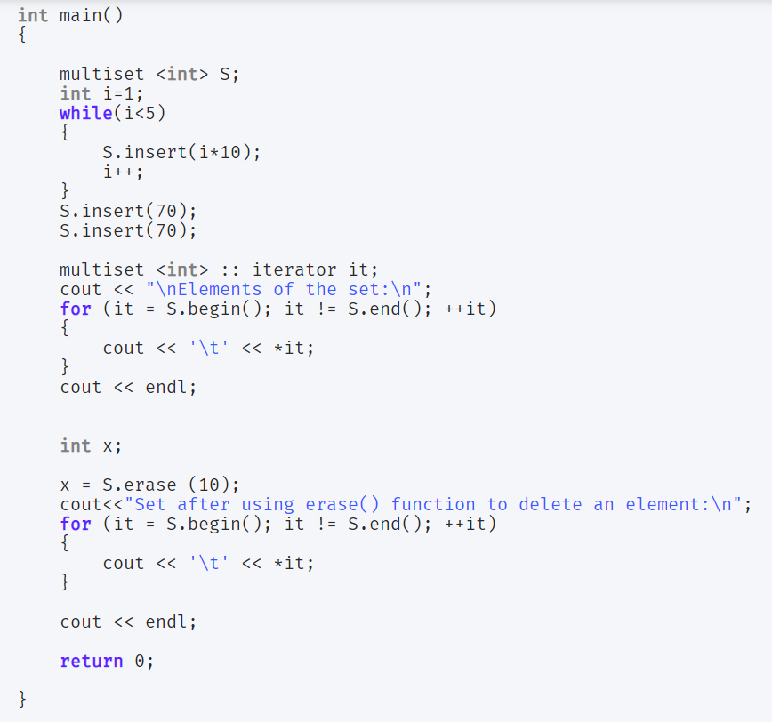
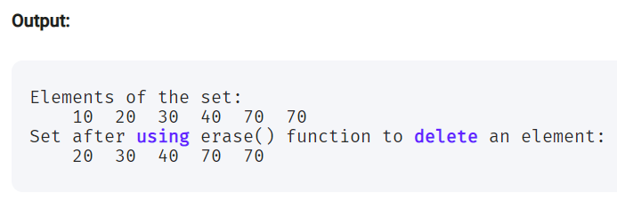
Associative Containers: MultiSet

Slide 20
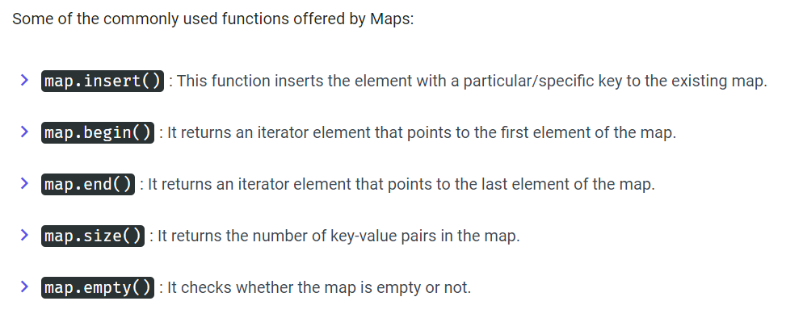
Associative Containers: Map
Maps store elements in a key-value pair.
Each value is mapped with a key unique element.
map<data_type of key, data_type of element> map_name;

Slide 21
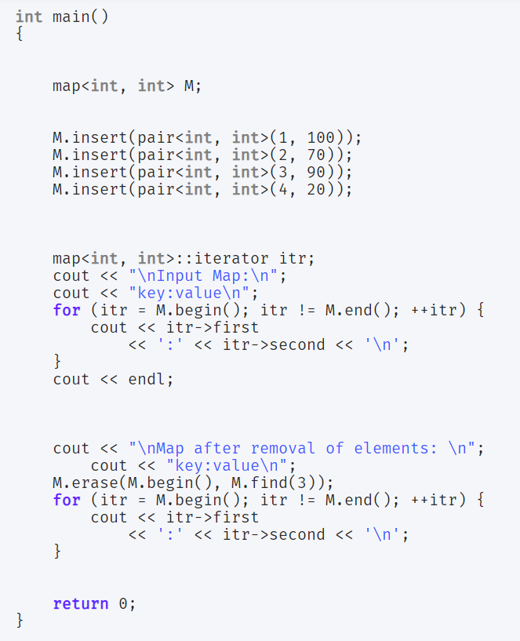
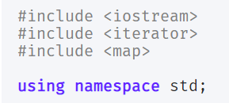
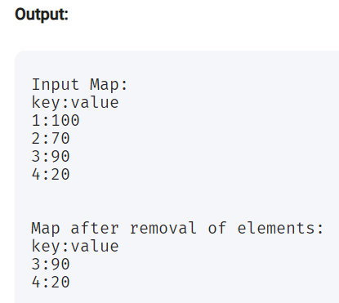
Associative Containers: Map

Slide 22
Multimap
Multimaps function the same way as Maps, but the only difference is that in Multimaps, redundant key values are allowed i.e.
the elements can have the same key values.
multimap<data_type of key, data_type of element> multimap_name;

Slide 23
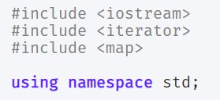
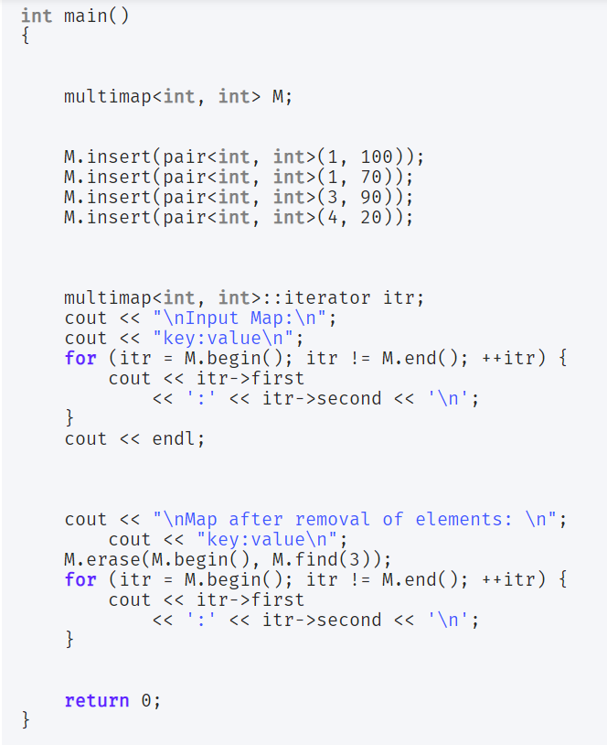
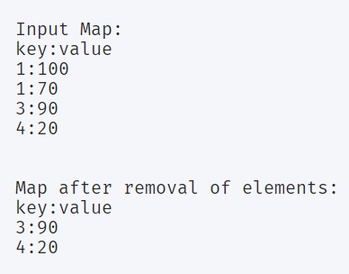

Slide 24
Container Adapters
Container Adapters provide a different interface to the Sequential Adapters.

Slide 25
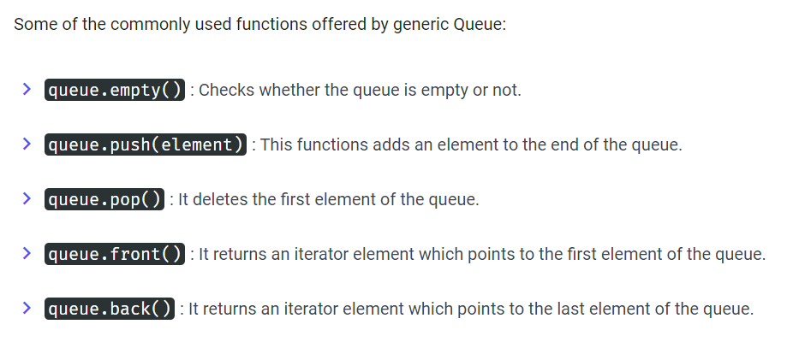
Queue
Queues work in First-In-First-Out(FIFO) fashion. The items are inserted from the rear i.e from the end and are deleted from the front
queue <data_type> queue_name;

Slide 26
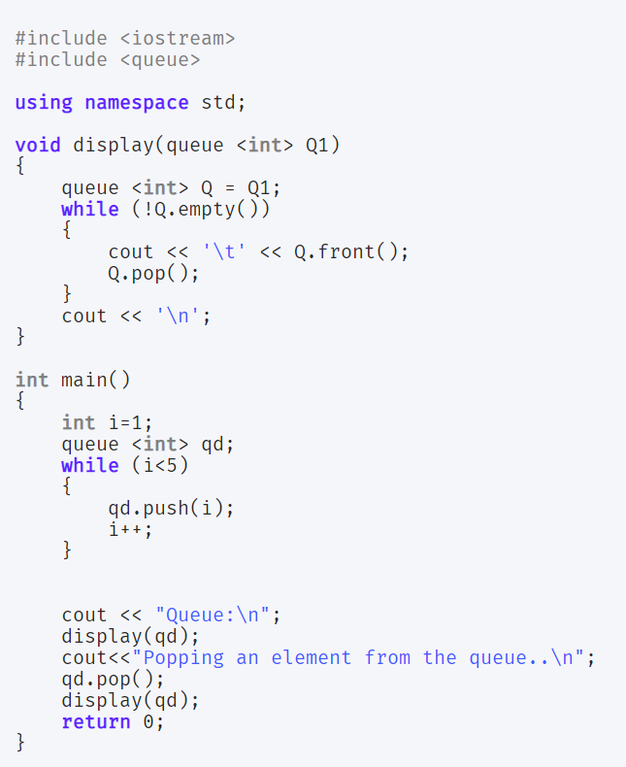
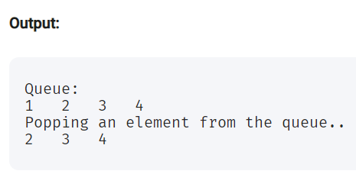

Slide 27
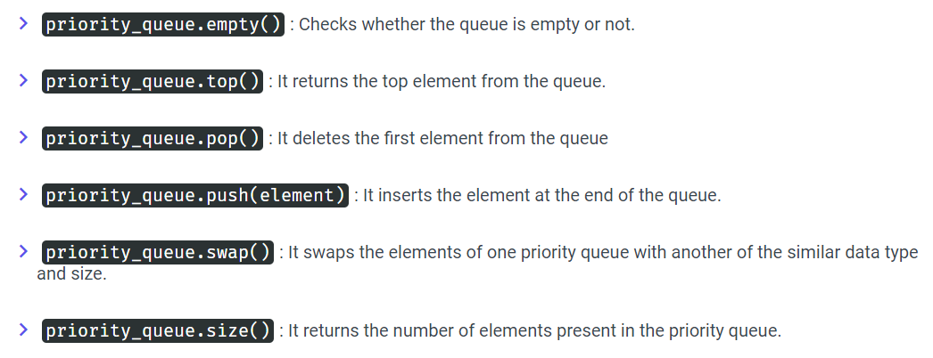
Priority queue
In priority queue, the elements are placed in decreasing order of their values and the first element represents the largest of all the inserted elements.
priority_queue <data_type> priority_queue_name;

Slide 28
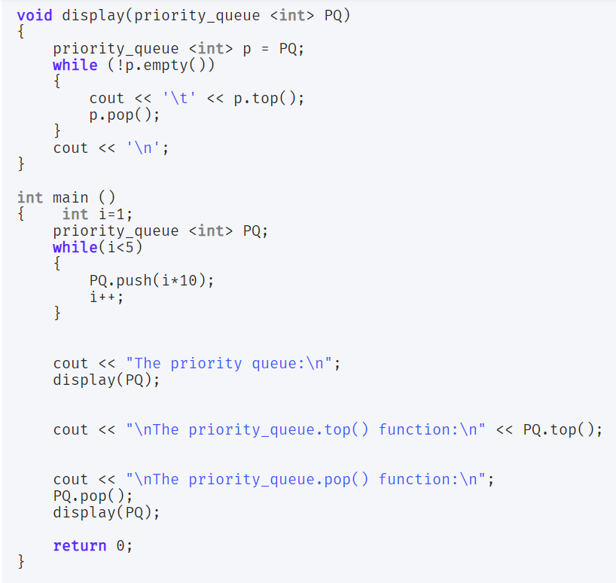
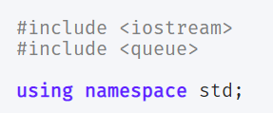
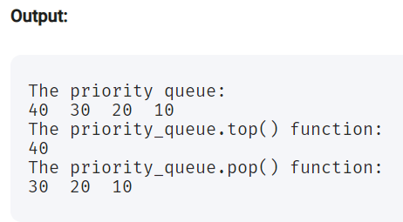

Slide 29
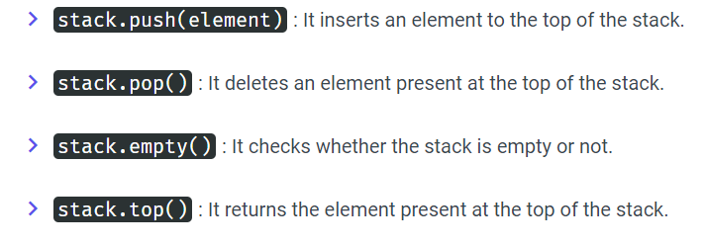
stack
Stack follows the Last-In-First-Out (LIFO) fashion. The items are inserted at one end of the stack and an item is deleted from the same end of the stack.
stack <data_type> stack_name;

Slide 30
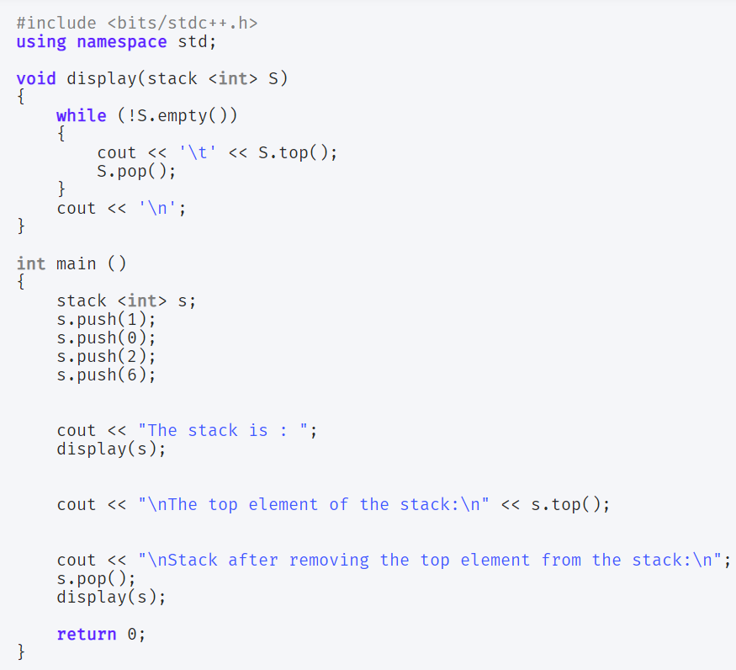
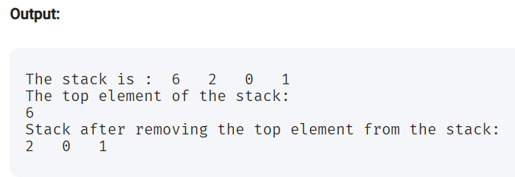

Slide 31
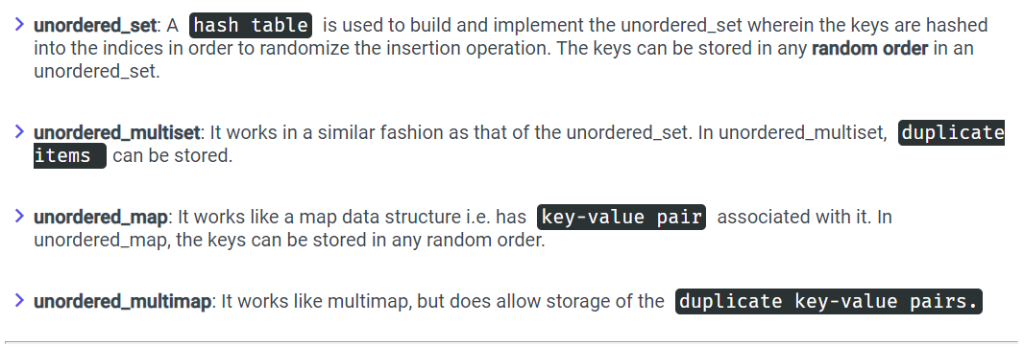
Unordered Associative Containers
Unordered Associative Containers provides sorted and unordered data structures that can be used for efficient searching operations.

Slide 32
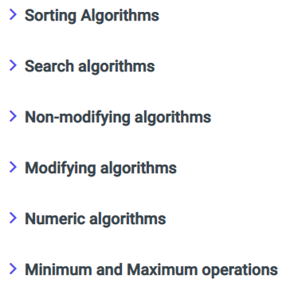
2. Algorithms in Standard Template Library
Standard Template Library provides us with different generic algorithms.
These algorithms contain built in generic functions which can be directly accessed in the program.
The Algorithm and its functions can be accessed with the help of Iterators only.

Slide 33
Sorting Algorithm in Standard Template Library
Standard Template Library provides built-in sort() method to sort the elements in a particular data structure.
Internally, it uses a combination of Quick Sort, Heap Sort, and Insertion Sort to sort the elements.
sort(starting index, end_element_index)

Slide 34
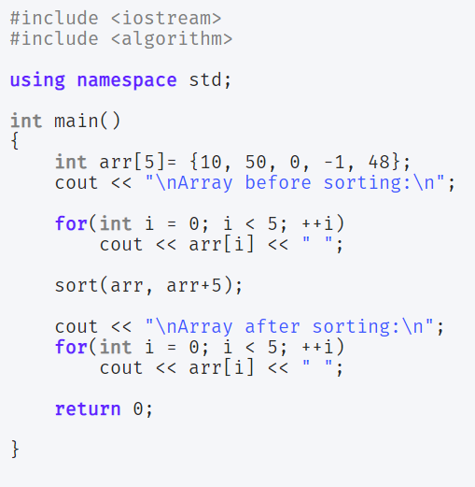
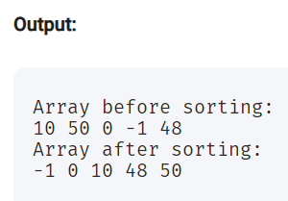

Slide 35
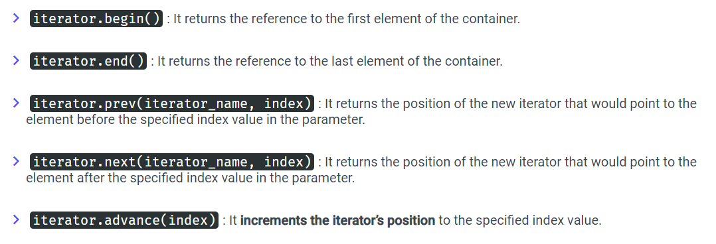
3. Iterators in Standard Template Library
Iterators are basically used to point or refer to a particular memory location of the element. They point at the containers and help them manipulate the elements in an efficient manner.

Slide 36
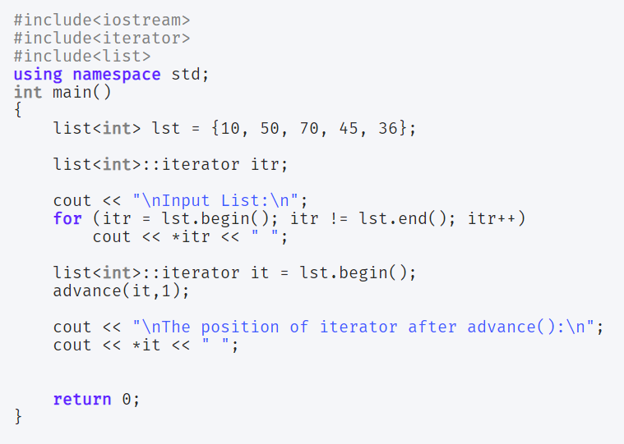
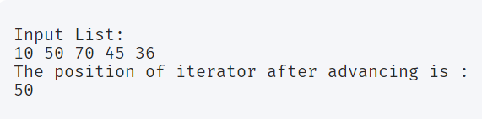
In the above snippet of code, advance(it, 1) points the iterator to the element at the index value = 1.

Slide 37
Resources:
https://www.cppreference.com/Cpp_STL_ReferenceManual.pdf

Slide 38
https://www.journaldev.com/36489/standard-template-library-in-c-plus-plus
https://www.youtube.com/watch?v=doA2h2nKBUQ
https://www.youtube.com/watch?v=Fk12ELJ9Bww

