Slide 1
Standard Template Library (STL):
What is STL?
Standard Template Library (STL) is a collection of standard C++ template classes.
It consists of generic methods and classes to work with different forms of data.
Standard Template Library is basically a generic library i.e. a single method/class can operate on different data types.
So, we won’t have to declare and define the same methods/classes for different data types.
Thus, STL saves a lot of effort, reduces the redundancy of the code and therefore, leads to the increased optimization of the code blocks.

Slide 2
Generic Functions using Template:
#include <iostream>
using namespace std;
template <typename T>
T myMax(T x, T y)
{
return (x > y) ? x : y;
}
int main()
{
// Call myMax for int
cout << myMax<int>(3, 7) << endl;
// call myMax for double
cout << myMax<double>(3.0, 7.0) << endl;
// call myMax for char
cout << myMax<char>('g', 'e') << endl;
return 0;
}

Slide 3
#include<iostream>
using namespace std;
template<class T>
class TempExample
{
public:
T a,b;
void setData(T n1,T n2)
{
a=n1;
b=n2;
}
void display()
{
cout<<"a+b="<<a+b;
}
};
int main()
{
TempExample<int> ob;
ob.setData(10,20);
ob.display();
return 0;
}

Slide 4
https://nuwen.net/mingw.html
https://www.youtube.com/watch?v=jvg4VtYEhKU

Slide 5
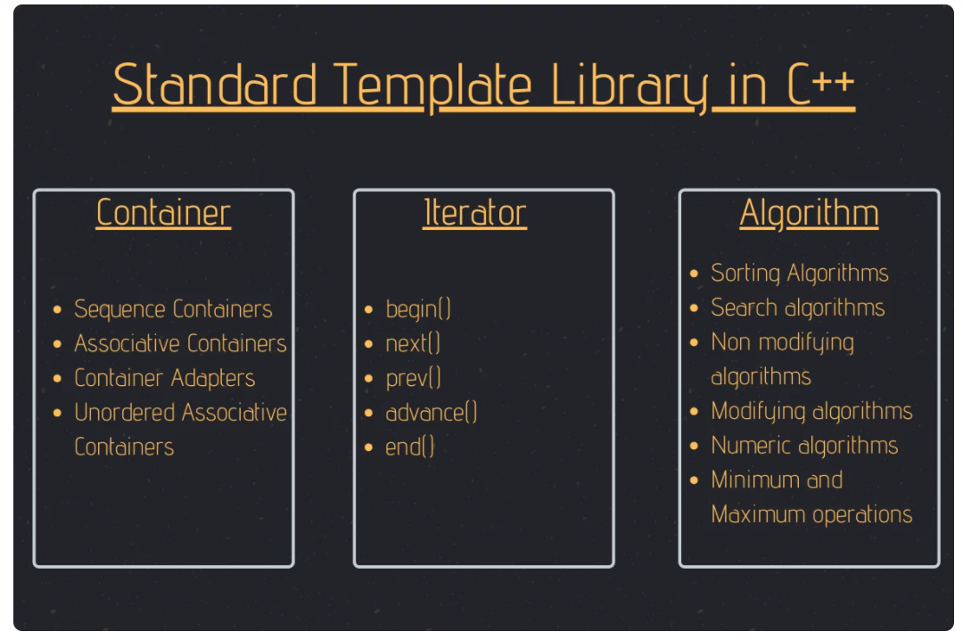

Slide 6
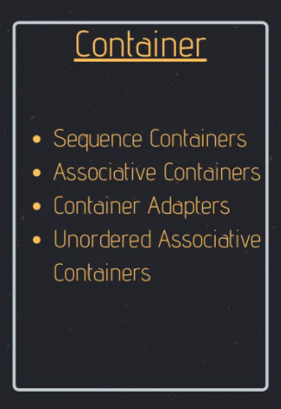
1. Containers in Standard Template Library
In Standard Template Library, Containers create and store data and objects.
Containers create generic data structures that can hold values of different data types altogether.
Sequence Containers
Array,Vector,List,Deque, etc
Associative Containers
Set,Map,Multiset,Multimap
Container Adapters
Queue, Priority Queue, Stack

Slide 7
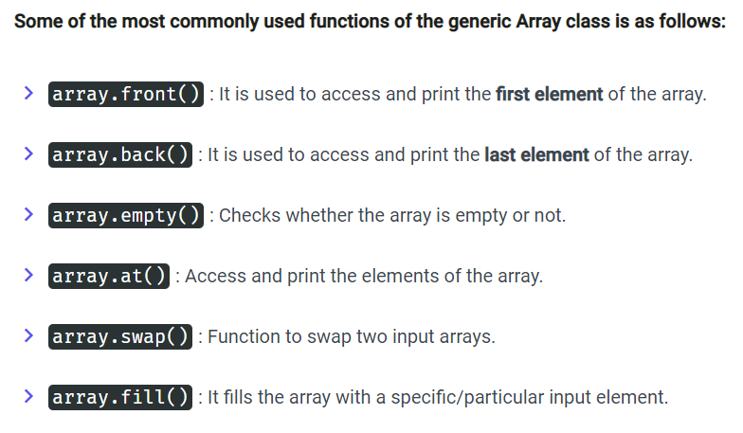
Sequence Containers: Arrays
The Array class of Sequential Containers is much more efficient than the default array structure.
array<data_type, size> = {value1, value2, ...., valueN};

Slide 8
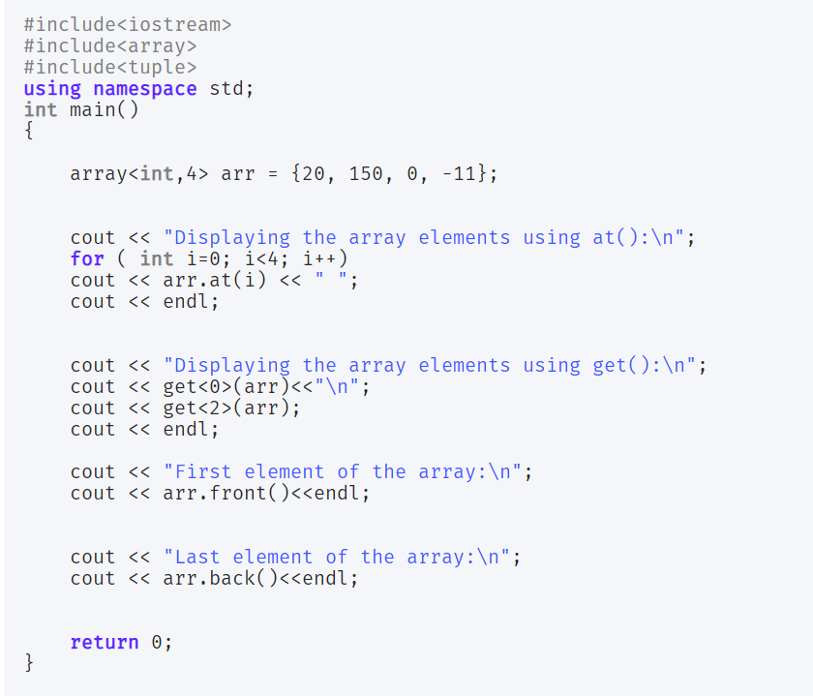
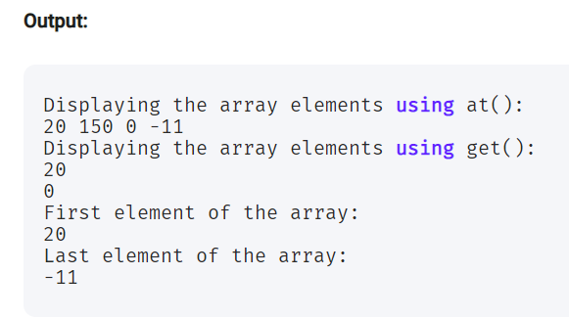

Slide 9
List
The List class of the Sequential Containers provides storage to elements with non-contagious memory locations.
list <data_type> list_name

Slide 10
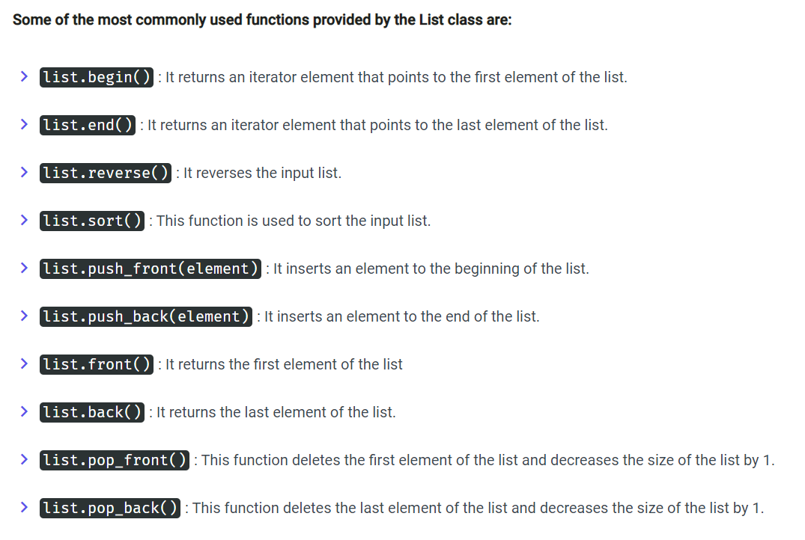

Slide 11
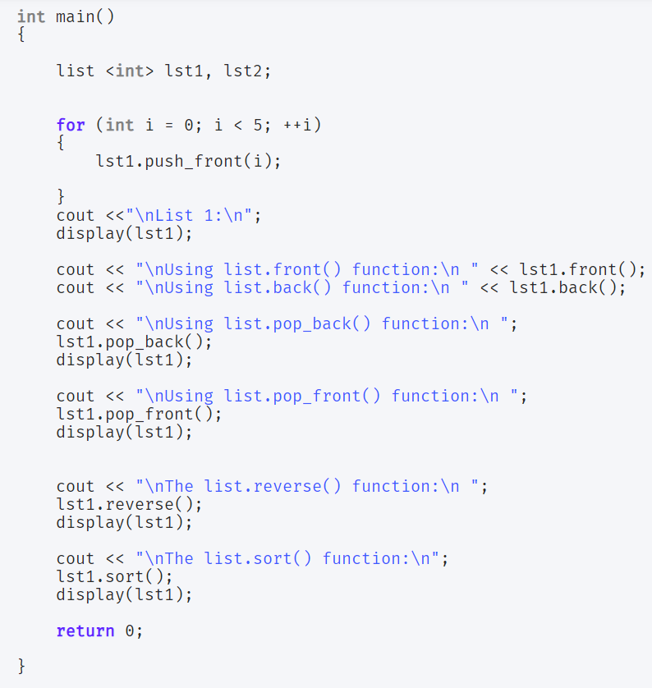
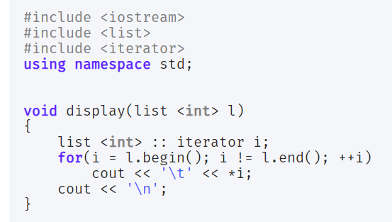
we have used an Iterator to traverse the list efficiently.

Slide 12
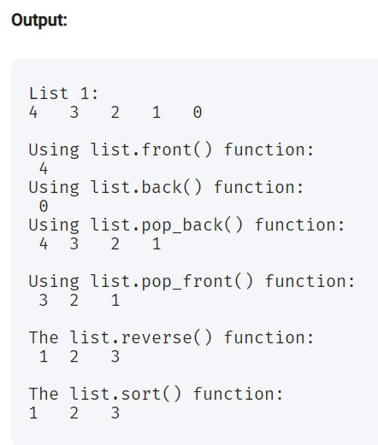

Slide 13
vector
Vectors in C++, function the same way as Arrays in a dynamic manner i.e. vectors can resize itself automatically whenever an item is added/deleted from it.
The data elements in Vectors are placed in contagious memory locations and Iterator can be easily used to access those elements. Moreover,
insertion of items in takes place at the end of Vector.
vector<data_type> vector_name;

Slide 14
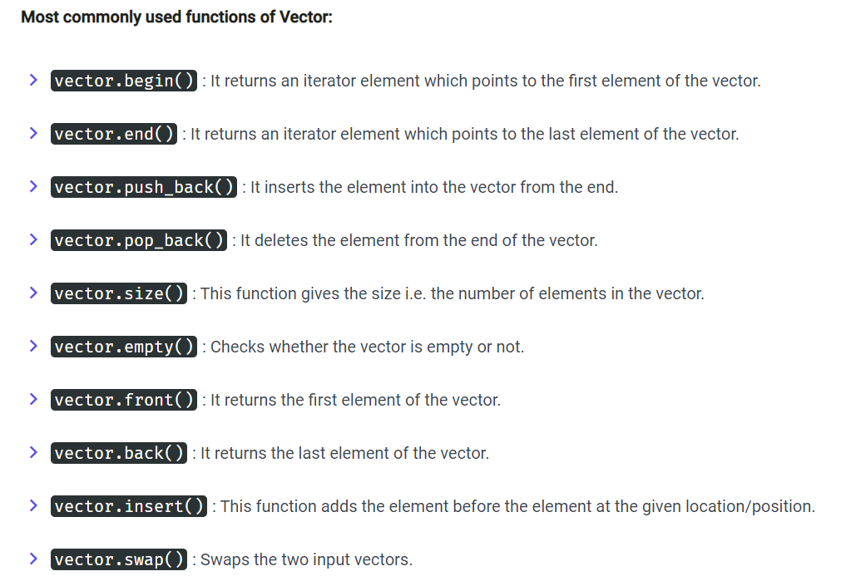

Slide 15
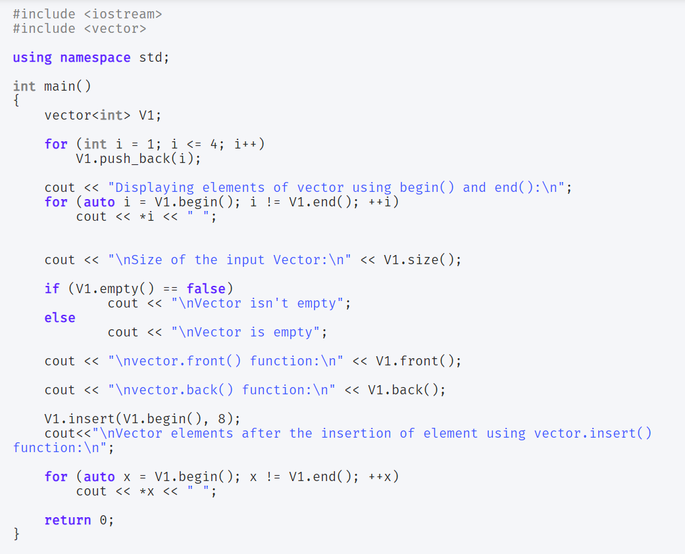
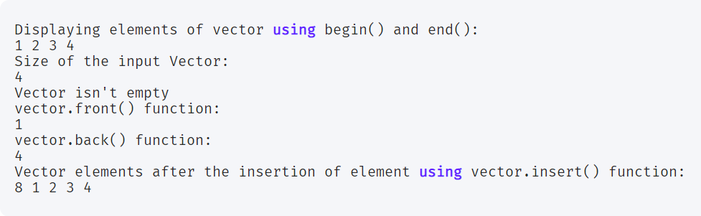

Slide 16
Associative Containers in Standard Template Library
Associated Containers implement and inculcate generic classes and functions with sorted data structures which in turns leads to reduced time complexity.

Slide 17
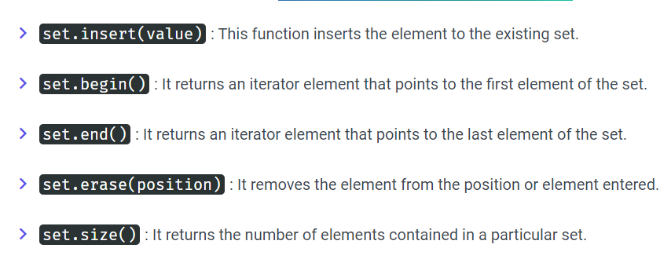
Set
Sets in Associative Containers stores unique elements i.e. redundant elements are not allowed.
Moreover, once the element is inserted into the set, it cannot be altered or modified.
set <data_type> set_name;

Slide 18
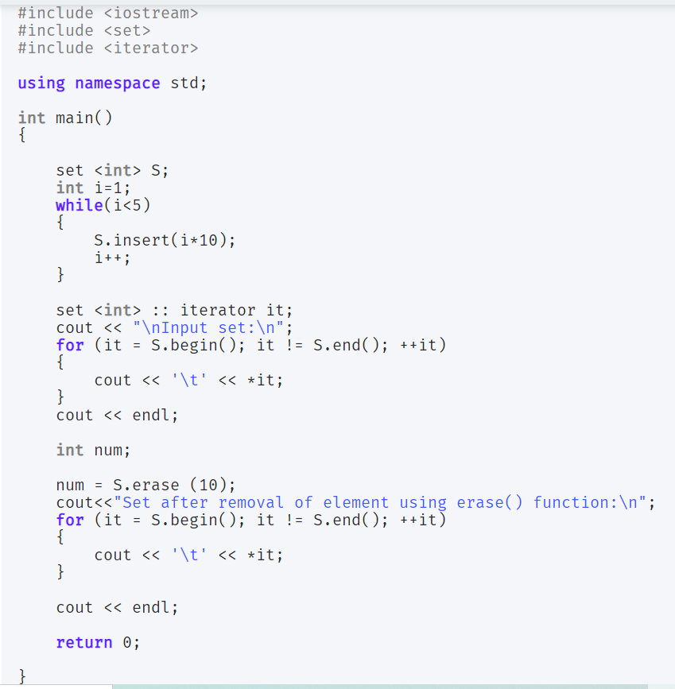
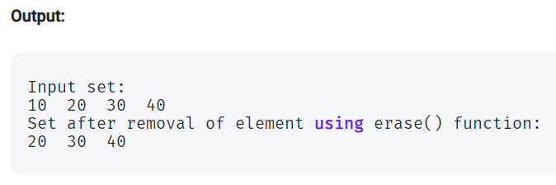

Slide 19
Multiset
Multisets serve the same functionality as that of Sets. The only difference is that Multisets can have duplicate elements in it i.e. it allows redundancy.
multiset<data_type> multiset_name;

Slide 20
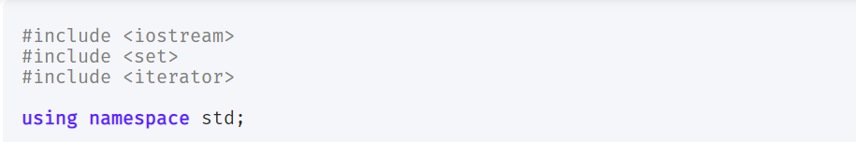
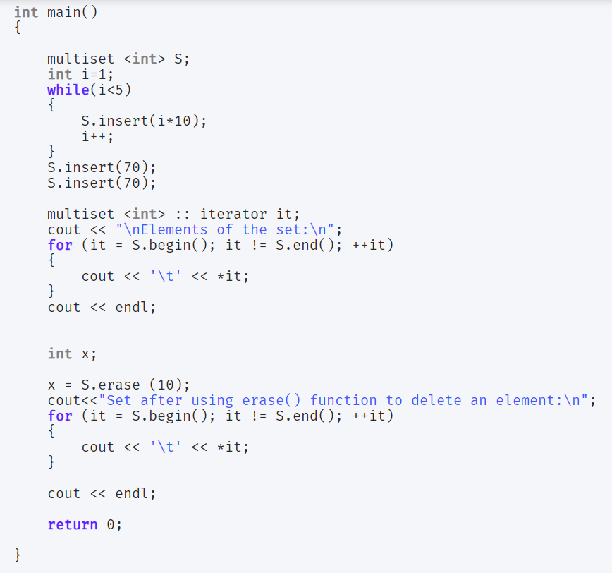
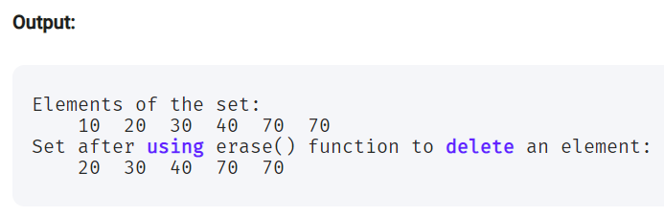

Slide 21
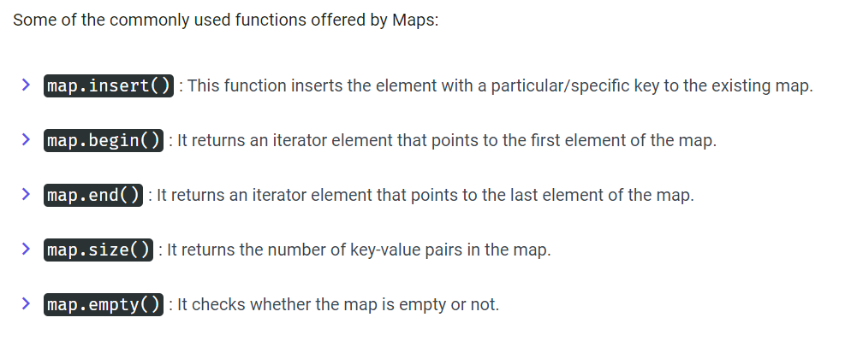
Map
Maps store elements in a key-value pair. Each value is mapped with a key unique element.
map<data_type of key, data_type of element> map_name;

Slide 22
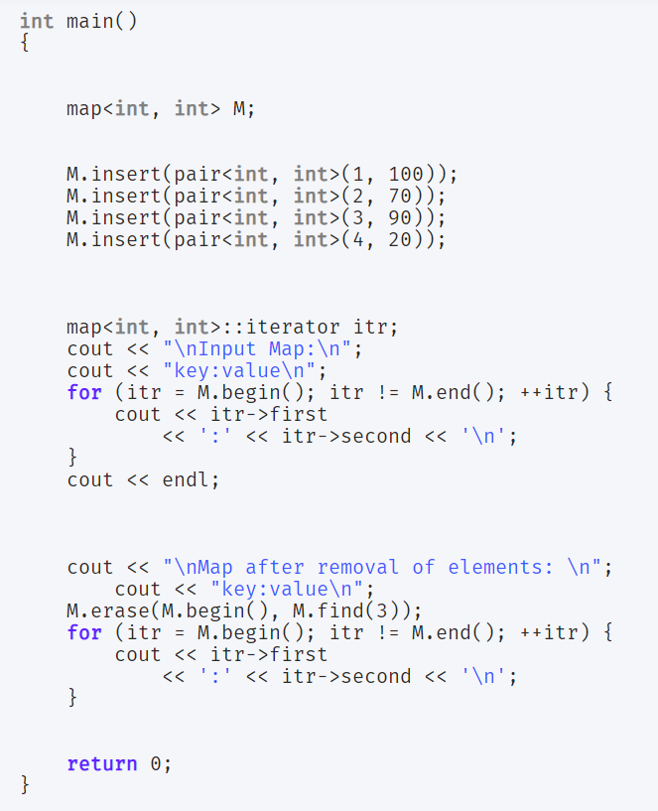
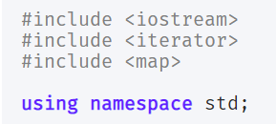
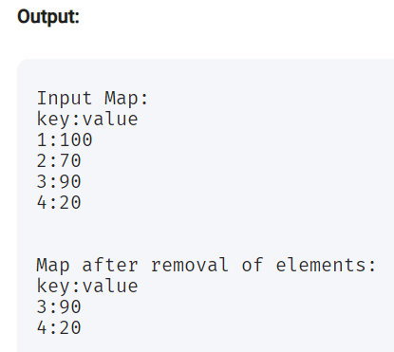

Slide 23
Multimap
Multimaps function the same way as Maps, but the only difference is that in Multimaps, redundant key values are allowed i.e.
the elements can have the same key values.
multimap<data_type of key, data_type of element> multimap_name;

Slide 24
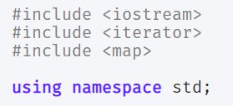
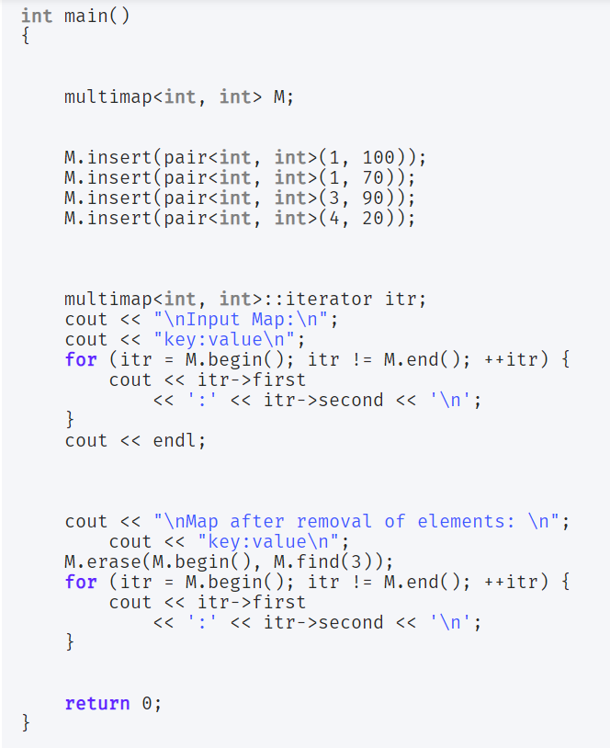
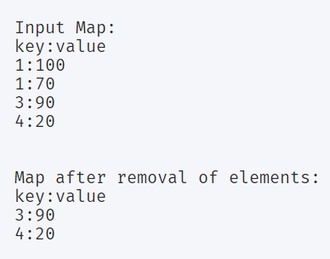

Slide 25
Container Adapters
Container Adapters provide a different interface to the Sequential Adapters.

Slide 26
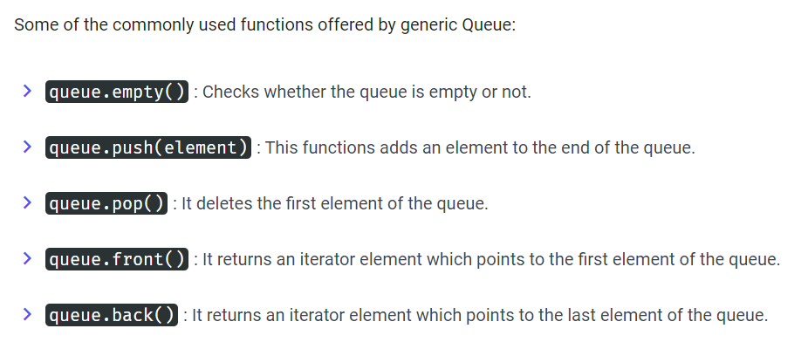
Queue
Queues work in First-In-First-Out(FIFO) fashion. The items are inserted from the rear i.e from the end and are deleted from the front
queue <data_type> queue_name;

Slide 27
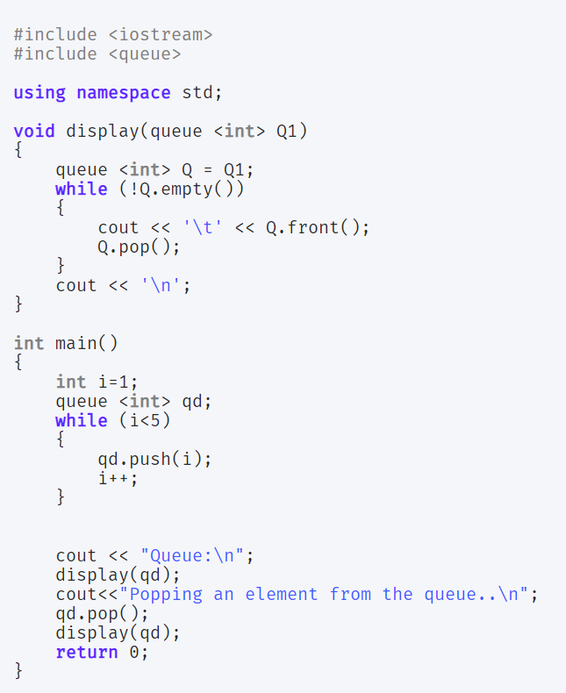
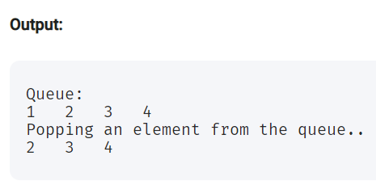

Slide 28
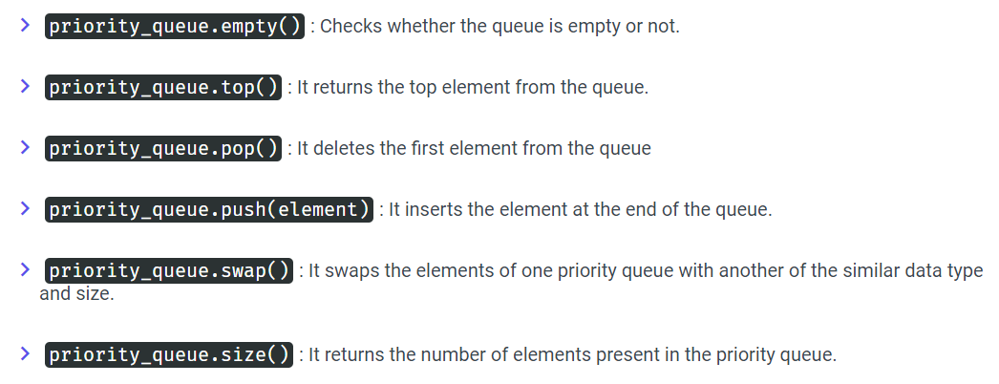
Priority queue
In priority queue, the elements are placed in decreasing order of their values and the first element represents the largest of all the inserted elements.
priority_queue <data_type> priority_queue_name;

Slide 29
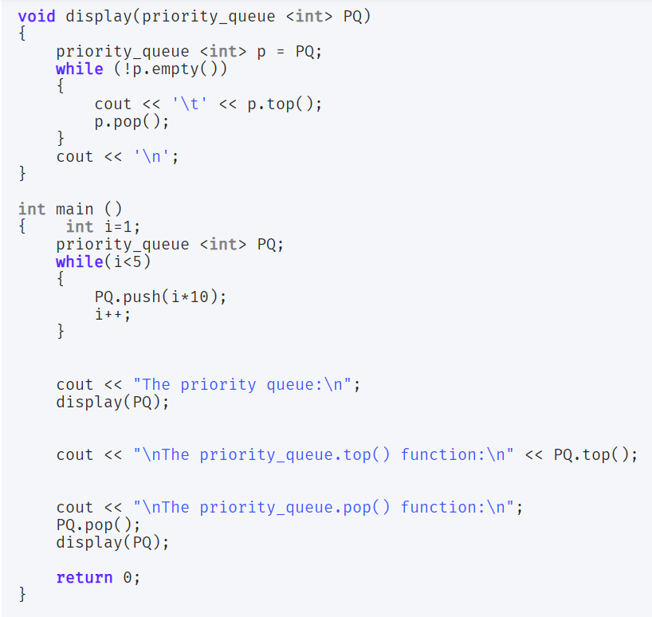
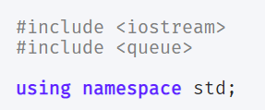
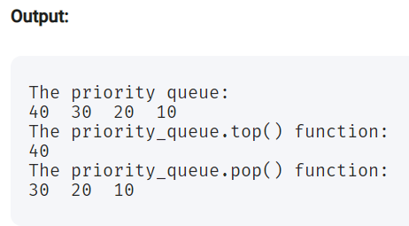

Slide 30
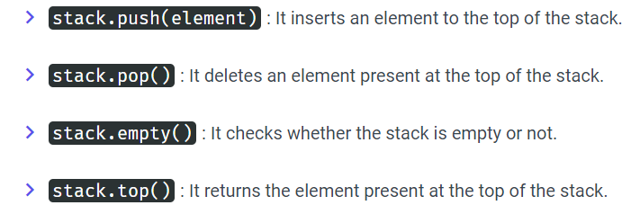
stack
Stack follows the Last-In-First-Out (LIFO) fashion. The items are inserted at one end of the stack and an item is deleted from the same end of the stack.
stack <data_type> stack_name;

Slide 31
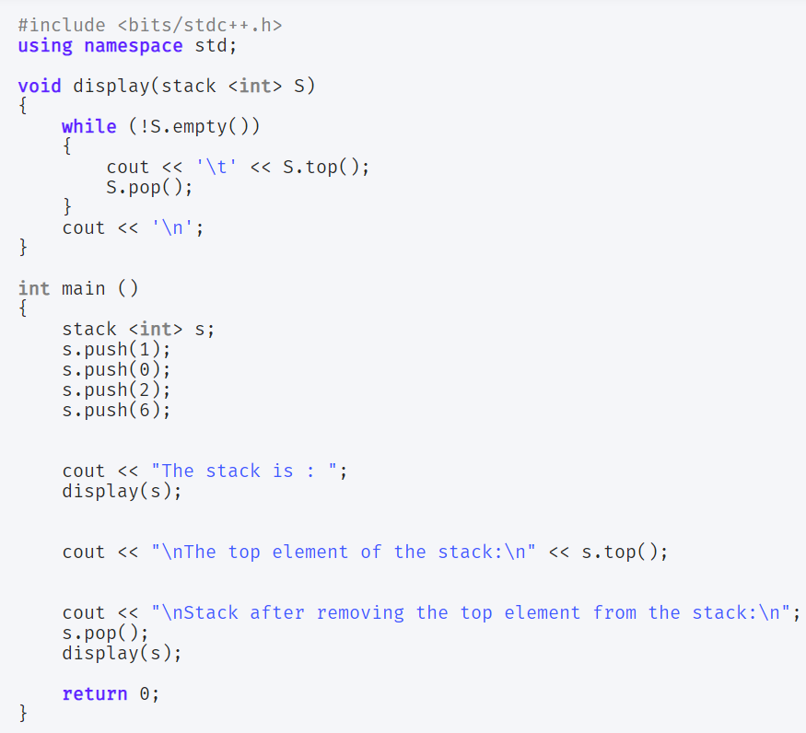
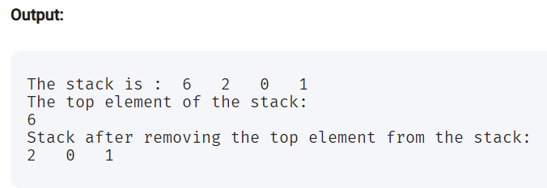

Slide 32
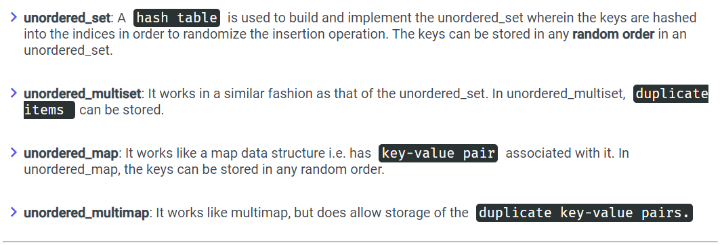
Unordered Associative Containers
Unordered Associative Containers provides sorted and unordered data structures that can be used for efficient searching operations.

Slide 33
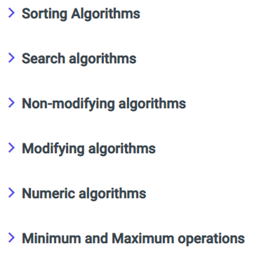
2. Algorithms in Standard Template Library
Standard Template Library provides us with different generic algorithms.
These algorithms contain built in generic functions which can be directly accessed in the program.
The Algorithm and its functions can be accessed with the help of Iterators only.

Slide 34
Sorting Algorithm in Standard Template Library
Standard Template Library provides built-in sort() method to sort the elements in a particular data structure.
Internally, it uses a combination of Quick Sort, Heap Sort, and Insertion Sort to sort the elements.
sort(starting index, end_element_index)

Slide 35
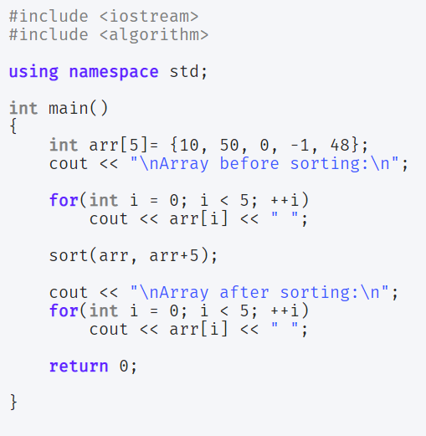
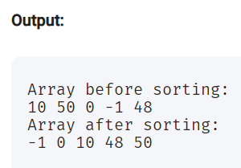

Slide 36
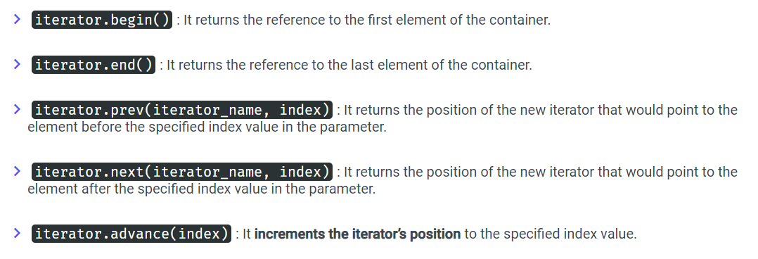
3. Iterators in Standard Template Library
Iterators are basically used to point or refer to a particular memory location of the element. They point at the containers and help them manipulate the elements in an efficient manner.

Slide 37
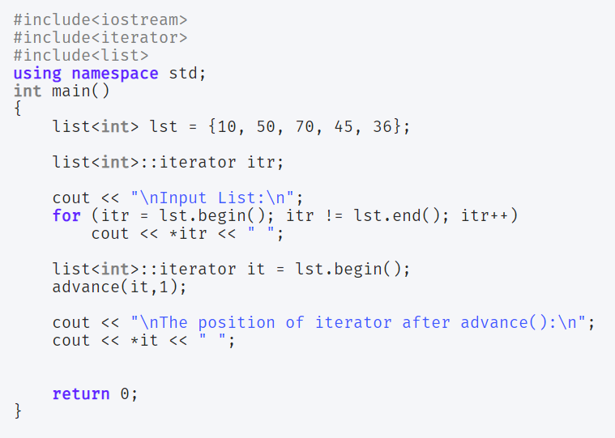
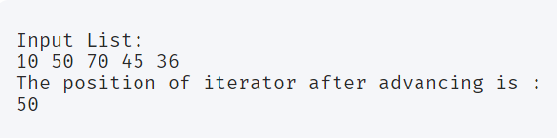
In the above snippet of code, advance(it, 1) points the iterator to the element at the index value = 1.

Slide 38
Resources:
https://www.cppreference.com/Cpp_STL_ReferenceManual.pdf

Slide 39
https://www.journaldev.com/36489/standard-template-library-in-c-plus-plus
https://www.youtube.com/watch?v=doA2h2nKBUQ

