Slide 1








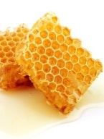


Why bees matter
85% plants exist because of bees.
More than 100 food crops are pollinated by bees.
Bees are responsible for food quality and safety.
We can thank a pollinator for as much as 1/3 of all food we eat!
You can thank bees for the grasses that feed our cows.
Without them there would be no milk or cheese.

Slide 2










