Slide 1
AI 380 H – AI in Healthcare
Github Repository Details :
High Risk Project
Phanikishore Cunchala
https://github.com/kishorecunchala/High_Risk_Project_Assignment
Data and Pre-Trained ML Model :
https://drive.google.com/drive/folders/1RZD0xXibDHFEMcNWTQrqSVq-1HxX87JL?usp=sharing

Slide 2
ICU Chat Agent for Mortality Prediction and Medication Optimization
Environment Setup
Methodology
Data Generation and csv file creation by leveraging tables from MIMIC III Dataset
Mortality and Survival Analysis Model creation, Hyper Tuning and Feature Engineering
Medication Prediction Model creation and Feature Engineering
ICU Chat Agent Implementation to leverage the Datasets and
pre-trained ML models developed in previous steps
Results
Conclusion
Notes:
Main idea : Integrate Data sets, pre-trained ML models in a chat interface that can provide useful evidence-based information about mortality risk and medications that lower the patient risk in ICU. The cohort are blood disease patients. Target audience are the healthcare professionals. The overarching goal is to ensure that the chat Agent leverages the pretrained models for prediction and medicine recommendations and not random guesses.

Slide 3
Environment Setup
Access to MIMIC III Dataset
Access to Big Query to execute queries to fetch required data
Access to Google Cloud Console for Project Key for BigQuery Client
Access to Google Colab environment to execute code
High RAM hosted environment in Colab
Access to Google Drive to store Data and Model files
Open AI API Key for chat Agent functions
Notes:
The set up assumes familiarity with MIMIC III Dataset and Google tools like Colab, BigQuery, Cloud Console, LLM tools like Open AI API’s

Slide 4
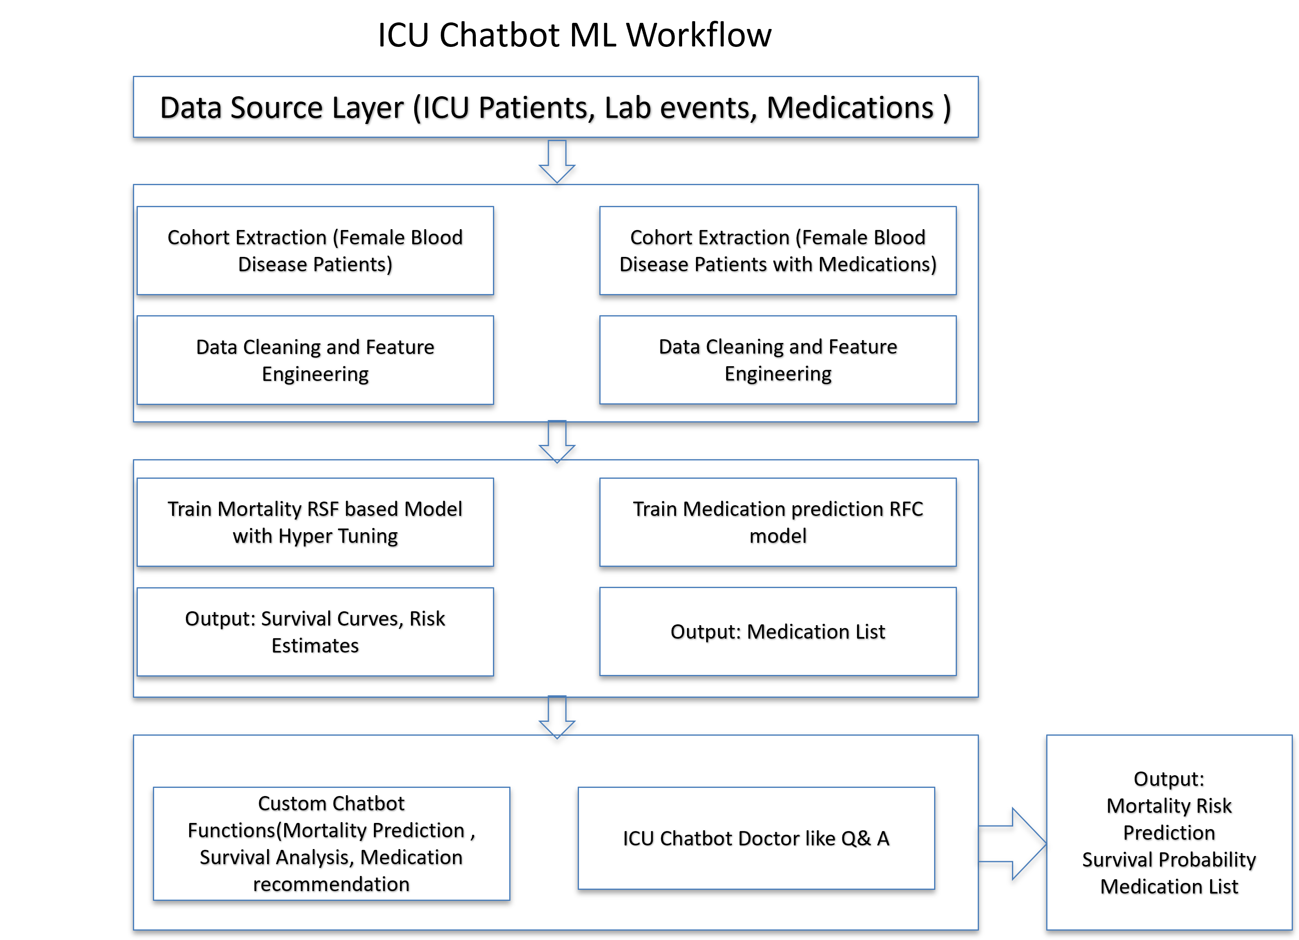
Methodology
Identify MIMIC III tables diagnoses_icd, icustays, patients, admissions, chartevents, labevents, prescriptions to identify data needed
2 sets of data are prepared in csv format
Female Patients admitted to ICU diagnosed with Blood disease
Female Patients admitted to ICU diagnosed with Blood disease with prescribed medications
Binary Classifier models to identify mortality rate
Cox Proportional Hazard Model and RSF model with Hyper tuning used for Mortality and Survival Analysis Model
Random Forest Classifier Model used to predict medications
Saved the prepared datasets and pre-trained models to Google drive
Leverage Open AI API for chat Agent custom functions and chatbot Q&A Interface
Examine and Test the output
Notes:
Adopted IEEE standard Software development Methodology.

Slide 5
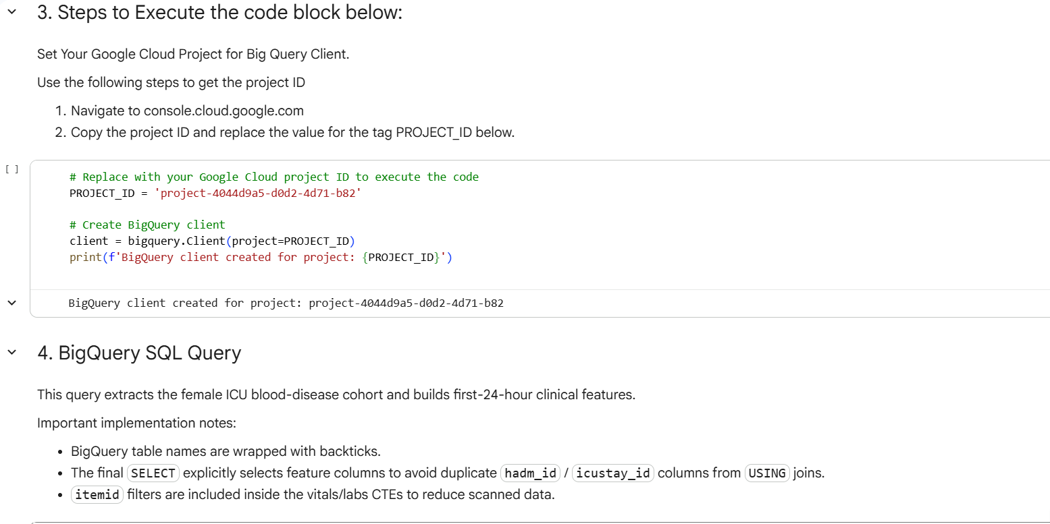
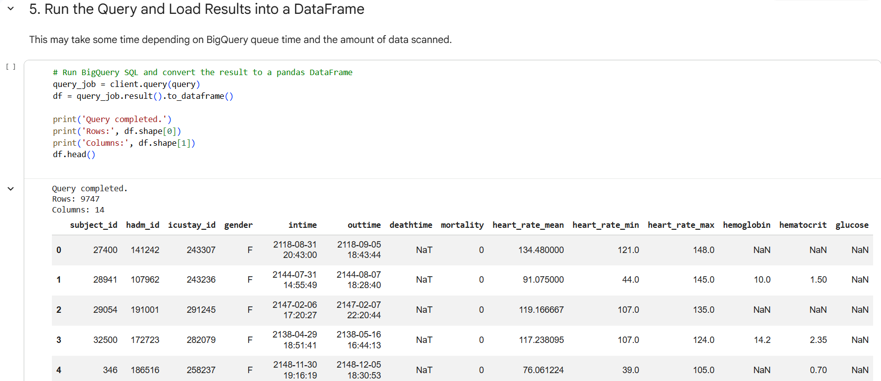
Data Generation and csv File Creation
Female Patients Cohort that have been diagnosed with Blood diseases ( ICD – 9 Codes 280 – 289) and admitted to ICU
Code File: Mimiciii_female_blood_disease_Cohort.ipynb
Tables : diagnoses_icd, icustays, patients, admissions, chartevents, labevents
Install the required libraries, BigQuery Client, execute the query.
Gather various patient features like Heart rate mean, min, max, lab results for Hemoglobin, Hematocrit and glucose
Save output in csv format for later use
Code snippets in the window
Notes:
First step in Dataset preparation for the model. All tables are in MIMIC III Dataset

Slide 6
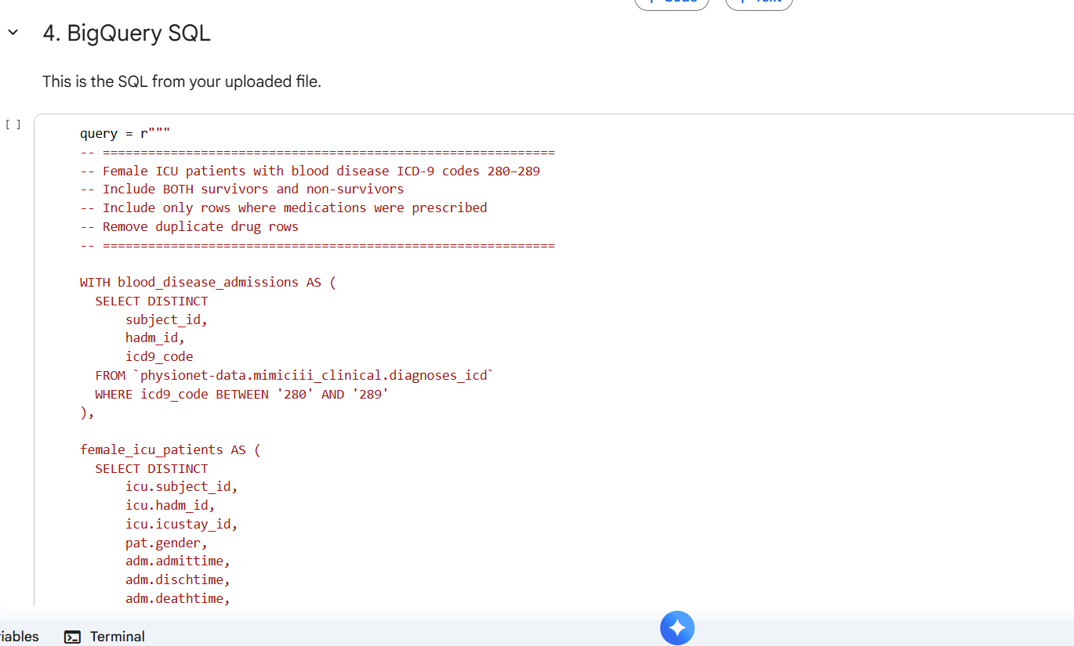
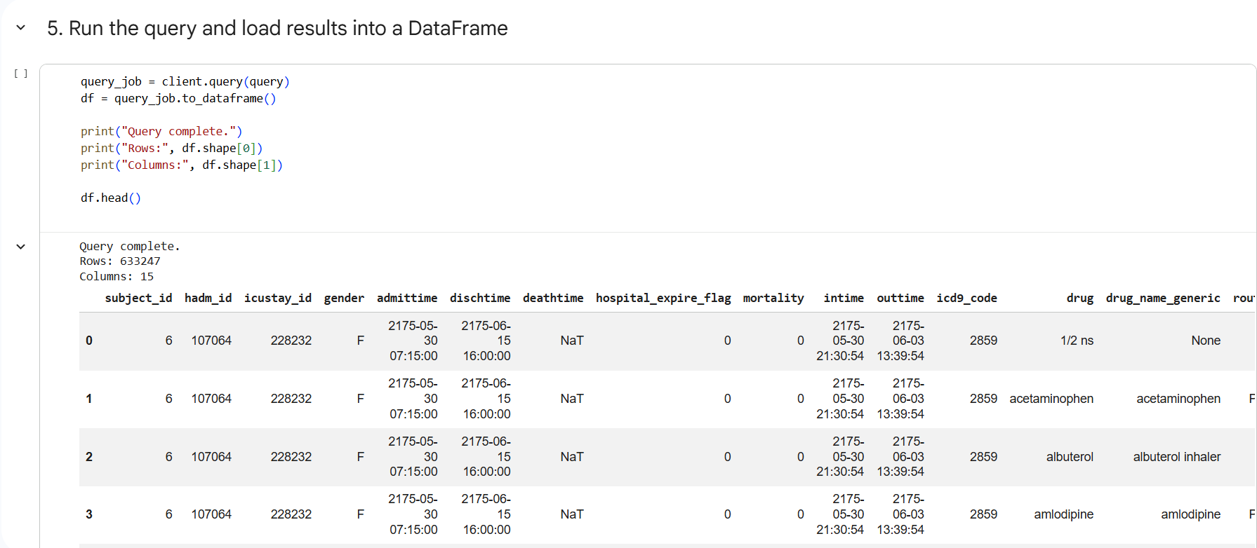
Data Generation and csv File Creation
Female Patients Cohort that have been diagnosed with Blood diseases ( ICD – 9 Codes 280 – 289) and admitted to ICU that have been suggested medications.
Code File: Mimiciii_female_blood_disease_with_meds_cohort.ipynb
Tables : diagnoses_icd, icustays, patients, admissions, prescriptions
Install the required libraries, BigQuery Client, execute the query.
Gather various patient medications and include both survivors and non-surviviors.
Save output in csv format for later use
Code snippets in the window
Notes:
First step in Dataset preparation for the model. All tables are in MIMIC III Dataset

Slide 7
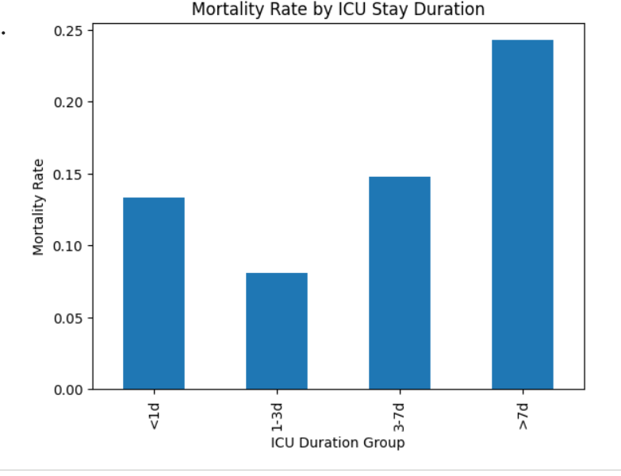
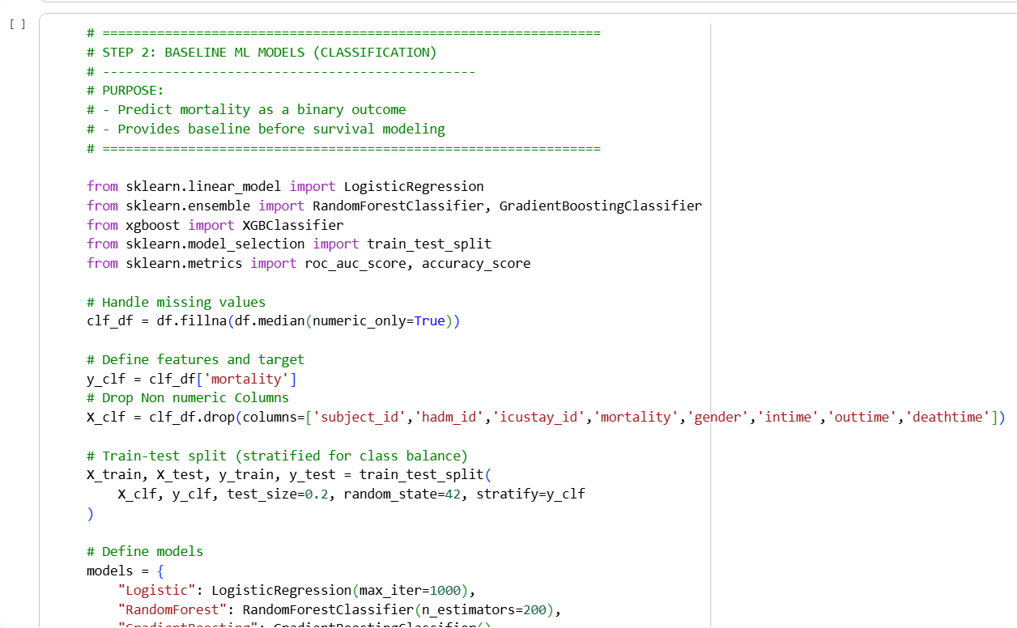
Mortality, Survival Analysis Model creation with Hyper Tuning And Feature Engineering
Code File:
Female_Blood_Patients_Mortality_Pred_Model.ipynb
Approach is to use Mortality rate and survival analysis as complimentary measures to get a complete picture.
The next step was data cleaning to handle missing values and drop nonnumeric values to establish a baseline for survival analysis
Used 4 binary classifier models : Logistic Regression, Random Forest Classifier, Gradient Boosting and XGB Classifiers for baseline
AUC Prediction and Accuracy were used as evaluation metrics. Got acceptable metrics of 0.7 for AUC and 0.8 for Accuracy.

Slide 8
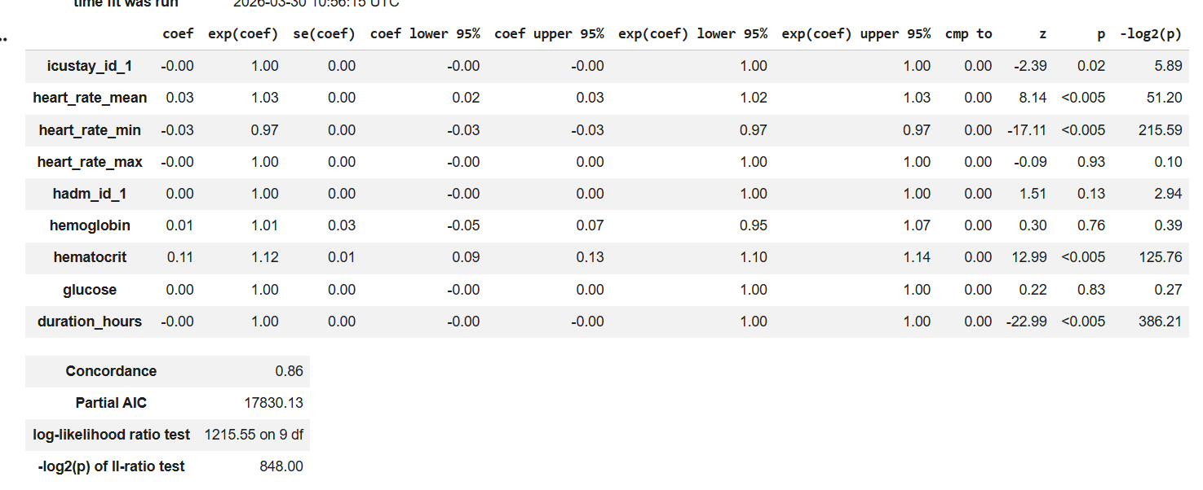
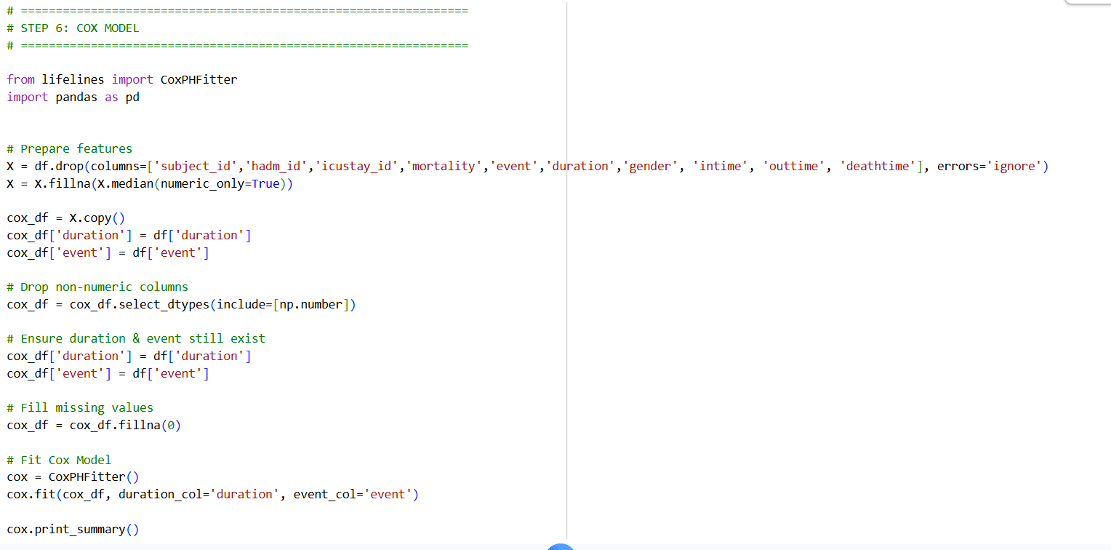
Mortality, Survival Analysis Model creation with Hyper Tuning And Feature Engineering
Code File:
Female_Blood_Patients_Mortality_Pred_Model.ipynb
For Survival Analysis , approach was to use Cox Proportional Hazard model to understand the relationship between patient features and risk of an event ( death) over time. Then build the Random Survival Forest on this to fine tune the model.
The Event Indicator (death or not) and the duration until the event were calculated and added to the Dataset.
Cox model execution demonstrated strong predictive performance ( C-Index 0.86)in estimating mortality risk among ICU patients.
Increased mean heart rate and hematocrit were associated increased mortality risk
The loglikely hood ratio indicated that selected co-variates improve survival prediction.

Slide 9
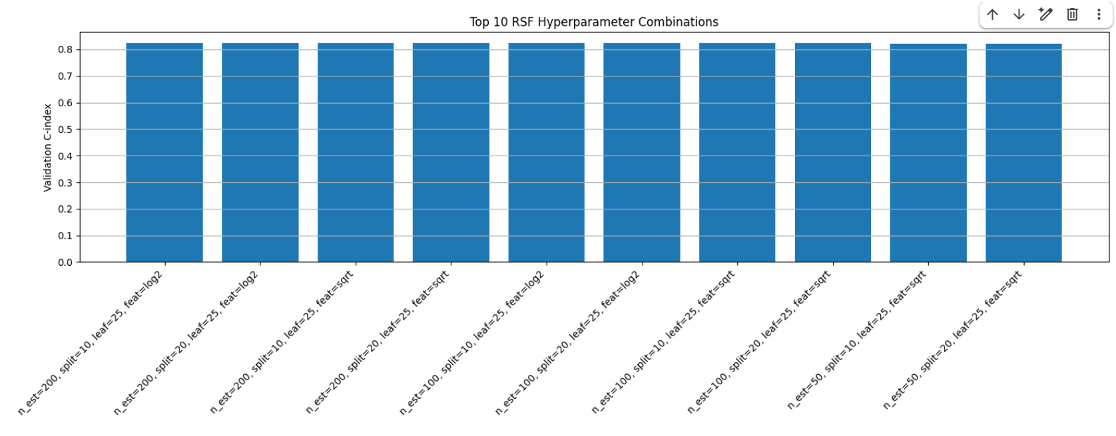
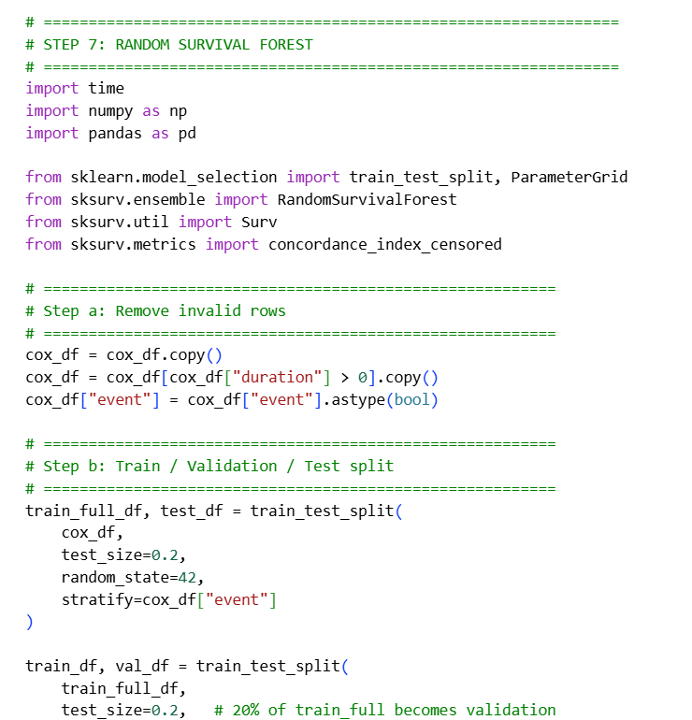
Mortality, Survival Analysis Model creation with Hyper Tuning And Feature Engineering
Code File:
Female_Blood_Patients_Mortality_Pred_Model.ipynb
Post Cox model, cleaned the data to improve data quality before Random Survival Forest Model execution.
The dataset was split into training, validation, and test sets with balanced target distributions to ensure reliable model evaluation.
Validation of C-Index was used as primary selection metric during Hyper tuning.
Key observation was that increasing the number of trees and using larger leaf sizes improved generalization, as reflected in higher validation C-index values and stable out-of-bag (OOB) scores.
The best-performing model achieved a validation C-index of 0.8239.
Finally, the selected model was retrained on combined training and validation data and evaluated it on the test set, achieving a C-index of 0.8634.
Model was saved for later use
Notes:
The tuning of RSF model presents a lot of challenges as it is very tedious and time consuming to hypertune. Particularly , I found it rather frustrating to keep playing around with values of number trees and Leaf sizes.

Slide 10
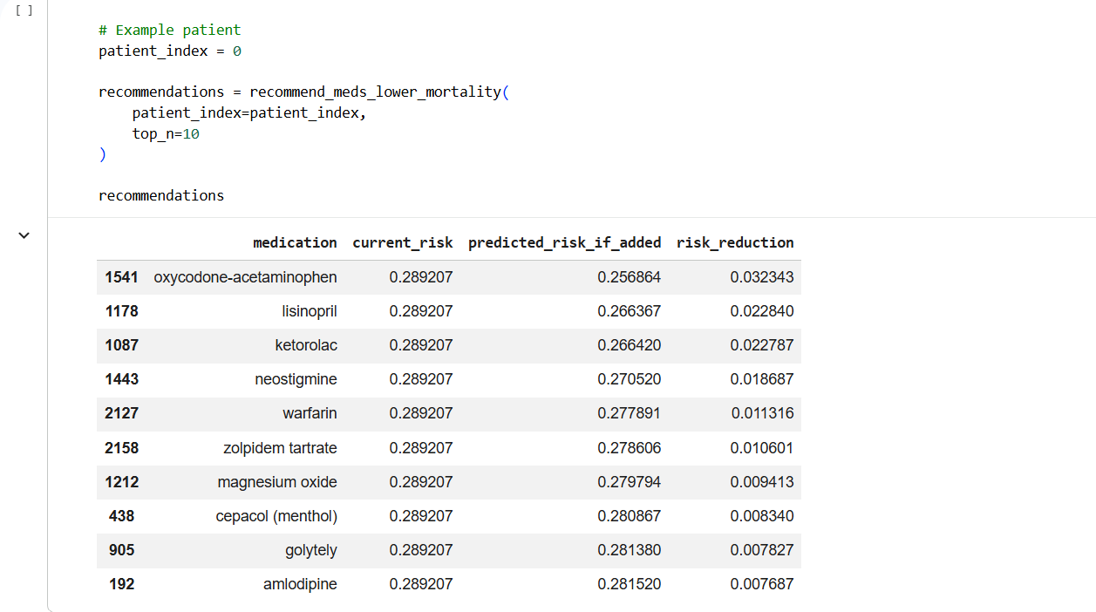
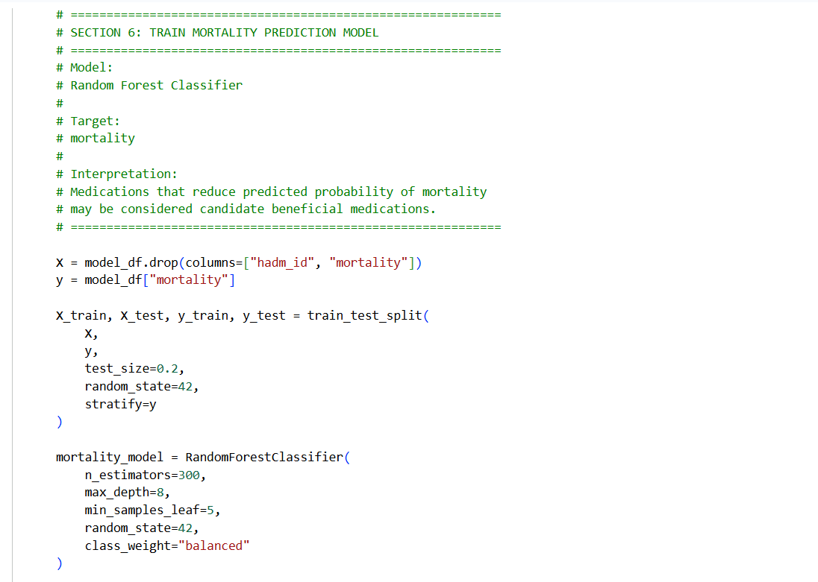
Medication Prediction Model creation and Feature Engineering
Code File:
Female_Blood_Patients_Meds_Recmd_Model.ipynb
First step was to clean the data by removing duplicates and normalizing medicine names.
Used feature Engineering to convert medicationlist to binary columns.
Used Random Forest Classifier as prediction model to produce recommendation of medications that lowers predicted risk
The Key metric is AUROC and AUPRC.
The model achieved 0.913 AUROC and 0.628 AUPRC demonstrating over all good rating capability with room to improve precision recall.
Model was saved for later use
Notes:
RFC is a Binary Classifier that is perfectly suited for predicting medications.

Slide 11
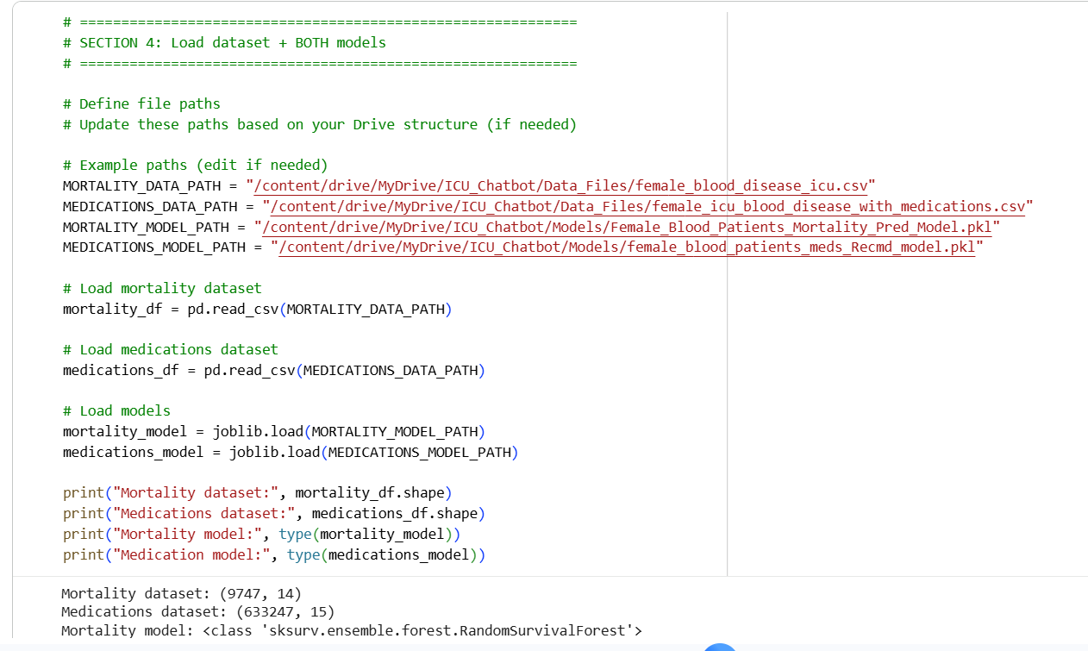
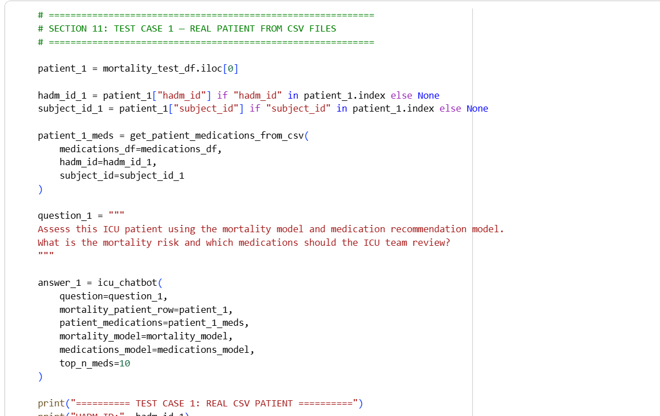
ICU Chat Agent Implementation
Code File:
ICU_Female_Blood_Patients_Chatbot.ipynb
Created a a structured pipeline in which machine learning outputs are generated first and subsequently interpreted through a conversational interface.
System is designed to be robust in loading large datasets and pre-trained models from external google storage drive.
Leverages the pre-trained models created earlier and dynamically calculates variables that are not provided.
The ICU chatbot interface invokes both the mortality and medication models and integrates their outputs into a structured context
The context is passed to a LLM via OpenAI API’s which generates clinically coherent explanations in a doctor-like conversational format.
Finally, the system was validated using real patient data extracted from CSV files derived from the dataset, demonstrating its applicability in realistic clinical scenarios
Notes:
This was the fun part where everything came together magically.

Slide 12
Results
Both pre-trained models performed as expected.
The mortality prediction and medication recommendations were found to be inline with the data set provided
Some Limitations like absence of Xray , CT-Scan data were identified. These could have further enhanced the tool recommendations.
Tool designed for a very specific disease for only the female population.
Absence of UI made this chat agent some what of an exploratory exercise.

Slide 13
Conclusion
The project was largely successful as it satisfied the primary aim of providing a Chat Agent that can make meaningful evidence-based predictions and recommend medications to lower mortality risk .
Even though it only addresses a specific disease, the pipeline template is there to build better tools to address a number of diseases in future.
Notes:
I have thoroughly enjoyed this course and had a lot fun learning and playing around with Python, Colab , Matplot , OpenAI , ML models.
Thanks much for the opportunity. -- PC

