Slide 1





Introduction to Robotic Process Automation
AUTOMATED YOUTUBE VIDEO DOWNLOADER BOT
220701135
Kishore Kaarthik S
Mrs. G.M. Sasikala, M.E Computer Science and Engineering

Slide 2
Abstract
This project demonstrates the creation of a YouTube video downloader bot using UiPath to automate the downloading of videos in bulk. The bot is designed to take video URLs as input from a CSV file, process each link through the website yt1d.com, and save the downloaded videos in a predefined location. By leveraging UiPath’s robust automation capabilities, this solution minimizes manual effort and improves efficiency. The bot begins by reading the CSV file containing a list of YouTube video links. Each link is validated to ensure it is in the correct format before proceeding. Using UiPath’s web automation tools, the bot interacts with yt1d.com, pastes the validated links into the designated input field, and triggers the download process. The downloaded files are then saved to a specified folder on the user’s system.

Slide 3
Need for the Proposed System
The proposed system introduces an RPA-based solution using UiPath to automate the bulk downloading of YouTube videos. This bot reads video URLs from a structured data source, such as a CSV file, and processes them sequentially. It interacts with an online downloader tool (yt1d.com), inputs the URLs, and initiates the download process. The downloaded files are saved to a predefined directory. By automating the process, this system reduces manual effort, enhances efficiency, and ensures accurate downloads, making it a valuable tool for handling large-scale video downloading tasks.

Slide 4
Advantages of the Proposed System
URL validation: Ensures that all URLs are in the correct format before processing.
Error handling: Skips invalid URLs, retries failed attempts, and logs errors for troubleshooting.
Scalability: Efficiently handles large datasets of video links without significant performance degradation.
Customizable Workflow: The bot can be easily adapted to work with other video downloading websites, providing flexibility for different user needs.
Time Efficiency: Automating the entire process significantly reduces the time required for bulk downloads compared to manual efforts.

Slide 5
Literature Survey
Paper 1: "Automation of Bulk Video Downloads Using Robotic Process Automation“
Summary: This paper explores using UiPath to automate bulk YouTube video downloads. The bot validates URLs, interacts with downloading websites, and manages downloads efficiently, emphasizing scalability, error handling, and time savings.
Advantages:
Automates repetitive download tasks.
Efficiently handles large datasets.
Includes robust error handling and detailed logs.
Disadvantages:
Initial setup costs and time investment are high.
Limited adaptability to changes in third-party sites.
Requires technical expertise for customization and maintenance.

Slide 6
Literature Survey
Paper 2: "Streamlining Multimedia Management with RPA-Based Video Download Automation “
Summary: This paper investigates the role of Robotic Process Automation (RPA) in simplifying multimedia management by automating the downloading of videos from online platforms. Using UiPath, the study demonstrates a bot capable of processing multiple video URLs, ensuring download reliability, and saving files systematically.
Advantages:
Reduces manual workload by automating repetitive tasks..
Saves time by processing multiple downloads simultaneously.
Disadvantages:
Susceptible to disruptions if the target website's layout changes.
Dependency on stable internet connectivity for reliable operation.

Slide 7
Main Objective
The main objective of the YouTube Video Downloader Bot project is to automate the process of downloading YouTube videos in bulk using UiPath. This system aims to eliminate manual efforts, reducing time spent on individual downloads while ensuring accuracy and consistency in the download process. By automating the downloading process, the project enhances operational efficiency, allowing users to handle large volumes of video downloads quickly and with minimal human intervention. The ultimate goal is to provide a scalable, reliable, and user-friendly solution for downloading and managing video files in bulk.

Slide 8
System Requirements
Hardware Requirements:
Processor: Intel i3 or higher (recommended Intel i5 or above).
RAM: Minimum 4 GB (8 GB recommended for optimal performance).
Storage: At least 10 GB free space.
Internet: Stable connection .
Software Requirements:
RPA Tool: UiPath Studio (Community or Enterprise edition).
Browser: Google Chrome with UiPath extension installed.
Data Source: Microsoft Excel or other structured data formats.
Operating System: Windows 10 or later (64-bit)

Slide 9
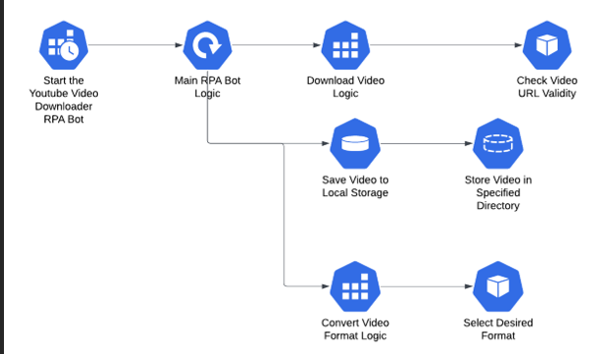
Architecture

Slide 10
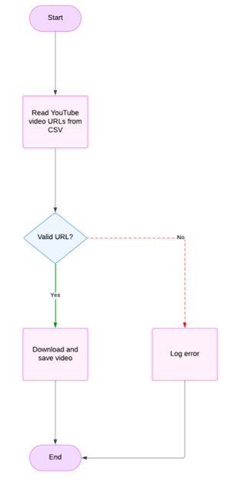
Functional Description
Activity Diagram

Slide 11
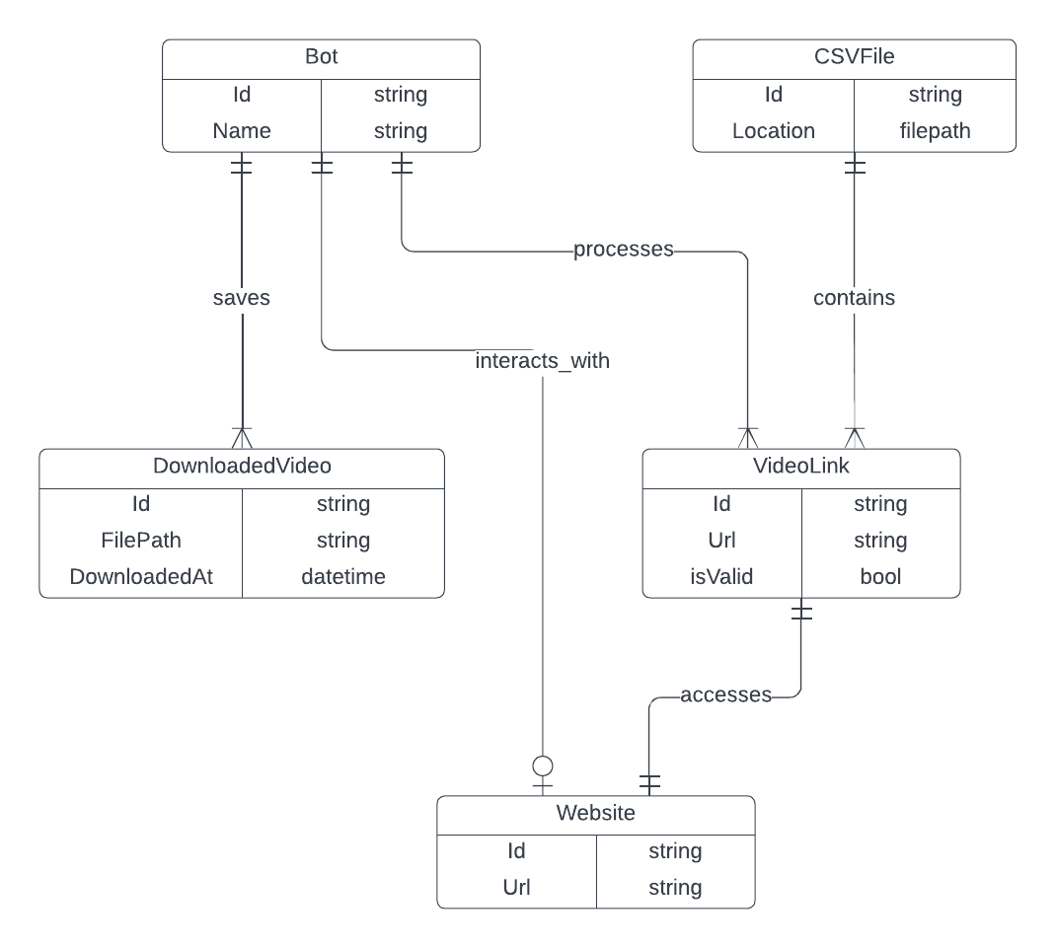
Table Design
Entity Relationship Diagram

Slide 12
Process Design
The YouTube Video Downloader Bot automates bulk video downloads using UiPath. It starts by reading URLs from a CSV file and validating them for correctness. The bot interacts with a video downloading website, pasting validated URLs into the input field and initiating the download. Files are saved in a predefined location. A detailed log is maintained to track successes and failures, ensuring efficiency, scalability, and easy troubleshooting.
Input Preparation and Validation: Read YouTube video URLs from a CSV file and validate URLs to ensure proper format.
Web Interaction: Open the video download website(e.g.,yt1d.com) using UiPath and paste the URLs in the input field.
Download Process: Stimulate click to initiate video downloads and save the downloaded files to a predefined folder.
Error Handling: Handle issues like network errors and broken links.
Logging and Reporting: Maintain a log of successful and failed downloads

Slide 13
Implementation
The bot starts by reading YouTube URLs from a CSV file using the Read CSV activity in UiPath. Each URL is validated with a regular expression, and invalid links are logged and skipped. For valid URLs, the Open Browser activity navigates to a video downloading website (e.g., yt1d.com), where the bot uses Type Into and Click activities to input the URL and trigger the download.
Error handling is implemented with Try-Catch and Retry Scope activities to manage network issues or failed downloads. Successfully downloaded videos are saved to a predefined folder, with file management handled for organization.

Slide 14
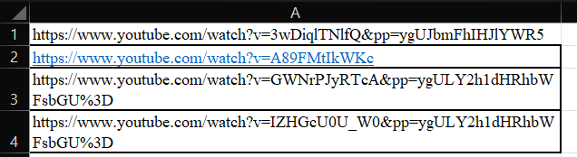
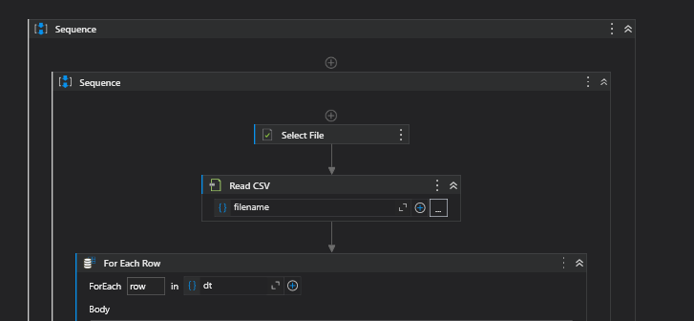
Implementation
Screenshots

Slide 15
Testing
Testing for YouTube video downloader bot
The YouTube Video Downloader Bot is tested in multiple stages to ensure reliability and efficiency. Unit testing verifies individual components, such as URL validation and website interaction, to ensure each works correctly. Integration testing ensures seamless data flow between modules, such as reading URLs, processing them, and initiating downloads. Error-handling capabilities are validated by simulating scenarios like valid URLs and broken links. Performance Testing assesses the bot’s ability to handle large datasets efficiently. End to end testing ensures the entire process, from URL input to file saving and logging guaranteeing the bot’s overall functionality and robustness

Slide 16
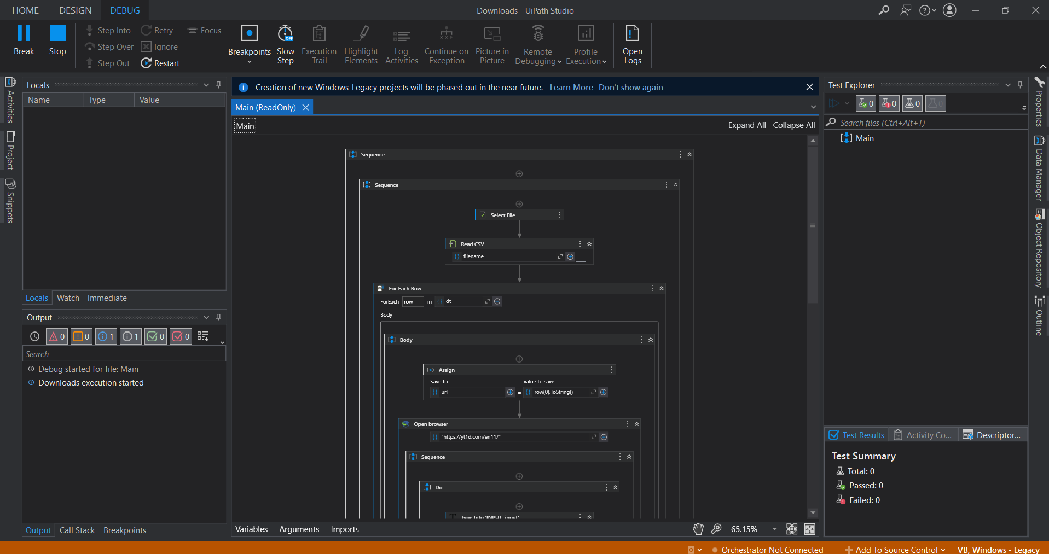
Testing
Screenshots

Slide 17
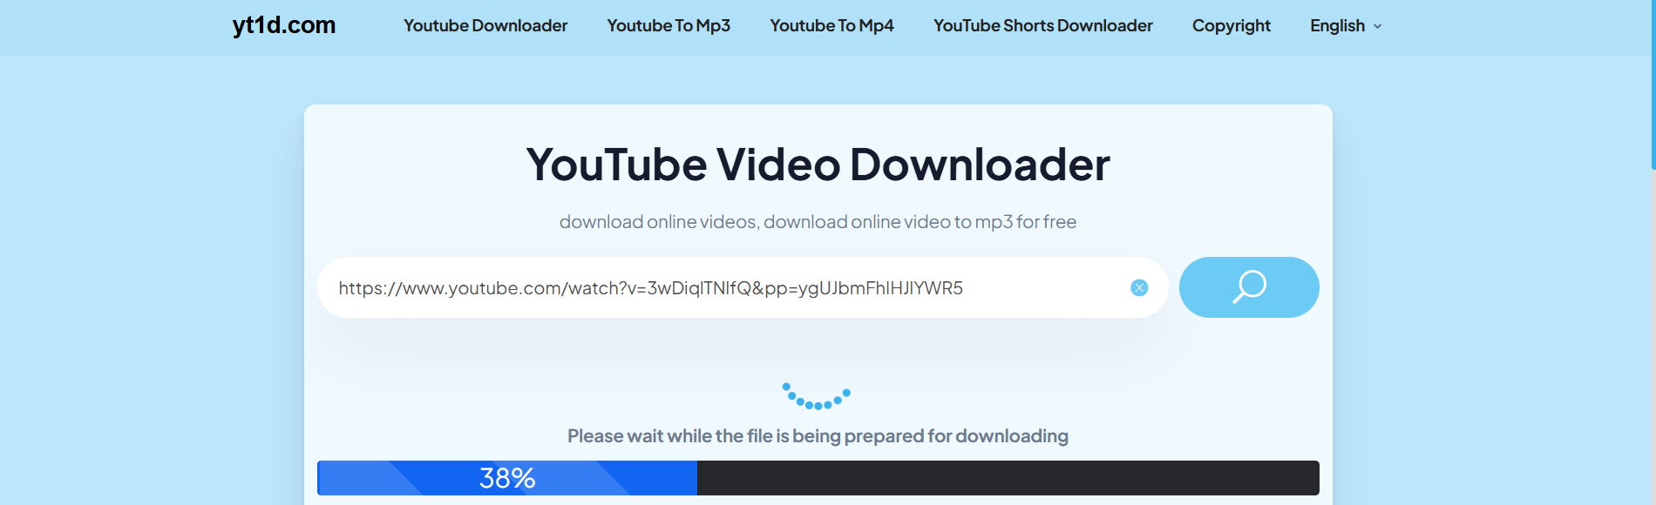
Testing
Screenshots

Slide 18
Conclusions
The YouTube Video Downloader Bot successfully showcases the potential of UiPath in automating repetitive and time-intensive tasks like bulk video downloading. By automating the process of URL validation, interaction with a video download website, and file management, the bot reduces manual effort and improves efficiency. Thorough testing ensures it handles edge cases, manages errors gracefully, and performs reliably with large datasets, making it scalable for real-world applications. This project highlights the effectiveness of Robotic Process Automation (RPA) in simplifying workflows and can be further adapted for similar automation needs in various industries.

Slide 19
References
UiPath Official Documentation. (n.d.). Robotic Process Automation (RPA) Overview. Retrieved from https://www.uipath.com/
Kumar, A., & Singh, P. (2023). Web Automation Using UiPath: Challenges and Solutions. International Journal of Advanced Automation, 15(2), 28-35.
Zhang, M., & Chen, L. (2022). A Study on RPA Applications in Web-Based Processes: Case of YouTube Automation. Journal of Digital Innovation, 19(3), 112-120. https://doi.org/10.5555/jdi.2022.19.3.112
UiPath Academy. (n.d.). Building Scalable Bots with UiPath: Best Practices and Techniques. Retrieved from https://academy.uipath.com/

Slide 20
Thank You

