Slide 1
Sudhersan K V (RA2011030010094)
Kishore Khan S - RA2011026010233
Allen D Benjamin - RA2011026010240
Harikesh P - RA2011026010193
The Impact of Layoffs: Insights and Trends from a Dataset

Slide 2
Dataset Source
Mr. S. Joseph James, Assistant Professor, has requested us to visualize a dataset on layoffs that he provided. This dataset includes information on the number of layoffs, the percentage of employees laid off, the date, the location, the industry, the company stage, the country, and the funds raised by the company. It has layoff data of around 2500 companies Source Link : https://layoffs.fyi/
Mr. S. Joseph James
josephjs@srmist.edu.in
Department of Computational Intelligence, College of Engineering & Technology, Kattankulathur - Chennai

Slide 3
Introduction
Layoffs have become a prevalent reality in the current economic climate, and understanding their impact on companies and employees is more important than ever.
Our aim is to provide insights and trends from this dataset, which can inform decision-making and help organizations navigate the challenges of workforce management..

Slide 4
Several companies across the world had to make the difficult decision to lay off some of their employees. Our dataset includes information on these layoffs, including the company name, location, industry, total number of employees laid off, the percentage of employees laid off, date, stage, country, and funds raised.
Looking at the dataset, we can see that the technology industry had the highest number of layoffs, with several companies in the sector having to let go of a large number of employees. The most significant percentage of layoffs was in the finance industry, with some companies laying off more than 50% of their workforce.

Slide 5
What the data tells us about layoffs
Total number of layoffs across industries, locations, and company stages
Percentage of layoffs across industries, locations, and company stages
Duration of layoffs across industries, locations, and company stages

Slide 6
Business Leaders
HR professionals
Researchers
Who Will Be Interested

Slide 7
SCHEMA AND DESCRIPTION
VARIABLE | VARIABLE TYPE
COMPANY | CATEGORICAL
LOCATION | CATEGORICAL
INDUSTRY | CATEGORICAL
TOTAL LAID OFF | NUMERICAL
PERCENTAGE LAID OFF | NUMERICAL
STAGE | CATEGORICAL
COUNTRY | CATEGORICAL
FUNDS RAISED | NUMERICAL

Slide 8
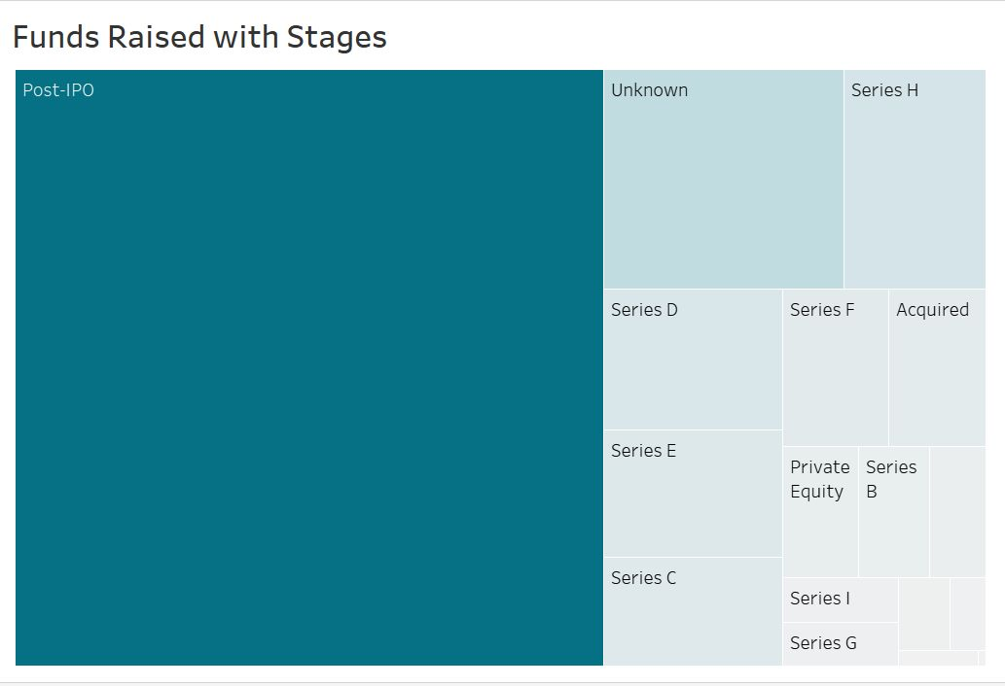
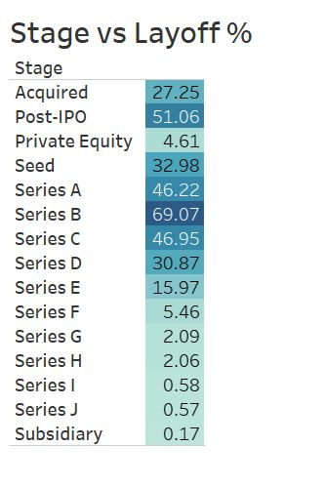
SAMPLE VISUALIZATIONS

Slide 9
THANK YOU

