Slide 1

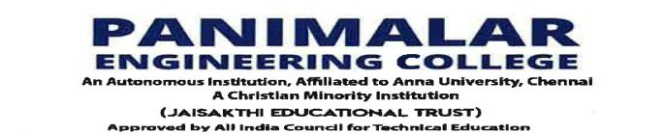

Department of Computer Science and Engineering
BLOCKCHAIN-BASED LAND REGISTRATION
FOR AGRICULTURAL LAND
KEVIN JOE CLIFFORD. J [211421104128] KISHORE. K [211421104131]
JEFIN JOE. J [211421104110]
Guide Name & Designation
Dr M. KRISHNAMOORTHY M.E., Ph.D.
ASSOCIATE PROFESSOR
Coordinator Name & Designation
Dr R. JOSEPHINLEELA M.E., Ph.D.
PROFESSOR

Slide 2
Abstract
The proposed system introduces a secure and blockchain-based land registration framework specifically designed for agricultural land. Traditional land registry systems rely on centralized databases, making them prone to fraud, data tampering, and unauthorized modifications. To address these challenges, we integrate Blockchain and AI technologies to ensure a transparent, immutable, and fraud-resistant land registration process. The system leverages AI models such as Logistic Regression (LR), Support Vector Machine (SVM), Random Forest (RF), Extreme Gradient Boosting (XGB), and Light Gradient Boosting Machine (LGBM) to classify land records as fraudulent or non-fraudulent. Only verified non-fraudulent land data is stored in the blockchain network, reducing computational overhead and enhancing efficiency. Smart contracts are deployed on the Spolia test network to validate land records, with Slither Solidity Analyzer ensuring security and vulnerability assessment. Non-fraudulent land data is securely stored in the Inter Planetary File System (IPFS), while its hash is recorded on the blockchain’s immutable ledger for data integrity and security. The system's performance is evaluated using AI accuracy metrics (ROC, log-loss score), blockchain scalability, gas cost utilization, and bandwidth efficiency. By integrating AI-driven fraud detection with blockchain’s decentralized security, the proposed system eliminates land fraud, enhances transparency, and ensures trust in agricultural land registration.

Slide 3
Introduction
Our study aims to introduce a Blockchain-Enabled Land Registration System powered by AI to ensure secure, transparent, and tamper-proof land ownership records in agriculture, enhancing trust and reducing fraud in the agricultural sector. This project aims to develop a secure and transparent land registration system for the agricultural sector using blockchain and AI technologies. Land ownership is a critical aspect of sustainability and development in agriculture, but the current land registration systems are often vulnerable to fraud and manipulation. By utilizing blockchain, we ensure that land records are immutable and tamper-proof, providing a trustworthy system for verifying ownership. AI models such as logistic regression, support vector machines, and random forests are used to detect and identify fraudulent data before it is entered into the blockchain. Only verified, non-fraudulent land data is stored on the blockchain, minimizing unnecessary computational load. Smart contracts are incorporated for land data validation, ensuring efficiency, accuracy, and security in the process. Additionally, non-fraudulent land information is securely stored on the Interplanetary File System (IPFS), and its hash is recorded on the blockchain, ensuring both accessibility and protection. The entire system undergoes a rigorous assessment for performance, including evaluating AI accuracy, blockchain scalability, and smart contract vulnerability, guaranteeing a robust and efficient solution. The Agri Safe system aims to provide a transparent, fraud-resistant method for land registration, which fosters trust among stakeholders and significantly reduces the risks of land disputes and ownership fraud in agriculture.

Slide 4
Objective of the Project
Project Scope:
The proposed system enhances the existing system solution by integrating advanced features for stronger land registration, improved performance, and broader applicability across agriculture and other industries. AI models, including XGB and LGBM, will improve fraud detection and handle more complex data. A real-time monitoring system will detect and alert authorities to potential fraud, ensuring quicker intervention. Dynamic smart contracts will adapt to changing laws and improve data validation. Interoperability with external land registries and GIS will enhance accuracy. Scalability improvements, such as sharding, will handle increased data volume. Decentralized identity management ensures privacy and security for landowners. Advanced vulnerability detection tools will enhance smart contract security. AI will also promote sustainable land practices. The system will feature an intuitive interface for better user experience and easier access to land records. These improvements ensure a more secure, efficient, and scalable solution for land registration.

Slide 5
Literature Survey
 | Authors | Title | Source | Pages | Date
1 | R. Sidharthan, V. R. Balasaraswathi | Secured land registration using Ethereum blockchain and IPFS | Proc. 3rd Int. Conf. Appl. Artif. Intell. Comput. (ICAAIC) | 1449-1454 | Jun. 2024
2 | I. Haider, M. A. Khan, M. Nazir, A. Hamza, O. Alqahtani, M. T.-H. Alouane, et al. | Crops leaf disease recognition from digital and RS imaging using fusion of multi self-attention RBNet deep architectures and modified dragonfly optimization | IEEE J. Sel. Topics Appl. Earth Observ. Remote Sens. | 17, pp. 7260-7277 | 2024
3 | M. Stefanovic, D. Przulj, S. Ristic, D. Stefanovic, and D. Nikolic | Smart Contract Application for Managing Land Administration System Transactions | IEEE Access | 39154–39176 | 2022

Slide 6
Literature Survey
 | Authors | Title | Source | Pages | Date
4 | A. L. Shrivastava, R. Kumar Dwivedi | Blockchain-based secure land registry system using efficient smart contract | Proc. Int. Conf. Intell. Data Commun. Technol. Internet Things (IDCIoT) | 165-170 | Jan. 2023
5 | G. Kusuma, C. Rupa, S. Reshma, G. Rochana | Secure storage of land records and implementation of land registration using Ethereum blockchain | Proc. 3rd Int. Conf. Artif. Intell. Smart Energy (ICAIS) | 404-409 | Feb. 2023
6 | S. Dubey, D. Vinod, A. Gupta, R. K. Dwivedi | Secure land registration management via Ethereum blockchain | Proc. Int. Conf. Intell. Data Commun. Technol. Internet Things (IDCIoT) | 185-191 | Jan. 2023

Slide 7
Literature Survey
 | Authors | Title | Source | Pages | Date
7 | N. Ncube, B. Mutunhu, K. Sibanda | Land registry using a distributed ledger | Proc. IST-Africa Conf. (IST-Africa) | 1-7 | May 2022
8 | M. I. Khalid, J. Iqbal, A. Alturki, S. Hussain, A. Alabrah, S. S. Ullah | Blockchain-based land registration system: A conceptual framework | Appl. Bionics Biomechanics | 2022, pp. 1-21 | Feb. 2022
9 | F. D. Rodrigues, J. M. Alonso, P. M. R. Castro | SICAP—Cadastral information and property management system | Proc. 17th Iberian Conf. Inf. Syst. Technol. (CISTI) | 1-6 | Jun. 2022

Slide 8
Problem Statement
Problem Statements
1. Limited AI Model Performance: Traditional AI models such as Logistic Regression and Support Vector Machines may struggle with handling complex, large-scale land registry data, leading to inefficiencies in fraud detection.
2. Lack of Pre-Trained Accuracy: The existing system does not leverage advanced pre-trained AI models, reducing the accuracy of fraud classification and land record verification.
3. Absence of Secure Land Document Generation: There is no mechanism to generate and store land documents securely, increasing the risk of forgery and unauthorized modifications.
4. Vulnerability to Transaction Fraud: The system lacks robust transaction validation, making it susceptible to fraudulent activities during land transfers.
5. Ineffective Land Fraud Detection: Existing approaches do not provide a reliable mechanism to detect and prevent land fraud, leading to disputes and unauthorized land claims.

Slide 9
Proposed System
The proposed system enhances land registration by integrating advanced AI and blockchain features for improved security, efficiency, and fraud prevention. AI models like XGB and LGBM, along with pre-trained models, significantly improve fraud detection accuracy. A real-time monitoring system detects fraudulent activities and alerts authorities for quick intervention. Dynamic smart contracts adapt to regulatory changes and enhance data validation. The system implements secure land document generation, ensuring tamper-proof digital records to prevent forgery and unauthorized alterations. Blockchain-based transaction validation mechanisms prevent transaction fraud, ensuring that only legitimate land transfers occur. AI-powered land fraud classification accurately detects fraudulent land records, reducing disputes and unauthorized claims. Sharding-based scalability enhancements optimize the system to handle large-scale data efficiently. Interoperability with external land registries improves verification accuracy and seamless integration. Decentralized identity management protects landowners' privacy and security while ensuring transparent ownership tracking. Advanced security tools like Slither strengthen smart contract protection against vulnerabilities and cyber threats. AI-driven sustainability analysis helps monitor land usage and promotes eco-friendly agricultural practices. An intuitive user interface ensures easy access to land records and improves usability for landowners and stakeholders. These enhancements create a robust, transparent, and fraud-resistant land registration system, ensuring trust, efficiency, and adaptability to future needs.

Slide 10
Software / Hardware used
HARDWARE REQUIREMENTS
Hard Disk : 250GB and Above
RAM : 6GB and Above
Processor : i3 and Above
SOFTWARE REQUIREMENTS
Windows 10 and Above
JDK 17
Python
MySQL
Visual Studio Code
Node.js
Ganache
IPFS (Inter Planetary File System)
TECHNOLOGIES USED
Spring Boot (Framework)
Thymeleaf (Template-Engine)
Machine Learning
Node JS
MySQL 8.0
Solidity
IPFS

Slide 11
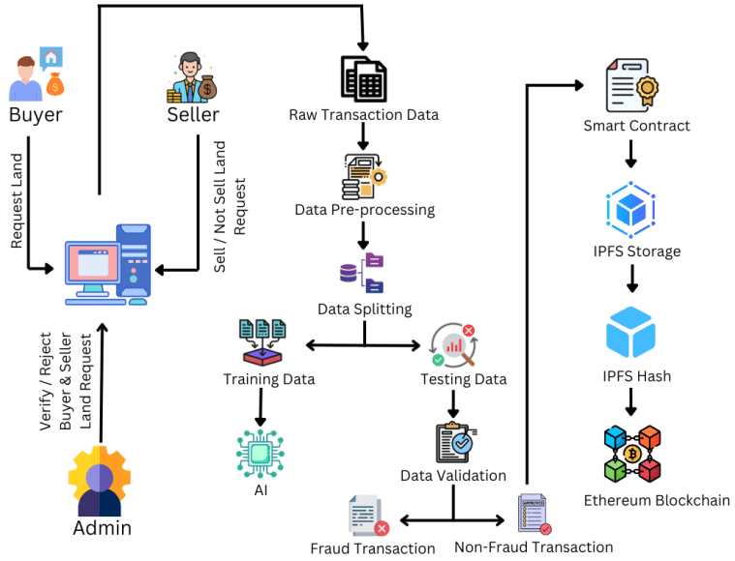
Architecture / Methodology used

Slide 12
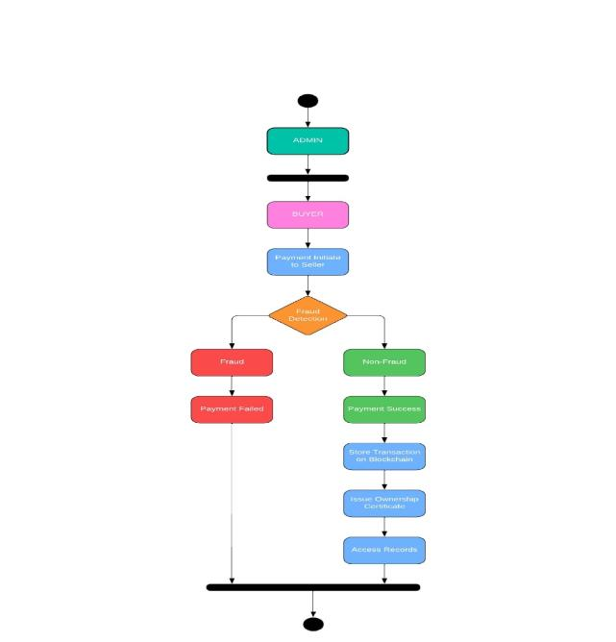
System Design - Flow Chart

Slide 13


System Design - DFD
Level 0:
Level 1:
Level 2:

Slide 14
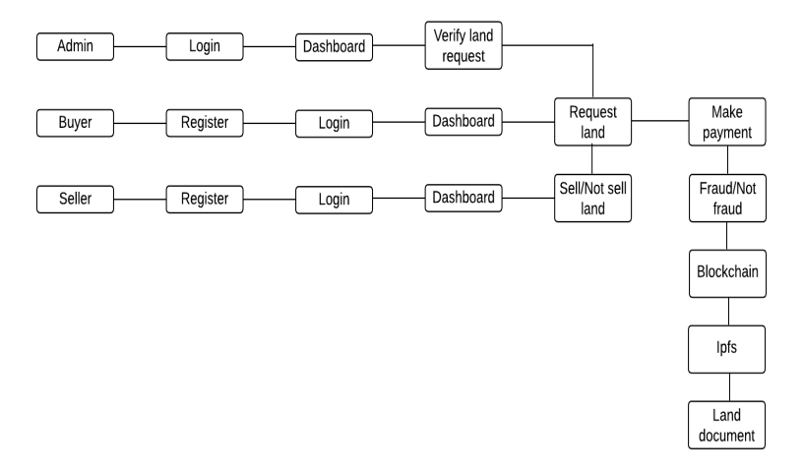
System Design - DFD
Level 3:

Slide 15
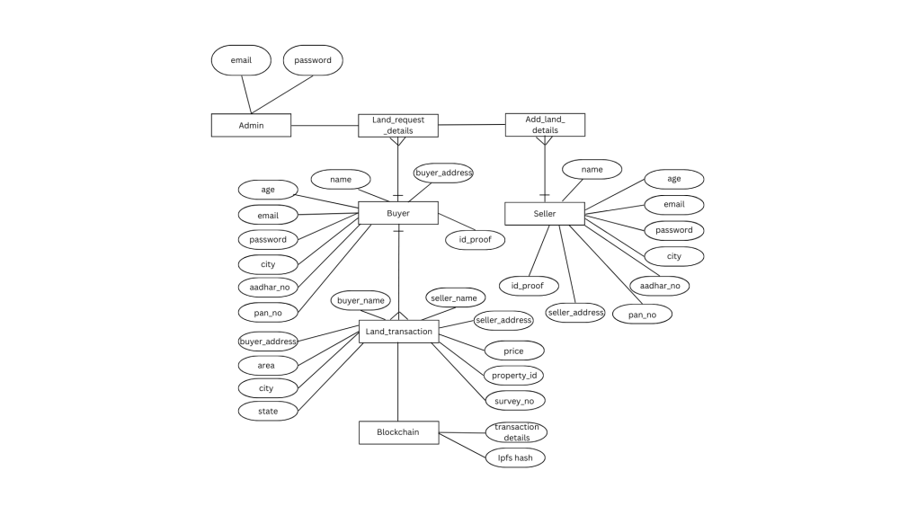
System Design - ER

Slide 16
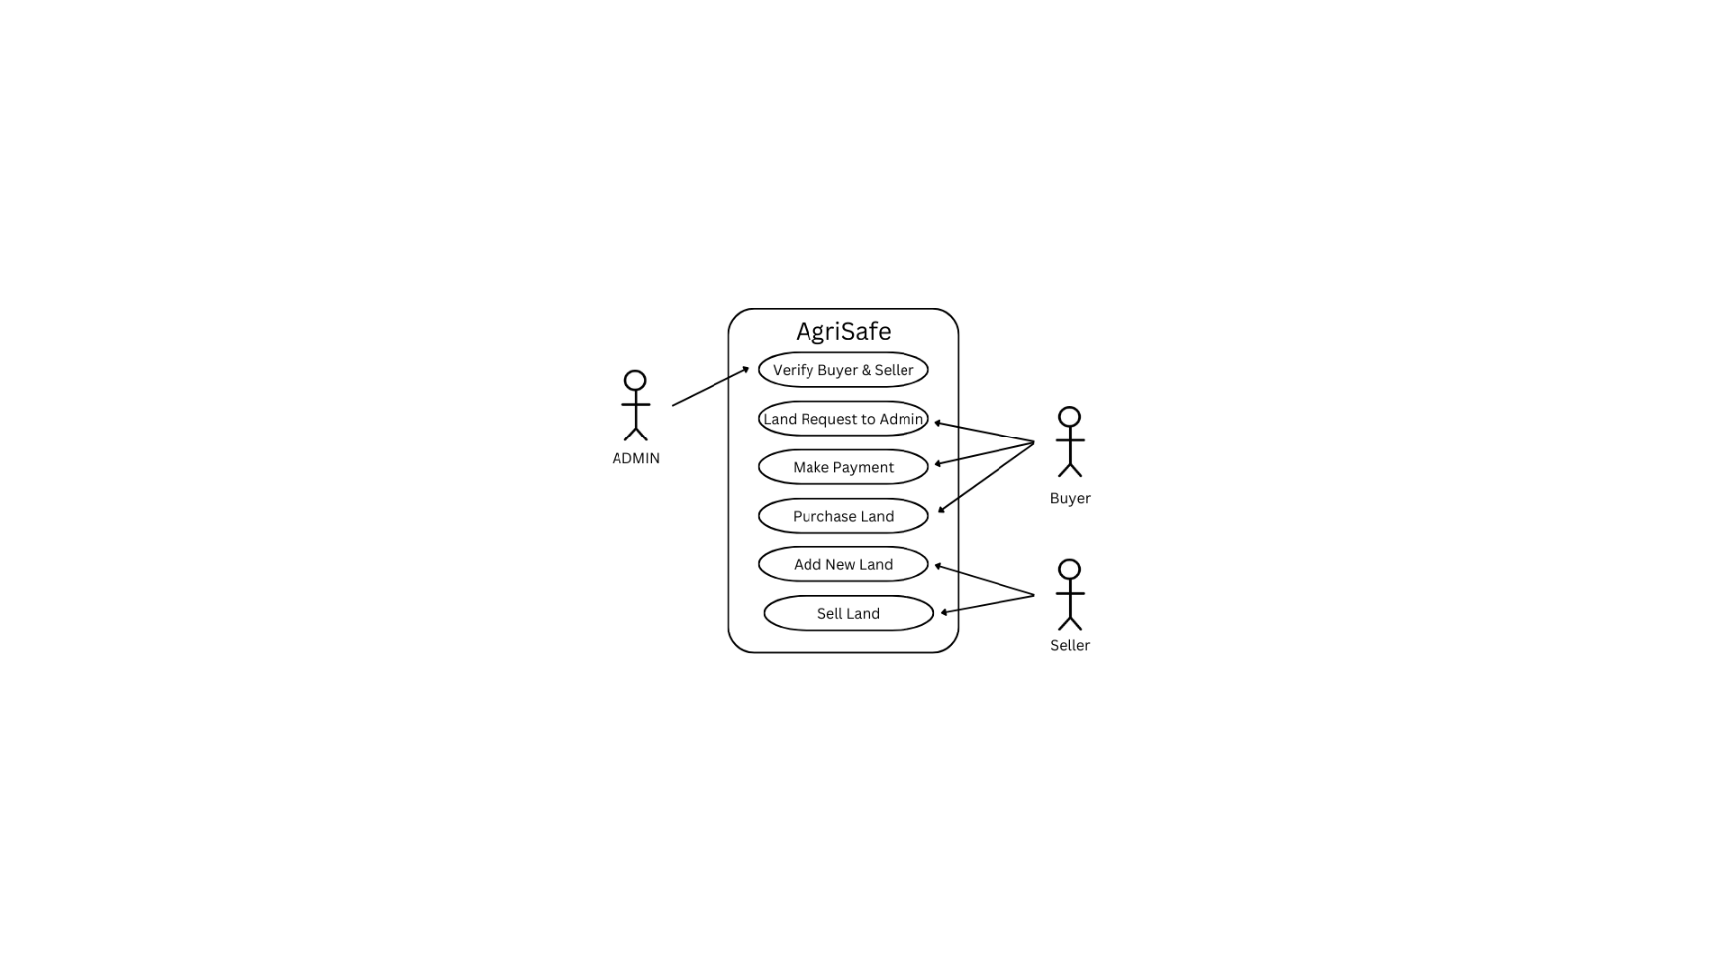
System Design - Use case Diagram

Slide 17
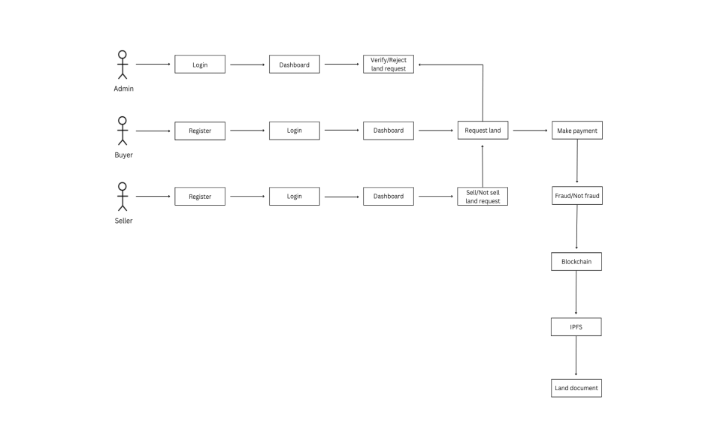
System Design - Collaboration Diagram
03-04-2025
Title of the Project
17

Slide 18
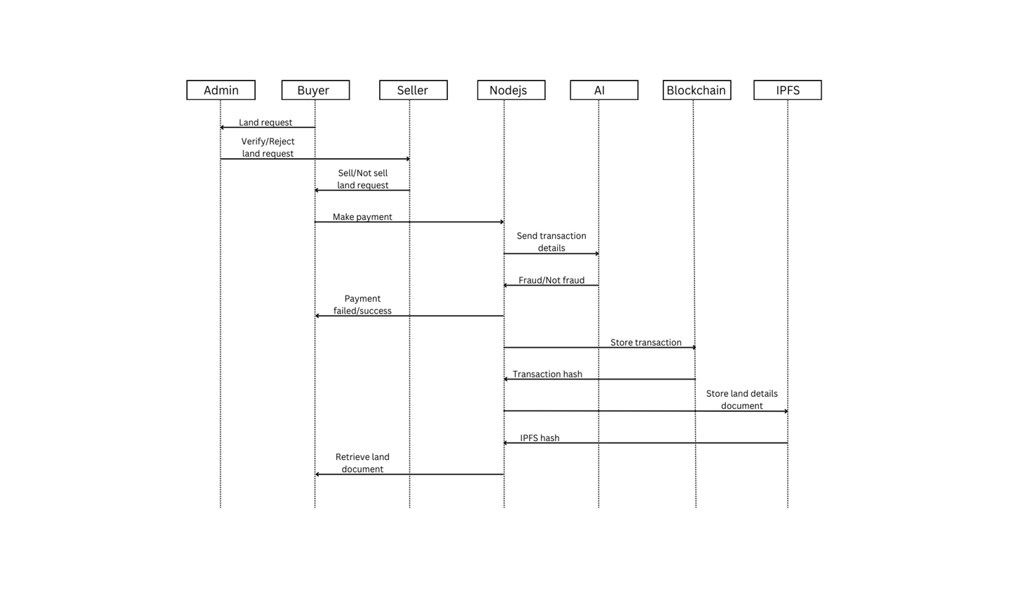
System Design - Squence Diagram
03-04-2025
Title of the Project
18

Slide 19
Module Description
Modules:
Admin (Land Inspector)
Buyer
Seller
Land Verification and Transaction Management using Blockchain
Machine Learning for Agriculture and Market Trend Analysis

Slide 20
Module Description
Admin (Land Inspector):
The Admin acts as the land inspector responsible for verifying the authenticity and ownership of a seller’s land. Before any transaction, the Admin must approve the seller's land, ensuring all land records are accurate and meet regulatory standards. Admin can access blockchain-stored verification data, perform checks, and confirm if a land parcel is eligible for sale. Only after this verification can the seller proceed to list the land for buyers to view and purchase. Admin actions are recorded on the blockchain to maintain transparency and accountability.

Slide 21
Module Description
Buyer:
The Buyer can browse verified land listings on the platform and make requests to purchase land that meets their criteria. Buyers are required to submit necessary identification and financial details to authenticate their requests. Once the Buyer submits a request, they can track the progress, communicate with the Seller, and complete transactions securely through blockchain. Only land verified by the Admin is available to the Buyer, ensuring the authenticity and security of their purchase.

Slide 22
Module Description
Seller:
The Seller owns land that they wish to sell within the platform. Sellers must submit proof of ownership and any necessary documentation, which will be reviewed by the Admin for verification. Once the land is verified, the Seller can list it for sale, set a price, and receive requests from potential buyers. Sellers can only complete a sale after Admin verification, adding an extra layer of security to prevent fraud and unauthorized transactions. All transactions are recorded on the blockchain, ensuring a traceable and tamper-proof record of ownership transfer.

Slide 23
Module Description
Land Verification and Transaction Management using Blockchain:
This module leverages blockchain technology to secure, record, and manage land verification and transactions. Blockchain ensures that each land asset is uniquely identifiable and that all ownership and transaction records are immutable and transparent. Through this module, the platform ensures compliance, verifies data integrity, and minimizes the risk of fraud. Buyers, Sellers, and Admins interact through this system, which guarantees that all records are trustworthy, secure, and traceable.

Slide 24
Module Description
Machine Learning for Agriculture and Market Trend Analysis:
Machine learning algorithms analyze market trends, land values, and agricultural productivity in the region. By processing historical and real-time data, the system provides insights to Sellers on ideal selling times and fair market values. Buyers can view predictions on land value appreciation or agricultural yield, aiding them in making informed decisions. This module uses data pre-processing, feature extraction, and correlation analysis to detect patterns that influence agricultural markets, adding value to the platform through predictive analytics.

Slide 25
Testing /Performance Evaluation / Results
Software Testing Techniques
Software testing ensures that the system functions accurately and efficiently before deployment. It aims to identify and fix errors, playing a crucial role in software quality assurance. Different types of testing help validate various aspects of the system. White Box Testing focuses on the internal structure of the software, ensuring all functions are fully operational. Black Box Testing verifies functionality without considering internal code, ensuring the system meets user requirements. Integration Testing checks how different modules interact, identifying data loss or function failures. Security Testing assesses the system’s protection against cyber threats by simulating hacking attempts. Validation Testing ensures the software meets customer expectations and functions as required. Finally, User Acceptance Testing (UAT) is conducted to gain end-user approval, ensuring the system is user-friendly and meets practical needs before final deployment.

Slide 26
Testing /Performance Evaluation / Results
Testing Methods & Key Strategies
White Box Testing examines the internal code structure and uses techniques such as Basis Path Testing and Cyclomatic Complexity to evaluate software logic. On the other hand, Black Box Testing focuses on functional requirements, using methods like Equivalence Partitioning and Boundary Value Analysis to ensure proper functionality. Integration Testing verifies seamless interaction between different modules, detecting potential data loss and function failures. Security Testing strengthens system defenses by simulating attacks to uncover vulnerabilities. Validation Testing ensures that the software aligns with user expectations through black box testing methods. Finally, User Acceptance Testing (UAT) is performed to confirm that the system meets user needs, with a focus on input and output screen design for improved usability and accessibility. These testing methods together ensure a robust, secure, and efficient land registry system.

Slide 27
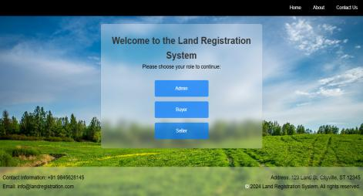
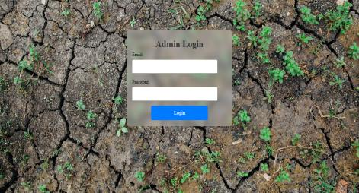
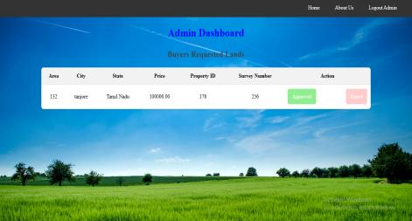
Screen Shots

Slide 28
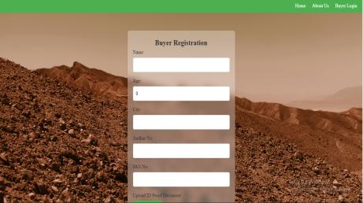
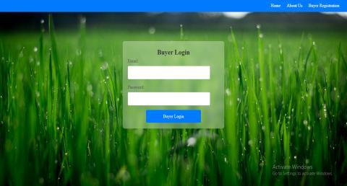
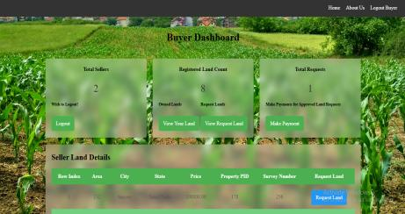
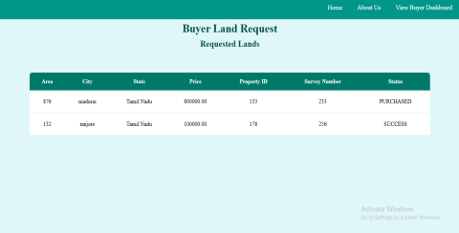
Screen Shots

Slide 29
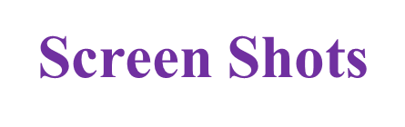
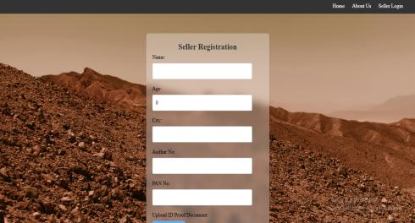
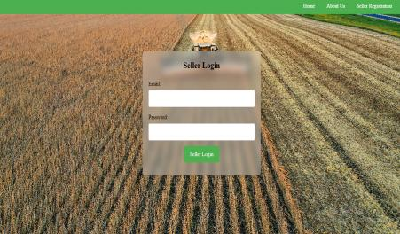
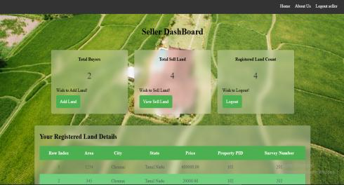
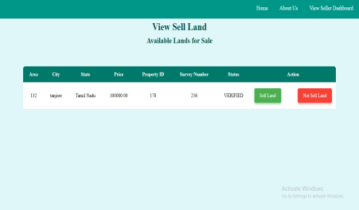

Slide 30
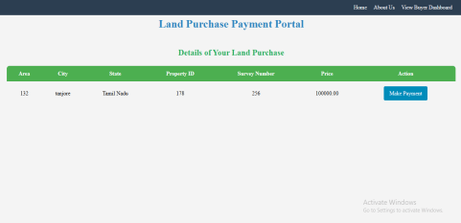
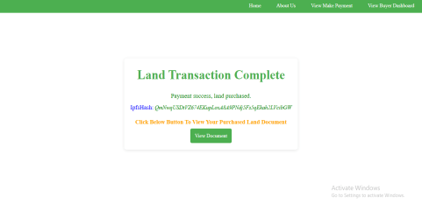
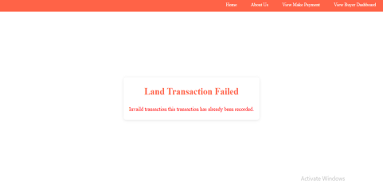

Slide 31
Conclusion / Feature Enhancement
Future Enhancement:
Future improvements to the current system could include using more advanced AI techniques like deep learning to improve fraud detection. Adding real-time monitoring and alerts would help authorities respond faster to potential fraud. The system can also be made more compatible with global land registries and GIS for better accuracy. Updating smart contracts to adapt to changing laws will keep the system current. Lastly, improving scalability and data privacy will ensure the system can grow and remain secure.

Slide 32
Conclusion / Feature Enhancement
Conclusion:
The Agri Safe system offers a secure, transparent, and efficient solution for land registration in agriculture by combining blockchain and AI technologies. By ensuring tamper-proof records and using AI to detect fraudulent data, it significantly reduces the risk of ownership disputes and fraud. The system's smart contracts and secure data storage on IPFS enhance the reliability and accessibility of land information. With its ability to scale and adapt, Agri Safe paves the way for a more trustworthy and sustainable land registration process in agriculture.

Slide 33
Reference Paper/ URL
https://www.researchgate.net/publication/383544695_GreenLand_A_Secure_Land_Registration_Scheme_for_Blockchain_and_AI-enabled_Agriculture_Industry_50

Slide 34
Conference / Publication / Patent Certificate/ Project Contest Winner Certificates

