Slide 1
Digital Portfolio
STUDENT NAME:KISHORE MANI.A
REGISTER NO AND NMID: 222402725 AND asunm163222402724
DEPARTMENT: Bsc.computer science
COLLEGE: COLLEGE/ UNIVERSITY
Hindustan college of arts & science/ Madras university

Slide 2
PROJECT TITLE
Digital student portfolio using html

Slide 3


AGENDA
Problem Statement
Project Overview
End Users
Tools and Technologies
Portfolio design and Layout
Features and Functionality
Results and Screenshots
Conclusion
Github Link
3/21/2024 Annual Review

Slide 4

PROBLEM STATEMENT
Existing solutions lack efficiency and user-friendliness
Difficulty in managing data/workflow
Limited accessibility and scalability
Need for a reliable, cost-effective system

Slide 5

PROJECT OVERVIEW
Developed a solution to address the identified problem
Focus on usability, performance, and security
Incorporates modern technologies for better efficiency
Scalable design for future improvements

Slide 6

WHO ARE THE END USERS?
Students & Learners – for education and practice
Developers & Programmers – to apply in real projects
Organizations/Businesses – to improve workflows
General Users – needing a simple, reliable solution

Slide 7

TOOLS AND TECHNIQUES
Programming Language: [Python/Java/JS etc.]
Frameworks: [Django/React/Node etc.]
Database: [MySQL/MongoDB etc.]
Version Control: Git & GitHub

Slide 8
POTFOLIO DESIGN AND LAYOUT
Clean and modern UI/UX design
Responsive layout for all devices
Organized navigation and sections
Professional visual appeal
8

Slide 9
FEATURES AND FUNCTIONALITY
User authentication and security
Real-time data processing
Easy-to-use dashboard/interface
Export, search, and filter options

Slide 10

RESULTS AND SCREENSHOTS
User authentication and security
Real-time data processing
Easy-to-use dashboard/interface
Export, search, and filter options
3/21/2024 Annual Review
10

Slide 11
CONCLUSION
Problem successfully addressed with the project
Achieved goals of usability, scalability, and efficiency
Provides a foundation for future upgrades
Ready for deployment and real-world use
11

Slide 12
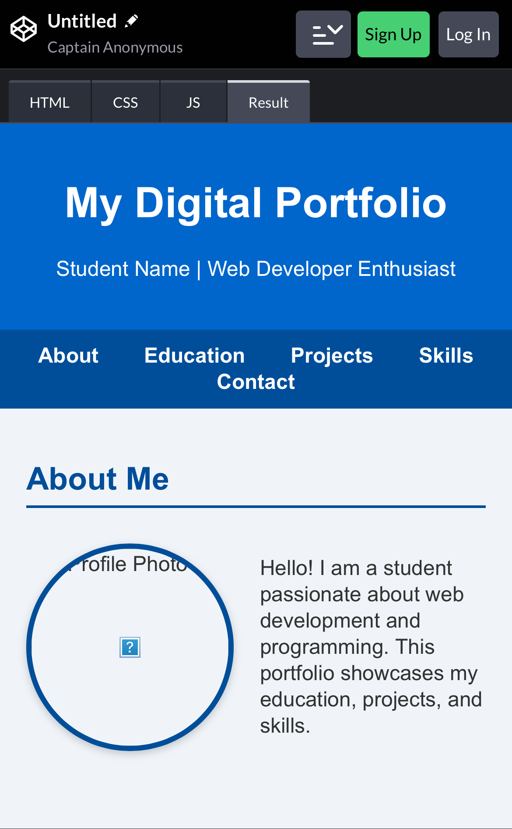
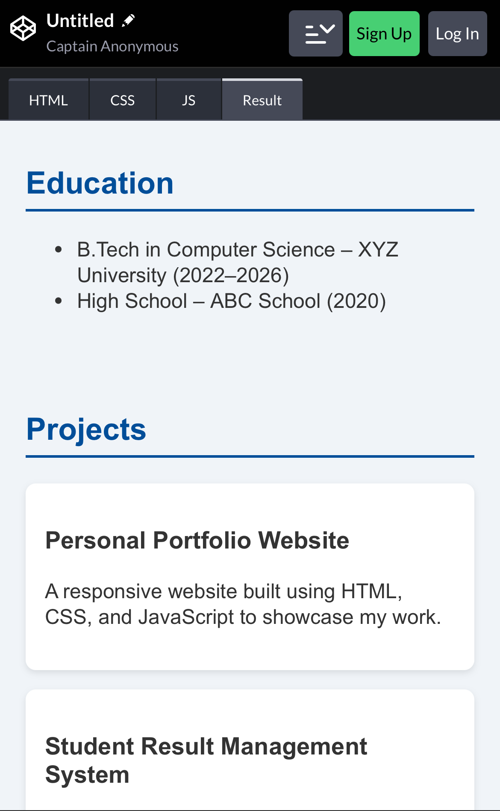
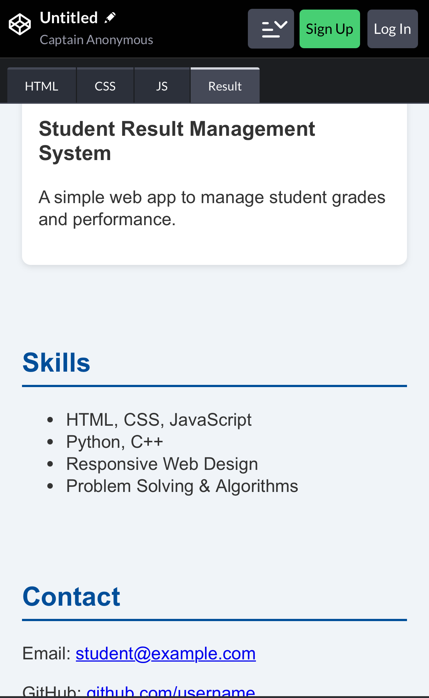
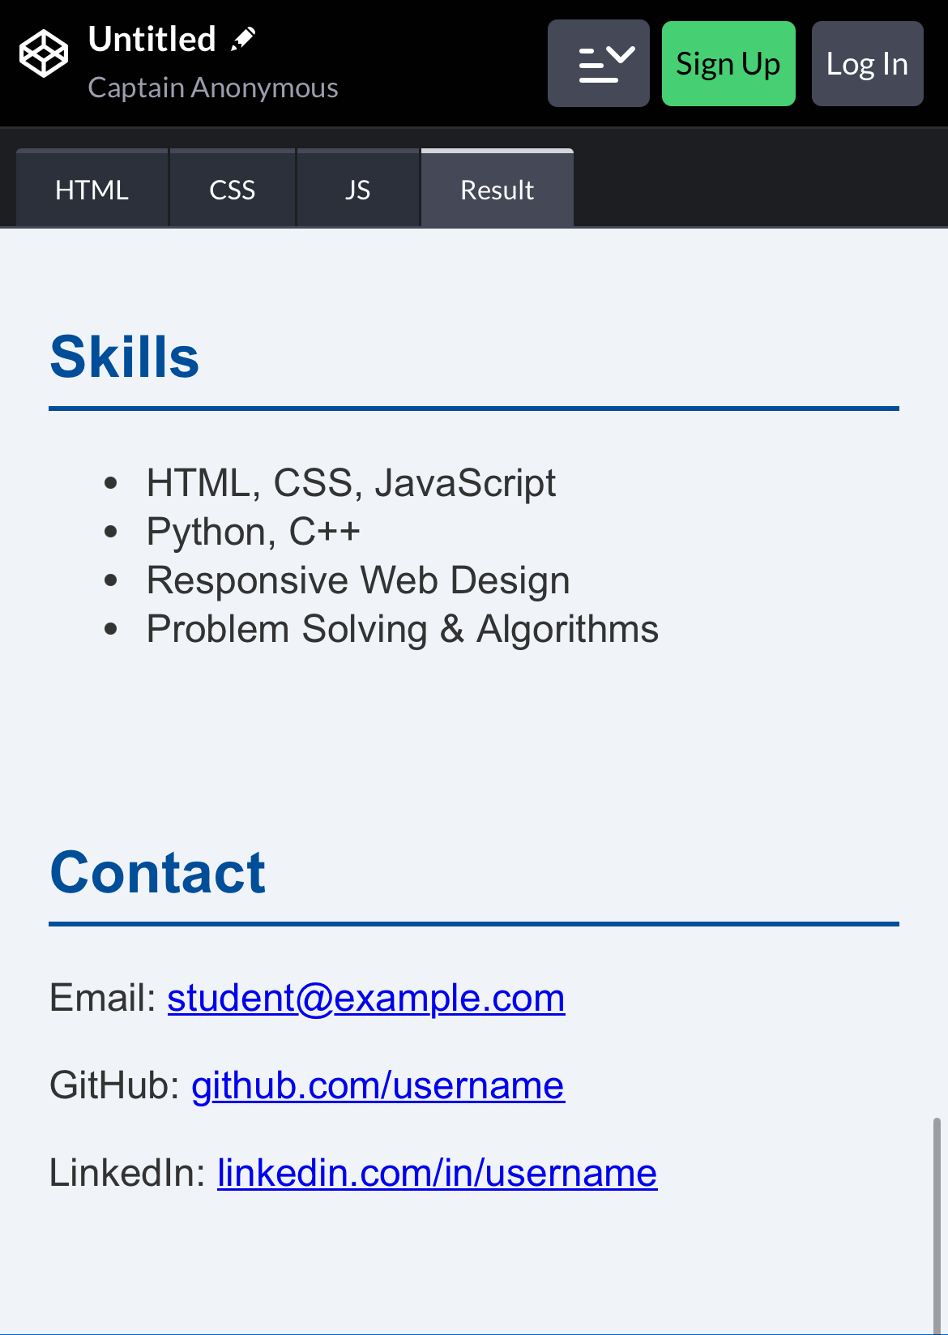
Screenshot

