Slide 1
Natural Language Processing (NLP)
Vineet Kumar
IBM Research Labs
vineeku6@in.ibm.com
@vineetmundhra

Slide 2
Outline
NLP Introduction
Deep Learning and NLP
Improve Word Vectors and NER using supervision

Slide 3
Part 1: NLP Introduction
What is NLP
NLP Applications
NLP Tasks
Why is NLP hard?

Slide 4
What is NLP? (1 / 2)

Slide 5
What is NLP? (2 / 2)
Using computers to process human or natural languages
language
Computer
language
understanding
NLU
generation
NLG
Adapted from Michael Collins’ Coursera Course on NLP

Slide 6
Part 1: NLP Introduction
What is NLP
NLP Applications
NLP Tasks
Why is NLP hard?

Slide 7
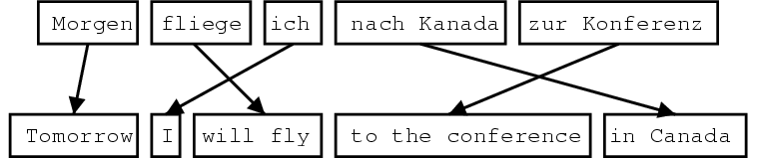
Statistical Machine Translation
Image Source: http://www.statmt.org/wpt05/mt-shared-task/

Slide 8
Information Extraction ( 1 / 3)
10TH DEGREE is a full service advertising agency specializing in direct and interactive marketing. Located in Irvine CA, 10TH DEGREE is looking for an Assistant Account Manager to help manage and coordinate interactive marketing initiatives for a marquee automative account. Experience in online marketing, automative and/or the advertising eld is a plus. Assistant Account Manager Responsibilities Ensures smooth implementation of programs and initiatives Helps manage the delivery of projects and key client deliverables : : : Compensation: $50,000-$80,000 Hiring Organization: 10TH DEGREE
Industry
Position
Location
Company
Salary
Adapted from Michael Collins’ Coursera Course on NLP

Slide 9
Information Extraction ( 2 / 3)
10TH DEGREE is a full service advertising agency specializing in direct and interactive marketing. Located in Irvine CA, 10TH DEGREE is looking for an Assistant Account Manager to help manage and coordinate interactive marketing initiatives for a marquee automative account. Experience in online marketing, automative and/or the advertising eld is a plus. Assistant Account Manager Responsibilities Ensures smooth implementation of programs and initiatives Helps manage the delivery of projects and key client deliverables : : : Compensation: $50,000-$80,000 Hiring Organization: 10TH DEGREE
Industry | advertising
Position | Assistant Account Manager
Location | Irvine CA
Company | 10th DEGREE
Salary | $50,000-$80,000
Adapted from Michael Collins’ Coursera Course on NLP

Slide 10
Information Extraction ( 3 / 3)
Goal: Map a document collection to structured database
Motivation:
Complex searches
“Find me all the jobs in advertising paying at least $50,000 in Boston"
Statistical queries
“How has the number of jobs in accounting changed over the years?"
Adapted from Michael Collins’ Coursera Course on NLP

Slide 11
Dialogue Systems ( 1 / 5)
User: I need a flight from Boston to Washington, arriving by 10 pm.
Adapted from Michael Collins’ Coursera Course on NLP

Slide 12
Dialogue Systems ( 2 / 5 )
User: I need a flight from Boston to Washington, arriving by 10 pm.
System: What day are you flying on?
System asks a clarification question
Adapted from Michael Collins’ Coursera Course on NLP

Slide 13
Dialogue Systems ( 3 / 5 )
User: I need a flight from Boston to Washington, arriving by 10 pm.
System: What day are you flying on?
User: Tomorrow
Adapted from Michael Collins’ Coursera Course on NLP

Slide 14
Dialogue Systems ( 4 / 5 )
User: I need a flight from Boston to Washington, arriving by 10 pm.
System: What day are you flying on?
User: Tomorrow
System: <Returns a list of flights>
Adapted from Michael Collins’ Coursera Course on NLP

Slide 15
Dialogue Systems ( 5 / 5)
User: I need a flight from Boston to Washington, arriving by 10 pm.
System: What day are you flying on?
User: Tomorrow
System: <Returns a list of flights>
Understanding
Generation
Adapted from Michael Collins’ Coursera Course on NLP

Slide 16
Part 1: NLP Introduction
What is NLP
NLP Applications
NLP Tasks
Why is NLP hard?

Slide 17
Tagging (1 / 6)
Strings to tagged sequences
a b e e a f h j
Adapted from Michael Collins’ Coursera Course on NLP

Slide 18
Tagging (2 / 6)
Strings to tagged sequences
a b e e a f h j => a/C b/D e/C e/C a/D f/C h/D j/C
Adapted from Michael Collins’ Coursera Course on NLP

Slide 19
Tagging (3 / 6)
Strings to tagged sequences
a b e e a f h j => a/C b/D e/C e/C a/D f/C h/D j/C
Example1: Part of Speech (POS) Tagging
Profits soared at Boeing Co. , easily topping forecasts on Wall Street
Adapted from Michael Collins’ Coursera Course on NLP

Slide 20
Tagging (4 / 6)
Strings to tagged sequences
a b e e a f h j => a/C b/D e/C e/C a/D f/C h/D j/C
Example1: Part of Speech (POS) Tagging
Profits/N soared/V at/P Boeing/N Co./N ,/, easily/ADV topping/V forecasts/N on/P Wall/N Street/N
Adapted from Michael Collins’ Coursera Course on NLP

Slide 21
Tagging (5 / 6)
Strings to tagged sequences
a b e e a f h j => a/C b/D e/C e/C a/D f/C h/D j/C
Example2: Named Entity Recognition (NER)
Profits soared at Boeing Co. , easily topping forecasts on Wall Street
Adapted from Michael Collins’ Coursera Course on NLP

Slide 22
Tagging (6 / 6)
Strings to tagged sequences
a b e e a f h j => a/C b/D e/C e/C a/D f/C h/D j/C
Example2: Named Entity Recognition (NER)
Profits/O soared/O at/O Boeing/S_ORG Co./I_ORG ,/, easily/O topping/O forecasts/O on/O Wall/S_LOC Street/I_LOC
Adapted from Michael Collins’ Coursera Course on NLP

Slide 23
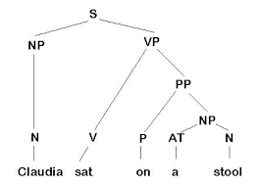
Parsing (1 / 3)
Input: Claudia sat on a stool
Output:
Image Source: http://www.lancaster.ac.uk/fss/courses/ling/corpus/Corpus2/parse.jpg

Slide 24
Parsing (2 / 3)
Input: Claudia sat on a stool
Output:
Image Source: http://www.lancaster.ac.uk/fss/courses/ling/corpus/Corpus2/parse.jpg

Slide 25
Parsing (3 / 3)
Input: Claudia sat on a stool
Output:
Parse Tree
Image Source: http://www.lancaster.ac.uk/fss/courses/ling/corpus/Corpus2/parse.jpg

Slide 26
Part 1: NLP Introduction
What is NLP
NLP Applications
NLP Tasks
Why is NLP hard?

Slide 27
Problem of Ambiguity (1 / 3)
“At last, a computer that understands you like your mother”
Adapted from Michael Collins’ Coursera Course on NLP

Slide 28
Problem of Ambiguity (2 / 3)
“At last, a computer that understands you like your mother”
It understands you as well as your mother understands you
It understands (that) you like your mother
It understands you as well as it understands your mother
Adapted from Michael Collins’ Coursera Course on NLP

Slide 29
Problem of Ambiguity ( 3 / 3)
“At last, a computer that understands you like your mother”
It understands you as well as your mother understands you
It understands (that) you like your mother
It understands you as well as it understands your mother
Adapted from Michael Collins’ Coursera Course on NLP

Slide 30
Ambiguity at many levels (1 / 2)
At the acoustic level (speech recognition)
“..., a computer that understands you like your mother”
“..., a computer that understands you lie cured mother”
Adapted from Michael Collins’ Coursera Course on NLP

Slide 31
Ambiguity at many levels (2 / 2)
At the acoustic level (speech recognition)
“..., a computer that understands you like your mother”
“..., a computer that understands you lie cured mother”
Much more likely!
Adapted from Michael Collins’ Coursera Course on NLP

Slide 32
Outline
NLP Introduction
Deep Learning and NLP
Improve Word Vectors and NER using supervision

Slide 33
Part 2: Deep Learning and NLP
Deep Learning Overview
Word Representations Overview
Word2Vec Model

Slide 34
Deep Learning ( 1 / 3)
Most current Machine Learning (ML) works well because of human designed features
Adapted from Deep Learning for NLP Tutorial Socher et al. NAACL 2013

Slide 35
Deep Learning (2 / 3)
Most current Machine Learning (ML) works well because of human designed features
ML then becomes optimizing weights to make a best final prediction
Adapted from Deep Learning for NLP Tutorial Socher et al. NAACL 2013

Slide 36
Deep Learning (3 / 3)
Most current Machine Learning (ML) works well because of human designed features
ML then becomes optimizing weights to make a best final prediction
Deep learning attempts to automatically learn good features or representations
Adapted from Deep Learning for NLP Tutorial Socher et al. NAACL 2013

Slide 37
Part 2: Deep Learning and NLP
Deep Learning Overview
Word Representations Overview
Word2Vec Model

Slide 38
Word Representations (1 / 5)
Vast majority of NLP work regards words as atomic symbols
Adapted from Deep Learning for NLP Tutorial Socher et al. NAACL 2013

Slide 39
Word Representations (2 / 5)
Vast majority of NLP work regards words as atomic symbols
In terms of vectors, a word is represented by a vector with a single 1 and rest zeroes. Also known as one-hot encoding
[0 0 0 0 0 1 0 0 ……. ]
Adapted from Deep Learning for NLP Tutorial Socher et al. NAACL 2013

Slide 40
Word Representations (3 / 5)
Vast majority of NLP work regards words as atomic symbols
In terms of vectors, a word is represented by a vector with a single 1 and rest zeroes. Also known as one-hot encoding
Problem with one-hot representation
Hotel = [0 0 0 0 0 1 0 0 ……. ] AND
Motel = [0 0 0 0 0 0 1 0 ……. ] = 0
Adapted from Deep Learning for NLP Tutorial Socher et al. NAACL 2013

Slide 41
Word Representations (4 / 5)
“You shall know a word by the company it keeps” (JR Firth 1957)
You can get a lot of value by representing a word by means of its neighbors
One of the most successful ideas of modern statistical NLP
government debt problems turning into banking crises as has happened in
saying that Europe needs unified banking regulation to replace the hodgepodge
Adapted from Deep Learning for NLP Tutorial Socher et al. NAACL 2013

Slide 42
Word Representations (5 / 5)
“You shall know a word by the company it keeps” (JR Firth 1957)
You can get a lot of value by representing a word by means of its neighbors
One of the most successful ideas of modern statistical NLP
government debt problems turning into banking crises as has happened in
saying that Europe needs unified banking regulation to replace the hodgepodge
Context words can be used to represent banking
Adapted from Deep Learning for NLP Tutorial Socher et al. NAACL 2013

Slide 43
Part 2: Deep Learning and NLP
Deep Learning Overview
Word Representations Overview
Word2Vec Model

Slide 44
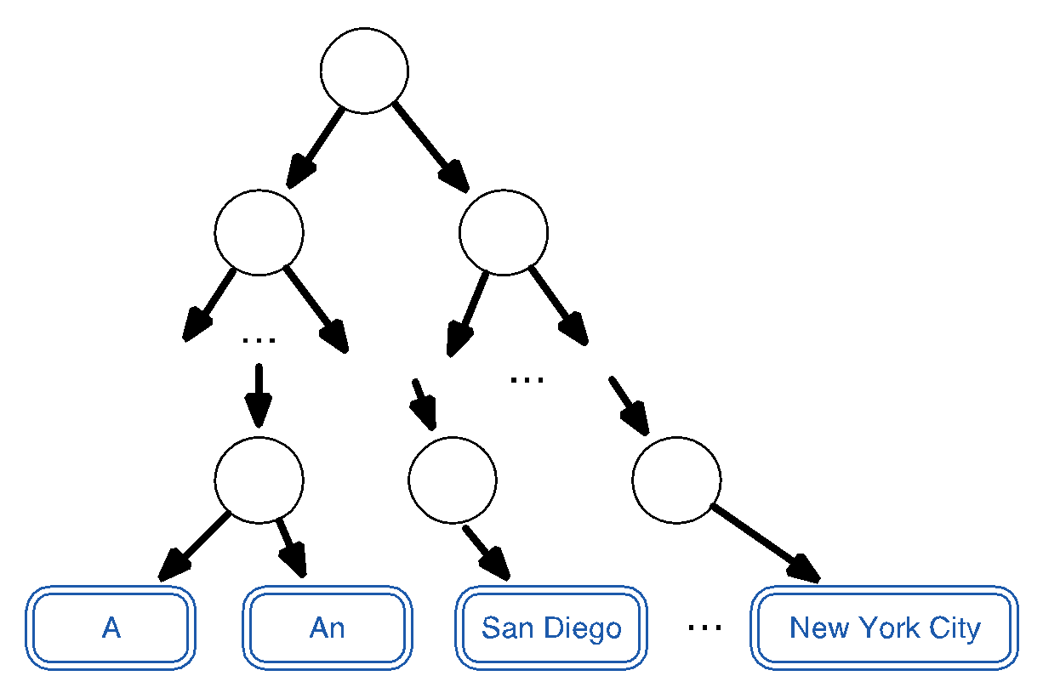
Word2Vec Model (1 / 4)
Put words in a Binary Huffman tree
Mikolov et al. 2013a, 2013b
Notes:
Thus, more frequently occurring words have shorter codes.

Slide 45
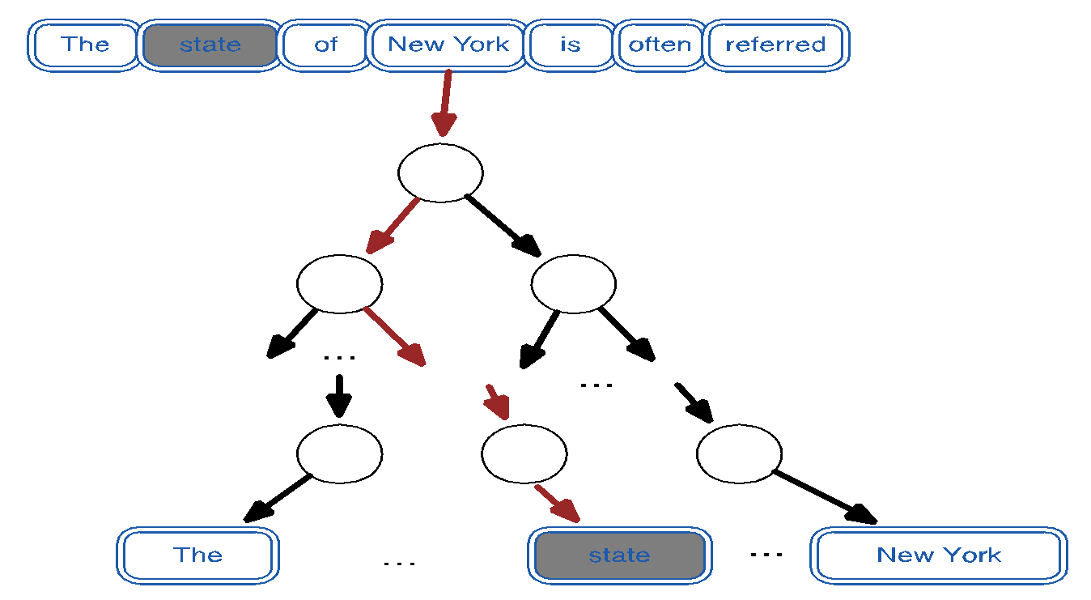
Word2Vec Model (2 / 4)
Mikolov et al. 2013a, 2013b
Notes:
Thus, more frequently occurring words have shorter codes.

Slide 46
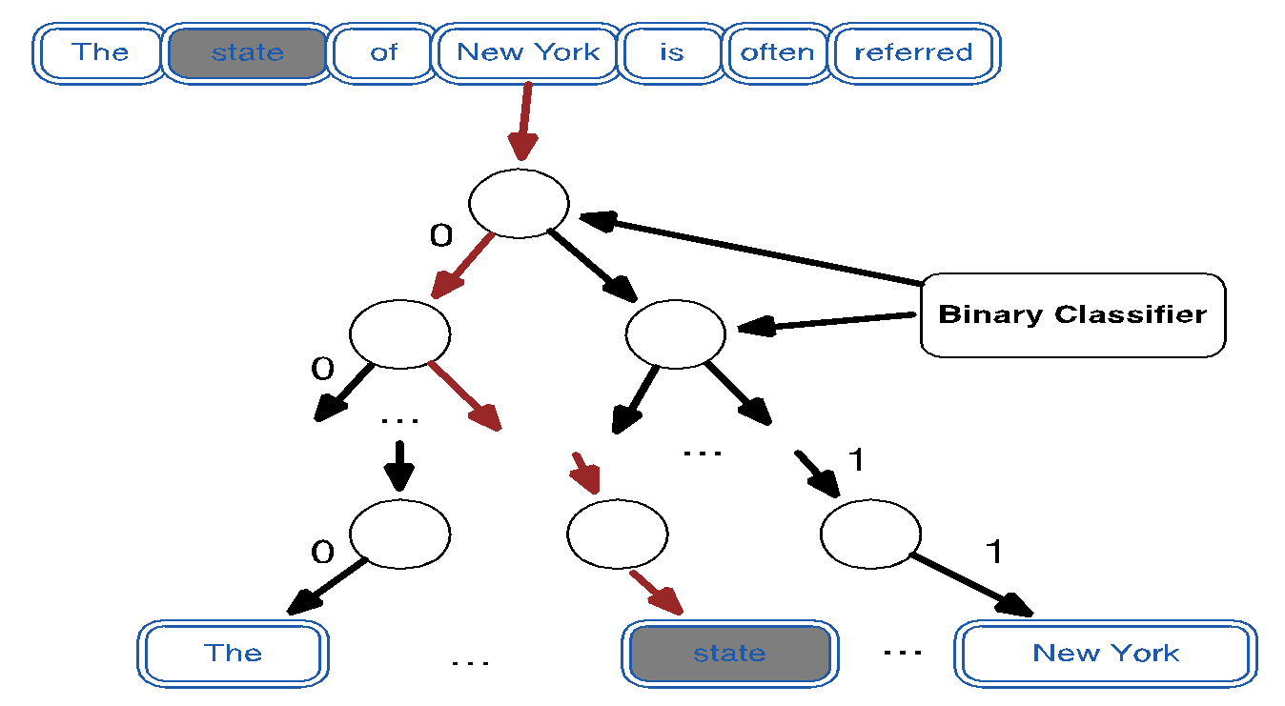
Word2Vec Model (3 / 4)
Mikolov et al. 2013a, 2013b
Notes:
Thus, more frequently occurring words have shorter codes.

Slide 47
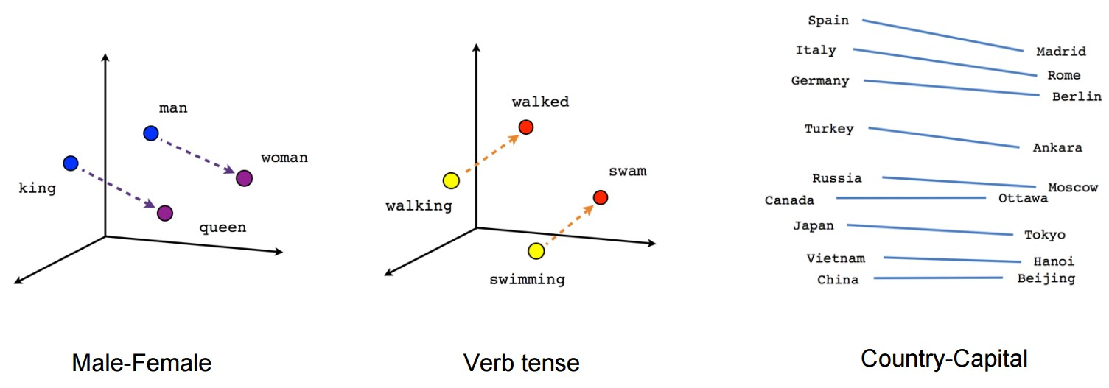
Word2Vec Model (4 / 4)
Image Source: https://www.distilled.net/uploads/word2vec_chart.jpg
Notes:
Thus, more frequently occurring words have shorter codes.

Slide 48
Outline
NLP Introduction
Deep Learning and NLP
Improve Word Vectors and NER using supervision

Slide 49
Lexicon-Infused Phrase Embeddings for Named Entity Recognition (NER) Conference on Computational Natural Language Learning (CoNLL 2014)
Vineet Kumar
Joint work with Alexandre Passos and Andrew McCallum
Information Extraction and Synthesis Lab (IESL)
School of Computer Science,
University of Massachusetts, Amherst

Slide 50
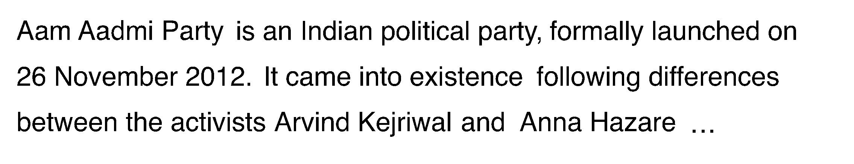
Named Entity Recognition (NER) (1 / 3)
Notes:
In NER, there are two goals. The first is to extract named entities.
The text has been extracted from English Wikipedia page of Aam Aadmi Party.

Slide 51
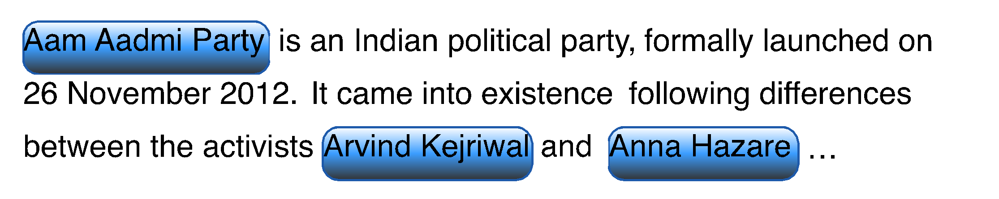
Named Entity Recognition (NER) (2 / 3)
Notes:
For example, we want to find named entities such as Aam Aadmi Party, Arvind Kejriwal and Anna Hazare.
2. This is not such a hard task, as there are enough clues such as Capitalization pattern.
3. Next, we want to predict entity type such as Organization, Location, Person, etc..

Slide 52
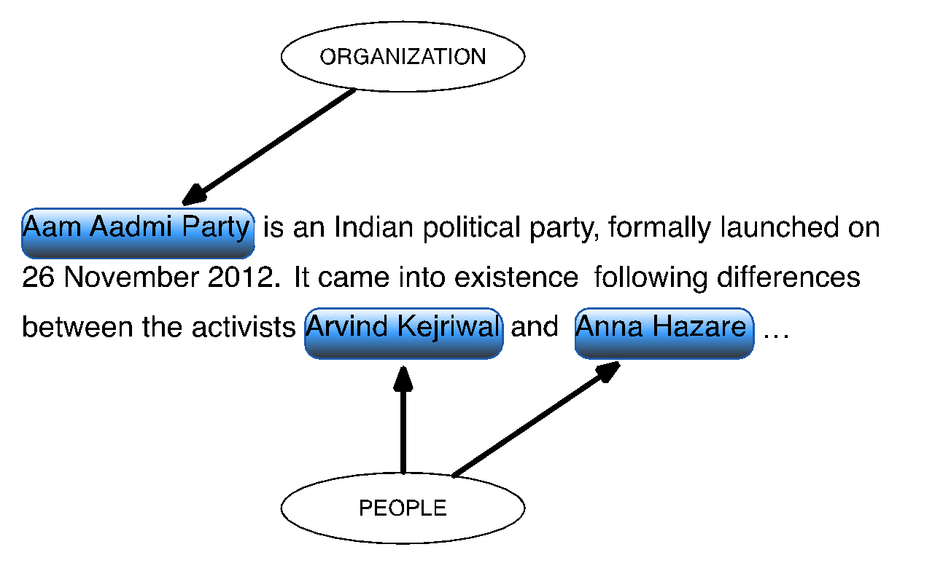
Named Entity Recognition (NER) (3 / 3)
Notes:
Identifying type of entity is important for some NLP pipelines.

Slide 53
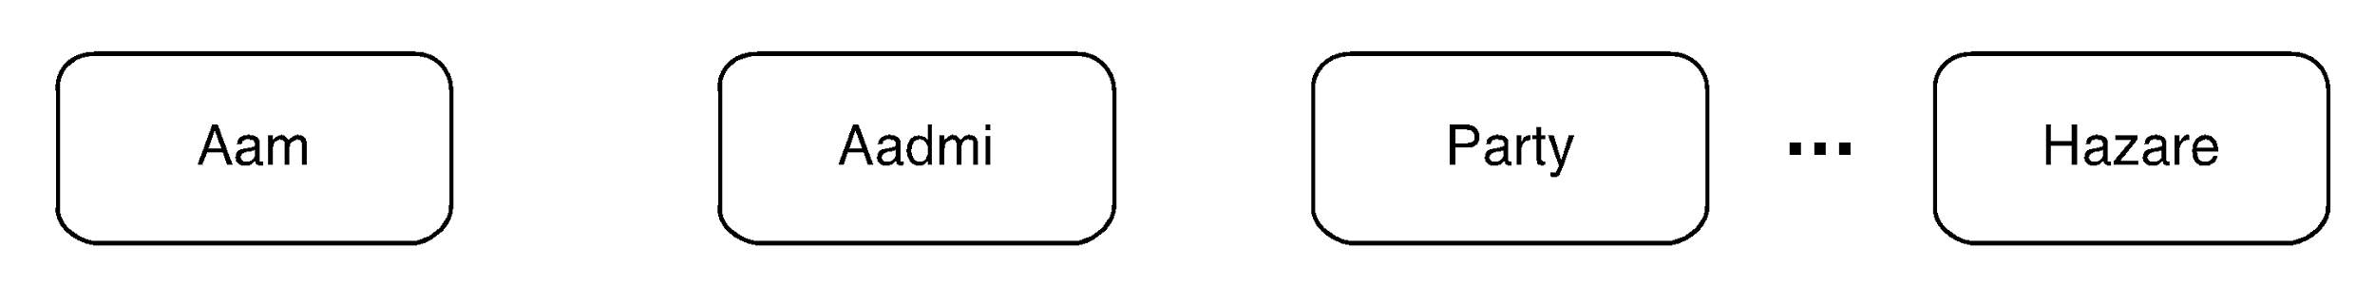
Building a NER System (1 / 4)
Notes:
We tokenize text, and then add token based features such as token identity, token capitalization..
Tokenization is done using a deterministic, regular-expression based method.

Slide 54
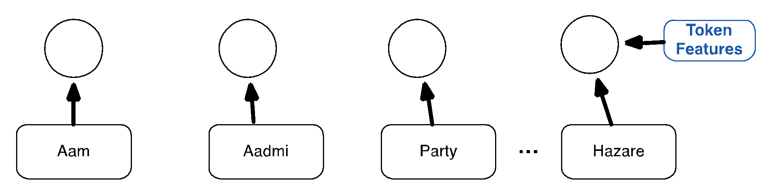
Building a NER System (2 / 4)
Notes:
We tokenize text, and then add token based features such as token identity, token capitalization..
Tokenization is done using a deterministic, regular-expression based method.

Slide 55
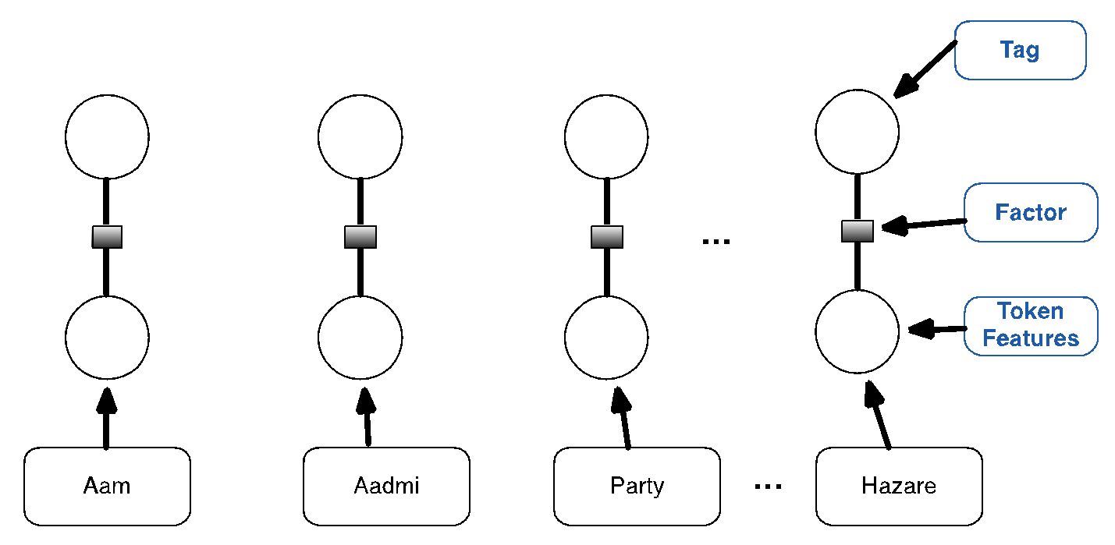
Building a NER System ( 3 / 4)
Notes:
We tokenize text, and then add token based features such as token identity, token capitalization..
Tokenization is done using a deterministic, regular-expression based method.

Slide 56
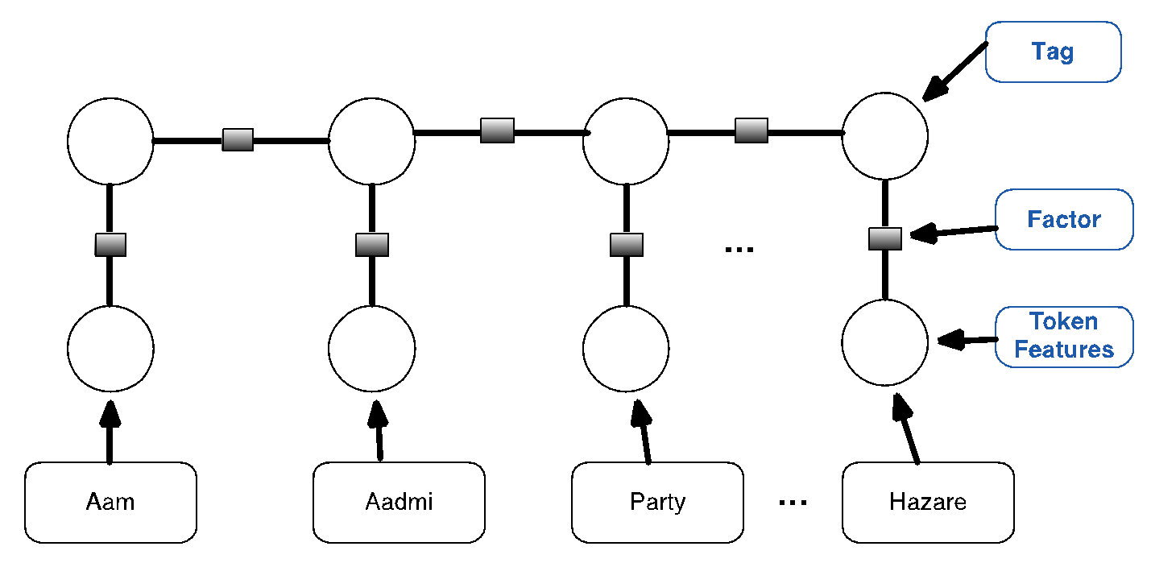
Building a NER System ( 4 / 4)
Notes:
We tokenize text, and then add token based features such as token identity, token capitalization..
Tokenization is done using a deterministic, regular-expression based method.

Slide 57
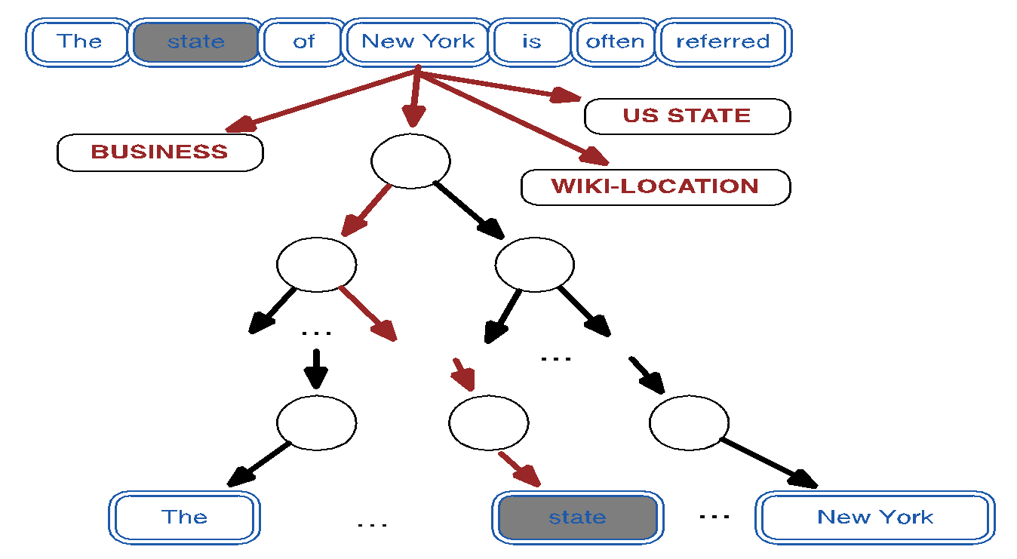
Lexicon infused Skip-gram ( 1 / 2)

Slide 58
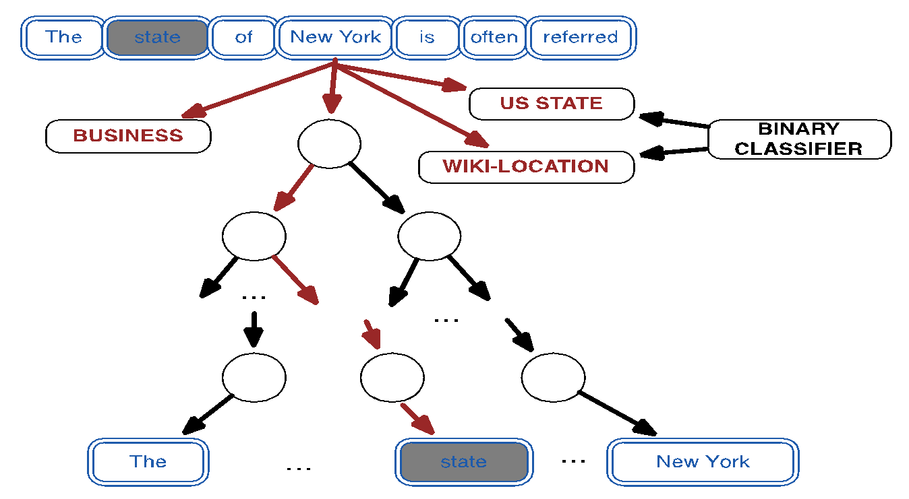
Lexicon infused Skip-gram (2 / 2)

Slide 59
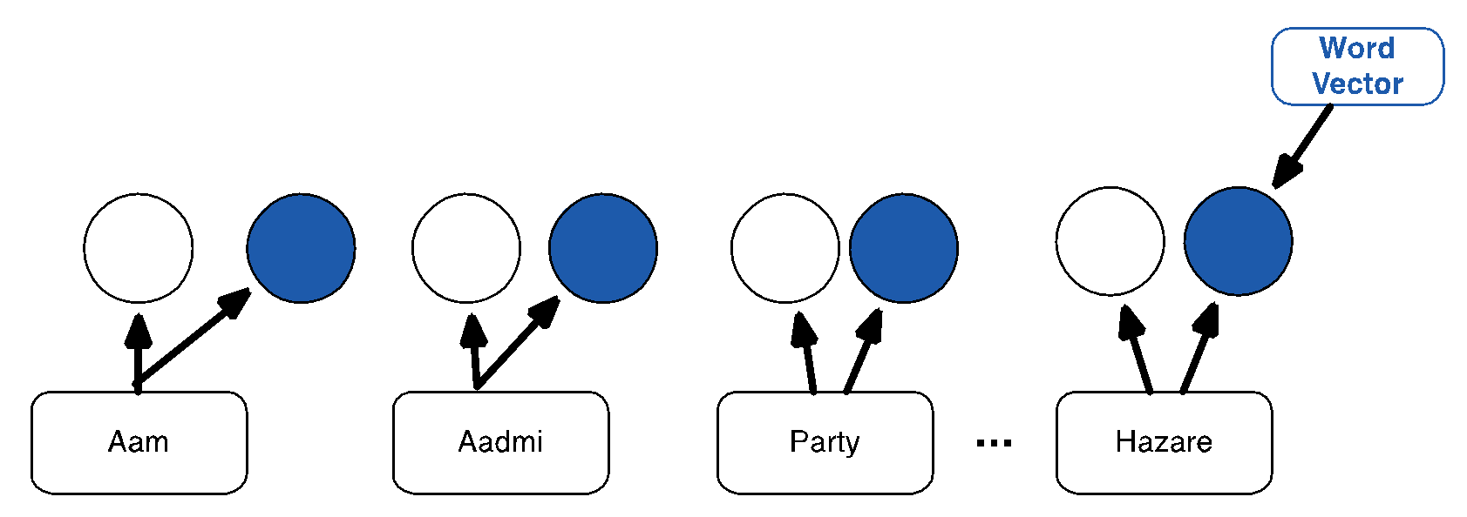
Adding Word Vectors to NER ( 1 / 2)
Notes:
Now, we also add word vectors

Slide 60
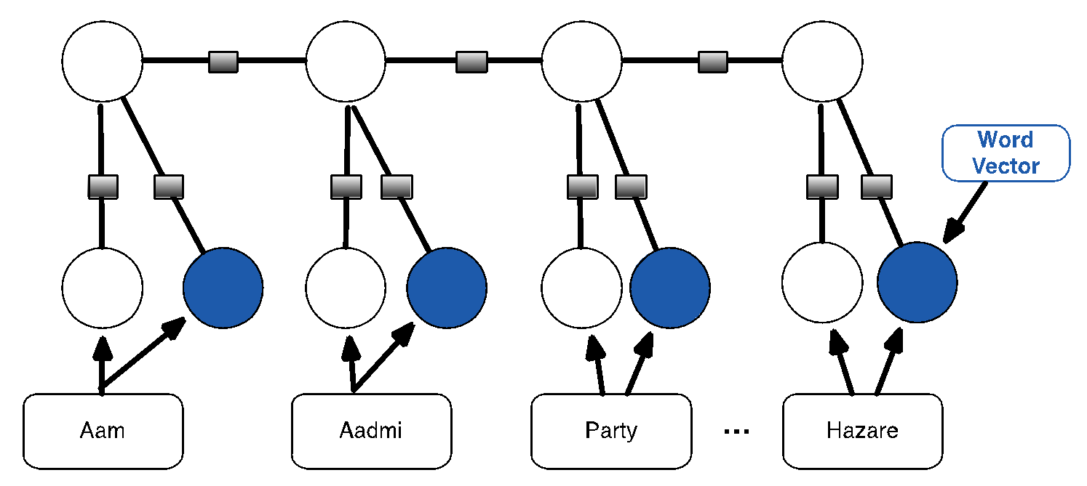
Adding Word Vectors to NER (2 / 2)
Notes:
Notice the additional word vectors, and a factor between word vector and tag. In essence, word vector also predicts tag.

Slide 61
Results on NER
System | Dev | Test
Baseline | 92.22 | 87.93
Baseline + Gazetteers | 93.69 | 89.27
Baseline + Gazetteers + Brown Clusters | 93.88 | 90.67
Baseline + Gazetteers + Skip-gram | 94.23 | 90.33
Baseline + Gazetteers + Lexicon-Skip-gram | 94.46 | 90.90
F1 Scores for CoNLL 2003 Shared NER Task. Task is to predict 4 Named Entity Types:
PERSON, LOCATION, ORGANIZATION, MISC

Slide 62
Conclusions
Word vectors can be learnt efficiently
Word vectors can be improved by external supervision
It is possible to build state-of-the-art NER system by using Word & Phrase Vectors as Features

Slide 63
References
Tomas Mikolov, Kai Chen, Greg Corrado, and Jeffrey Dean. 2013a. Efficient estimation of word representations in vector space. arXiv preprint arXiv:1301.3781.
Tomas Mikolov, Ilya Sutskever, Kai Chen, Greg Corrado, and Jeffrey Dean. 2013b. Distributed representations of words and phrases and their compositionality. arXiv preprint arXiv:1310.4546.

