Slide 1

Online Academy
Team Members
Srilekha Soma 700762977
Adudodla Sindhu 700756302
Bindu Sree Attipatla 700760695
Manas Abhinay Gajula 700757201
K. Shiva Sai Prasad 700763464

Slide 2

Technologies Used
AWS Services
RDS
Lambda
API Gateway
SES
EC2
React.js
Next.js
Node.js
Clerk
Stripe
Mux
uploadthing

Slide 3

Core Functions and Implementations
User Authentication Purpose: Ensuring secure access and management of user logins and sessions. Clerk has been integrated to enhance the authentication handling capabilities. Guarantees robust and dependable user access management.
Course Management Purpose: Capability for instructors to generate, modify, and oversee courses. The backend application programming interfaces (APIs) communicate with Amazon RDS (Relational Database Service) in order to store the data related to courses. Simplifies the process of creating and managing courses for educators.
Video Hosting and Streaming Purpose: Transmit superior educational content. Employs a multiplexer (MUX) to optimize the process of video streaming. Offers a smooth and uninterrupted video experience on various devices.
Payment Processing Purpose: Ensuring the safe and reliable handling of course payments. Incorporating Stripe for financial transactions. Streamlines and ensures secure registration for courses.
Analytics Dashboard Purpose: Monitor and analyze revenue and student engagement. The dashboard was constructed using React.js, and the data was retrieved from RDS. Empowers educators to make well-informed choices by utilizing data-driven insights.

Slide 4
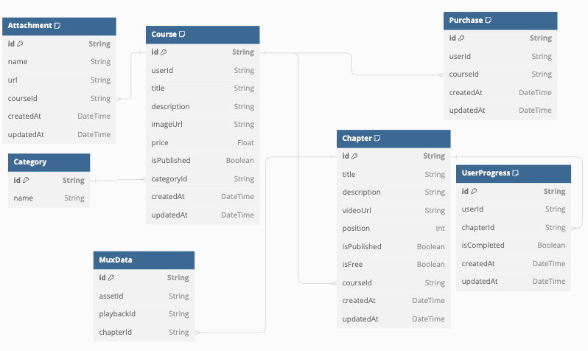
ER Diagram

Slide 5
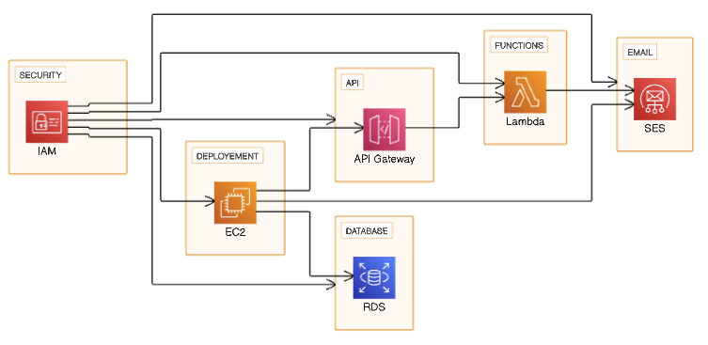
Architecture Diagram

Slide 6
Key Learnings
1. Importance of Scalable Architecture
Learning: Implementing AWS services such as EC2, Lambda, and RDS ensured our system could handle growth efficiently.
Impact: Enabled seamless scaling in response to varying user demands without compromising performance.
2. Integration of Third-Party Services
Learning: Leveraging services like Clerk, MUX, and Stripe can accelerate development and enhance functionality.
Impact: Reduced development time and increased reliability and security of critical operations like authentication and payments.
3. User-Centric Design Approach
Learning: Focusing on user experience in the design phase helped in building an intuitive and accessible platform.
Impact: Increased user engagement and satisfaction by ensuring the platform is easy to navigate and use.
4. Continuous Testing and Feedback
Learning: Implementing agile methodologies facilitated ongoing testing and adaptation based on user feedback.
Impact: Quick identification and resolution of issues, leading to a more robust and user-friendly product.
5. Data-Driven Decision Making
Learning: Utilizing analytics to monitor user behavior and platform performance informed better strategic decisions.
Impact: Enabled targeted improvements and optimizations, enhancing overall platform effectiveness.

Slide 7
AWS Lambda & API Gateway
AWS Lambda
Function: Executes backend operations in a serverless setting, activated by events like HTTP requests through API Gateway or modifications to tables in DynamoDB.
Benefits: Reduces cost by charging only for the compute time used, without requiring server provisioning and management.
API Gateway
Function: Oversees the management of all the RESTful APIs that establish connections between web clients and backend AWS Lambda functions.
Benefits: Offers functionalities such as traffic regulation, authentication and permission control, surveillance, and management of API versions.

Slide 8
AWS RDS & S3
Amazon RDS (Relational Database Service)
Function: Offers a scalable and managed service for relational databases, featuring multiple types of database instances.
Benefits: Streamlines the process of setting up, operating, and expanding databases; provides robustness and protection for applications that rely on databases.
Amazon S3 (Simple Storage Service)
Function: The storage solution is designed to securely store and safeguard large volumes of data for various purposes, including hosting websites, running mobile applications, performing backup and restore operations, archiving data, and supporting enterprise applications.
Benefits: Offers unparalleled scalability, data availability, security, and performance.

Slide 9
AWS SES
Amazon SES (Simple Email Service)
Function: A streamlined and economical email platform that enables seamless sending and receiving of emails using personalized email addresses and domains.
Benefits: It has the ability to work together with other AWS services, which makes it a versatile tool for sending notifications, marketing communications, or transactional emails.

Slide 10
AWS EC2
AWS EC2 (Elastic Compute Cloud)
Function: Provides the necessary infrastructure for the Online Academy platform, including web servers and application logic. Benefits: Provides flexible computational resources that can be easily adjusted based on user traffic and system requirements, guaranteeing optimal performance.

