Slide 1
Recursive clustering of Mobile Phone Call Database
B.Tech Project
Department of Electrical Engineering
Indian Institute of Technology
By:
Kishore Rathinavel
Guided by:
Prof. Pawan Lingras

Slide 2
Motivation
Mobile phones are the future for social networking – they offer professional as well as personal networking opportunities
Smartphones outsold PCs in 2011 and due to new banking facilities, they are replacing wallets too.
Some examples of interesting mobile data mining:
iPhones save location information and relay it to a central server. Simulations of the path you(your phone) followed is very interesting. Predictions can be drawn on the same data.
People have developed algorithms that predict how much your tweets will be reblogged/shared.

Slide 3
Introduction
What new things are we trying in this project?
Recursive clustering
Clustering techniques used:
Present stage of project: Crisp clustering
Future stages:
Fuzzy C-means clustering
Granular clustering
Data set used:
Reality Mining Database from MIT

Slide 4
Recursive clustering
It is called Recursive clustering because we are using the results of each iteration for clustering in the next iteration
We get new insights by this method into the social structure of the callers – especially about the groups within the callers and how they are connected

Slide 5
Data set used
Call logs of 106 phone numbers for over 9 months
We cluster only 92 of these phone numbers because the others primarily send/receive only packet data and MMS
VARIABLE | DESCRIPTION
myHashNum | Origin phone number
DateTime | Date and time of call
Event | Unique number for call
Description | Type of call – SMS/MMS/Call etc.
Direction | Outgoing/Incoming
Duration | Duration of call
hashNum | Destination phone number

Slide 6
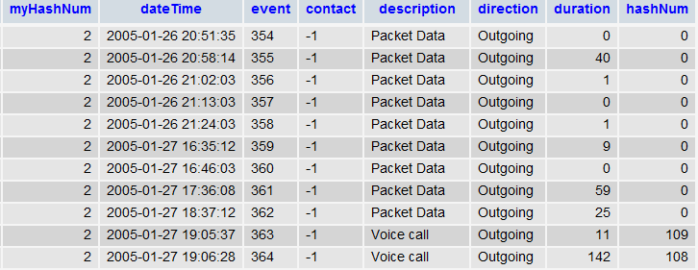
Screenshot of Raw Data

Slide 7
Further information the data
Volume of calls vs origin phone number arranged in order of increasing packet data volume. Packet data is eliminated before further processing

Slide 8
Calls data vs Numbers data
The data is categorized into 2 types:
Calls data:
Data about all the calls that are made
Apart from Raw Data we added a few other columns based on our inferences from the Raw data:
Weekend (1/0), DayNight(1/0), Missed(1/0), PacketData(1/0), SMS(1/0), MMS(1/0), Voicecall(1/0), Long Duration call(1/0)
Numbers data:
Average statistics about the calls made by each phone number
Average duration of phone calls, average number of Weekend/Weekday(1/0), average number of Daytime/night-time(1/0), average number of outgoing/incoming(1/0), average number of missed calls(1/0), average number of SMS(1/0), average number of Voice calls(1/0), average number of long duration calls(1/0)

Slide 9
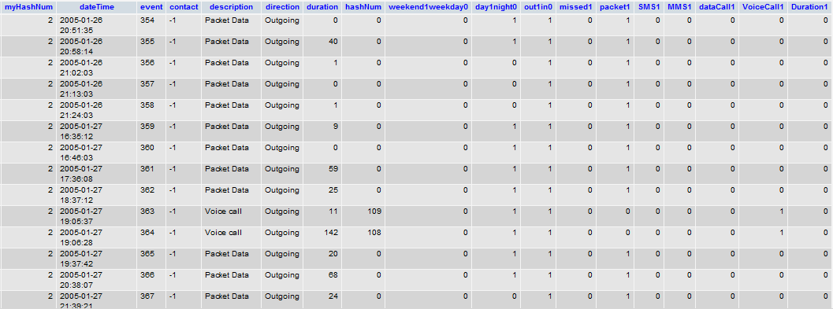
Calls table

Slide 10
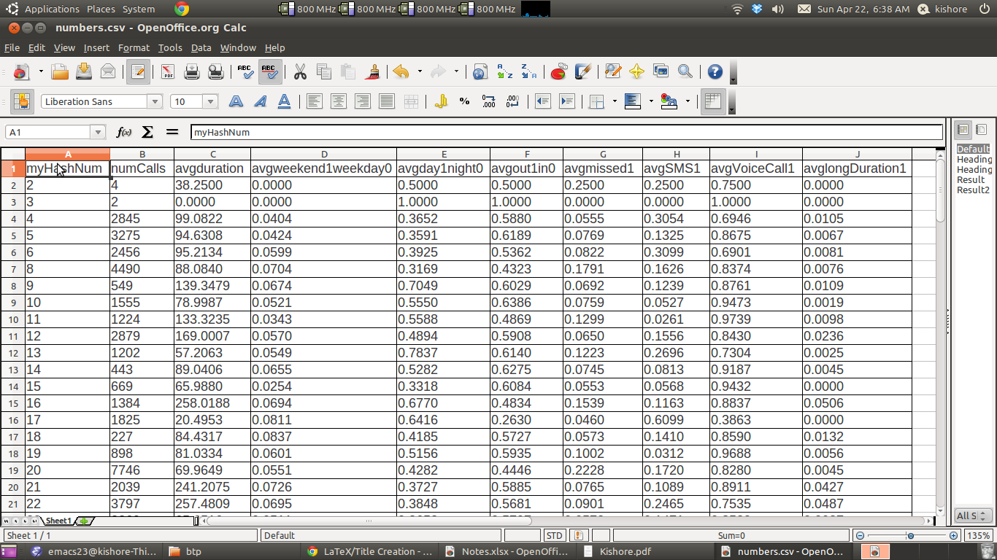
Numbers table

Slide 11
Outline of clustering analysis
Initial cluster analysis of calls data
We get information about outliers and we introduce new variables to handle the outliers
Preliminary cluster analysis of numbers to determine optimum clusters
Recursive clustering – the experiment will be described later

Slide 12
Some terminology
Withinss: Describes how sparse cluster points are within a cluster. Lower, the better.
Betweenss: Describes how much separation there is between clusters. Higher, the better.
Davies Bouldin Index: A comprehensive index indicating the cluster quality. Lower, the better.
Outliers: Data points whose value falls far outside the normal range of values.

Slide 13
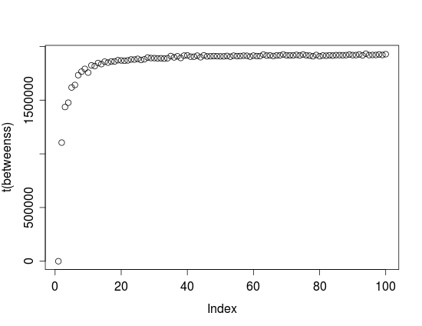
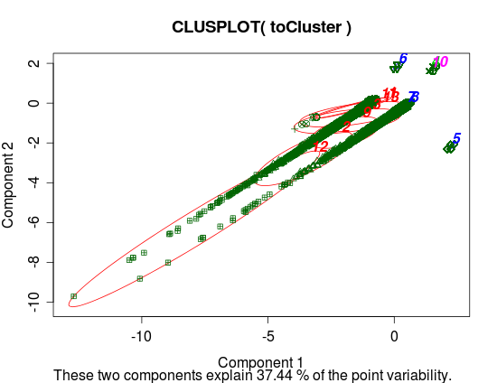
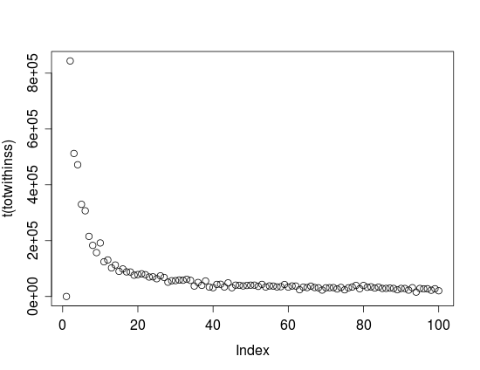
Initial clustering of Calls data
Optimum number of clusters is found using withinss, betweenss and Davies-Bouldin Index(DBI). We get the optimum number to be 13.
Clusters are of very poor quality and there is indication of several outliers.
Betweenss plot
Withinss plot

Slide 14
Handling outliers
Outliers are mainly based on duration of calls.
The median of the duration is just 1/10 of the mean of the durations. And the 3rd quartile is 0.6 times the mean.
Hence, we find a suitable point for separating the calls into low duration calls and high duration calls.
Old average duration : 104
New Average is 75 and 2500 approx.

Slide 15
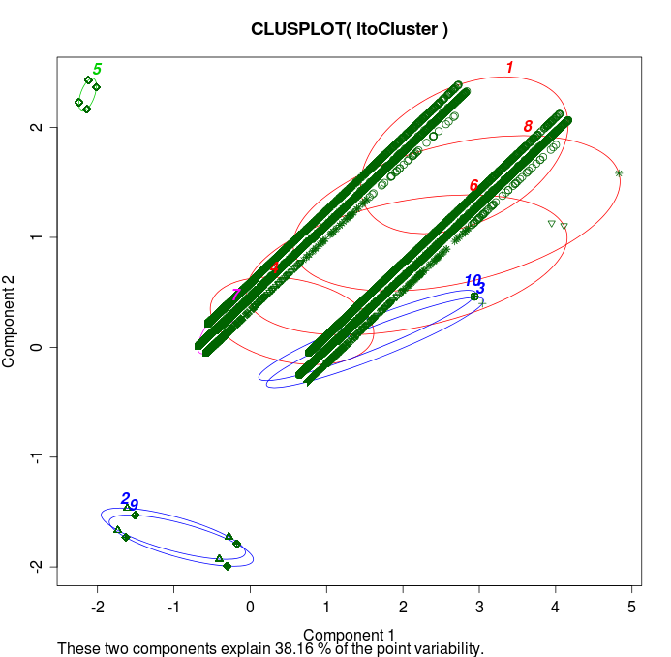
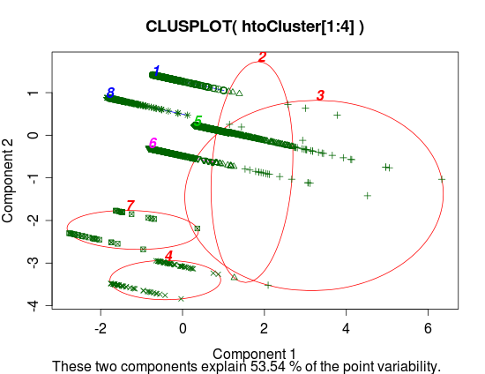
New Calls clustering results
Low duration calls
High duration calls

Slide 16
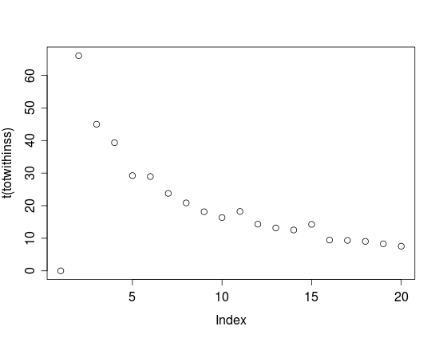
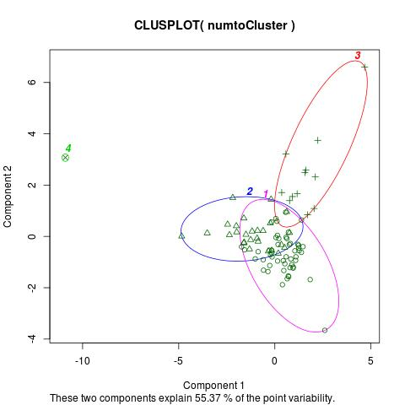
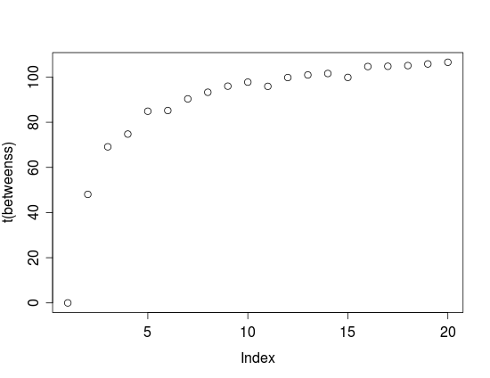
Preliminary Numbers clustering
Withinss plot
Betweenss plot

Slide 17
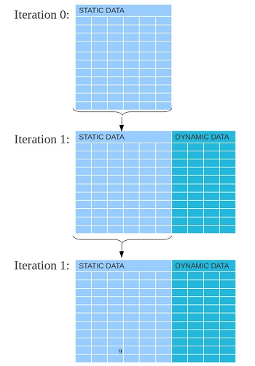
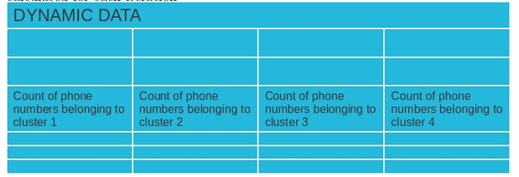




Design of Experiment

Slide 18

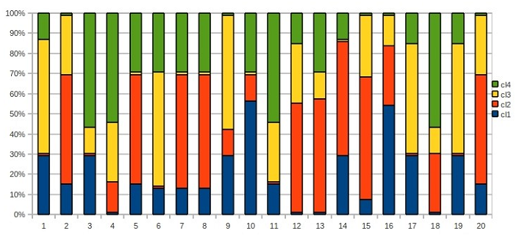
Static Results – based on
Cluster Sizes
The same pattern of cluster sizes is repeated from iteration to iteration.
Similarly, the cluster centers also have a repeating pattern interchanging between the clusters.
Iteration | Cluster1 | Cluster2 | Cluster3 | Cluster4
1991 | 12 | 27 | 52 | 1
1992 | 52 | 12 | 1 | 27
1993 | 52 | 12 | 1 | 27
1994 | 1 | 12 | 52 | 27
1995 | 27 | 12 | 52 | 1
1996 | 14 | 50 | 1 | 27
1997 | 28 | 56 | 1 | 7
1998 | 52 | 12 | 27 | 1
1999 | 27 | 12 | 52 | 1
2000 | 1 | 12 | 27 | 52
Stacked bar graph of sizes changing through iterations.

Slide 19
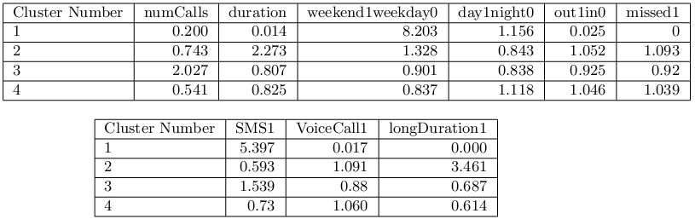
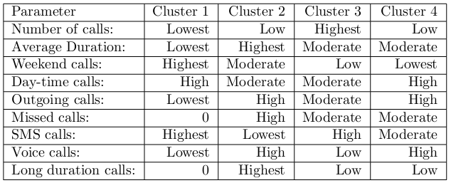
Static Results(cont…)
Cluster Centers for all static parameters
Based on the cluster centers table above, cluster profiles can be derived.

Slide 20

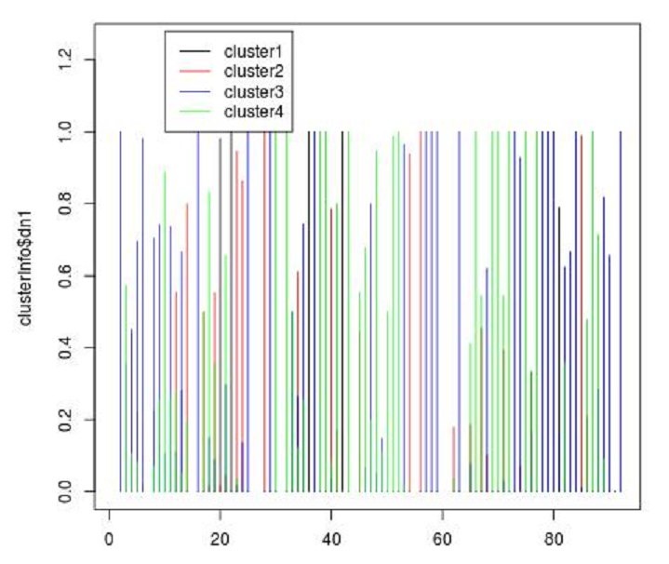
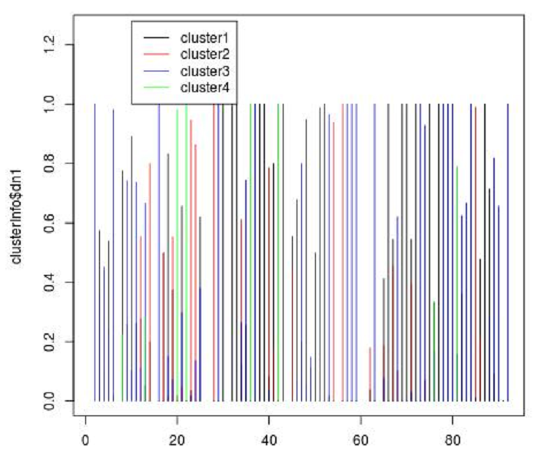
Dynamic Results – Based on
The colored lines indicate the probability of a phone number's
calls to belong to a particular cluster number from among clusters 1,2, 3 and 4.
Iteration 1
Iteration 2000

Slide 21
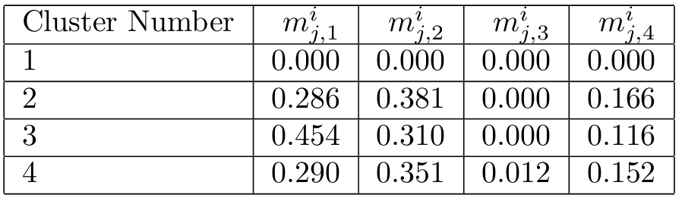
Dynamic Results(cont…)
Cluster Centers for the dynamic parameters
Based on the above table we can infer:
Cluster 1 is least socially connected
Cluster 3 is least contacted by other clusters
Cluster 3 is mostly in contact with cluster 1 and 2
Cluster 4 is most socially active and has connections in every cluster
For each cluster, cluster 2 phone numbers are contacted the most
For each cluster, cluster 4 phone numbers are contacted the least.

Slide 22
Conclusions and Future Work
Recursive cluster gives us new insights into the social structuring of a group
Future work comprises of doing the same experiment for other types of clustering such as:
Fuzzy C-means clustering
Granular clustering

Slide 23
THANK YOU

