Slide 1
Optimized Decomposition
Notes:
Now the question is how do we come up with the binary patterns and illumination values to represent a 3-D virtual scene?

Slide 2
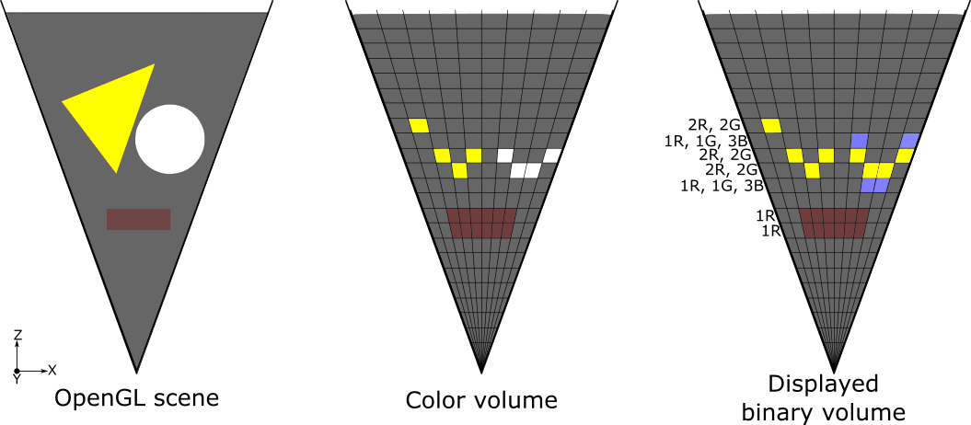
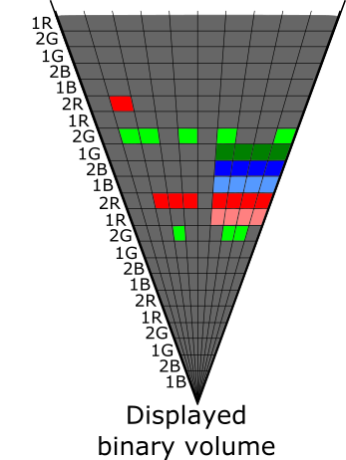
Optimized Color-to-Binary Decomposition: Motivation
Will reduce depth blur by using fewer binary voxels to depict a color voxel
Will enable same visual quality for displays with fewer depth planes
Will enable transparencies: if fewer binary voxels encode a color voxel, then more color voxels can be depicted in depth
Will enable High Dynamic Range (HDR) imagery

Slide 3
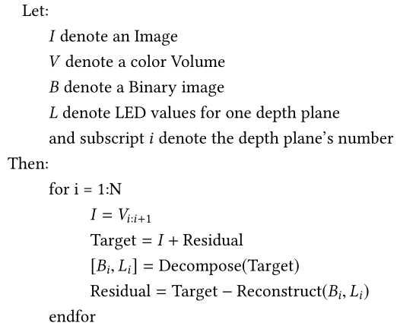
Optimized Color-to-Binary Decomposition: Approach
Developed three algorithms
All algorithms are setup similar to error-diffusion

Slide 4
Optimized Color-to-Binary Decomposition: Approach
Heuristic (or brute-force)
Calculates binary images and LED values for all combinations of target image’s color channels (R, G, B, RG, GB, RB, RGB) and selects the case which reduces the overall error the most
Highest energy channel minimization
Calculates binary images and LED value only for the color channel with highest errors
Projected-gradients
Uses iterative optimization to jointly optimize the decomposition for all three color channels
Similar to Non-negative Matrix Factorization (NMF)
Thresholding to arrive at binary image

Slide 5
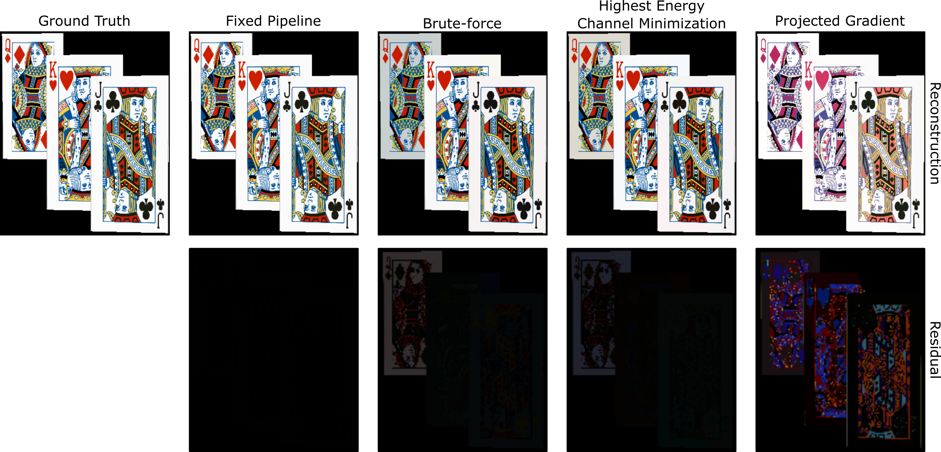
Simulation Results: Visual quality

Slide 6
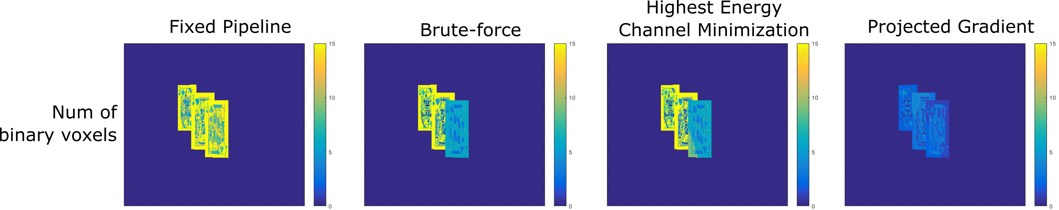
Simulation Results: Depth Blur

