Slide 1

Leading causes of death in the united states
By:
Jugal Kishore Ruvva
016587519

Slide 2

Why
Irrespective of age and gender, many people face different kinds of health issues
The causes vary from person to person and place to place
Treatment costs are too high, resulting high death rate
Most of the available insurance doesn't provide coverage for all diseases
What
Helps researchers to concentrate on the root cause
Reforming insurance

Slide 3
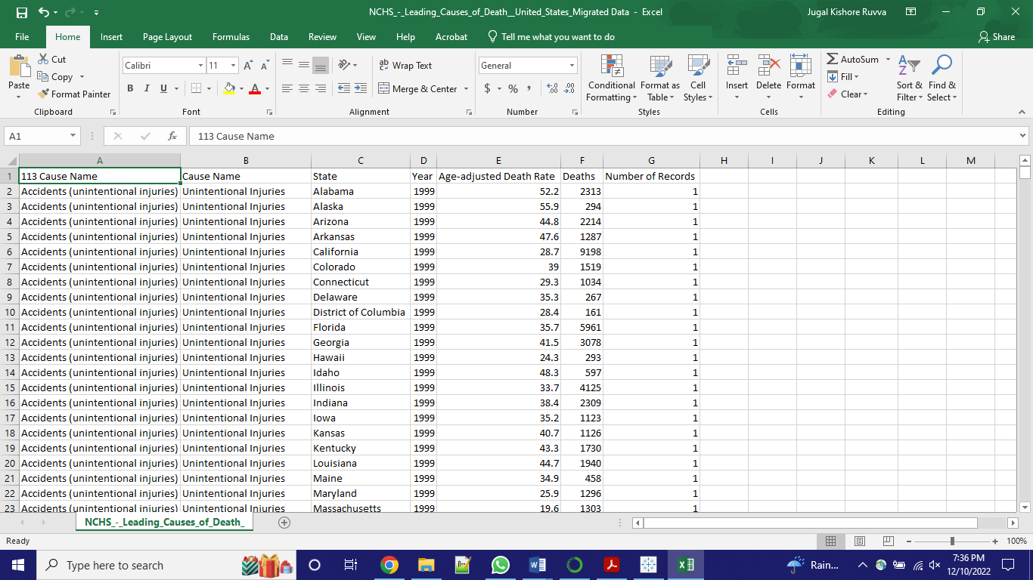
Data set
Data Source:
National Center for Health Statistics

Slide 4
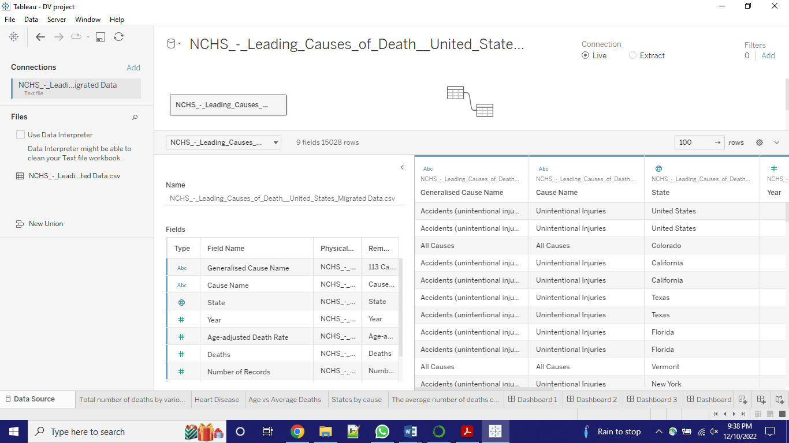
DATA WRANGLING
There are seven columns with various datatypes, as seen in the data set above.
I have uploaded the data into Tableau
Identified and eliminated columns with null values,
‘Number of Records’ can be skipped as this column is less critical for analysis

Slide 5
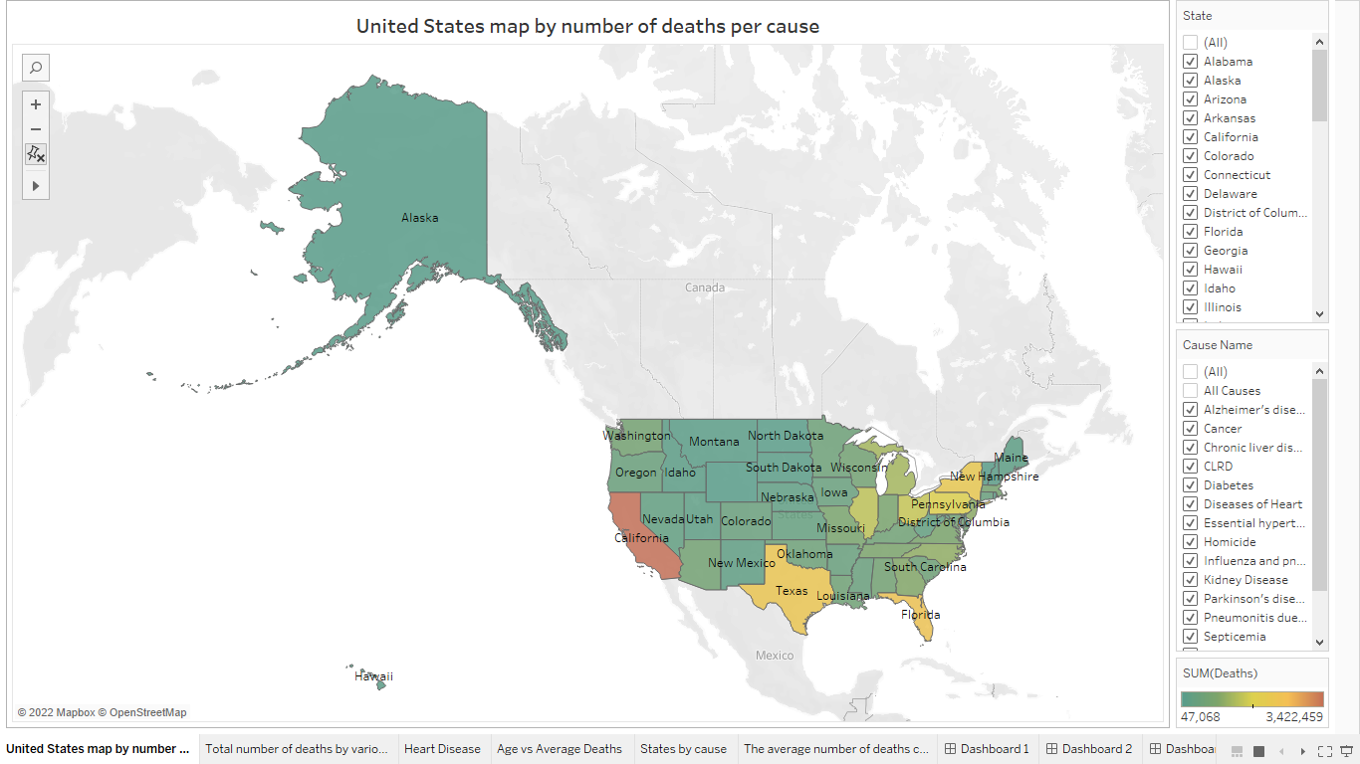
United States map by number of deaths per cause
Total number of deaths in California is around 3.5 million
Alaska state as many as 47 thousand deaths.

Slide 6
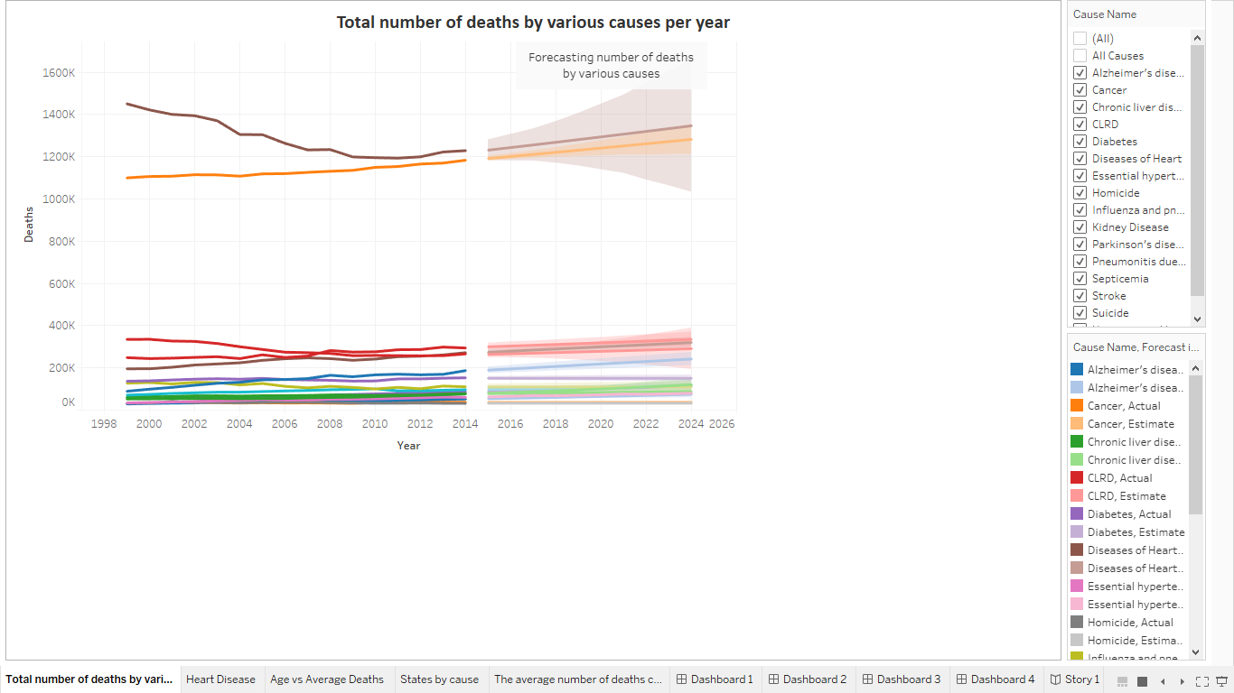
Total number of deaths by various causes per year
Number of deaths by disease of heart and cancer is way more high compared to other causes
Forecasting the number of deaths for coming years

Slide 7
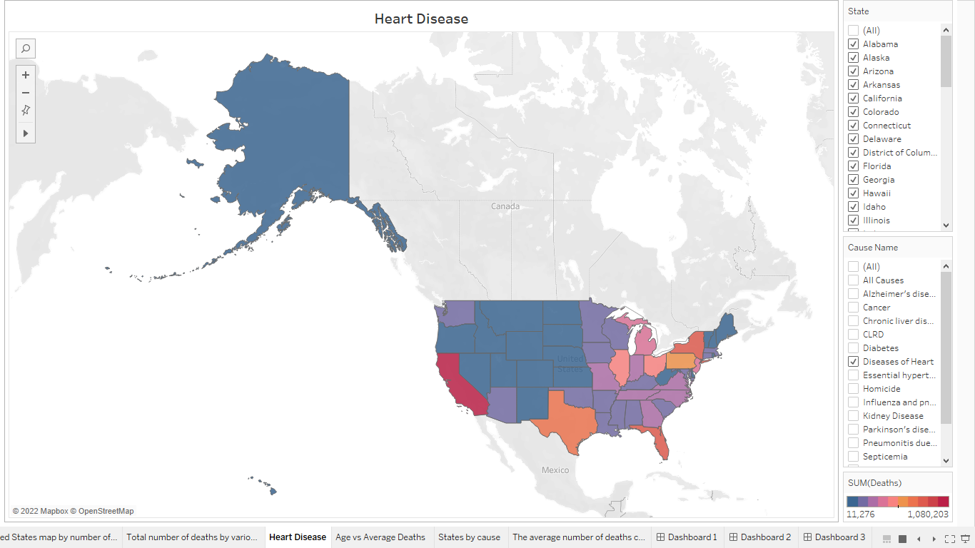
Heart Disease
Leading causes of death is heart disease
Red being a high death toll and blue being a smaller number of deaths
California has more number of deaths
View can be changed by selecting different disease

Slide 8
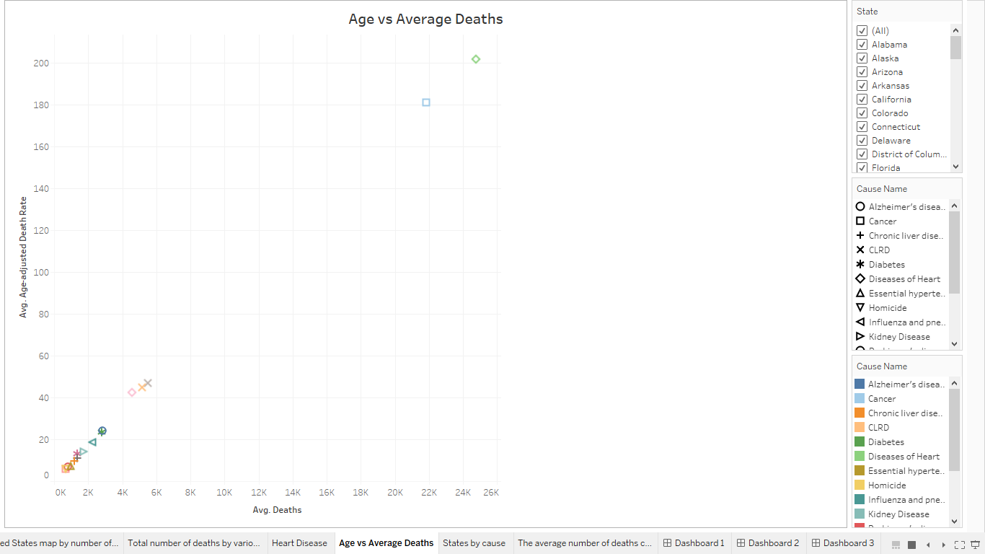
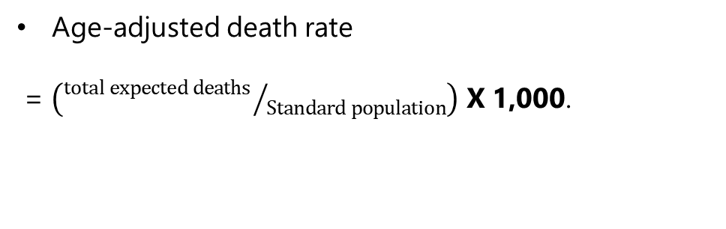
Age vs Average Deaths
Age-adjusted death rate
= $\left({total expected deaths }/{Standard population}\right)$ X 1,000.
Using a scatter plot expecting to find at what age people die because of different causes

Slide 9
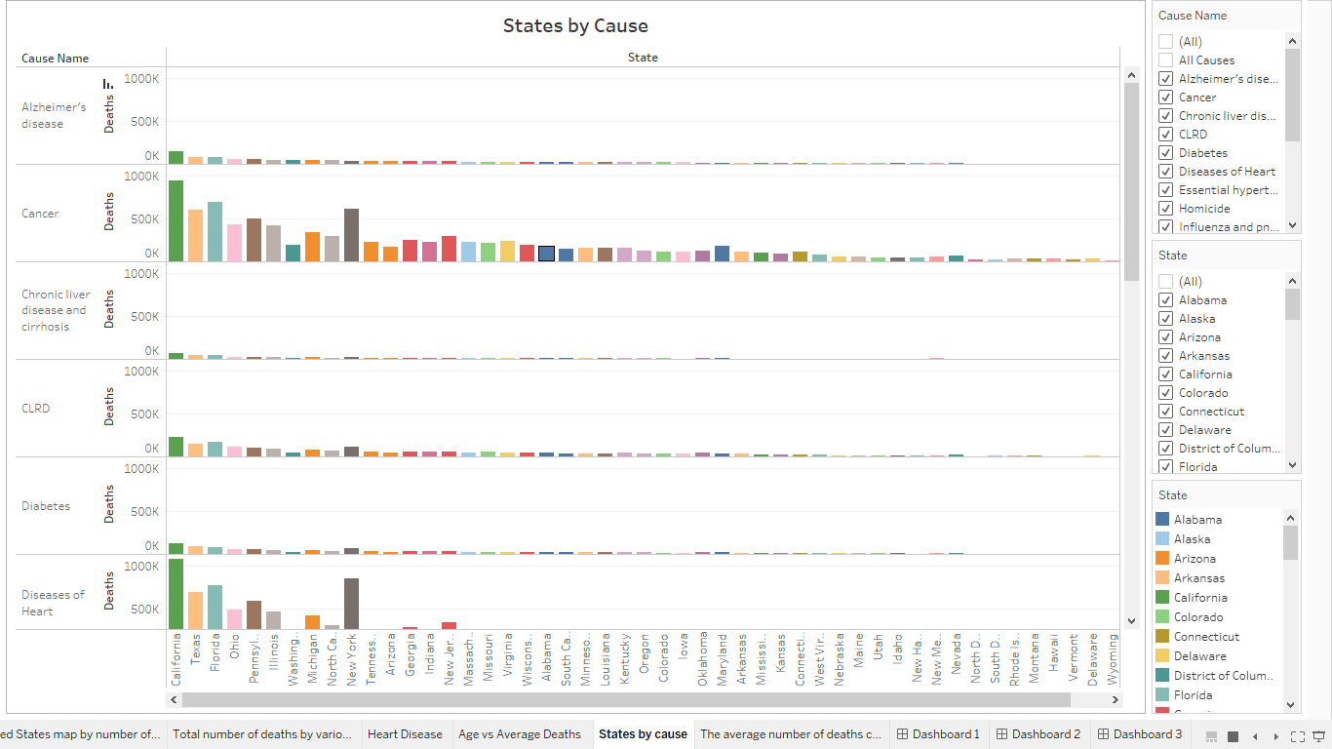
States by Cause

Slide 10
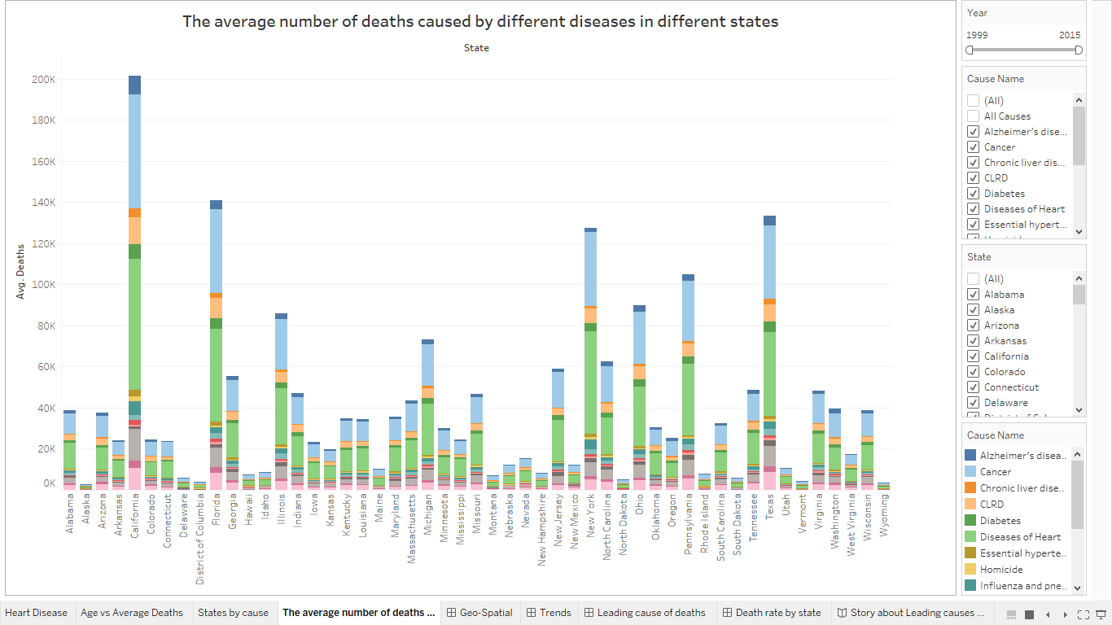
The average number of deaths caused by different diseases in different states
Time scale analysis of the deaths that happened from the year 1999 to the year 2015
Year as a filter

Slide 11
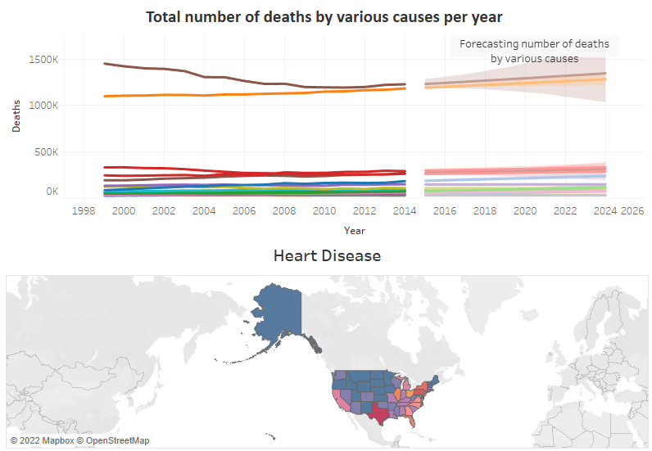
LIVE DEMO

Slide 12

Conclusion
The major diseases in the world are cancers, cardiovascular diseases, and chronic respiratory diseases
Cost-effective, personalized health.

