Slide 1
AZURE STORAGE

Slide 2
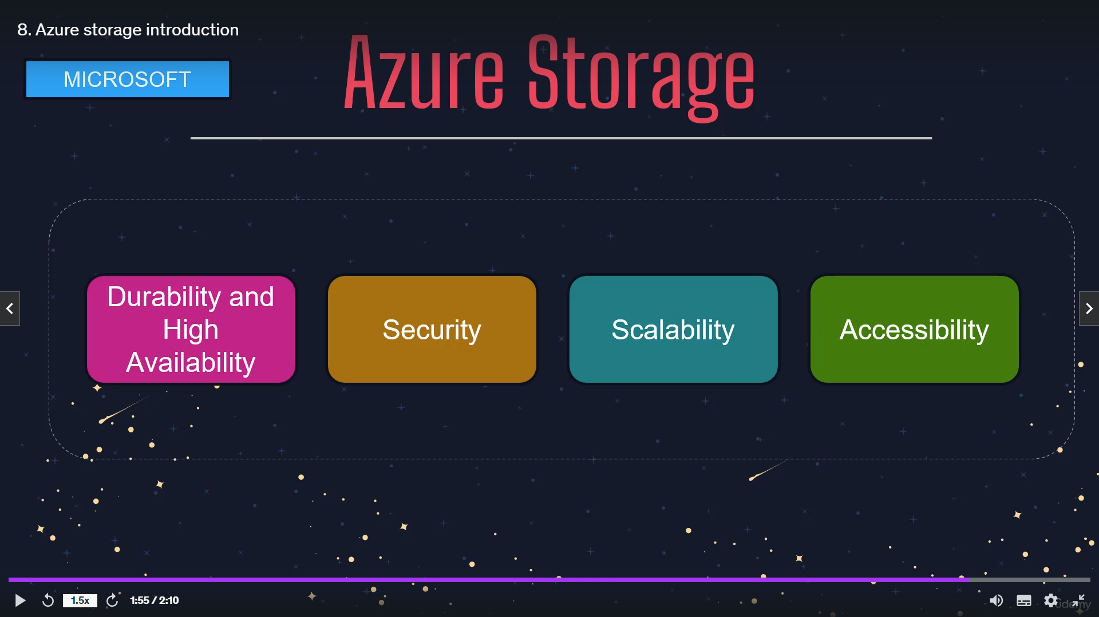

Slide 3
BLOB STORAGE
Blob storage is a service which stores structure data as objects, binaries or blobs.
This blob storage can store any type of data such as document file, media file like image or application setup file.
FILE STORAGE
Azure files offers fully managed cloud files shares that you can access from anywhere via the industry standard, which is server message protocol or SMB protocol.
TABLE STORAGE
It has not become a part of Azure Cosmos DB but azure tables stores the structured NOSQL data in the cloud with key structure attribute.
QUEUE STORAGE
Azure queue is a storage service for large number of messages that can be accessed from anywhere in the world via authenticated calls using HTTP or HTTPS.
Azure Queues is commonly used in microservices architecture.
But Azure queues basically allows for asynchronous message queue between application components.

Slide 4
BLOB STORAGE CREATION CONSTRAINTS
When we creating a blob account, you have to choose the access tier.
The most common access tier are HOT and COLD.
HOT grant us the lowest latency possible.
Because of that, it should be used with data that is frequently accessed.
If storing images or PDF documents that you have to access, we should go with HOT access tier.
And bcoz of this low latency its more expensive.
The COLD access tier is less in perfomence than the hot access tier. Its offers heigh latency, bcoz of that cost is lower.
But cold access tier should be used where the data’s are not frequently used.

Slide 5
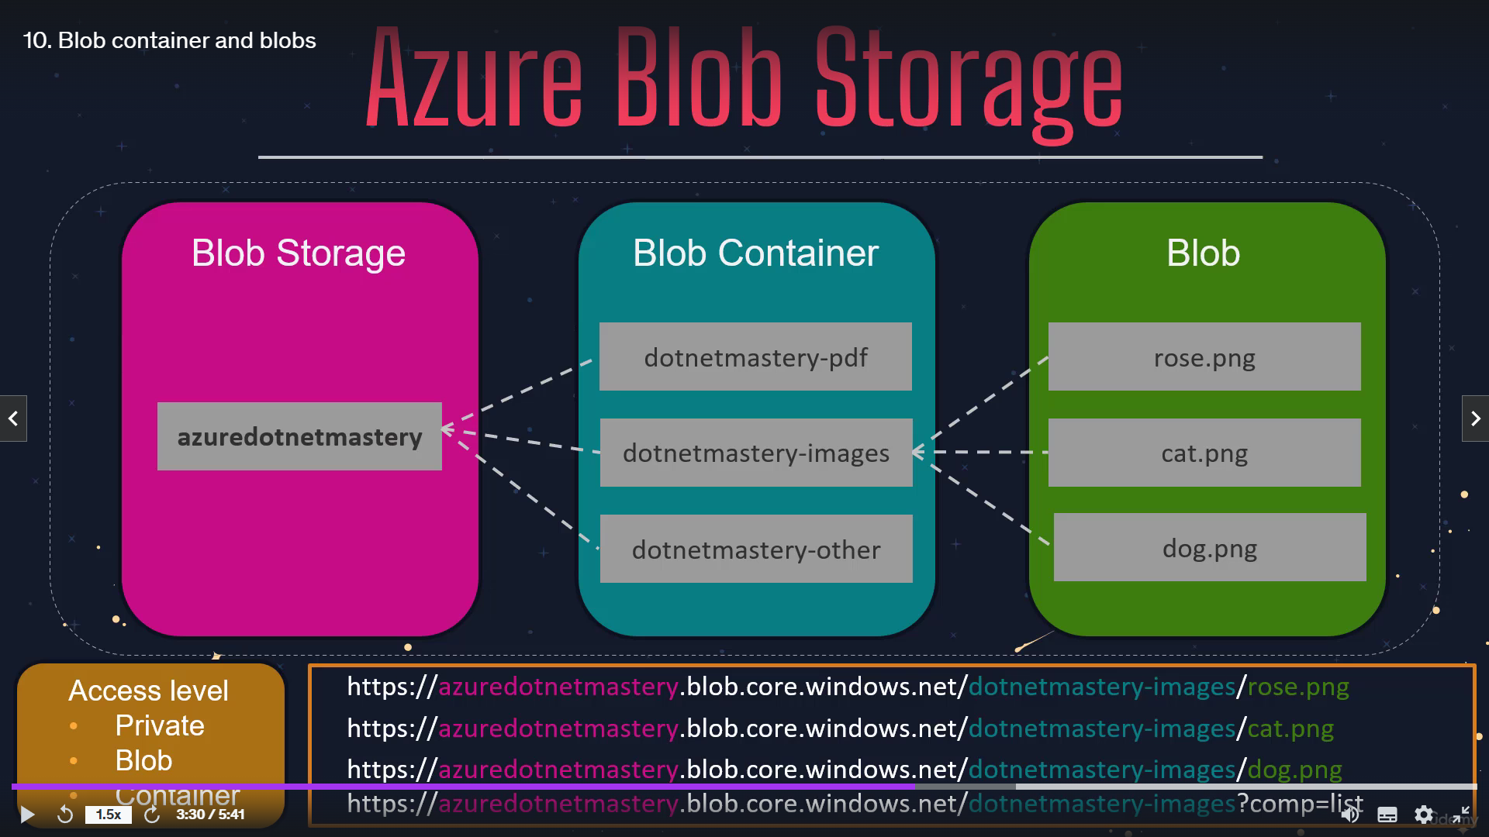
This below picture shows that flow of the BLOB storage being stores the data of fiels.
Root folder
Access level

Slide 6
The terms Queue and Queue Triggers are closely related in the context of azure, but they refer to different concepts.
Queue:
An azure Queue is a storage service provided by the azure storage that allow you to store the large number of messages.
These messages typically small, with maximum amount of 64kb, and are stored in a first in first out (FIFO) order.
Purpose
Queues are used to decouple and distribute the workloads between different components of an application. For example you might use a queue to buffer work items that need to be processed by background services or to manage communication between distributed components.
Features
Allows a asynchronous message processing.
Support a million of messages.
Provides message retention of up to 7 days to default.
Enable scalable and reliable message handling.
Example of use cases
An e-commerce application might place new orders into a queue. A background worker (another service) would then process each order from the queue to update inventory, charge the customer, and send a confirmation email

Slide 7
Queue Trigger:
A Queue trigger in Azure function is a mechanism that automatically invokes when the new message is added to an azure queue. The function is triggered by the pressure of a message queue.
Queue triggers are used to automatically starts the execution of a function whenever a new message is added to a specific queue. This allow you to build event-driven, serverless workflows that respond to queue without polling or manual interventions.
Features:
Automatically scales with the number of messages in the queue.
Simplifies processing of queue messages by integrating directly with Azure Functions.
Supports retries and poison message handling if processing fails.
Handles message deletion automatically after successful processing.
Example Use Case:
Continuing the e-commerce example, a Queue Trigger could be set up to start a function that processes each order message from the queue. Once processed, the function might update the database, notify the user, and then delete the message from the queue.

