Slide 2
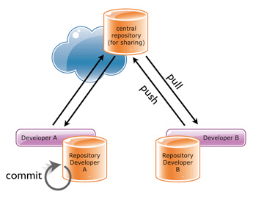
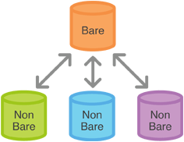
Bare & Shared Repo’s
Bare and Shared Repo(Central Repo)
– No Working Directory(Remote)-
– Admin Creates it using GitLab.
Non Bare Repo(Developer Repo’s)
– Has Working Directory(Developer Machine)
– Developer creates using Source Tree/ Tortoise GIT or
Command Prompt.

Slide 3
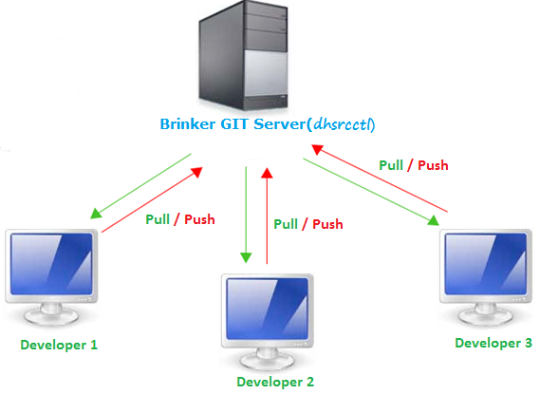
GIT Architecture in Brinker

