Slide 2
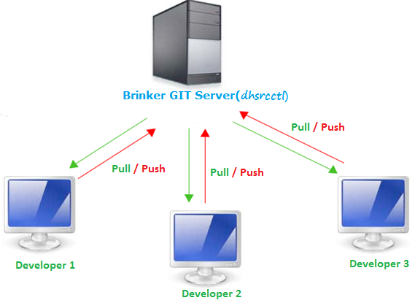
GIT Architecture in Brinker

