Slide 1
POWER BI BUSINESS INTELLIGENCE PROJECT
SAFEMOVE
SAFE
EVERYDAY
EVERYWHERE
Women’s Safety & Urban Mobility Analytics
Turning incident data into clearer safety insights
for safer journeys and stronger cities.
DATA
INSIGHTS
SAFER TOMORROW
PROJECT TOOLKIT
Microsoft Power BI • Power Query • DAX • Data Visualization
PROJECT PRESENTATION • 2026

Slide 2
DATA | INSIGHTS | SAFER TOMORROW
Project at a Glance
From incident data to interactive safety intelligence
TOTAL RECORDS
REPORTED INCIDENTS
SAFETY INDEX
RESPONSE TIME
100K incident records represented in the dashboard.
91K reported incidents shown in the Overview KPIs.
Overall Safety Index displayed: 62.81.
Average emergency response time: 19.54 minutes.
PROJECT FOCUS
FOUR ANALYTICAL PERSPECTIVES
• Explore incidents across cities, areas, times and transport modes.
• Compare safety indicators and severity patterns.
• Review emergency response measures and case outcomes.
• Overview — key indicators and broad trends
• Hotspots — time patterns and area-level incidents
• Transport — mode, environment and severity
• Response — response time and outcomes
02

Slide 3
DATA | INSIGHTS | SAFER TOMORROW
Problem Statement & Objectives
A focused analytical view of women’s safety during urban mobility
PROBLEM STATEMENT
PROJECT OBJECTIVE
Women’s safety during urban travel can vary by location, time, transport mode, environmental conditions and emergency response. SafeMove brings these dimensions into one interactive report to explore reported incidents and safety indicators.
Develop a Power BI analytics dashboard to examine safety-related patterns, compare risk indicators across areas and transport modes, and review emergency response performance.
KEY QUESTIONS
• Which areas and time periods show higher incident counts or risk indicators?
• How do transport modes, severity and environmental scores compare?
• What do response-time and case-resolution visuals show in the current report?
03

Slide 4
DATA | INSIGHTS | SAFER TOMORROW
Data Preparation & Analytical Method
A structured workflow for building a report-ready analytical model
01 SOURCE REVIEW
02 DATA PREPARATION
Reviewed incident fields, categories and numerical indicators.
Prepared fields and data types for analysis in Power Query.
03 DATE MODELING
04 DAX MEASURES
Created a DateTable and connected it to the incident table.
Built measures for incident counts, safety index, risk percentages and response time.
05 VISUAL VALIDATION
Presented results through KPIs, charts, tables, slicers and navigation.
Principle: consistent measures and interactive filters make comparisons easier to explore.
04

Slide 5
DATA | INSIGHTS | SAFER TOMORROW
Dashboard Architecture
Four connected analytical pages create a guided report experience
OVERVIEW
HOTSPOTS
TRANSPORT
RESPONSE
Executive KPIs and trends
Area and time patterns
Mode, environment and severity
Response and outcomes
→
→
→
DATA → PREPARE → MODEL → VISUALIZE → INTERACT → INSPECT
Page navigation provides a consistent way to move between report views.
05

Slide 6
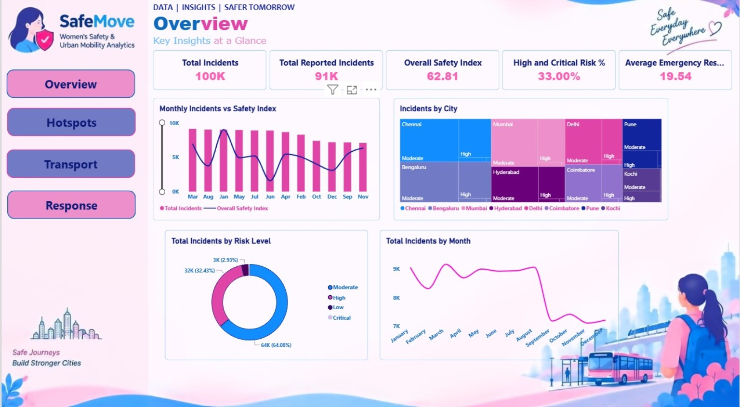
DATA | INSIGHTS | SAFER TOMORROW
Executive Overview
Key indicators, city comparisons and monthly incident patterns
WHAT THIS PAGE ANSWERS
01 100K total incidents and 91K reported incidents appear in the KPI row.
02 Overall Safety Index: 62.81; High and Critical Risk: 33.00%.
03 Average emergency response time is displayed as 19.54.
04 Monthly incident trends and risk-level distribution support exploration.
06

Slide 7
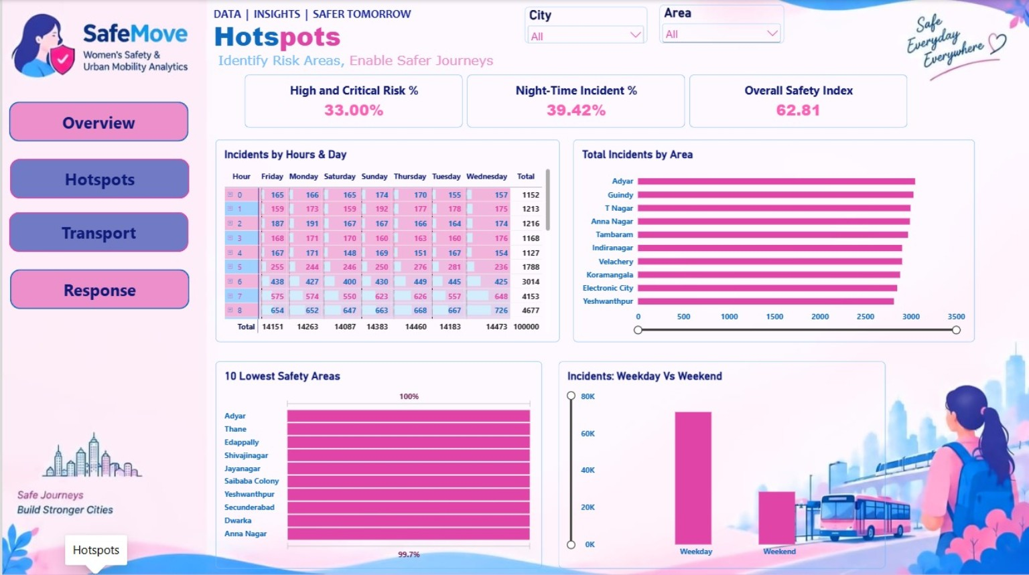
DATA | INSIGHTS | SAFER TOMORROW
Hotspots
Identify risk areas and examine incident timing patterns
WHAT THIS PAGE ANSWERS
01 High and Critical Risk: 33.00%; Night-Time Incident: 39.42%.
02 Overall Safety Index is displayed as 62.81.
03 Hour-by-day matrix compares incidents across days and hours.
04 Area counts and weekday-versus-weekend visuals support hotspot exploration.
07

Slide 8
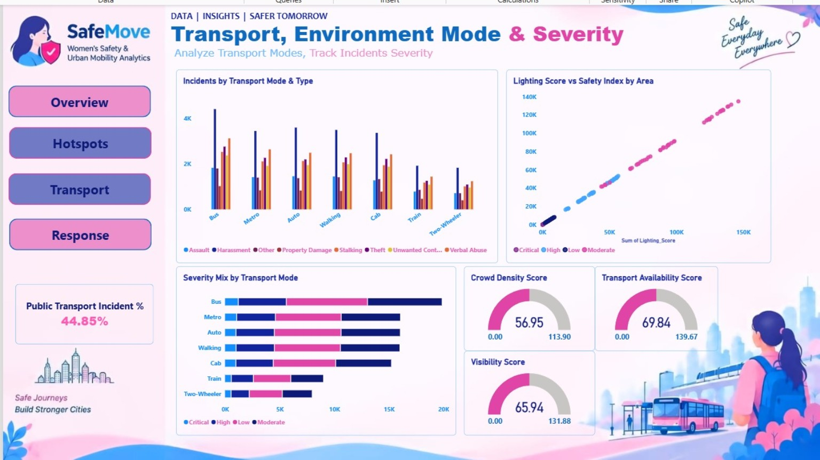
DATA | INSIGHTS | SAFER TOMORROW
Transport, Environment Mode & Severity
Compare transport categories and environmental indicators
WHAT THIS PAGE ANSWERS
01 Incident types are compared across seven transport categories.
02 Severity mix is compared by transport mode.
03 Public Transport Incident is displayed as 44.85%.
04 Lighting, crowd density, visibility and transport availability scores are included.
08

Slide 9
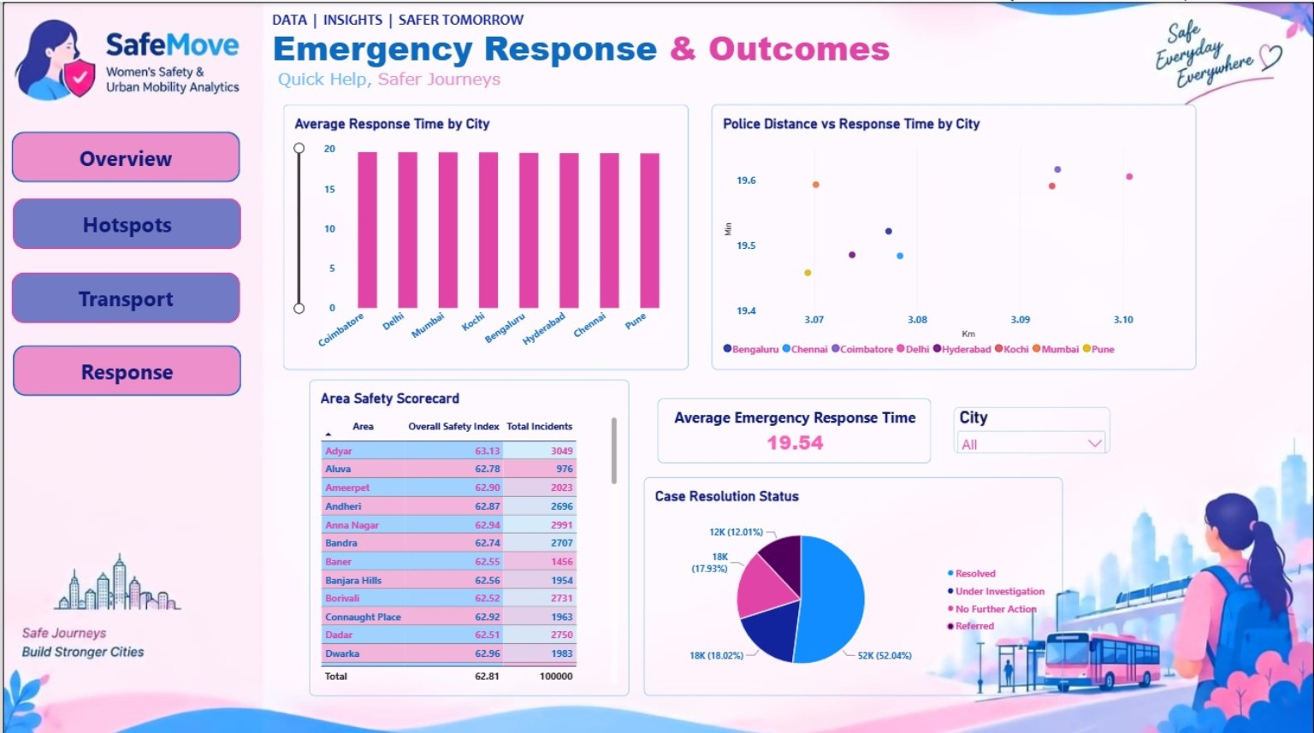
DATA | INSIGHTS | SAFER TOMORROW
Emergency Response & Outcomes
Review response time, area-level safety and case resolution
WHAT THIS PAGE ANSWERS
01 Average Emergency Response Time is displayed as 19.54.
02 Response time by city and police distance versus response time are visualized.
03 Area Safety Scorecard compares safety index and total incidents.
04 Case status categories include Resolved, Under Investigation, No Further Action and Referred.
09

Slide 10
DATA | INSIGHTS | SAFER TOMORROW
Key Insights from the Current Dashboard
Descriptive observations visible in the submitted dashboard screenshots
INCIDENT SCALE
RISK INDICATORS
Overview shows 100K total incidents and approximately 91K reported incidents.
High and Critical Risk is 33.00%; Night-Time Incident is 39.42%.
SAFETY INDICATOR
TRANSPORT ANALYSIS
The Overall Safety Index displayed is 62.81.
Public Transport Incident measure is displayed as 44.85%.
EMERGENCY RESPONSE
TIME AND PLACE
Average Emergency Response Time is shown as 19.54.
Hotspots compares hour/day patterns, area counts and weekday/weekend incidents.
10

Slide 11
DATA | INSIGHTS | SAFER TOMORROW
Design System & Technical Skills
A consistent visual language supports clear dashboard navigation
TECHNICAL STACK
DESIGN PRINCIPLES
• Microsoft Power BI
• Power Query for data preparation
• DAX measures and KPI calculations
• DateTable and date relationship
• Data visualization and interactive filtering
• Dashboard navigation and layout design
• Consistent page navigation
• KPI-first visual hierarchy
• Coordinated blue, pink and white palette
• Clear chart titles and labels
• Multiple views for different analytical questions
• Tables, charts, cards and slicers in one report
CORE TOOLS • POWER BI • POWER QUERY • DAX • DATA STORYTELLING
11

Slide 12
SAFEMOVE
From Data to Safer Mobility Insights
SafeMove brings together incident trends, hotspot exploration, transport and environmental indicators, and emergency response outcomes in one interactive Power BI experience.
THANK YOU
Questions & Discussion

